Slide 1


Ant Colony Optimization. A metaheuristic approach to hard network optimization problems

Slide 2

Presentation Outline
Traveling Salesman Problem (materials taken from Introduction to Algorithms: Second Edition by Cormen et al., Cambridge, 2001)
Conventional heuristics
Metaheuristics
Ant Colony System and its progenitor
Additional applications
Ant Colony System

Slide 3

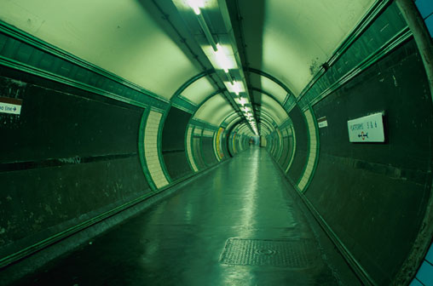




Temple of Heaven, Bejing
London Underground, London
Wall Street, New York City
The Traveling Salesman Problem
Finding a least cost Hamiltonian cycle
Palace of Winds, Jaipur
Worker and Farmer Statue, Moscow
The City Beautiful, Orlando

Slide 4
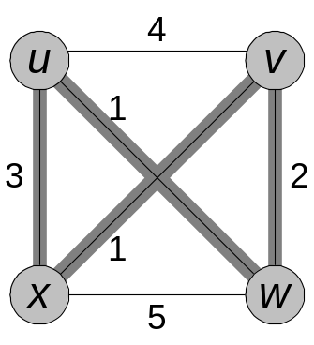

In the traveling-salesman problem, which is closely related to the Hamiltonian-cycle problem, a salesman must visit n cities. Modeling the problem as a complete graph with n vertices, we can say that the salesman wishes to make a tour, or Hamiltonian cycle, visiting each city exactly once and finishing at the city he starts from. There is a cost c(i, j) to travel from city i to city j. In a symmetric TSP, c(i, j) equals c(j, i). The salesman wishes to make the tour whose cost is minimum, where the total cost is the sum of the individual costs along the edges of the tour. For example, in the figure below, the minimum-cost tour is ‹u, w, v, x, u›, with cost 7. The formal language for the corresponding decision problem is:
TSP = {‹G, c, k› : G = (V, E) is a complete graph,
c is a function from V × V→Z,
k Z, and
G has a traveling-salesman tour with cost at most k}.
8-1, R & D

Slide 5
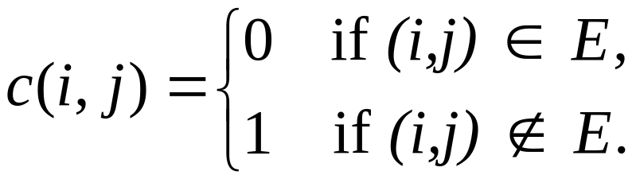
The following theorem shows that a fast algorithm for the traveling-salesman problem is unlikely to exist.
Theorem. The traveling-salesman problem is NP-complete.
Proof: We first show that TSP belongs to NP. Given an instance of the problem, we use as a certificate the sequence of n vertices in the tour. The verification algorithm checks that this sequence contains each vertex exactly once, sums up the edge costs, and checks whether the sum is at most k. This process can certainly be done in polynomial time.
To prove that TSP is NP-hard, we show that HAM-CYCLE ≤_{P} TSP. Let G = (V, E) be an instance of HAM-CYCLE. We construct an instance of TSP as follows. We form the complete graph G′ = (V,E ′), where E ′ = {(i, j) : i, j V and i ≠ j}, and we define the cost function c by
8-2, R & D

Slide 6
(Note that because G is undirected, it has no self-loops, and so c(ν, ν) = 1 for all vertices ν in V.) The instance of TSP is then (G′, c, 0), which is easily formed in polynomial time.
We now show that graph G has a Hamiltonian cycle if and only if graph G′ has a tour of cost at most 0. Suppose that graph G has a Hamiltonian cycle h. Each edge in h belongs to E and thus has cost 0 in G′. Thus, h is a tour in G′ with cost 0. Conversely, suppose that graph G′ has a tour h′ of cost at most 0. Since the costs of the edges in E′ are 0 and 1, the cost of tour h′ is exactly 0 and each edge on the tour must have cost 0. Therefore, h′ contains only the edges in E. We conclude that h′ is a Hamiltonian cycle in graph G.
8-3, R & D

Slide 7
A 2-approximation algorithm outputs problem solutions no more than twice the cost of an optimal solution. The 2-approx. algorithm for the TSP presented by Cormen et al. begins by computing a minimal spanning tree (MST) whose weight represents a lower bound on the length of an optimal TSP tour. The MST is used to create a tour whose cost is no more than twice that of the MST’s weight, as long as the cost function satisfies the triangle equality. The following algorithm implements this approach, calling Prim’s MST algorithm as a subroutine.
APPROX-TSP-TOUR(G,c)
Select a vertex r V[G] to be a “root” vertex
Compute a minimum spanning tree T for G from root r using Prim
Let L be the list of vertices visited in a preorder tree walk of T
Return the Hamiltonian cycle H that visits the vertices in the order L
Additional information and a proof for APPROX-TSP-TOUR is available under section 35.2.1 of Introduction to Algorithms: Second Edition.
8-4, R & D

Slide 8
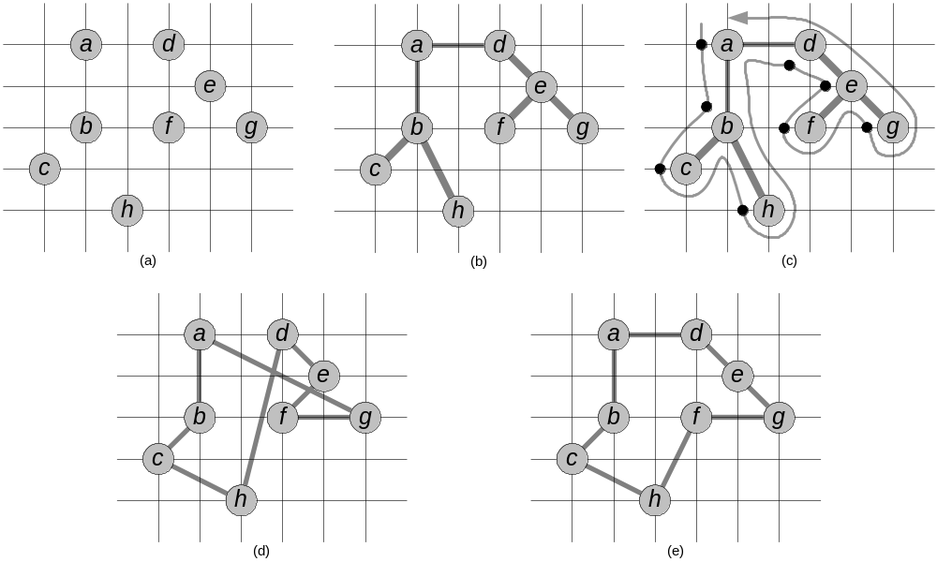
Illustrated above is the operation of APPROX-TSP-TOUR. Part (a) of the figure shows the given set of vertices, and part (b) shows the minimum MST grown from root vertex a using Prim’s MST algorithm. Part (c) shows how the vertices are visited by a preorder walk of T, and part (d) displays the corresponding tour, which is the tour returned by APPROX-TSP-TOUR. Part (e) displays an optimal tour, which is about 23% shorter.
-Source: Cormen et al., Figure 35.2
8-5, R & D

Slide 9
Simple and Intermediate
Algorithms and Heuristics
These are less complicated, general algorithms and heuristics used to solve the TSP.
Construction
  Nearest Neighbor Heuristic
  Insertion Heuristic
Improving Solutions
  2-opt Exchanges
  Chained Lin-Kernighan
(TSP Algorithms in Action)
Ant Colony Optimization (ACO)
Notes:
Was first introduced in Marco Dorigo’s Ph.D. thesis.
As we have seen, the TSP provides an excellent test environment…
In problems like the quadratic assignment problem and the sequential ordering problem these ACO algorithms outperform all known algorithms on vast classes of benchmark problems.

Slide 10
Advanced heuristics
These are highly specialized algorithms, many of which, either alone or working in conjunction, are capable of optimally solving symmetric TSP problems. Their specialization limits abstraction to more discrete TSP variations and certainly to other types of optimization problems.
Ant Colony Optimization (ACO)
Notes:
Was first introduced in Marco Dorigo’s Ph.D. thesis.
As we have seen, the TSP provides an excellent test environment…
In problems like the quadratic assignment problem and the sequential ordering problem these ACO algorithms outperform all known algorithms on vast classes of benchmark problems.

Slide 11
Metaheuristics
Metaheuristics are semi-stochastic approaches to solving a variety of hard optimization problems. While in many cases they are augmented with additional approaches to enhance performance for specific problems, these techniques can be widely adapted to not only TSP and its variations, but to other hard optimization problems as well. Additional applications include the ATSP, quadratic assignment, and job-shop scheduling.
Simulated annealing (SA)
Tabu search (TS)
Genetic algorithms (GA)
Ant Colony Optimization (ACO)
Ant Colony Optimization (ACO)
Notes:
Was first introduced in Marco Dorigo’s Ph.D. thesis.
As we have seen, the TSP provides an excellent test environment…
In problems like the quadratic assignment problem and the sequential ordering problem these ACO algorithms outperform all known algorithms on vast classes of benchmark problems.

Slide 12
Why Study Metaheuristics?
For problems such as quadratic assignment and sequential ordering, ACO-type algorithms outperform all other known algorithms.
Ant Colony Optimization (ACO)

Slide 13
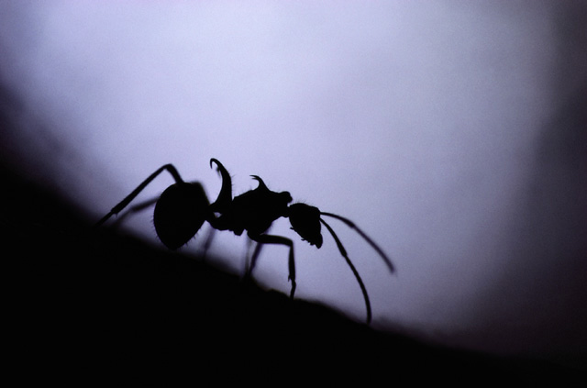
Ant Colony Optimization
Real ants
Stigmergy
Autocatalyzation
Ant System
Ant Colony System

Slide 14
Overview
“Ant Colony Optimization (ACO) studies artificial systems that take inspiration from the behavior of real ant colonies and which are used to solve discrete optimization problems.”
-Source: ACO website, http://iridia.ulb.ac.be/~mdorigo/ACO/about.html
Ant Colony Optimization (ACO)
Notes:
Was first introduced in Marco Dorigo’s Ph.D. thesis.
As we have seen, the TSP provides an excellent test environment…
In problems like the quadratic assignment problem and the sequential ordering problem these ACO algorithms outperform all known algorithms on vast classes of benchmark problems.

Slide 15
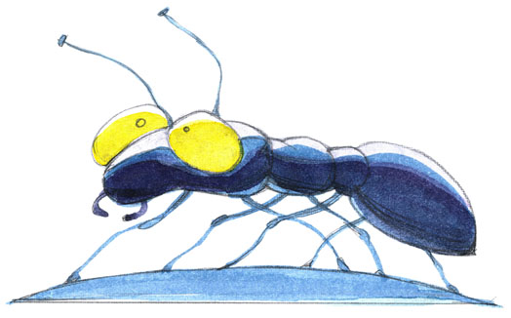
Almost blind.
Incapable of achieving complex tasks alone.
Rely on the phenomena of swarm intelligence for survival.
Capable of establishing shortest-route paths from their colony to feeding sources and back.
Use stigmergic communication via pheromone trails.
Notes:
Ethologist discovered pheromones

Slide 16
Follow existing pheromone trails with high probability.
What emerges is a form of autocatalytic behavior: the more ants follow a trail, the more attractive that trail becomes for being followed.
The process is thus characterized by a positive feedback loop, where the probability of a discrete path choice increases with the number of times the same path was chosen before.
Notes:
Ethologist discovered pheromones

Slide 17

Naturally Observed Ant Behavior
All is well in the world of the ant.
Ant Colony Optimization (ACO)
Notes:
Was first introduced in Marco Dorigo’s Ph.D. thesis.
As we have seen, the TSP provides an excellent test environment…
In problems like the quadratic assignment problem and the sequential ordering problem these ACO algorithms outperform all known algorithms on vast classes of benchmark problems.

Slide 18
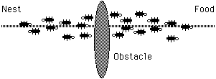
Naturally Observed Ant Behavior
Oh no! An obstacle has blocked our path!
Ant Colony Optimization (ACO)
Notes:
Was first introduced in Marco Dorigo’s Ph.D. thesis.
As we have seen, the TSP provides an excellent test environment…
In problems like the quadratic assignment problem and the sequential ordering problem these ACO algorithms outperform all known algorithms on vast classes of benchmark problems.

Slide 19
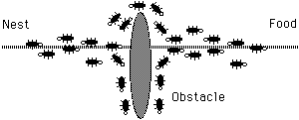
Naturally Observed Ant Behavior
Where do we go? Everybody, flip a coin.
Ant Colony Optimization (ACO)
Notes:
Was first introduced in Marco Dorigo’s Ph.D. thesis.
As we have seen, the TSP provides an excellent test environment…
In problems like the quadratic assignment problem and the sequential ordering problem these ACO algorithms outperform all known algorithms on vast classes of benchmark problems.

Slide 20
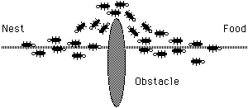
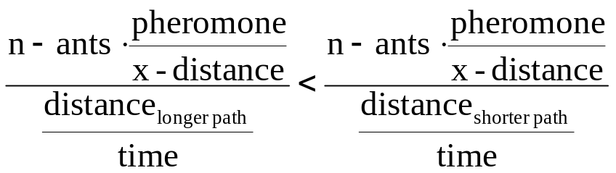
Naturally Observed Ant Behavior
Shorter path reinforced.
Ant Colony Optimization (ACO)
Notes:
Was first introduced in Marco Dorigo’s Ph.D. thesis.
As we have seen, the TSP provides an excellent test environment…
In problems like the quadratic assignment problem and the sequential ordering problem these ACO algorithms outperform all known algorithms on vast classes of benchmark problems.

Slide 21
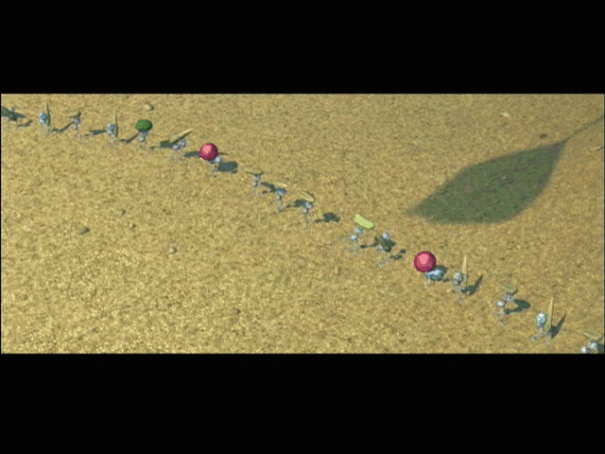

Slide 22
“Stigmergic?”
Stigmergy, a term coined by French biologist Pierre-Paul Grasse, is interaction through the environment.
Two individuals interact indirectly when one of them modifies the environment and the other responds to the new environment at a later time. This is stigmergy.
Ant Colony Optimization (ACO)

Slide 23
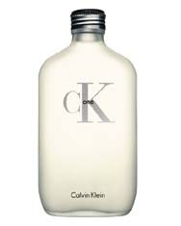
Stigmergy
Real ants use stigmergy. How again?
PHEROMONES!!!
Ant Colony Optimization (ACO)

Slide 24
Autocatalyzation
What is autocatalytic behavior?
Ant Colony Optimization (ACO)

Slide 25
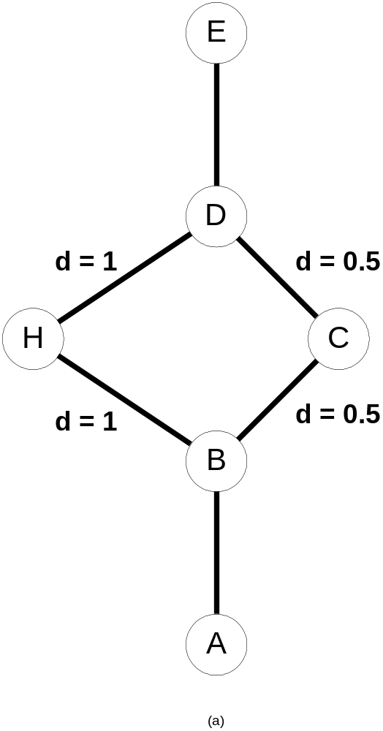
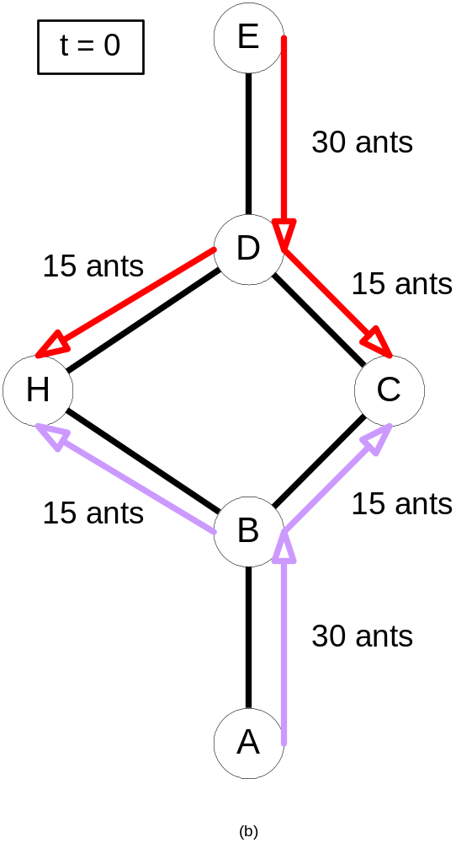
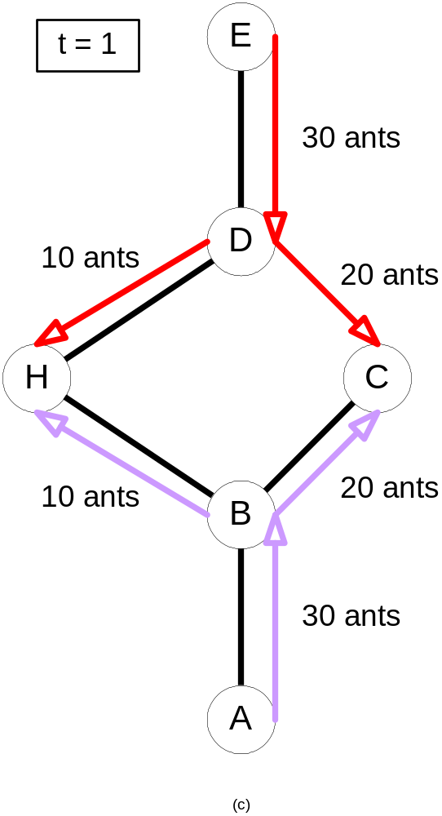
Initial state:
no ants
τ = 15
τ = 30
τ = 15
τ = 30

Slide 26
Autocatalyzation
This is why ACO algorithms are called autocatalytic positive feedback algorithms!
Remember that!
Ant Colony Optimization (ACO)

Slide 27
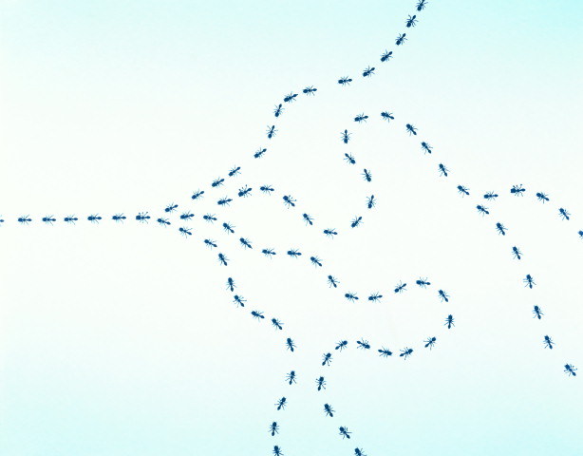
Ant Colony Optimization
The Ant System (AS)
Notes:
Represented a new computational paradigm.
Proposed as a viable new approach to stochastic combinatorial optimization.
Main characteristics of this model are positive feedback, distributed computation, and the use of a constructive greedy heuristic.

Slide 28
Ant System
First introduced by Marco Dorigo in 1992
Progenitor to “Ant Colony System,” later discussed
Result of research on computational intelligence approaches to combinatorial optimization
Originally applied to Traveling Salesman Problem
Applied later to various hard optimization problems
Ant Colony Optimization (ACO)
Notes:
Was first introduced in Marco Dorigo’s Ph.D. thesis.
As we have seen, the TSP provides an excellent test environment…
In problems like the quadratic assignment problem and the sequential ordering problem these ACO algorithms outperform all known algorithms on vast classes of benchmark problems.

Slide 29
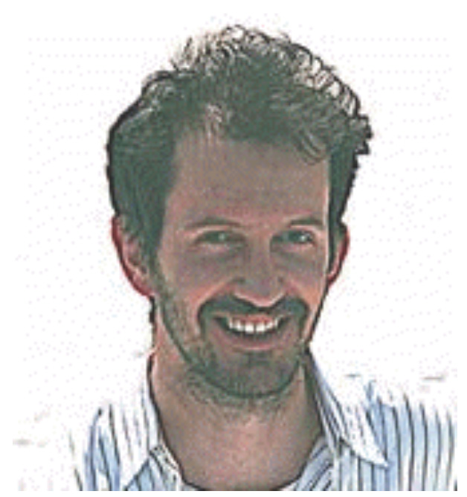
Would you trust this man?
Ant Colony Optimization (ACO)
Notes:
Was first introduced in Marco Dorigo’s Ph.D. thesis.
As we have seen, the TSP provides an excellent test environment…
In problems like the quadratic assignment problem and the sequential ordering problem these ACO algorithms outperform all known algorithms on vast classes of benchmark problems.

Slide 30
Performance Chart
Problem Name | MST | AS | ACS_{R&D} | ACS_{D} | GA | EP | SA | Optimum
Eil50 (50-city problem) | 615 [1] 44.71% | 450 [36] 5.89% | 463.423 [3] 9.04% | 425 [1,830] 0.00% | 428 [25,000] 0.71% | 426 [100,000] 0.23% | 443 [68.512] 4.24% | 425 [N/A]
Eil75 (75-city problem) | 740 [1] 38.31% | 570 [238] 6.5% | 576.749 [10] 7.80% | 545 [3,840] 1.87% | 545 [80,000] 1.87% | 542 [325,000] 1.31% | 580 [173,250] 8.41% | 535 [N/A]
KroA100 (100-city problem) | 30517 [1] 43.39% | 22,943 [228] 7.81% | 24497.6 [37] 15.11% | 21,282 [4,820] 0.00% | 21,761 [103,000] 2.25% | N/A [N/A] N/A | N/A [N/A] N/A | 21,282 [N/A]
Our Results
MST 2-approximation TSP algorithm
AS Ant System
(α = 1, β = 5, ρ = .5)
ACS_{R&D} Ant Colony System
(α = 0.1, β =2, ρ = .1, m = 50)
Published Results
ACS_{D} Ant Colony System
GA Genetic Algorithm
EP Evolutionary Programming
SA Simulated Annealing
Ant Colony System
Notes:
Was first introduced in Marco Dorigo’s Ph.D. thesis.
As we have seen, the TSP provides an excellent test environment…
In problems like the quadratic assignment problem and the sequential ordering problem these ACO algorithms outperform all known algorithms on vast classes of benchmark problems.

Slide 31
Ants as Agents
Each ant is a simple agent with the following characteristics:
It chooses the town to go to with a probability that is a function of the town distance and of the amount of trail present on the connecting edge;
To force the ant to make legal tours, transitions to already visited towns are disallowed until a tour is complete (this is controlled by a tabu list);
When it completes a tour, it lays a substance called trail on each edge (i, j) visited.
Ant Colony Optimization (ACO)
Notes:
Was first introduced in Marco Dorigo’s Ph.D. thesis.
As we have seen, the TSP provides an excellent test environment…
In problems like the quadratic assignment problem and the sequential ordering problem these ACO algorithms outperform all known algorithms on vast classes of benchmark problems.

Slide 32
The symmetric TSP has a Euclidean based problem space. We use d_{ij} to denote the distance between any two cities in the problem. As such
d_{ij} = [(x_{i}-x_{j})² + (y_{i}-y_{j})²]^{1/2}
Ant Colony Optimization (ACO)
Notes:
Was first introduced in Marco Dorigo’s Ph.D. thesis.
As we have seen, the TSP provides an excellent test environment…
In problems like the quadratic assignment problem and the sequential ordering problem these ACO algorithms outperform all known algorithms on vast classes of benchmark problems.

Slide 33
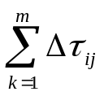
We let τ_{ij}(t) denote the intensity of trail on edge (i,j) at time t. Trail intensity is updated following the completion of each algorithm cycle, at which time every ant will have completed a tour. Each ant subsequently deposits trail of quantity Q/L_{k} on every edge (i,j) visited in its individual tour. Notice how this method would favor shorter tour segments. The sum of all newly deposited trail is denoted by ∆ τ_{ij}. Following trail deposition by all ants, the trail value is updated using τ_{ij}(t + n) = р × τ_{ij}(t) + ∆ τ_{ij}, where p is the rate of trail decay per time interval and ∆ τ_{ij = .}
Ant Colony Optimization (ACO)
Notes:
Was first introduced in Marco Dorigo’s Ph.D. thesis.
As we have seen, the TSP provides an excellent test environment…
In problems like the quadratic assignment problem and the sequential ordering problem these ACO algorithms outperform all known algorithms on vast classes of benchmark problems.

Slide 34
Two factors drive the probabilistic model:
1) Visibility, denoted η_{ij}, equals the quantity 1/d_{ij}
2) Trail, denoted τ_{ij}(t)
These two factors play an essential role in the central probabilistic transition function of the Ant System.
In return, the weight of either factor in the transition function is controlled by the variables α and β, respectively. Significant study has been undertaken by researchers to derive optimal α:β combinations.
Ant Colony Optimization (ACO)
Notes:
Was first introduced in Marco Dorigo’s Ph.D. thesis.
As we have seen, the TSP provides an excellent test environment…
In problems like the quadratic assignment problem and the sequential ordering problem these ACO algorithms outperform all known algorithms on vast classes of benchmark problems.

Slide 35
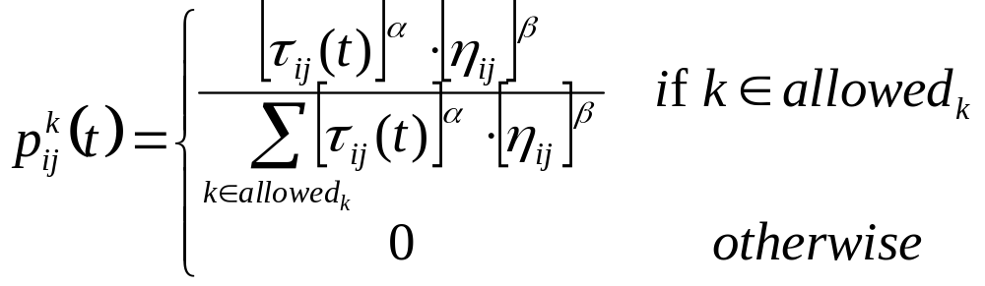
Probabilistic Transition Function
Ant Colony Optimization (ACO)
Notes:
Was first introduced in Marco Dorigo’s Ph.D. thesis.
As we have seen, the TSP provides an excellent test environment…
In problems like the quadratic assignment problem and the sequential ordering problem these ACO algorithms outperform all known algorithms on vast classes of benchmark problems.

Slide 36
A high value for α means that trail is very important and therefore ants tend to choose edges chosen by other ants in the past. On the other hand, low values of α make the algorithm very similar to a stochastic multigreedy algorithm.
Ant Colony Optimization (ACO)
Notes:
Was first introduced in Marco Dorigo’s Ph.D. thesis.
As we have seen, the TSP provides an excellent test environment…
In problems like the quadratic assignment problem and the sequential ordering problem these ACO algorithms outperform all known algorithms on vast classes of benchmark problems.

Slide 37
Ant System (AS) Algorithm
Initialization
Randomly place ants
Build tours
Deposit trail
Update trail
Loop or exit
Ant Colony Optimization (ACO)
Notes:
Was first introduced in Marco Dorigo’s Ph.D. thesis.
As we have seen, the TSP provides an excellent test environment…
In problems like the quadratic assignment problem and the sequential ordering problem these ACO algorithms outperform all known algorithms on vast classes of benchmark problems.

Slide 38
Computational Complexity
The complexity of this ACO algorithm is O(NC×n² ×m) if we stop the algorithm after NC cycles, where n is the number of cities and m is the number of ants.
Step 1 is O(n² + m)
Step 2 is O(m)
Step 3 is O(n² × m)
Step 4 is O(n² × m)
Step 5 is O(n²)
Step 6 is O(n × m)
Researchers have found a linear relation between the number of towns and the best number of ants, so the complexity of the algorithm is O(NC ×n³).
Ant Colony Optimization (ACO)
Notes:
Was first introduced in Marco Dorigo’s Ph.D. thesis.
As we have seen, the TSP provides an excellent test environment…
In problems like the quadratic assignment problem and the sequential ordering problem these ACO algorithms outperform all known algorithms on vast classes of benchmark problems.

Slide 39
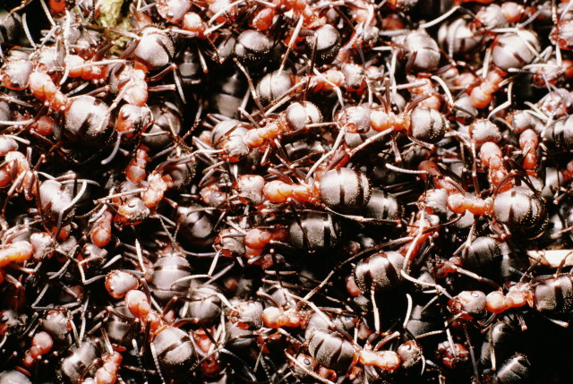
How many ants do you need?
m ≈ n

Slide 40
Ant Colony Optimization
The Ant Colony System (ACS)
Notes:
Represented a new computational paradigm.
Proposed as a viable new approach to stochastic combinatorial optimization.
Main characteristics of this model are positive feedback, distributed computation, and the use of a constructive greedy heuristic.

Slide 41
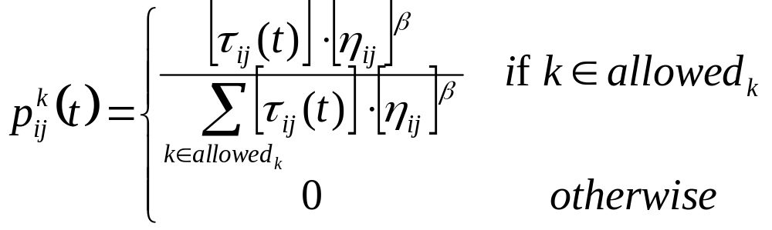
AS  ACS
Change to the probabilistic function: drop alpha
Ant Colony Optimization (ACO)
Notes:
Was first introduced in Marco Dorigo’s Ph.D. thesis.
As we have seen, the TSP provides an excellent test environment…
In problems like the quadratic assignment problem and the sequential ordering problem these ACO algorithms outperform all known algorithms on vast classes of benchmark problems.

Slide 42
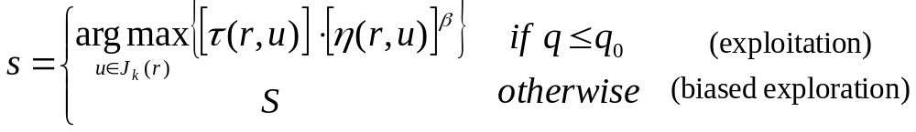
AS  ACS
New state transition rule; used to balance between exploration and exploitation.
Here q₀ is a constant parameter, q is a random variable, and S is the outcome of the probabilistic transition function.
Ant Colony Optimization (ACO)
Notes:
Was first introduced in Marco Dorigo’s Ph.D. thesis.
As we have seen, the TSP provides an excellent test environment…
In problems like the quadratic assignment problem and the sequential ordering problem these ACO algorithms outperform all known algorithms on vast classes of benchmark problems.

Slide 43
AS  ACS
Local updating rule:
Here ∆tau₀ is a predetermined constant or function. The edge (r,s) is updated following each iteration of an ant search.
Ant Colony Optimization (ACO)
Notes:
Was first introduced in Marco Dorigo’s Ph.D. thesis.
As we have seen, the TSP provides an excellent test environment…
In problems like the quadratic assignment problem and the sequential ordering problem these ACO algorithms outperform all known algorithms on vast classes of benchmark problems.

Slide 44
How many ants do you need?
m = 10

Slide 45
Advanced Topics
Discrete Approaches to
ACO Improvement
& Implementation

Slide 46
Check out
http://www.conquerware.com/
dbabb/academics/research/aco
for supplementary materials.
Ant Colony Optimization (ACO)
Notes:
Was first introduced in Marco Dorigo’s Ph.D. thesis.
As we have seen, the TSP provides an excellent test environment…
In problems like the quadratic assignment problem and the sequential ordering problem these ACO algorithms outperform all known algorithms on vast classes of benchmark problems.

Slide 47
Conclusion
The main characteristics of this class of algorithms are a natural metaphor, a stochastic nature, adaptivity, inherent parallelism, and positive feedback. Ants have evolved a highly efficient method of solving the difficult Traveling Salesman Problem. Furthermore, the Ant Colony Optimization can be applied to many other hard problems.
Ant Colony Optimization (ACO)
Notes:
Was first introduced in Marco Dorigo’s Ph.D. thesis.
As we have seen, the TSP provides an excellent test environment…
In problems like the quadratic assignment problem and the sequential ordering problem these ACO algorithms outperform all known algorithms on vast classes of benchmark problems.

Slide 48
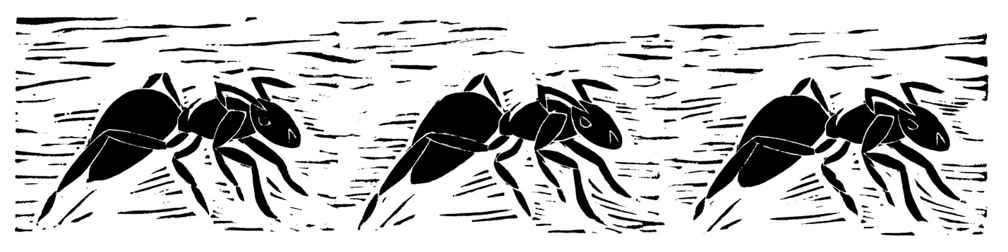
Questions, Comments?
Thank You

