Slide 1
x
f
x
f
g
f(x)
g(f)
w
df
lop
g_grad
f_grad
f
x

Slide 2
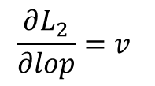
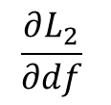
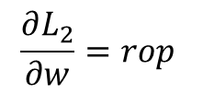
w
df
lop
g_grad
f_grad
f
x
$$\frac{∂L_{2}}{∂lop}=v$$
$$\frac{∂L_{2}}{∂df}$$
$$\frac{∂L_{2}}{∂w}=rop$$
f_grad_
grad
g_grad_
grad
df
w
x
f

