Slide 1
Capstone Project: Deep Learning Identification of Plasmodium spp. from Thin Blood Smears using Deep Learning.
LaKeta L Kemp
Applied Data Science Program
Massachusetts Institute of Technology, Great Learning
December 13, 2022
Notes:
Hello my name is LaKeta Kemp.
I would like to discuss the use of a Deep Learning, Convolutional Neural Network to identify the Malaria parasite in blood smear images.

Slide 2
Problem Definition
Malaria is a parasite transmitted by mosquitos.
There are 241 million infections and 627,000 deaths annually.
Thin blood smears read by trained and certified Parasitologist with specialized training.
Subject matter expertise is a small group of individuals.
A computer vision model can be trained to identify Malaria infections.
Notes:
Executive Summary
Malaria is a human pathogen transmitted to the bloodstream by the common mosquito.
Diagnosis is performed as a thin blood smear by a trained and certified medical laboratory scientist or health scientist.
Specialized training is required and there are a limited number of certified professionals.
The testing is two different color stains to visualize all phases of the parasite life cycle.
The parasite cells stain blue while human cells stain red.
The images have characteristics that would aid visualization by machine learning model.
Problem Summary
Due to the limited number of trained scientists to perform the testing, there is a need for an alternative method to read blood smear slides for the detection of Malaria.

Slide 3
Solutions Design
Differential microscopy allows identification of key features.
Two dimensional convolutional layers with
Dense layers, pooling, normalization, regularization, reshaping
Model Evaluation Metric minimizes validation loss.
Model Performance Metric is the ratio of recall and precision to maximize overall performance.
Reduce false reporting to the minimum.
Notes:
Objectives
The goal is to build a computer vision model that is successful at identifying Malaria infections.
A collection of infected and uninfected blood smears would be analyzed for key features.
The parasite has five stages to the life cycle with varying sizes and shapes, variability that could make identification complex.
To be successful the model should target common features that remain consistent across the parasite life cycle.
Building a Convolutional Neural Network is the next step.
the model should flatten and pool the dense layers trained over several steps and model iterations to yield a high-performing model with a high degree of accuracy.
False negative samples could have serious health outcomes including mortality thus precision and accuracy must match or exceed the accuracy rate of traditional light microscopy.

Slide 4
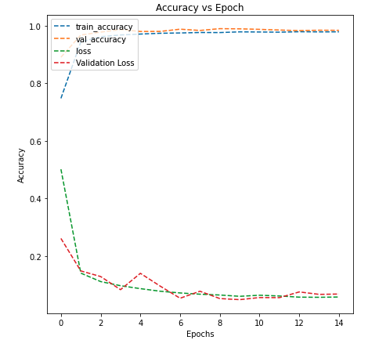
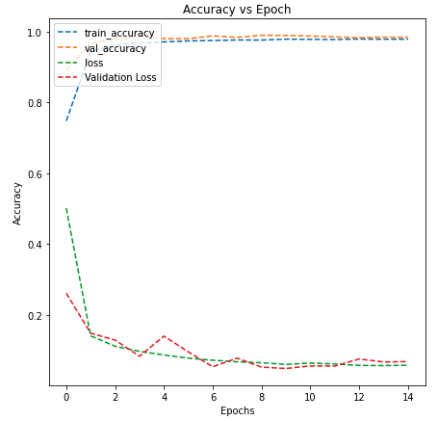
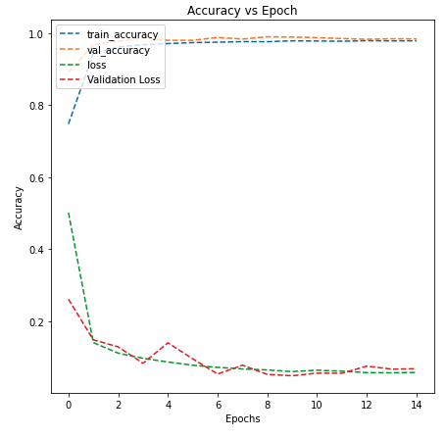
Model Performance
Base Model
Model 2
VGG16 Model
Notes:
These plots show the accuracy of the model with each training step. The training and validation accuracy are seen as dashed orange and blue lines approaching the same value.
For the Base Model, Model 2, and the VGG16 model seen here, the validation accuracy performed very close to the training accuracy. This suggests the models fit the data well with minimal false classifications.
The models were trained to minimize validation loss, allowing it to stop when no further changes to the validation were noted. The plots show a reduction of the validation loss across each step eventually flattening out as expected.
Early stopping also prevents excessive computational energy when no further training can be achieved, balancing computational energy budget to precision.

Slide 5
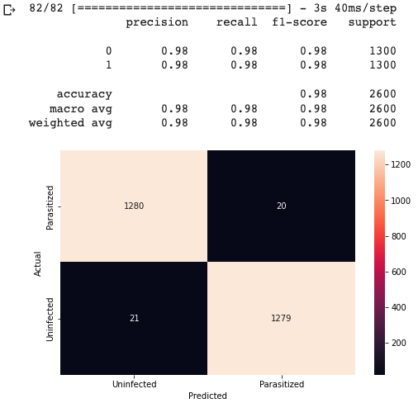
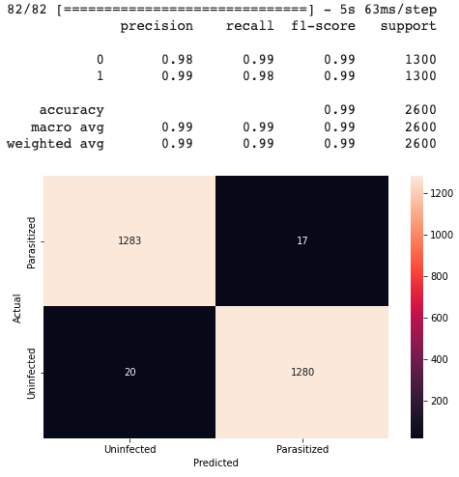
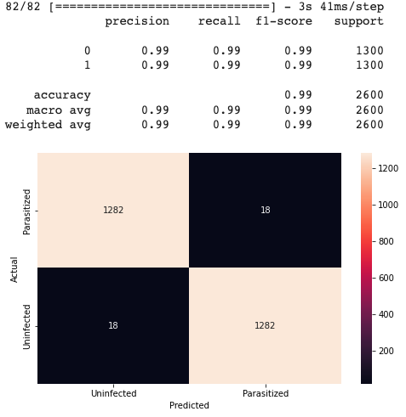
Model Evaluation
Base Model
Model 2
VGG16 Model
Notes:
The base model predicts the presence of the parasite with high precision indicating a connection between the trainable key features used to identify the parasite in blood smears.
The recall shows the model can correctly identify the parasite despite variability in the images.
There is only one parasitized cell not predicted by the base model. This is a concern as using this model would produce a false negative. This could result in treatment not being prescribed and death if left untreated.
Model two has high validation accuracy, and precision for infected cells. There are three false negatives from this model.
The VGG16 model shows significantly better recall and precision as compared to previous models. The validation and test accuracies match, suggesting good training and the model accurately predicted all infected cells.

Slide 6
Key Observations & Insights
VGG16 performs better than Model 2.
False reporting has serious health outcomes, minimizing false reporting is a key performance indicator for the model.
False Negatives: serious negative health outcomes including death without treatment.
False Positives: negative health outcomes due to toxicity of treatment.
The VGG16 matches the current accuracy and precision for light microscopy.
Notes:
Of the models evaluated, the VGG16 model performed best when detecting malaria from blood smear images.
The predictive nature of this model shows significantly better recall and precision as compared to previous models.
The validation and test accuracy match suggesting good training with minimal false reporting.
The VGG16 model demonstrated the importance of well selected layers each working to improve the ability to discern features in image data.
The VGG16 model performs with similar accuracy to traditional techniques used to diagnose Malaria.

Slide 7
Recommendations
The VGG16 model is recommended to identify Malaria in blood smear images.
Positive Predictive Value (Precision): 99%
Correct Identification (Accuracy): 99%
Predictive Performance (Recall): 99%
Ratio of False Identifications (F1 Score): 99%
False Negatives: <1%
False Positives: <1%
Notes:
I recommend using the VGG16 model to detect Malaria in blood smear images. The model performed with 99% precision, accuracy, recall, exceeding all other models analyzed.
This model correctly identified infected cells with zero false positives and zero false negatives.
The VGG16 model is a pre-trained model that has become a standard for computer vision use.
The model has successfully been applied to a variety of images within the medical field including tumor detection from digital mammography and detection of abnormal human cells for cancer in thin tissue biopsies.
This suggests the parameters to analyze the images for key features appreciates with repeated training and dataset size.
Combining fine-tuned parameters and utilizing the CNN architecture to maximize key features for the images allows a robust model to be created that is capable of visualizing parasites in blood smears.
This includes augmented images that are rotated, flipped, and magnified suggesting the model can be successful with low image quality.

Slide 8
Works Cited
Giemsa Stain. Clinical Microbiology Procedures Handbook, 3 Volume Set, 4th Edition Amy L. Leber. doi:10.1128/9781555818814.ch.9.8.1
Detection of Blood Parasites. Clinical Microbiology Procedures Handbook, 3 Volume Set, 4th Edition Amy L. Leber. doi:10.1128/9781555818814.ch.9.8.1
Pillow Python Imaging Library. PIL Fork Documentation.
OpenCV. OpenCV: Smoothing Images API Documentation.
WHO Guidelines for malaria, 25 November 2022. Geneva: World Health Organization; 2022 (WHO/UCN/GMP/2022.01 Rev.3). License: CC BY-NC-SA 3.0 IGO.
Center for Disease Control and Prevention Division of Parasitic Diseases and Malaria (DPDM). DPDx - Laboratory Identification of Parasites of Public Health Concern
A. A. Alonso-Ramírez et al., Classifying Parasitized and Uninfected Malaria Red Blood Cells Using Convolutional-Recurrent Neural Networks. IEEE Access, vol. 10, pp. 97348-97359, 2022, doi: 10.1109/ACCESS.2022.3206266.
Jdey, I., Hcini, G., & Ltifi, H. (2022). Deep learning and machine learning for Malaria detection: overview, challenges, and future directions. arXiv preprint arXiv:2209.13292.
How to Configure Image Data Augmentation in Keras. Deep Learning for Computer Vision. Brownlee J. https://machinelearningmastery.com/how-to-configure-image-data-augmentation-when-training-deep-learning-neural-networks/
Understanding Data Augmentation | What is Data Augmentation & how it works? Great Learning Blog AI and Machine Learning. Arun K. https://www.mygreatlearning.com/blog/understanding-data-augmentation/
Everything you need to know about VGG16. Medium.com Blog. Rohini G. September 23, 2021. Everything you need to know about VGG16.
Step by step VGG16 implementation in Keras for beginners. Towards Data Science Blog. Thakur, Rohit. August 6, 2019. Step by step VGG16 implementation in Keras for beginners.
Very Deep Convolutional Networks for Large-Scale Image Recognition. Simonyan, K. and Zisserman, A. https://arxiv.org/abs/1409.1556. September 4, 2014
Notes:
Core layers include activations designate the functions used to generate the tensors passed to the hidden layers in the next layer of neurons. The ReLU function is a rectified linear activation function that generates a max value based on the input shapes.
Dense layers act as core layers of the CNN generated by the dot product of the input matrix and kernel, designating the dimensionality of the output space. Filters designate the number of output filters in each convolution while the kernel size specifies the height and width of the convolutional window.
Pooling layers use the input height and width to return the maximum value from the designated window size allowing the window to shift with each dimension in the input layers.
Normalization layers normalize the continuous features by scaling and/or shifting inputs based on the mean values and variance. This acts as a background subtraction allowing weight to be added to significant values.
Regularization layers randomly assign zero input values to help prevent overfitting during training.
Reshaping layers These methods include flattening which reshape the input thereby reflecting a change in the dimensionality of the output.
The LeakyReLU function leaks small positive samples close to zero allowing additional balance. As the ReLU values approach zero the model learning rate slows, and no additional performance is achieved. Through the random leaking of values close to zero the model can continue to learn and improve recall. Adding Batch Normalization will use the mean and variance to normalize the data, shifting the distribution close to the actual values with each epoch.

