Slide 1
Ain’t It ‘Suite’? Bundling in the PC Office Software Market
Neil Gandal, Sarit Markovich & Michael Riordan August, 2014

Slide 2



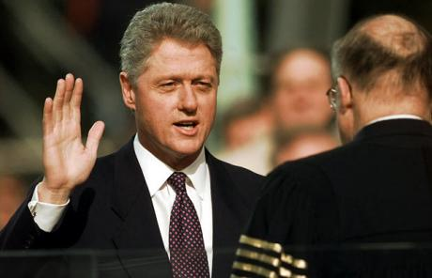
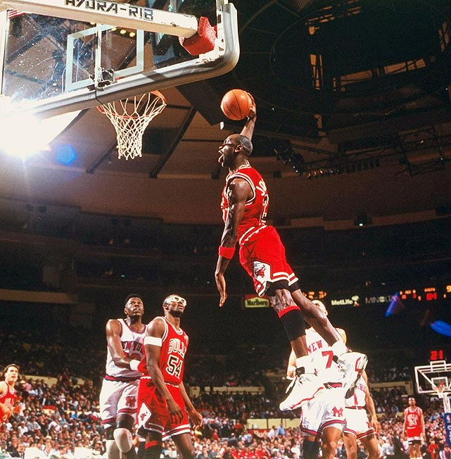

Take yourself back to the 90s

Slide 3
Take yourself back to the 90s
What Office software did you use?
Did you use a word processor?
Word? WordPerfect?
Did you use a spreadsheet?
Excel? Lotus? Quattro-Pro?
When did you buy your first suite?
Microsoft’s? WordPerfect’s?

Slide 4
Questions
Focus: The effect of correlation of consumer preferences for spreadsheets & word processors on profitability, welfare and strategic interaction
Does the introduction of the suite raise or lower consumer surplus?
When do rivals prefer mixed bundling rather than pure bundling?

Slide 5
What do we do/find?
Estimate correlation in consumer preferences across spreadsheets and word processors using a discrete choice model
Modeling + Econometric analysis are inputs. Use parameter values to conduct simulations/counterfactuals
Main estimation results:
Positive correlation of consumer values for spreadsheets and word processors
Bonus value for suites
An advantage for Microsoft products.
Main simulations results:
Greater correlation enhances the profitability of bundling
Market expansion and suite bonus effects
The introduction of Microsoft’s Office increased consumer welfare
Competitors may be better off under mixed bundling, relative to pure bundling

Slide 6
Evolution of the PC Office Software Market
The 1990’s saw dramatic structural shifts in office software market
Tremendous growth between 1991-1998.
Shift from DOS to Windows operating system.
Shift in market leadership away from Lotus (in spreadsheets) and WordPerfect (in word processors) to Microsoft.
Change in marketing strategy from selling components to suites.
LM: for the period we analyze, most 'sales' of office software were direct to consumers rather than via OEM market.

Slide 7
The market grew steadily Windows quickly replaced DOS

Slide 10
Office suites became increasingly important

Slide 11
Microsoft dominated the market for suites

Slide 12
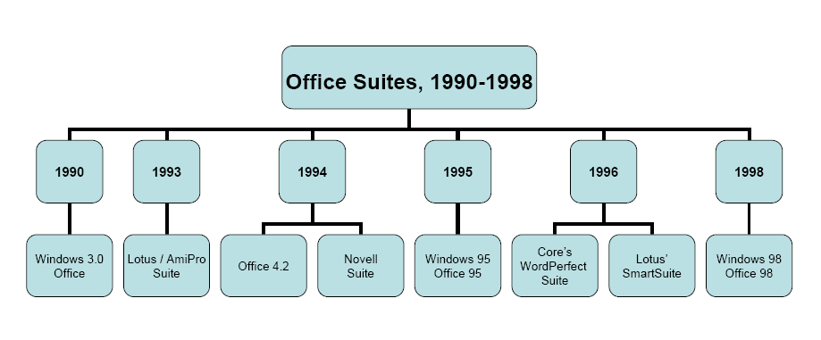
Bundling in the PC Office Software Market

Slide 13
Microsoft suites were priced significantly higher

Slide 14
Related Literature
Bundling
Theory:
Stigler (1968), Adams and Yellen(1976); Schmalensee (1982); McAfee, McMillan and Whinston (1989); Salinger (1995), Nalebuff (2004), Chen and Riordan (2011)
Empirical:
Crawford (2008), Discriminatory Incentives to Bundle in CATV
Crawford & Yurukoglu (2011), Welfare Effects of Bundling in Multi-channel TV Markets
Channels sold in large bundles, but not enough data to estimate individual channel demand. Channels
Gentzkow (2007), Chu, Leslie, and Sorensen (2011)
Computer software industry:
Liebowitz and Margolis (2001), Gandal (1994), Gandal, Greenstein & Salant (1999)
Discrete choice models of product differentiation:
Berry (1994), BLP (1995), Nevo (1998)

Slide 15
Data
Three basic products
Word processors
Spreadsheets
Suites
Allow for mix-and-match combinations
Sample period 1992-1998
Dataquest/Gartner Reports: Annual Revenue and shipments by product, vendor, and platform
Three Firms:
MS
Corel/WP
Lotus/IBM
After 1996, IBM/Lotus sold very few word processors, and Corel/WP sold very few word processors and spreadsheets
62 observations
Products characteristics
Price and quantity:
Dataquest/Gartner Reports
Quality (scale of 10)
Liebowitz and Margolis: Indices constructed from product reviews
Rel qual spread = (qual_j)/qual_lotus
Rel qual word proc = (qual_j)/qual_wp
Microsoft
1 if MS word proc or spreadsheet
2 if MS suite
Product type dummies
SS = spread or suite
WP = word processor or suite
Suite dummy - 0 for mix/match
Year dummies
YEARXX Dummy variable = 1 in year XX
No network effects – compatibility

Slide 16
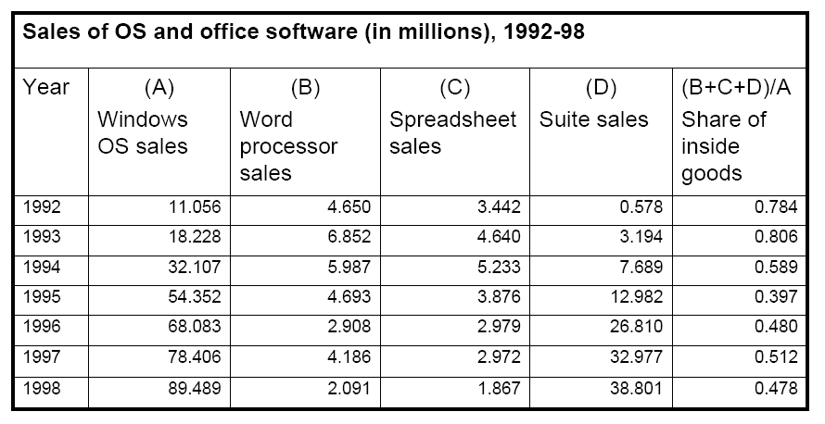
Potential market for office software is defined to be the # of operating systems sold/distributed via OEMs

Slide 17
Discrete choice model
Each consumers compares “products” across four categories
Spreadsheets
Wordprocessors
Suites
Mix-and-match bundles
Unobservable taste for spreadsheets is correlated with unobservable taste for wordprocessors.
Idiosyncratic preference for individual products. (Independent double exponential)
For suites, can be interpreted as an unobservable degree of product complementarity or additional components of suite
Unobserved product characteristics

Slide 18
Econometric model
Product utility: U_{jk} = δ_{j} + θ _{jk}
(1) Mean utility:
δ_{j} = β₁* PRICE_{j} + β₂*SUITE_{j} +
β₃*YEAR94_{j} + β₄*YEAR95_{j} + β₅*YEAR96-98_{j} +
β₆* SS_{j *} RELQUAL_SS_{j} + β₇* WP_{j *}RELQUAL_WP_{j} +
β₈* SS_{j *} RELQUAL_SS_{j}² + β₉* WP_{j *}RELQUAL_WP_{j}² +
β₁₀* MICROSOFT_{j} + β₁₁* MICROSOFT_{j}*SUITE_{j}*YEAR96-98_{j} + ξ _{j}
(2) Random utility: θ_{jk}=σ₁*SS_{j}*y_{k}+σ₂*WP_{j}*y_{k}+ε_{jk}
θjk includes a common (software category) component yk (std. normal)
~ i.i.d. double exponential, which implies
j indexes the product; k indexes the consumer; time subscript is suppressed

Slide 19

Correlation in Preferences
An important feature of this specification is that it allows a consumer’s demand for a word processor to be correlated with the consumer’s demand for a spreadsheet.
The correlation in consumer preferences between spreadsheet and arbitrary word processor (CWPSS) is .
1/2
1/2

Slide 20
Instrumental Variables
Instrument for price. We have four IVs:
Relative quality of best rival product in the same category
Relative quality of best rival suite (for spreadsheets or word processors); best rival constituent product (for suites)
Relative quality of firm’s own other constituent product (for spreadsheets or word processors); relative quality of ‘best’ own constituent product (for suites)
Dummy Variable for Year 95-98 –Prices declined beginning in 1995 due to the exogenous technological change in OS to Windows95, which made it easier (cheaper) to produce office software
Reasonably high correlation between IVs and price

Slide 21
Intuition for Identification: Linear Parameters
Our data set contains sales and shipments by products and by year.
Variation across products and time
Year dummies: Variation in the share of potential consumers who elect the outside good.
Microsoft dummy: varies across products, but not over time. Variations of shares of Microsoft products relative to other products.
Suite dummy: variation in market share of suites.
Price & Quality: shifts in market shares of products over

Slide 22
Intuition for Identification: Non-Linear Parameters
σ - an increase in σ increases the sales of the relevant class of products (spreadsheets and word processors).
High σ (say word processors):an increase in (say) WordPerfect’s price leads more consumers to substitute within the class, i.e., to another word processor.
When σ is low, more consumers will substitute away from that component, rather than purchase another product in the class when price rises.

Slide 23
Estimation Algorithm
Step 1: Take random draws of (Y_{1k}) for 100,000 consumers per year.
Step 2: Assume initial values for σ₁ and σ₂ and find δ using the following contraction mapping until convergence obtained
Step 3:Run the GMM regression =Xβ+ξ. Obtain estimates
where X is the matrix of right hand side variables, Z is the matrix of exogenous right hand side variables and instrumental variables, and the weighting matrix W=(Z’Z)⁻¹
Step 4: Compute the implied values of the unobservables
and evaluate GMM objective function
Step 5: Update the values of σ₁ and σ₂ & return to step 2.

Slide 24
Empirical Results OLS, Linear IV and Non-Linear Instrumental Variable Estimates
 | Logit (OLS) |  |  | Logit (IV ) |  |  | Random Coefficients Model (IV)
 | Coef. | SE | T-Statistic | Coef. | SE | T-Statistic | Coef. | SE | T-Statistic
σ₁ |  |  |  |  |  |  | 0.87 | 1.42 | 0.62
σ₂ |  |  |  |  |  |  | 1.82 | 2.52 | 0.72
Price | -0.01 | 0.01 | -1.57 | -0.14 | 0.11 | -1.25 | -0.11 | 0.13 | -0.83
YEAR94 | -0.72 | 0.49 | -1.46 | -3.18 | 2.63 | -1.21 | -2.45 | 2.67 | -0.92
YEAR95 | -1.3 | 0.5 | -2.58 | -7.46 | 5.34 | -1.40 | -6.07 | 15.45 | -0.39
YEAR96-98 | -1.81 | 0.68 | -2.66 | -14.18 | 10.56 | -1.34 | -11.24 | 13.02 | -0.86
MICROSOFT | 1.31 | 0.37 | 3.52 | 3.73 | 2.50 | 1.49 | 3.23 | 3.07 | 1.05
SS*RELQUAL_SS | -1.27 | 2.12 | -0.6 | -7.45 | 9.18 | -0.81 | -6.73 | 8.57 | -0.78
WP*RELQUAL_WP | 0.12 | 4.28 | 0.03 | -15.44 | 17.79 | -0.87 | -12.81 | 20.76 | -0.62
SUITE | 3.19 | 0.53 | 6.01 | 2.36 | 2.02 | 1.17 | 2.59 | 2.61 | 1.00
SS*RELQUAL_SS² | -0.12 | 2.31 | -0.05 | 14.75 | 14.54 | 1.01 | 12.15 | 15.66 | 0.78
WP*RELQUAL_WP² | -1.64 | 4.12 | -0.4 | 22.65 | 2.43 | 1.01 | 18.16 | 26.82 | 0.68
MICROSOFT*SUITE*YEAR96-98 | 1.66 | 1.09 | 1.52 | 2.75 | 4.01 | 0.69 | 2.34 | 2.51 | 0.93
63 observations | Adj. R²=0.31 |  |  |  |  |  | GMM | 18.45

Slide 25
Empirical Results
σ_{2,WP} (1.82) is larger than σ _{1,SS} (0.87) : correlation = 0.46
Spreadsheet use during the 1990s was primarily for simple calculations; likely less variance in that value than in the variance of the value placed on word processors.
Coefficient on Microsoft dummy is positive but not significant
Microsoft benefited from better reputation, better service, additional components in the suite, better integration of components
Coefficient on the variable SUITE is positive, although not statistically significant. Value of “suite bonus” is obtained by dividing the SUITE coefficient by the absolute value of the PRICE coefficient, i.e. approximately $23.4

Slide 26
Elasticities – Logit Model
Own and cross elasticities from the logit model are:
First column is the elasticity of the product (j) in each row with respect to changes in the price of MS Word. Since this only depends on the price and market share of MS Word, the cross elasticities are the same for all products in the column.
MS Word MS Excel WP Word Lotus SS MS Suite
MS Word -14.96 0.61 0.46 0.53 6.48
MS Excel 0.68 -16.96 0.46 0.53 6.48
WP Word 0.68 0.61 -12.18 0.53 6.48
Lotus SS 0.68 0.61 0.46 -16.68 6.48
MS Suite 0.68 0.61 0.46 0.53 -26.93

Slide 27
Elasticities – Random coefficients Model
Own and cross elasticities from the random coefficient model are:
MS Word MS Excel WP Word Lotus SS MS Suite
MS Word -11.95 0.63 0.63 -0.60 0.63
MS Excel 0.58 -13.43 -0.42 0.58 0.58
WP Word 0.53 -0.70 -9.58 -0.39 0.53
Lotus SS -0.31 0.43 -0.22 -10.18 0.43
MS Suite 5.10 5.10 5.10 5.10 -22.15

Slide 28
Simulations
We wish to examine how correlation of preferences over word processors and spreadsheets affects profitability in oligopoly settings.
One convenient way of varying correlation is to take two draws rather than a single draw (for each consumer) from independent standard normal random variables (denoted Y_{1k} and Y_{2k}. )
With these two draws, define µ₁ and µ₂ as follows: µ₁ = σ₁Y₁ and µ₂= σ₂ρY₁ + σ₂(1 - ρ²)^{1/2} Y₂.
Then (μ_{1k},μ_{2k})∼N(0,0, σ₁, σ₂,ρ) is a bivariate normal distribution, where σ₁ and σ₂ are the standard deviations of μ_{1k} and μ_{2k} respectively and ρ is the correlation coefficient of the bivariate normal distribution.
In such a case, the random utility of the model is
Note that when ρ=1, this random utility reduces to equation (2).
Correlation in preferences = ρ* (CWPSS)

Slide 29
CPS Supplement on Computer and Internet
Home Use | Use Spreadsheets?
Use WPs? | Yes | No
Yes | 0.27 | 0.32
No | 0.05 | 0.36
Office Use | Use Spreadsheets?
Use WPs? | Yes | No
Yes | 0.50 | 0.17
No | 0.12 | 0.21
158,865 individuals from the 2001 CPS Supplement. The CPS uses weights to produce basic demographic and labor force estimates.
Define dummy variable that take on the value one (zero) if the answer to a question is (yes) no.
The estimate of the correlation between these variables (which is an imperfect proxy for the correlation in consumer preferences over word processors and spreadsheets) is 0.37 for home use and 0.36 for office use.

Slide 30
Using a Moment from CPS
The following moment could be added to the estimation.
Given our initial estimates, we could lower ρ (which is set to one) and re-estimate the model.
We would again calculate the overall correlation – and compare our estimate of the overall correlation to the overall correlation in the CPS data.
estimation CPS

Slide 31
Simulations
Conducted simulations for 1995 & 1998. Results presented are for 1995
Marginal costs are 'backed' out of the first order conditions under the assumption that the firms are competing in prices and there is a Nash equilibrium.
Marginal cost includes MC of marketing and of providing consumer support
Estimated marginal costs for 1995:
MS Word - $97; MS Excel - $112; MS Suite - $226
WordPerfect word processor - $81
Lotus spreadsheet - $86.
Software and Information Industry Association (1990): 38% of total costs are variable costs in the form of sales costs, marketing costs, technical support, and consumer support.
Suite Bonus:
MC of MS Suite exceeds the sum of the marginal costs for Word and Excel by $16.7
Given an estimated suite bonus of $23.4, the suite generated $6.7 social surplus
The suite presented a profit opportunity to Microsoft independently of on any price discrimination benefit from for bundling.

Slide 32
Simulations Monopoly Market Structures No Bonus for Mix-and-Match Combinations
Table 4
Pure bundling: profits increase in ρ.
Market expansion effect (JM 2006, “expanding niche market”)
Separate Selling (no suite bonus for mix-and-match): Profits are independent of ρ
Mixed bundling: profits increase in ρ.
interaction of the niche market and the suite bonus effects.
JM - profits of a firm increase in dispersion when (i) consumers heterogeneous and (ii) a firm serves a relatively small group of the potential market. (Variance of random utility of suite increases in ρ)

Slide 33
Simulations Monopoly Market Structures – welfare effects
For ρ=1
Separate selling—Excel + Word = $235
Office price (under mixed or pure bundling) = ~$248
Suite bonus ($23.4) > $13 = $248-$235
Mixed bundling:
Net gain = $9.6 :
Excel & Word prices are higher than in separate selling
Consumers are “encouraged “to buy the suite
Price penalty increases with ρ
Welfare increases by more when ρ=1, despite higher prices
The higher ρ, the larger the share of consumers that buy the suite; the higher the share of consumers that enjoy the $9.6 net gain the suite creates
ρ =1: 6.3% purchase both components separately when suites are not available; ρ=-1: 0.3%

Slide 34
Simulations Oligopolistic Competition No Bonus for Mix-and-Match Combinations
ρ=1: MS sells mostly suites; 73% of its profits come from suites; size of the component market falls by at least 50%

Slide 35
Simulations Oligopolistic Competition - Cont
Suite increases welfare regardless of ρ
ρ=1: Net gain over components= $9.5
Prices under bundling are higher, but:
With strong positive correlation, many consumers who purchase both components separately when suites are not available buy now the suite and enjoy the net gain of $9.5
More products are sold overall
Combinations of both effects increases welfare
Competing firms may be better off under mixed bundling rather than pure bundling
Under mixed bundling, consumers can mix-and-match Microsoft product with Lotus/WordPerfect product
When correlation in consumers preferences is high, there is higher demand for consuming both products, and thus the mix-and-match effect dominates the ‘reduction in competition’ effect

Slide 36
Robustness Analysis
In order to test for the robustness of our results, we run the simulations presented in Tables 4 and 5 based on 60,000 draws taken based on the estimated variance-covariance matrix.
Given that our price coefficient is not significant, we get a positive price coefficient in about 10% of the draws. We drop these draws.
We run the simulations on the remaining 90% of the draws; however, for some of these draws the program is unable to find the equilibrium cost estimate or equilibrium prices

Slide 37
Robustness Analysis - continued
We then examine the robustness of our result that the introduction of the suite is pro-competitive regardless of the value of ρ. In all cases, welfare is higher with the introduction of the suite than it is in the case when the firms sell components only.

Slide 38
Robustness Analysis - continued
We then examined the relationship between the ‘mix-and-match effect’ and the ‘reduction in competition’ effect. The table below presents the share of cases where Lotus’ spreadsheet (WordPerfect’s) profits were higher under mixed bundling than under pure bundling.
Share of simulation runs where | ρ=1 | ρ=0 | ρ=-1
Higher profits under mixed bundling
WordPerfect word processor | 0.89 | 0.75 | 0.65
Lotus spreadsheet | 0.69 | 0.5 | 0.39

Slide 39
Conclusion
Consumer demands for word processors and spreadsheets are positively correlated
Johnson & Myatt’s (2006):
Niche-market expansion effect: Higher correlation implies increased variance of preferences for suite – and raises profits for pure bundling
We find that this effect holds not only in ‘niche’ markets
In the case of mixed bundling, profits increase in correlation because of the interaction of the suite bonus with the market expansion effect
Changes in correlation affect strategic interaction significantly

Slide 40
Evidence for Positive correlation in preferences
The dependent variable is USE, where USE=(2 if the answer to both questions is yes, 1 if the answer to one of the questions is yes and 0 if the answer to both questions is no).
Independent variables are
INCOME - takes on whole numbers between 1-14 that correspond to ranges of yearly family income. For example, 1=less than $5000, 7=$20,000-$24,999, and 14=$75000 or more.
EDUCATION - represents the total years of schooling. It takes on the range 31-46, where 31=less than first grade, 39=a school high degree, and 46=Ph.D. degree.
COMPUTERS – represents the number of computers in the household, where 0=no computers, 1=one computer, 2=two computers, and 3=three or more computers.
SCHOOL – takes on the value one if the individual is in school and zero otherwise.
INTERNET – takes on the value one if the household has Internet service and zero otherwise.
Independent Variables | Home Use |  | Office Use
 | Coefficient | T-Statistic | Coefficient | T-Statistic
Constant | 0.08 | 25.33 | -0.12 | -33.15
INCOME | 0.0043 | 16.84 | 0.013 | 43.67
EDUCATION | 0.013 | 160.42 | 0.014 | 147.54
COMPUTERS | 0.18 | 148.98 | 0.078 | 56.07
SCHOOL | 0.037 | 22.69 | -0.09 | -49.32
INTERNET | -0.16 | -89.16 | -0.11 | -55.58
Number of Obs. | 158,865 |  | 158,865
Adj. R-squared | 0.33 |  | 0.20

Slide 41
Descriptive Statistics

Slide 42
Another CPS Moment – Mix & Match
We calculate the following moment: the percent of consumers who use both word processors and spreadsheets, either at home or at work.
This essentially calculates the percent of consumers who use suites or mix-and-match products.
Here we find from the CPS data that 94.5% of the consumers who have a computer use both products in 2001, either at work or at home.
In the case of 1998, 90.7% who make a purchase buy suites. (The other 9.3% are fairly evenly split between word processors and spreadsheets.)
Hence, the difference between 94.5% and 90.7% (which is 3.8%) can be taken as an estimate of the consumers who mix-and-match in 1998.
The simulated percentage of consumers who mix and match from 1998 is 6.1%.
This suggests that our simulation estimates of the percent that mix-and-match is reasonable. (less mix and match over time.)

Slide 43
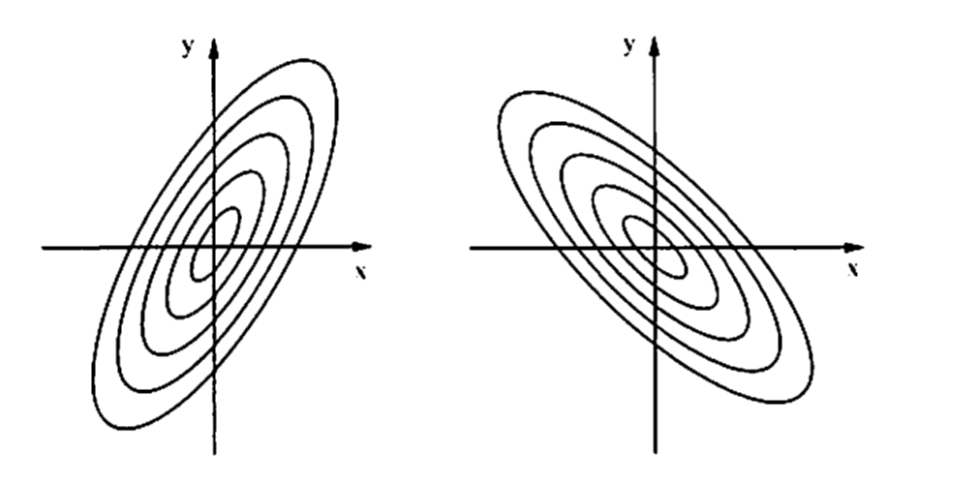
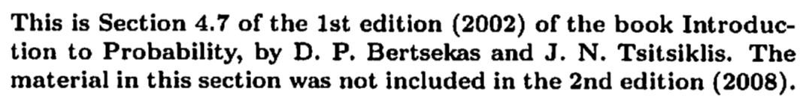
The Bivariate Normal Distribution
Positive correlation
Negative correlation

Slide 44
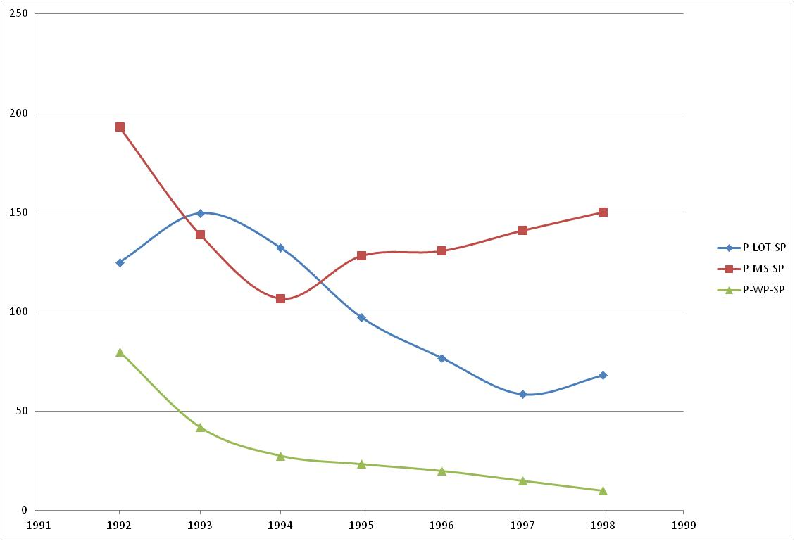
Spreadsheet Prices

Slide 45
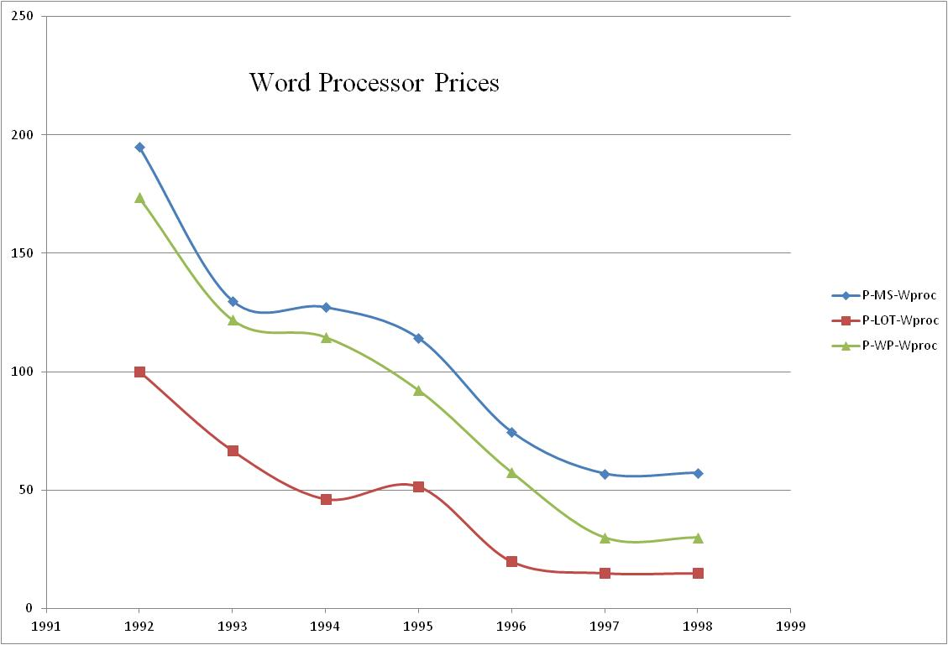

Slide 46
Significant suite discount after 1995

