Slide 1

Course offered by:
Johns Hopkins University
On:
Coursera.org

Slide 2
What is AngularJS?
AngularJs is a platform and framework for building single-page client applications using HTML and JavaScript.

Slide 3
Why AngularJs?
Why don’t keep things simple?

Slide 4
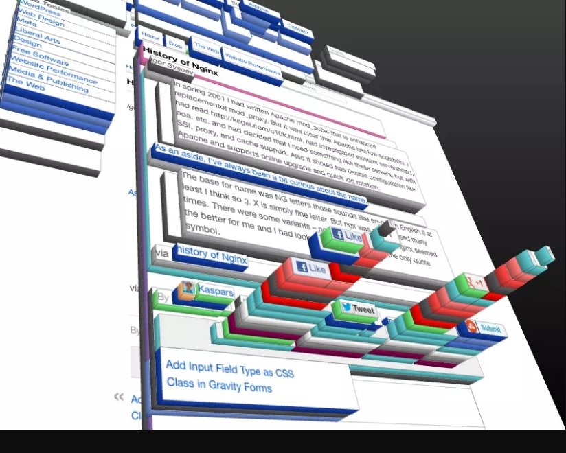
Complexity
Maintenance
Scalability
Reusability

Slide 5

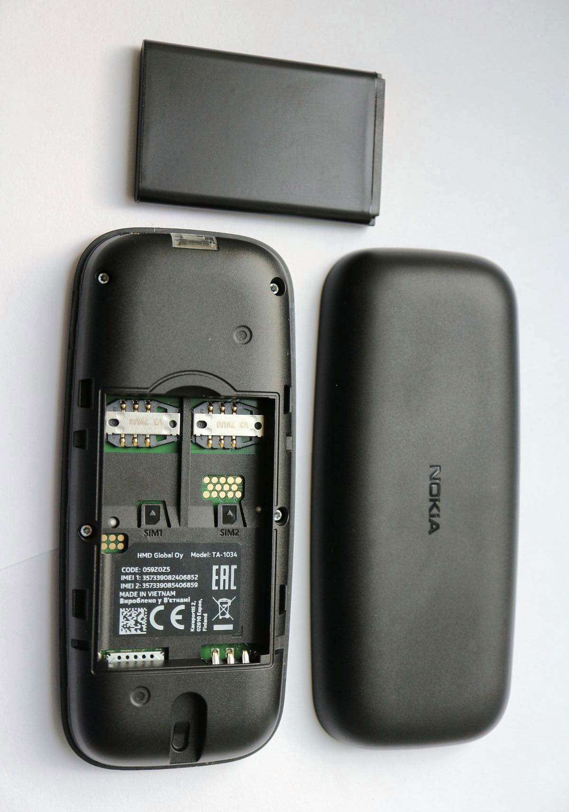
Loose coupling VS tight coupling
Tight coupling
Loose coupling

Slide 6
High cohesion
Low cohesion
High cohesion
Me
Computer
wakeUp()
breackFast()
shower()
catchBus()
attendClass()
lunch()
goToWork()
gym()
dinner()
homework()
brushTeeths()
Sleep()
on()
loadsOs()
process()
off()

Slide 7
Different versions of angular
AngularJS October 2010
Angular 2 September 2016
Angular 4 March 2017
Angular 5 November 2017
Angular 6 May 2018
Angular 7 October 2018
Angular 8 May 2019
Angular 9 February 2020
Angular 10 June 2020
Angular 11 November 2020
Angular 12 May 2021
Angular 13 November 2021
Angular 14 June 2022

Slide 8
Prerequisites :
HTML
CSS
JavaScript
The basic idea of the MVC (Model-View-Controller) architecture.
Basic knowledge of Node. js and npm (Node Package Manager).
Experience working with the command line.

Slide 9
Installation and setup
https://angularjs.org/

Slide 10
What did AngularJS add to the web dev?

Slide 11
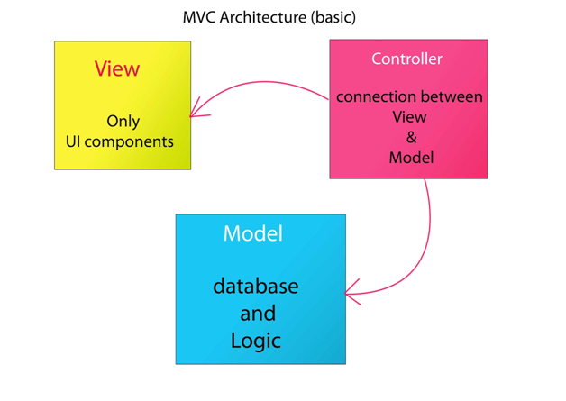
MVC

Slide 12
Controller

Slide 13
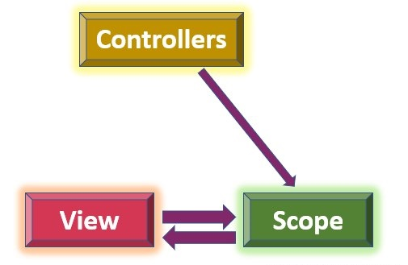
The controller in AngularJS is a JavaScript function that maintains the application data and behavior using $scope object.

Slide 14
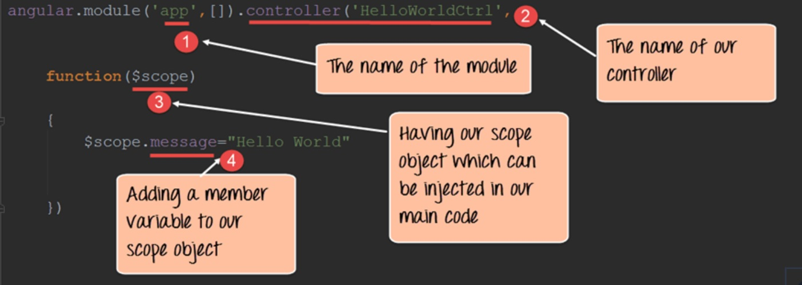
Scope

Slide 15
Service

Slide 16
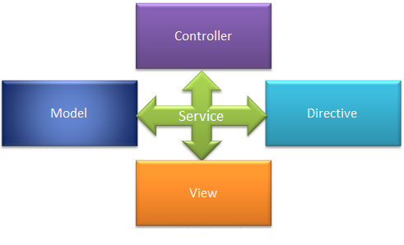
In AngularJS, a service is a function, or object, that is available for, and limited to, your AngularJS application. AngularJS has about 30 built-in services. One of them is the $location service.

Slide 17
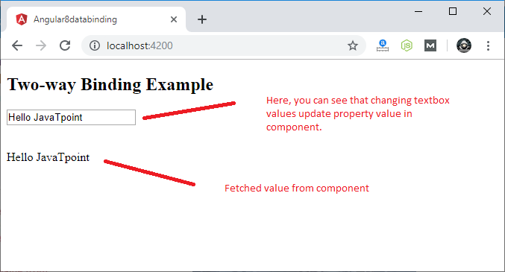
Data binding

Slide 18
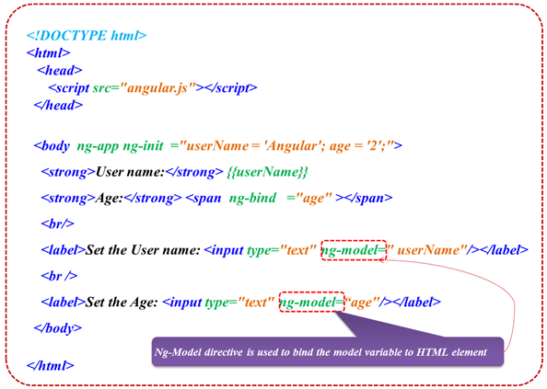
Data binding

Slide 19
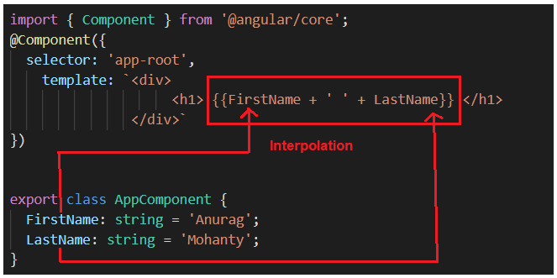
Expression and interpolation

Slide 20
Dependency Injection

Slide 21


Slide 22
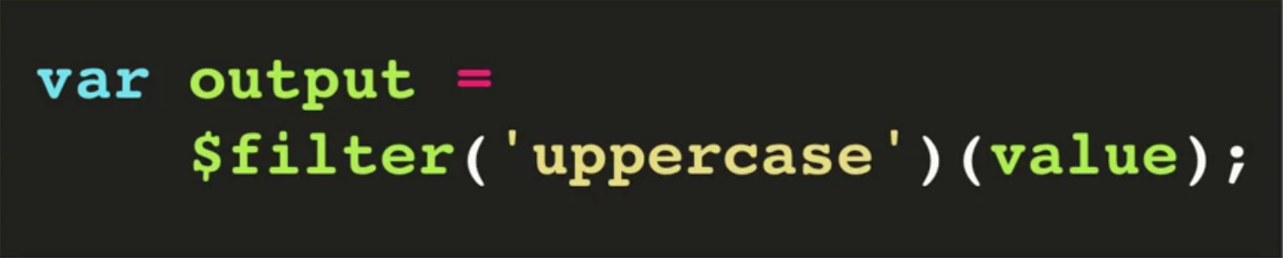
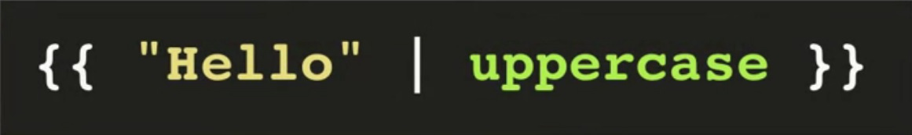
Filters and pipes
In JS
Or in HTML

Slide 23
Filters and pipes
Example :
Output :
Cost : $ 1.45

Slide 24
Directives?

Slide 25
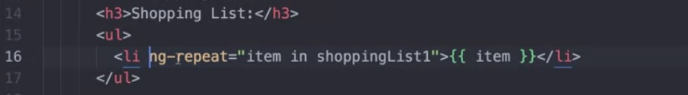
A directive is a decorator that marks a class as an Angular directive. You can define your own directives to attach custom behavior to elements in the DOM.
Example:

Slide 26
Example of what we can do with AngularJs
https://lakhdarwalid.github.io/movieslibrary/

Slide 27
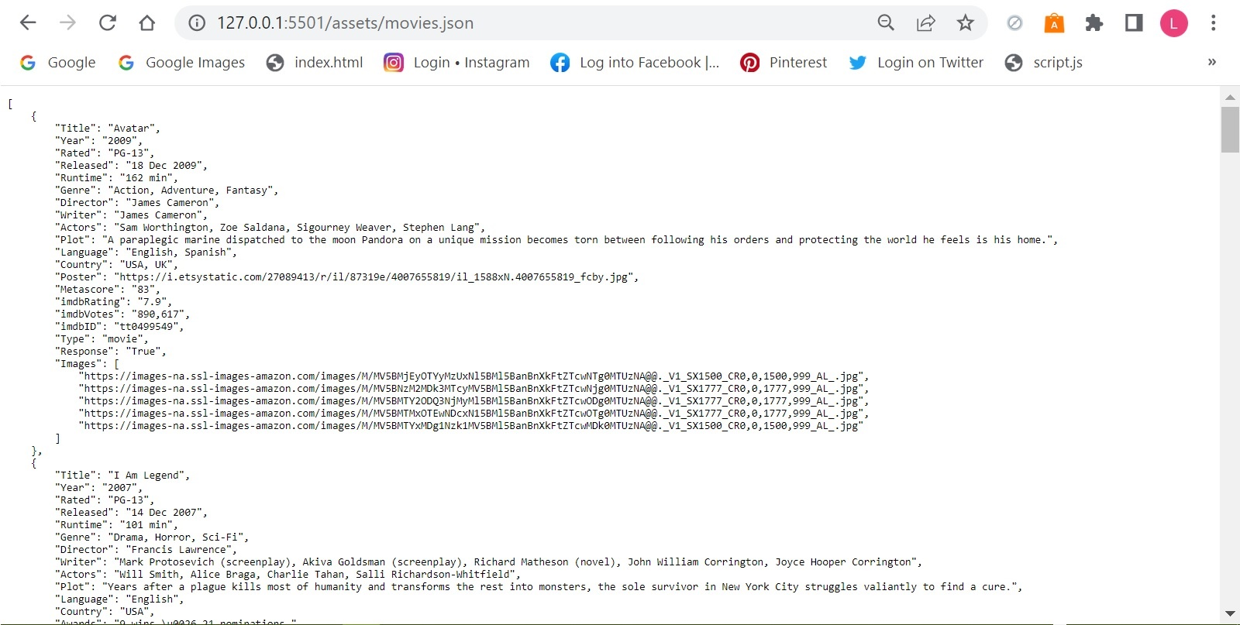

Slide 28
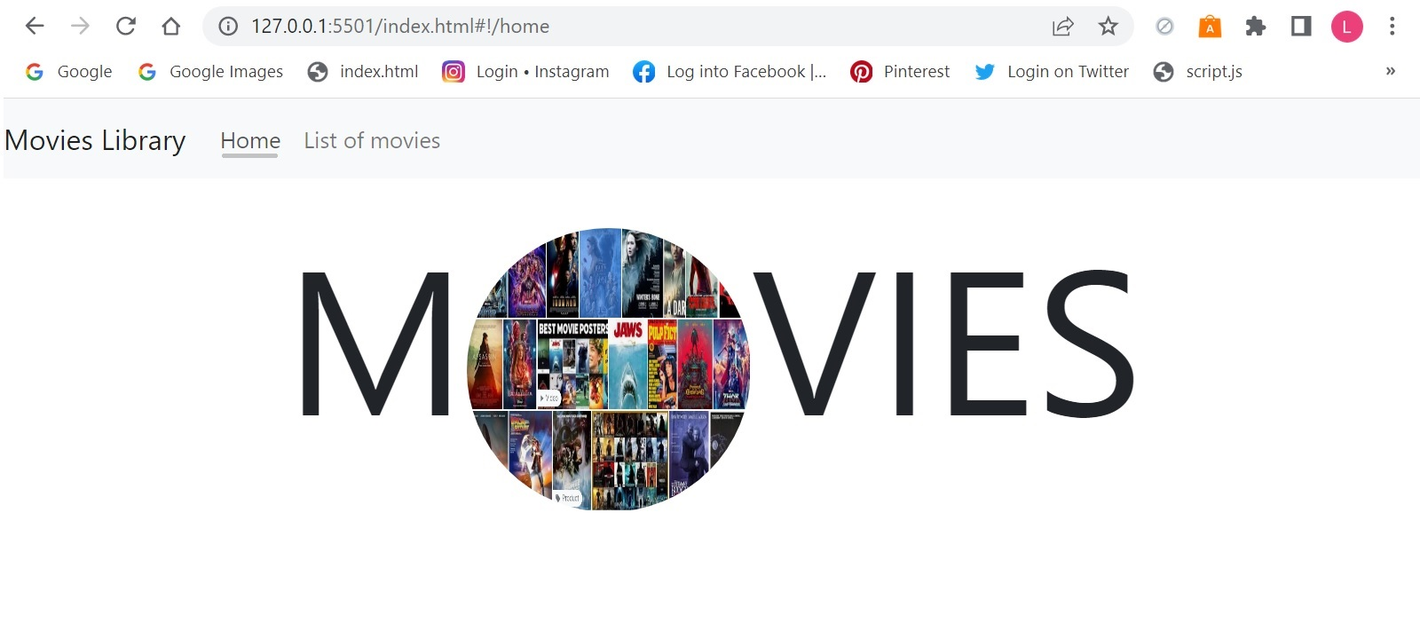

Slide 29
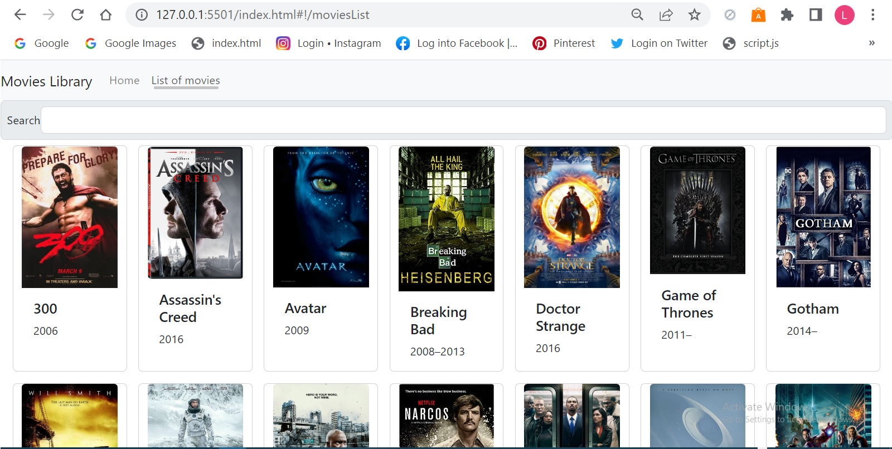

Slide 30
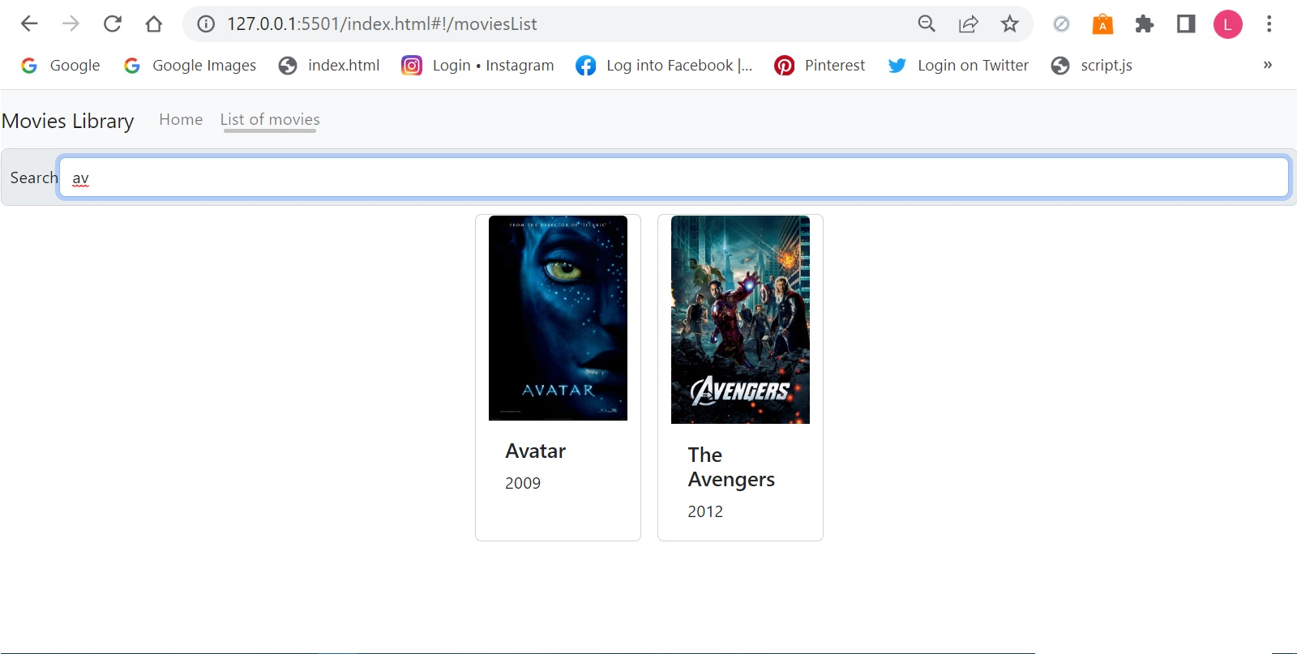

Slide 31
The end….
Thank you

