Slide 1
TEMPLATE GUIDE / KEEP FOR AUTHORS
Fill. Duplicate. Present.
01
02
03
Choose a page
Replace the prompts
Keep the hierarchy
Use the page index, then duplicate the closest variant for your story.
Bracketed copy, image labels and example data are fields to replace.
Keep Lora for the main statement and DM Sans for everything supporting it.
Install the bundled Lora and DM Sans fonts before editing.
Notes:
Keep this slide for internal authors or delete it before presenting.
[Sources]
- User-provided SEARULEA brand guideline

Slide 2
TEMPLATE INDEX / 57 PAGES
Every common presentation page, ready to duplicate.
03–06
Covers
4 variants
34–39
Charts
6 variants
07–09
Agendas
3 variants
40–43
Comparison
4 variants
10–13
Dividers
4 variants
44–46
Tables
3 variants
14–18
Narrative
5 variants
47–50
People
4 variants
19–24
Image-led
6 variants
51–54
Proof & place
4 variants
25–28
Metrics
4 variants
55–57
Closing
3 variants
29–33
Process
5 variants
Notes:
Use this index while authoring; delete it from the client-facing presentation.
[Sources]
- User-provided SEARULEA brand guideline

Slide 3
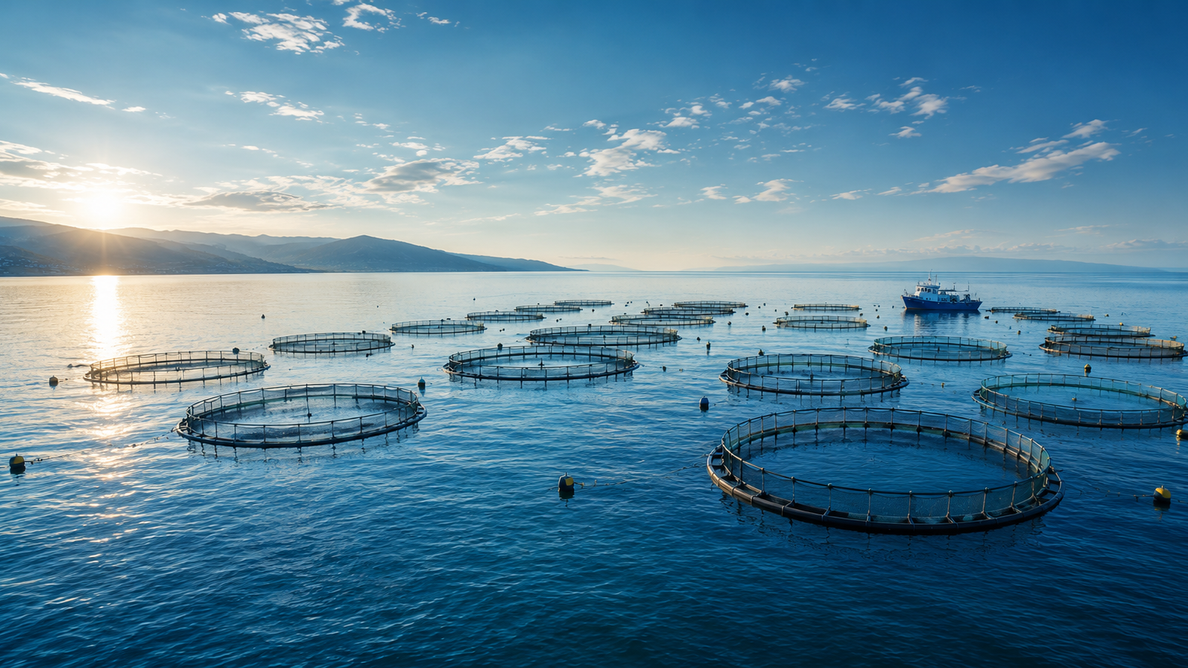

[PRESENTATION TYPE / CLIENT]
[ADD PRESENTATION
TITLE]
[Add one concise sentence describing the purpose or outcome.]
[Month Year] · [Presenter] · [Confidentiality]
Notes:
Photo-led cover. Replace the full-slide image and keep the title to two lines maximum.
[Sources]
- User-provided SEARULEA brand guideline
- User-provided hero-cages.jpg

Slide 4

[PRESENTATION TYPE / CLIENT]
[ADD DECK
TITLE]
[Add one concise sentence describing the purpose or outcome.]
[Month Year] · [Presenter] · [Confidentiality]
Notes:
Formal Deep Sea cover. Keep the gradient spiral unchanged and use amber only inside this approved motif.
[Sources]
- User-provided SEARULEA brand guideline
- User-provided SEARULEA gradient spiral

Slide 5
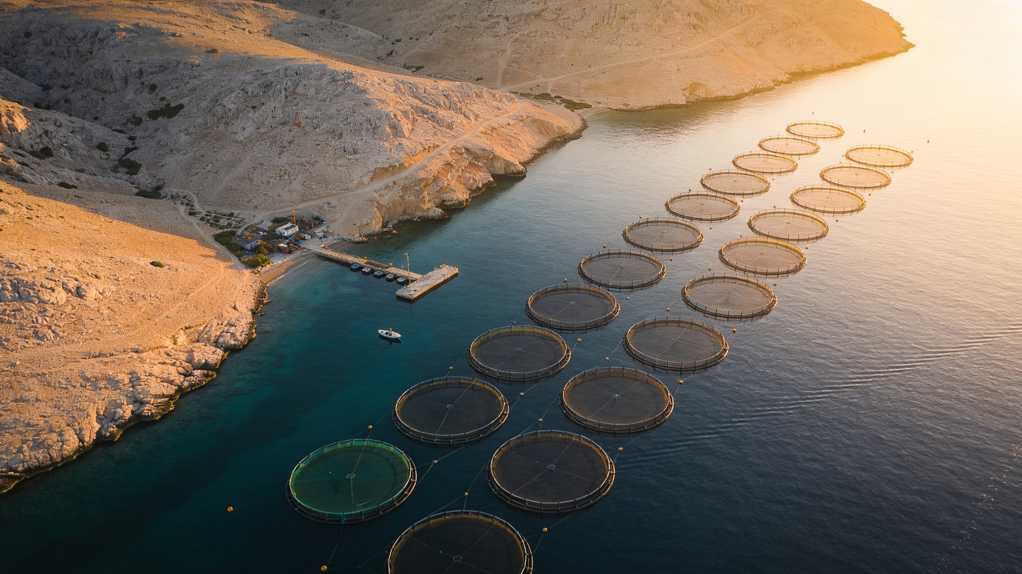
[PRESENTATION TYPE]
[ADD PRESENTATION TITLE]
[Month Year] · [Presenter]
Notes:
Full-bleed photographic cover. Replace the image and keep important subjects above the title band.
[Sources]
- User-provided SEARULEA brand guideline
- User-provided 5_coast_sovereignty.jpg

Slide 6

[PRESENTATION TYPE / CLIENT]
[ADD PRESENTATION TITLE]
[Add one concise sentence describing the purpose or outcome.]
[Month Year] · [Presenter] · [Confidentiality]
Notes:
Minimal Pearl cover for proposals, reports and formal updates.
[Sources]
- User-provided SEARULEA brand guideline
- User-provided SEARULEA gradient spiral

Slide 7
PRESENTATION OVERVIEW
[ADD A SIMPLE AGENDA TITLE]
01
[SECTION TITLE]
[Add a short description of what this section covers.]
02
[SECTION TITLE]
[Add a short description of what this section covers.]
03
[SECTION TITLE]
[Add a short description of what this section covers.]
04
[SECTION TITLE]
[Add a short description of what this section covers.]
Notes:
Classic four-part agenda. Add or remove rows while preserving the spacing rhythm.
[Sources]
- User-provided SEARULEA brand guideline

Slide 8
PRESENTATION OVERVIEW
[ADD A THREE-CHAPTER AGENDA TITLE]
01
02
03
[CHAPTER TITLE]
[CHAPTER TITLE]
[CHAPTER TITLE]
[Add one or two lines describing this chapter.]
[Add one or two lines describing this chapter.]
[Add one or two lines describing this chapter.]
Notes:
Three-chapter agenda for concise presentations.
[Sources]
- User-provided SEARULEA brand guideline

Slide 9
PRESENTATION OVERVIEW
[ADD A JOURNEY-STYLE AGENDA TITLE]
01
02
03
04
05
[STEP]
[STEP]
[STEP]
[STEP]
[STEP]
[Short description]
[Short description]
[Short description]
[Short description]
[Short description]
Notes:
Five-stage journey agenda. Keep the stage labels short.
[Sources]
- User-provided SEARULEA brand guideline

Slide 10
[SECTION 01]
[ADD SECTION TITLE]
[Add one line that sets up the next chapter.]
Notes:
Primary section divider. Keep the title to two lines maximum.
[Sources]
- User-provided SEARULEA brand guideline
- User-provided SEARULEA Sea Foam spiral

Slide 11
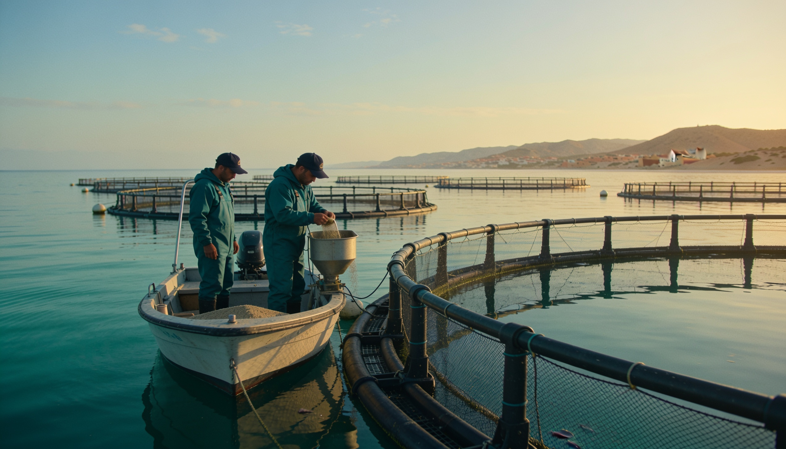

[SECTION 02]
[ADD SECTION TITLE]
[Add one line that sets up the next chapter.]
Notes:
Photographic section divider. Replace the image and preserve the Deep Sea panel.
[Sources]
- User-provided SEARULEA brand guideline
- User-provided 1_offshore_ops.jpg

Slide 12

[SECTION 03]
[ADD SECTION TITLE]
[Add one line that sets up the next chapter.]
Notes:
Minimal Pearl section divider for quieter transitions.
[Sources]
- User-provided SEARULEA brand guideline

Slide 13

[SECTION 04]
[ADD SECTION TITLE]
[Add one line that sets up the next chapter.]
Notes:
Sea Foam split divider for a more expressive brand transition.
[Sources]
- User-provided SEARULEA brand guideline
- User-provided SEARULEA Sea Foam spiral

Slide 14
SECTION / TOPIC
[ADD A CLEAR, DECISION-LED TITLE]
[Add a short opening paragraph that establishes the context.]
[Use a second paragraph to explain the implication or decision.]
[Add the first supporting point.]
[Add the second supporting point.]
[Add the third supporting point.]
Notes:
Single-column narrative. Aim for two short paragraphs and no more than three bullets.
[Sources]
- User-provided SEARULEA brand guideline

Slide 15
SECTION / TOPIC
[ADD A CLEAR, DECISION-LED TITLE]
[LEFT COLUMN HEADING]
[Add the left-side argument, context or current-state explanation.]
[Add the first supporting point.]
[Add the second supporting point.]
[Add the third supporting point.]
[RIGHT COLUMN HEADING]
[Add the right-side argument, implication or future-state explanation.]
[Add the first supporting point.]
[Add the second supporting point.]
[Add the third supporting point.]
Notes:
Two-column narrative. Use parallel structures on both sides.
[Sources]
- User-provided SEARULEA brand guideline

Slide 16
[VISION / POSITIONING]
[ADD ONE DEFINING STATEMENT]
[Add one supporting sentence that turns the statement into a clear implication.]
Notes:
Use for a thesis, point of view or memorable chapter statement.
[Sources]
- User-provided SEARULEA brand guideline

Slide 17
SECTION / TOPIC
[ADD A CLEAR, DECISION-LED TITLE]
01
02
03
[POINT TITLE]
[POINT TITLE]
[POINT TITLE]
[Add two or three concise sentences explaining this point and why it matters.]
[Add two or three concise sentences explaining this point and why it matters.]
[Add two or three concise sentences explaining this point and why it matters.]
Notes:
Three-point narrative. Keep all three points at similar depth.
[Sources]
- User-provided SEARULEA brand guideline

Slide 18
SECTION / TOPIC
[ADD A CLEAR, DECISION-LED TITLE]
[Add the main narrative here. Use two or three short paragraphs.]
[Explain the implication, evidence or next decision.]
[Add the first supporting point.]
[Add the second supporting point.]
[Add the third supporting point.]
[SIDEBAR LABEL]
[Add a short key takeaway or definition.]
Notes:
Sidebar narrative. Use the colored panel for a definition, takeaway or important context.
[Sources]
- User-provided SEARULEA brand guideline

Slide 19
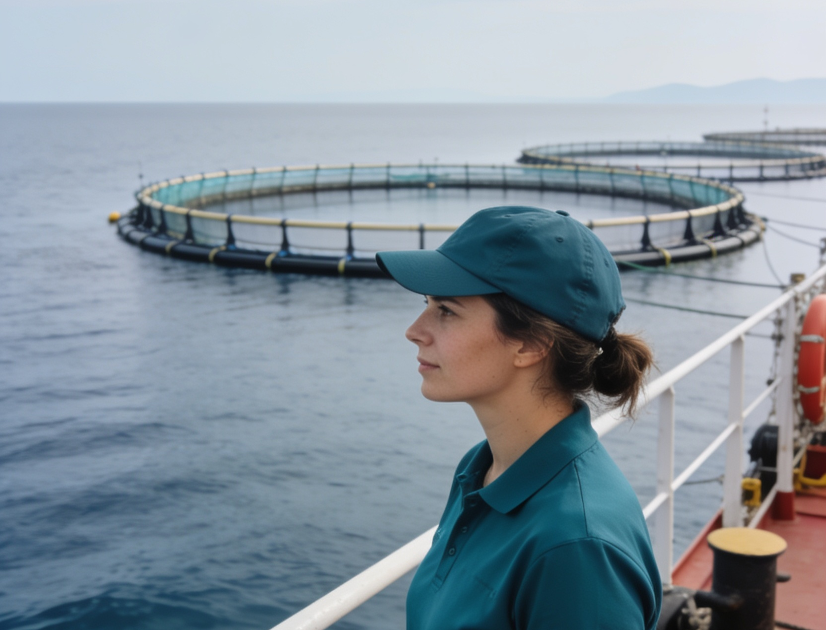
SECTION / TOPIC
[ADD A CLEAR, DECISION-LED TITLE]
[ADD A SUPPORTING SUBHEAD]
[Add two or three concise sentences that explain what the image proves.]
[Add the first supporting point.]
[Add the second supporting point.]
[Add the third supporting point.]
REPLACE IMAGE
Notes:
Image-left story. Replace the image and use the text column to explain its relevance.
[Sources]
- User-provided SEARULEA brand guideline
- User-provided 3_women_searulea.jpg

Slide 20

SECTION / TOPIC
[ADD A CLEAR, DECISION-LED TITLE]
[ADD A SUPPORTING SUBHEAD]
[Add two or three concise sentences that establish the context and implication.]
[Add the first supporting point.]
[Add the second supporting point.]
[Add the third supporting point.]
REPLACE IMAGE
Notes:
Image-right story. Use when the narrative should lead before the visual evidence.
[Sources]
- User-provided SEARULEA brand guideline
- User-provided 4_traceability_tech.jpg

Slide 21
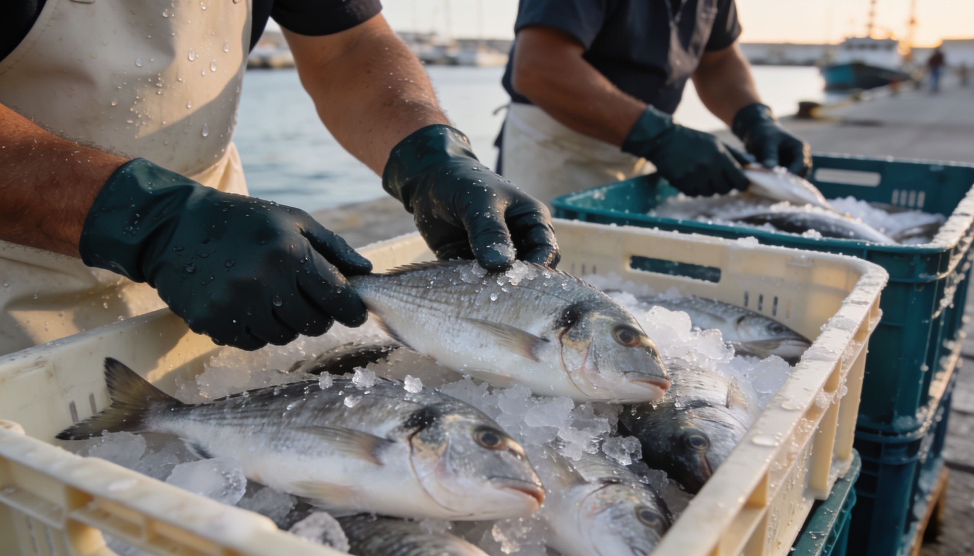
[SECTION / TOPIC]
[ADD A STRONG IMAGE-LED TITLE]
[Add one short paragraph explaining why this image matters.]
REPLACE IMAGE
Notes:
Full-bleed image story. Replace the image and keep the dark text panel to roughly two-fifths of the slide.
[Sources]
- User-provided SEARULEA brand guideline
- User-provided 2_fresh_at_port.jpg

Slide 22

SECTION / TOPIC
[ADD A CLEAR, DECISION-LED TITLE]
REPLACE IMAGE
[ADD A SHORT CAPTION HEADLINE]
[Explain what the image shows and the implication the audience should take from it.]
Notes:
Panoramic evidence page. Use a wide image with one concise caption and implication.
[Sources]
- User-provided SEARULEA brand guideline
- User-provided 6_team_coldchain.jpg

Slide 23
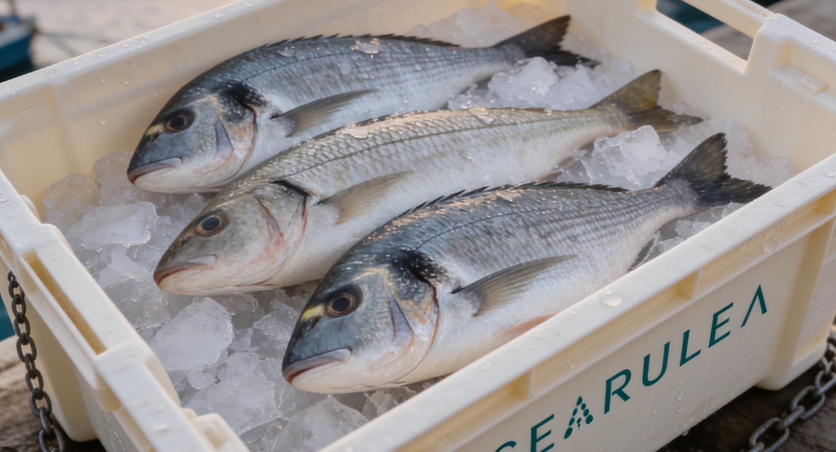

SECTION / TOPIC
[ADD A CLEAR, DECISION-LED TITLE]
REPLACE IMAGE
REPLACE IMAGE
[LEFT IMAGE TITLE]
[RIGHT IMAGE TITLE]
[Add one sentence explaining the first image.]
[Add one sentence explaining the second image.]
Notes:
Two-image comparison or sequence. Use consistent crops and parallel captions.
[Sources]
- User-provided SEARULEA brand guideline
- User-provided SEARULEA packaging and truck mockups

Slide 24

[PROOF / TESTIMONY]
“[ADD A CONCISE QUOTE OR PROOF POINT.]”
[Name] · [Role] · [Organisation]
REPLACE IMAGE
Notes:
Photo quote. Verify the quote, speaker and image before presenting.
[Sources]
- User-provided SEARULEA brand guideline
- User-provided 11_office_glass.jpg

Slide 25
KEY FIGURES / SNAPSHOT
[ADD A CLEAR, DECISION-LED TITLE]
[00]
[00]
[00]
[Add the metric label and unit.]
[Add the metric label and unit.]
[Add the metric label and unit.]
[Optional one-line context]
[Optional one-line context]
[Optional one-line context]
Notes:
Three-metric snapshot. Use values with similar visual weight and explain the unit in each label.
[Sources]
- User-provided SEARULEA brand guideline

Slide 26
KEY FIGURES / DASHBOARD
[ADD A CLEAR, DECISION-LED TITLE]
[00]
[00]
[00]
[00]
[Metric label]
[Metric label]
[Metric label]
[Metric label]
[Short context]
[Short context]
[Short context]
[Short context]
Notes:
Four-metric dashboard. Keep the numbers short and use the final line for context, not another metric.
[Sources]
- User-provided SEARULEA brand guideline

Slide 27
[KEY FIGURE / OUTCOME]
[00%]
[Add one sentence explaining what the number means and why it matters.]
[Optional period, baseline or source note]
Notes:
Hero metric. Use one number only and include enough context to prevent misinterpretation.
[Sources]
- User-provided SEARULEA brand guideline

Slide 28
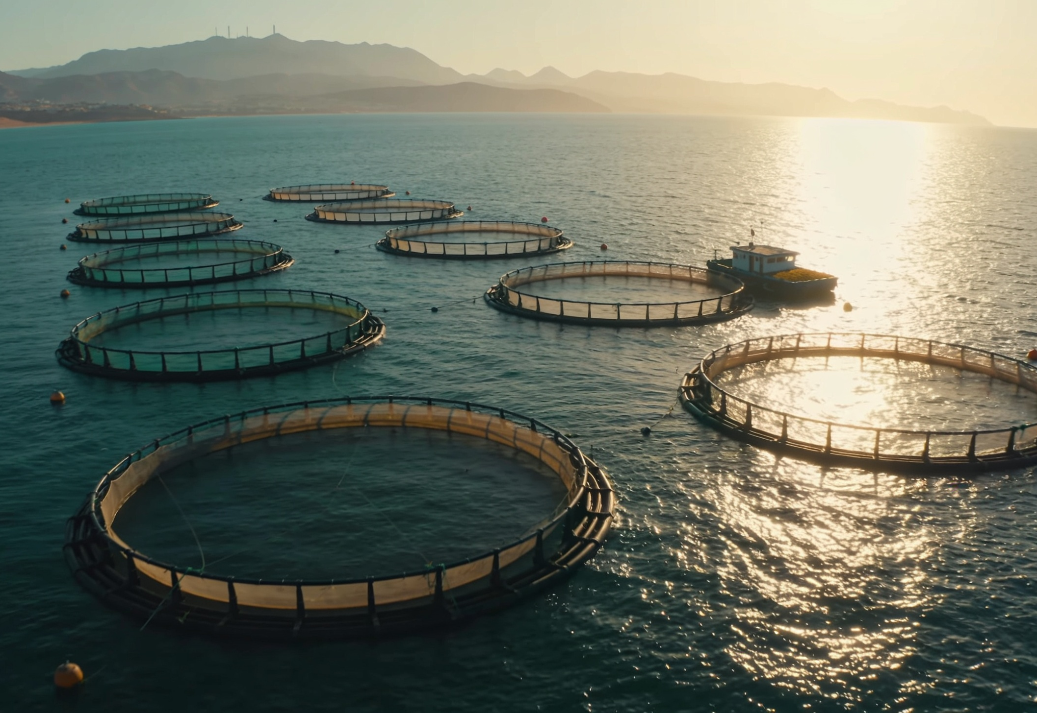
KEY FIGURES / EVIDENCE
[ADD A CLEAR, DECISION-LED TITLE]
[00]
[Metric label and concise context]
[00]
[Metric label and concise context]
[00]
[Metric label and concise context]
REPLACE IMAGE
Notes:
Image-plus-metrics page. Use the image for evidence and the right rail for three related figures.
[Sources]
- User-provided SEARULEA brand guideline
- User-provided SEARULEA cover mockup

Slide 29
PROCESS / THREE STEPS
[ADD A CLEAR, DECISION-LED TITLE]
01
02
03
[STEP TITLE]
[STEP TITLE]
[STEP TITLE]
[Add one or two lines describing this step.]
[Add one or two lines describing this step.]
[Add one or two lines describing this step.]
Notes:
Three-step process. Connectors sit behind nodes; keep each step equally concise.
[Sources]
- User-provided SEARULEA brand guideline

Slide 30
PROCESS / FOUR STEPS
[ADD A CLEAR, DECISION-LED TITLE]
01
02
03
04
[STEP]
[STEP]
[STEP]
[STEP]
[Short description of the step]
[Short description of the step]
[Short description of the step]
[Short description of the step]
Notes:
Four-step process. Use the final accent node for the result or handoff.
[Sources]
- User-provided SEARULEA brand guideline

Slide 31
ROADMAP / MILESTONES
[ADD A CLEAR, DECISION-LED TITLE]
[DATE]
[DATE]
[DATE]
[DATE]
[MILESTONE]
[MILESTONE]
[MILESTONE]
[MILESTONE]
[Short description]
[Short description]
[Short description]
[Short description]
Notes:
Four-milestone timeline. Keep dates above and implications below the line.
[Sources]
- User-provided SEARULEA brand guideline

Slide 32
ROADMAP / FIVE PHASES
[ADD A CLEAR, DECISION-LED TITLE]
[DATE]
[DATE]
[DATE]
[PHASE]
[PHASE]
[PHASE]
[Short description]
[Short description]
[Short description]
[DATE]
[DATE]
[PHASE]
[PHASE]
[Short description]
[Short description]
Notes:
Alternating five-phase timeline. Keep descriptions to one short line where possible.
[Sources]
- User-provided SEARULEA brand guideline

Slide 33
ROADMAP / PHASED DELIVERY
[ADD A CLEAR, DECISION-LED TITLE]
PHASE 01
PHASE 02
PHASE 03
[PHASE TITLE]
[PHASE TITLE]
[PHASE TITLE]
[DATE RANGE]
[DATE RANGE]
[DATE RANGE]
[Key activity]
[Key activity]
[Expected outcome]
[Key activity]
[Key activity]
[Expected outcome]
[Key activity]
[Key activity]
[Expected outcome]
Notes:
Phased roadmap. Use unequal band widths when phase duration or effort differs materially.
[Sources]
- User-provided SEARULEA brand guideline

Slide 34
DATA / COMPARISON
[ADD THE INSIGHT, NOT THE CHART TYPE]
EDIT DATA · Replace categories, values, units and title before presenting.
Notes:
Full-width bar chart. Right-click the chart and choose Edit Data.
[Sources]
- User-provided SEARULEA brand guideline

Slide 35
DATA / COMPARISON
[ADD THE INSIGHT, NOT THE CHART TYPE]
[WHAT THE CHART MEANS]
[Add the conclusion in one or two sentences.]
[Add the first supporting point.]
[Add the second supporting point.]
[Add the third supporting point.]
Notes:
Horizontal bar chart with commentary. Use the right column for meaning and action, not a restatement of values.
[Sources]
- User-provided SEARULEA brand guideline

Slide 36
DATA / TREND
[ADD THE TREND OR CHANGE THAT MATTERS]
EDIT DATA · Replace periods, values, units and title before presenting.
Notes:
Full-width line chart for a single trend over time.
[Sources]
- User-provided SEARULEA brand guideline

Slide 37
DATA / TREND
[ADD THE RELATIONSHIP BETWEEN THE TWO SERIES]
[WHAT THE CHART MEANS]
[Add the conclusion in one or two sentences.]
[Add the first supporting point.]
[Add the second supporting point.]
[Add the third supporting point.]
Notes:
Two-series trend with commentary. Use amber only for the secondary series.
[Sources]
- User-provided SEARULEA brand guideline

Slide 38
DATA / COMPOSITION
[ADD THE WHOLE-TO-PART CONCLUSION]
[ADD THE MAIN TAKEAWAY]
[Explain the most important segment and why the composition matters.]
EDIT DATA to replace the example values.
Notes:
Doughnut chart for three to five categories. Use only when parts sum to a meaningful whole.
[Sources]
- User-provided SEARULEA brand guideline

Slide 39
DATA / MIX OVER TIME
[ADD THE CHANGE IN COMPOSITION THAT MATTERS]
EDIT DATA · Ensure every column represents the same whole before presenting.
Notes:
Stacked column chart for composition across periods or segments.
[Sources]
- User-provided SEARULEA brand guideline

Slide 40
DECISION / TWO OPTIONS
[ADD A CLEAR, DECISION-LED TITLE]
[OPTION A]
[OPTION B / RECOMMENDED]
[OPTION TITLE]
[OPTION TITLE]
[Criterion or benefit]
[Criterion or benefit]
[Criterion or benefit]
[Criterion or benefit]
[Criterion or consideration]
[Criterion or consideration]
Notes:
Two-option comparison. Keep criteria parallel and mark a recommendation only when the evidence supports it.
[Sources]
- User-provided SEARULEA brand guideline

Slide 41
DECISION / THREE OPTIONS
[ADD A CLEAR, DECISION-LED TITLE]
[OPTION A]
[OPTION B]
[OPTION C]
[OPTION TITLE]
[OPTION TITLE]
[OPTION TITLE]
[Key strength]
[Key trade-off]
[Best fit or use case]
[Key strength]
[Key trade-off]
[Best fit or use case]
[Key strength]
[Key trade-off]
[Best fit or use case]
[OPTIONAL NOTE]
[RECOMMENDED, IF APPLICABLE]
[OPTIONAL NOTE]
Notes:
Three-option comparison. Use the center accent only when that option is recommended.
[Sources]
- User-provided SEARULEA brand guideline

Slide 42
CHANGE / BEFORE AND AFTER
[ADD A CLEAR, DECISION-LED TITLE]
BEFORE / CURRENT STATE
AFTER / FUTURE STATE
[CURRENT-STATE TITLE]
[FUTURE-STATE TITLE]
[Current constraint]
[Current constraint]
[Current consequence]
[Future capability]
[Future capability]
[Expected outcome]
Notes:
Before-and-after comparison. Keep both sides parallel and grounded in the same criteria.
[Sources]
- User-provided SEARULEA brand guideline

Slide 43
DECISION / TRADE-OFFS
[ADD A CLEAR, DECISION-LED TITLE]
[BENEFITS / UPSIDE]
[CONSIDERATIONS / RISKS]
[Add the first point and its implication.]
[Add the second point and its implication.]
[Add the third point and its implication.]
[Add the fourth point if needed.]
[Add the first point and its implication.]
[Add the second point and its implication.]
[Add the third point and its implication.]
[Add the fourth point if needed.]
Notes:
Balanced trade-off page. Use matched levels of specificity on both sides.
[Sources]
- User-provided SEARULEA brand guideline

Slide 44
DATA / SUMMARY TABLE
[ADD A CLEAR, DECISION-LED TITLE]
[Column 1] | [Column 2] | [Column 3] | [Column 4]
[Row label] | [Value] | [Value] | [Value or note]
[Row label] | [Value] | [Value] | [Value or note]
[Row label] | [Value] | [Value] | [Value or note]
[Row label] | [Value] | [Value] | [Value or note]
EDITABLE TABLE · Keep to five or fewer rows on a standard slide.
Notes:
Concise editable data table. Add a source or methodology note when the values are externally sourced.
[Sources]
- User-provided SEARULEA brand guideline

Slide 45
PLAN / WORKSTREAMS
[ADD A CLEAR, DECISION-LED TITLE]
[Workstream] | [Owner] | [Timing] | [Status] | [Outcome]
[Workstream] | [Name / team] | [Date] | [Status] | [Expected outcome]
[Workstream] | [Name / team] | [Date] | [Status] | [Expected outcome]
[Workstream] | [Name / team] | [Date] | [Status] | [Expected outcome]
[Workstream] | [Name / team] | [Date] | [Status] | [Expected outcome]
EDITABLE TABLE · Make ownership and timing explicit.
Notes:
Workplan table for ownership, timing, status and outcome.
[Sources]
- User-provided SEARULEA brand guideline

Slide 46
RISK / PRIORITISATION MATRIX
[ADD A CLEAR, DECISION-LED TITLE]
[Risk] | [Likelihood] | [Impact] | [Priority] | [Mitigation / owner]
[Risk description] | [Low / Med / High] | [Low / Med / High] | [Priority] | [Action and owner]
[Risk description] | [Low / Med / High] | [Low / Med / High] | [Priority] | [Action and owner]
[Risk description] | [Low / Med / High] | [Low / Med / High] | [Priority] | [Action and owner]
[Risk description] | [Low / Med / High] | [Low / Med / High] | [Priority] | [Action and owner]
EDITABLE TABLE · Define the scoring method before assigning priority.
Notes:
Risk register. Define likelihood and impact scales in notes or an appendix.
[Sources]
- User-provided SEARULEA brand guideline

Slide 47
LEADERSHIP / PROFILE
[ADD A CLEAR, DECISION-LED TITLE]
[NAME SURNAME]
[TITLE / FUNCTION]
[Add a short biography focused on relevant experience and current responsibility.]
[Add two or three proof points rather than a full career history.]
[Add the first supporting point.]
[Add the second supporting point.]
[Add the third supporting point.]
REPLACE
PORTRAIT
Notes:
Single profile. Replace the portrait and verify the person's title and biography.
[Sources]
- User-provided SEARULEA brand guideline

Slide 48
LEADERSHIP / TWO PROFILES
[ADD A CLEAR, DECISION-LED TITLE]
[NAME SURNAME]
[NAME SURNAME]
[TITLE / FUNCTION]
[TITLE / FUNCTION]
REPLACE
PORTRAIT
REPLACE
PORTRAIT
[Add a concise biography focused on relevant experience, responsibility and proof.]
[Add a concise biography focused on relevant experience, responsibility and proof.]
[Key credential or outcome]
[Key credential or outcome]
Notes:
Two-profile leadership page. Keep biographies parallel in length and emphasis.
[Sources]
- User-provided SEARULEA brand guideline

Slide 49
TEAM / THREE PROFILES
[ADD A CLEAR, DECISION-LED TITLE]
REPLACE
PORTRAIT
REPLACE
PORTRAIT
REPLACE
PORTRAIT
[NAME SURNAME]
[NAME SURNAME]
[NAME SURNAME]
[TITLE / FUNCTION]
[TITLE / FUNCTION]
[TITLE / FUNCTION]
[One-line responsibility or relevant proof.]
[One-line responsibility or relevant proof.]
[One-line responsibility or relevant proof.]
Notes:
Three-person team page. Use one line of proof per person.
[Sources]
- User-provided SEARULEA brand guideline

Slide 50
TEAM / FOUR PROFILES
[ADD A CLEAR, DECISION-LED TITLE]
REPLACE
PORTRAIT
REPLACE
PORTRAIT
REPLACE
PORTRAIT
REPLACE
PORTRAIT
[NAME SURNAME]
[NAME SURNAME]
[NAME SURNAME]
[NAME SURNAME]
[TITLE / FUNCTION]
[TITLE / FUNCTION]
[TITLE / FUNCTION]
[TITLE / FUNCTION]
[One-line responsibility]
[One-line responsibility]
[One-line responsibility]
[One-line responsibility]
Notes:
Four-person team page. Keep names and roles concise.
[Sources]
- User-provided SEARULEA brand guideline

Slide 51
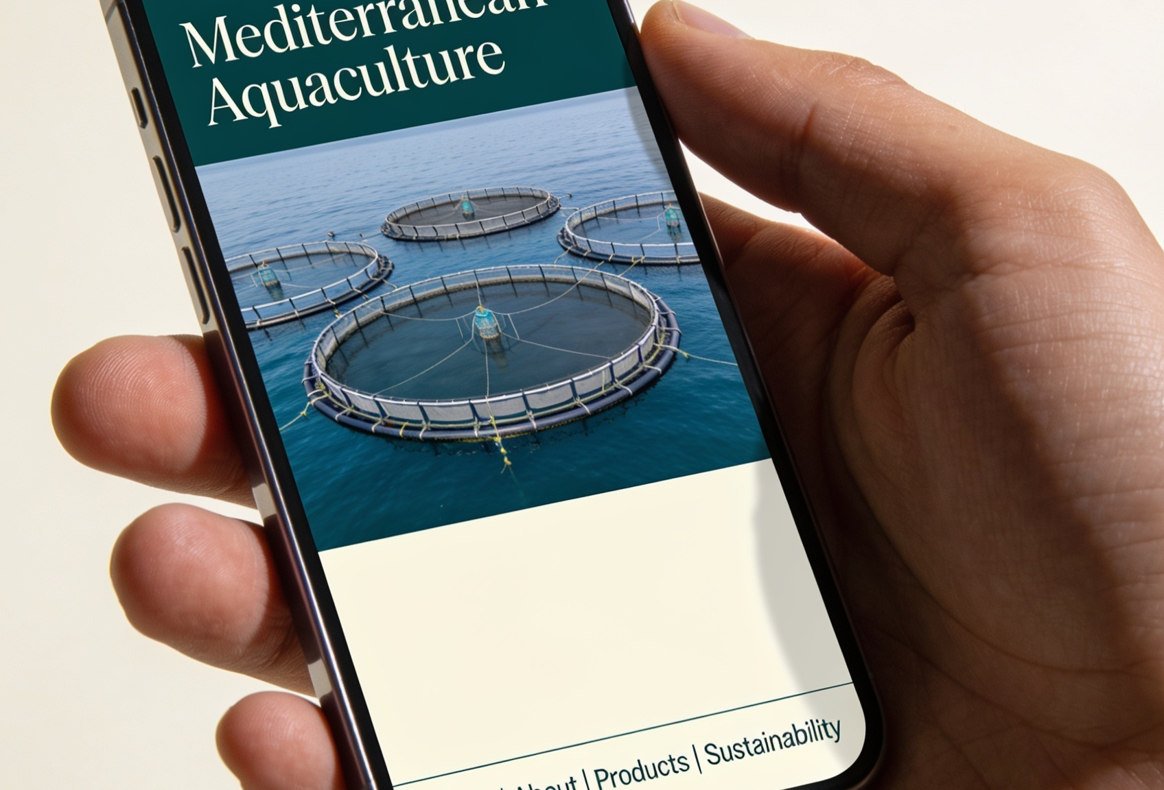
CASE STUDY / PROOF
[ADD THE CASE STUDY OUTCOME]
[CLIENT / PROJECT / LOCATION]
[Add a two-sentence summary of the challenge, intervention and result.]
CHALLENGE [Add one concise sentence.]
APPROACH [Add one concise sentence.]
RESULT [Add one verified outcome.]
REPLACE IMAGE
Notes:
Case study page. Replace the image and use only verified results.
[Sources]
- User-provided SEARULEA brand guideline
- User-provided SEARULEA phone mockup

Slide 52



PROOF / THREE IMAGES
[ADD A CLEAR, DECISION-LED TITLE]
REPLACE IMAGE
REPLACE IMAGE
REPLACE IMAGE
[IMAGE TITLE 01]
[IMAGE TITLE 02]
[IMAGE TITLE 03]
[One sentence explaining what this image proves.]
[One sentence explaining what this image proves.]
[One sentence explaining what this image proves.]
Notes:
Three-image evidence gallery. Use consistent crops and captions that explain meaning.
[Sources]
- User-provided SEARULEA brand guideline
- User-provided SEARULEA signage, billboard and pole-banner mockups

Slide 53
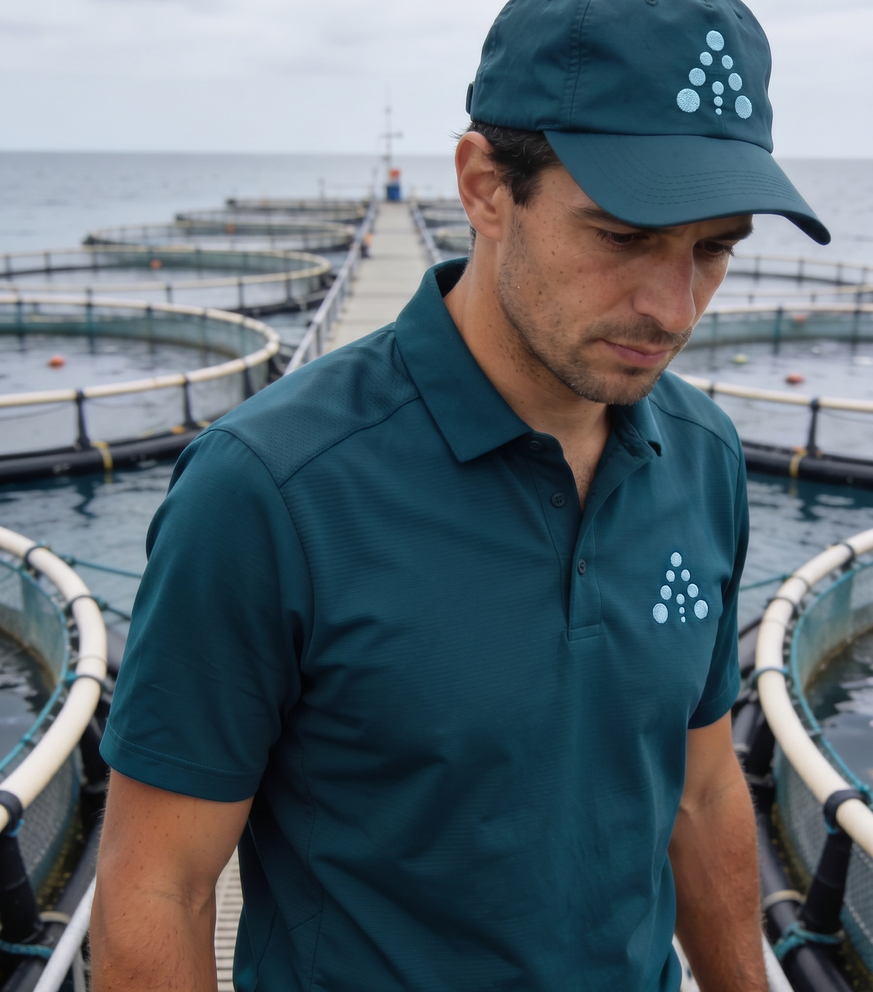



PROOF / FOUR IMAGES
[ADD A CLEAR, DECISION-LED TITLE]
REPLACE IMAGE
REPLACE IMAGE
REPLACE IMAGE
REPLACE IMAGE
[IMAGE 01]
[IMAGE 02]
[IMAGE 03]
[IMAGE 04]
[Short proof-oriented caption.]
[Short proof-oriented caption.]
[Short proof-oriented caption.]
[Short proof-oriented caption.]
Notes:
Four-image gallery. Use this only when each visual earns its place.
[Sources]
- User-provided SEARULEA brand guideline
- User-provided SEARULEA apparel, stationery, tote/cap and roll-up mockups

Slide 54
LOCATION / SITE
[ADD A CLEAR, DECISION-LED TITLE]
[LOCATION / SITE NAME]
[Geographic advantage]
[Infrastructure or capacity]
[Access or connectivity]
[Strategic implication]
REPLACE WITH VERIFIED
MAP OR SITE IMAGE
Notes:
Location page. Replace the right frame with a verified map or site photograph.
[Sources]
- User-provided SEARULEA brand guideline

Slide 55
[ADD THE FINAL SYNTHESIS OR CALL TO ACTION]
[email@searulea.com]
[www.searulea.com]
[Optional next step, decision or meeting date]
Notes:
Primary closing page. Resolve the opening question with a clear next action.
[Sources]
- User-provided SEARULEA brand guideline
- User-provided SEARULEA Sea Foam spiral and logo

Slide 56
CONTACT / NEXT STEP
[ADD A SHORT CLOSING LINE]
[Name Surname]
[Title / Function]
[email@searulea.com]
[+000 000 000 000]
[www.searulea.com]
Notes:
Minimal contact closing. Replace every contact field and verify details.
[Sources]
- User-provided SEARULEA brand guideline
- User-provided SEARULEA gradient spiral

Slide 57
DISCUSSION / Q&A
Questions and next decisions.
[Add the decision, discussion prompt or follow-up action you want to leave visible.]
Notes:
Q&A page. Keep a useful decision prompt visible instead of a generic thank-you message.
[Sources]
- User-provided SEARULEA brand guideline

