Slide 1
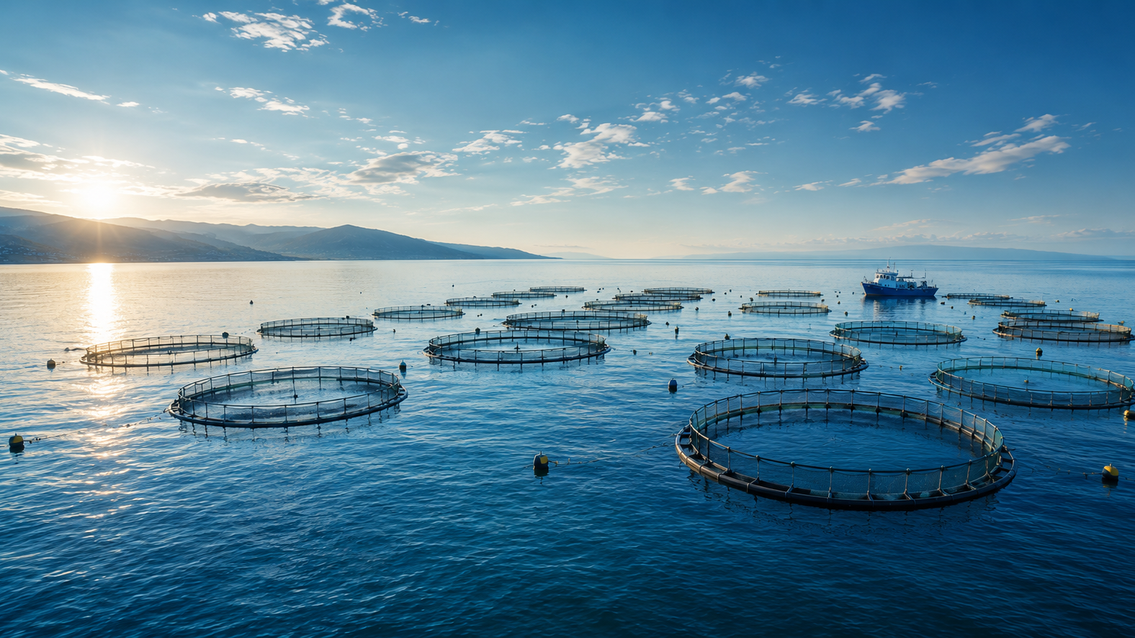

CLIENT PRESENTATION / 2026
Tomorrow’s aquaculture. Built today.
A reusable presentation system for SEARULEA’s clients, partners and institutions.
August 2026 · SEARULEA · Confidential
Notes:
Duplicate this slide for photo-led covers. Replace the full-slide image and keep the title to two lines maximum.
[Sources]
- User-provided SEARULEA brand guideline
- User-provided hero-cages.jpg

Slide 2

INVESTOR / TRADE / INSTITUTIONAL
From our sea to your port.
Use the dark cover when the presentation needs a more formal, institutional opening.
Month Year · Presenter · Confidential
Notes:
Duplicate this slide for formal covers. The gradient spiral is the only approved use of amber in the identity.
[Sources]
- User-provided SEARULEA brand guideline
- User-provided SEARULEA gradient spiral asset

Slide 3
TEMPLATE GUIDE / DELETE BEFORE PRESENTING
A flexible system, one visual language.
01
02
03
Start with the closest layout
Replace content, not the system
Keep every slide decisive
Duplicate an example slide or choose its named layout from the New Slide menu.
Keep the official logo, grid, type hierarchy and palette. Replace images, text and data in place.
One Lora statement per slide. DM Sans carries the explanation, labels and numbers.
Office-safe fallbacks: Lora → Georgia · DM Sans → Arial / Helvetica
Notes:
This is the only authoring guide slide. Delete it before sending or presenting the client deck.
[Sources]
- User-provided SEARULEA brand guideline

Slide 4
PRESENTATION OVERVIEW
Today’s conversation
01
Context
Why the opportunity matters now
02
Approach
How the integrated model works
03
Evidence
Milestones, capacity and operating proof
04
Decision
The partnership or action required
Notes:
Use for agendas of three to five sections. Keep section labels short and write the third column as an audience outcome.
[Sources]
- User-provided SEARULEA brand guideline

Slide 5


SECTION 01 / CONTEXT
Why now
The market context that makes this chapter necessary.
Notes:
Duplicate for major section breaks. Use a short title—ideally one to four words.
[Sources]
- User-provided SEARULEA brand guideline
- User-provided SEARULEA Sea Foam spiral asset

Slide 6
VISION / POSITIONING
Ras El Ma can become the reference point for Mediterranean aquaculture.
An integrated, traceable and biosafe model turns natural advantage into durable production capacity.
Notes:
Use for a single high-level claim, mission, vision or recommendation. Keep the supporting sentence to two lines.
[Sources]
- User-provided SEARULEA brand guideline

Slide 7
COMPANY / OVERVIEW
SEARULEA builds the infrastructure behind Moroccan aquaculture.
SEARULEA operates an integrated value chain at Ras El Ma, Oriental Region.
Offshore farming, fresh conditioning at port, refrigerated export and traceability are designed to operate as one system—not as separate businesses.
The result is a platform built for international standards from day one, with local capability and documentation at every stage.
375 ha offshore concession · 2,790 t target capacity · 3 species
Notes:
Use for an executive narrative or company overview. Aim for three short paragraphs and one proof line.
[Sources]
- User-provided SEARULEA brand guideline

Slide 8
STRATEGY / OPERATING MODEL
Integration creates control at every handoff.
One chain
Offshore production at Ras El Ma
Fresh conditioning at port
Cold chain and lot-level traceability
Export documentation through one operator
One standard
ONSSA requirements built into operations
European market documentation
Biosafety designed into the CAPEX
Clear ownership from cage to client
Notes:
Use for two parallel arguments, current/future states or complementary workstreams. Keep the columns balanced.
[Sources]
- User-provided SEARULEA brand guideline

Slide 9
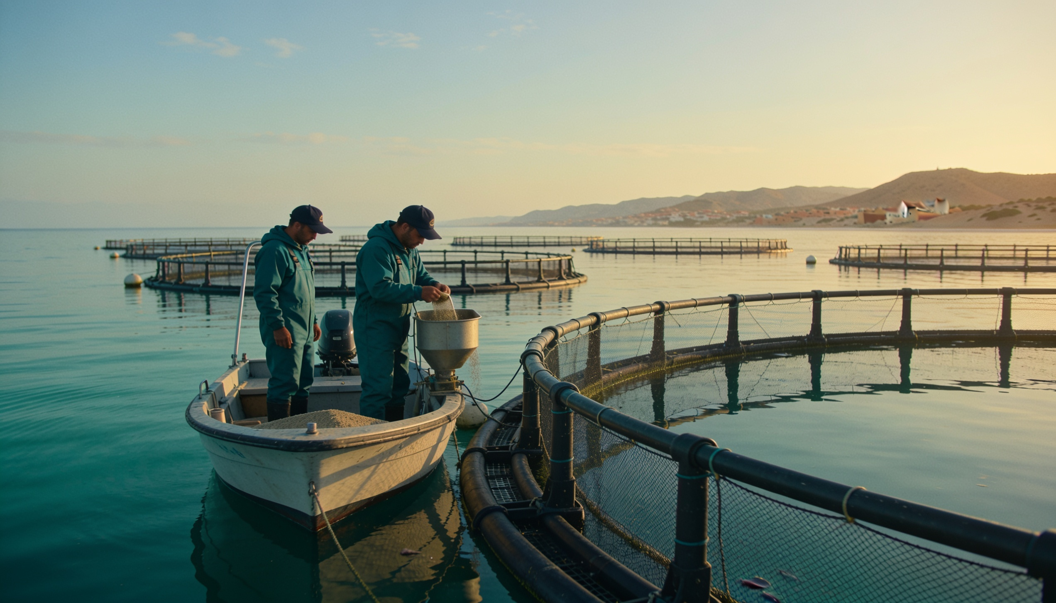
OPERATIONS / OFFSHORE
Evidence starts where the work happens.
Production at Ras El Ma
375-hectare government concession
Sea bream, seabass and meagre
Continuous monitoring and documented lots
Built to scale in defined phases
Notes:
Use for image-led evidence with four or fewer supporting bullets. Replace the image using Change Picture to preserve the crop.
[Sources]
- User-provided SEARULEA brand guideline
- User-provided 1_offshore_ops.jpg

Slide 10
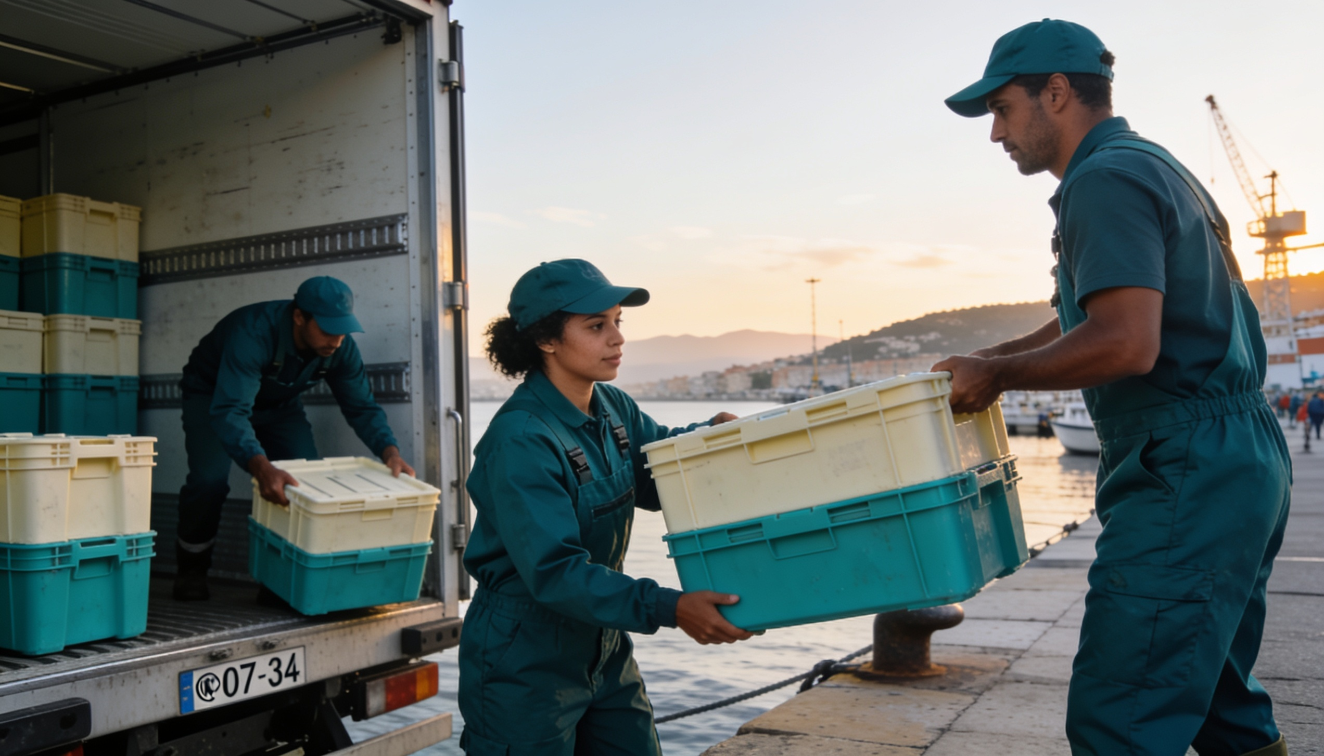
QUALITY / COLD CHAIN
Control continues after the harvest.
Fresh, documented, ready to move
Fresh conditioning at port
Refrigerated logistics and export documentation
One point of contact for commercial partners
Traceability carried through the chain
Notes:
Use when the narrative should lead and the image should validate it. Replace the image using Change Picture.
[Sources]
- User-provided SEARULEA brand guideline
- User-provided 6_team_coldchain.jpg

Slide 11
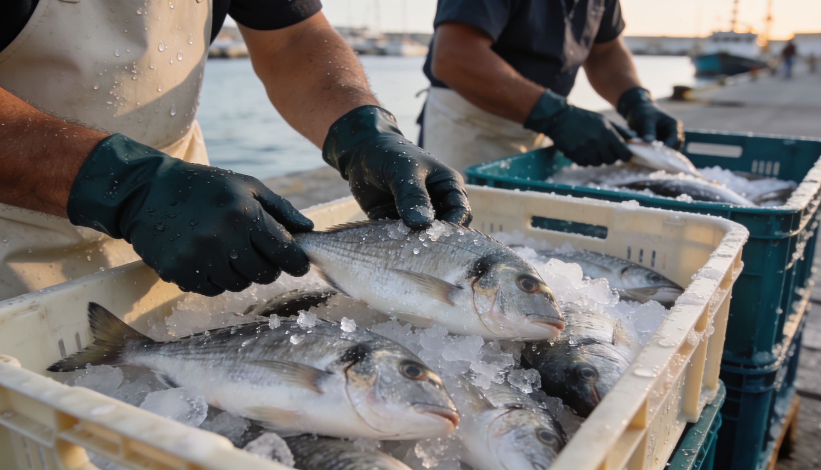
PROOF / PARTNERSHIP
“One operator. One documented chain. One standard.”
Client or partner name · Role · Organisation
Notes:
Use for a verified testimonial, quotation or high-confidence proof point. Never invent quotes; replace the attribution before presenting.
[Sources]
- User-provided SEARULEA brand guideline
- User-provided 2_fresh_at_port.jpg

Slide 12
PROOF / KEY FIGURES
The scale is visible in four numbers.
375
2,790
40%
3
HECTARES
TONNES
WOMEN
SPECIES
Offshore government concession
Target annual capacity by 2031
Workforce commitment
Sea bream, seabass and meagre
Use verified numbers and write the meaning directly below each one.
Notes:
Use for three or four key figures. Keep units separate from values so the hierarchy stays clear.
[Sources]
- User-provided SEARULEA brand guideline

Slide 13
OPERATING MODEL / PROCESS
One chain, four controlled handoffs.
01
02
03
04
Offshore farming
Fresh at port
Cold chain
Export
Monitored production at Ras El Ma
Conditioning, quality and documentation
Refrigerated handling with traceability
One commercial handoff to the client
Our chain. Our commitments. Your certainty.
Notes:
Use for three to five sequential stages. Connectors sit behind nodes; keep every step to one short title and one explanation.
[Sources]
- User-provided SEARULEA brand guideline

Slide 14
ROADMAP / MILESTONES
Capacity grows in documented phases.
2026
2028
2029–30
2031+
Build
First sales
Scale
Full capacity
Infrastructure and certification
605 t in the first commercial phase
Production ramps to 1,744 t
2,790 t and 71 direct jobs
Notes:
Use for three to five milestones. Keep dates above the line and implications below it.
[Sources]
- User-provided SEARULEA presentation PDF

Slide 15
CAPACITY / SCALE-UP
The operating plan reaches 2,790 tonnes by 2031.
Editable chart — right-click → Edit Data to replace the example series.
Notes:
Use for categorical comparisons or phased scale-up. The chart is native and editable in PowerPoint.
[Sources]
- User-provided SEARULEA presentation PDF

Slide 16
WORKFORCE / DEVELOPMENT
Employment grows with operating capacity.
What the chart means
71 direct roles at full capacity
A minimum 40% commitment for women
Skills grow with each operating phase
Illustrative template data — replace with verified figures before presenting.
Notes:
Use for trends over time with one or two series. The example job progression is illustrative template data; replace before presenting.
[Sources]
- User-provided SEARULEA brand guideline

Slide 17
PORTFOLIO / PRODUCT MIX
Three species balance demand and operating resilience.
Use the headline to state the conclusion—not the chart type.
This layout works for portfolio mix, allocation, audience composition or any whole-to-part story with three to five categories.
Right-click → Edit Data to replace the example values.
Notes:
Use for whole-to-part analysis with three to five segments. The chart is native and editable in PowerPoint.
[Sources]
- User-provided SEARULEA presentation PDF

Slide 18
DECISION / COMPARISON
Compare options against the criteria that matter.
OPTION A
OPTION B / RECOMMENDED
Current approach
Integrated chain
Fragmented responsibility
One accountable operator
Multiple handoffs
Controlled cold chain
Variable documentation
One documented standard
Notes:
Use for two alternatives, current/future states or build/buy choices. Keep both sides parallel and make the recommendation explicit only when appropriate.
[Sources]
- User-provided SEARULEA brand guideline

Slide 19
PLAN / DELIVERY
Make ownership and timing unambiguous.
Workstream | Owner | Timing | Outcome
Infrastructure | Operations | 2026–27 | Port and offshore readiness
Certification | Quality | 2026–27 | ONSSA and export documentation
Commercial launch | Trade | 2028 | First client deliveries
Scale-up | Executive team | 2029–31 | Full operating capacity
Editable table — keep to five or fewer rows on a standard slide.
Notes:
Use for plans, responsibilities, requirements or concise data. The table is native and editable in PowerPoint.
[Sources]
- User-provided SEARULEA presentation PDF

Slide 20
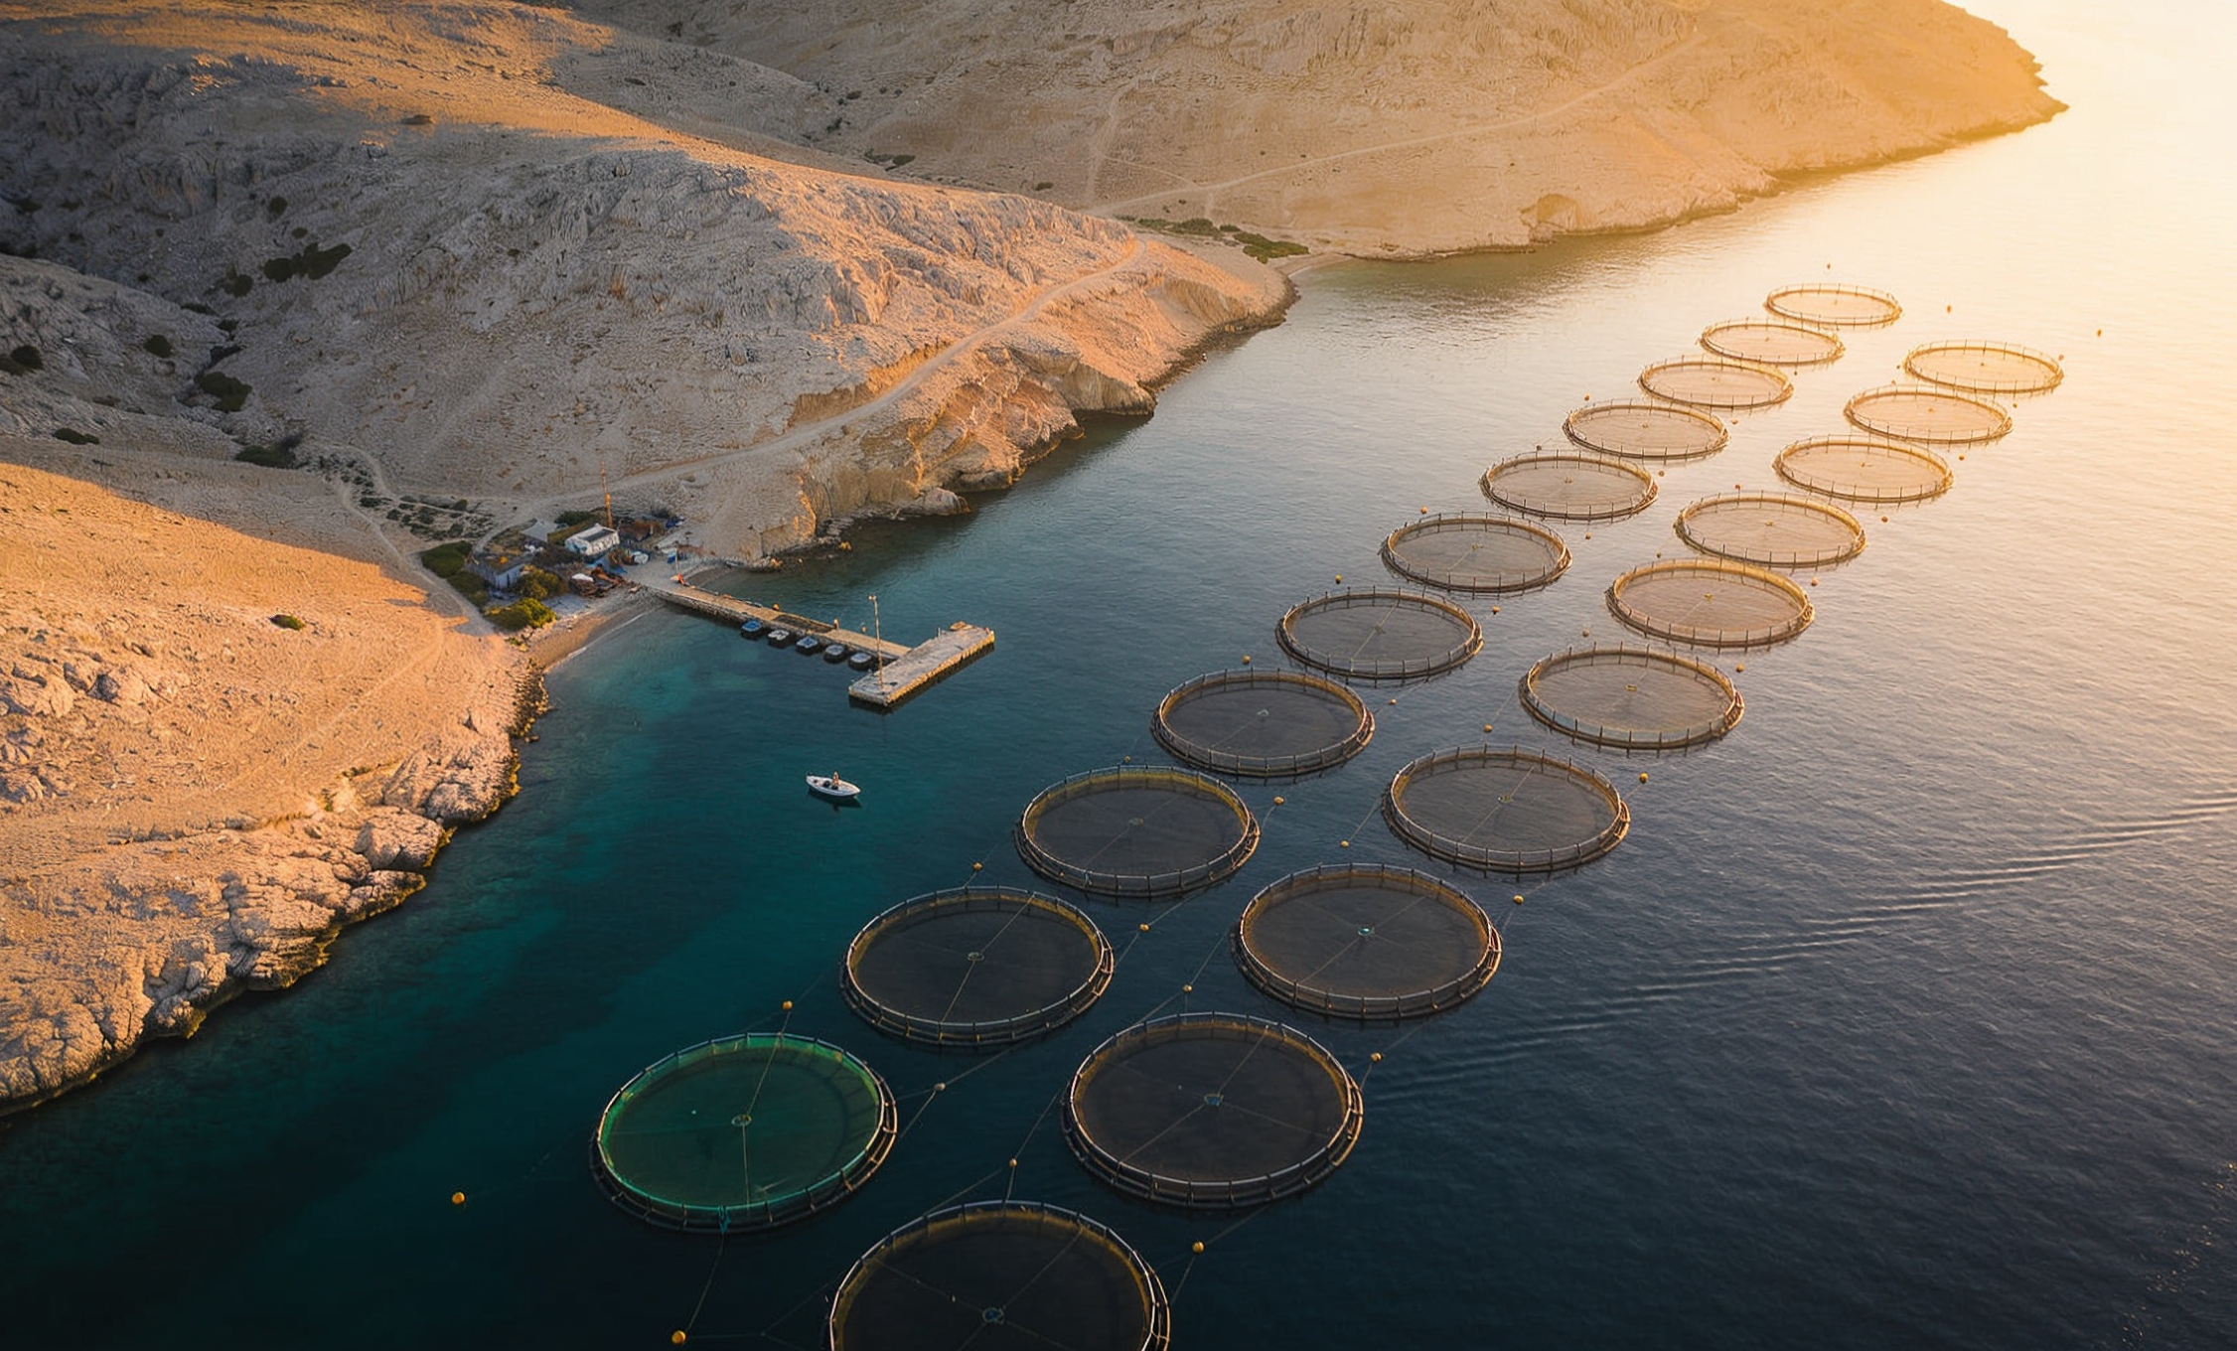
LOCATION / RAS EL MA
The site connects natural advantage to export access.
Ras El Ma, Oriental Region
Direct Mediterranean access
375-hectare offshore concession
Port connection for fresh logistics
Proximity to European markets
Notes:
Use for a location, facility or market-access story. Replace the image with a verified map or site photograph when available.
[Sources]
- User-provided SEARULEA brand guideline
- User-provided 5_coast_sovereignty.jpg

Slide 21
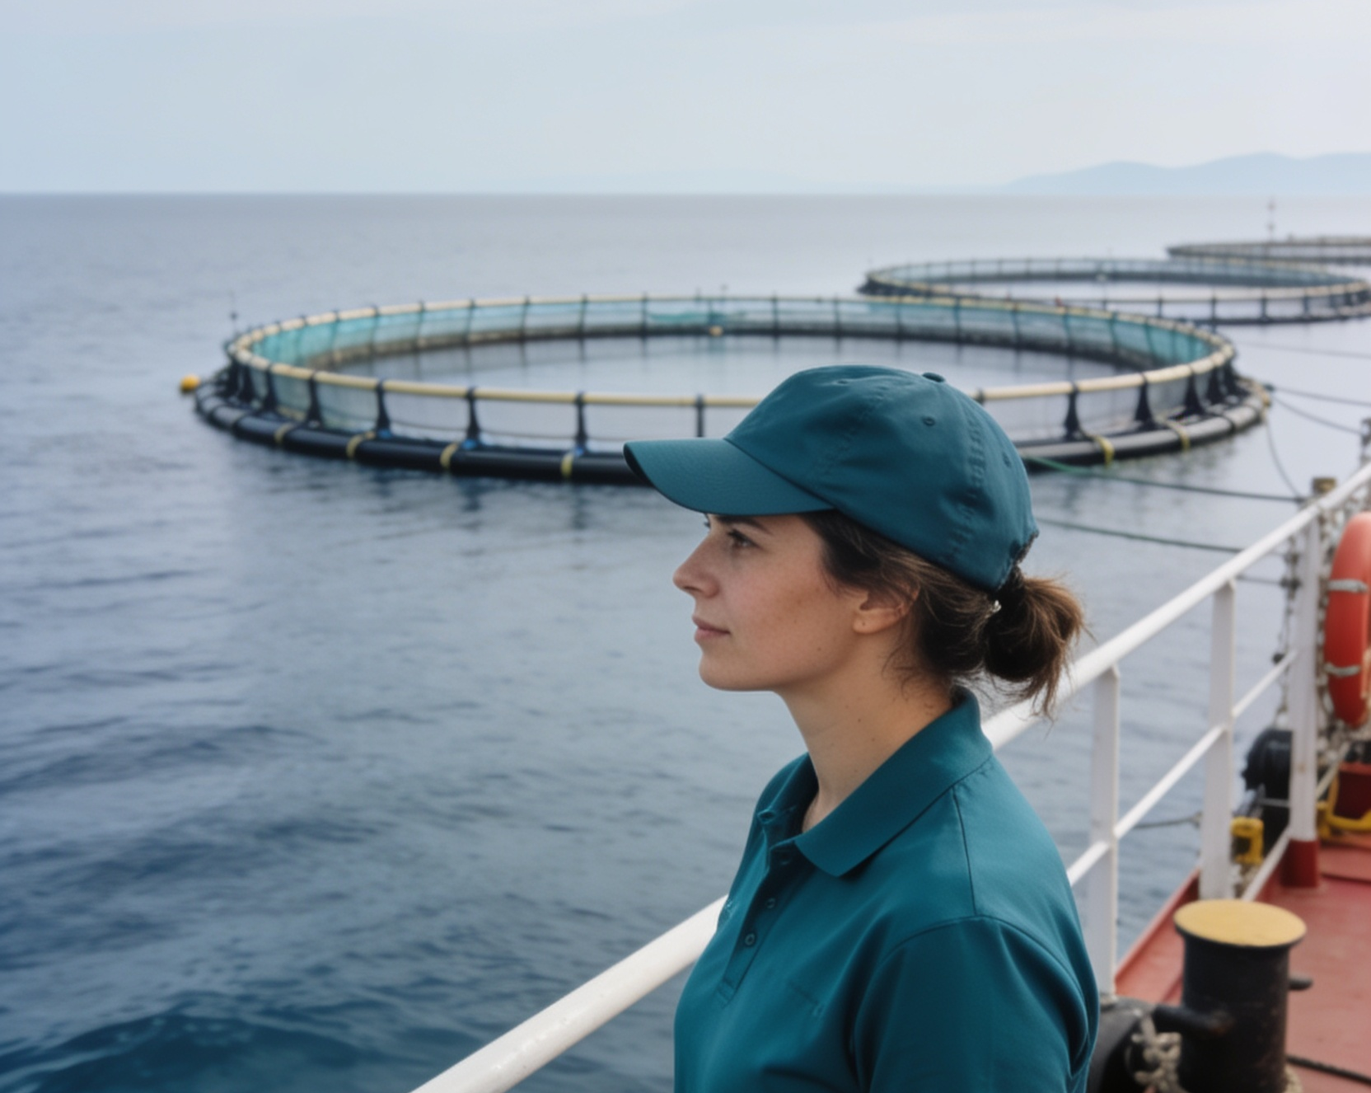
LEADERSHIP / PROFILE
Leadership rooted in execution.
Name Surname
TITLE / FUNCTION
Use a short biography focused on relevant experience, operating credibility and the person’s role in the decision at hand.
Add two or three proof points rather than a full career history.
Relevant experience
Specific responsibility
Decision or outcome owned
Notes:
Use for a founder, executive, project lead or client contact. Replace the placeholder name and verified photograph before presenting.
[Sources]
- User-provided SEARULEA brand guideline
- User-provided 3_women_searulea.jpg

Slide 22
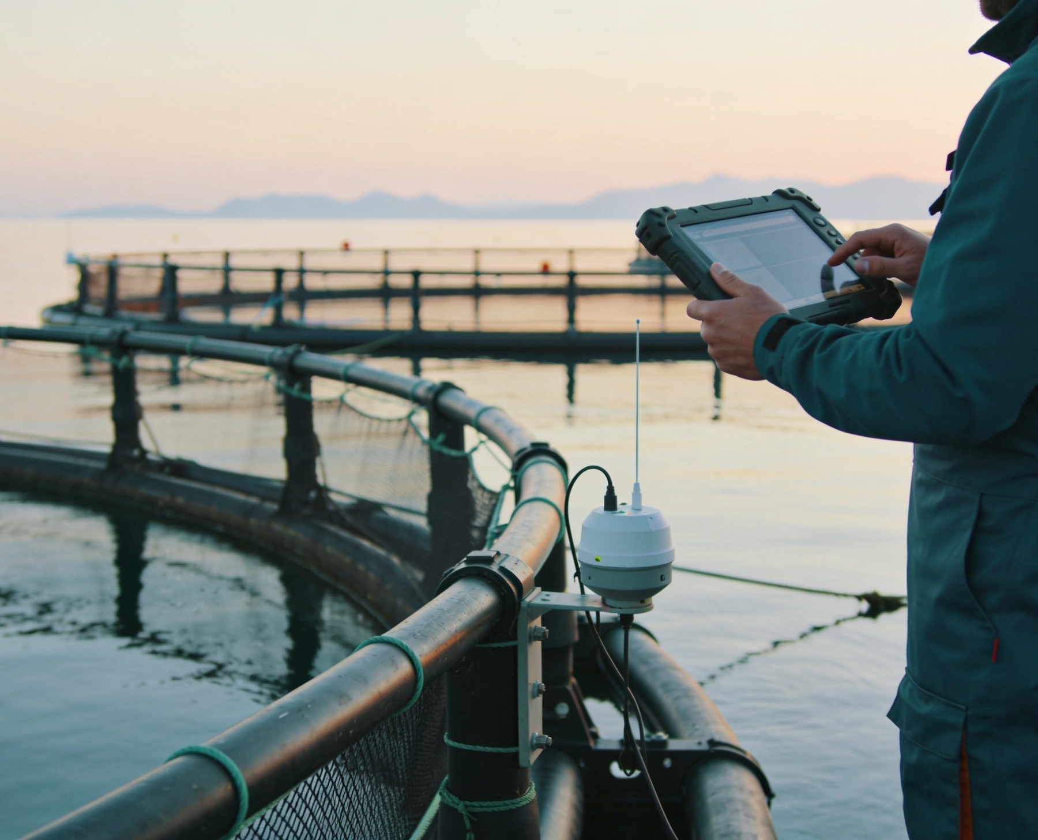
PROOF / PHOTOGRAPHY
Show the system through evidence, not decoration.
Offshore operations
Traceability
Cold chain
One sentence that explains what the image proves.
One sentence that explains what the image proves.
One sentence that explains what the image proves.
Notes:
Use for a three-image evidence sequence. Keep crops consistent and write captions that explain what each image proves.
[Sources]
- User-provided SEARULEA brand guideline
- User-provided environment photography

Slide 23

Let’s build the next chapter from Ras El Ma.
hello@searulea.com
www.searulea.com
From our sea to your port.
Notes:
Use as the closing synthesis and contact slide. Replace placeholder contact details with verified client information.
[Sources]
- User-provided SEARULEA brand guideline
- User-provided SEARULEA Sea Foam spiral and logo assets

