Slide 2
INFO 6210 –Data Management and Database Design
IMDB Database

Slide 3
OBJECTIVE
Design & populate an IMDb database

Slide 4
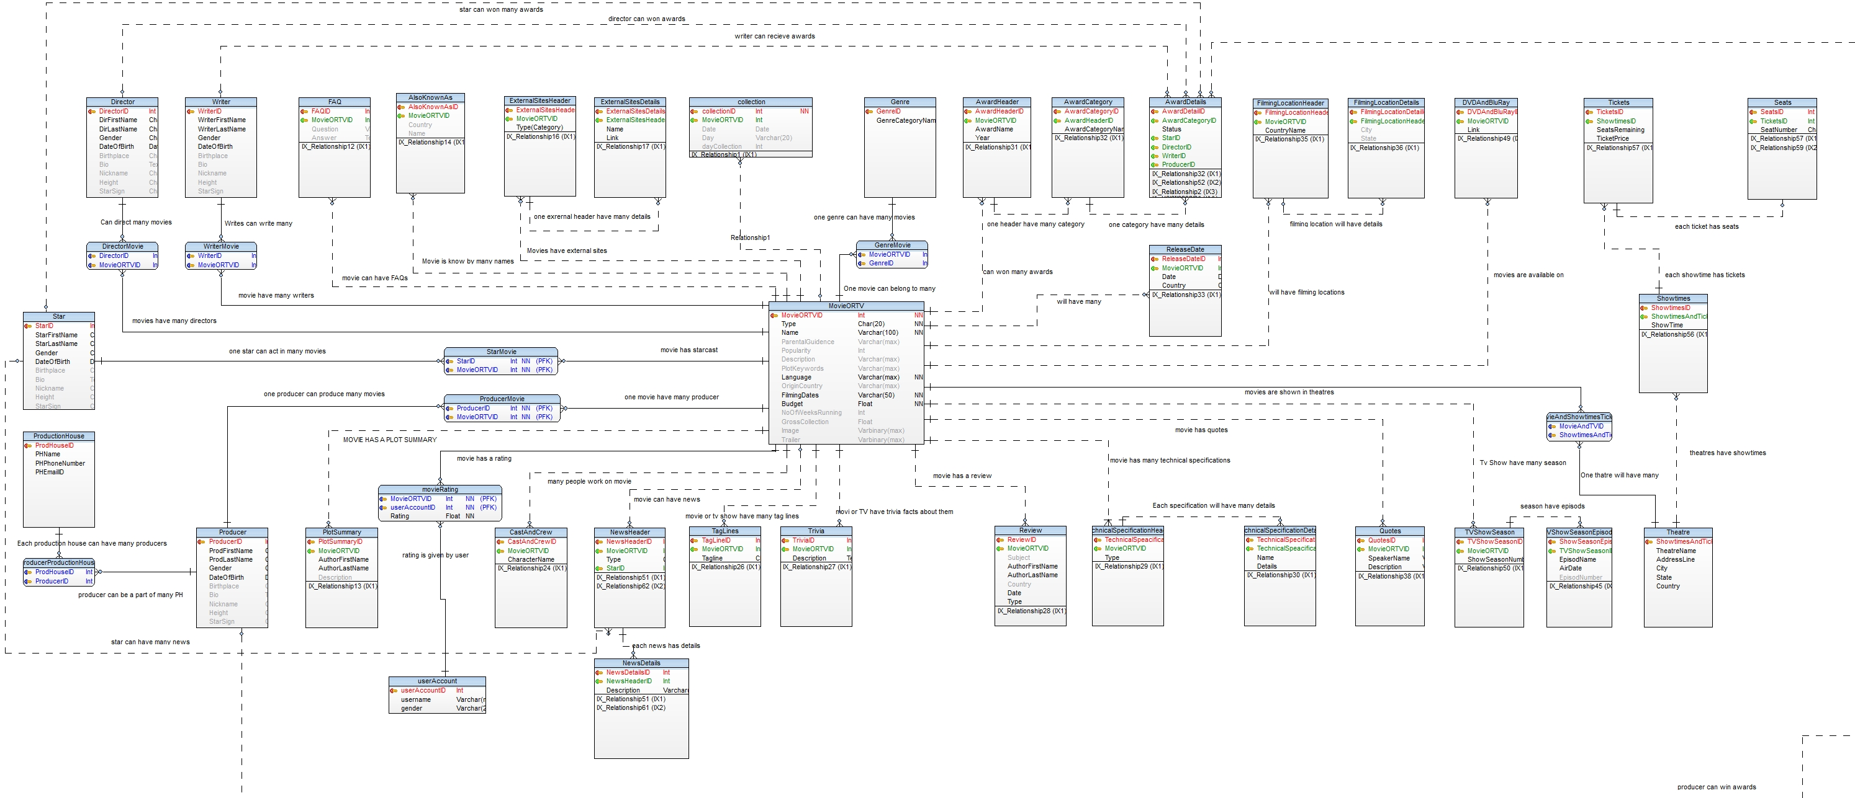
Data Model

Slide 5
Triggers:
Trigger to update the rating of movie

Slide 6
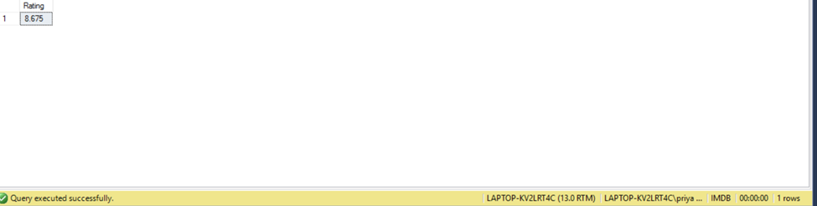
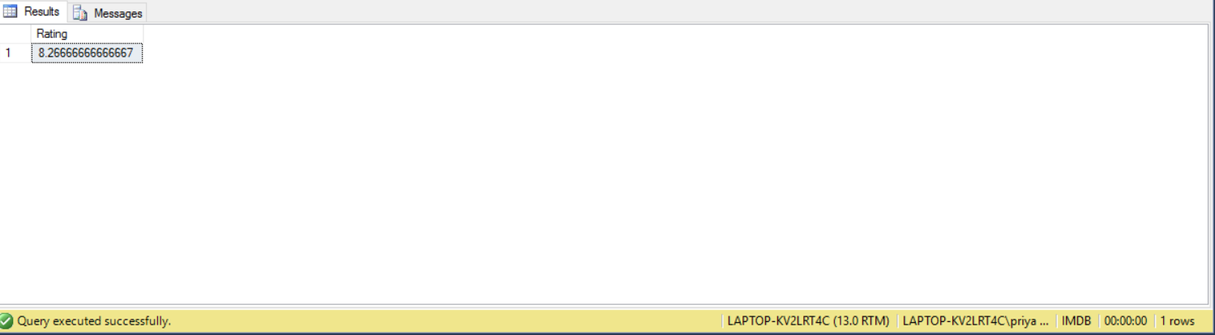
Trigger Execution:
Before Trigger execution:
insert into dbo.movieRating values(1,13,5);
After Trigger execution:

Slide 7
Trigger to update the collection of movie:

Slide 8
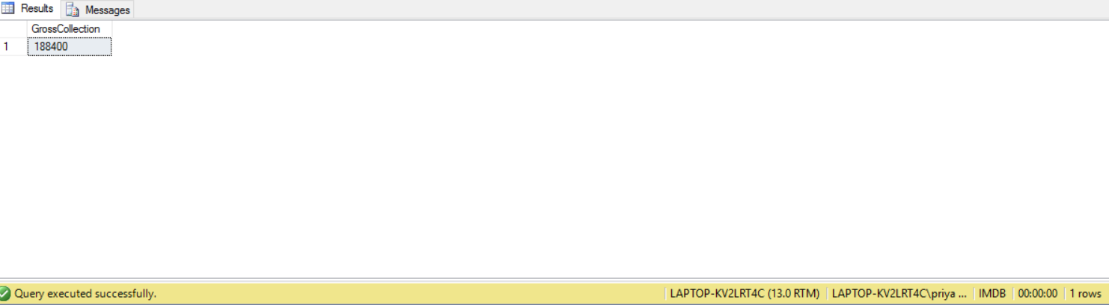
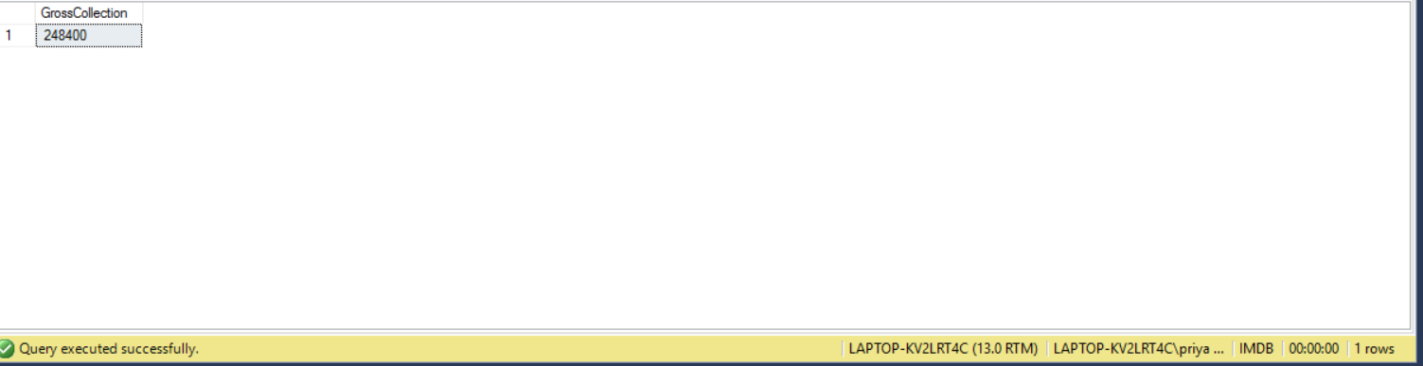
Trigger Execution:
insert into dbo.collection values(49,2,'2016-12-12','Wed',60000)
Before trigger execution gross collection of movie:
insert into dbo.collection values(49,2,'2016-12-12','Wed',60000)
After trigger execution gross collection

Slide 9
Procedure
Procedure to backup the IMDB database

Slide 10
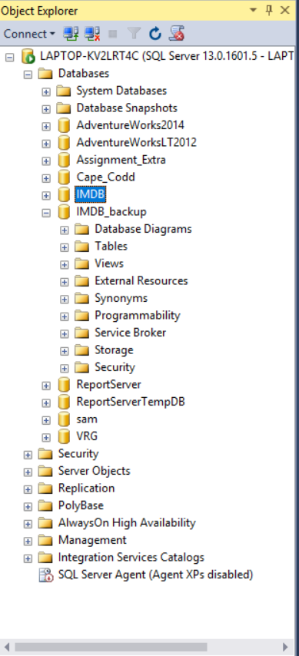
Procedure Execution:

