Slide 1
Translation script Lazar Vujadinović

Slide 2


Explanation of task structure : Translation-Glossary.xlsx Database_Extract.s3db (SQLite Database)
Translation Glossary
READ
notTranslated.xml
msg.PM Database
Translation Script
READ
STORE
TRANSLATE
STORE
Non Translated Terms List
PMKFORMULA (OBJECTID, DOMAINID, FORMULATEXTWORK)

Slide 3
Main task:
Establish connection (read & write) to msg.PM Database SQLite (other DBMS supported by db.properties file)
Parse Glossary Excel (Establish internal data structure for the glossary -> map)
Apply Glossary on formula text and identify not translated terms (Ignore reserved terms & comments)
Bonus task:
Apply Store the non translated terms in separate XML file also. The structure of the file is left up to you to define.
(Non translated terms written into notTranslated.xml)

Slide 4
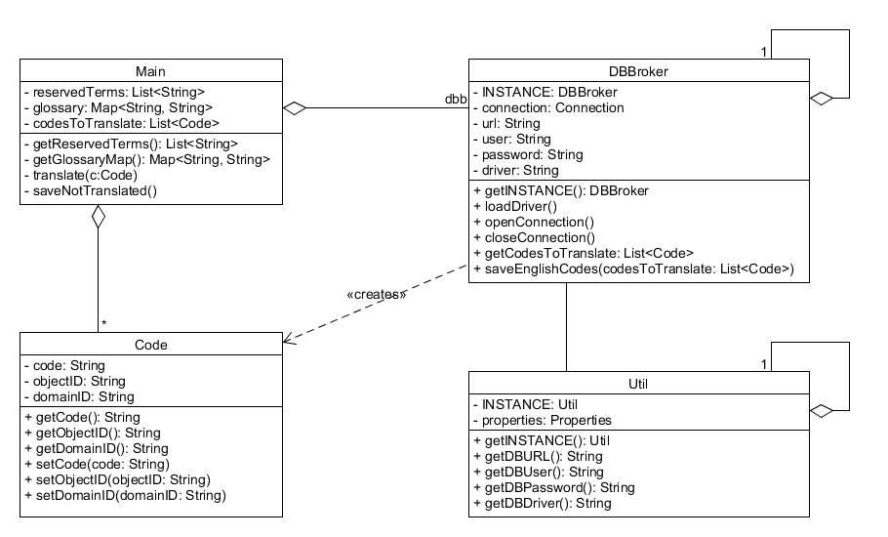

Slide 5
public static void main(String[] args) {
try {
reservedTerms = getReservedTerms();
glossary = getGlossaryMap();
dbb = DBBroker.getINSTANCE();
dbb.loadDriver();
dbb.openConnection();
codesToTranslate = dbb.getCodesToTranslate();
for (Code c : codesToTranslate) {
translate(c);
}
System.out.println("All codes translated.");
dbb.saveEnglishCodes(codesToTranslate);
dbb.closeConnection();
saveNotTranslated();
} catch (Exception ex) {
ex.printStackTrace();
}
}

Slide 6
private static Map<String, String> getGlossaryMap() throws Exception {
InputStream glossaryFile = new FileInputStream(new File("Translation- Glossary.xlsx"));
XSSFWorkbook wb = new XSSFWorkbook(glossaryFile);
Map<String, String> map = new HashMap<>();
for (int i = 0; i < wb.getNumberOfSheets(); i++) {
XSSFSheet sheet = wb.getSheetAt(i);
XSSFRow row; //Apache poi
Iterator rows = sheet.rowIterator();
while (rows.hasNext()) {
row = (XSSFRow) rows.next();
if (row == null || row.getCell(0) == null || row.getCell(0).getStringCellValue().equals("German")) {
continue;
}
map.put(row.getCell(0).getStringCellValue(), row.getCell(1).getStringCellValue());
}
}
System.out.println("Translation Glossary loaded.");
return map;
}

Slide 7
db.properties
private Util() {
properties = new Properties();
try {
properties.load(new
FileInputStream("db.properties"));
} catch (Exception ex) {
ex.printStackTrace();
}
}
public String getDBURL() {
return properties.getProperty
(properties.getProperty("current_db")
+ "_url");
}
current_db=sqlite
sqlite_url=jdbc:sqlite:Database_ Extract.s3db
sqlite_user=
sqlite_password=
sqlite_driver=org.sqlite.JDBC
newDB_url=
newDB_user=
newDB_password=
newDB_driver=

Slide 8
public List<Code> getCodesToTranslate() {
try { Statement stmt = connection.createStatement();
String sql = "SELECT * FROM PMKFORMULA";
List<Code> lc = new ArrayList<>();
ResultSet rs = stmt.executeQuery(sql);
while (rs.next()) {
Code c = new Code();
String code = rs.getString("FORMULATEXTWORK");
if (code.startsWith("\"")) {
c.setCode(code.substring(1, code.length() - 1));
} else {
c.setCode(code);
}
c.setDomainID(rs.getString("DOMAINID"));
c.setObjectID(rs.getString("OBJECTID"));
lc.add(c);
}
rs.close();
stmt.close();
System.out.println("German codes loaded.");
return lc;
} catch (Exception ex) {
ex.printStackTrace();
}
return null;
}

Slide 9
private static void translate(Code c) {
String newCode = c.getCode();
for (Map.Entry<String, String> entrySet : glossary.entrySet()) {
String key = entrySet.getKey();
String value = entrySet.getValue();
newCode = newCode.replaceAll(key, value);
}
c.setCode(newCode);
System.out.println("Code: " + c.getObjectID() + ", " + c.getDomainID() + " translated.");
}

Slide 10
public void saveEnglishCodes(List<Code> codesToTranslate) throws Exception {
Statement statement = connection.createStatement();
String sql = "CREATE TABLE IF NOT EXISTS PMKFORUMULA_ENG"
+ "(OBJECTID CHAR(10) NOT NULL,“ + " DOMAINID CHAR(10) NOT NULL,"
+ " FORMULATEXTWORK TEXT,“ + " PRIMARY KEY(OBJECTID,DOMAINID))";
statement.executeUpdate(sql);
statement.close();
Statement deleteStatement = connection.createStatement();
String sqlDelete = "DELETE FROM PMKFORUMULA_ENG";
deleteStatement.executeUpdate(sqlDelete);
deleteStatement.close();
String query = "INSERT INTO PMKFORUMULA_ENG(OBJECTID,DOMAINID,FORMULATEXTWORK) VALUES(?,?,?)";
for (Code c : codesToTranslate) {
PreparedStatement ps = connection.prepareStatement(query);
ps.setString(1, c.getObjectID());
ps.setString(2, c.getDomainID());
ps.setString(3, c.getCode());
System.out.println("Code: " + c.getObjectID() + ", " + c.getDomainID() + " saved.");
ps.executeUpdate();
ps.close();
}
System.out.println("English codes saved."); }

