Slide 1

Machine Learning analysis on parking ticket data

Slide 2

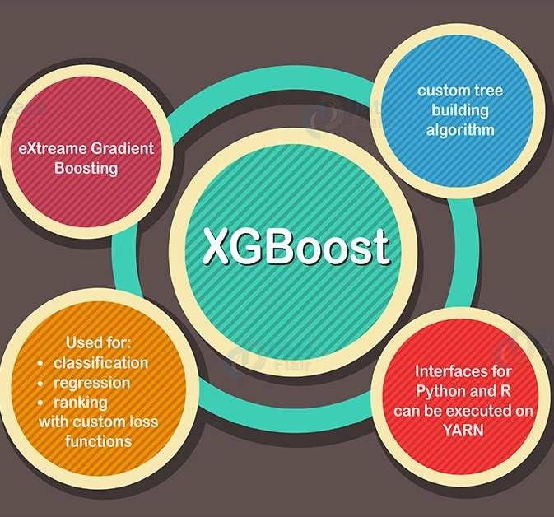
Gradient Boosting Tree
Performance and Scalability
XGBoost offers high-speed performance and efficiency, making it ideal for handling large datasets across multiple cores.
Model Enhancement Features
It supports built-in handling of missing data, regularization to avoid overfitting, and allows customization of the optimization objective.
Versatility and Wide Adoption
Widely used in the machine learning community, XGBoost can tackle both regression and classification problems across various programming languages.

Slide 3
Objective
Features
Datetime data: Year, Month, Day of a week, hour of a day;
Characters: Street name, type of violation
Target
Number of violation in this one-hour window
what we want to achieve:
Help better resource allocation
Enhanced Policy-Making and Strategic Planning
Improved Revenue Forecasting (maybe)

Slide 4

Key metric
1.15 | 2.36 | 0.46
MAE | RMSE | R2
KPI

Slide 5
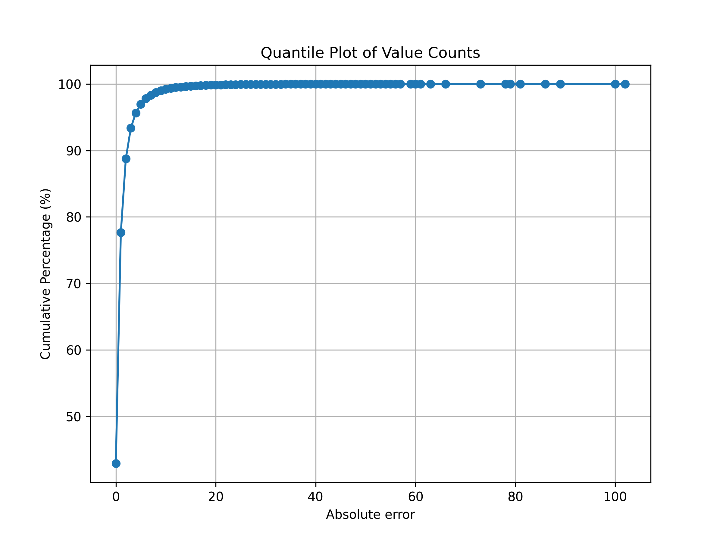
Abs error on test set
This curve shows that we have high confident (>95%) that our prediction is within 20 off the real data.

Slide 6
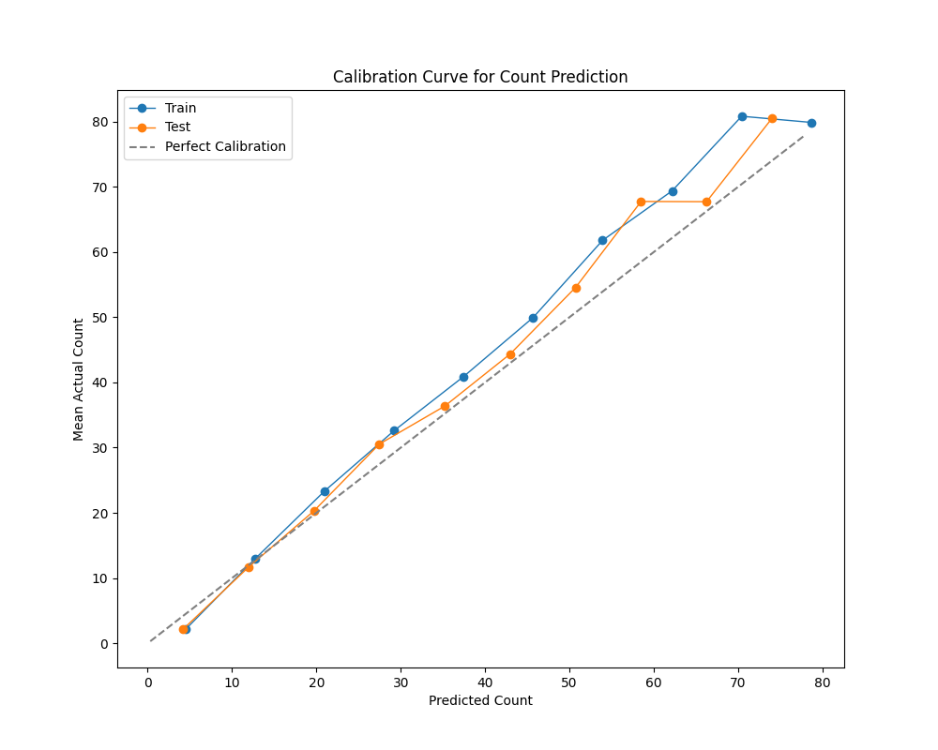
Calibration Curve
A Calibration Curve is a graphical representation used to evaluate how well the predicted probabilities from a machine learning model match the actual outcomes.
Our model is a bit Over-Confidence

Slide 7
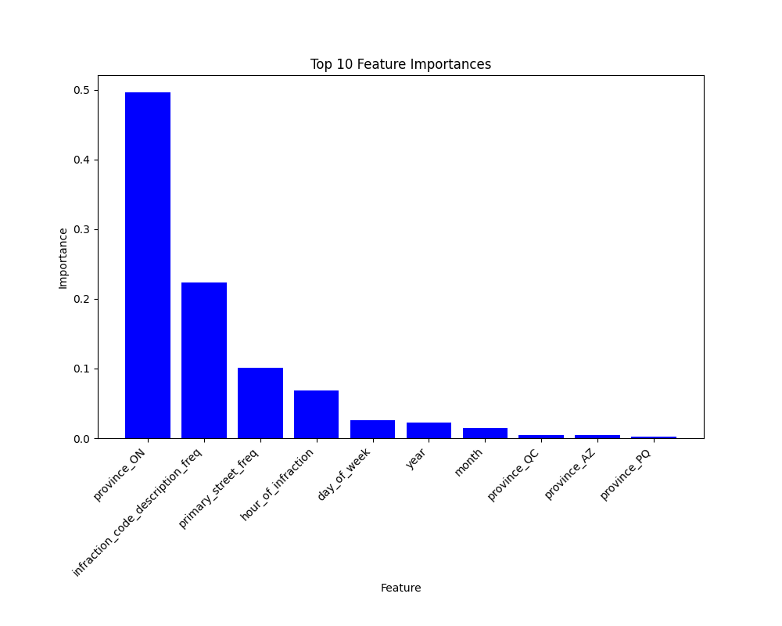
Feature importances analysis
Province = ‘ON’ is the most important feature.
Type of violation, street also plays important roles.
Hour of a day > day of week > year > month

Slide 8
Conclusion
Actionable Insights
Strategic Impact
The model was evaluated on several metrics, including calibration and error analysis, to ensure reliable and interpretable predictions. By focusing on feature importance, we identified the key drivers behind violations, which opens opportunities for further optimization and refinement.
Next step: GIS data, weather..

