Slide 1


MopEye: Opportunistic Monitoring of Per-app Mobile Network Performance
Daoyuan Wu*, Rocky K. C. Chang†,
Weichao Li†, Eric K. T. Cheng†, and Debin Gao*
https://mopeye.github.io
*
†

Slide 2
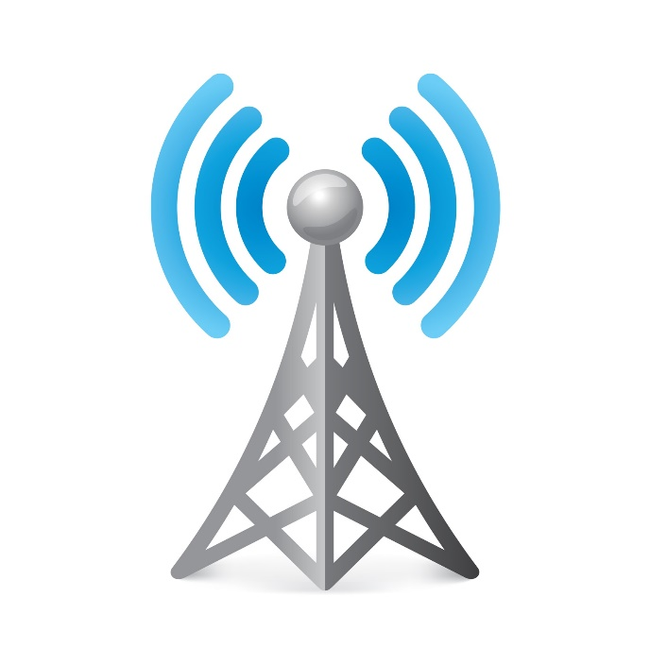
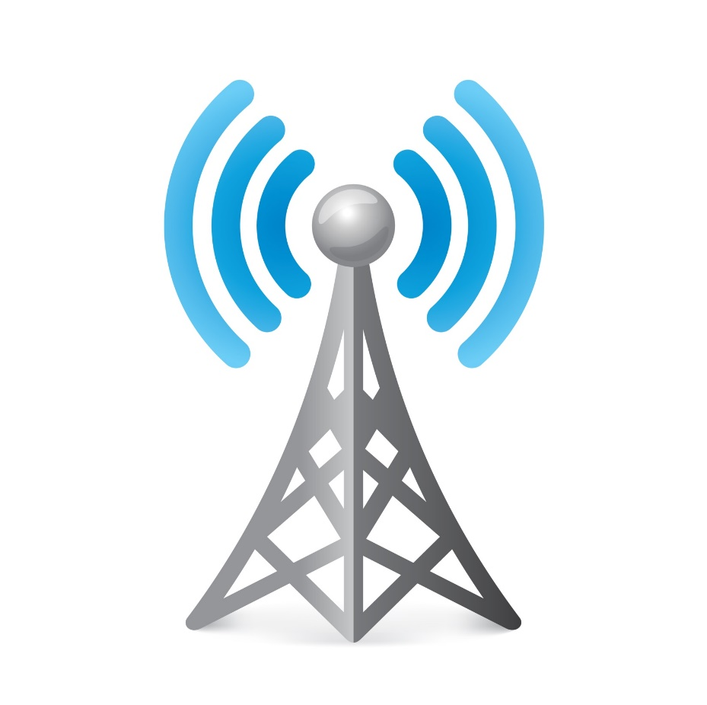

Understanding and improving
mobile users’ network performance
We are living in a networked world.
Notes:
We are living in a networked world. Billions of people use smartphones to connect various networks.
It is thus important to understand mobile users’ network performance and further improve them.

Slide 3
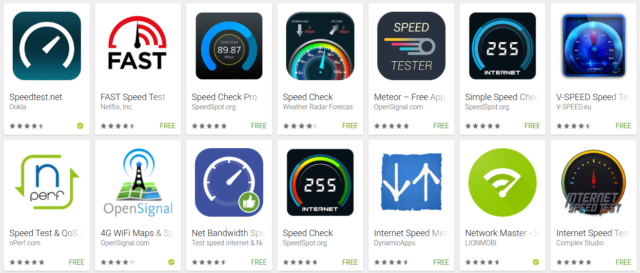
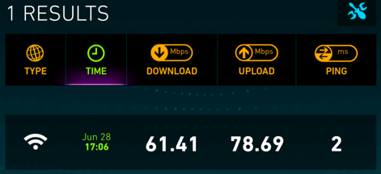





Many “Speedtest” Apps for Mobile Networks
Follow the landline measurement paradigm.
Measurement servers
Actively send probe packets
“Effective”: the overall performance of networks
×
Measurement apps
?
Various app servers
App and app server agnostic
App time-of-use agnostic
Notes:
Despite the implementation difference and different user interfaces, these existing mobile measurement apps all …
Once user clicks the “Begin Test” button, they actively send probe packets to user-specified remote endpoints, typically fixed measurement servers.
During this process, they will obtain an overall performance of the tested network at that moment and report it to users.
This is effective in terms of understanding the overall performance of users’ connected networks. Essentially, this performance only represents … between …
But the problem is …
Someone may say that …
But this approach has two problems: 1. Indeed, ...
To address these problems, (jump to next slide)

Slide 4
Our Goal
A speedtest app that can accurately and promptly measure latency (and other metrics) on the app level with minimal overheads
Accuracy: comparable to tcpdump
Promptness: Always-on monitoring
App level: each active app and its domains
Minimal overheads: No additional probe traffic; low latency, energy and bandwidth overhead

Slide 5
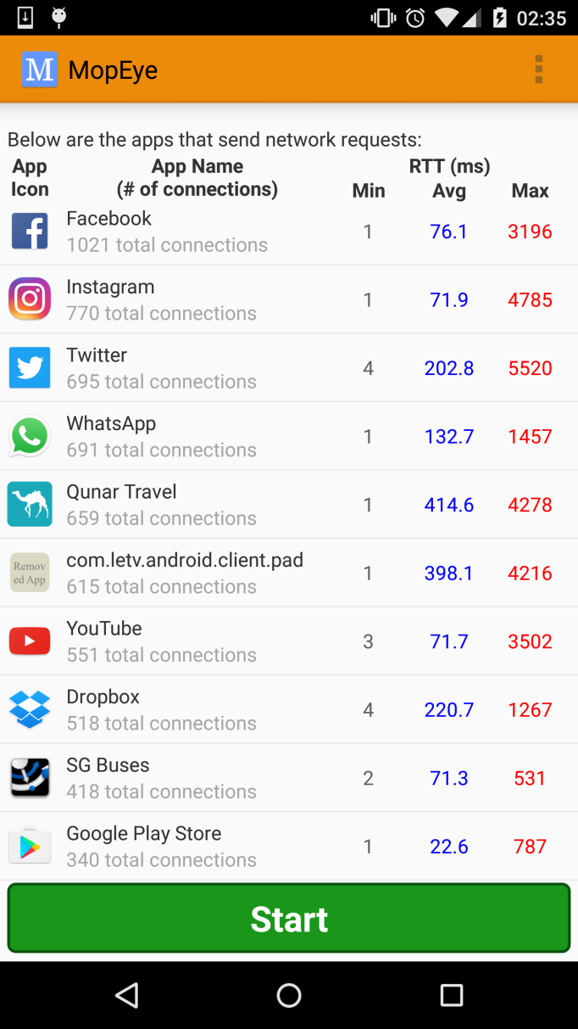
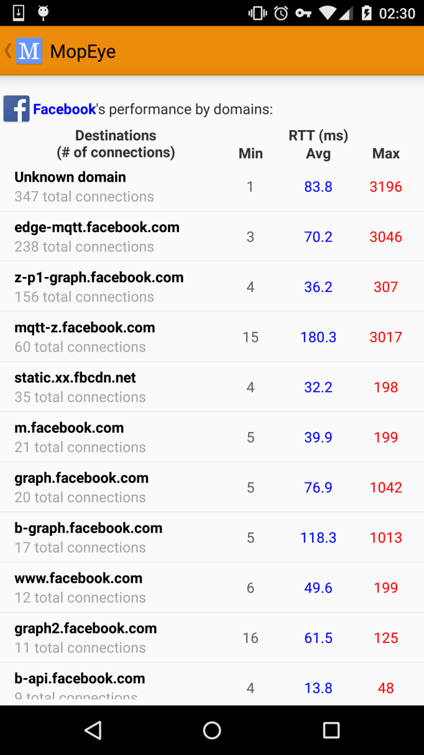
MopEye: An Android Measurement App
Per-app measurement
Opportunistic Monitoring
A new paradigm of measuring per-app network performance
Perform the measurement whenever there is app traffic
The detailed performance of different Facebook’s domains.
Leverage the VpnService API available on Android 4.0+ to
passively capture the traffic initiated by all apps;
and forward them actively to the remote app servers using socket calls.
A list of different apps’
performance
No rooting, additional traffic and user intervention
Notes:
We propose MopEye, a novel mobile measurement app.
MopEye is built upon two new concepts.
First, MopEye is based on a new paradigm of measuring per-app mobile network performance.
That is, MopEye measures mobile network performance for each app from user’s smartphone to the app servers.
For example, the figure here shows that a list of different apps’ performance has been captured by MopEye.
Second, an effective approach to per-app measurement is to perform the measurement only when there is app traffic. We call this “”.
To do so, we leverage .. Since the VpnService is a regular API and we do not use native sockets for packet forwarding, MopEye can be implemented without the root privilege and thus be deployed widely.
Hope at this moment, you have understand the measurement objective of MopEye.

Slide 6

Packet Relaying and RTT Measurement
internal connections
relay
external connections
(raw IP packets)
(socket channels)
TCP/UDP client 1
....
Which app for an outgoing packet?
....
How to splice the two?
....
How to measure RTT?
Tunnel
....
Virtual network interface
User-space TCP state machine
Apps
Socket instance
TCP/UDP client n
Servers
MopEye

Slide 7
Packet-to-app Mapping
Two steps:
Socket address in the packet → the app’s UID (using 4 pseudo files in the proc filesystem)
The app’s UID→ app’s name (using Android’s PackageManager APIs)
Perform for only TCP SYN for TCP applications

Slide 8

RTT Measurement
A connect() call
A write() call
Data
SYN
SYN-ACK
FIN


A single round of packets
May involve multiple rounds
A read() call
A close() call
Data
FIN
FIN
FIN


May involve multiple rounds
May not always elicit an ACK
Notes:
We use tcpdump to test the relationship between socket calls and their underlying packet sending behaviors.
There are four types of socket calls. In the first scenario, . So it satisfies our requirement.

Slide 9
Connection Splicing and Packet Processing
Using two-way referencing to link the state machine and the socket
Tunnel packet processing
TCP SYN
TCP data
Pure ACK (no relay)
TCP FIN
TCP RST
Socket packet processing
Socket read: Retrieve the data from the read buffer and form packet for the internal connection
Socket write: Send data to the write buffer and ACK the internal connection.

Slide 10
Challenge 1: Measurement Accuracy
MopEye uses non-blocking SocketChannel APIs to relay packets for efficient packet relay.
It has to wait for the system’s notification for a received ACK.
This event-based notification may introduce an additional delay up to several milliseconds.
Affect the accuracy of the post-connect() timestamp.
Temporarily set the socket into blocking mode for each connect() call.
MopEye runs a connect() call in a temporary new socket-connect thread.
Once the connection is established, MopEye resumes the non-blocking mode and switches back to the main thread.

Slide 11
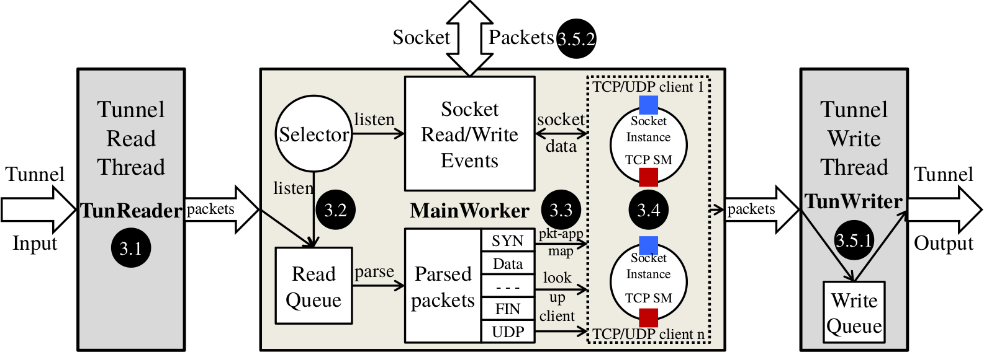
Challenge 2: Handling bottlenecks
Monitoring Both Socket Events and Read Queue
3.5.1 & 3.5.2:
Fast Dispatching of Tunnel and Socket Packets
Lazy
Packet-to-App Mapping
Tuning TCP Performance (e.g., maximum segment size and receive window size)
Zero-delay Packet Retrieval from the
VPN Tunnel

Slide 12
Evaluation
Measurement Accuracy
Measurement Overheads
Resource Consumption
Large-scale Crowdsourcing Measurement Results
Dataset
Per-app Measurement
DNS Measurement
Notes:
We present two sets of evaluation results.
The additional delay introduced by MopEye to other apps’ packets

Slide 13
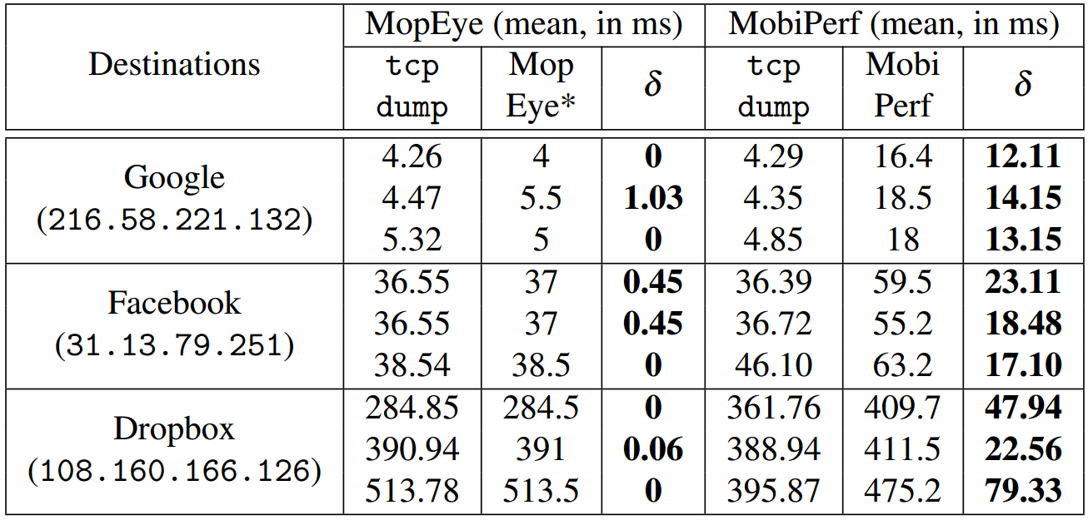
Measurement Accuracy
MopEye’s accuracy is much better than MobiPerf’s HTTP ping measurement
Destinations with different levels of network latency
MopEye’s measurement accuracy is close to that of tcpdump
- HttpURLConnection.connect()
- Overhead of invoking pre-connect functions
- Millisecond-level currentTimeMillis()
Notes:
Q&A: Why round the result to ms-level, because we want give users simply presented results.

Slide 14
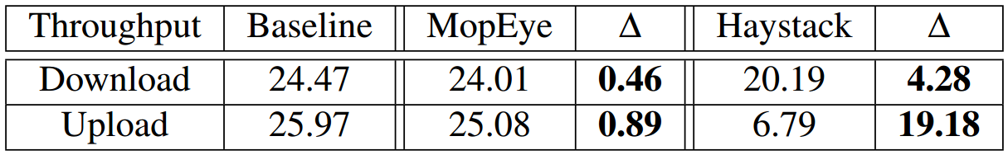
Measurement overheads
The mean delay overhead of a round of packets
The download and upload throughput overhead
SYN <--> SYN/ACK: 3.26∼4.27ms
Data packets: 1.22∼2.18ms
The median of all 714,675 LTE RTTs in our dataset is 76ms
Notes:
stable throughput at around 25Mbps for both download and upload links.

Slide 15
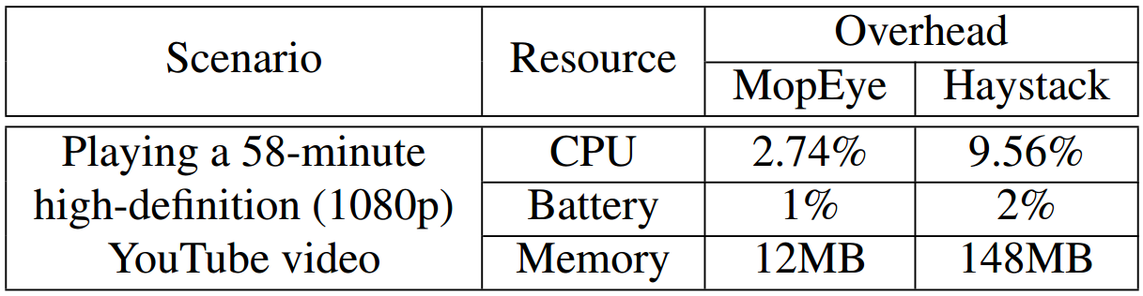
Resource Consumptions
The average CPU overhead within that one hour
Used 1% of the total battery in that one hour
Notes:
For memory: the user interface of MopEye is simple at that time.

Slide 16
MopEye Deployed to Google Play for an IRB-approved crowdsourcing study
Implemented in 11,786 LOC and deployed since
16 May 2016
Around 10K
Total installs
Over 2K
Alive installs
25 users gave the highest
5-star rating
(out of a total of 37 ratings)

Slide 17
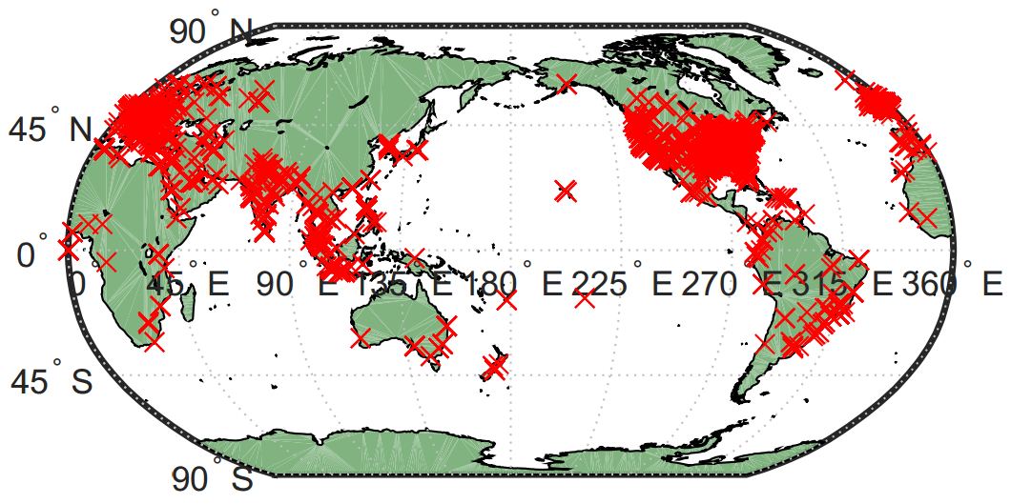
The first large-scale per-app measurement dataset
Over 9 months
(May 2016 to Jan 2017)
2,351 devices made at least one measurement
Measurements
for 6,266 apps
5M+ RTT measurements
3.5M+ TCP measurements
1.6M+ DNS measurements
114 countries worldwide

Slide 18
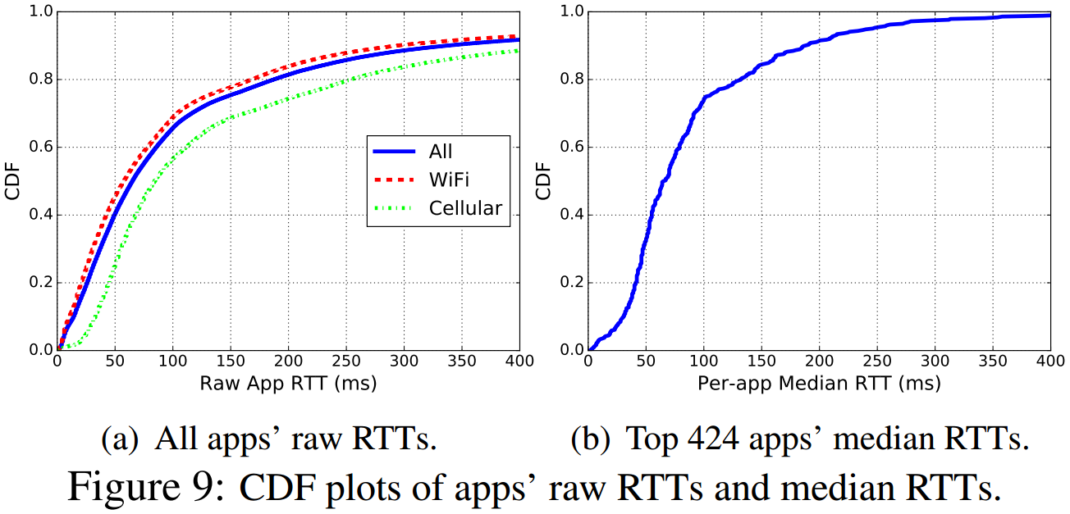
The overall app performance in our dataset
~ 10% with > 400ms
The overall median RTT: 65ms
~ 10% with > 200ms
> 70% with < 100ms
Median RTT for
WiFi: 58ms; Cellular : 84ms;
LTE alone: 76ms

Slide 19
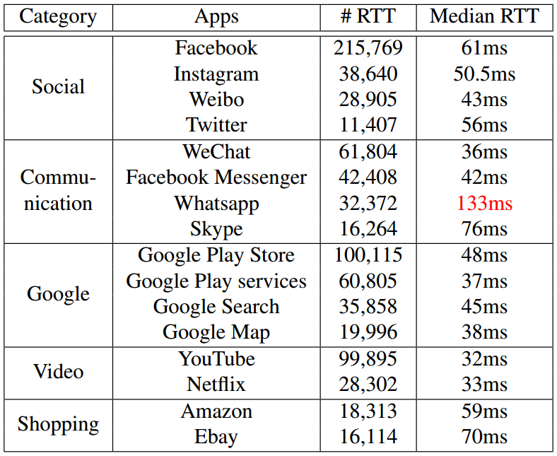
Representative apps’ performance

Slide 20
The vast majority of *.whatsapp.net domains do not perform well in many networks.
331 domains with
> 200ms
Only 2 networks with < 100ms
Deployed in SoftLayer Technologies
How do those 331 domains perform in 20 most accessed networks?
A total of 334 *.whatsapp.net domains
Six networks with [100,200]ms
Mean RTT: 261ms
Only 3 domains with mean RTT < 100ms:
mme, mmg, pps
Eight networks with [200,300]ms;
Four networks with
> 300ms
Our manual Ping tests from SG and HK:∼250ms
Deployed in Facebook CDN

Slide 21
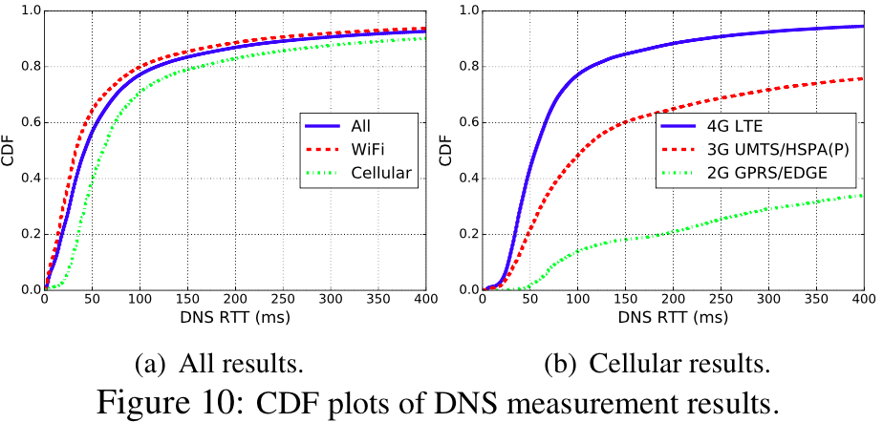
The overall DNS performance in our dataset
~ 80% with < 100ms
(per-app RTT: ~80% with < 200ms)
Overall median DNS RTT: 42ms
Median DNS RTT for
WiFi: 33ms; Cellular: 61ms.
Median DNS RTT for
4G LTE: 56ms;
3G: 105ms; 2G: 755ms.

Slide 22
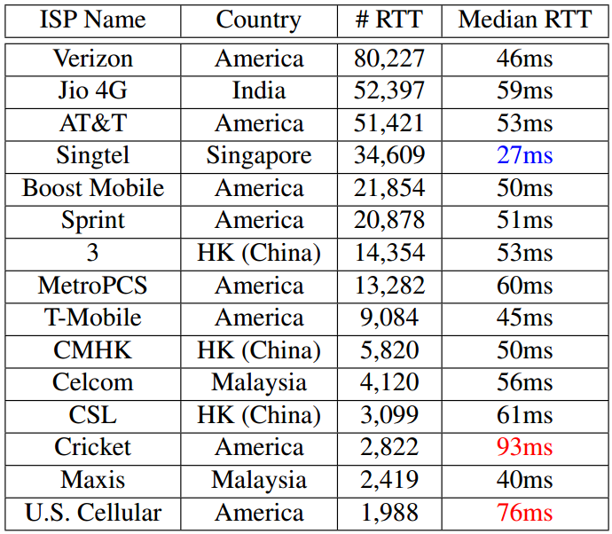
DNS performance of 15 LTE 4G operators
Singtel has deployed the latest upgrade of LTE, Tri-band 4G+, countrywide.
DNS RTTs (64% of Cricket and 45% of U.S. Cellular) are still
from non-LTE networks.

Slide 23
Conclusions
MopEye: a novel VPN-based app for per-app mobile measurement.
Accurate and lightweight, and enabling a large-scale deployment of per-app measurements.
Contact: Daoyuan Wu dywu.2015@smu.edu.sg
https://mopeye.github.io/

Slide 24
Future Work
Improving MopEye:
Support more metrics beyond RTT and also measure non-DNS UDP traffic.
Improve the robustness. (research prototype → commercial grade)
MopEye on iOS
Conduct an in-depth (and possibly an automated) analysis of our dataset.
Release results for developers and ISPs to optimize their performance:
We have already helped Tencent fix a WeChat DNS misconfiguration for hkminorshort.weixin.qq.com. (See our CoNEXT’15 poster)

Slide 25
Please download MopEye from Google Play
Simply search “MopEye”
or visit https://mopeye.github.io/

Slide 26
Backup Slides

Slide 27
Could MopEye also be implemented on iOS?
We believed so and we are on the way implementing the iOS version.
The underlying packet capturing technique based on the TUN virtual network device has been supported on Linux/UNIX-based systems for over 15 years.
https://www.kernel.org/doc/Documentation/networking/tuntap.txt
Indeed, Apple has provided the TUN-based VPN API as a private API since iOS 4.2 and recently released it as a public API through the network extension framework in iOS 8.
http://ramezanpour.net/post/2014/08/03/configure-and-manage-vpn-connections-programmatically-in-ios-8/

Slide 28
How does MopEye preserve user privacy?
MopEye adopts the local phone-side traffic forwarding scheme, without additional risks associated with VPN servers, such as leaking user traffic.
This is different from most of VPN apps on the market that use VPN servers for traffic relay.
Further, unlike PrivacyGuard and Haystack that perform traffic content inspection, MopEye makes no such attempt, let alone the TLS interception performed by those two.
We collected only the RTT information for each domain, no any URL or HTTP header information.
Notes:
In line with the recommended practice,
we do not collect person-identifiable information, such as device IMEI,
IP, MAC addresses or fine-grained locations. Instead,
we collect only a randomly generated ANDROID ID [4]
(hashed in SHA-1 with a secret salt), non-sensitive phone
model and OS version, and coarse-grained locations.
Moreover, we use only encrypted HTTPS connections to
transmit the measurement data to our server.

Slide 29
On the major permission required by MopEye
MopEye requires the VPN permission, similar to other VPN-based apps.
android.permission.BIND_VPN_SERVICE
Not a root privilege and can be requested by any app.
This permission needs to be granted by users dynamically.
But only once at the first time.

