Slide 1



Towards Understanding Android System Vulnerabilities: Techniques and Insights
ACM Asia Conf. on Comp. and Comm. Security (AsiaCCS), Auckland, Jul 2019
Daoyuan Wu¹, Debin Gao¹, Eric K. T. Cheng²,
Yichen Cao³, Jintao Jiang³, and Robert H. Deng¹
¹
²
³

Slide 2
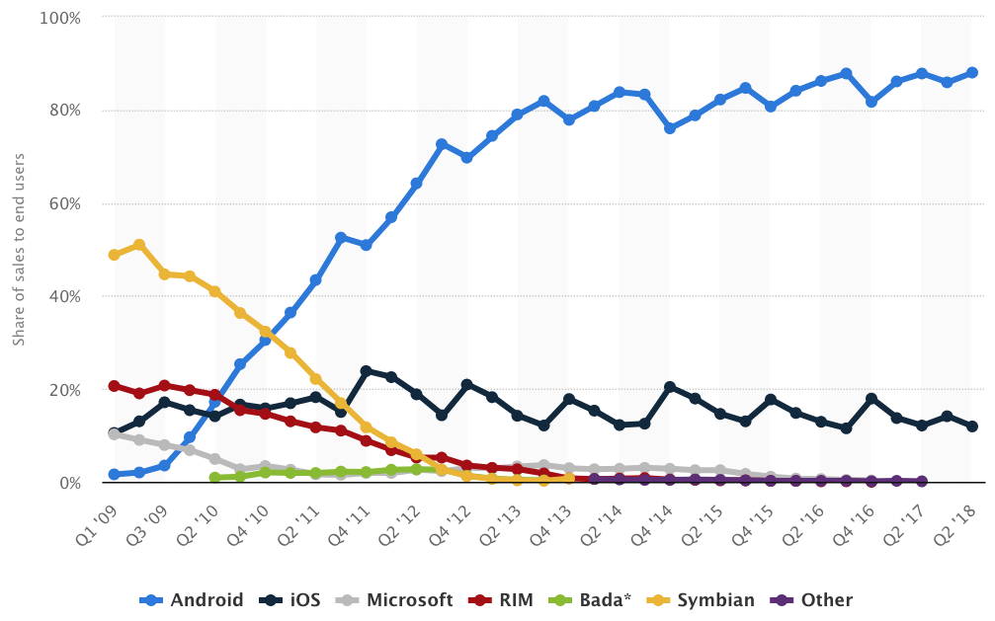
Android has become the most popular system
A global market share at over 80% since 2013
https://www.statista.com/statistics/266136/global-market-share-held-by-smartphone-operating-systems/
Notes:
Android has become the most popular system for pervasive devices over years, with a global market share of smartphones at over 80%since 2013. Here ...

Slide 3
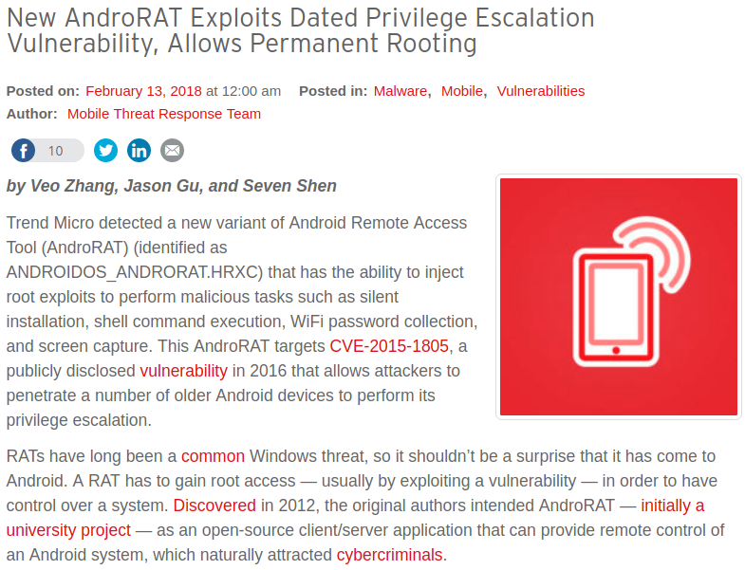
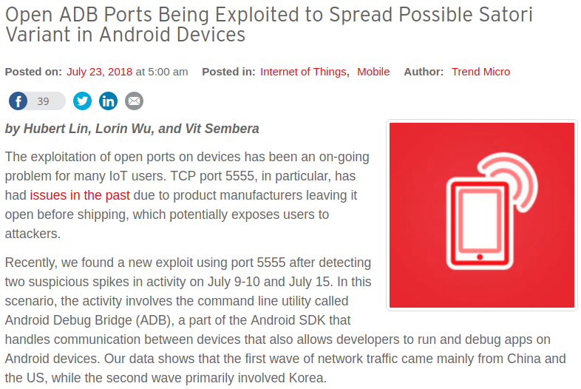
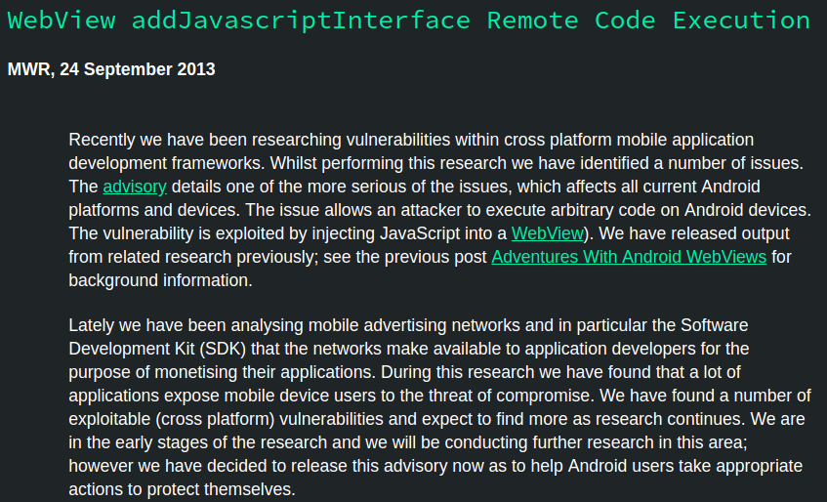
More and more attacks targeted at Android
Notes:
Naturally, more and more attacks are targeting at Android by exploiting vulnerabilities in its apps and the system
For example, the wide-spreading …

Slide 4
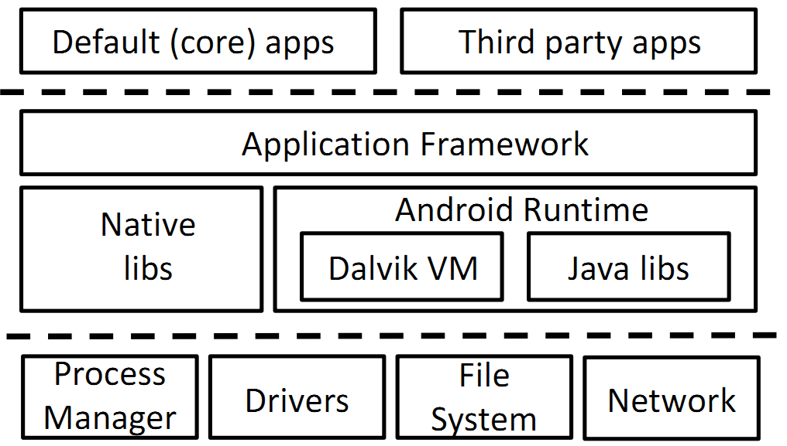
Prior Arts in analyzing Android vulnerabilities
Woodpecker [NDSS’12]
CHEX [NDSS’12]
SSLMalloDroid [CCS’12]
CryptoLint [CCS’13]
FileAtk [ISC’14]
CredMiner [WiSec’15]
UnixSocket [CCS’16]
XAWI [CCS’17]
OSV [S&P’18]
App level extensively studied
System level much less explored in the literature
Mostly on framework issues
[CCS’15], [NDSS’16], [NDSS’18] ...
Specific drivers: ION [CCS’16] Binder [ACSAC’16]
And their exposed interfaces: [S&P’14] and [USENIX SEC’18]
Notes:
As a result, Detecting and analyzing Android vulnerabilities has been an emerging topic in Android security research. To understand prior arts ...

Slide 5
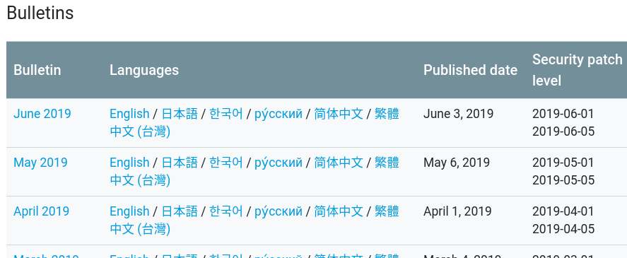
Google maintained a new source for white-hats to report Android system vulnerabilities
Android Security Bulletin program
2,179 vulnerabilities reported over around three years
(08/2015 -- 06/2018)
Could we effectively mine these vulnerabilities for insights?
Notes:
Fortunately, industrial whitehats report a lot of Android system vulnerabilities to Google through …
In this program, Google will release a set of vulnerabilities that can be public each month.

Slide 6
Outline
Background and Objectives
Our analysis framework
Some interesting results

Slide 7
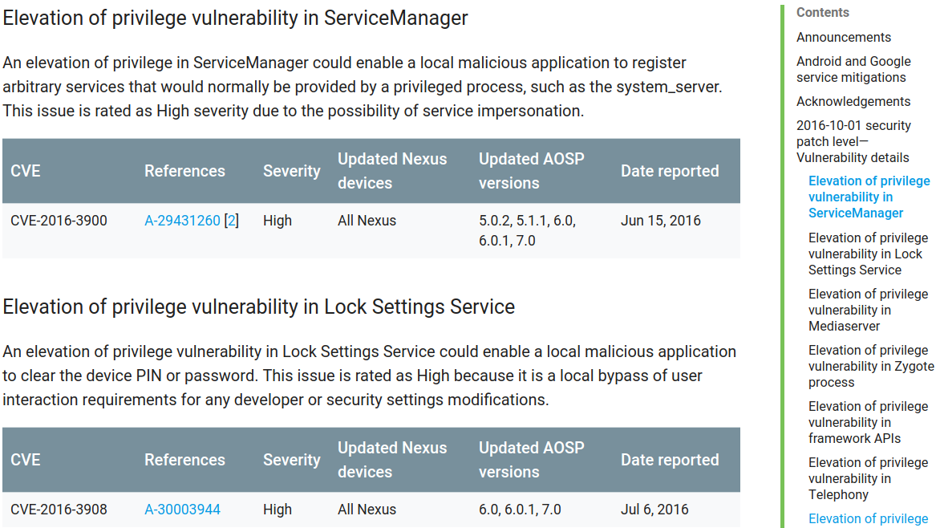
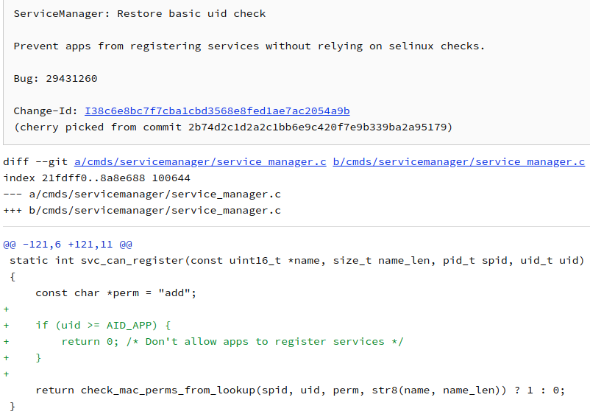
A sample webpage of Android Security Bulletin
Commit description
Patched code file(s)
Detailed code fragments
Notes:
Here shows its sample web page in Oct 2016. It will first show a list of vulnerabilities released in this month. Then for each vulnerability, it will some basic information.

Slide 8
Analysis Objectives
platform/system/bt/bta/dm/bta.cc
Modules of Vulnerabilities
Patch Code Complexity
Patch Code Patterns
<h3 id="eopv-in-servicemanager">
Shed light on the system modules that are susceptible and require more security attention.
Implementation bugs can be an important source of Android system vulnerabilities.
These patterns can be leveraged for automatic vulnerability detection.
Need a database structure that can store all the text and code information in an organized and searchable structure.

Slide 9
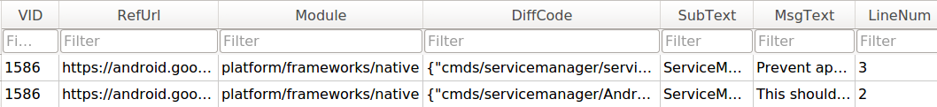
Designing a Hierarchical Database Structure
{"cmds/servicemanager/Android.mk":[{"line":1, "code":[["D","LOCAL_SHARED_LIBRARIES := liblog libselinux"], ["A","LOCAL_SHARED_LIBRARIES := liblog libcutils libselinux"]]}], "cmds/servicemanager/service_manager.c":[{"line":1, "code":[["D","if (uid >= AID_APP) {"], ["A","if (multiuser_get_app_id(uid) >= AID_APP) {"]]}]}
One vulnerability record in the metadata DB
“add” ”del” “ctx” “hunk”
One or more code fragments in
each JSON block
Two corresponding records in the patch code DB
select median ( json_array_length(value) )
from PatchTable, json_each(PatchTable.DiffCode)
where PatchTable.DiffCode like '{%}' and key not like '%.s';
searchable

Slide 10
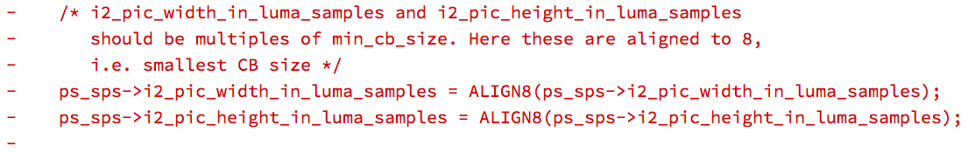
A robust method to study the complexity of patch code
Must exclude auxiliary code lines: blank, import/include, and comment lines.
countFrag = max(countAdd, countDel)
- (ps_sps->i1_log2_ctb_size > 6)) + (ps_sps->i1_log2_ctb_size > 6) ||
+ (ps_sps->i2_pic_width_in_luma_samples % (1 << ps_sps->i1_log2_min_coding_block_size) != 0))
countFrag = 2
countFile = sum(countFrag)
Notes:
During generating the JSON block, we count the actual lines of code change for each vulnerability … In order to robustly …

Slide 11
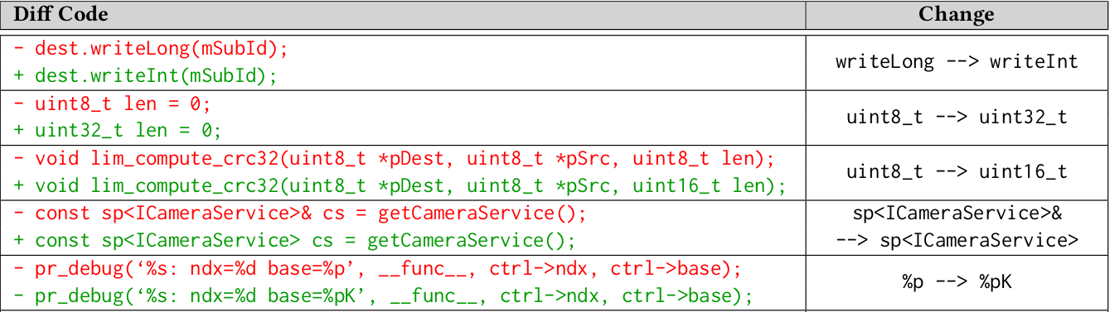
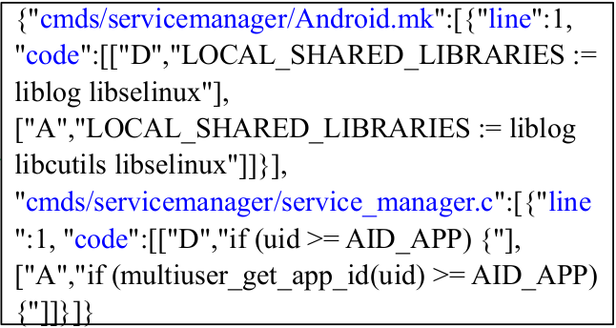
Automatically Clustering Patch Code Patterns
uint8_t --> uint32_t
uint8_t --> uint16_t
writeLong --> writeInt
…
--> = 0
if --> if || value <= 0
%p --> %pK
Diff Code Fragments
Extract essential changes
Cluster 1
uint8_t --> uint32_t
uint8_t --> uint16_t
…
uint8_t --> uint16_t
Cluster N
%p --> %pK
%p --> %pK
%p --> %pK
%p --> %pK
…
%p --> %pK
%p --> %pK
[[ 1. 0.96774193 ..., 0.67603485]
[ 0.96296296 1. ..., 0.68240740]
[ 0.97530864 0.95238095 ..., 0.68954248]
...,
[ 0.58308895 0.63878788 ..., 0.99649122]
[ 0.59872153 0.59206192 ..., 1. ]
[ 0.57966764 0.56245791 ..., 0.99649122]]
Generate clusters via affinity propagation
[Science’07]
Calculate
pairwise similarity
…
…
…

Slide 12
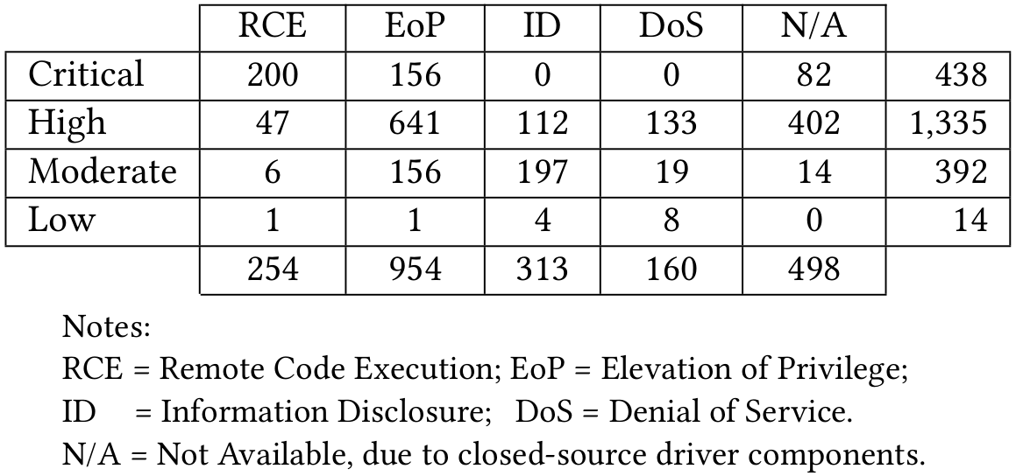
Dataset and Vulnerability Metadata
2,179 vulnerabilities; 1,349 publicly available patches
81%
(1,773)
55% (1,208)
+23%
Notes:
severity level

Slide 13
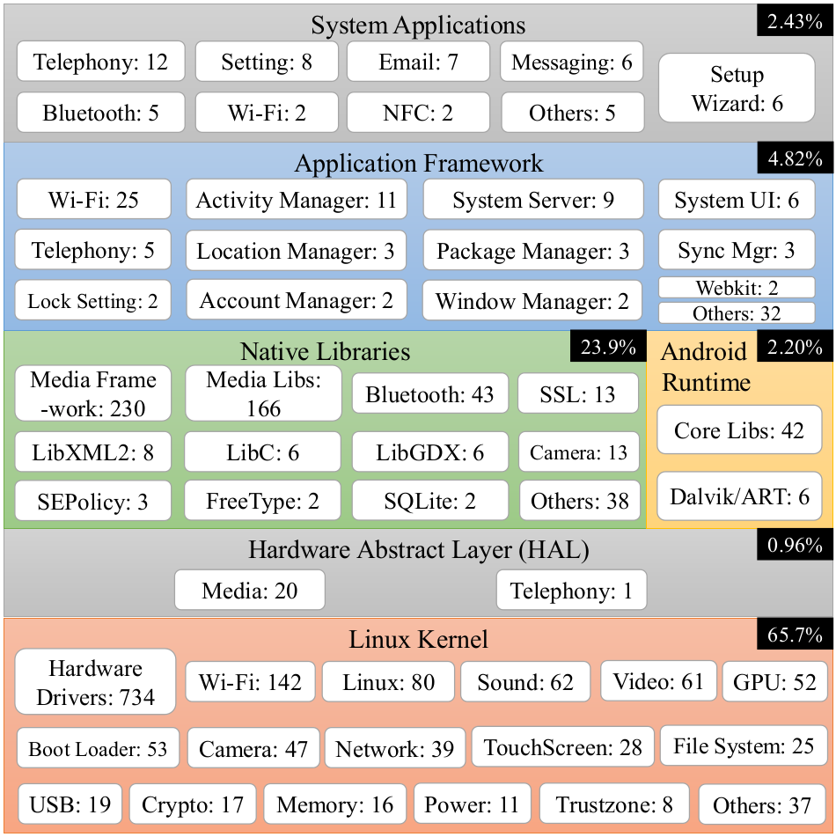
Analysis of Vulnerable Modules
8%
92%

Slide 14
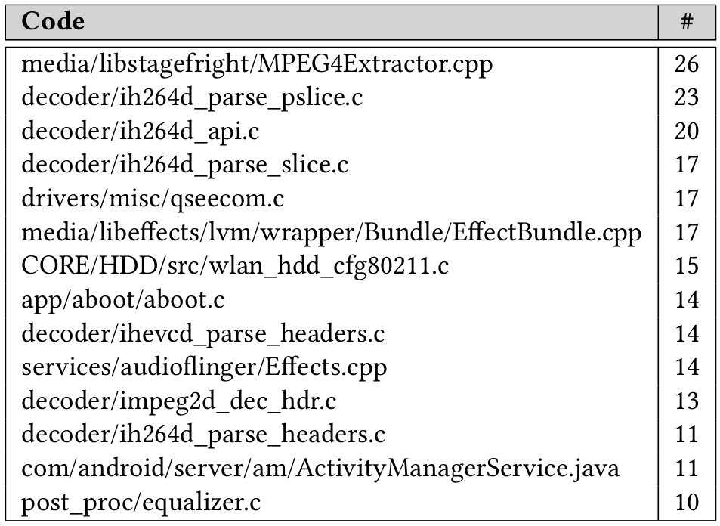
Code that was frequently reported vulnerable
Can help developers avoid making similar mistakes in the same module or code
Notes:
These detailed code paths and their vulnerabilities can help …

Slide 15
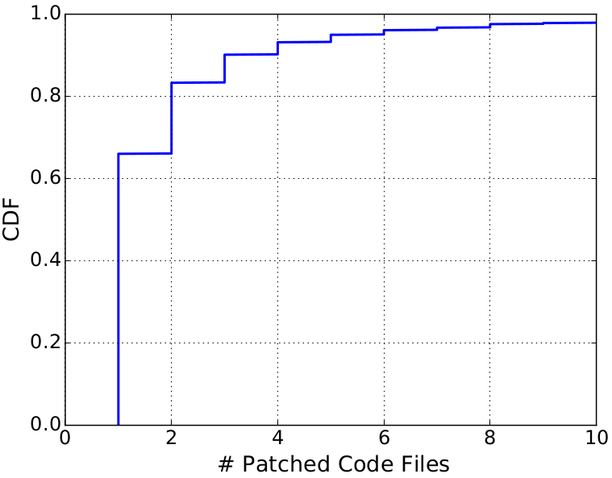
Analysis of Patch Code Complexity
60% requiring only one file change

Slide 16
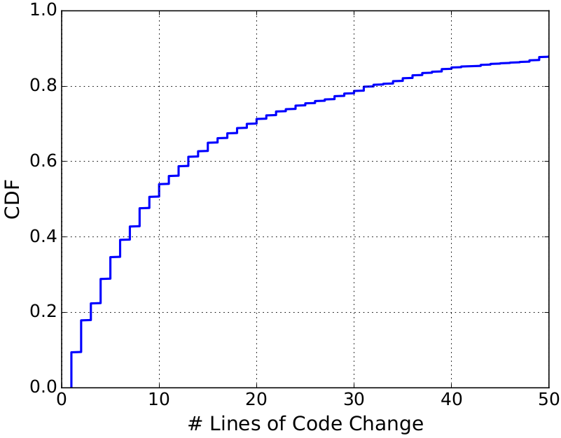
Analysis of Patch Code Complexity (Cont’d)
50% fixable in less than 10 lines of code
20% requiring only one/two lines of code

Slide 17
Intermediate results of our pattern clustering
83 initial clusters
33 actual clusters
19 security clusters
9 non-security clusters
84.8% associated with certain patterns
50 small-size clusters with fewer than 10 code fragments each
16 vulnerability patterns
Notes:
Focus on short code fragments…
quickly filter out

Slide 18
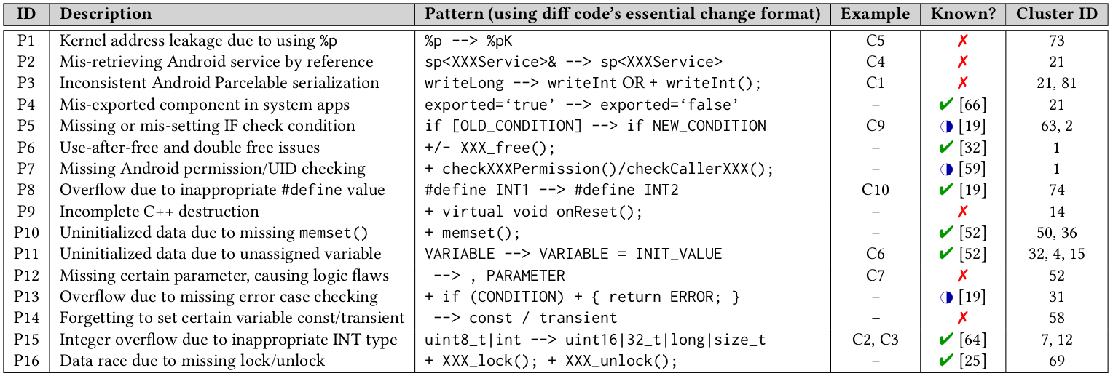
16 Clustered Patterns for Android System Vulns
Six new patterns: P1, P2, P3, P9, P12, P14
Two more Android-specific patterns: P4, P7

Slide 19
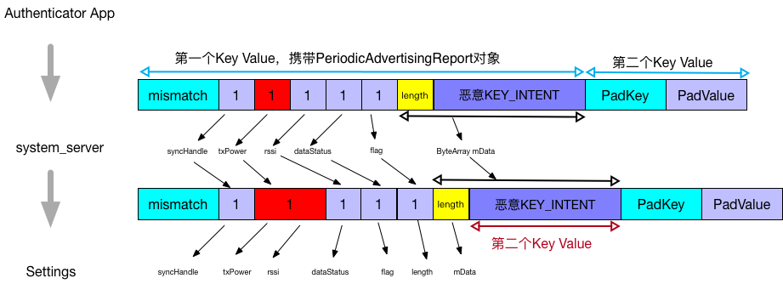
P3: Inconsistent Android Parcelable serialization
CVE-2017-13315: telephony/java/com/android/internal/telephony/DcParamObject.java
CVE-2017-13288: core/java/android/bluetooth/le/PeriodicAdvertisingReport.java
public void writeToParcel(Parcel dest, int flags) {
- dest.writeLong(mSubId);
+ dest.writeInt(mSubId);
}
private void readFromParcel(Parcel in) {
mSubId = in.readInt();
}
Intent Overflow Attack
public void writeToParcel(Parcel dest, int flags) {
dest.writeInt(syncHandle);
- dest.writeLong(txPower);
+ dest.writeInt(txPower);
dest.writeInt(rssi);
dest.writeInt(dataStatus);
Trigger malicious Intent
http://www.ms509.com/2018/07/03/bundle-mismatch/
Notes:
This kind of a new attack, which you can imagine buffer overflow attack on Intent

Slide 20
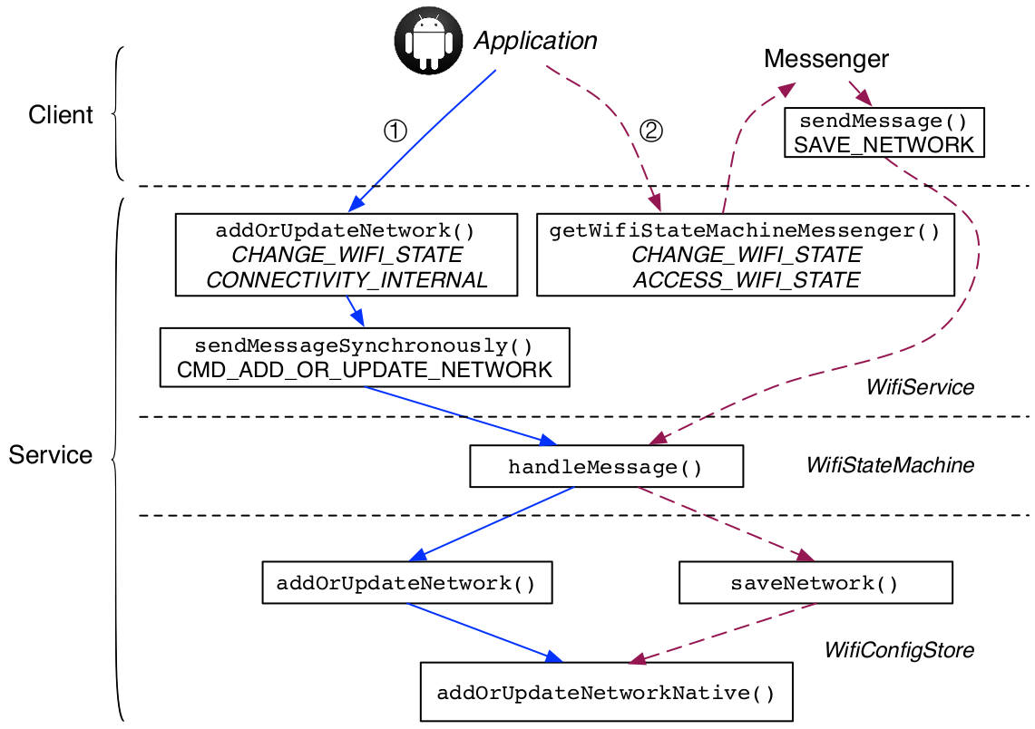
P7: Missing Android permission/UID checking
Kratos [NDSS’16]
AceDroid [NDSS’18]
CVE-2017-13236: keystore/key_store_service.cpp
(native-level C/C++ code)
Only for the framework-level Java code
- if (!checkBinderPermission(P_GEN_UNIQUE_ID))
+ if (!checkBinderPermission(P_GEN_UNIQUE_ID) ||
originalUid != IPCThreadState::self()->getCallingUid())
{
return ResponseCode::PERMISSION_DENIED;
}

Slide 21
Conclusion and Future Work
Conducted the first systematic study of Android system vulnerabilities by analyzing all 2,179 vulnerabilities and their 1,349 publicly available patches on the Android Security Bulletin program over around three years.
Proposed an analysis framework and its three analyzers, including the novel similarity-based clustering algorithm, to:
Pinpoint the modules of Android vulnerabilities;
Study the complexity of Android patch code;
Obtain 16 vulnerability patterns, including six new ones not in the literature.
Future work: Improve our clustering algorithm to support long code fragments, because the current version is limited to short code fragments only.
Contact: Daoyuan Wu
Twitter @dao0x

Slide 22
Backup Slides

Slide 23
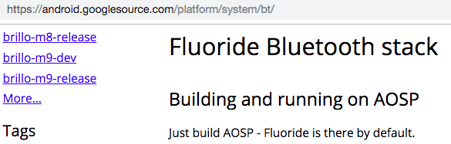
A lightweight technique to pinpoint the affected modules of given vulnerabilities
Via code path
Via HTML structure
platform/system/bt/bta/dm/bta_dm_act.cc
https://android.googlesource.com/ platform/system/bt/+/99a263
<h3 id="eopv-in-servicemanager">

