Slide 1

Measuring the Declared SDK Versions and Their Consistency with API Calls in Android Apps
Daoyuan Wu, Ximing Liu*, Jiayun Xu*, David Lo, and Debin Gao
School of Information Systems
Singapore Management University
*: co-second author.

Slide 2
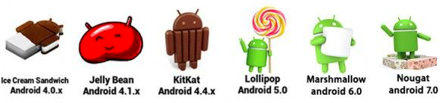


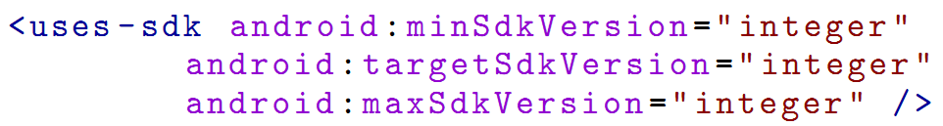
The fast-evolving Android has multiple platform versions active in the market!
Declare the supported platform SDK versions
An Android App
a modern software mechanism
Image source: http://olx.uz/obyavlenie
Notes:
Android has been the most popular smartphone system, with multiple platform versions active in the market.
However, it is thus difficult for developers to manage their applications’ compatibility with multiple platform versions.
Developers may feel confused.
To help developers overcome the app compatibility problem, Android allows apps to declare the supported platform SDK versions in their manifest files, like this.
This kind of declared SDK version is a modern software mechanism.
In this work, we aim to make a first study on the effectiveness of this modern software mechanism.

Slide 3
The Declared SDK (DSDK) Versions in Android Apps
It is different from the traditional compiling SDK (CSDK).
DSDK records the supported platform SDK versions, which are for the runtime Android system to check apps’ compatibility.
The minSdkVersion integer specifies the minimum platform SDK version required for the app to run.
The targetSdkVersion integer designates the platform SDK version that the app targets at. “backward-compatible”
The maxSdkVersion integer specifies the maximum platform SDK version on which the app can run.
Notes:
Unlike the CSDK for the compiling purpose, DSDK …
This figure shows how to declare the supported SDK versions in Android apps’ manifest files.
It has three attributes.
Or in Android terminology, the minimum platform API level.
An important implication of this attribute is that the Android system will enable backward-compatible behaviors of the corresponding target SDK version, even when the app is running on a higher version of the Android platform. As I will show later, it may cause some security risks.
Note that Android does not encourage developers to claim this attribute.

Slide 4
Does this software mechanism work as Google thought? (Is it a silver bullet?) Could developers declare the supported platform SDK versions correctly?
Notes:
Given this modern software mechanism, it is natural to think that …
In particular, …

Slide 5
First, we show that in theory, this software mechanism do have side effects.

Slide 6
Inappropriate DSDK Versions and Two Side Effects
Added APIs
Removed APIs
A patched API
minSDK
targetSDK
maxSDK
From app manifest:
minLevel
maxLevel
From app API calls:
Crash
Less secure
Crash
Android platforms:
Notes:
Let me use this slide to explain …
The first side effect is easy to understand, so we elaborate more on the second effect

Slide 7
Examples of the Side Effect II: Making Apps Fail to Get Secure
Content provider component is by default exported prior to Android 4.2.
Caused a number of vulnerable apps in year 2011-12.
Android changed this policy since 4.2 (API level 17).
However, developers need to set targetSdkVersion >= 17.
Otherwise, Android still uses the old policy, even on higher versions of platforms.
addJavascriptInterface remote code execution via Java reflection
Android 4.2 disables such Java reflection based attacks.
Similarly, developers need to upgrade targetSdkVersion.
Notes:
The second side effect is that because of the inappropriate targetSDK version, apps fail to get secure that they originally should be able to.

Slide 8
How about the reality? Do real-world apps suffer from these two side effects?
Notes:
Then the problem is whether …

Slide 9
The Objectives of Our Study
Android App
Manifest
<uses-sdk>
Dex bytecodes
2
“Consistency”
1
The current practice of DSDK versions in real apps
Notes:
More specifically, we have two objectives …

Slide 10
Methodology
Crawled
Android Apps
Google Play
Websites
Android API
Documents
Google Play
Analysis
Document Analysis
Three-dimensional analysis:
Google Play level
Android Document level
Android App level
Filtered multiple-apk apps
API-SDK mapping
Single-apk Apps
Manifest
Bytecode
aapt
dexdump
Min/Target/Max
DSDK versions
API calls and their SDK versions
App
Analysis
Comparison
Characteristic
Results
Consistency
Results
Notes:
Now let me introduce the methodology of our study.
This right-hand figure gives an overview of …. It perform analysis at three dimensions.
First, …, which I will introduce in next slide.

Slide 11
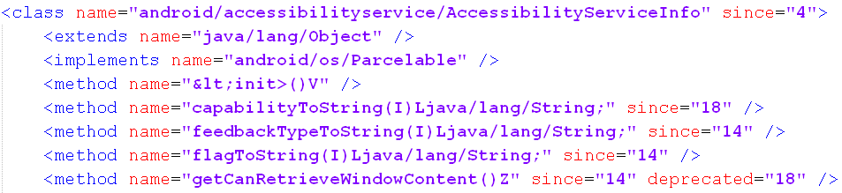
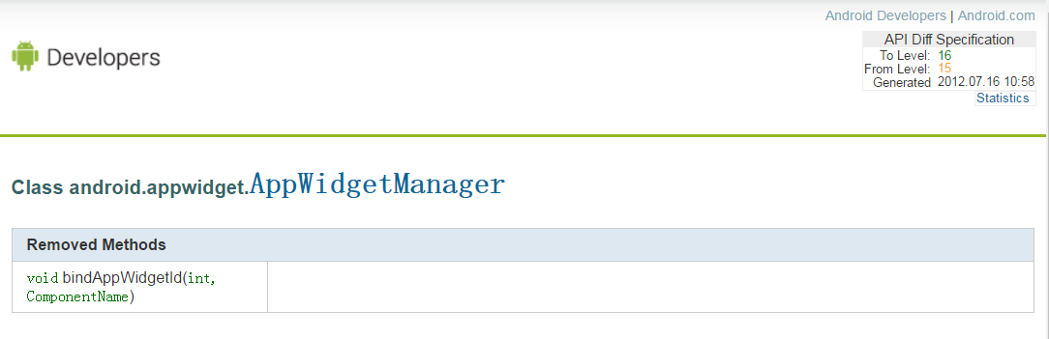
Android Document Analysis
All added APIs are given by api-versions.xml
The removed APIs can be got from the api_diff directory included in the Android Doc.
Notes:
Now we comes to the …

Slide 12
The Result of Document Analysis
A total of 30,083 APIs are added
794 deprecated APIs
190 removed APIs among all the 23 versions
However, we found that such document-based analysis initially proposed by an ICSM’13 work [1] has problems:
The deprecated and removed lists are not accurate.
[1] T. McDonnell, B. Ray, and M. Kim, An Empirical Study of API Stability and Adoption in the Android Ecosystem, In Proc. IEEE ICSM, 2013.

Slide 13
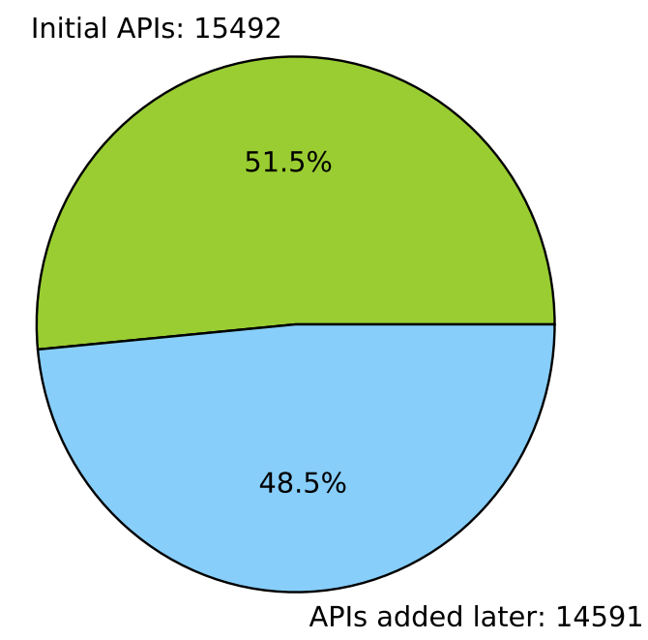
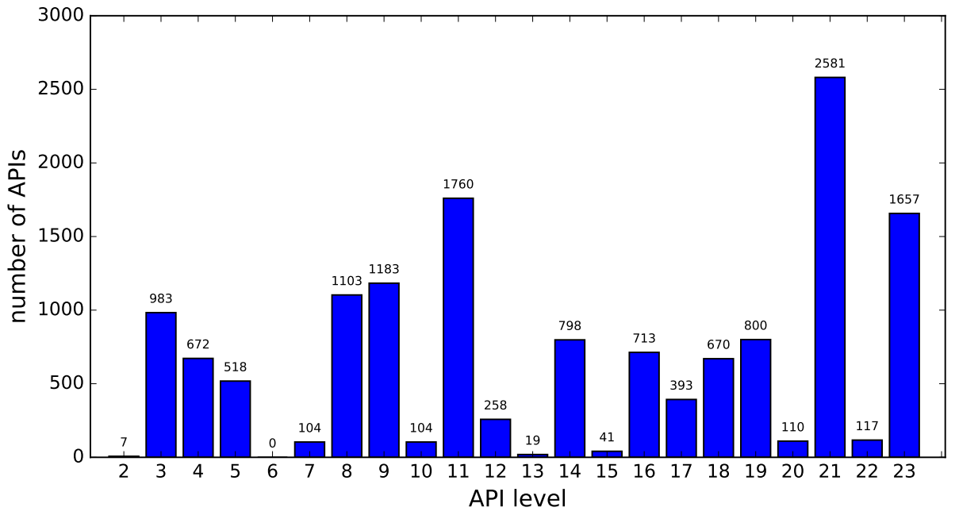
So We Focus on Added APIs
Distribution of the versions of added APIs
APIs added in version 1 and
APIs added later
Distribution of APIs added in the versions >1

Slide 14
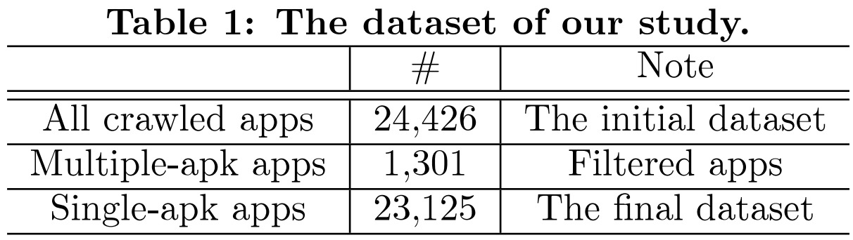
The dataset of our study
All apps were crawled in July 2015.
Our analysis was finished in April 2016, when Android 6.0 was the latest version.
Notes:
Here is the dataset of …
Finally, among the 24426 apps, we find that 1301 apps provide multiple-apk and the rest of apps only have single-apk.
This is our final dataset. The following experiments are based on this dataset.

Slide 15
Android App Analysis
We wrote python scripts to drive aapt (Android Asset Packaging Tool) and dexdump tools.
These two are more robust than apktool and dex2jar.
All succeed for aapt;
Only two failed for dexdump. “2/23,125”
API-SDK mapping
Single-apk Apps
Manifest
Bytecode
aapt
dexdump
Min/Target/Max
DSDK versions
API calls and their SDK versions
Comparison
App
Analysis
Consistency
Results
In contrast, the failure rate of apktool is 6/1,000.
Notes:
In the third module, …

Slide 16
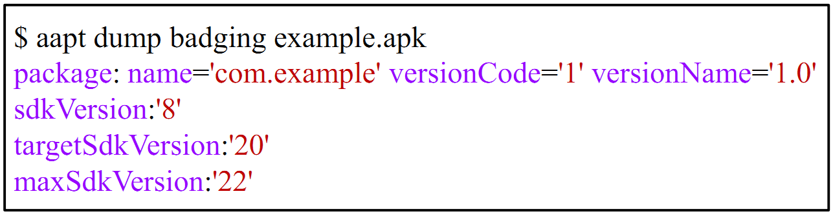
Retrieving Declared SDK Versions
Observed and handled two kinds of special cases:
Some apps define minSdkVersion multiple times, for which we only extract the first value.
We apply the by-default rules for the non-defined minSdkVersion and targetSdkVersion.

Slide 17
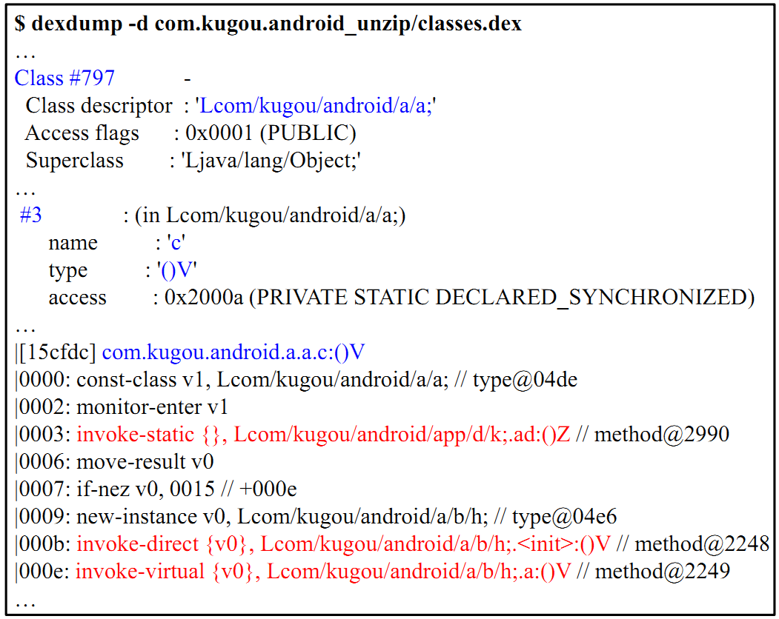
Extracting API Calls
Whether clsName covers pkgName
(1) Also locate the “class” line
(for excluding the library code)
(1) Locate the “invoke” lines
(2) Extract the API portion
(3) Remove the redundancy

Slide 18
Computing the Levels of API Calls
minLevel
maxLevel
From app API calls:
API added in v1
API added in v5
API never removed
API removed in v17
API added in v1
API added in v9
API never removed
API removed in v19
minLevel = 9
maxLevel = 17

Slide 19
Evaluation
Research Questions
Key Findings
RQ1: What are the characteristics of the DSDK versions in real-world apps?
RQ2: Could we identify the inconsistency between DSDK versions and API calls in real apps?
In particular, could we discover crash bugs and potential security vulnerabilities?
Out of 23,125 apps we analyzed:
Around 17% apps do not claim the targeted DSDK versions or declare them inappropriately.
Around 1.8K apps under-set the minimum DSDK versions, causing them to crash when running on lower platforms.
Over 400 apps under-claim the targeted DSDK versions, making them potentially exploitable by remote code execution.

Slide 20
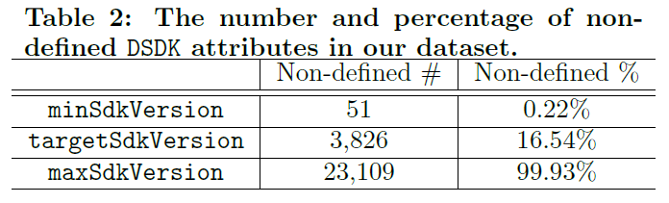
Not all apps define the minSdkVersion and targetSdkVersion attributes, and 16.5% apps do not claim the targetSdkVersion attributes.

Slide 21
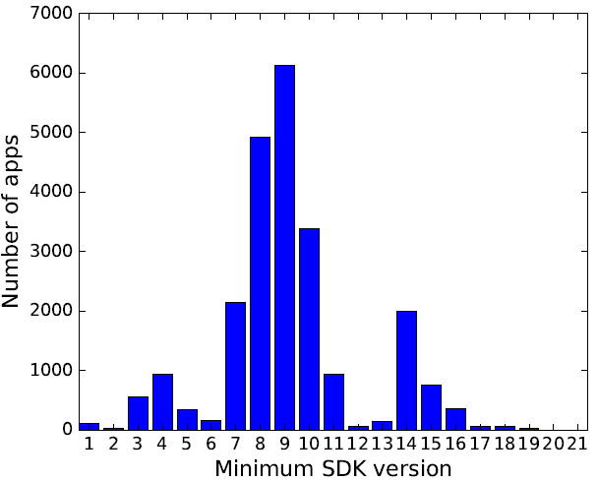
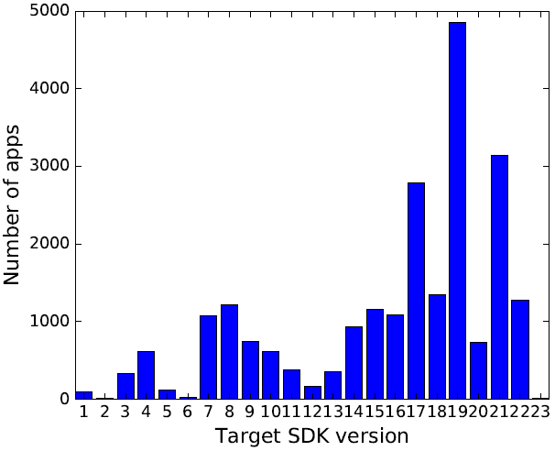
The minimal platform versions most apps support are Android 2.3 and 2.2, whereas the most targeted platform versions are Android 4.4 and 5.0. (for our dataset in July 2015)
Android 4.4
Android 2.3
Android
5.0
Android
2.2

Slide 22
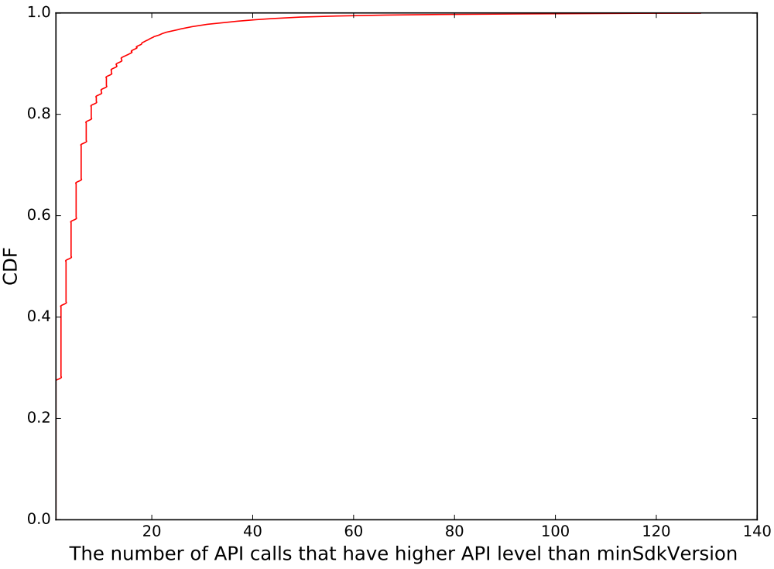
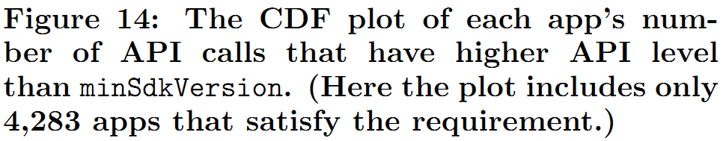
Around 1.8K apps under-set the minSdkVersion value, causing them to crash on lower platforms.
2
1
minLevel > minSdkVersion
1
apiOverNum >=5: 1 – 60% = 40% = 1,750
2
apiOverNum >=10: 1 – 84% = 16% = 692
5
10

Slide 23
Around 400 apps fail to update their targetSdkVersion values, making them potentially exploitable by remote code execution.
909 apps call the addJavascriptInterface() API
Based on all API calls for app codes.
413 apps are potentially vulnerable,
Because their targetSdkVersion < 17 (Android 4.2)
Interestingly, 238 of them do not define the targetSdkVersion attribute (i.e., it is null).

Slide 24
Conclusions and Takeaways
We are the first to systematically measure the declared SDK versions (a modern software mechanism) and their consistency with API calls in Android apps.
Two key findings (out of 23,125 apps we analyzed):
Around 1.8K apps under-set the minimum DSDK versions, causing them to crash on lower platforms;
Over 400 apps under-claim the targeted DSDK versions, making them potentially exploitable on all platforms.
Contact: Daoyuan Wu (dywu.2015@smu.edu.sg)

Slide 25
Backup Slides

Slide 26
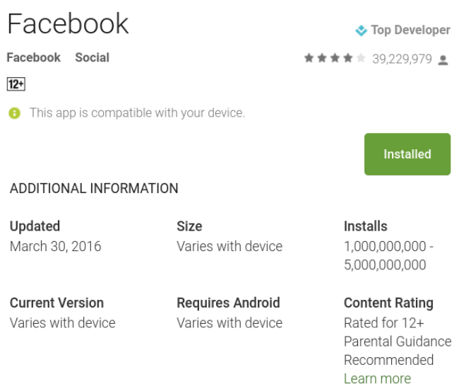

Google Play Analysis
To filter multiple-apk apps (e.g., Facebook)
We wrote python scripts based on Selenium, a web browser automation tool.
Notes:
From google play webpage, we estimate whether this app provides multiple-apk from these three values. We also collect the downloads value of each app.

Slide 27
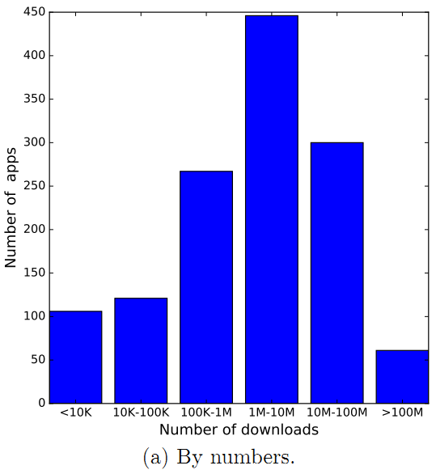
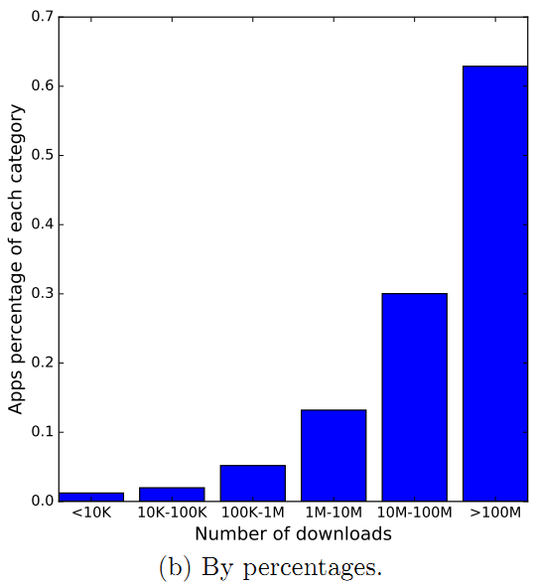
The download distribution of multiple-apk apps
Notes:
This slide lists … We can infer that popular apps are much more likely to publish multiple-apk apps.

Slide 28
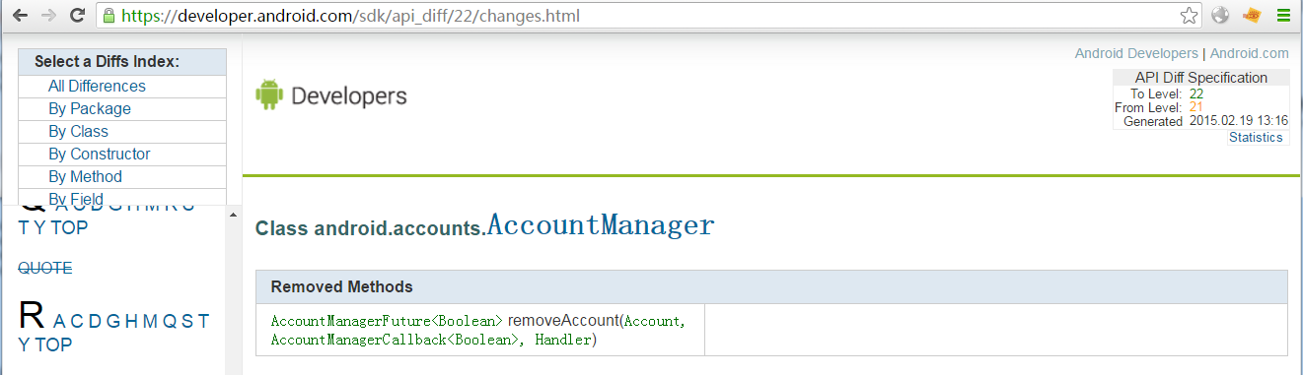
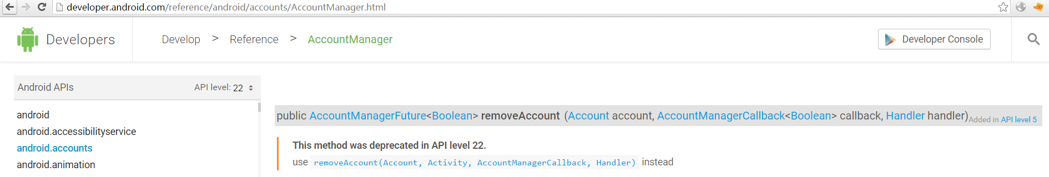
The api_diff is not accurate
One example on a “removed” API:
android/accounts/AccountManager/removeAccount(Account;AccountManagerCallback;Handler)
We will use Soot to build an accurate API-SDK mapping by directly analyzing each SDK jar file.

