Slide 1

CLASSIFICATION OF BLOOD CELL IMAGES
USING DEEP LEARNING
ANNA UNIVERSITY
REGIONAL CAMPUS , COIMBATORE
Guided by
Dr.M.NEWLIN RAJKUMAR M.S.,M.B.A.,Ph.D.,
Assistant Professor,
Department of CSE,
Anna University Regional Campus,
Coimbatore – 641046.
Presented by
D.MAREESWARI LAKSHMI Reg.No: 710019405001,
M.E Computer Science & Engg.,
Anna University Regional Campus,
Coimbatore – 641046.

Slide 2
Blood Cell Classification
The average human adult has more than 5 liters (6 quarts) of blood in his or her body.
Blood carries oxygen and nutrients to living cells and takes away their waste products.
Three kinds of blood cells namely RBC,WBC and platelets adds up to a total 45% of the blood tissue.
Hemoglobin is an iron-containing protein that is present in RBC.
Every second, 2-3 million RBCs are produced in the bone marrow and released into the circulation.

Slide 3
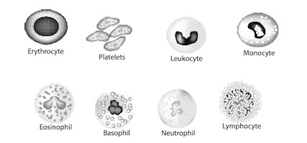
Fig.1 - Components in blood

Slide 4
Importance of Blood Cell Classification
A complete blood count (CBC) gives information about the cells in blood.
Importance of Complete Blood Cell (CBC) are,
To check anemia
To diagonize leukamia
To check other health conditions like fever, weakness.
To check genetic disorders

Slide 5
Traditional Methods
1658 - Jan Swammerdam observed red blood cells under a microscope
1695 - microscopist Antoni van Leeuwenhoek, was the first to draw an illustration of "red corpuscles”.
1842 - Alfred Donné discovered platelets
1843 - Gabriel Andreil discovered leucocytes
1879 - Paul Ehlrich discovered blood cell stain filming technique

Slide 6
Traditional Methods
Manual gating has been performed for measuring CBC.
Further advancements lead to automated gating technique.
In automated the sample is divided into two channels and various reagents are added to analyze different health conditions.
In manual testing we apply romanowsky stain to visualize blood cells clearly.
In both, manual and automated we use microscope to count the blood cells.

Slide 7
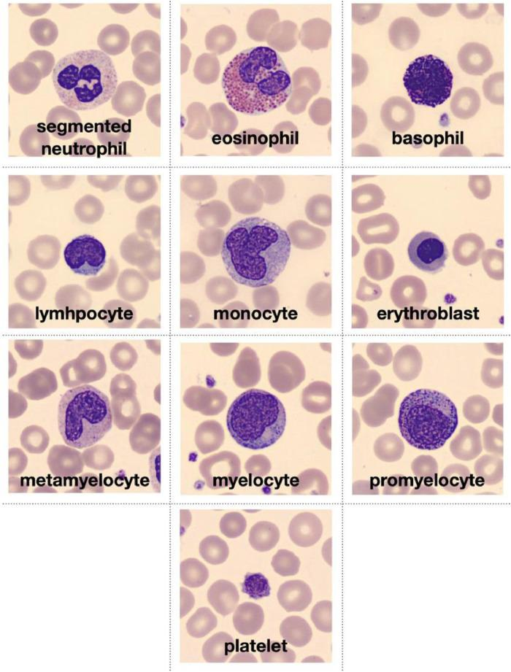

Slide 8
Traditional Method
Blood cell images have been classified by using spatial and spectral information from hyperspectral cubes using Gabor wavelet.
Gabor channel is typically utilized to extricate low-level contextual highlights,, such as edges, corners, bearings, may loses some data.
It is hard to decide, if these subspaces.
This CNN model uses CONV_2D.

Slide 9
Traditional Method
Tomas et.al [1] proposed a convolutional neural network model to detect epileptic seizure effects.
Tomas et al. CNN model had reached a sensitivity and specificity level of 0.68 and 0.67.
Also Tomas et al. concludes that an accurate tool for clinical/hospital usage will not be constructed unless the shift of paradigm occurs.

Slide 10
Traditional Method
Remote sensing image acquisition and processing are used in monitoring and observing our earth.
Traditional methods and algorithms used are not much efficient in processing and computing the hyperspectral images obtained.
Paoletti et al.[2] developed a new CNN model that is a combination of both spatial and spectral features contained in hyperspectral images.
Paoletti et al. faced challenges in “preprocessing” of the images.
By combining the features of both spectral and spatial images Paoletti et al. had reached better classification.

Slide 11
Traditional Method
Hyperspectral images captured by satellite sensors are very rich in spectral information.
Xudong gang et al.[3] proposed Gabor filtering based deep network (GFDN), for hyperspectral images.
features from Gabor and spectral are collected to form these fused features.
To improve the gabor filtering performance, Xudong et al. had used a combination of gabor filters with SAE.
The main challenge faced by Xudong et al. is that training a sample requires more number of samples that are correctly labelled.

Slide 12
Traditional Method
Hyperspectral images (HSIs) is a combination of rich spectral and spatial information.
These images suffer from the problem of over fitting.
Yushi chen et al.[4] proposed a Gabor filtering combined with deep CNN classification framework.
Thus Yushi chan et al. Concludes that thought they faced difficulty in obtaining spatial features from Hyperspectral images.
This method showed better results for limited samples.

Slide 13
Traditional Method
Measuring a food’s safety and quality are based on physical and chemical attributes.
Hui Huang et al. proposed that hyperspectral imaging are good at obtaining internal spectral information of samples.
Hui Huang et al.[5] used identification of key wavelengths in hyperspectral images.
Hui Huang et al. Proposed method achieved greater potential in detecting safety and quality.

Slide 14
Challenges of Blood Cell Classification
May produce inaccurate results,
Another antibody-mediated condition that can affect complete blood count results is red blood cell agglutination,
Takes more number of trials.
Gabor channel is typically utilized to extricate low-level contextual highlights,, such as edges, corners, bearings, may loses some data.
Collecting samples is a difficult task.

Slide 15
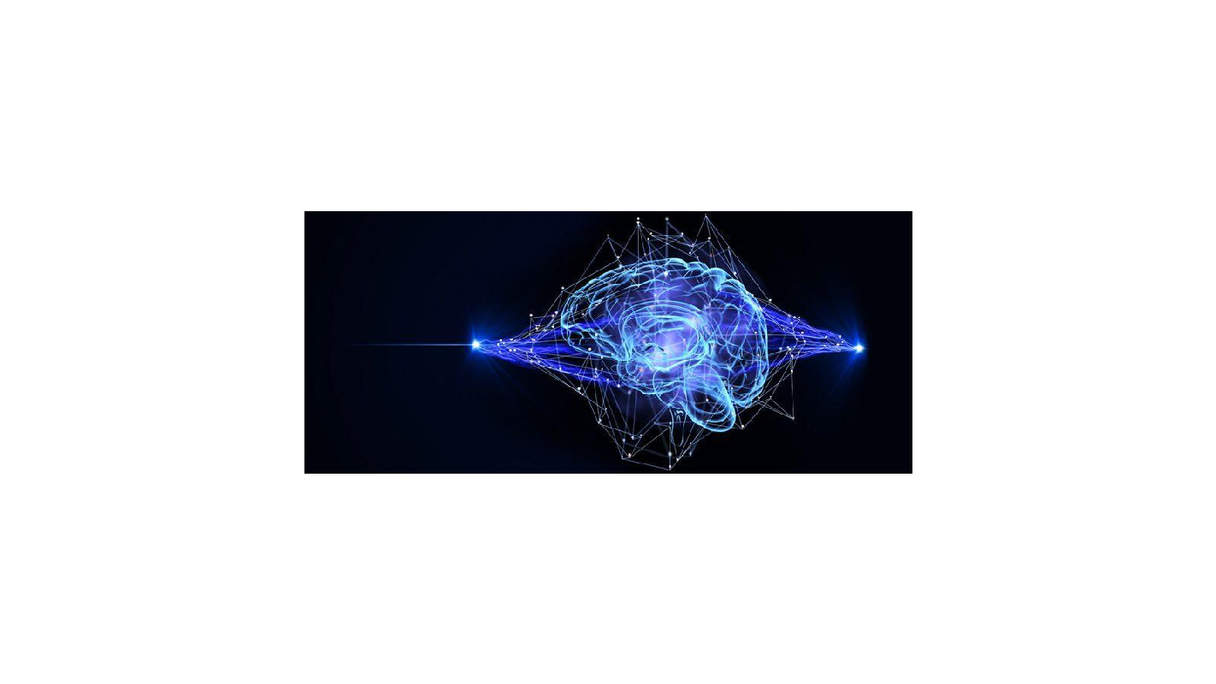
Neural network

Slide 16
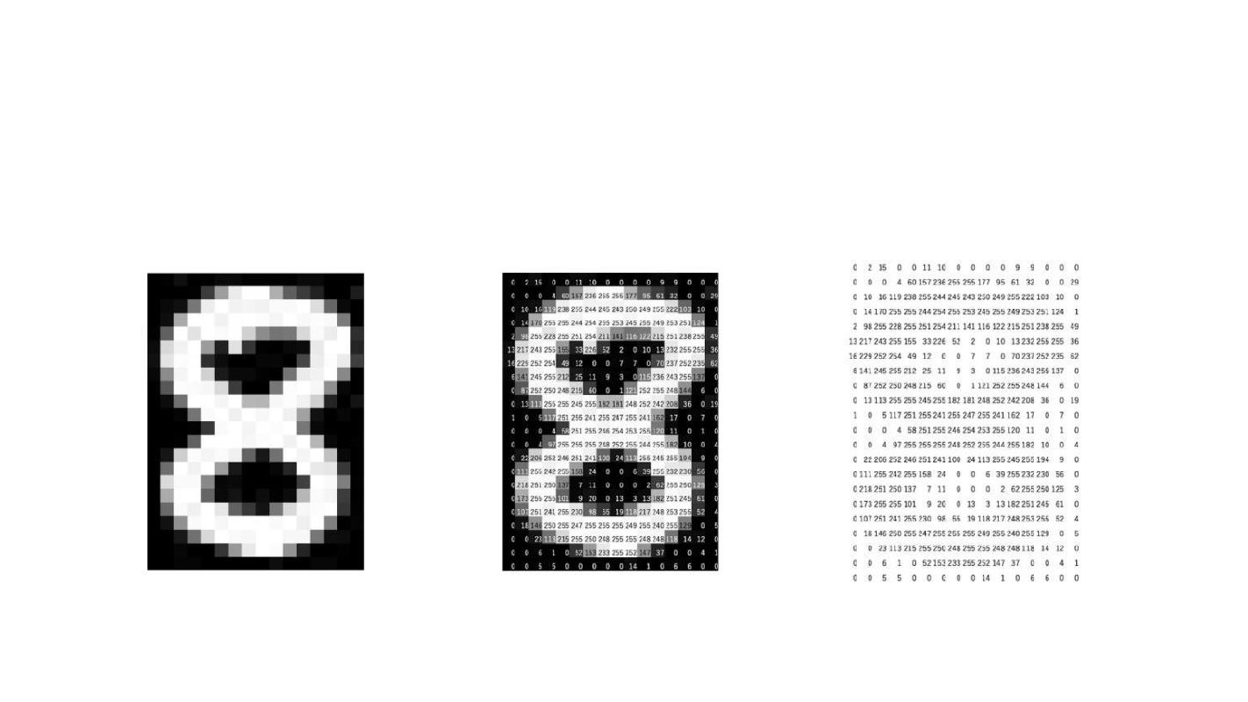
Pixel rep

Slide 17
Convolution

Slide 18
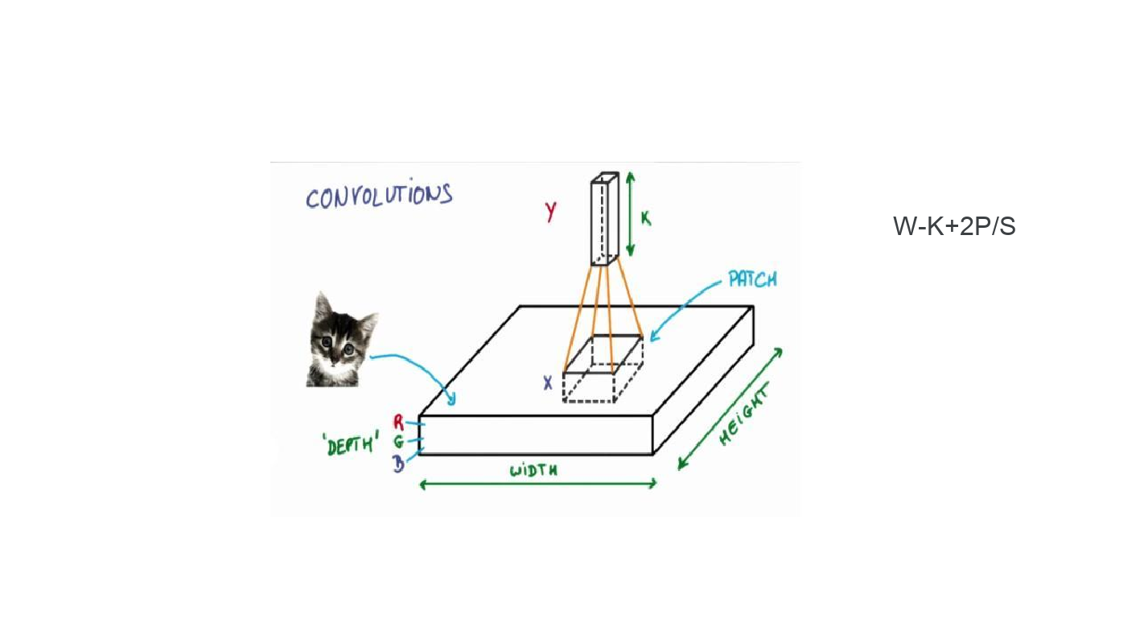
Convolutions – contd.

Slide 19
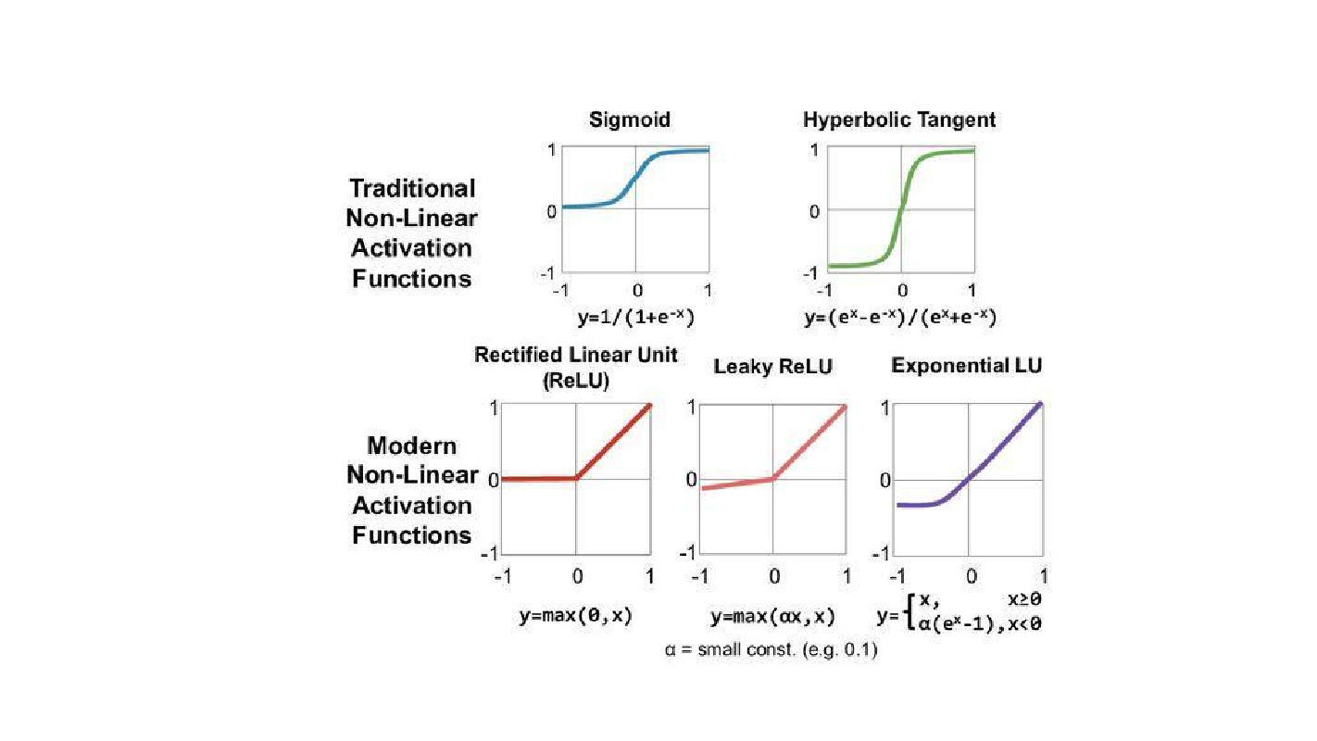
Activations

Slide 20
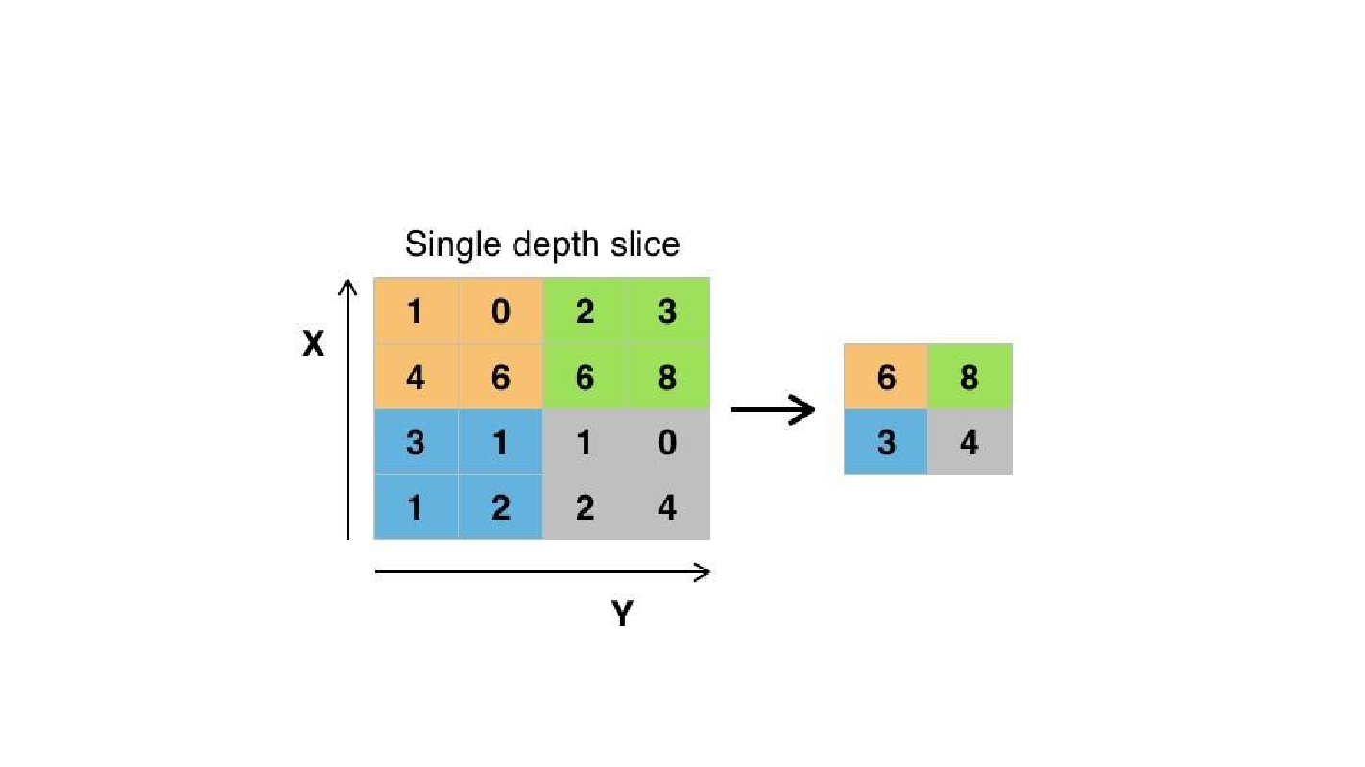
Maxpooling

Slide 21
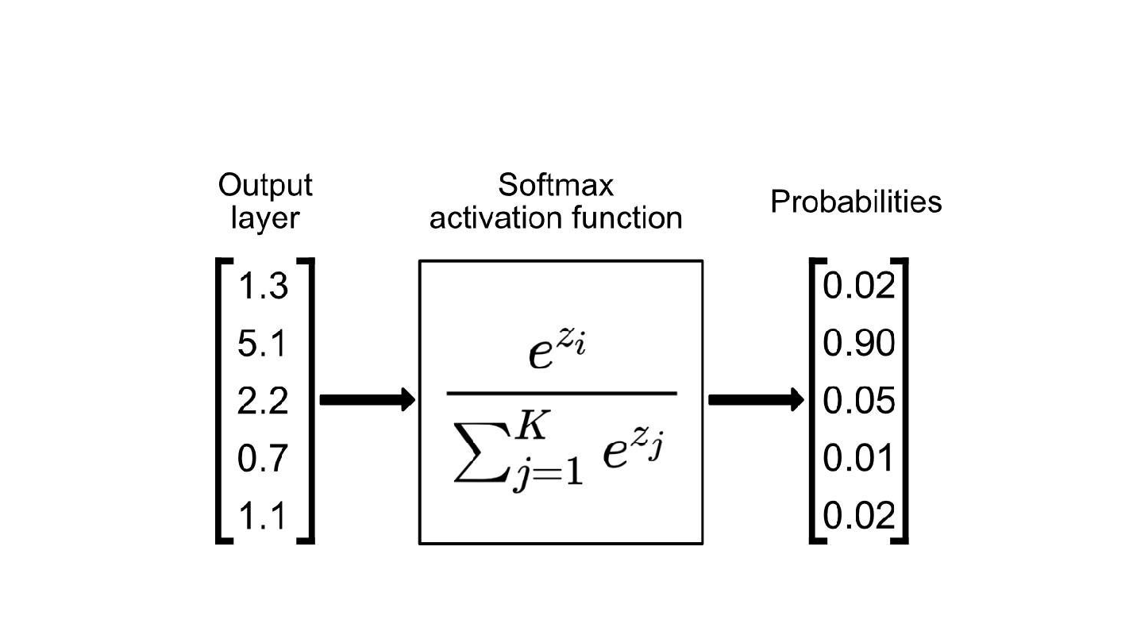
Softmax

Slide 22
Proposed System
In order to explore various methods and to overcome the challenges in blood cell classification, following CNN model is proposed.
In this proposed work features are extracted with the help of Morlet Wavelets.
These initial cnn modulated kernels are fed as input to our second convolutional layer followed by batch normalization and relu.
Max pooling is performed on this obtained final modulated cnn kernels, followed by a softmax layer providing us the output with classification labels.
The Morlet wavelet change technique introduced offers a natural extension among recurrence and time.

Slide 23
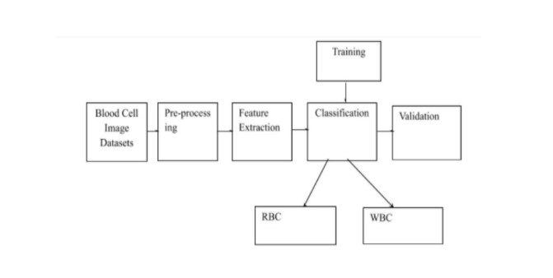
Flowchart

Slide 24
Dataset
Blood cell Image Dataset used in this project has been acquired from kaggle.
Images are of size 640 x 480
This dataset consists of 384 images
Digital images of normal peripheral blood cells were obtained from samples in this following manner,
blood smears collected from patients without any infections,
Initially, Autoanalyzer Advia 2120 instrument is used to obtain a general cell count.
Then stained using May Grünwald-Giemsa in the autostainer Sysmex SP1000i.
resulting stained smear goes through the CellaVision DM96 .

Slide 25
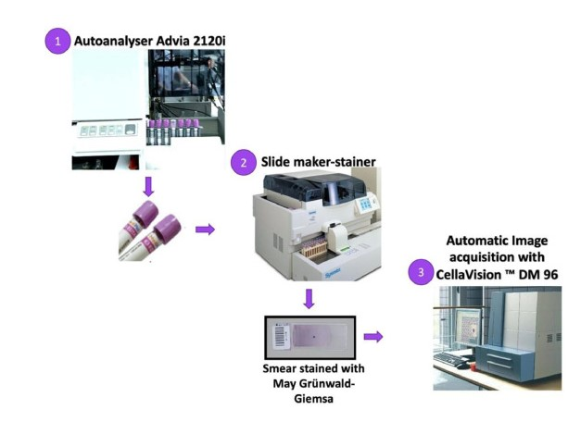

Slide 26
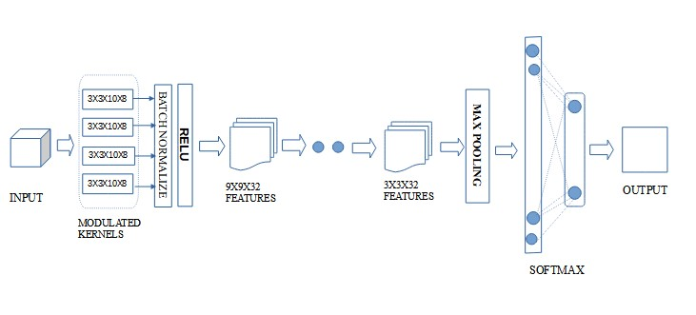
Architectural Diagram

Slide 27
Implementation
Programming Language - Python
Libraries used
Keras
Tensorflow
fastai
System Configuration
GPU - preferably CUDA
Colab

Slide 28
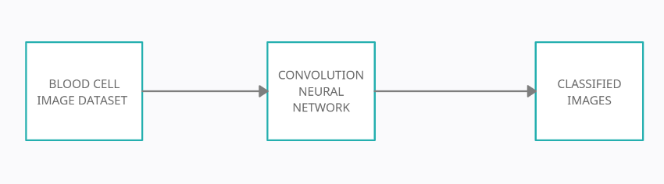
DFD LEVEL - 0

Slide 29
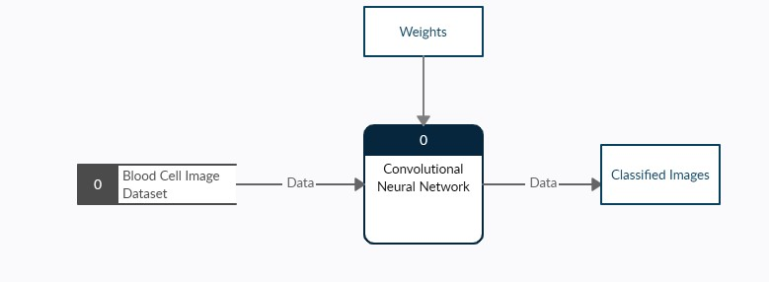
DFD LEVEL -1

Slide 30
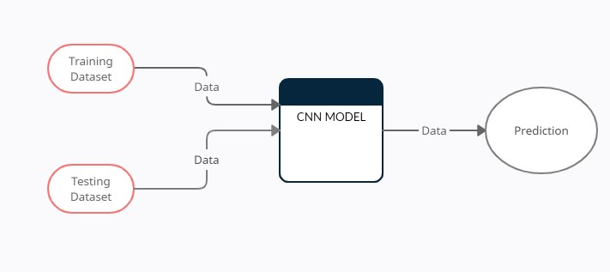
DFD LEVEL -2

Slide 31
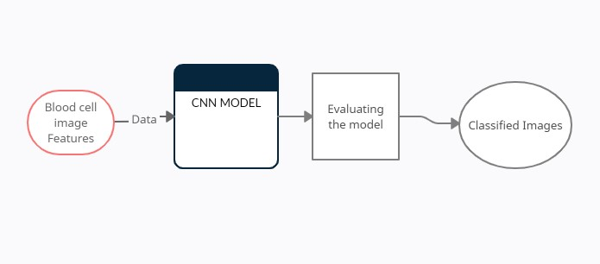
DFD LEVEL -3

Slide 32
Works Completed in Phase - I
For phase - 1 Data collection and preprocessing has been completed.
In order to improve the GPU efficiency we are using “COLAB” offered by Google
The main difficulty that we faced is to make our dataset to get iterated
Fastai have been used for the iteration method.

Slide 33
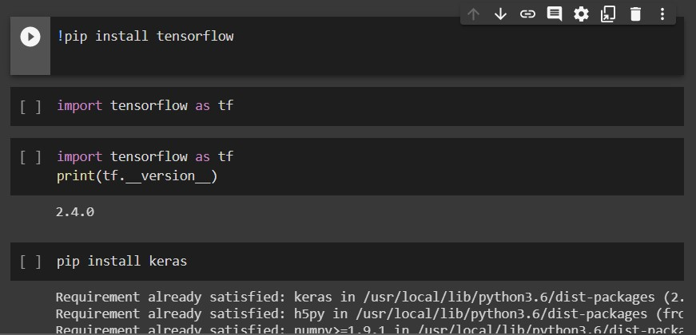
Installing Libraries

Slide 34
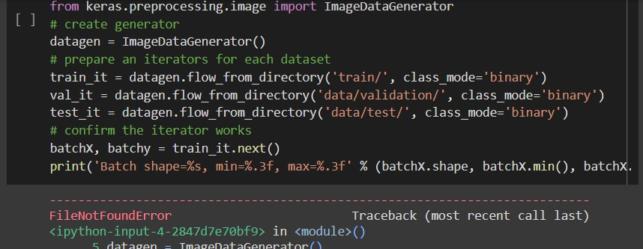
ImageDataGenerator

Slide 35
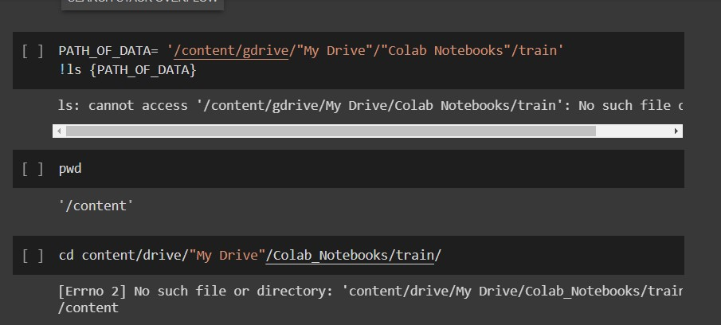
Mounting Google Drive

Slide 36
Works Completed in Phase2
Features are extracted using hidden layers, in convolution process features are extracted by using morlet wavelets function.
These features are given as input to RELU
Relu is used as an activation function.
Then maxpooling is performed, followed by softmax.

Slide 37

Kaggle API Key

Slide 38
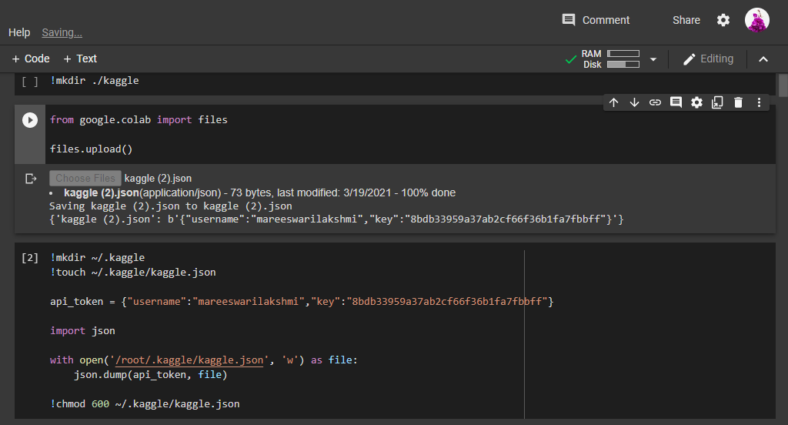
API KEY - COLAB

Slide 39
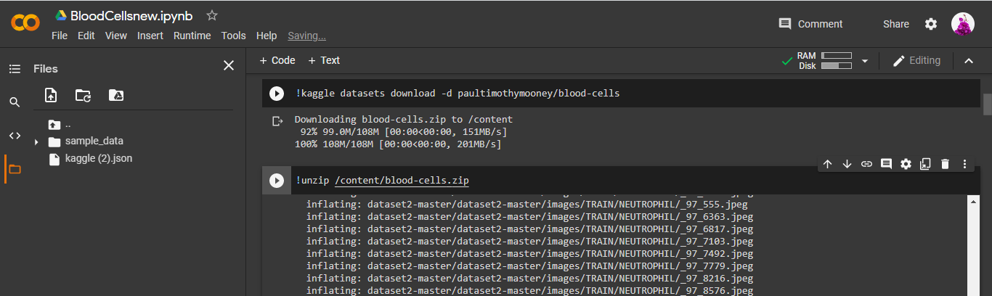
Unzipping Dataset

Slide 40
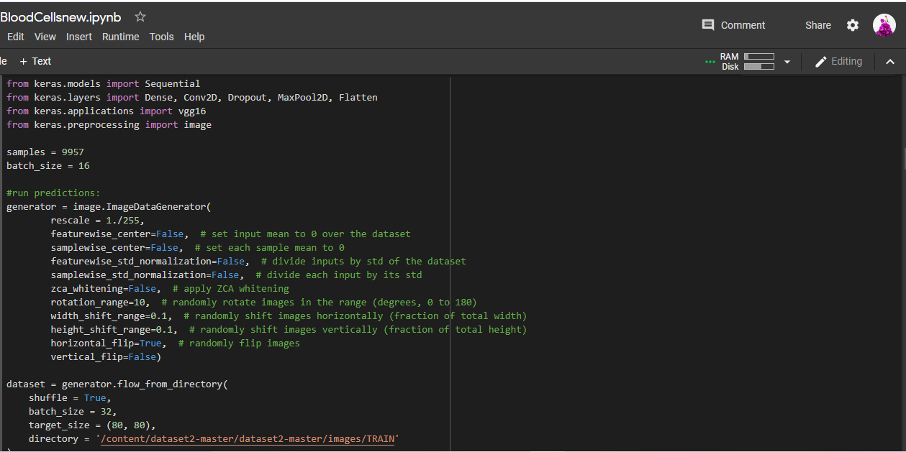
ImageDataGenerator

Slide 41
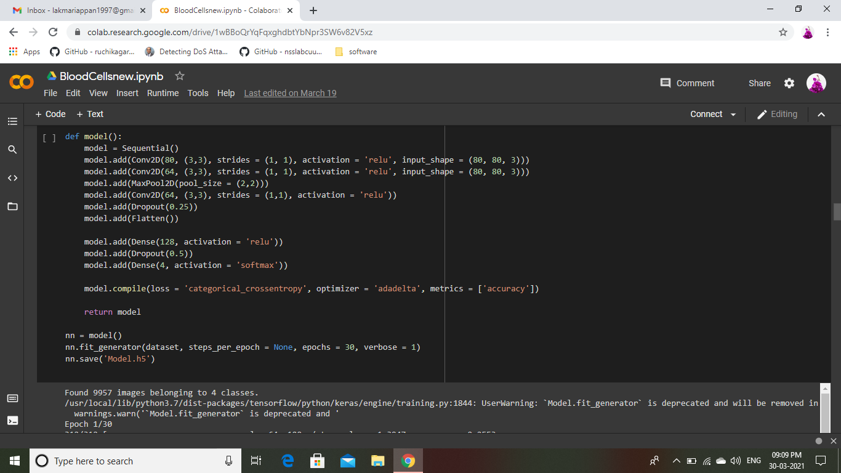
Model

Slide 42
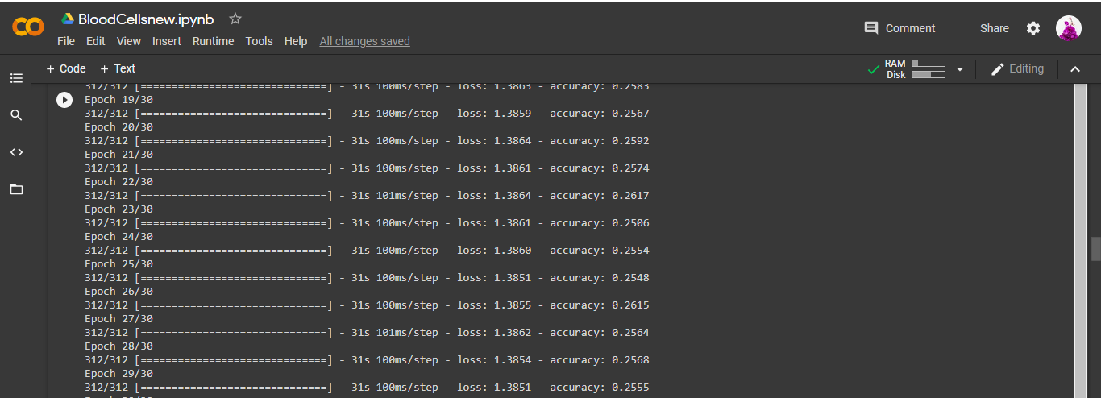
Training the Model

Slide 43
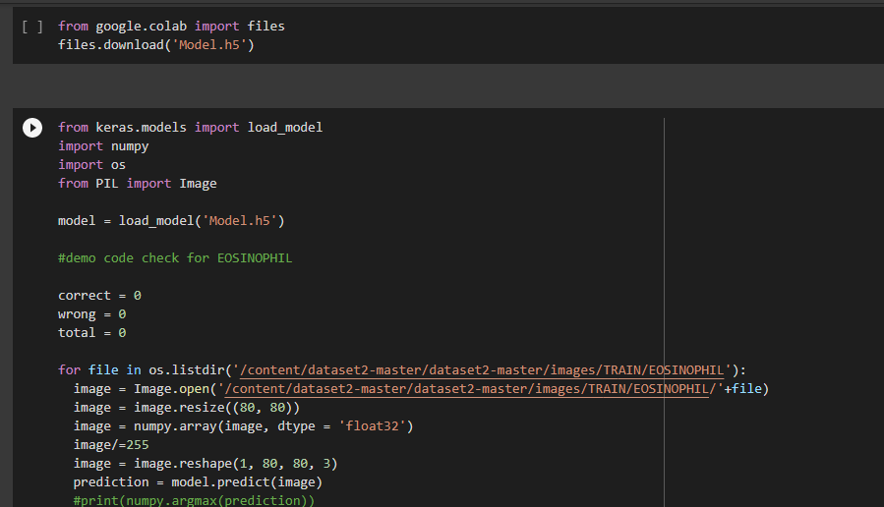
Model.h5

Slide 44
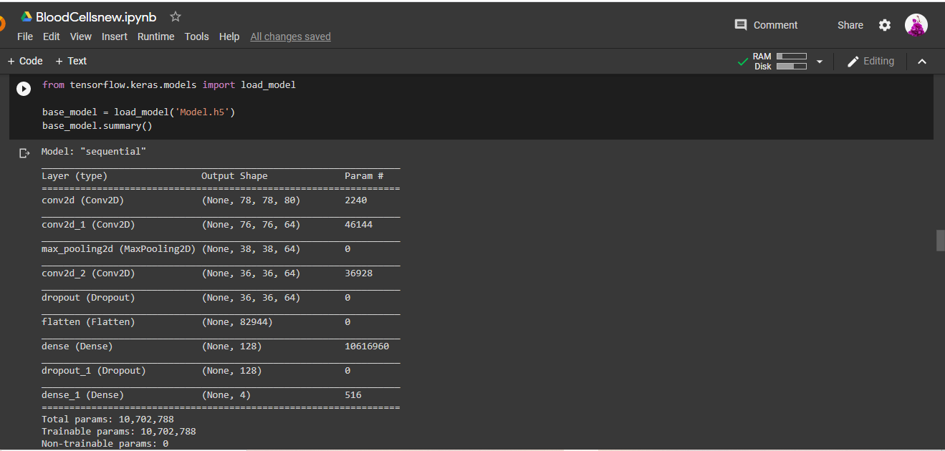
Model - Summary

Slide 45
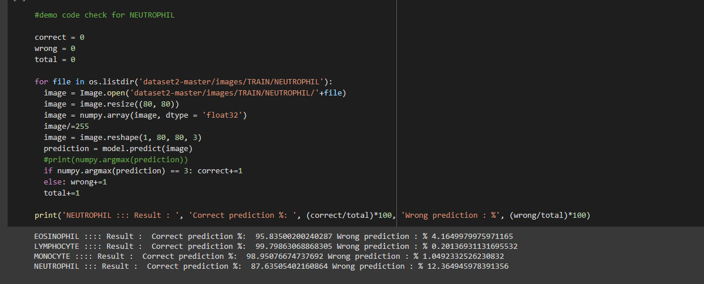
Result

Slide 46
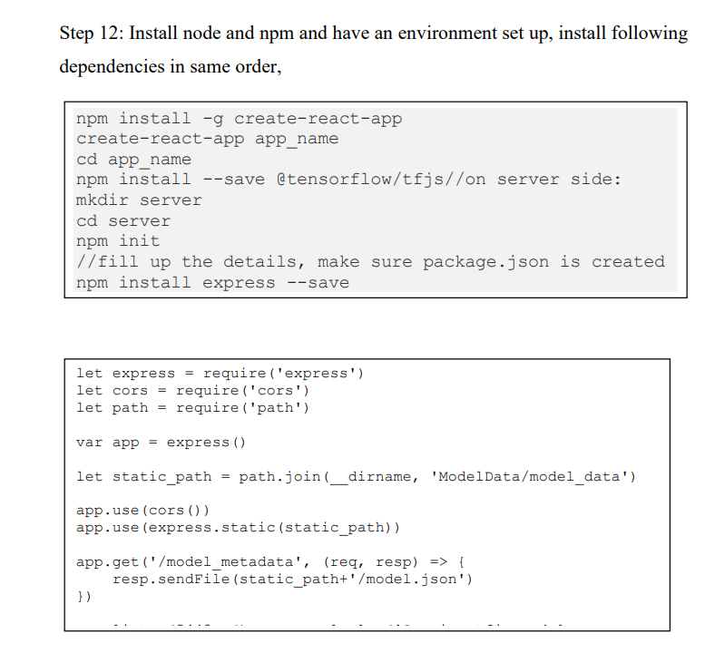
Create-react-app

Slide 47
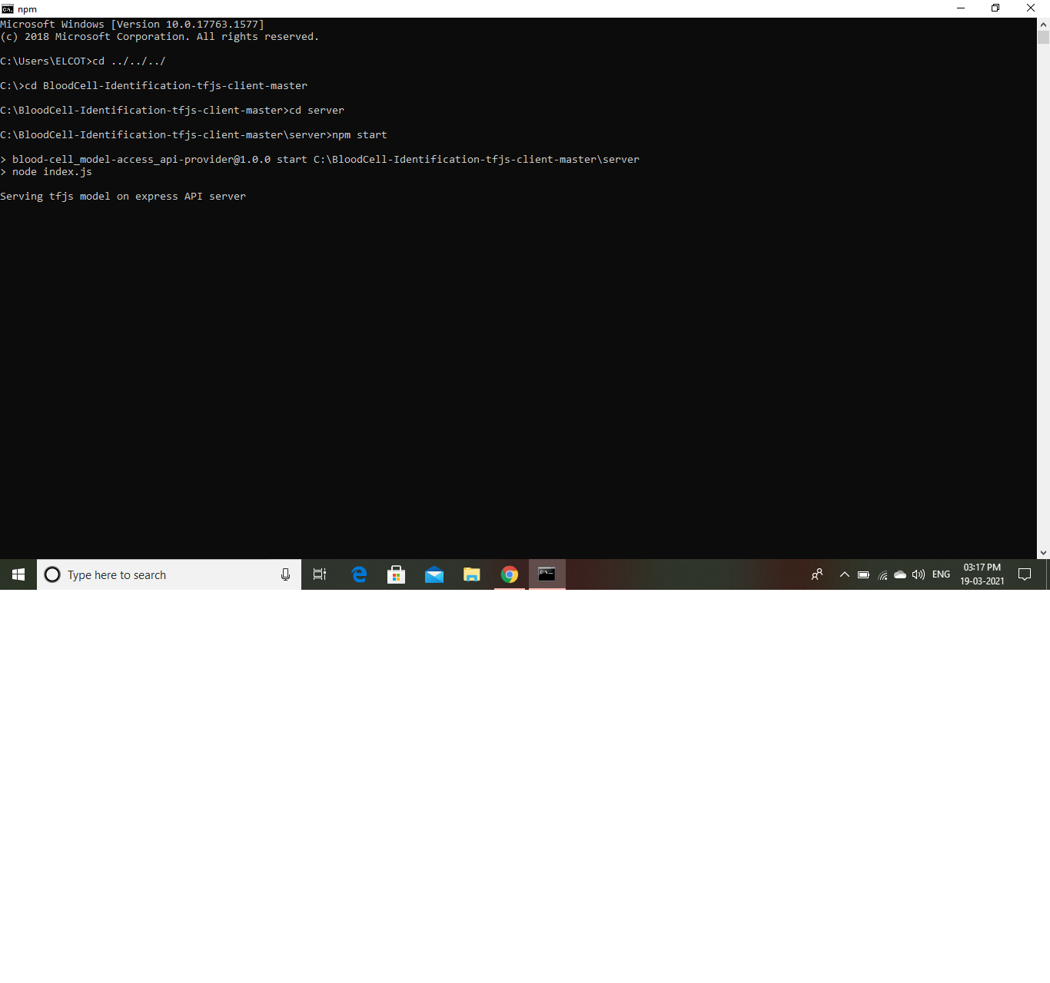
Server start

Slide 48

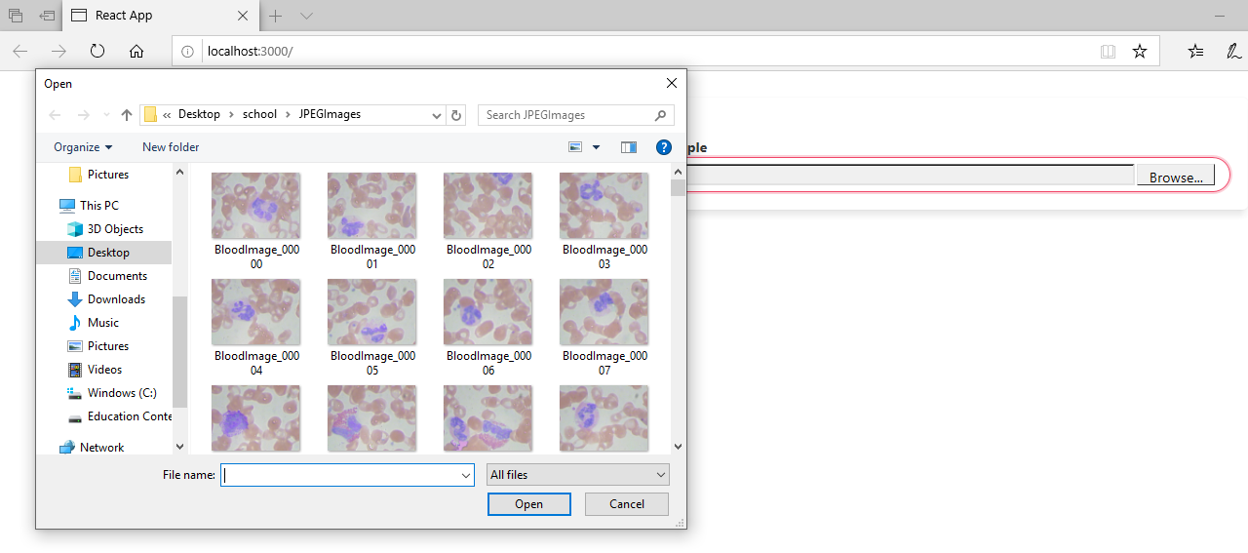
App window

Slide 49
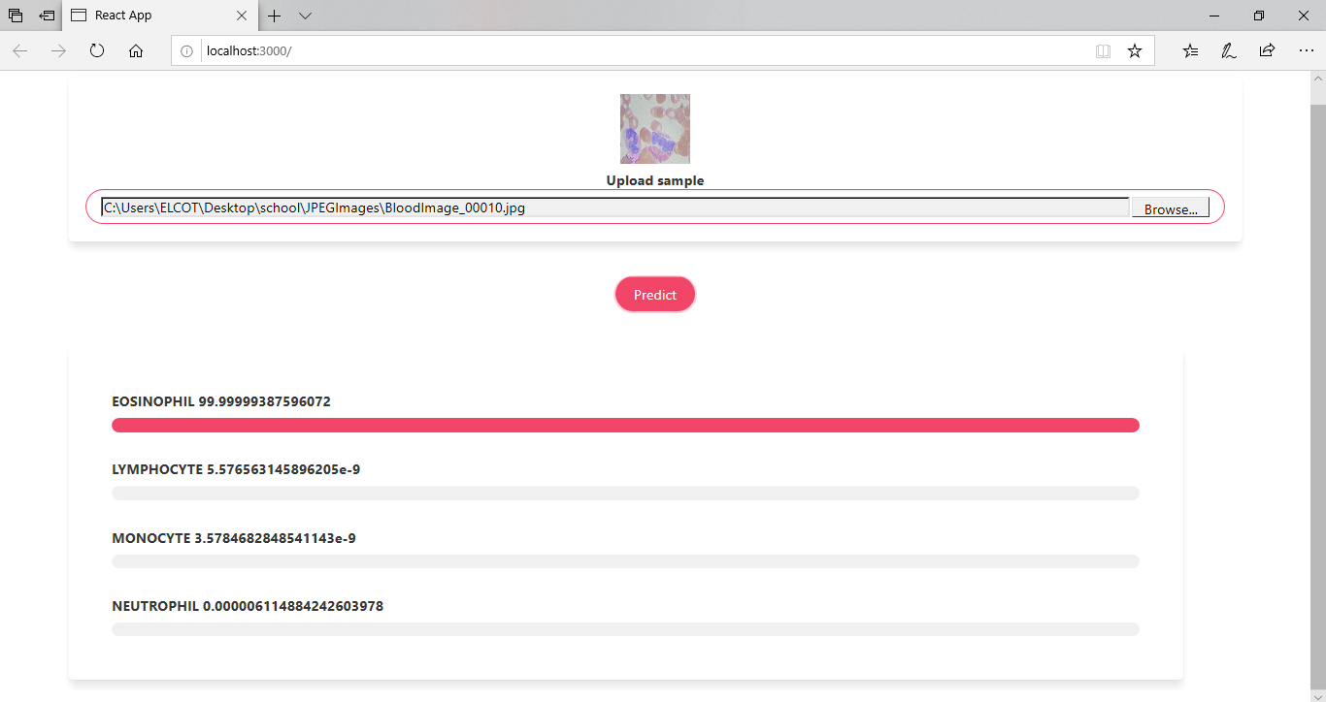
Prediction

Slide 50
Evaluating the Model
The model that we have trained and used for prediction has an accuracy of 93%.
This model has been very good at finding the clear images.

Slide 51
FUTURE WORK
We have implemented blood cell image classification using convolutional neural networks. CNN doesn't encode the position and direction of the item into their expectations.
To overcome these disadvantages we are trying to extend the work on Capsule Neural Network.

Slide 52
REFERENCE
1. Iešmantas,Tomas,and Robertas Alzbutas. ‘Convolutional neural network for detection and classification of seizures in clinical data’, Medical & Biological Engineering & Computing(2020): 1-14.
2. Paoletti M.E., Haut J.M., Plaza J. and Plaza A. ‘A new deep convolutional neural network for fast hyperspectral image classification’, ISPRS journal of photogrammetry and remote sensing 145 (2018): 120-147.
3. Kang, Xudong, Chengchao Li, Shutao Li, and Hui Lin. ‘Classification of hyperspectral images by Gabor filtering based deep network.’ IEEE Journal of Selected Topics in Applied Earth Observations and Remote Sensing 11, no. 4 (2017): 1166-1178.

Slide 53
4. Chen, Yushi, Lin Zhu, Pedram Ghamisi, Xiuping Jia, Guoyu Li, and Liang Tang. ‘Hyperspectral images classification with Gabor filtering and convolutional neural network’, IEEE Geoscience and Remote Sensing Letters 14, no. 12 (2017): 2355-2359.
5. Huang, Hui, Li Liu and Michael Ngadi O. ‘Recent developments in hyperspectral imaging for assessment of food quality and safety.’ Sensors 14, no. 4 (2014): 7248-7276.
6. Yang Y., Yan L.F., Zhang X., Han Y., Nan H.Y., Hu Y.C., ‘Glioma grading on conventional MR images: a deep learning study with transfer learning’, Frontiers Neuroscience.2018 vol 12.

Slide 54
7. Talo M., Baloglu U.B., Acharya U.R., ‘Application of deep transfer learning for automated brain abnormality classification using MR images’, Cognitive Systems Research. 54.
8. Rajasekaran K.A., and Chellamuthu C., ‘Advanced Brain Tumour Segmentation from MRI Images’, Chapter in High-Resolution Neuroimaging, Intech open Publications.2018 https://doi.org/10.5772/intechopen.71416.
9. Gu Y., Lu X., Yang L., Zhang B., Yu D., Zhao Y., Thou T., ‘Automatic lung nodule detection using a 3D deep convolutional neural network combined with a multi-scale prediction strategy in chest CI's’, Computers in Biology and Medicine. 2018 Vol 103, pp.220-231.

Slide 55
10. Yousefi M., Krzysiak A., Suen C.Y., ‘Mass detection in digital breast tomosynthesis data using convolutional neural networks and multiple instance learning’, Computers in Biology and Medicine.2018 vol. 96 pp.283-293.
11. Nyoman Abiwinanda, Muhammad Hanif, Tafwida Hesaputra S., Astri Handayani, and Tati Rajab Mengko, ‘Brain Tumor Classification Using Convolutional Neural Network’, Lhotska et al. (eds.), World Congress on Medical Physics and Biomedical Engineering 2018, IFMBE Proceedings. Vol 103, pp.220-231.
12. Sunanda Das, Riaz Rahman Aranya O.F.M., Nishat Nayla Labiba, ‘Brain Tumor Classification Using Convolutional Neural Network’, 1st International Conference on Advances in Science, Engineering and Robotics Technology 2019 (ICASERT 2019).

Slide 56
13. Amin J., Sharif M. and Gul N., Yasmin M. and Shad S.A., ‘Brain tumor classification based on DWT fusion of MRI sequences using Convolutional neural network’, Pattern Recognition Letters, 2020 Vol.no. 129, pp. 115-122.
14. Ucuzal H., YAŞAR S. and Çolak C., ‘Classification of brain tumor types by deep learning with convolutional neural network on magnetic resonance images using a developed web-based interface’, 3rd International Symposium on Multidisciplinary Studies and Innovative Technologies (ISMSIT), Ankara, Turkey, 2019, pp. 1-5, doi: 10.1109/ISMSIT.2019.8932761.
15. Ari A., Hanbay D., ‘Deep learning based brain tumor classification and detection system’, Turkish Journal of Electrical Engineering and Computer Sciences, 2018 Vol. 26, pp.2275–2286.

Slide 57
16. Seetha J., Raja S., ‘Brain tumor classification using Convolutional neural Networks’, Biomedical and Pharmacology Journal, 2018 vol.11, no.3, pp. 1457-1461.
17. Fatih Özyurt, Eser Sert, Engin Avci, Esin Dogantekin. ‘Brain tumor detection based on Convolutional Neural Network with neutrosophic expert maximum’, pp.106830(1-8).https://doi.org/10.1016/j.measurement.2019.07.058
18. Ali Mohammad Alqudah, Hiam Al Quran, Isam Abu Qasmieh, Amin Alqudah,Wafaa Al-Sharu,. ‘Brain Tumor Classification Using Deep Learning Technique – A Comparison between Cropped, Uncropped, and Segmented Lesion Images with Different Sizes’, International Journal of Advanced Trends in Computer Science and Engineering, 2019 Vol.8,no.6, pp.3684-3691.

Slide 58
Webinars attended so far

Slide 59
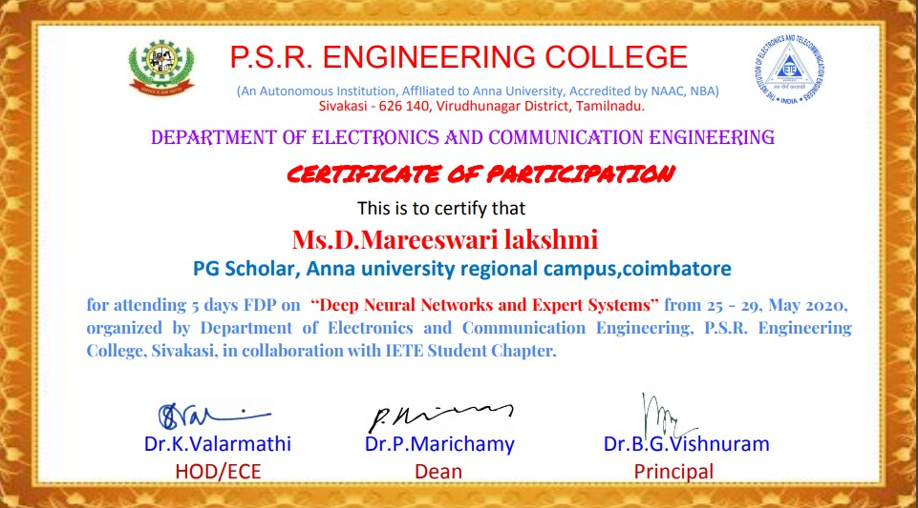
FDP on Deep Neural Networks and Expert Systems

Slide 60
THANK YOU

