Slide 1
Cardiff Metropolitan University
Smart Campus
Management System
SCMS – A Java-Based Software Prototype
Module: CMP7001 Advanced Programming
⬛ VS Code
☕ JDK 21
▶ Video Link: [https://drive.google.com/drive/u/1/folders/1wSv0TPZgTMRe_c3nLs5cSfhLfat-qD_R] ▶ One Drive Link - [ST20162800_CMP7001_PRES1]

Slide 2
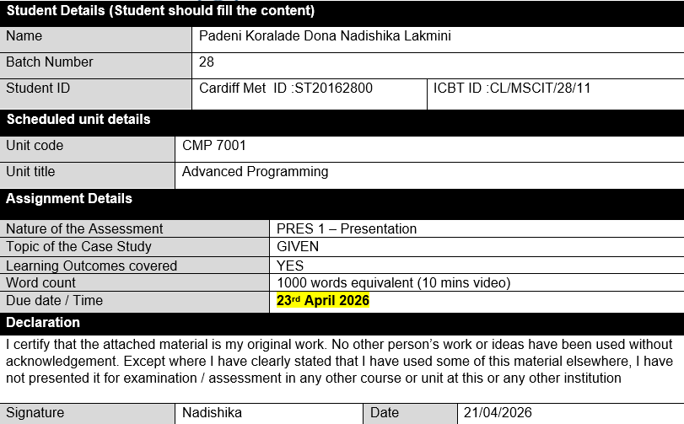
Student Details
2 / 16
CMP7001 Advanced Programming | Cardiff Metropolitan University | PRES1

Slide 3
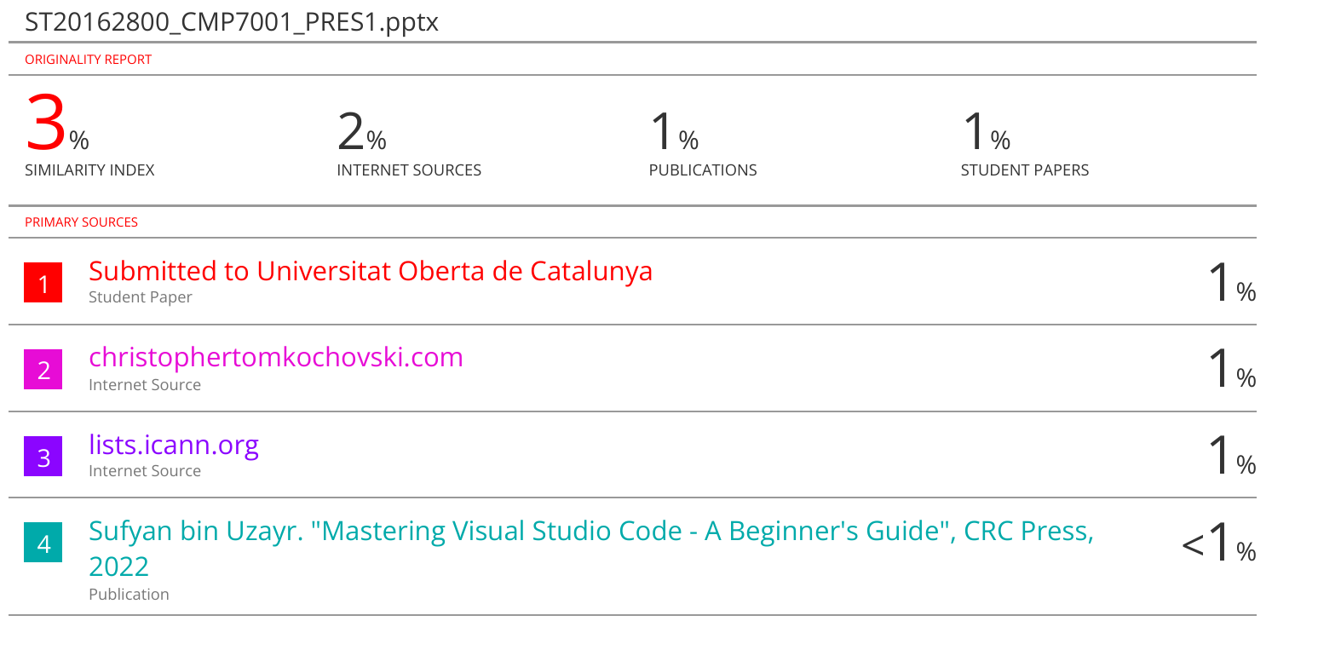
Turniting Current View
2 / 16
CMP7001 Advanced Programming | Cardiff Metropolitan University | PRES1

Slide 4
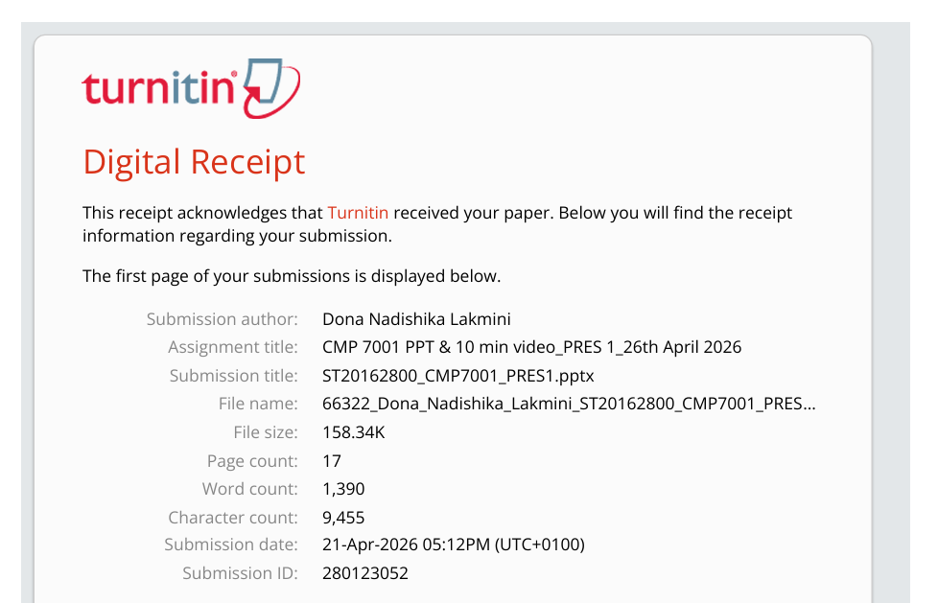
Turnitin Digital Receipt
2 / 16
CMP7001 Advanced Programming | Cardiff Metropolitan University | PRES1

Slide 5
Presentation Agenda
2 / 16
01
Introduction & Project Overview
05
Design Patterns Implemented
02
Development Environment
06
Exception Handling Strategy
03
Class Diagram Overview
07
Test Results & Analysis
04
Polymorphism in SCMS
08
Reflection & Lessons Learned
CMP7001 Advanced Programming | Cardiff Metropolitan University | PRES1

Slide 6
Introduction & Project Overview
3 / 16
What is SCMS?
25
4
A Java-based software prototype for Cardiff Metropolitan University. The system unifies room booking, maintenance request tracking, and campus-wide notifications into a single modular platform — demonstrating OOP, design patterns, and robust exception handling.
Java Classes
Design Patterns
15
3
Unit Tests
User Roles
👤 Administrator
🏫 Staff Member
🎓 Student
Manage rooms, users, maintenance & analytics
Book rooms, report maintenance, notifications
View rooms, request bookings, announcements
CMP7001 Advanced Programming | Cardiff Metropolitan University | PRES1

Slide 7
Development Environment – VS Code + JDK 21
4 / 16
⬛ Visual Studio Code
☕ JDK 21 (Adoptium Temurin)
Extension Pack for Java
Installed from VS Code marketplace — provides:
• Language Support for Java
• Debugger for Java
• Java Test Runner
• Maven for Java
Run shortcut: Click ▶ Run above main()
Test shortcut: Click ▶ Run above TestRunner.main()
Eclipse Temurin JDK 21 LTS
Downloaded from adoptium.net
Why JDK 21?
• LTS (Long Term Support) release
• Switch expressions (used in RoomFactory)
• Text blocks (used in ConsoleUI menus)
• Record types for test fixtures
Verify installation:
java -version → openjdk 21
Setup: Install JDK 21 → Install VS Code → Install Extension Pack for Java → Open SCMS_Project folder → Click ▶ Run on Main.java
CMP7001 Advanced Programming | Cardiff Metropolitan University | PRES1

Slide 8
Class Diagram Overview
5 / 16
UI Layer
ConsoleUI
Facade Layer
CampusFacade ← Facade Pattern
Service Layer
UserService | RoomService | BookingService | MaintenanceService
Pattern Layer
NotificationService (Singleton+Observer) | RoomFactory (Factory)
Model Layer
User | Admin | Staff | Student | Room | Booking | MaintenanceRequest | Notification
Exception Layer
RoomAlreadyBookedException | UnauthorizedActionException | DuplicateEntityException | EntityNotFoundException
Key: User △── Admin/Staff/Student (Inheritance) | CampusFacade──>Services (Composition) | ConsoleUI implements NotificationObserver (Interface)
CMP7001 Advanced Programming | Cardiff Metropolitan University | PRES1

Slide 9
Polymorphism in SCMS
6 / 16
Two forms of polymorphism applied throughout the system
① Inheritance Polymorphism
② Interface Polymorphism
Abstract class User declares:
getPermissionSummary() [abstract]
Admin → "Manage rooms, users..."
Staff → "Book rooms, report issues..."
Student → "View rooms, request bookings..."
CampusFacade accepts a User reference at runtime — correct subtype resolved automatically. Implemented in VS Code, compiled with JDK 21 switch expressions.
Interface NotificationObserver:
onNotification(Notification n)
ConsoleUI implements this interface.
NotificationService holds:
List<NotificationObserver>
Services call notify() — ConsoleUI.onNotification() dispatched at runtime. Neither service knows about ConsoleUI directly.
CMP7001 Advanced Programming | Cardiff Metropolitan University | PRES1

Slide 10
Design Patterns Implemented
7 / 16
One pattern from each GoF category
CREATIONAL › Singleton
CREATIONAL › Factory Method
NotificationService
RoomFactory
Guarantees one shared notification hub. Multiple instances would break the observer registry and split the inbox.
Creates Rooms pre-configured with the correct equipment per type (LECTURE_HALL, COMPUTER_LAB, etc.).
STRUCTURAL › Facade
BEHAVIOURAL › Observer
CampusFacade
NotificationObserver + NotificationService
Single API to 4 subsystems. The UI only calls CampusFacade. Role-based access enforced in requireAdmin().
Decouples notification producers (services) from consumers (ConsoleUI). Services call notify() blindly.
CMP7001 Advanced Programming | Cardiff Metropolitan University | PRES1

Slide 11
Design Patterns – Code Walk-Through
8 / 16
Singleton – NotificationService.getInstance()
Facade – requireAdmin() guard
private static NotificationService instance;
public static NotificationService getInstance() {
if (instance == null)
instance = new NotificationService();
return instance;
}
private void requireAdmin(User caller)
throws UnauthorizedActionException {
if (caller.getRole() != UserRole.ADMIN)
throw new UnauthorizedActionException(...);
}
Observer – notify() dispatches to registered observers
Factory – JDK 21 switch expression
public Notification notify(String userId, String msg) {
Notification n = new Notification(userId, msg);
inbox.get(userId).add(n);
observers.get(userId).forEach(o -> o.onNotification(n));
return n;
}
public static Room create(RoomType type,
String id, String name, int cap) {
return switch(type) { // JDK 21
case LECTURE_HALL -> new Room(id, name,
cap, List.of("Projector",...));
};
}
💡 In VS Code: open each class → the ▶ Run button appears above main(). Use Explorer panel to navigate packages.
CMP7001 Advanced Programming | Cardiff Metropolitan University | PRES1

Slide 12
Exception Handling Strategy
9 / 16
4 Custom Checked Exception Classes — targeted, meaningful error handling
RoomAlreadyBookedException
Trigger: New booking overlaps existing CONFIRMED booking for same room/time | Example: Book R101 09:00-11:00 when 10:00-12:00 already exists
UnauthorizedActionException
Trigger: Non-admin user attempts admin-only operation | Example: Student calls facade.addRoom() — fixed in ConsoleUI.java
DuplicateEntityException
Trigger: Room ID or user email already registered in the system | Example: Admin adds Room 'R101' when R101 already exists
EntityNotFoundException
Trigger: Referenced entity (room/booking/user/request) does not exist | Example: Booking with unknown Room ID 'R999'
✔ Bug fixed: ConsoleUI adminAddRoom() signature corrected — DuplicateEntityException now handled internally ✔ IllegalArgumentException for invalid time windows
CMP7001 Advanced Programming | Cardiff Metropolitan University | PRES1

Slide 13
Test Results Overview – 15 Test Cases
10 / 16
ID | Test Name | Scope | Result
TC01 | Successful room booking | Booking | PASS
TC02 | Double-booking prevention | Booking | PASS
TC03 | Non-overlapping bookings succeed | Booking | PASS
TC04 | Owner cancels own booking | Booking | PASS
TC05 | Booking deactivated room rejected | Exception | PASS
TC06 | Maintenance lifecycle PENDING→DONE | Maintenance | PASS
TC07 | Booking confirmation notification | Notification | PASS
TC08 | Maintenance assignment notification | Notification | PASS
TC09 | Student adds room (intentional fail) | Exception | FAIL*
TC10 | Duplicate Room ID rejected | Exception | PASS
TC11 | Invalid login rejected | Auth | PASS
TC12 | Non-owner cancel rejected | Exception | PASS
TC13 | Admin cancels any booking | Booking | PASS
TC14 | RoomFactory equipment check | Factory | PASS
TC15 | Invalid time window rejected | Exception | PASS
* TC09 intentionally fails — proves UnauthorizedActionException guard works. Run: java -cp out scms.test.TestRunner
CMP7001 Advanced Programming | Cardiff Metropolitan University | PRES1

Slide 14
Test Analysis & Error Discussion
11 / 16
TC09 analysis: assertDoesNotThrow() was intentionally called on facade.addRoom(student,...). The Facade's requireAdmin() always throws UnauthorizedActionException for non-admin users — so the test fails, proving the security guard works. This technique tests negative behaviour.
CMP7001 Advanced Programming | Cardiff Metropolitan University | PRES1

Slide 15
Bug Fix, Limitations & Future Improvements
12 / 16
🔴 Bug Fixed
⚠ Known Limitations
🔧 Future Improvements
ConsoleUI.adminAddRoom() declared
'throws DuplicateEntityException'
but caller catch block didn't
catch it → compile error in VS Code
Fix: Removed from method signature
since it was already caught
internally with try/catch.
Lesson: Java forces all checked
exceptions to be handled — VS Code
and JDK 21 surface these clearly.
Data is in-memory only
— no persistence between runs
Console UI only
— no graphical interface
No recurring booking support
(optional feature not built)
Singleton not thread-safe
(single-threaded application)
No input validation middleware
beyond exception throwing
Add CSV/database persistence
JavaFX GUI using VS Code
JavaFX extension
Recurring bookings
with Strategy pattern
Command pattern for
undo/redo of bookings
Thread-safe Singleton
using enum pattern
CMP7001 Advanced Programming | Cardiff Metropolitan University | PRES1

Slide 16
Reflection – OOP Techniques & Lessons Learned
14 / 16
What I Learned
What I Found Challenging
Design Patterns
Applying GoF patterns in a real system made their value clear — the Facade dramatically simplified the UI layer and centralised access control.
Observer Pattern
Seeing notifications fire automatically when a booking was confirmed — without the booking code knowing about the UI — made the concept click.
JDK 21 Features
Using switch expressions in RoomFactory and text blocks in ConsoleUI showed how modern Java features improve readability and reduce boilerplate.
Exception Hierarchy
Designing custom exceptions taught how meaningful error messages improve debugging and user experience — and VS Code's compiler surfaced the missing handler immediately.
Singleton Thread Safety
Understanding why a null-check Singleton is not thread-safe was challenging. Enum-based or double-checked locking patterns would be needed in production.
Test Design
Writing TC09 as an intentional failure required thinking in reverse — proving a negative. Designing tests that validate what the system rejects was a new concept.
Separation of Concerns
Keeping business logic out of ConsoleUI required constant discipline. The bug fix — where DuplicateEntityException leaked into the UI layer — was a real-world example of this challenge.
VS Code Setup
Configuring the Extension Pack for Java and ensuring JDK 21 was on PATH required careful setup but VS Code detected the JDK automatically after installation.
CMP7001 Advanced Programming | Cardiff Metropolitan University | PRES1

Slide 17
Thank You
Smart Campus Management System – SCMS
⬛ VS Code
☕ JDK 21
25 Java classes | 4 Design Patterns | 15 Unit Tests | 14 Passing
OOP Principles: Abstraction · Encapsulation · Inheritance · Polymorphism
Questions?
CMP7001 Advanced Programming | Cardiff Metropolitan University | PRES1 | April 2026

