Slide 1
What the model is looking at
SHAP explanations of T20 score prediction at overs 6, 10, 12 and 15
Module B12, Track B | Muskan, Pooja, Kunal, Samarth
Source: SRL scorecards, 383 matches, 10 seeds

Slide 2
The 165 problem
A projected score is shown with total confidence and no reason
"The model said so" is not an answer a commentator can give
B12 supplies the reason, and shows how it changes through the innings
Source: SRL scorecards, 383 matches, 10 seeds | B12 | 2

Slide 3
What B12 hands over
results/feature_importance.csv
over_mark | feature | importance | direction
6 | wickets_down | mean |SHAP|, runs | negative
15 | runs_so_far | mean |SHAP|, runs | positive
Consumes B1 (score at six) and B2 (checkpoint models). Extra column importance_std at the end.
Source: SRL scorecards, 383 matches, 10 seeds | B12 | 3

Slide 4
Data and checkpoints
Shared contract: matches, deliveries, checkpoints
One row = one innings at over 6, 10, 12 or 15
Features: runs, wickets, balls since boundary, innings, plus last-2-over momentum from deliveries
Dropped current_run_rate: it is runs / over, so it splits SHAP credit
Source: SRL scorecards, 383 matches, 10 seeds | B12 | 4

Slide 5
Baseline and method
Baseline: current run rate held flat to over 20
Model: gradient boosting, one per checkpoint
Split by match, 10 seeds, report mean and spread
SHAP TreeExplainer: importance = mean |SHAP|, direction = sign of correlation
Source: SRL scorecards, 383 matches, 10 seeds | B12 | 5

Slide 6
Beats the baseline at every checkpoint
10 seeds, split by match
Over 6: 34.37 to 20.74 runs, std about 1, far smaller than the gain.
Gain narrows by over 15: less of the innings is unseen.
Source: SRL scorecards, 383 matches, 10 seeds | B12 | 6

Slide 7
What changes between over 6 and over 15
Runs on the board take over as the innings advances.
Wickets lost matter less and less as the innings advances.
Momentum features stay small. (innings is a data effect, see limits.)
Source: SRL scorecards, 383 matches, 10 seeds | B12 | 7

Slide 8
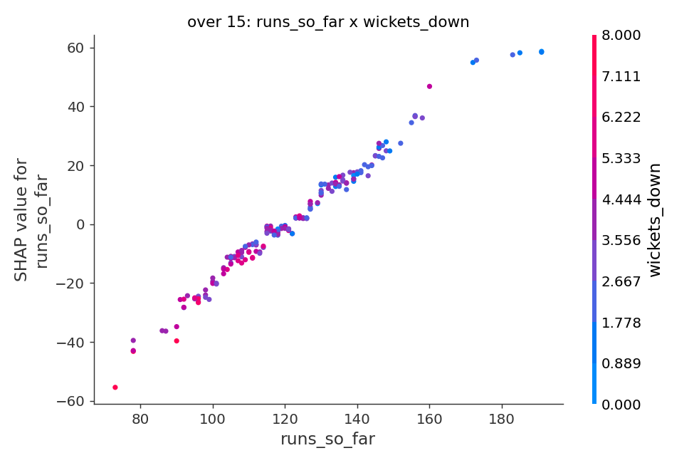
An interaction, in cricket terms
runs_so_far x wickets_down
Strongest pair at over 15: 1.36 runs.
Strongest pair excluding innings: the same score is worth more with wickets in hand, because batters still to come can accelerate.
Source: SRL scorecards, 383 matches, 10 seeds | B12 | 8

Slide 9
Can we trust the explanation?
Seed-to-seed rank agreement of importances: 0.92, 0.94, 0.96, 0.81 (overs 6, 10, 12, 15)
Cross-check with permutation importance: rank agreement 0.95, 0.74, 0.93, 0.9 (rho)
SHAP explains the model, not cricket: no causal claims
Source: SRL scorecards, 383 matches, 10 seeds | B12 | 9

Slide 10
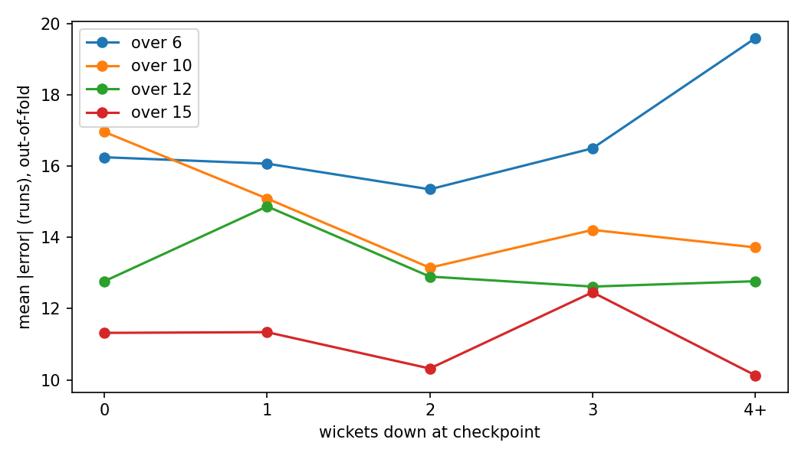
Where it fails
73% of the 100 worst misses are chases that ended early.
The explanation points to what it can see, never to the overs not yet bowled.
Cases listed in results/failure_cases.csv
Source: SRL scorecards, 383 matches, 10 seeds | B12 | 10

Slide 11
Limits and stress tests
10% of training data: RMSE rises by about 3.8 runs at over 6
3% corrupted inputs add 0.7 to 3.1 runs of RMSE
Chase scores are censored, so innings is a top feature for data reasons
Explains our own model; B1/B2 model files still needed
Source: SRL scorecards, 383 matches, 10 seeds | B12 | 11

Slide 12
Tested against B1 at over 6
Same 766 over-6 rows, out-of-fold.
Gap B1 minus ours, 95% bootstrap: [0.92, 2.04] runs.
B1 range covers truth 90.7% of the time.
Caveat: B1 features and validation unknown.
Source: SRL scorecards, 383 matches, 10 seeds | B12 | 12

Slide 13
Integration and next steps
Message B1 and B2 for model files and an agreed match ID
Get B1/B2 model files so SHAP explains their models
Add the chase target as a feature to remove the censoring effect
Handover: feature_importance.csv + results/README.md
Source: SRL scorecards, 383 matches, 10 seeds | B12 | 13

