Slide 1
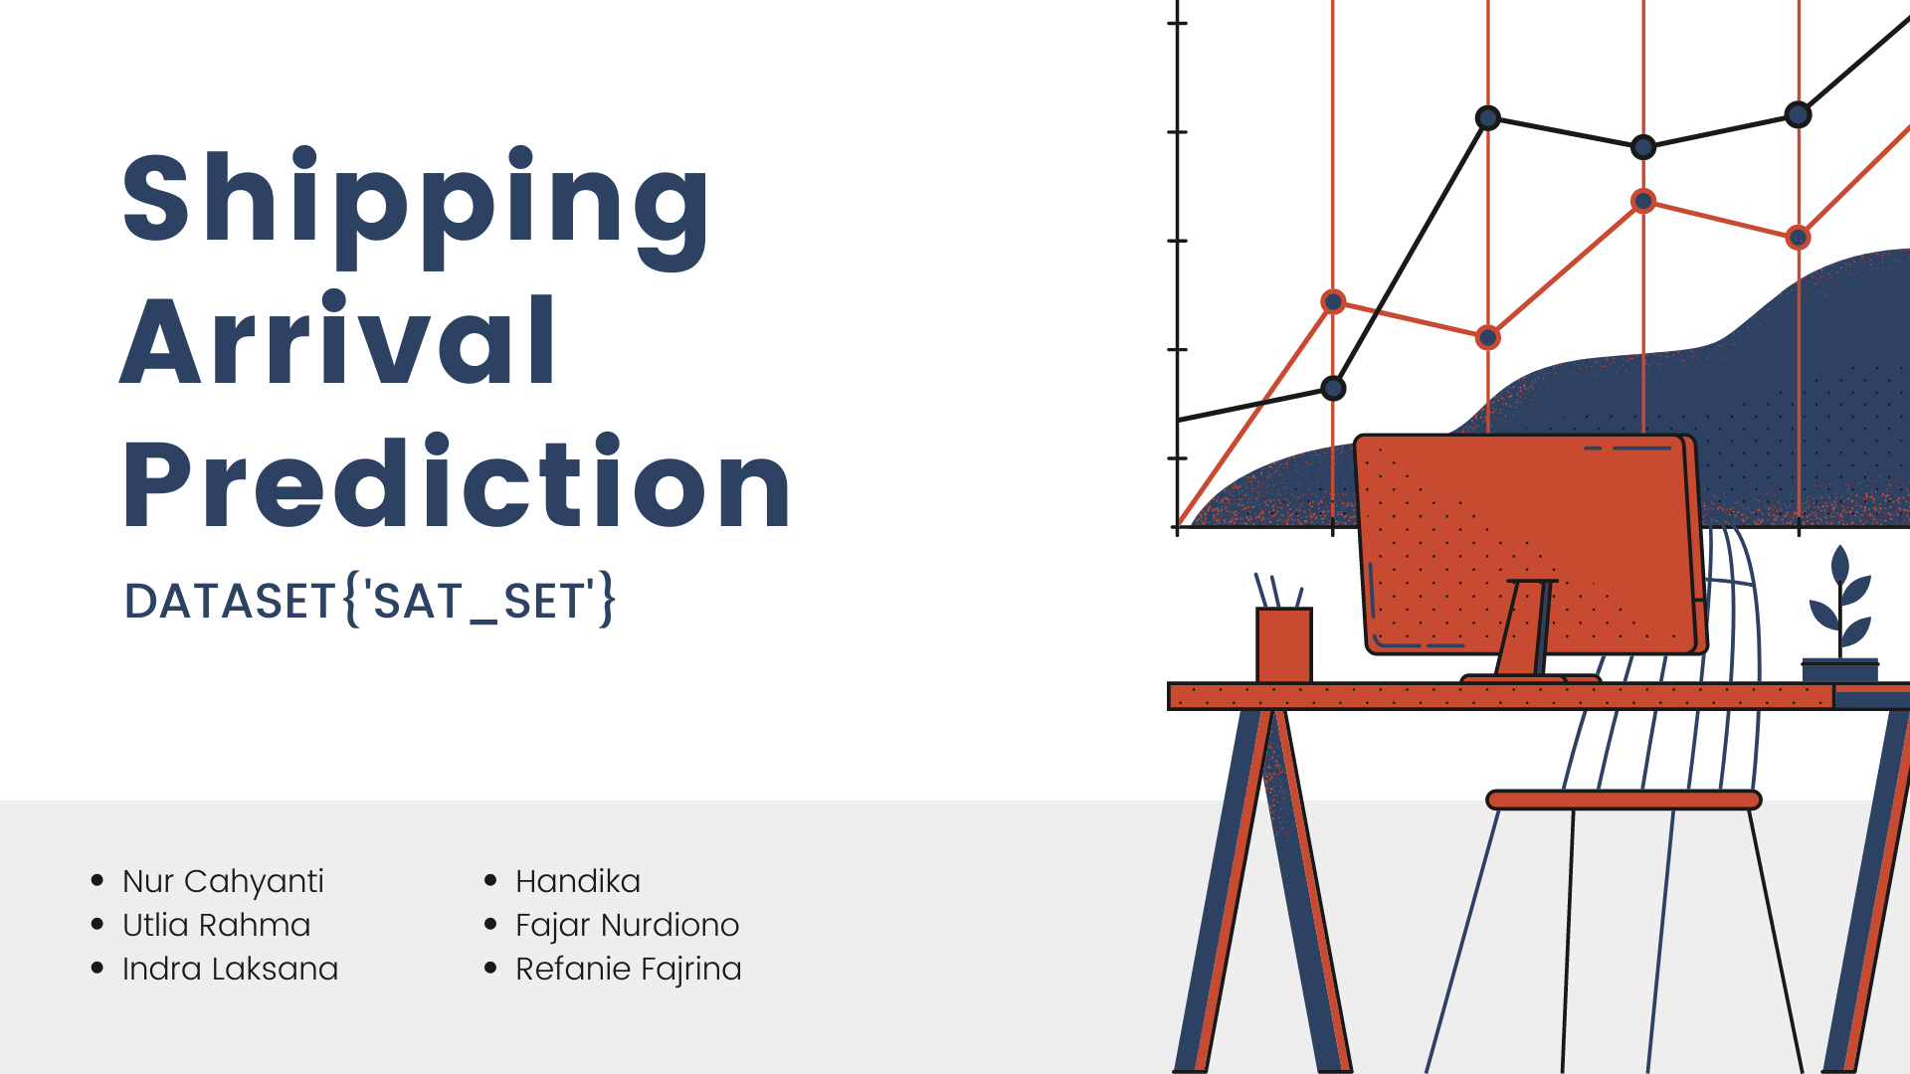

Slide 2
OUTLINE
Exploratory Data Analysis
Machine Learning Modelling
Recommendations
Business Understanding
Data Preprocessing
Impact After Modelling

Slide 3




Business Understanding | Who are we?
E-commerce Elektronik
Data Science Team
Refanie
Indra
Yanti
Fajar
Rahma
Handika
Has its own delivery fleet
Notes:
Divisi Data Science yang baru dibentuk di PT Kota Elektronik. Perusahaan merupakan e-commerce yang bergerak dalam penjualan barang elektronik dan memiliki divisi ekspedisi sendiri. Kami bertanggung jawab untuk memberikan rekomendasi berdasarkan data yang ada guna meningkatkan kinerja divisi ekspedisi.

Slide 4

Business Understanding | Problems
DELIVERY DELAY PERCENTAGE
69.7% customers are unlikely to return to a store if the product they purchased arrives late without prior notification.
shopify.co.id, 2020
40.3%
On-time
59.7%
Late
56% consumers shop at other stores because their regular store cannot deliver products on time.
shopify.co.id, 2020

Slide 5
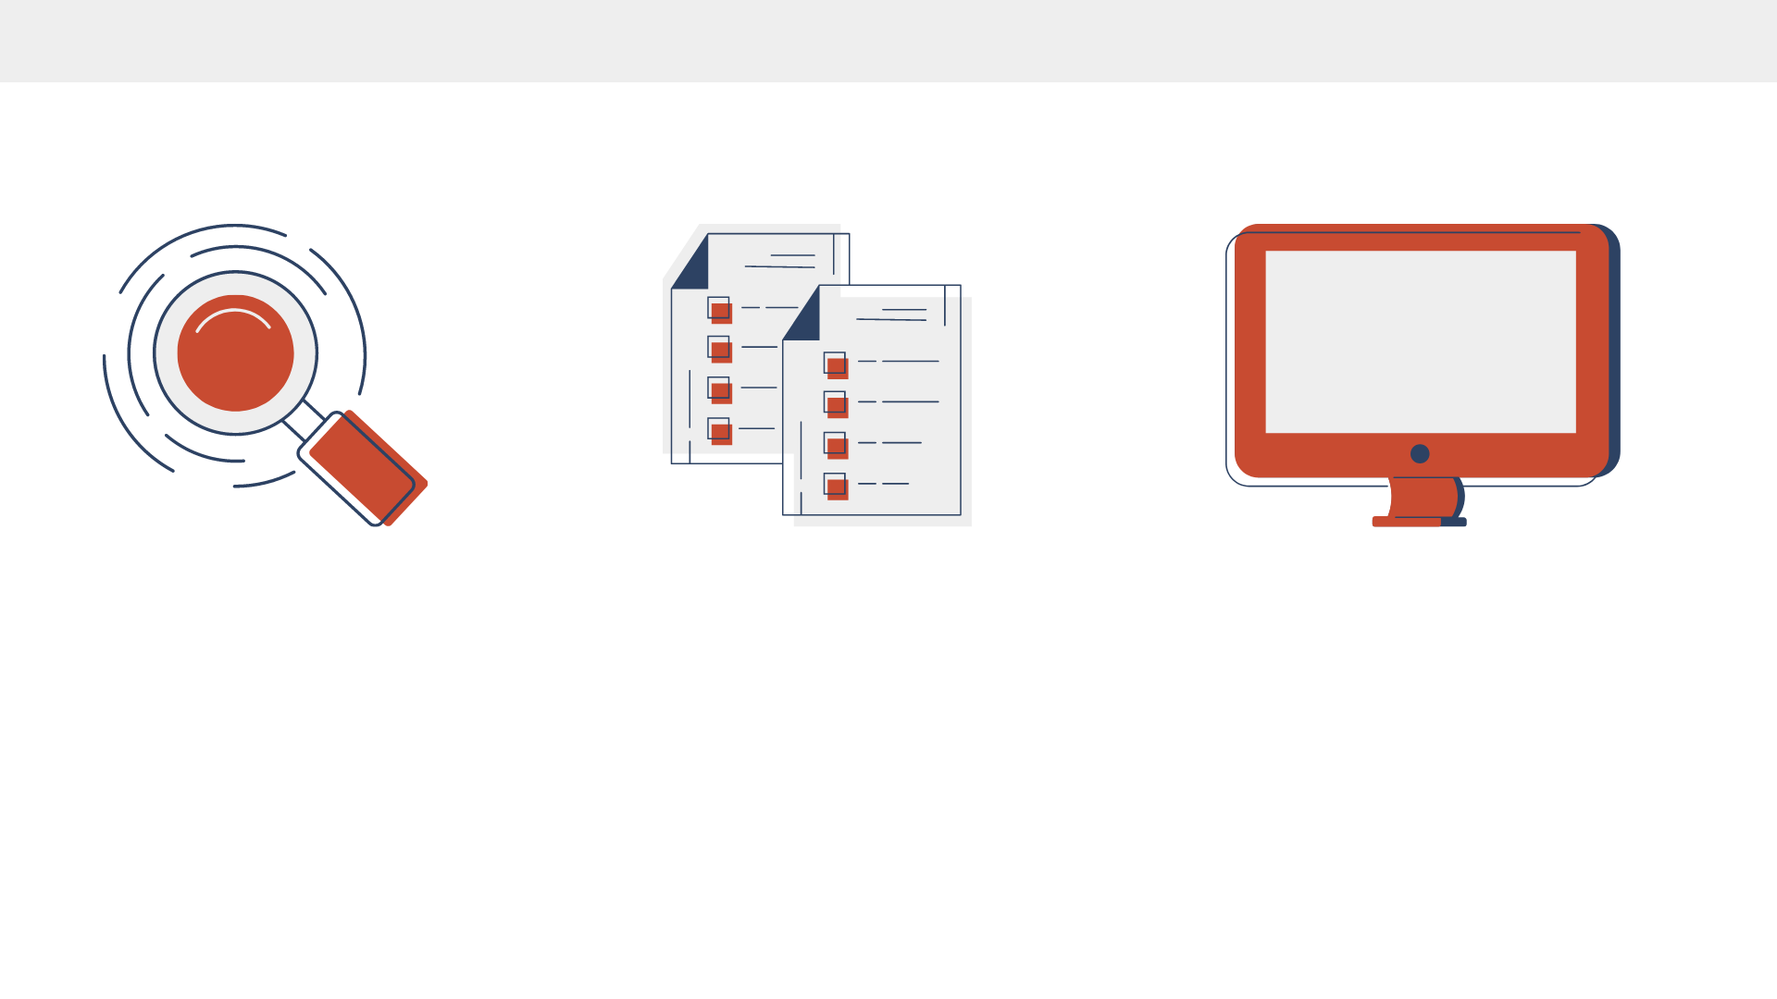
Business Understanding | Goals, Objectives, and Solutions
Goals
Objectives
Business Metrics
Reduce late-arriving packages
Build a machine learning model to predict whether a package will arrive late or not.
Percentage of packages delivered on time

Slide 6
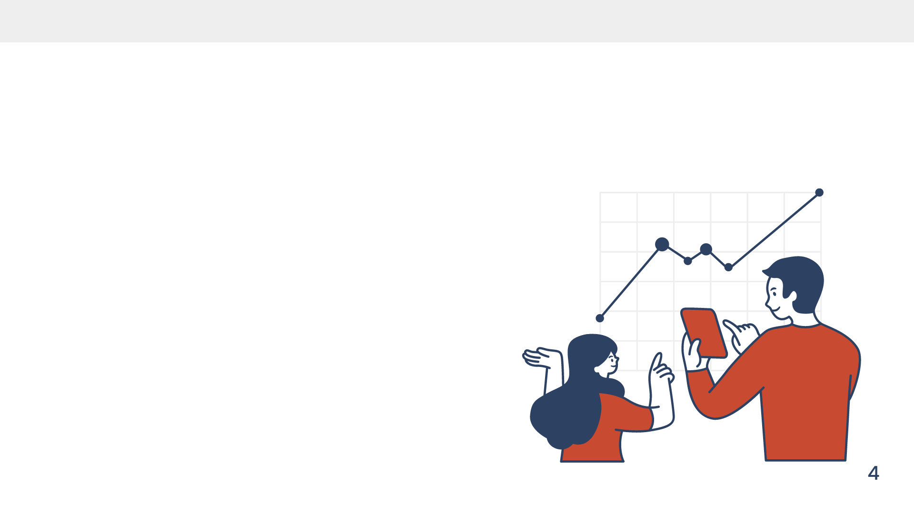
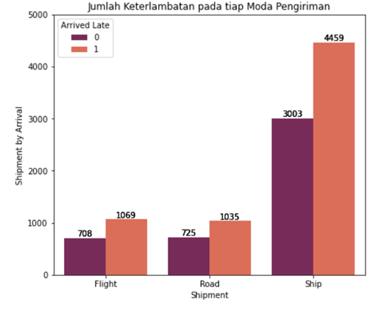

Exploratory Data Analytics | Goals, Objectives, and Solutions
The majority of products are shipped by sea, regardless of whether products arrive late or not

Slide 7
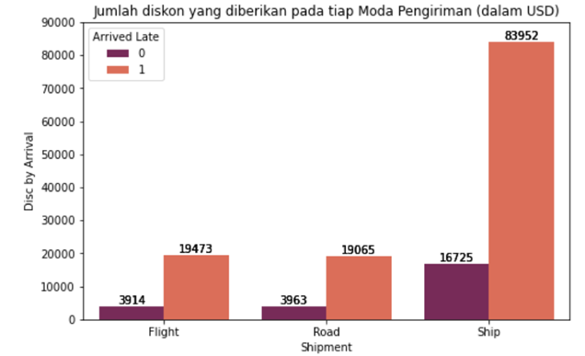
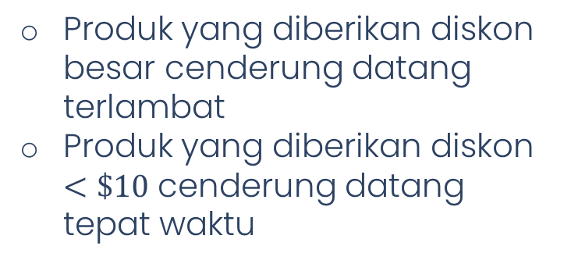
Exploratory Data Analytics | Goals, Objectives, and Solutions

Slide 8
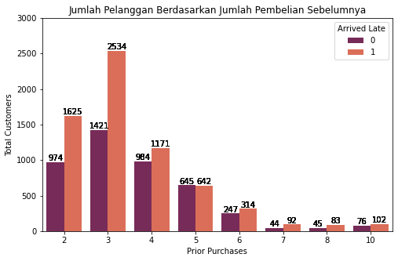
Exploratory Data Analytics | Goals, Objectives, and Solutions
The majority of customers have made 3 prior purchases, regardless of whether products arrive late or not

Slide 9
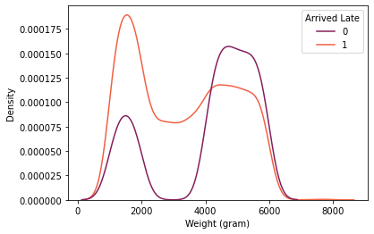
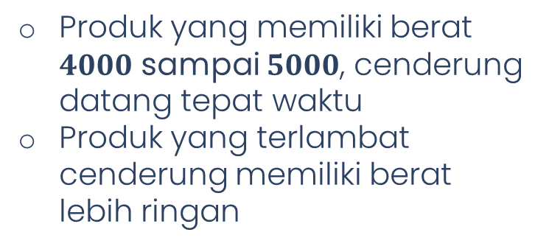
Exploratory Data Analytics | Goals, Objectives, and Solutions

Slide 10

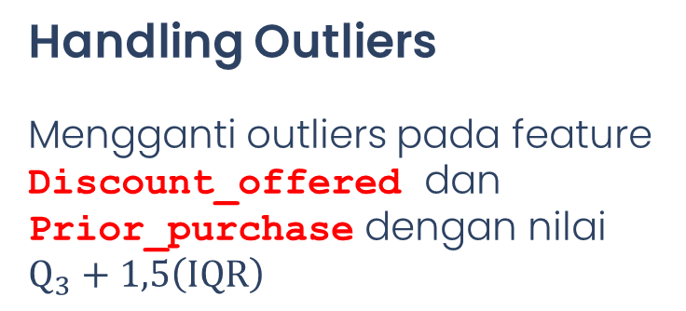
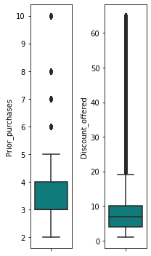
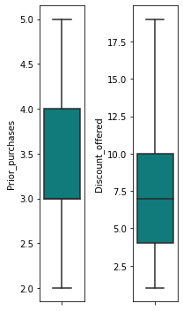

Data Preprocessing | Handling Outliers
BEFORE
AFTER

Slide 11


Data Preprocessing | Transformation and Encoding
Discount_offered
Transformation
(Normalization)
Cost_of_the_Product
Prior_purchase
Weight_in_gms
Encoding
Onehot Encoding
Label Encoding
Product_importance
Warehouse_block
Gender
Mode_of_Shipment

Slide 12
Data Preprocessing | After Preprocessing
DROP COLUMNS
‘ID’, ‘Customer_care_calls’, dan ‘Customer_rating’
Before
Preprocessing
After
Preprocessing
11 Feature
1 target
12 Feature
1 target

Slide 13
Machine Learning Modelling | Modelling Result After Tuning
SPLIT DATA
Train Data = 70 | Test Data = 30
Metric
LOGISTIC REGRESSION
K-NEAREST NEIGHBOR
DECISION TREE
RANDOM FOREST
XG BOOST
GRADIENT BOOSTING
Accuracy
0.6376
0.6370
0.6394
0.6645
0.6515
0.6685
Precision
0.6924
0.7194
0.7430
0.7968
0.7310
0.7760
Recall
0.7064
0.6420
0.6049
0.5876
0.6582
0.6247
F1 – Score
0.6993
0.6785
0.6669
0.6764
0.6927
0.6922
ROC-AUC (test)
0.7208
0.7047
0.7123
0.7315
0.7341
0.7420
ROC-AUC (train)
0.7209
0.7919
0.7803
0.8391
0.9802
0.7488

Slide 14
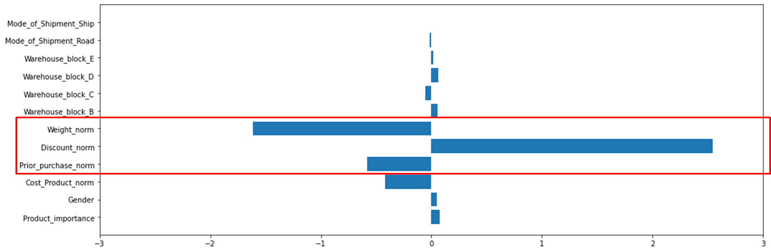
Machine Learning Modelling | Feature Importance
Koefisien Logistic Regression
Assumed Impact of Feature Importance on Prediction Results
The company runs a large-scale short-term sales promotion. The program can be joined by customers with the following conditions:
Each customer receives a special discount;
This program is exclusively for items weighing < 5000 grams;
Not applicable for existing customers
Notes:
Akibat perhitungan yang kurang matang dari program yang dijalankan, maka terjadi keterlambatan hampir di setiap produknya.

Slide 15

Recommendations | Business Recommendation
Recommendations:
Well-planned discount program design.
limit on number of customers
limit on item weight
personalized discounts by membership tier
Partner with third parties (delivery services) to increase shipping capacity during peak season / while the program is active.
Optimize delivery fleet utilization.
Notes:
disesuaikan dengan tim operasional.

Slide 16
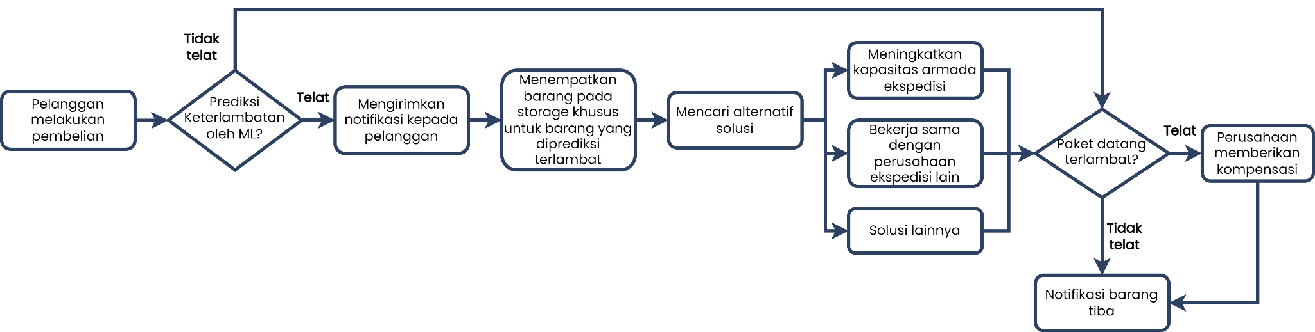
Recommendations | Flow Chart
Before the Company Implements Machine Learning
After the Company Implements Machine Learning

Slide 17

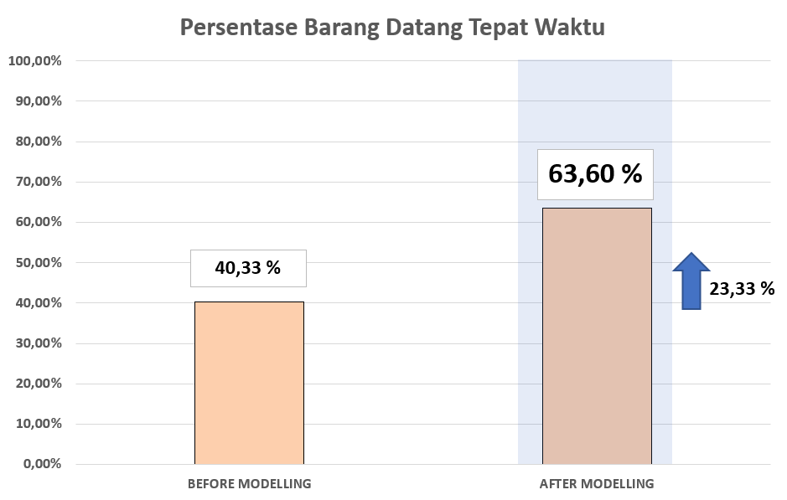
Recommendations | Impact After Modelling
There is an increase of 23,27% in on-time deliveries after implementing the model

Slide 18


Ending | Questions?
Terima kasih
THANK YOU

