Slide 1
Predicting Secondary School Student Performance in Portugal
Curtis Herges, Lakshmi Kanikkannan, Jeffrey Oliver

Slide 2
Project Outline
Project Goal: Predict the final grades (G3) of secondary school students’ course in “Portuguese” using a combination of socio-demographic and historic education factors as features. A variety of Machine Learning approaches will be used to find the model with the best prediction results.
Data: Collected from two Portugese schools during the 2005 - 2006 school year for the Cortez and Silva (2008) study
Grades for each student were collect three times during the school year
Social, emotional, economic, and other school related variables were collected via surveys
Analysis: ML models from SKlearn in Python were used for prediction

Slide 3
Research Question
Main Hypothesis
Can Portuguese language grades for secondary school students in Portugal be accurately predicted, and if so, what are the most important academic and social factors that would contribute to this prediction?
We hypothesize that across a variety of classification and regression models, we will be able to accurately predict Portuguese language grades without having to include G1 and G2 and that some variables will be more significant in our prediction than others.

Slide 4
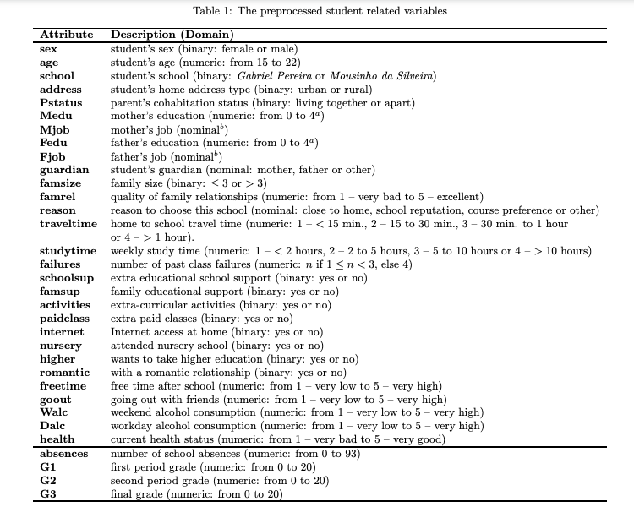
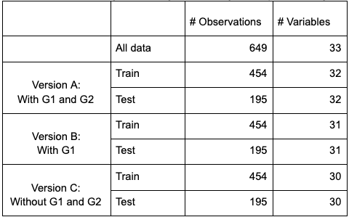
Variables
Notes:
All of the features to be used in the model can be seen on the right which is a combination of social factor and previous school performance. and the different combination of outcomes can be seen on the left. There will be three versions of the outcome variables (A,B, and C) just like in the paper. Many of these variables were categorical variables so we used one-hot encoding and dummy encoding

Slide 5
Outcomes
Binary Classification (Pass/Fail)
Pass: 10 or greater
Multi-Class Classification (5 Levels)
Regression (20 Levels)
Notes:
Three variations of the final grades outcome were used for this analysis. Those were binary (pass/fail), Multi-class Classification with 5 levels similar to letter grades in the U.S., and Regression with all 20 grade levels being used. Various ML models were tested for each of these outcomes

Slide 6
Binary Classification (Pass/Fail)
Classification Algorithm Parameters are for model fit to Variation C | A | B | C
Logistic Regression C: 1.0, Multi class: ovr, Penalty: l2 | Accuracy = .94 F1 Avg = .94 | .91 .91 | .90 .85
Random Forest Max Feat: 7, N Estimators: 8, Criterion: gini, Min Samples/Split: 2 | Accuracy = .91 F1 Avg = .93 | .91 .91 | .90 .86
Notes:
For the binary outcome two models were used for the analysis: Logistic Regression (with L2 regularization) and Random Forest. 5-fold cross validation was used to determine the best hyperparameters for C (in LogReg) and for Max Features and N Estimators (for the RF model). All accuracies and F1 scores are shown for versions A, B, and C. Unsurprisingly, the accuracy was highest for version A when both the G1 and G2 test grades were present. The binary outcome presents a unique challenge for evaluating the model because a majority of the students pass so the accuracy rate will inherently be high

Slide 7
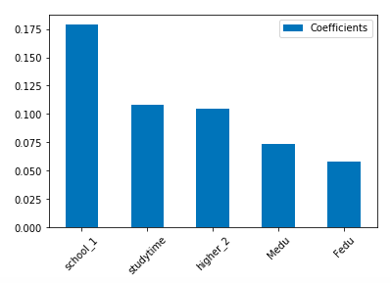
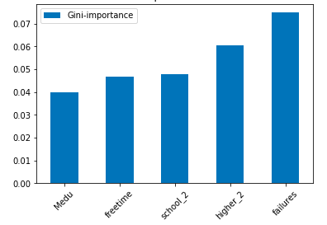
Binary Classification Feature Importance
RF Gini Index Feature Importance Version C. Top Variables: “Failures”, “Higher Education”, “School”, “Free Time”, “Mother’s Education”
LogReg Coefficient Feature Importance Version C. Top Variables: “School”, “Study Time”, “Higher Education”, “Mother’s Education”, “Father’s Education”
Notes:
For the RF model, we used the Gini Index Feature importance to determine the most significant predictors of final grades. For LogReg, we used the coefficients in order to estimate a rough idea for feature importance. The bar charts in this slide show the feature importance for Version C as a focal point. Both versions showed that the school attended, desire for higher education, and mother’s education were significant features for predicting final grades

Slide 8
5-Level Classification
Classification Algorithm Parameters are for model fit to Variation C | A | B | C
Logistic Regression C: 0.01, Random state: 0, Multi class: ovr, Penalty: l2 | Accuracy = .75 AUC = .94 | .66 .88 | .37 .71
Random Forest Max Feat: sqrt, N Estimators: 50, Max Depth: 9, Criterion: gini, Min Samples/Split: 2, Random State: 0 | Accuracy = .75 AUC = .93 | .60 .86 | .36 .69
Support Vector Classifier C: 0.01, Gamma: 0.5, Kernel: poly, Degree: 3, Random State: 0 | Accuracy = .66 AUC = .92 | .48 .85 | .37 .70
Notes:
Three different models were fit to the test data: a logistic regression model, a random forest model, and a support vector classifier. Cross-validation was used to determine the best parameters. The parameters listed below the model in the table are the best parameters for variation C, which excludes G1 and G2. The Logistic Regression model had the highest accuracy and AUC for all three variants, however, the accuracy and AUC were very similar across all three models. While the Logistic Regression model did perform the best using the selected metrics, it may not be th emost desirable model. The confusion matrix on the next slide will demonstrate why.

Slide 9
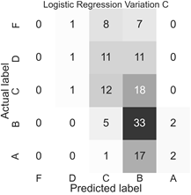
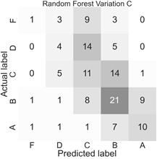
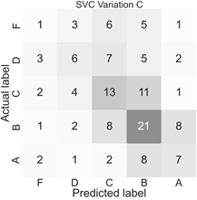
5-Level Classification Confusion Matrix (C)
Notes:
These are the confusion matrices for the three models fit to variant C. Remember the logistic regression model had the highest accuracy and AUC. However, the Logistic regression model does not predict any students to fail. The random forest and SVC models do predict students to fail, but is not particularly accurate with those predictions. The random forest and the SVC model also tend to be better at predicting the remaining levels, while the logistic regression model tends to indicate students will have a B or C grade. This is consistent with the precision and recall scores for all of the models (not shown). The random forest and SVC model had greater precision and recall than the logistic regression model. For this reason, either of the other two models may be preferred. The random forest tends to be the simplest to explain to a layperson, so it may be the preferred model.

Slide 10
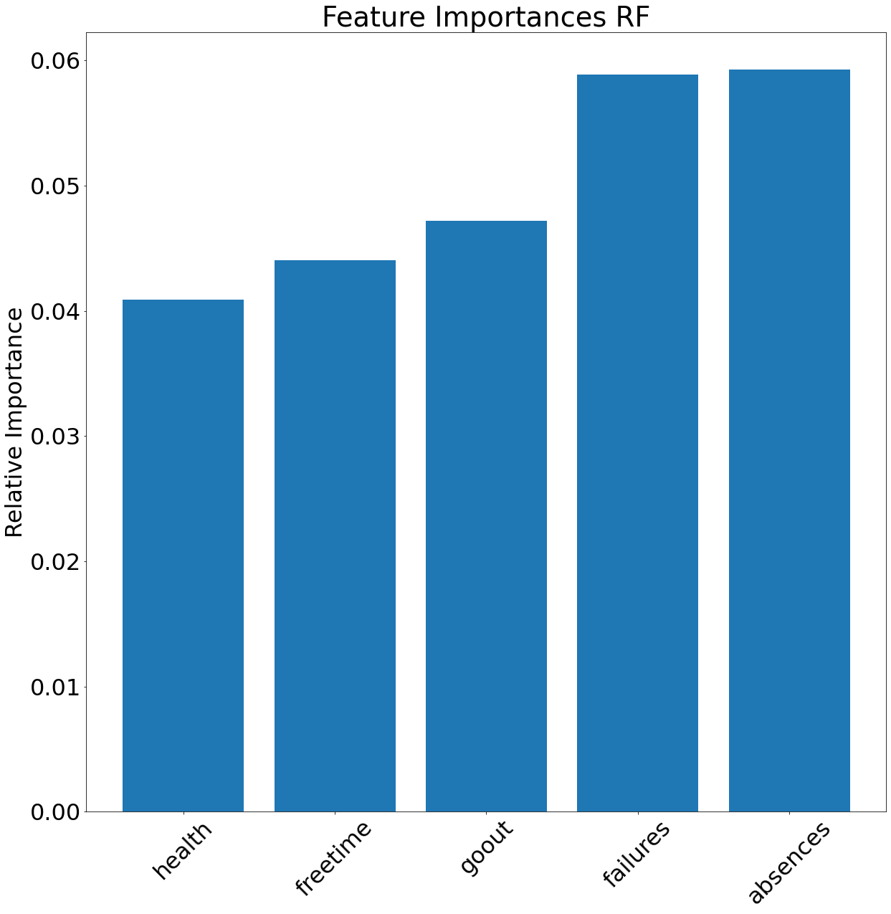
5-Level Classification Variable Importance (C)
The Random Forest Model indicated that the top five most important variables were:
number of absences
number of prior class failures
whether the student goes out with friends
how much freetime the student had
and the students health rating.
Notes:
The random forest model was used to determine the Gini index of each variable included in the model fit to variant C. The five most important variables are included in the plot above. These variables did not have a particularly large feature importance, in comparison with the remaining variables. The graph for all variables (not shown) showed that there was a drop off in variable importance after the first twelve variables. However, this drop off was not very steep.

Slide 11
Regression (0-20)
Classification Algorithm Parameters are for model fit to Variation C | A | B | C
Ordinary Least Squares Regression | R2 = .82 RMSE = 1.47 | .59 2.22 | .31 2.88
Ridge Regression (l2 penalty) | R2 = .82 RMSE = 1.47 | .59 2.22 | .31 2.88
LASSO Regression (l1 penalty) | R2 = .82 RMSE = 1.46 | .59 2.22 | .31 2.89
ElasticNet Regression | R2 = .79 RMSE = 1.60 | .59 2.21 | .31 2.88
Notes:
Several regression models were built and evaluated to determine the best model for predicting a numeric output between 0 and 20 for the G3 variable – the final grade. Linear Regression (using the OLS method), Ridge Regression, Lasso Regression, and ElasticNet Regression. Ridge Regression is an extension of Linear Regression where the loss function is modified by adding a penalty, a value equivalent to the magnitude of the coefficients squared, to minimize model complexity. Lasso Regression is an extension of Linear Regression where the loss function is modified by adding a different penalty, equivalent to the sum of the absolute model coefficients, again to minimize model complexity. ElasticNet Regression is yet another extension of Linear Regression – that is actually a combination of both Ridge and Lasso Regression: it applies both penalties.
R2 is the proportion of variation in the G3 variable that is explained by the other predictors we have. RMSE is the average error resulting from a model in an effort to predict G3 for a single observation. The better models will have a high R2 value and a low RMSE value.
When both G1 and G2 are included as predictors, OLS, Ridge, and Lasso regressions all perform similarly, with an RMSE value of approximately 1.46 and an R^2 value of 0.82. The ElasticNet regression performs slightly worse, with an RMSE value of 1.60 and an R^2 value of 0.79. G1 and G2 are the best predictors of G3, so this set of models performed the best.
When G2 was dropped from the array of predictors, OLS, Ridge, Lasso, and ElasticNet regressions all performed similarly, with an RMSE value of about 2.21 and an R^2 value of 0.59.
When both G1 and G2 were excluded as predictors, it became very clear that the predictive ability of the models suffered, with all of the models having an RMSE value of about 2.88 and an R^2 close to 0.31.
When either G1, G2, or both were dropped as predictors, it can be seen that the models had a much more difficult time predicting G3, than when both G1 and G2 were included.

Slide 12
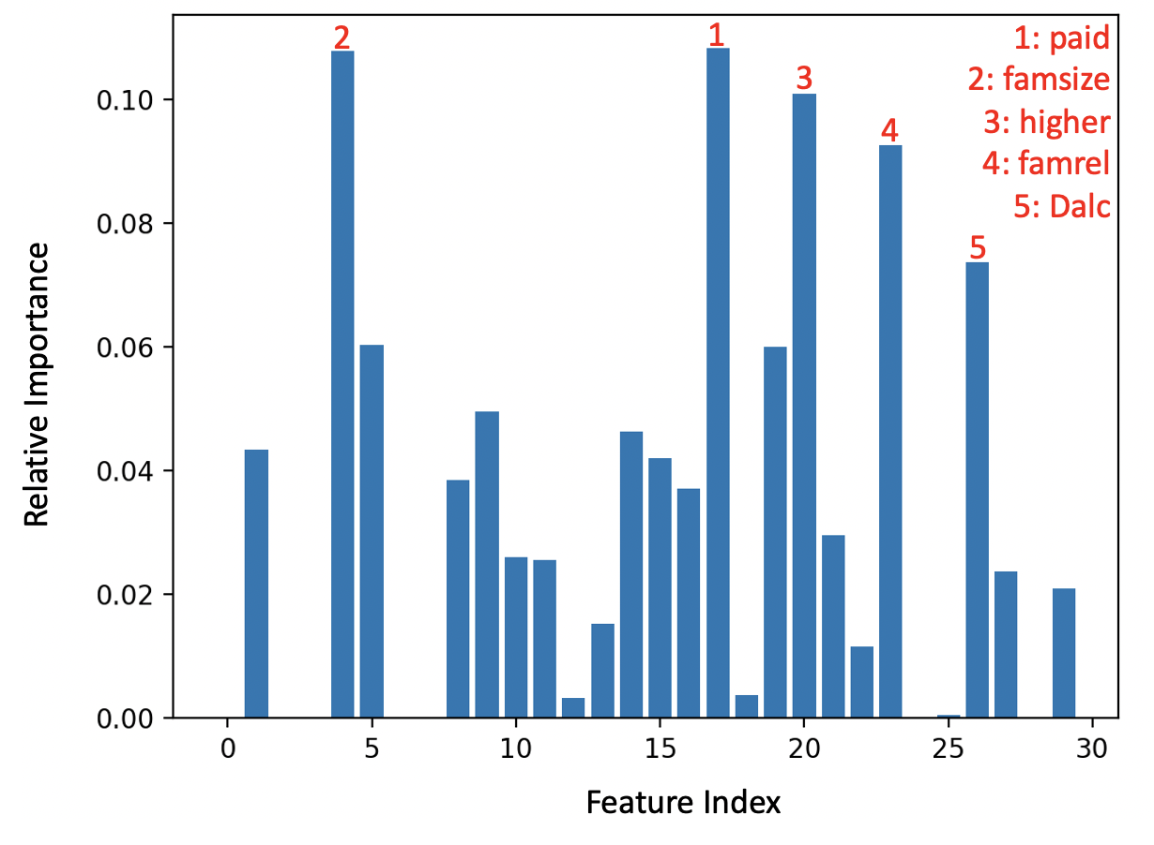
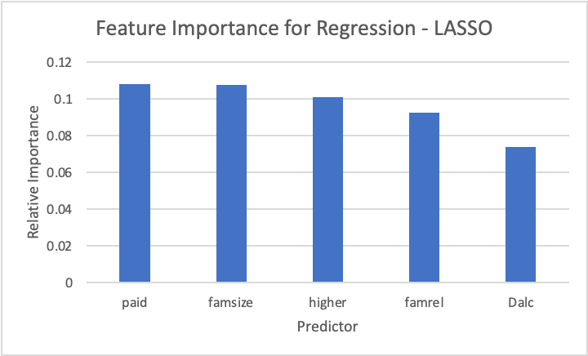
LASSO Regression - Feature Importance
Notes:
The LASSO regression model applies a penalty to the coefficients, forcing some of them to reach zero and others to take non-zero weights. The LASSO regression coefficients can be useful to also determine feature importance. Figure 7 shows that the top five features for the numeric output prediction case were if the students had access to and taken extra paid classes within the course subject, the size of the student’s family, if the student wanted to pursue higher education, the quality of the student’s family relationships, and the student’s workday alcohol consumption.

Slide 13
Conclusions
The models in the paper demonstrate that final grades for students can be predicted with the highest accuracy using previous test grades for the course.
Hypothesis Revisited: We were not able to accurately predict school grades in the absence of G1 and G2.
Feature Importance commonalities:
Binary/Five Level: previous failures
Binary/Regression: interest in pursuing higher education

Slide 14
Study Limitations
This analysis did not exhaust all of the machine learning models available to us (e.g. Gradient Boosting, L1 regularized Logistic Regression, Nearest Neighbors) and accuracy could have improved with additional models
The data is based on school grades from 2005-2006 (15 years old)
For this analysis we only analyzed one school subject (Portuguese). Other subjects can also be important indicators of school success, especially mathematics.
Different variable transformations may have resulted in enhanced accuracy.

