Slide 1
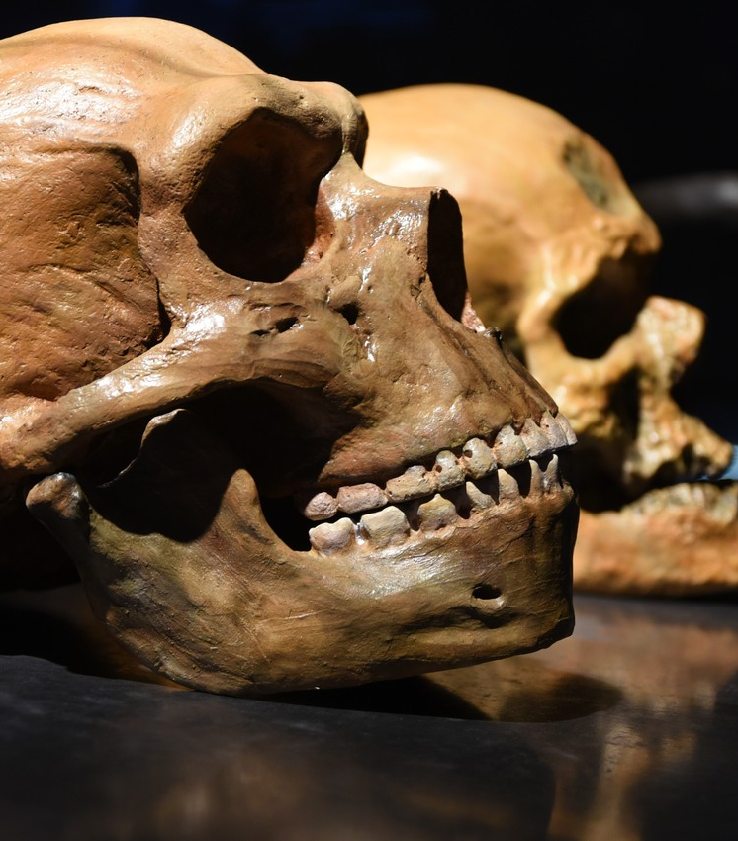
Humans
Stephan, Max, Laksan, Sebastian

Slide 2
Contents
Neanderthals
Genealogical DNA-testing
2.1 Homo neanderthalensis and Homo sapiens comparison
2.2 mitochondrial DNA
2.3 genealogical DNA testing
Our Work
3.1 BioPython and Matlab
3.2 Our Pipeline
Results
Conclusion

Slide 3
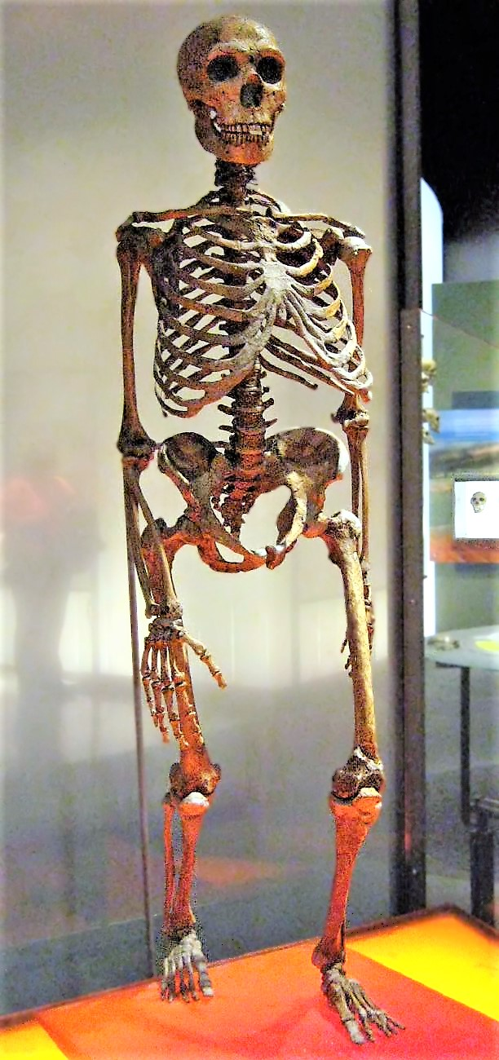
Neanderthals
Not an ancestor of humans
Latest common ancestor: Homo erectus
Evolved in Eurasia about 600.000 years ago
Extinction: 30.000 years ago

Slide 4
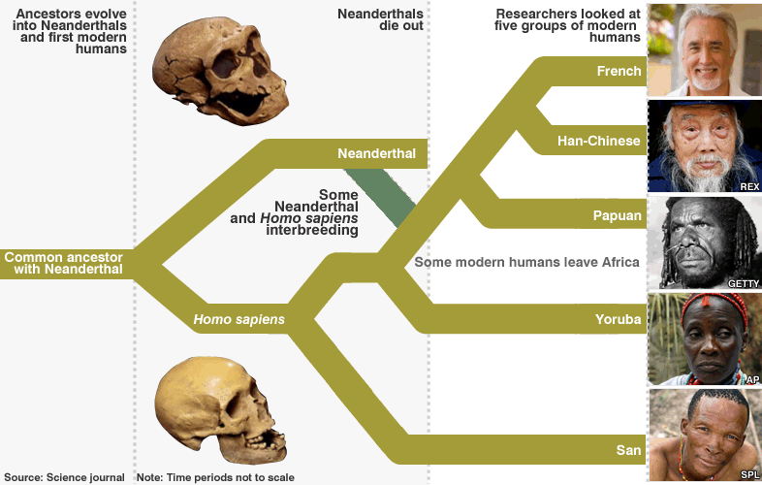
Neanderthals and Humans
202 differences in mtDNA compared to humans
Probable geneflow from Neanderthals to Humans
Gene mixing estimated at 1.15% to 1.3% in autosomes

Slide 5
References

Slide 6
Picture Courtesies
title picture: hairymuseummat https://www.theverge.com/2017/10/9/16448412/neanderthal-stone-age-human-genes-dna-schizophrenia-cholesterol-hair-skin-loneliness
Neanderthal skeleton: Claire Houck from New York City, USA - Neanderthal Skeleton
geneflow picture: http://news.bbc.co.uk/nol/shared/spl/hi/sci_nat/10/neanderthal/img/neanderthals_786.gif

