Slide 1
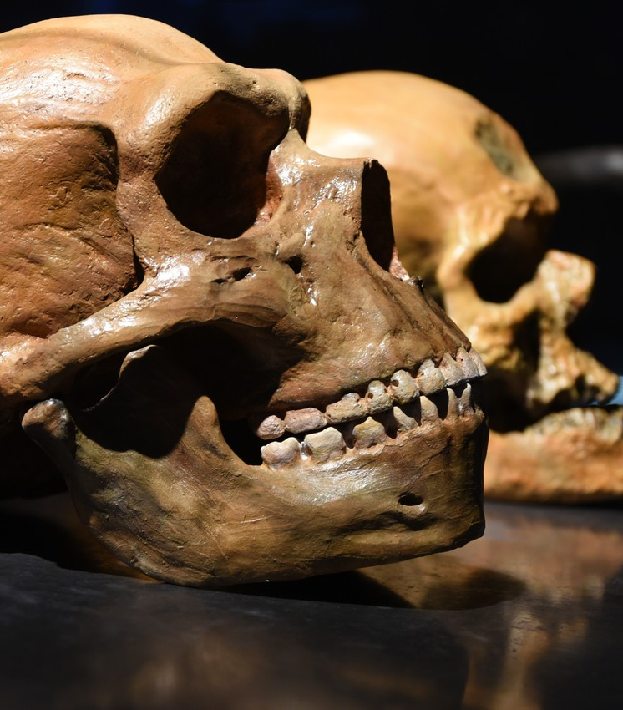
Genetic comparison of Human and Neanderthal mtDNA
Stephan, Max, Laksan, Sebastian

Slide 2
Contents
Neanderthals
Genetic Analysis
Experimental procedure
Results
Conclusion

Slide 3
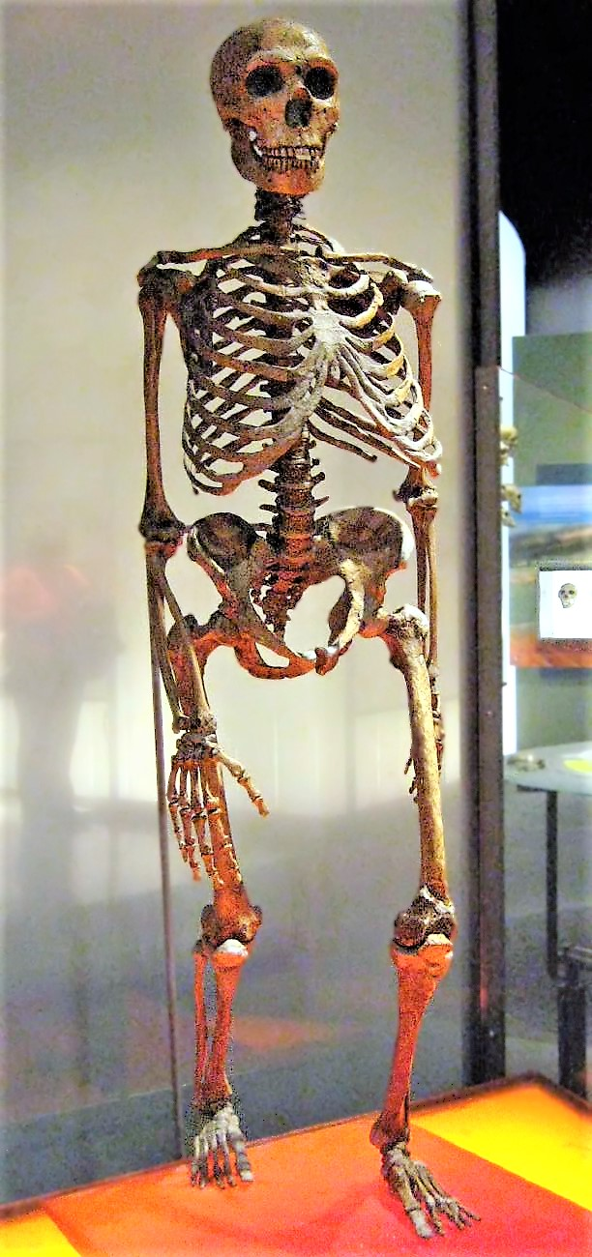
Neanderthals
Related to Humans
Latest common ancestor: Homo erectus
Evolved in Eurasia about 600.000 years ago
Extinction: 30.000 years ago

Slide 4
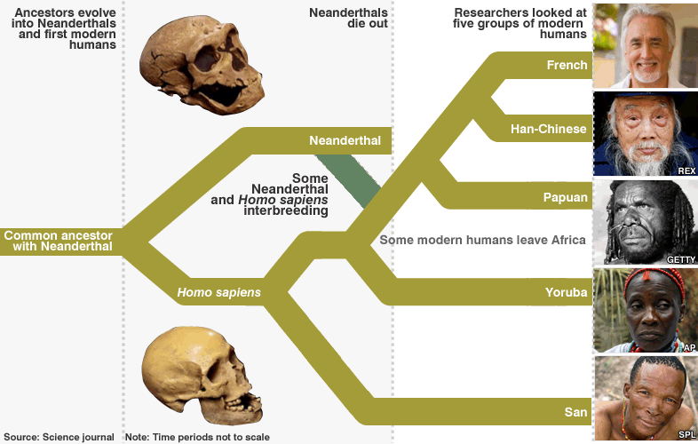
Neanderthals and Humans
About 202 differences in mtDNA compared to humans
Geneflow from Neanderthals to Humans
Gene mixing estimated at 1.15% to 1.3% in autosomes

Slide 5
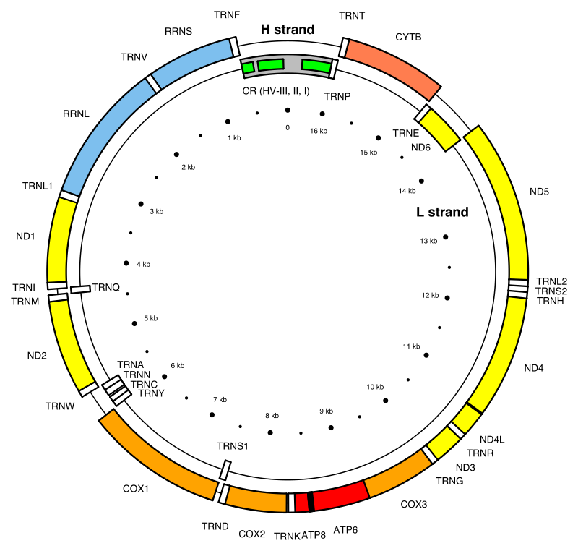
Genetic Analysis Mitochondrial DNA (mtDNA)
16,569 base pairs form 37 genes
Maternally inherited
→ No recombination
→ mutations only through evolution
Coding Region and Control Region
Region of interest
→ Control Region HV-I and HV-II
Notes:
HV -> Hypervariable Regions, high mutation-rate -> good for finding differences in related species

Slide 6
Genetic Analysis Genealogical DNA-Testing
Alignment: Compare Sequences and find Nucleotide Substitutions
Compute Phylogenetic Tree (UPGMA)
Use differences to create Distance-Matrix (Jukes-Cantor)
Deduce relatedness and geneflow

Slide 7
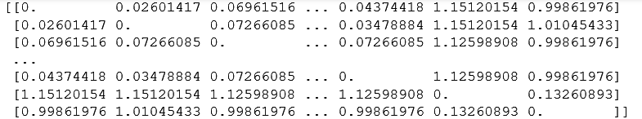
Experimental procedure Genetic Distances
Calculated mean distances…
among any two H. sapiens: 0.0890
between Neanderthal and any modern human: 1.0739

Slide 8
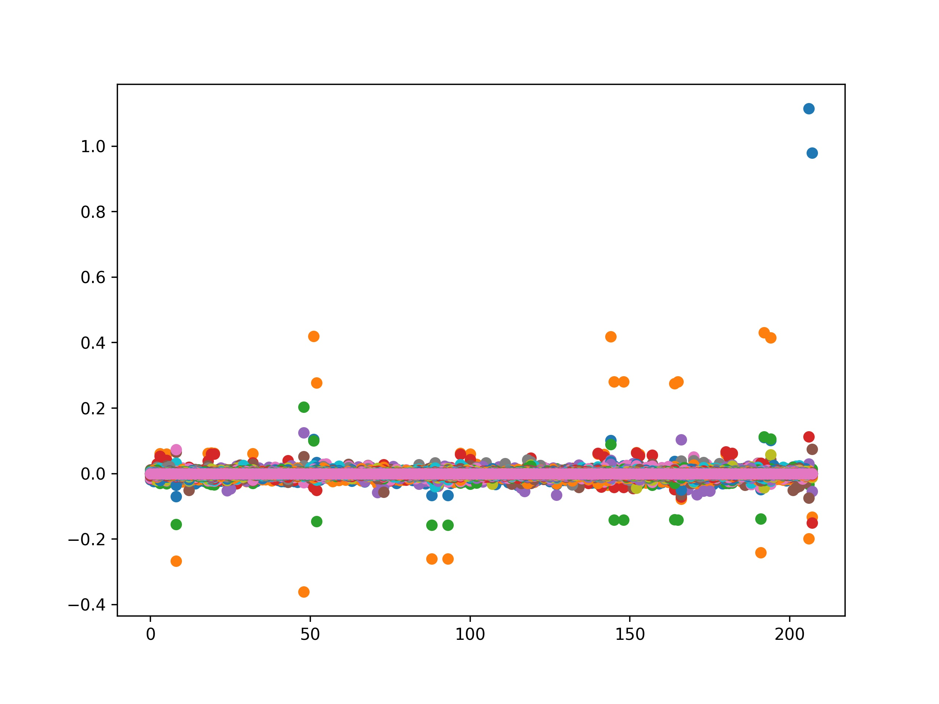
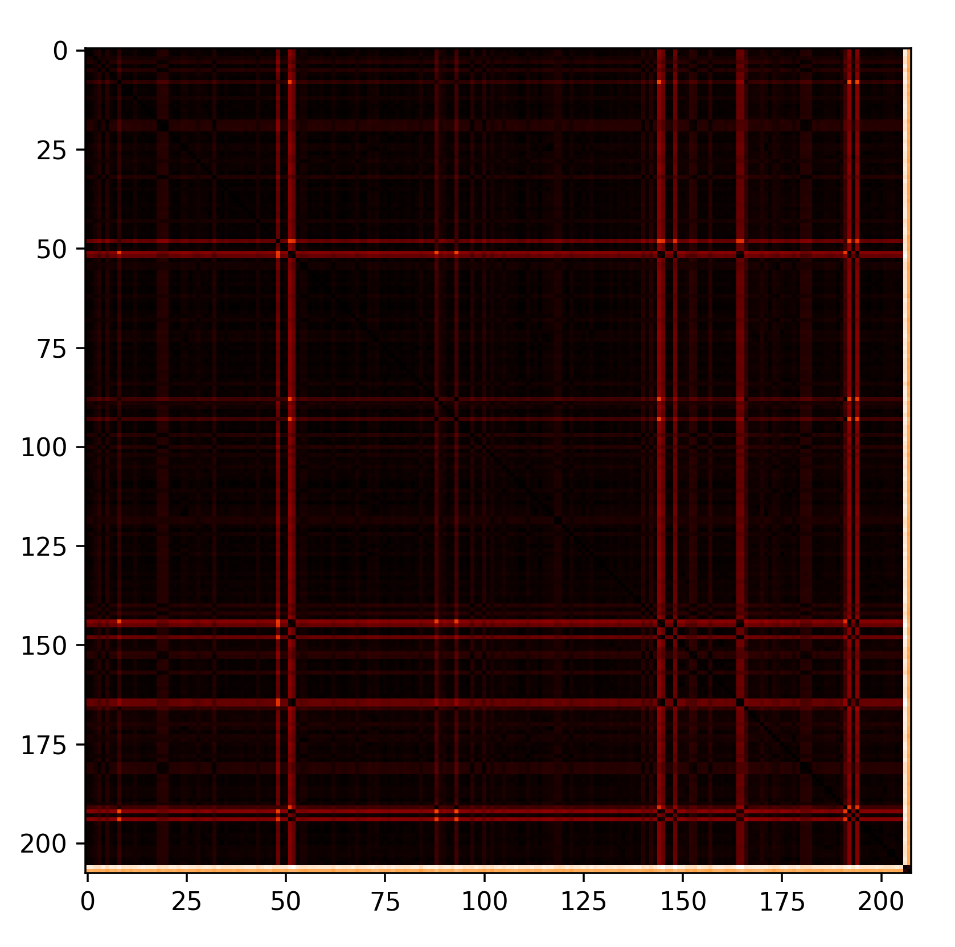
Experimental procedure Genetic Distances
Neanderthals
Neanderthals
Neanderthals

Slide 9
References
Sriram Sankararaman et al.: The genomic landscape of Neanderthal ancestry in present-day humans. In: Nature. Band 507, 2014, S. 354–357, doi:10.1038/nature12961
https://www.ncbi.nlm.nih.gov/pubmed/20448178
https://www.eurekalert.org/pub_releases/2016-02/m-egf021616.php
Richard E. Green et al.: A Complete Neandertal Mitochondrial Genome Sequence Determined by High-Throughput Sequencing
https://www.theverge.com/2017/10/9/16448412/neanderthal-stone-age-human-genes-dna-schizophrenia-cholesterol-hair-skin-loneliness

Slide 10
Picture Courtesies
title picture (skulls): hairymuseummat https://www.theverge.com/2017/10/9/16448412/neanderthal-stone-age-human-genes-dna-schizophrenia-cholesterol-hair-skin-loneliness
Neanderthal skeleton: Claire Houck from New York City, USA - Neanderthal Skeleton
geneflow picture: http://news.bbc.co.uk/nol/shared/spl/hi/sci_nat/10/neanderthal/img/neanderthals_786.gif
mtDNA Picture: Emmanuel Douzery

