Slide 1
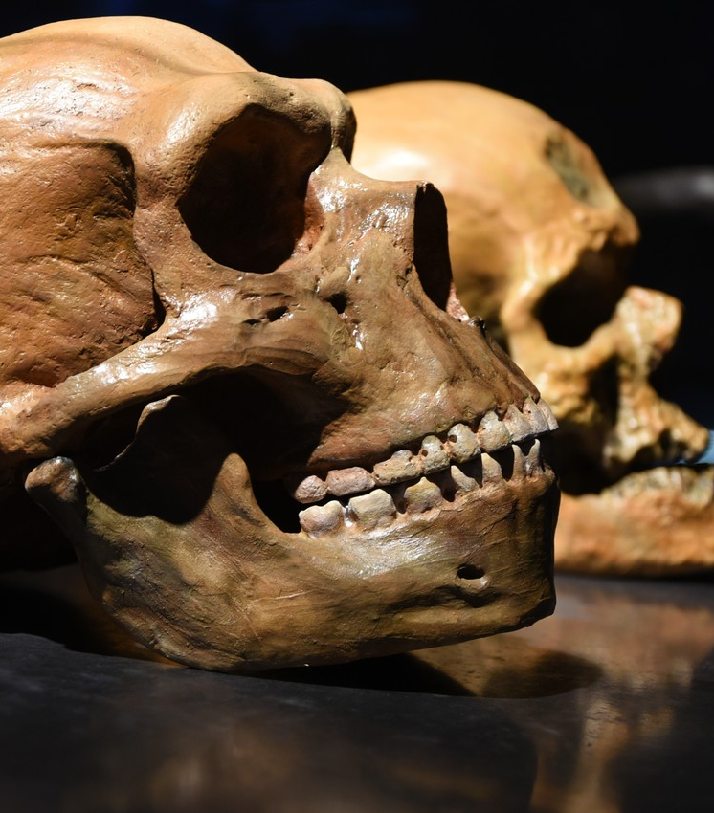
Genetic comparison of Human and Neanderthal mtDNA
Stephan, Max, Laksan, Sebastian

Slide 2
Contents
Neanderthals
Genetic Analysis
Experimental procedure and Results
Conclusion

Slide 3
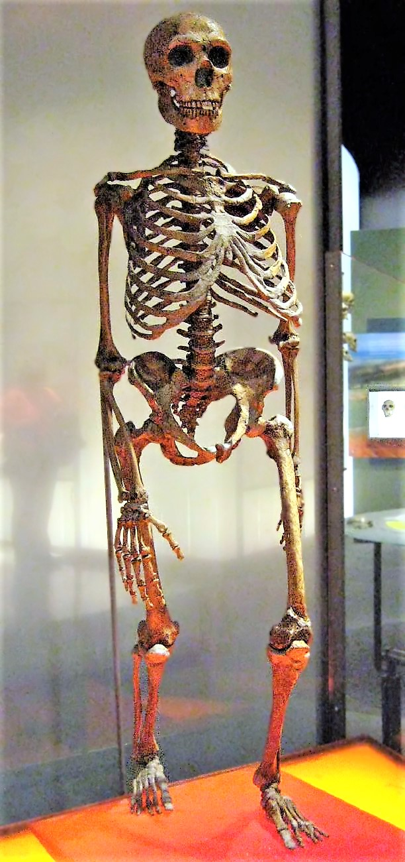
Neanderthals
Lived side by side with H. sapiens (that’s us)
Latest common ancestor: Homo erectus
Evolved in Eurasia about 600.000 years ago
Extinction: 30.000 years ago
Related to Humans?

Slide 4
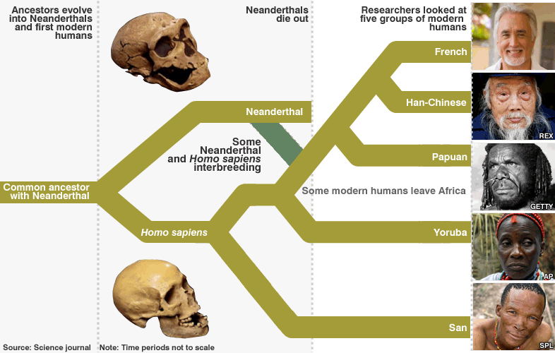
Neanderthals and Humans
About 202 differences in mtDNA compared to humans
Geneflow from Neanderthals to Humans
Gene mixing estimated at 1.15% to 1.3% in autosomes

Slide 5
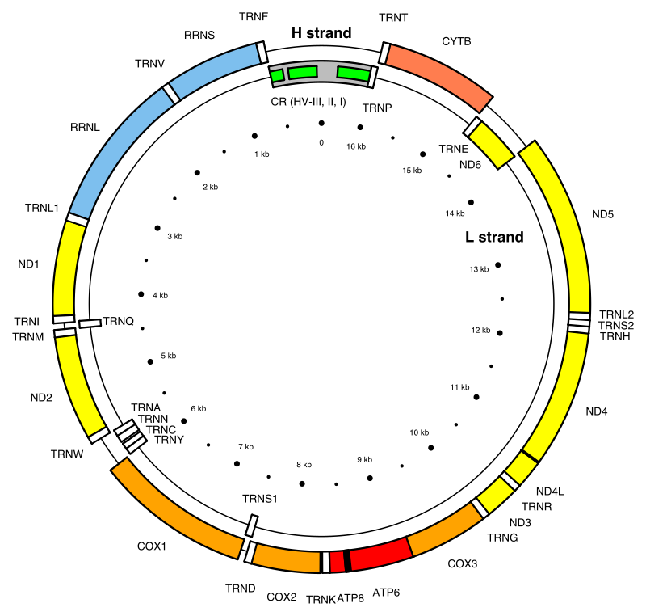
Genetic Analysis Mitochondrial DNA (mtDNA)
16,569 base pairs form 37 genes
Maternally inherited
→ No recombination
→ mutations only through evolution
Coding Region and Control Region
Region of interest
→ Control Region HV-I and HV-II
Notes:
HV -> Hypervariable Regions, high mutation-rate -> good for finding differences in related species

Slide 6
Genetic Analysis Genealogical DNA-Testing
Alignment: Compare Sequences and find Nucleotide Substitutions
Compute Phylogenetic Tree (UPGMA)
Use differences to create Distance-Matrix (Jukes-Cantor)
Deduce relatedness and geneflow

Slide 7
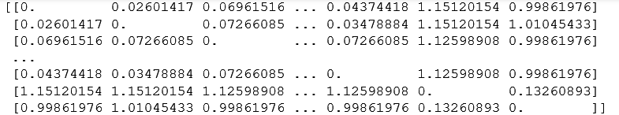
Experimental procedure Genetic Distances
Calculated mean distances…
among any two H. sapiens: 0.0890
between Neanderthal and any modern human: 1.0739

Slide 8
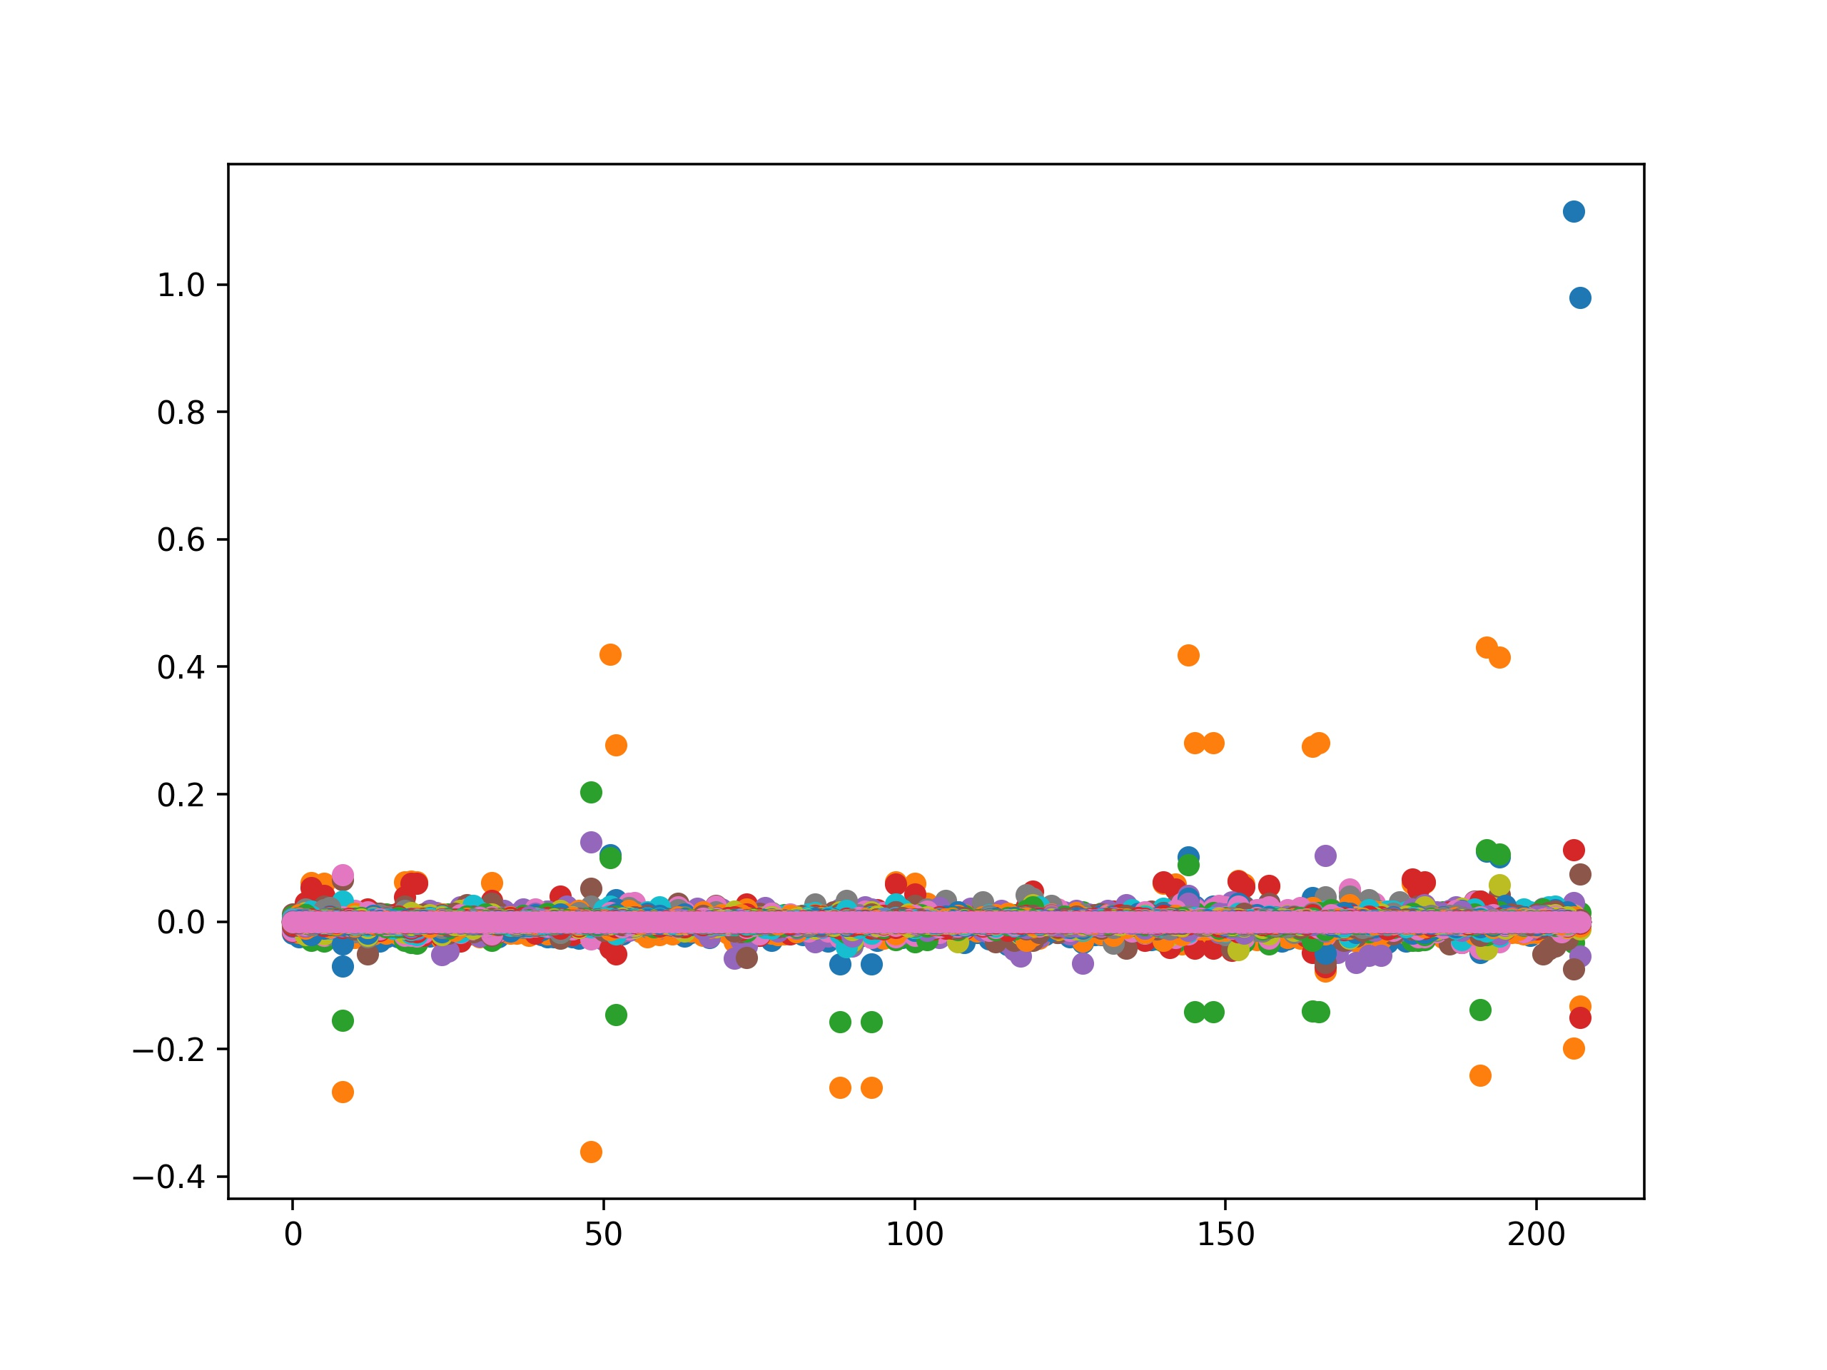
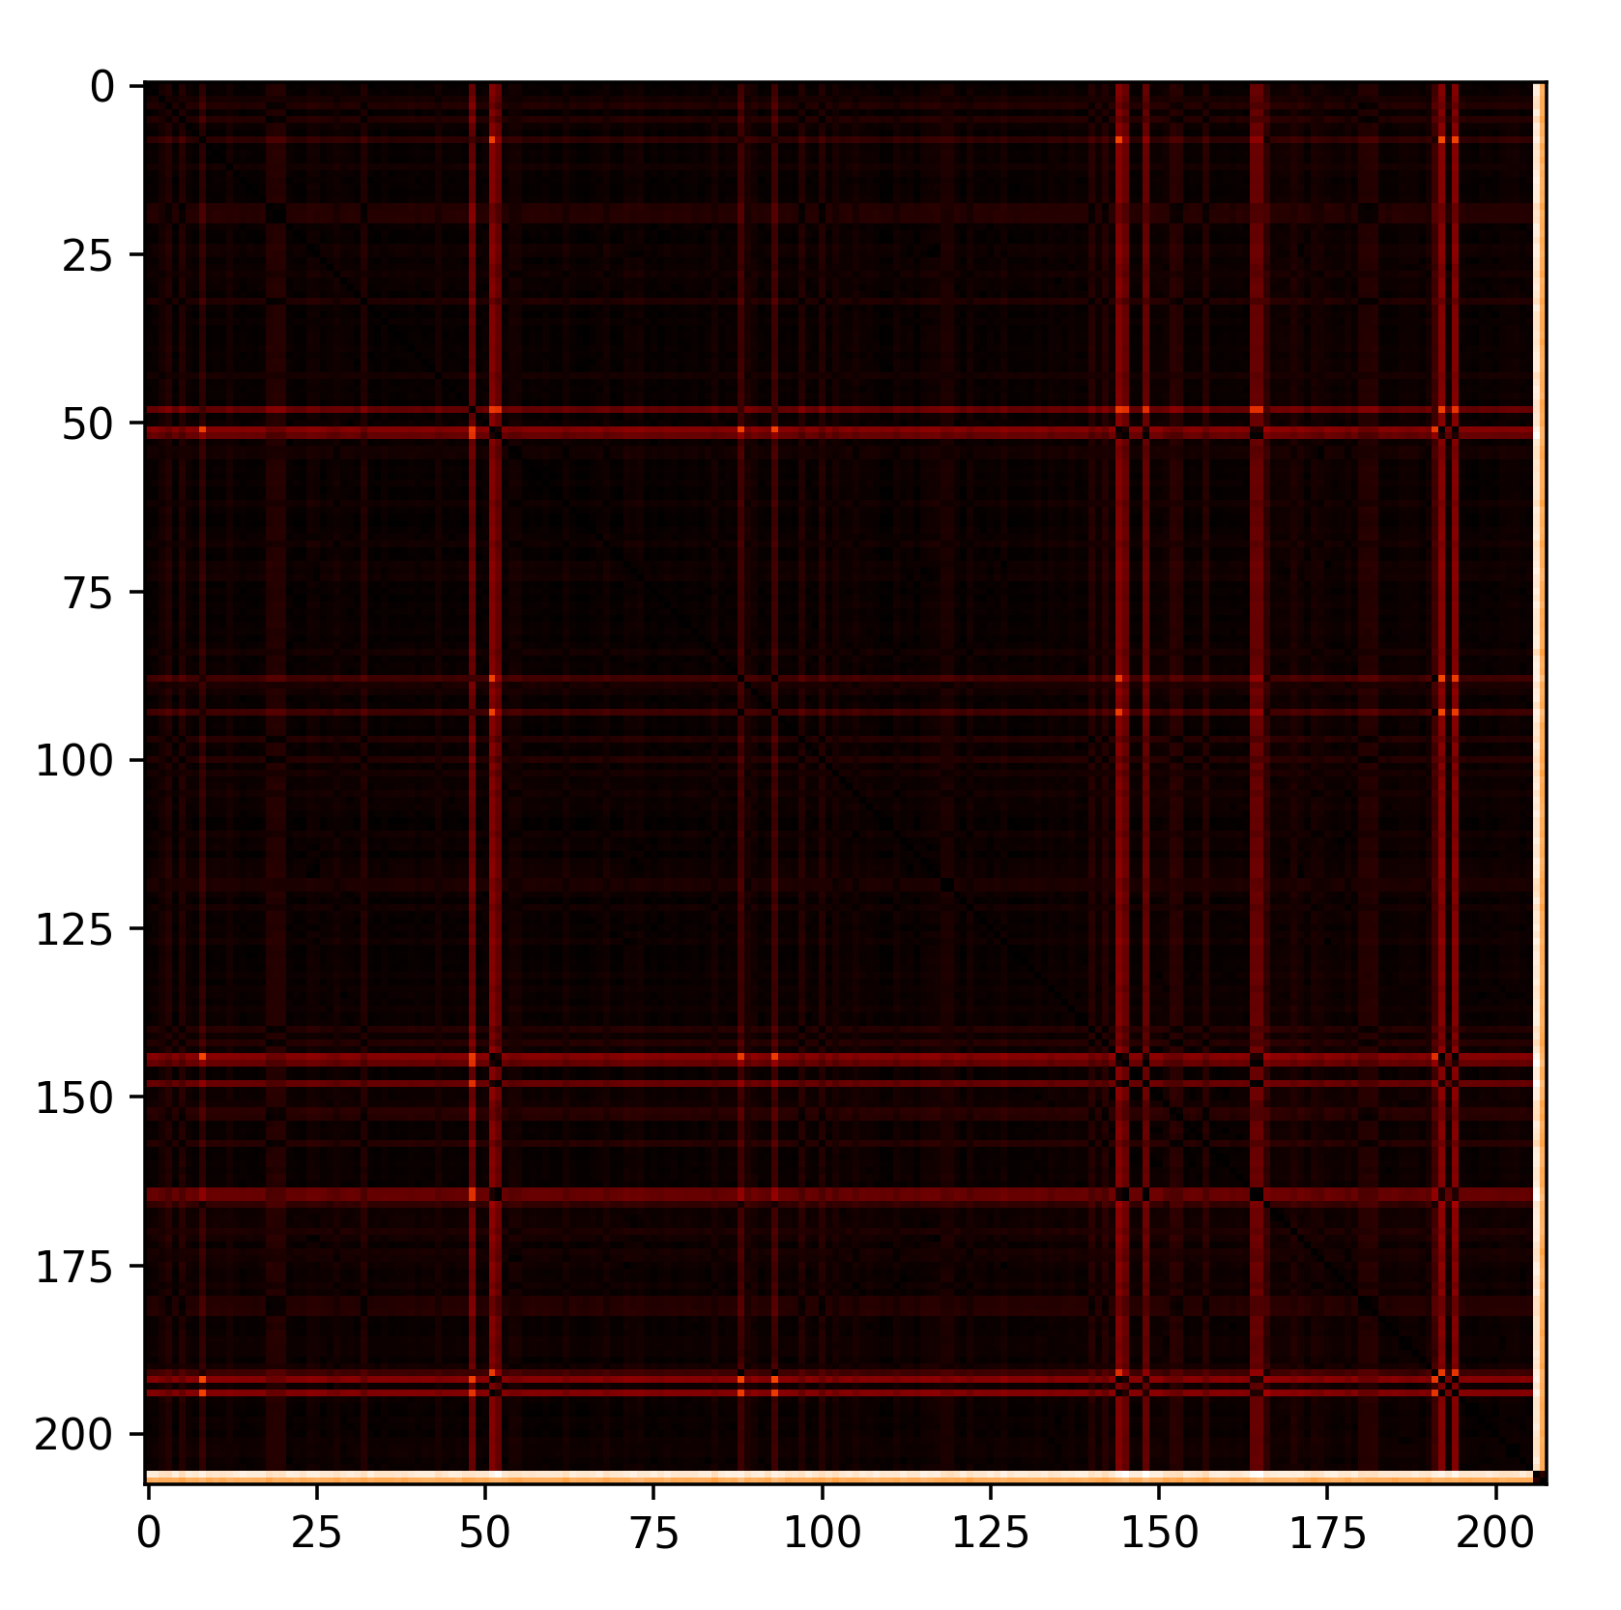
Experimental procedure Genetic Distances
Neanderthals
Neanderthals
Neanderthals

Slide 9
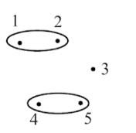
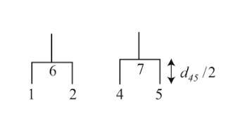
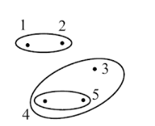
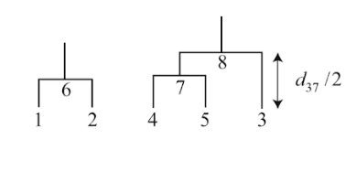
Experimental procedure
UPGMA

Slide 10
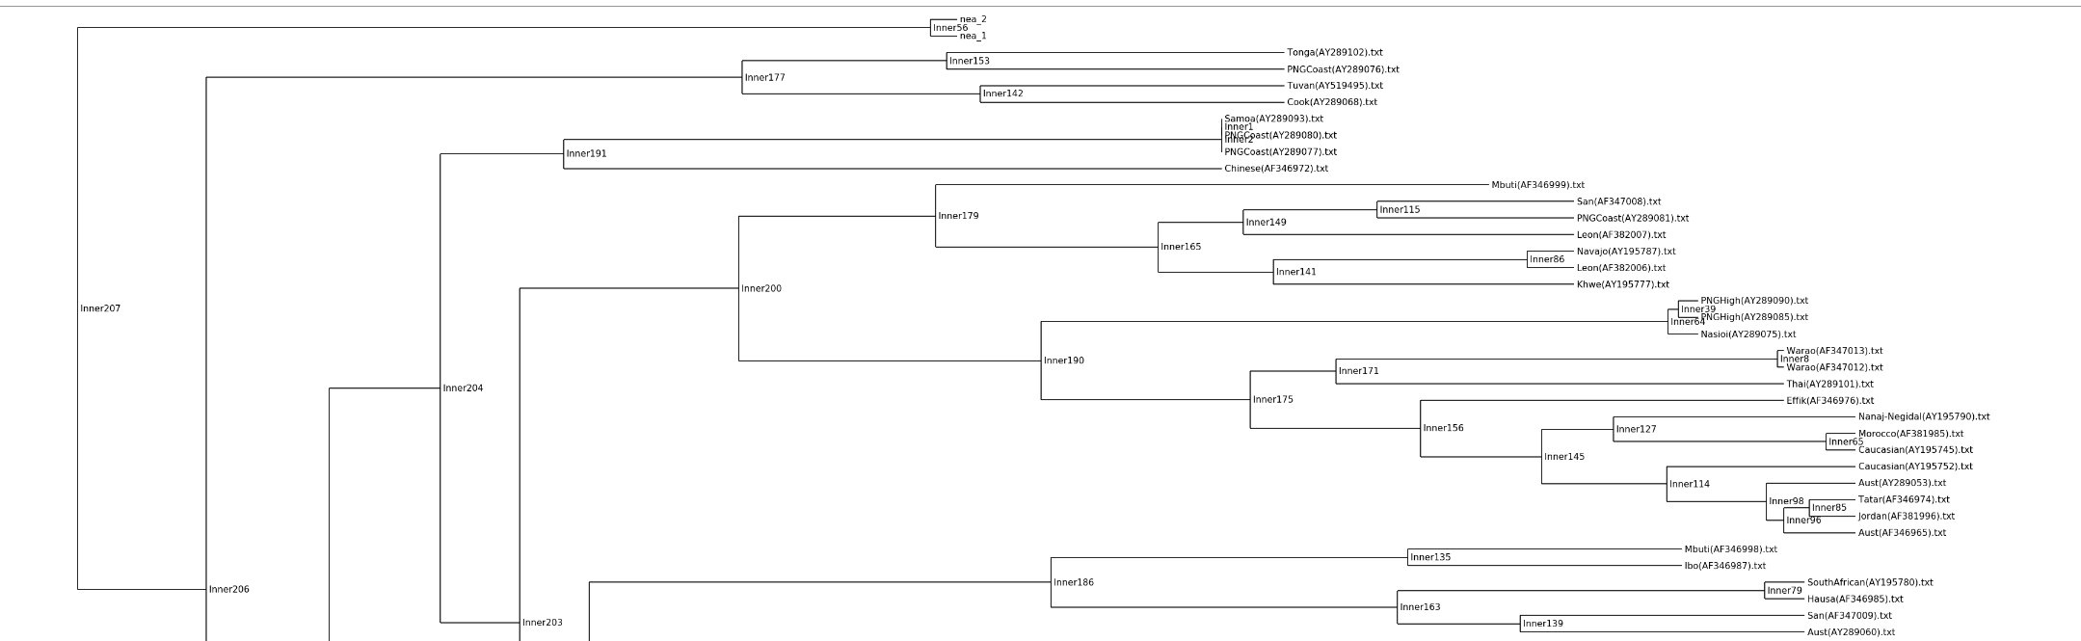
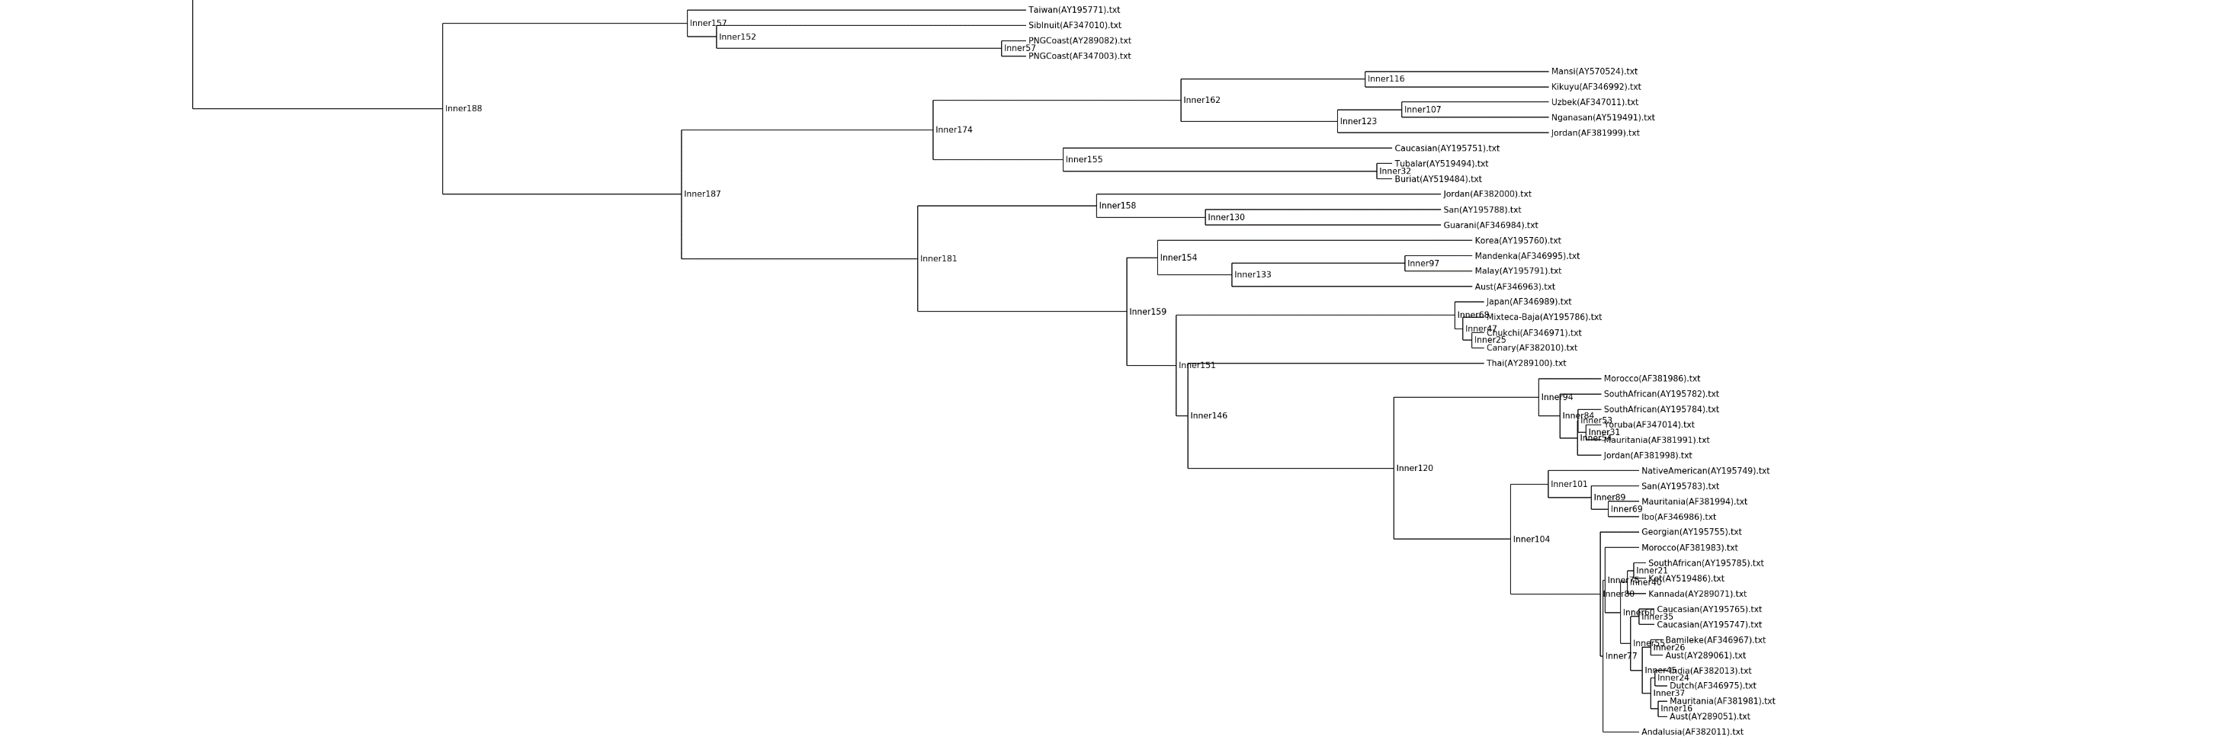
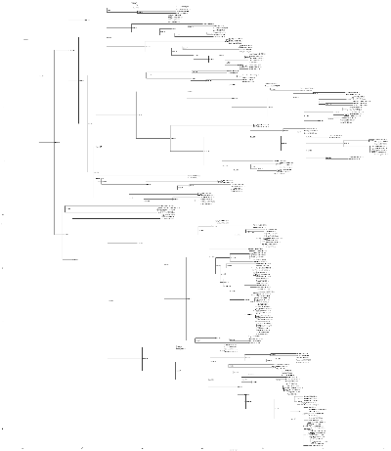
Phylogenetic tree of 206 modern humans and 2 neanderthals
neanderthals are genetically distant from modern humans
[…]

Slide 11
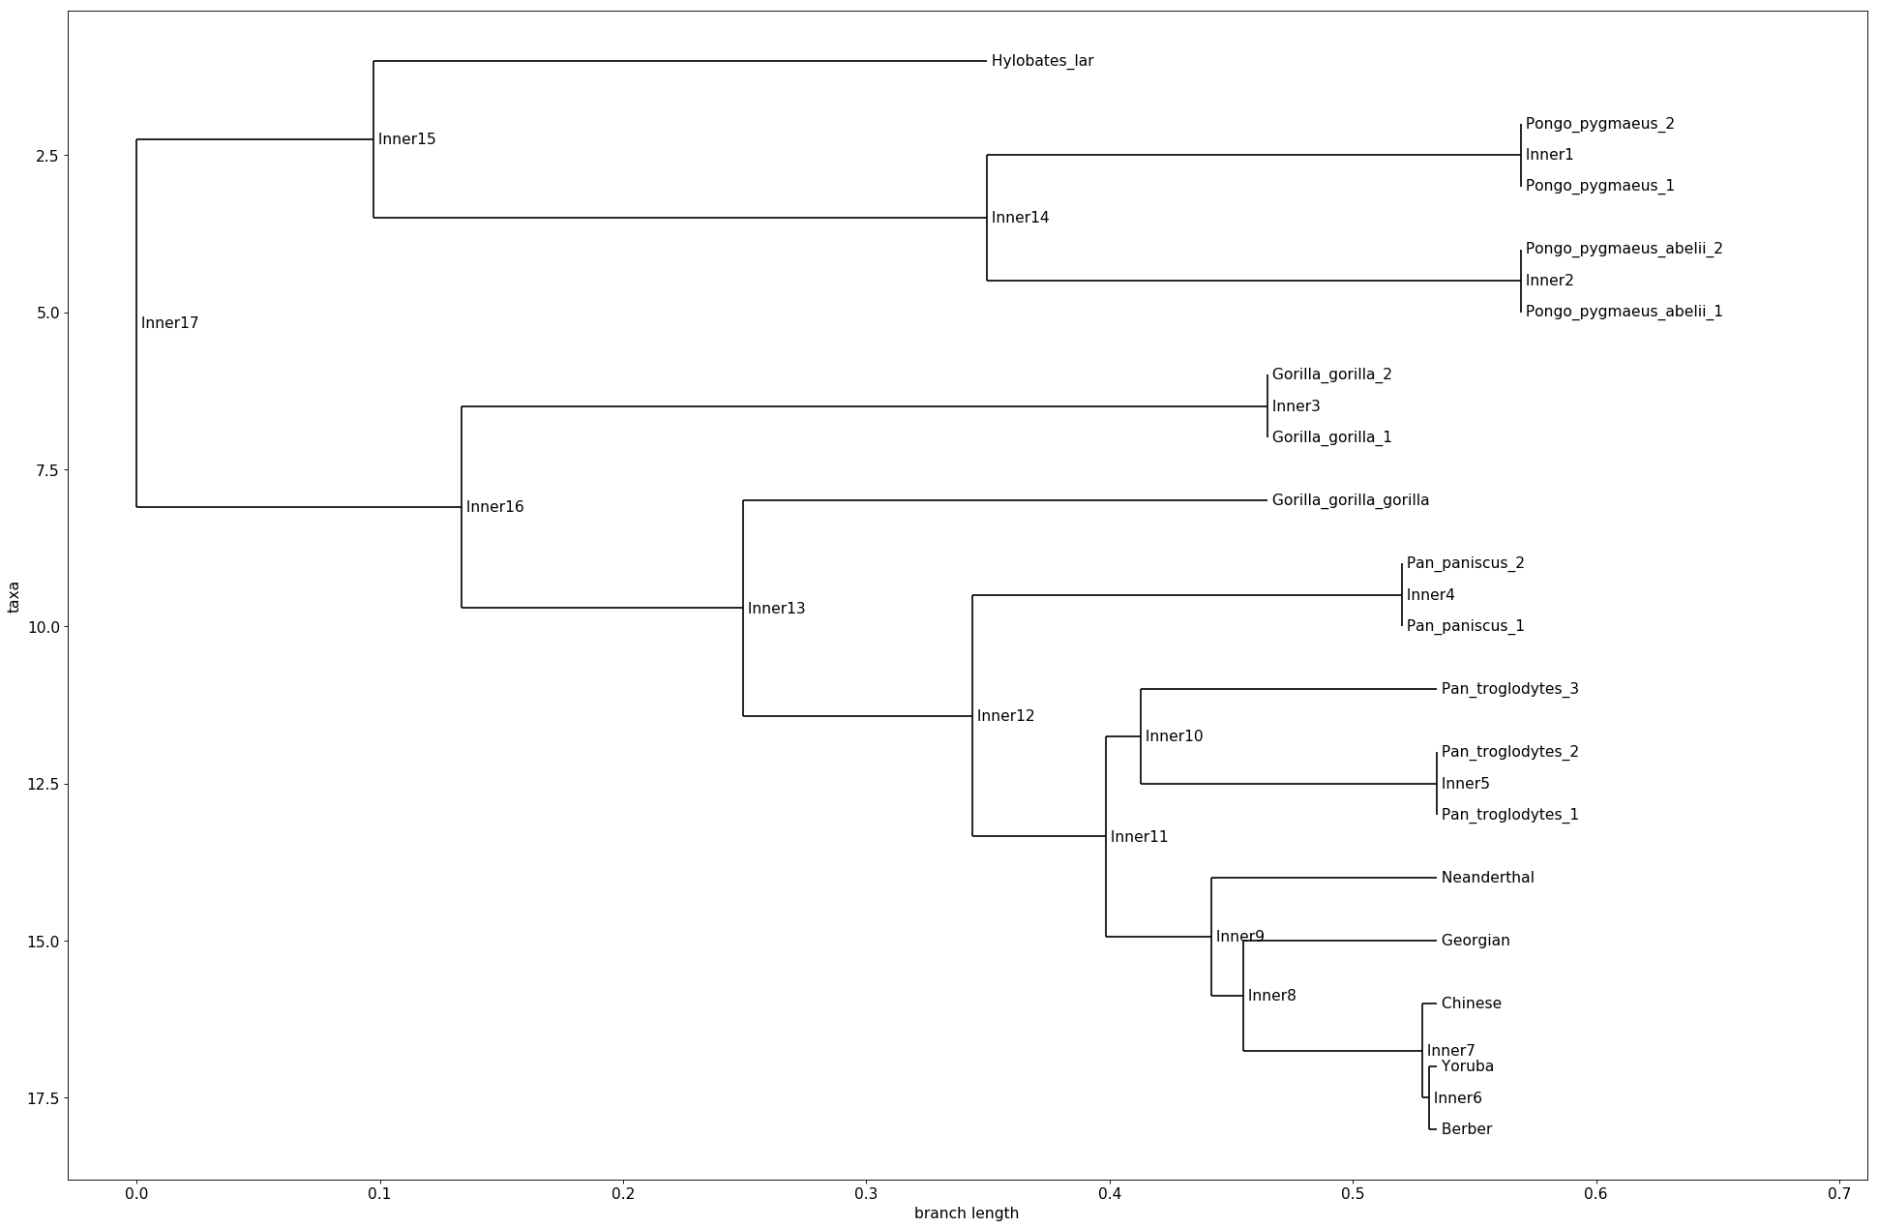

Slide 12
Conclusion
Neanderthal closely related to modern humans, when compared to other primates
The distance between Neanderthals and Humans show that they were two different species
Our results don’t show weather there was a geneflow between the two species
The split-off of Georgians from the other human groups, indicates that there might be inaccurate measurements. This could potentially be fixed by using different distance matrices.

Slide 13
References
Sriram Sankararaman et al.: The genomic landscape of Neanderthal ancestry in present-day humans. In: Nature. Band 507, 2014, S. 354–357, doi:10.1038/nature12961
https://www.ncbi.nlm.nih.gov/pubmed/20448178
https://www.eurekalert.org/pub_releases/2016-02/m-egf021616.php
Richard E. Green et al.: A Complete Neandertal Mitochondrial Genome Sequence Determined by High-Throughput Sequencing
https://www.theverge.com/2017/10/9/16448412/neanderthal-stone-age-human-genes-dna-schizophrenia-cholesterol-hair-skin-loneliness

Slide 14
Picture Courtesies
title picture (skulls): hairymuseummat https://www.theverge.com/2017/10/9/16448412/neanderthal-stone-age-human-genes-dna-schizophrenia-cholesterol-hair-skin-loneliness
Neanderthal skeleton: Claire Houck from New York City, USA - Neanderthal Skeleton
geneflow picture: http://news.bbc.co.uk/nol/shared/spl/hi/sci_nat/10/neanderthal/img/neanderthals_786.gif
mtDNA Picture: Emmanuel Douzery

