Slide 1
Discriminative Machine Learning
for Maximal Representative Subsampling
Laksan Nathan

Slide 2
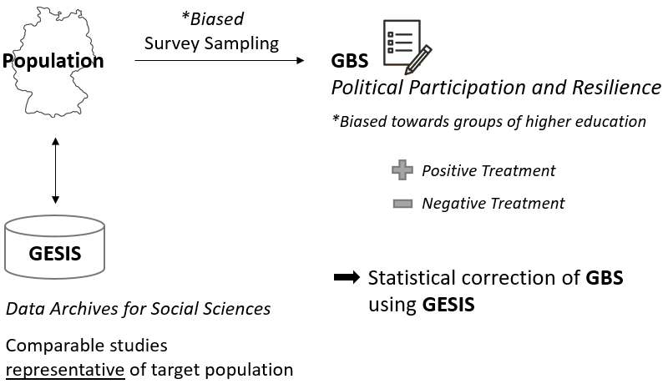
Outline
The Learning Problem
Overfitting
Covariate Shift
Results
One-Class Classification
Logistic Regression
Positive Unlabeled Learning
Future Work

Slide 3

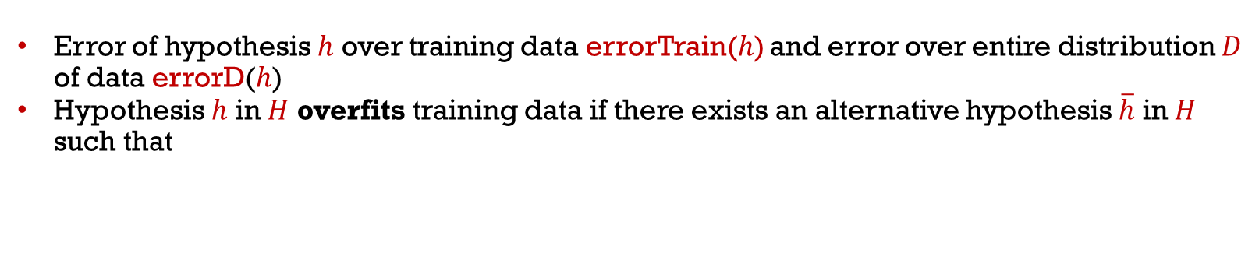
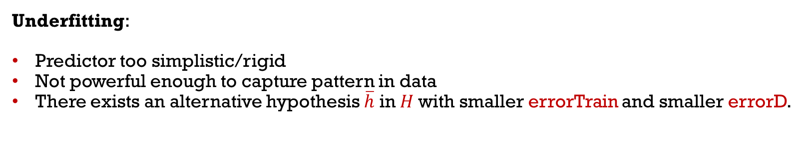
Overfitting
Error of hypothesis $h$ over training data errorTrain($h$) and error over entire distribution $D$ of data errorD($h$)
Hypothesis $h$ in $H$ overfits training data if there exists an alternative hypothesis $\overline{h}$ in $H$ such that
errorTrain($h$) < errorTrain($\overline{h}$)
and
errorD($h$) > errorD($\overline{h}$)
Data D
Train
Underfitting:
Predictor too simplistic/rigid
Not powerful enough to capture pattern in data
There exists an alternative hypothesis $\overline{h}$ in $H$with smaller errorTrain and smaller errorD.

Slide 4
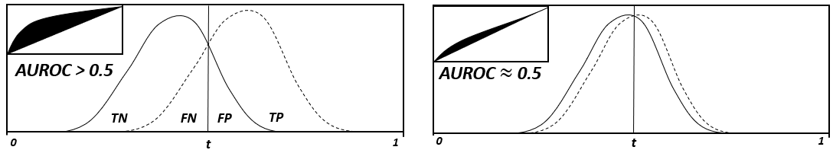
Covariate-Shift
Basic premise for (traditional) machine learning:
Training and test set are drawn i.i.d. from the same probability distribution.
Discriminative learners to predict the probability of the source of survey participant origin (GESIS or GBS).
Instance classified as GBS: regions of feature space overrepresented by GBS
→ Remove GBS instances from result set (Undersampling).
(AU)ROC as proxy measure for degree of bias.

Slide 5
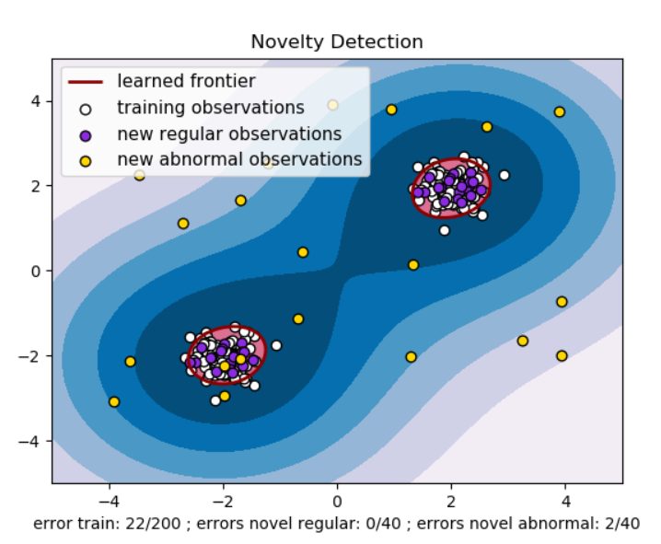
One-Class Support Vector Machines
One-class SVMs to classify GBS as similar or different to GESIS.
There is no proper probabilistic interpretation of SVM. Platt scaling as small „cheat“ simply fits another, probabilistic model, typically Logistic Regression, on top of SVM projection).
Instead, OCC-SVM voting ensemble trained on resamples of GESIS to get probabilities.

Slide 6
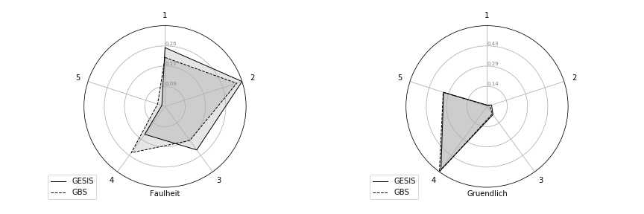
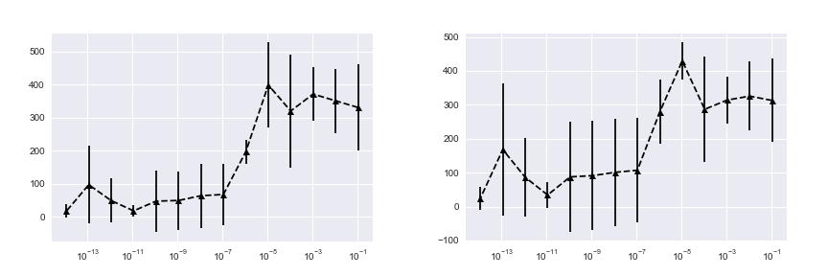
One-Class Support Vector Machines
Ideally, OCC-SVMs correctly classify most GESIS instances.
Experiments:
Ensemble suffers from high variance.
Not enough training data (?)
GESIS and GBS indistinguishable (with respect to BFI-10 attributes).
GBS GESIS

Slide 7
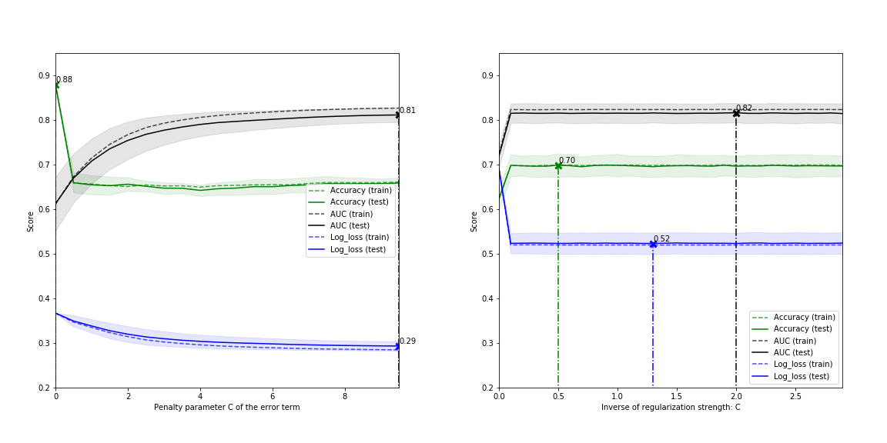
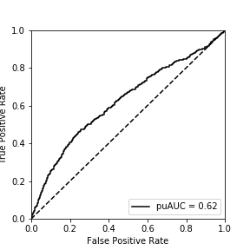
Binary Classification
Linear SVM (left) outperformed by Logistic Regression (right).
LR with puROC = 0.62 on hold-out set.
Nested strat. 10-fold CV for param tuning and training.

Slide 8
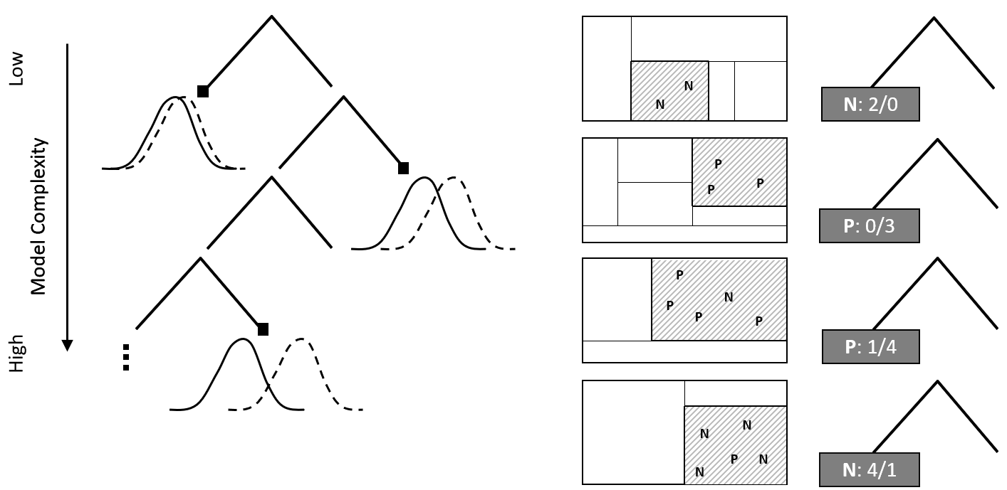
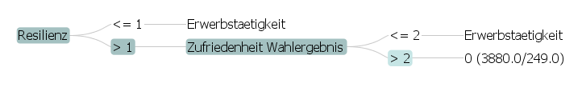
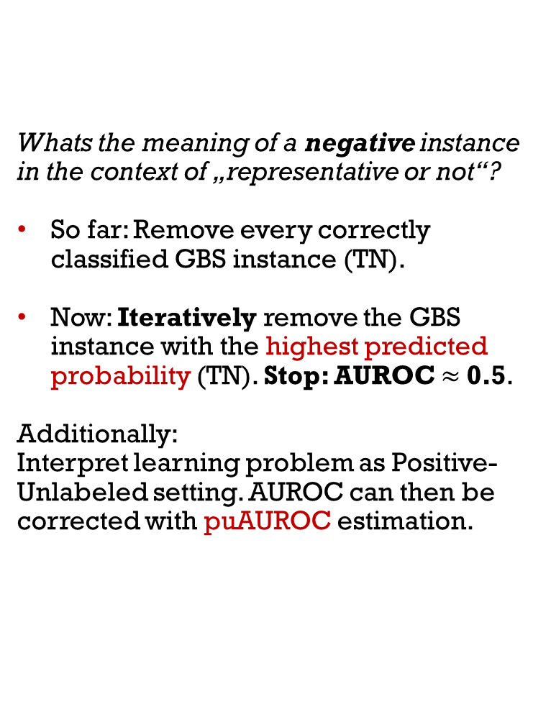
Positive Unlabeled Learning
(or: Iterative Removal of Most Accurate TNs)
Whats the meaning of a negative instance in the context of „representative or not“?
So far: Remove every correctly classified GBS instance (TN).
Now: Iteratively remove the GBS instance with the highest predicted probability (TN). Stop: AUROC $≈$0.5.
Additionally:
Interpret learning problem as Positive-Unlabeled setting. AUROC can then be corrected with puAUROC estimation.

Slide 9
Positive Unlabeled Learning
Zurückhaltend, leicht Vertrauen, Faulheit, Entspannt, wenig künstlerisches Interesse, Gesellig, Andere kritisieren, Gründlich, Nervös, Phantasievoll, Geschlecht, Netto-Haushalt, Netto-Selbst, Geburtsjahr, Geburtsland
puAUC reduction: 0.15 - 0.18
In addition: Berufsgruppe, Aktiv, Familienstand, Berufliche Ausbildung
puAUC reduction: 0.27 - 0.35

Slide 10
Positive Unlabeled Learning
Running (PU)-algorithm on these (additional) attributes pinpoints potential weaknesses:
If not properly stopped, then AUC keeps decreasing without converging to „random guessing“.
Stopping criterion cannot be (pu)AUC = 0.5.
Stopping criterion cannot be Highest Predicted Probability (of GBS) = 0.5.
In addition: Berufsgruppe, Aktiv, Familienstand, Berufliche Ausbildung
puAUC reduction: 0.27 - 0.35

Slide 11
Future Work
SMOTE as another way to validate results („oversampling before undersampling“).
Test methodology on academic datasets (less prone to mistakes in preprocessings).
Introduce stopping criterion (based on proper scoring rules). Only if number of instances to exclude is not known in advance.
For GESIS vs. GBS use F-Measure instead of AUC. This is due to high class imbalance.
Analyse Prediction of Political Participation and Resilience in GBS before and after Maximal Representative Subsampling
and…
…wait for new dataset „Brief Resilience Scale (BRS)“.

Slide 12
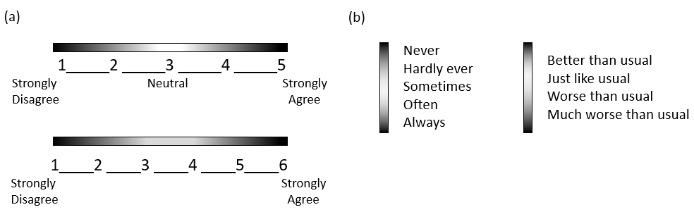
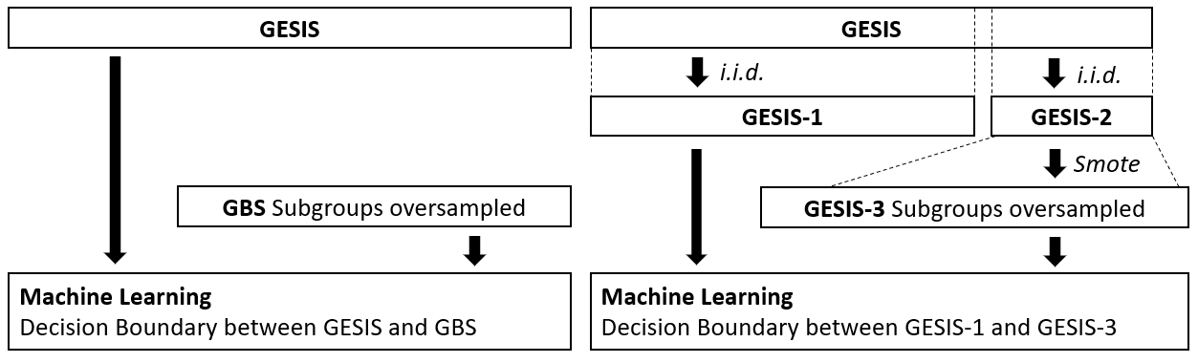
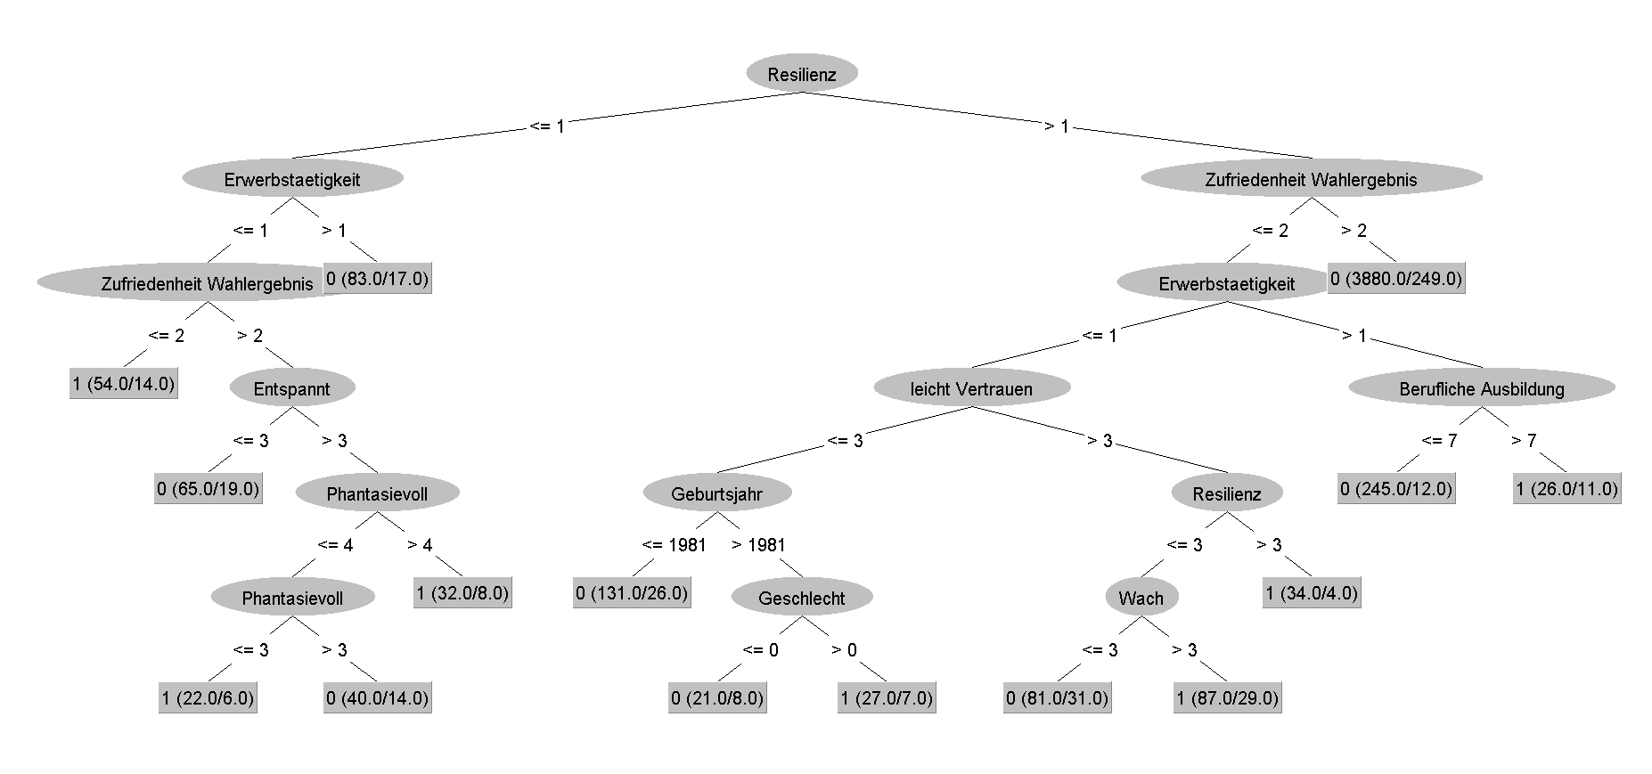
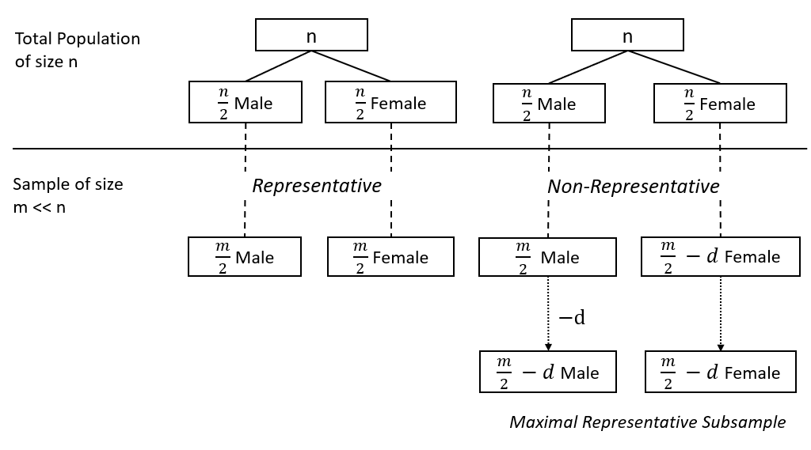
Appendix

Slide 13
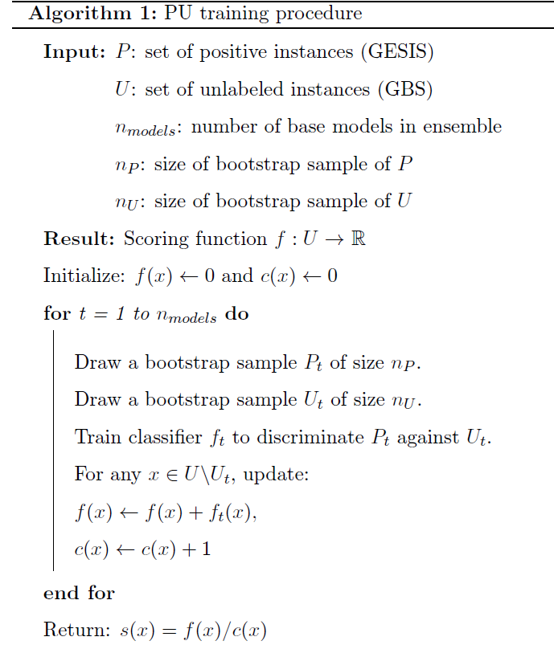
Appendix
Instead: Remove correctly classified GBS instance with highest predicted probability.

