Slide 1


*Biased
Survey Sampling
Population
GBS
Political Participation and Resilience
*Biased towards groups of higher education
Positive Treatment
Negative Treatment
GESIS
Statistical correction of GBS using GESIS
Data Archives for Social Sciences
Comparable studies
representative of target population

Slide 2
GESIS
GESIS
i.i.d.
i.i.d.
GESIS-1
GESIS-2
Smote
GBS Subgroups oversampled
GESIS-3 Subgroups oversampled
Machine Learning
Decision Boundary between GESIS and GBS
Machine Learning
Decision Boundary between GESIS-1 and GESIS-3
GESIS: positive class
GBS: negative class
True negatives are removed from result set
GESIS-1: positive class
GESIS-3: negative class
True negatives are removed from result set

Slide 3
GESIS
GESIS
i.i.d.
i.i.d.
GESIS-1
GESIS-2
Smote
GBS Subgroups oversampled
GESIS-3 Subgroups oversampled
Machine Learning
Decision Boundary between GESIS and GBS
Machine Learning
Decision Boundary between GESIS-1 and GESIS-3

Slide 4
Initial Data Analysis
Initial Data Analysis
Research Question
Predicting Political Participation in GBS
Feature Importance of Psychological Resilience
→ Results might be biased
Maximal Representative Subsample of GBS
Predicting Survey of Participants
Binary Classification
x
Positive Unlabeled Learning
with adjusted evaluation metrics
Dataset Comparison
Predicting Political Participation in GESIS
… (after all is done; Results)
Predicting Political Participation on subset of GBS
Feature Importance of Psychological Resilience
→ Results might be less biased

Slide 5











n
n
Total Population
of size n
$\frac{n}{2}$Male
$\frac{n}{2}$Female
$\frac{n}{2}$Male
$\frac{n}{2}$Female
Sample of size
m << n
Representative
Non-Representative
$\frac{m}{2}$Male
$\frac{m}{2}$Female
$\frac{m}{2}$ Male
$\frac{m}{2} −d$Female
$$−d$$
$\frac{m}{2} −d$Male
$\frac{m}{2} −d$Female
Maximal Representative Subsample

Slide 6
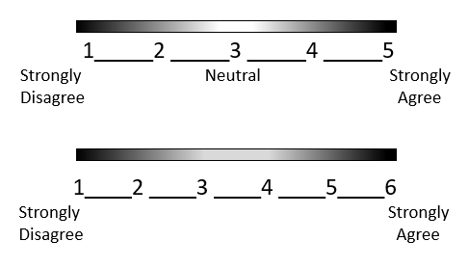
Never
Hardly ever
Sometimes
Often
Always
Better than usual
Just like usual
Worse than usual
Much worse than usual

Slide 7

AUROC > 0.5
AUROC $≈$ 0.5
TN
FN
FP
TP
0
t
1
0
t
1

Slide 8
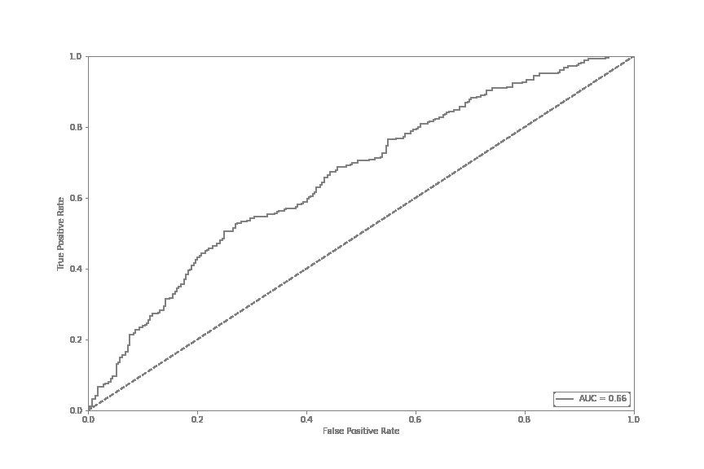
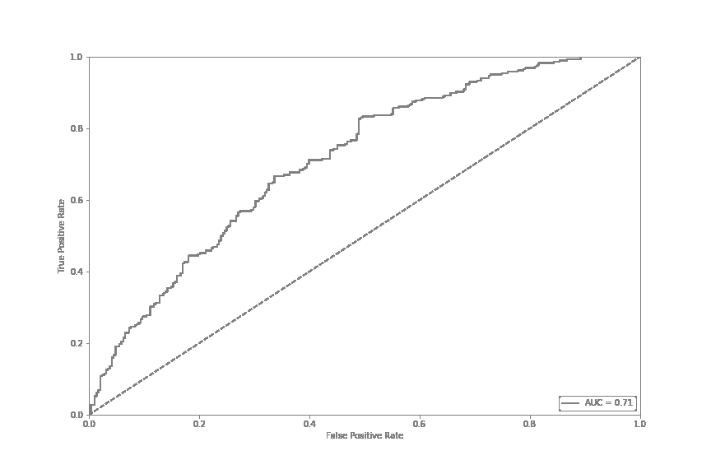
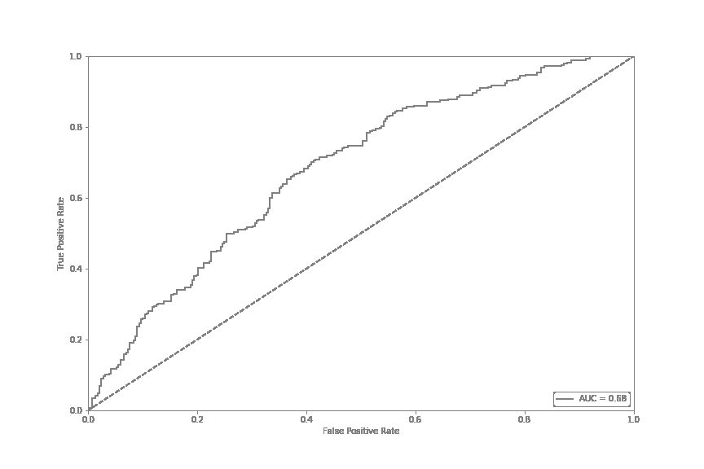
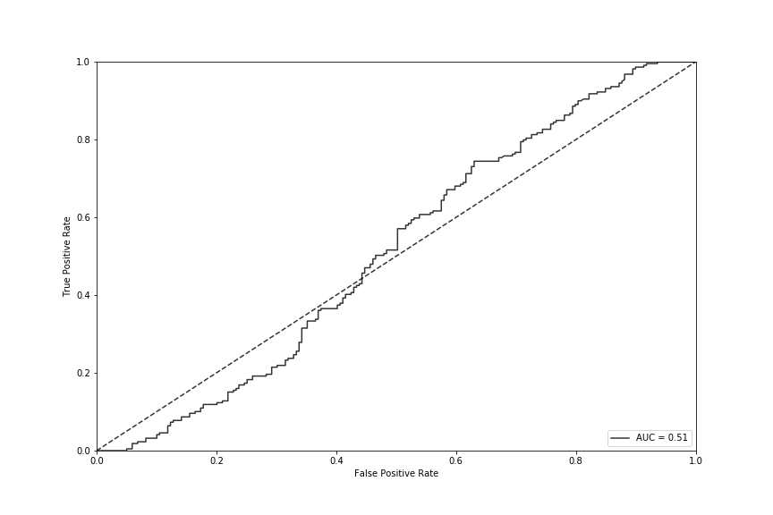
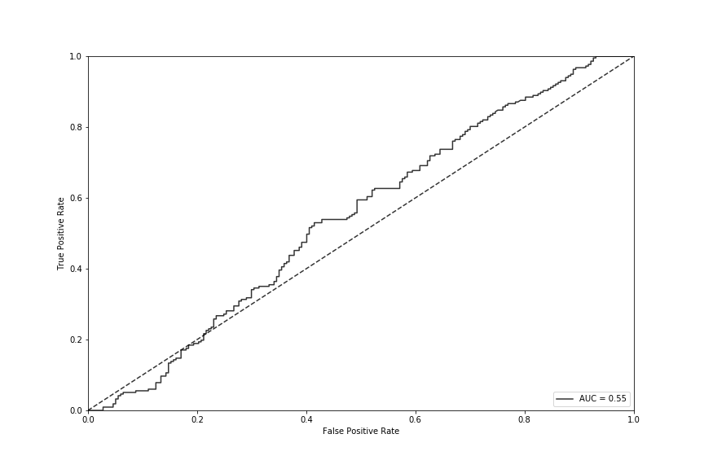
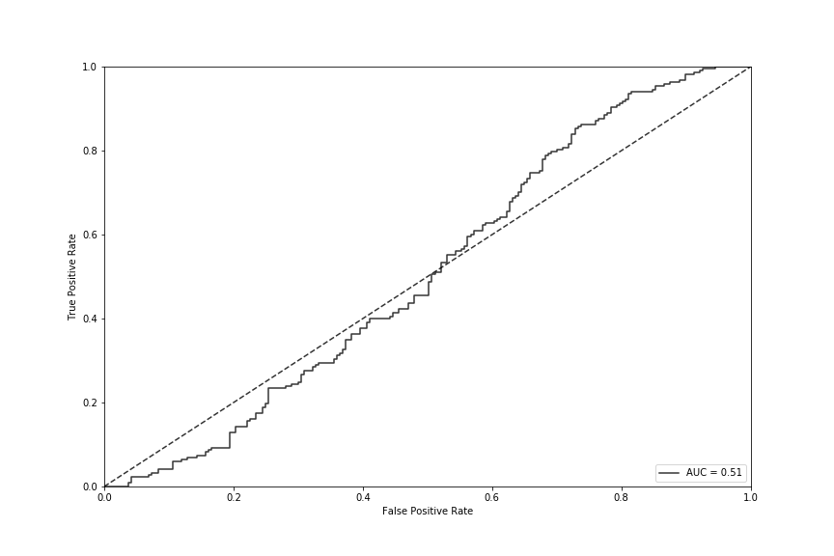
Iteration 1: AUROC = 0.66
Iteration 2: AUROC = 0.71
Iteration 3: AUROC = 0.68
Iteration 141: AUROC = 0.51
Iteration 142: AUROC = 0.55
Iteration 143: AUROC = 0.51

Slide 9
4. Rescale
Values
1. Add Feature
3. Error
Analysis
2. Run
Algorithm

Slide 10
Low
Model Complexity
Model Complexity
High

Slide 11
Low
N
N
N: 2/0
P
P
P
Model Complexity
Model Complexity
P: 0/3
P
P
N
P
P
High
P: 1/4
N
N
N
P
N
N: 4/1

Slide 12
N
N
N: 2/0
P
P
P
P: 0/3
P
P
N
P
P
P: 1/4
N
N
N
P
N
N: 4/1

Slide 13
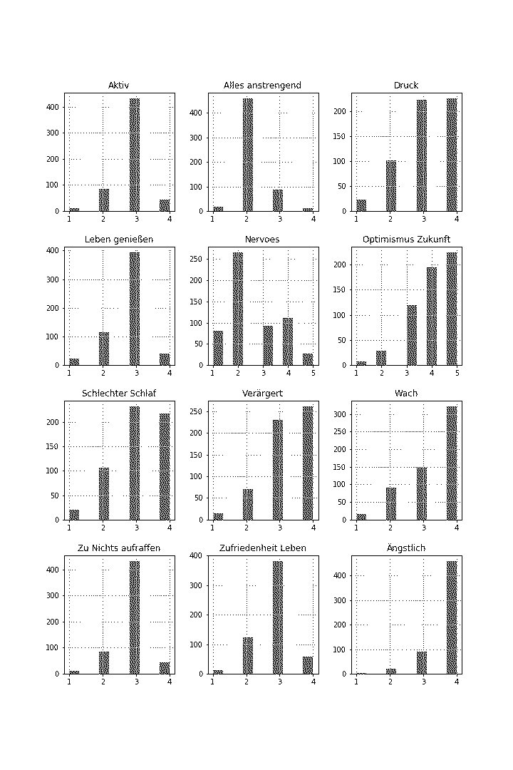
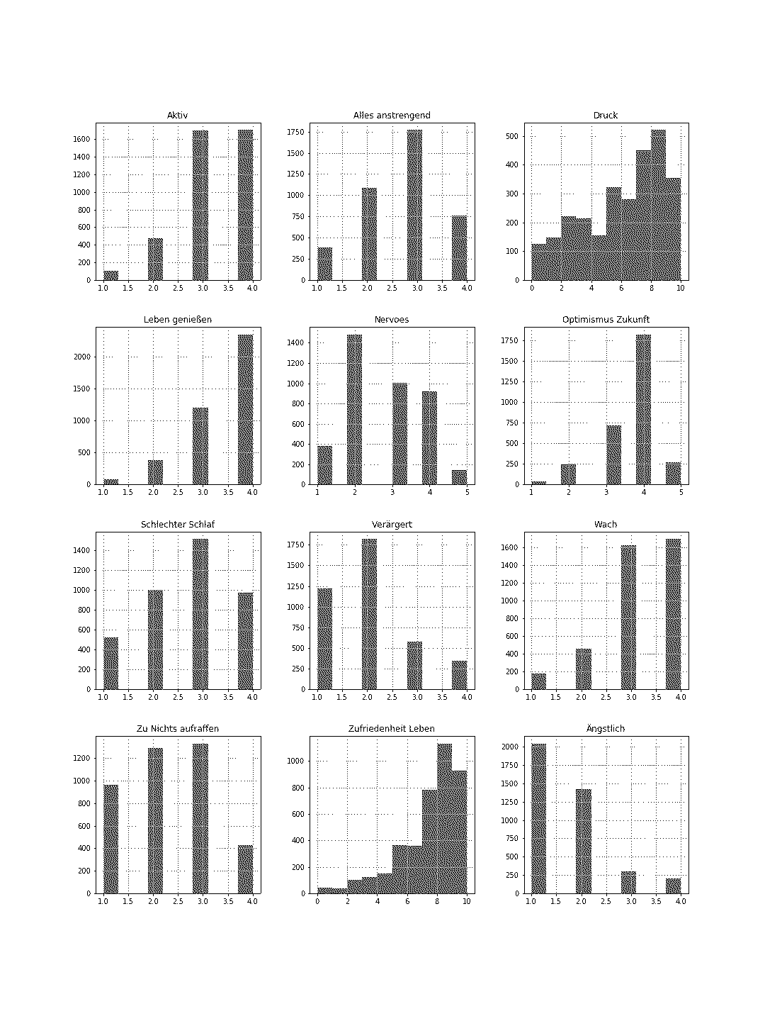

Slide 14
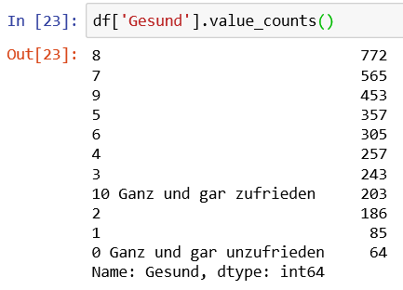
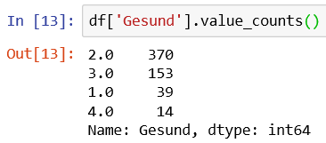

Slide 15
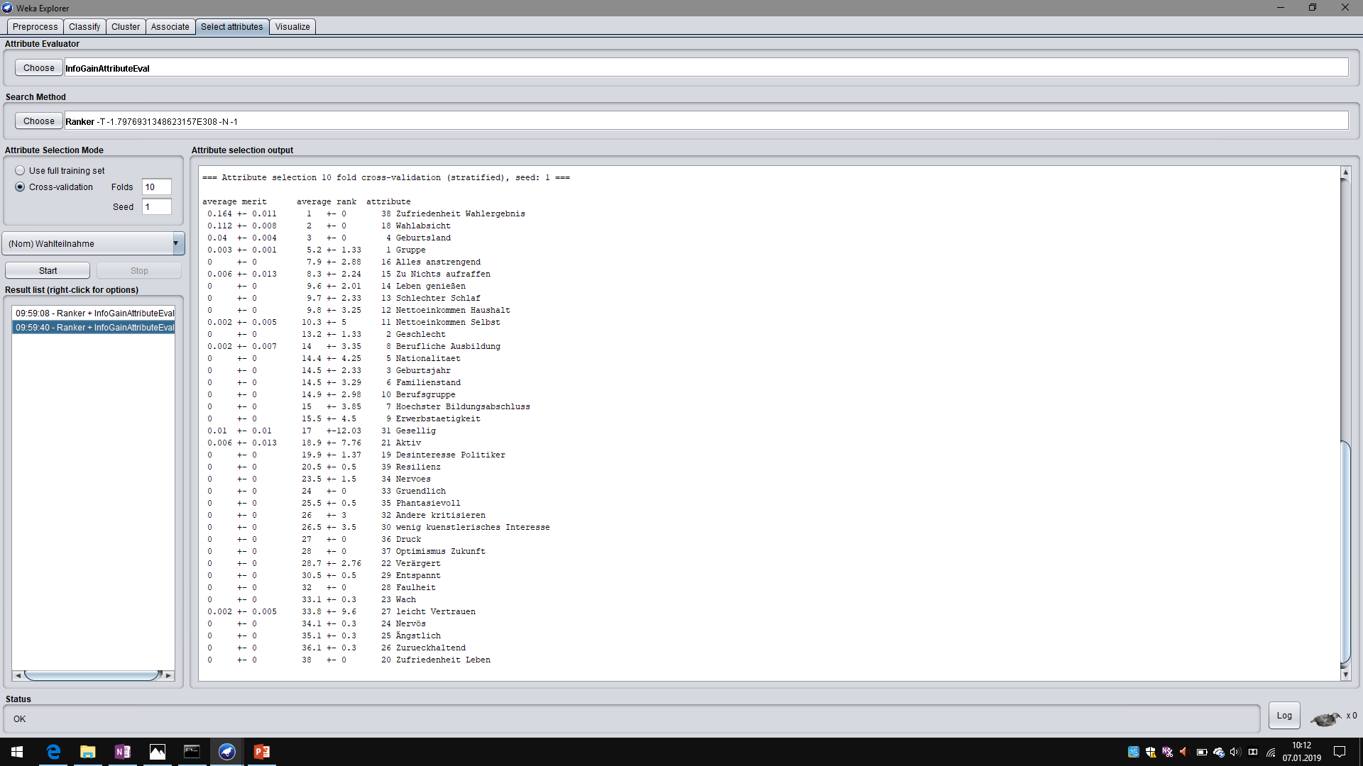

Slide 16
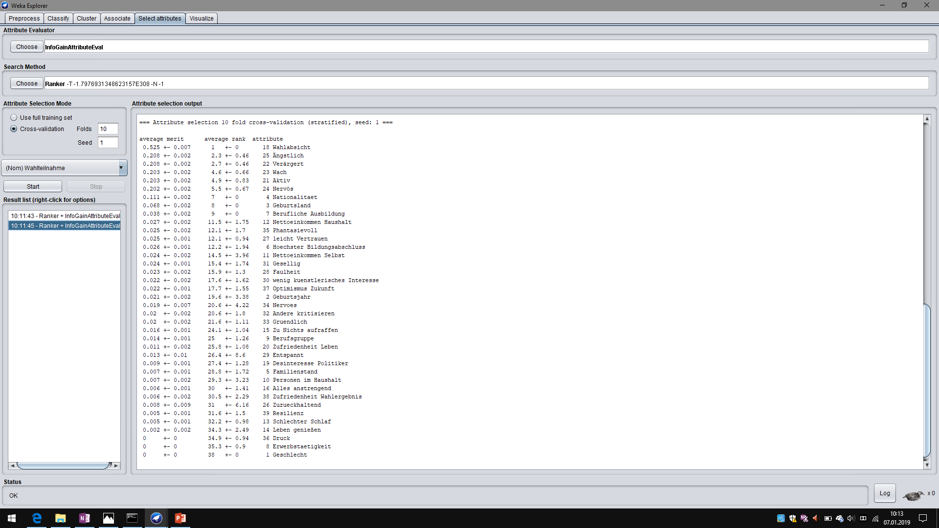

Slide 17
