Slide 1
Quality-Aware, Parallel, Multistage Detection and Correction of Sequencing Errors using Storm
Lakshmisha Bhat
Johns Hopkins University

Slide 2
Illumina Sequencing
Illumina Sequencing Video
Short reads, high coverage, large data
0.5-2.5 Substitution Errors (Kelly et. al)
Substitution bias

Slide 4
Error Correction
If we can correct sequencing errors up-front, we can prevent De Bruijn graph from growing much beyond the G bound
How do we correct errors?
Consider two k-mers that are within a small Hamming distance and present in the read dataset.
If our genome does not contain many non-exact repeats, then it is likely that both of these k-mers were generated by the k-mer among them that has higher multiplicity.

Slide 6
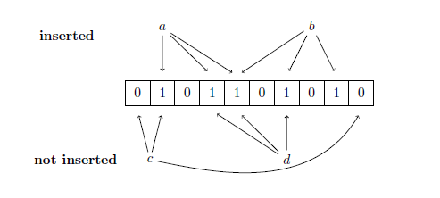
Bloom Filter
An example of a Bloom filter with three hash functions.
The k-mers a and b have been inserted, but c and d have not.
The Bloom filter indicates correctly that k-mer c has not been inserted since not all of its bits are set to 1. k-mer d has not been inserted, but since its bits were set to 1 by the insertion of a and b, the Bloom filter falsely reports that d has been seen already.
But we use a distributed Bloom Filter

Slide 7
Storm Topology

Slide 8
Error Correction: Overlaps (Kelly et. al 2010)

Slide 9
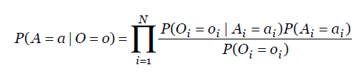


Error Correction: Model
Kelly et al. 2010
Simple Naïve Bayes Model.
Makes Independence Assumptions.

Slide 10
Experiments

Slide 11
Strom: Setup
4 Node cluster. 1 Nimbus, 3 supervisors, 8 workers.
32/64 Executors per bolt.
That’s a lot of threads!

Slide 12
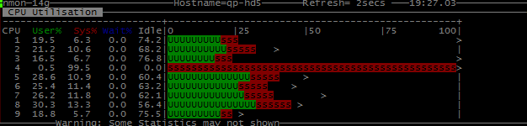
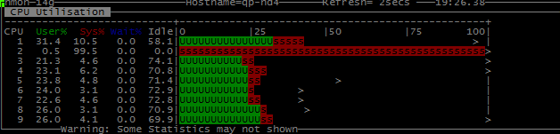
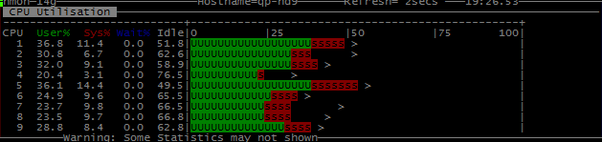
Strom: Load Distribution
4 Node cluster. 1 Nimbus, 3 supervisors, 8 workers.
32/64 Executors per bolt.

Slide 13
Results: Comparison by Yang et al. 2012

Slide 14
Results: Discussion
We do it in 40 minutes.
BUT, storm has been benchmarked to process 1 Million 100 B messages/second and we are only able to push 100,000/s.
We persist all the data while other systems are just in-memory.
We are using single spout.
We are fault-tolerant with exactly once semantics.
But do we care?
Is this really a streaming application?

Slide 15

Namaste

