Slide 1
Disc Space Renting System
By
Laksh Gangwani- 18BCS046
Ashutosh Ghanto - 18BCS014
Avinash Kumar - 18BCS015
Sujeet Kumar - 18BCS100

Slide 2
CONTENTS
IDEA
INTERPLANETARY FILE STORAGE
IMPLEMENTATION
NEED OF A NEW INTERNET PROTOCOL??
BLOCKCHAIN
RESULTS
TECHNOLOGY
DESIGN
CONCLUSION AND SCOPE

Slide 3
Next generation end to end encrypted, decentralized file storage system using blockchain technology where only you have access to your data.
IDEA

Slide 4
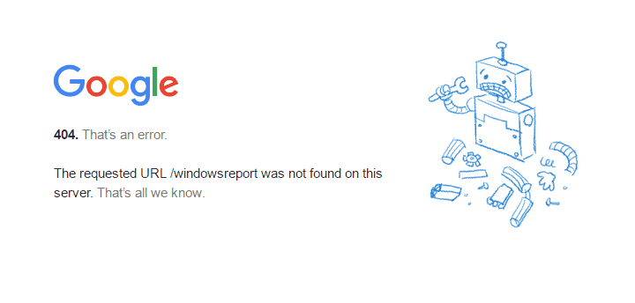
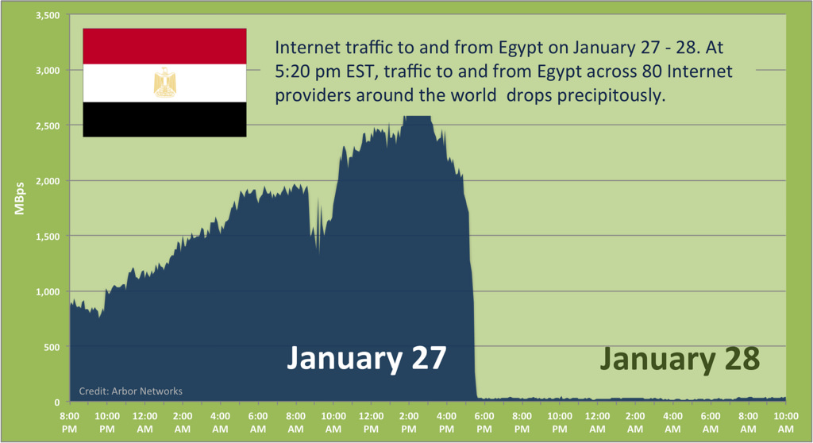
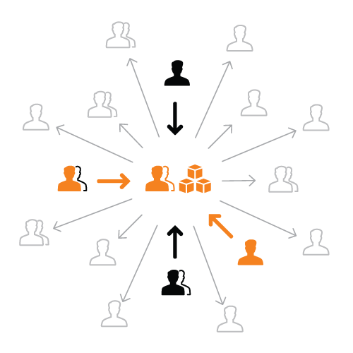
NEED OF A NEW INTERNET PROTOCOL
Single point of Failure
Impermanence
Censorship

Slide 5


INTERPLANETARY FILE STORAGE (IPFS)
A protocol and network designed to create a content-addressable, peer-to-peer method of storing and sharing hypermedia.
TECHNOLOGY
BLOCKCHAIN
A digital ledger in which transactions made in bitcoin or another cryptocurrency are recorded chronologically and publicly.

Slide 6
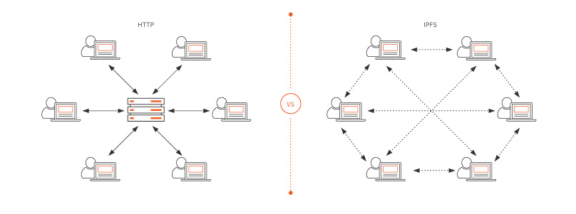
HTTP
Location Addressing
IPFS
Content Addressing

Slide 7
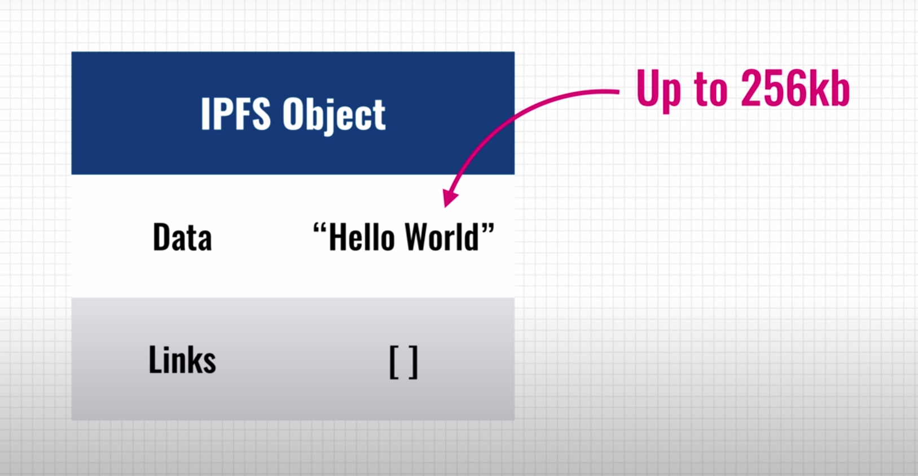

Slide 8
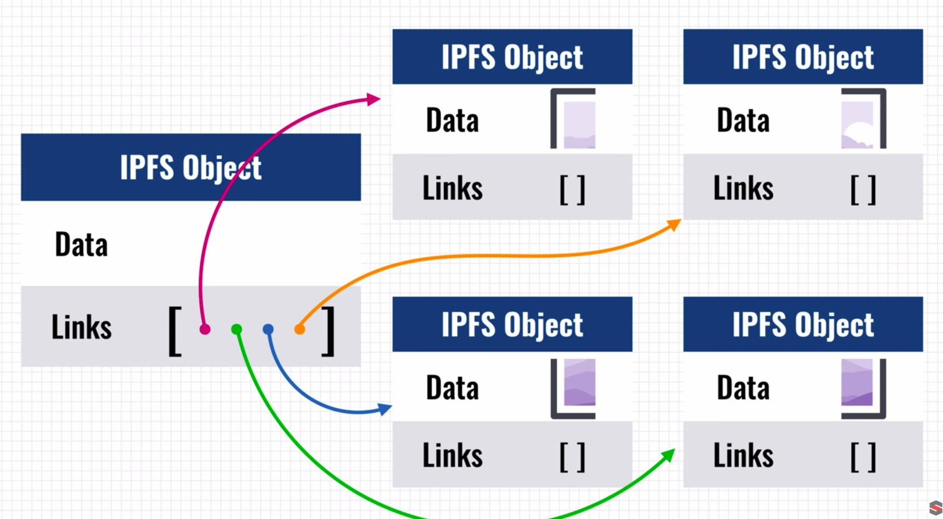

Slide 9
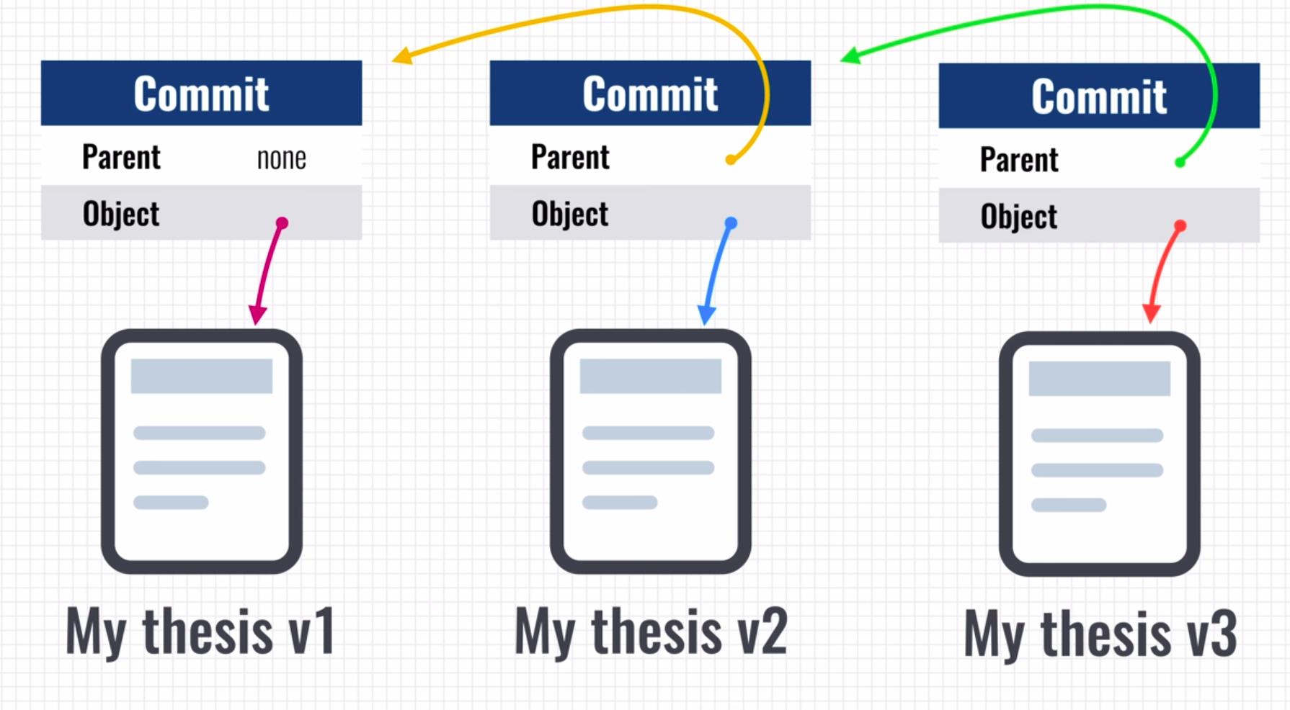

Slide 10
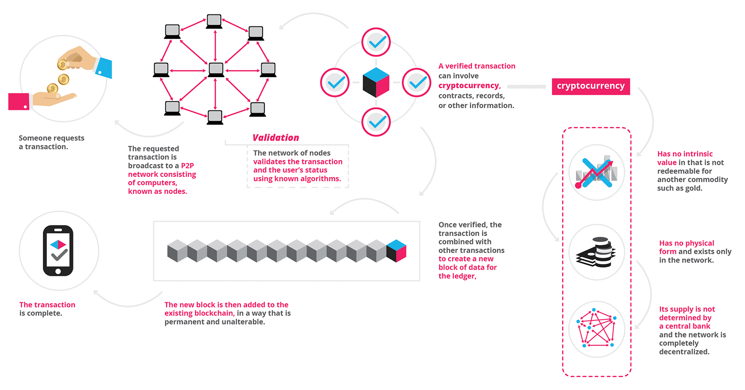
WHY BLOCKCHAIN

Slide 11
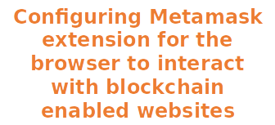
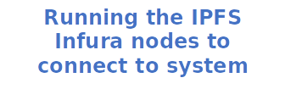

IMPLEMENTATION
IPFS INFURA
METAMASK
NODE JS
SMART CONTRACTS
ETHEREUM
Contracts implemented on remix ide nodes for legit connection
Ethereum blockchain to store the hash of the saved file on Ipfs

Slide 12
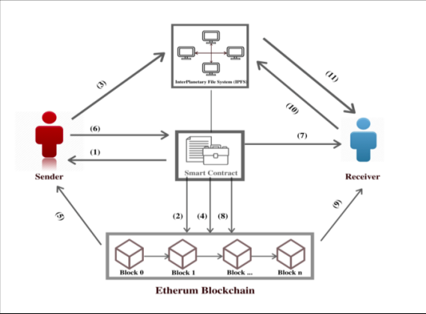
DESIGN

Slide 13
RESULTS
The system is able to share and store files in a secured way. Combination of Ethereum blockchain and InterPlanetary File System (IPFS) works together efficiently. Blockchain and InterPlanetary File System (IPFS) ensures high data security for the system.

Slide 14
SCOPE
Storage Platform leveraging underutilized hard drive capacity around the world to create a data storage marketplace that is more reliable and lower cost than traditional cloud storage

