Slide 1
Email System securing and encrypting channel based on PGP and DNS
INFORMATION SECURITY ANALYSIS AND AUDIT

Slide 2
PROJECT MEMBERS
SHOURYA MAHESHWARI(18BCI0179)
LAKSH GUPTA(18BCI0190)
MIHIR SRIVASTAVA(18BCI0214)

Slide 3
ABSTRACT
Here we try to implement a custom email application using techniques like ssl and tls, and an openpgp application using pretty good privacy itself and due to this when we try to intercept packets while sending the email, we find the packets to be encrypted.
Our email app helps protect the email by converting the content of the email to an unreadable gpg file, to read this gpg file we need a secret key that is known only to the sender of the email and the sender has to send this to the receiver via some other secure channel.
DNS is a TCP/IP protocol used on different platforms. The domain name space is divided into three different sections: generic domains, country domains, and inverse domain. DNS cache poisoning, also known as DNS spoofing, is a type of attack that exploits vulnerabilities in the domain name system (DNS) to divert Internet traffic away from legitimate servers and towards fake ones.

Slide 4
TASKS
Open PGP implementation using subprocess
RSA Based Key Pair Generation using OPENPGP Tool: Private and Public
Generate a gpg file using subprocess using our app
GPG file uses RSA and PGP Digital Signature for Authenticity and Integrity
Packet Capturing and checking whether message is encrypted or not
Creating a python application which is capable of sending email using SMTPLIB
Encrypting the channel through which the mail is sent using TLS
Using Packet Capturing tools to detect whether channel is secure or not
To create an authentication system which will detect any DNS spoofing or DNS cache poisoning and preventing server to return an incorrect result record or IP Address.

Slide 5
METHODOLOGY
Pretty Good Privacy (PGP)
is a program that converts text to pgp file provides cryptographic privacy and authentication for data communication. PGP is used for signing, encrypting, and decrypting texts, e-mails, files, directories, and whole disk partitions and to increase the security of e-mail communications.
For exporting pgp file through email we will use our pgp code. It is designed especially for functions like emailing
With the help of this first we generate our key pair and a GPG File using message = subprocess.check_output(["gpg", "--armor", "--export", email, ">", file])
Then we will share our File with people who want to send mail to us.
After receiving the mail from others we will try to open the GPG File using our custom python application using subprocess using subprocess.call(["gpg", "--output", name_file, "--decrypt", encrypted_file]) .
This will help us to protect our mail from any attacker who try to see our mail.

Slide 6
CUSTOM PYTHON EMAIL APP
Python console emailer is a console (terminal) based python application that allows the user to sign in to their email and generate a PGP pair. The application allows the user to insert a morphed text file in the email via the command line (terminal).
The purpose of this project is to gain a greater understanding of how emails are created, encrypted, and sent. The application can be developed with the smtplib python module to emulate some of the functionality of the email python module.
The python app also allows the user to convert txt file to gpg files and vice versa.
server = smtplib.SMTP("smtp.gmail.com", 587)
server.starttls()
server.login(sender, password)
server.sendmail(sender, receiver, msg)
server.quit()
print("Mail sent successfully")

Slide 7
DNS
Mailserver for proper sending and receiving of mail, it is necessary to configure your public DNS records so that other mail servers can find you to send mail to your users, and so that other mailservers will trust you to receive your mail. There are also DNS records designed to protect you from spam and to help other servers to trust that your server is not a spam host. This article attempts to put all the DNS considerations together into one document for your review.
The Domain Name System (DNS) is a hierarchical and decentralized naming system for computers, services, or other resources connected to the Internet or a private network. It associates various information with domain names assigned to each of the participating entities. Most prominently, it translates more readily memorized domain names to the numerical IP addresses needed for locating and identifying computer services and devices with the underlying network protocols.

Slide 8
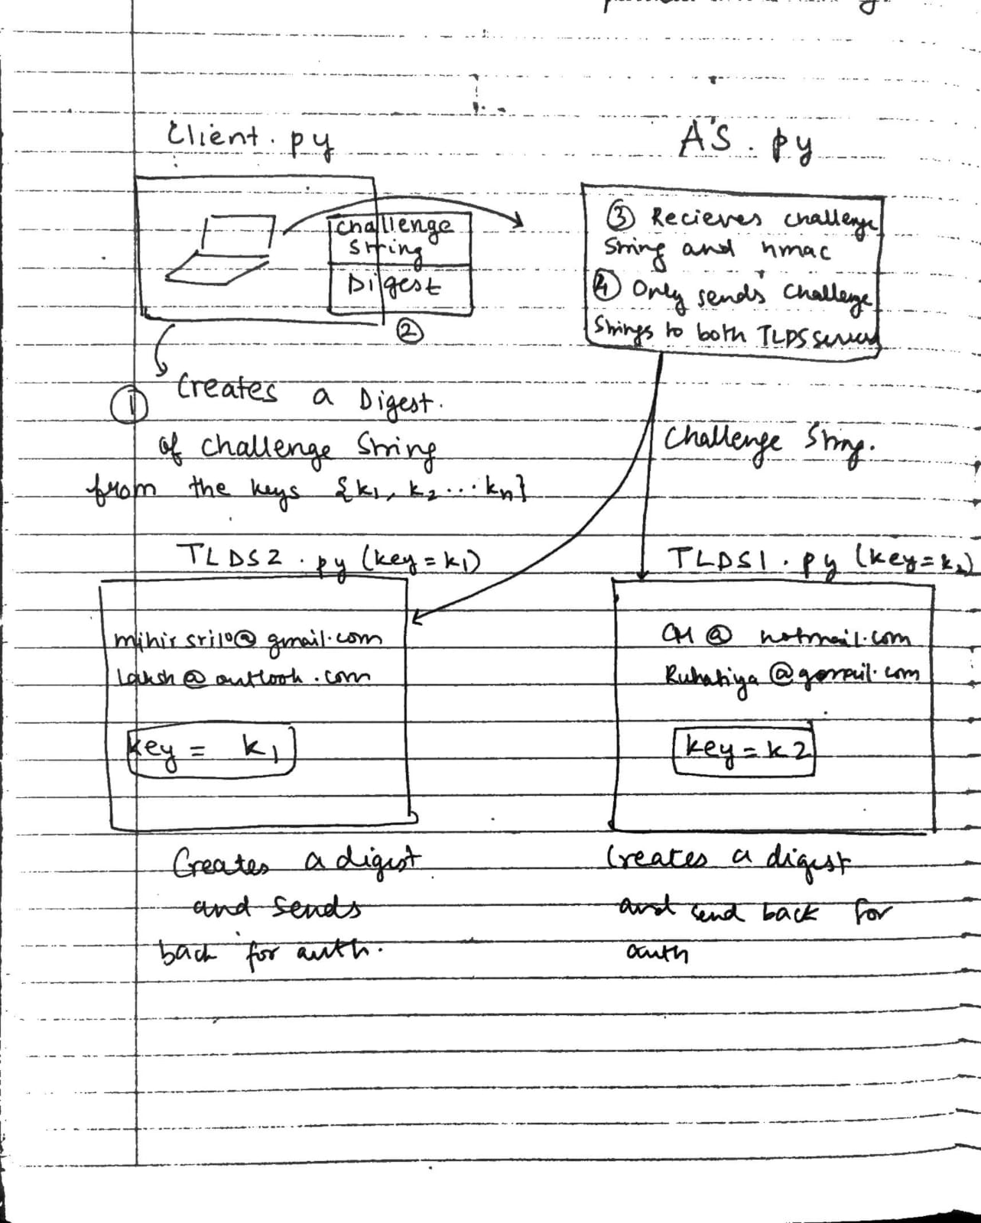
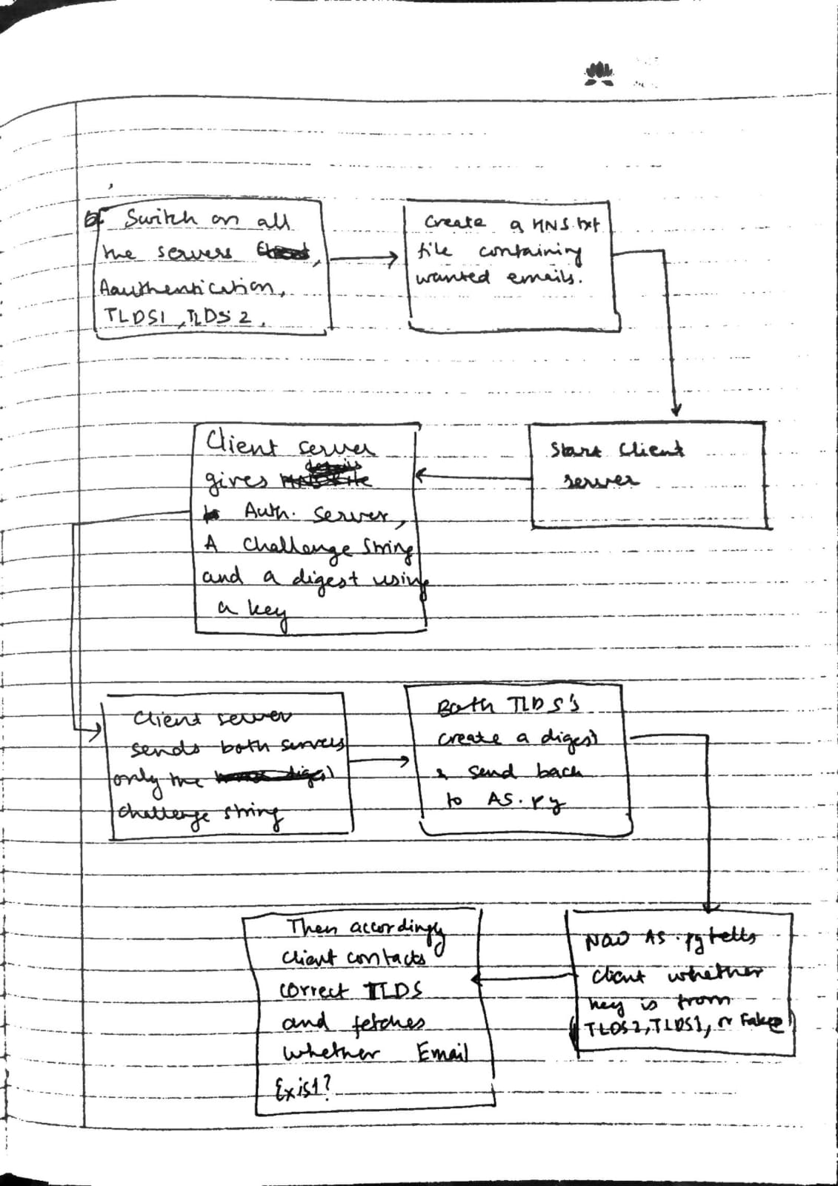
Architectural Diagram

Slide 9
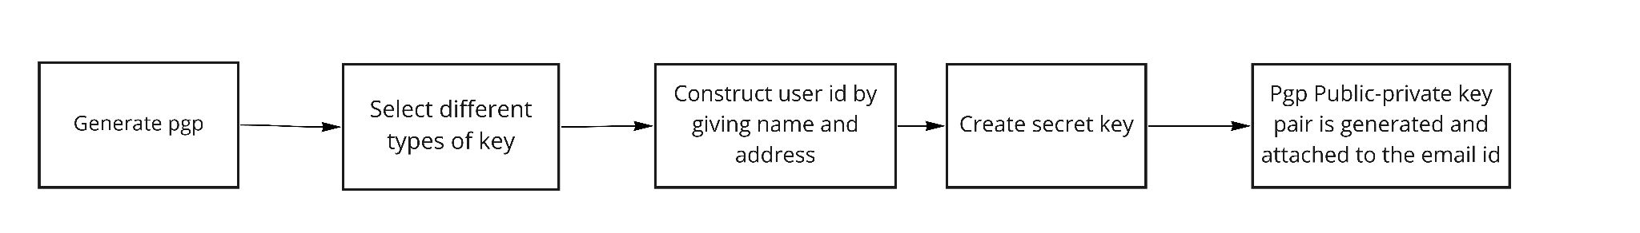
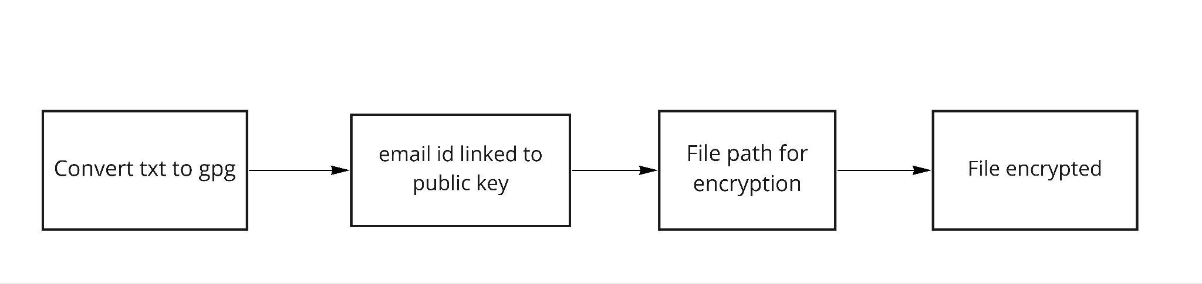
Creating PGP public private key pair
Converting Email to a gpg file

Slide 10
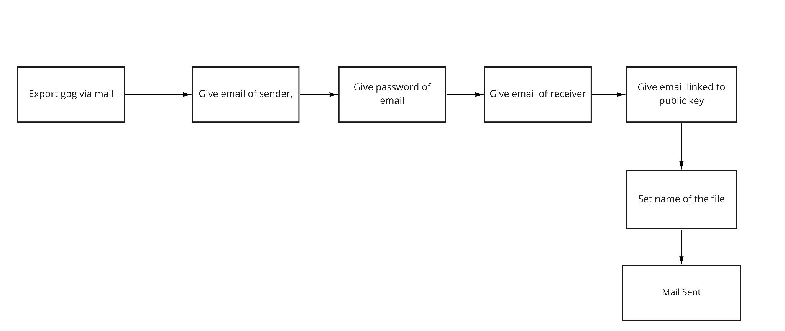
Exporting the GPG file via Email

Slide 11
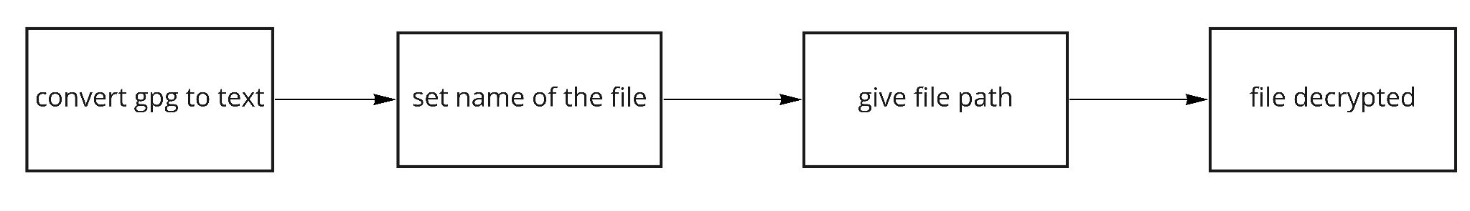
Decoding the received gpg file

Slide 12
PURPOSE OF OUR APPLICATION
Here we use TLS for securing the line of smtp.
When you use a standard POP or IMAP connection to download your email (the most popular method still in use), your username and password is sent in cleartext across the Internet. This means that anyone using the same wireless connection as you, or the same network as you, or watching traffic at your ISP - or anyone in a position to see your Internet traffic can potentially "intercept" your network traffic and clearly read your username and password. With this information, they can easily read all your email and worse, steal confidential information, send out spam or other malicious acts.
The DNS client program uses a key and a challenge string to create a digest and sends the challenge string as well as the digest to the authentication server. The authentication sever, sends ONLY the challenge string to both the TLDS servers and the TLDS servers return the respective digests. The TLDS servers each store a key and only of them matches the key that the client used to create the digest. Hence, only one of the responses from the TLDS servers match the digest sent by the client. The Authentication server (root server) sends the hostname of the TLDS server with the correct match to the client. The DNS client then connects to that TLDS server with a query string and obtains the A record (if found) from the authenticated TLDS server.

Slide 13
EXPECTED RESULT
In the open source Openpgp application with the help of tool first we generate our PGP pair for the email ID.
Then we will share our puk with people who want to send mail to us.
After receiving the mail from others we will try to open the gpg file using our prk.
This will help us to protect our mail from any attacker who try to see our mail.
On the other hand the purpose of this custom email project is to gain a greater understanding of how emails are created,secured, and sent. The application can be developed with the smtplib python module to emulate some of the functionality of the email python module.
K123 obama www.princeton.edu Here is a sample string sent from the client to the AS server obama c8c5230843ec953882c5724701e62cc8 Here is a sample string sent from the AS server to the TLDS server obama Here is a sample response string sent from the TLDS server back to the AS server c8c5230843ec953882c5724701e62cc8 Here is a sample output line: TLDS1 ge.com 68.4.3.2 A

Slide 14
Expected Result
K123 obama www.mihirsri10@gmail.com
Here is a sample string sent from the client to the AS server
obama c8c5230843ec953882c5724701e62cc8
Here is a sample string sent from the AS server to the TLDS server
obama
Here is a sample response string sent from the TLDS server back to the AS server
c8c5230843ec953882c5724701e62cc8
Here is a sample output line:
TLDS1 mihirsri10@.com 68.4.3.2 A

Slide 15
TOOLS USED
OPENPGP
Python smtp console
Wireshark
DNS
Pthon Socket Programming

Slide 16
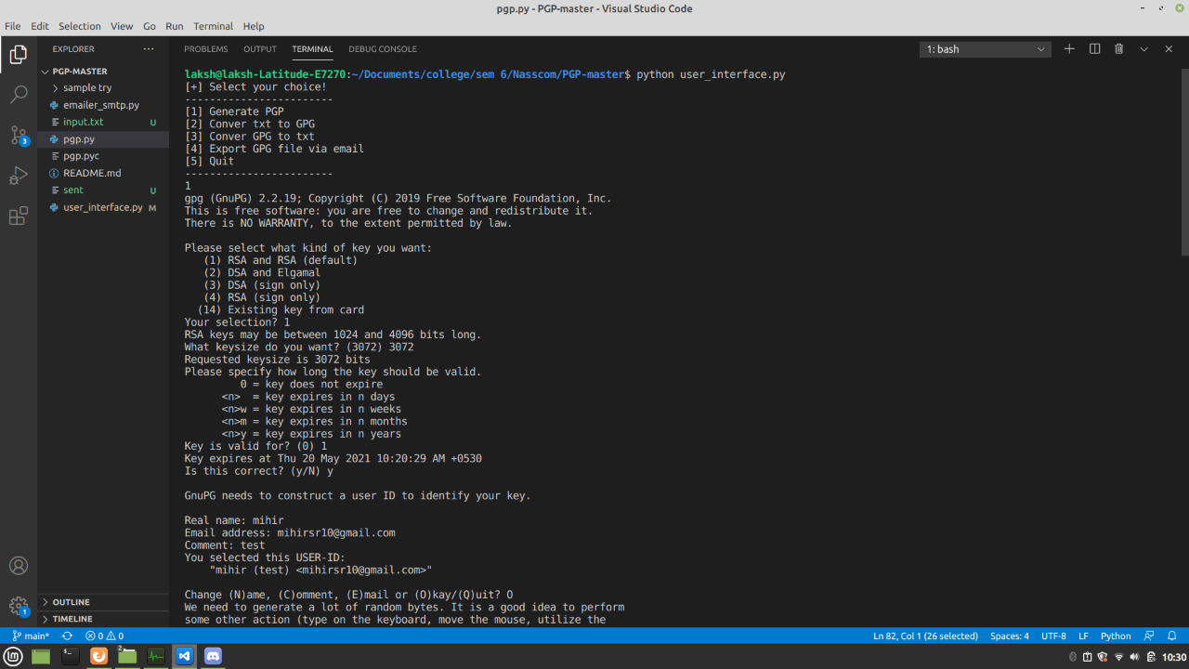
Generate PGP

Slide 17
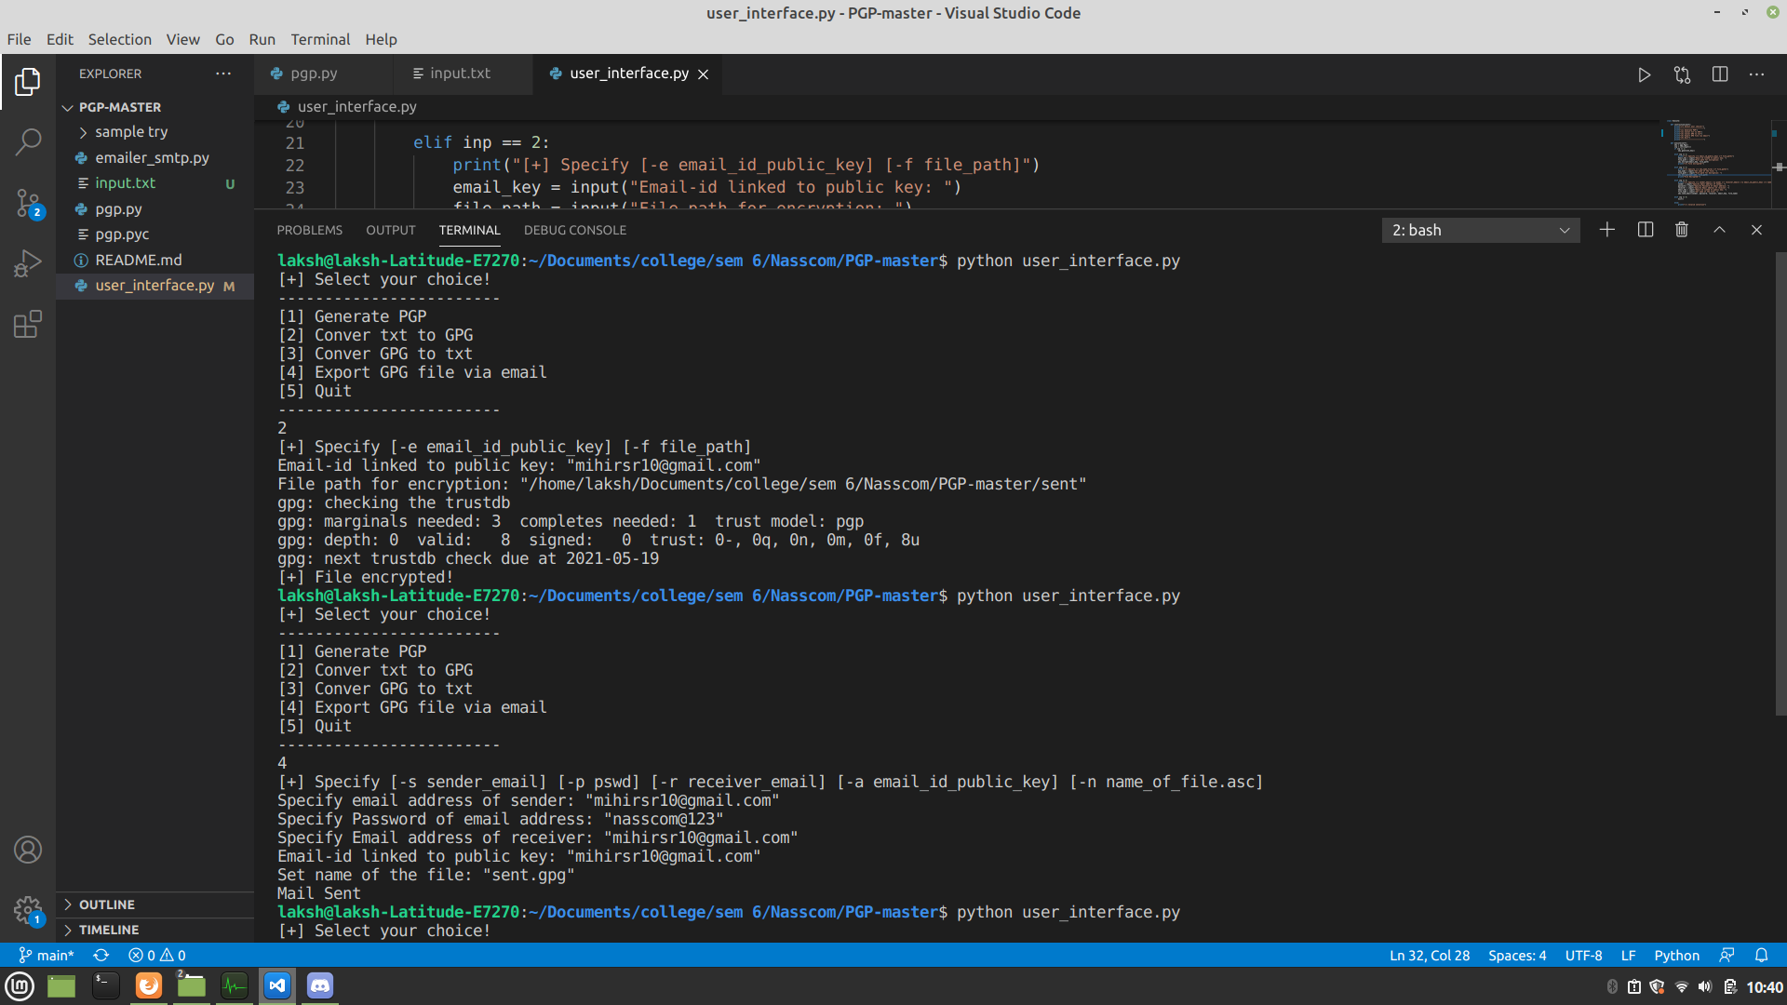
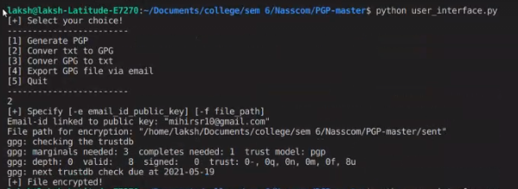
Converting txt file to GPG

Slide 18
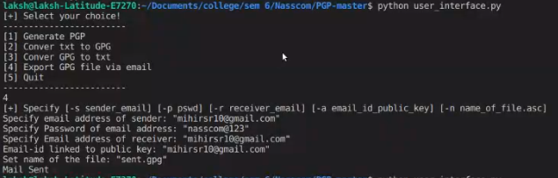
Using SMTPLIB to send GPG to receiver

Slide 19
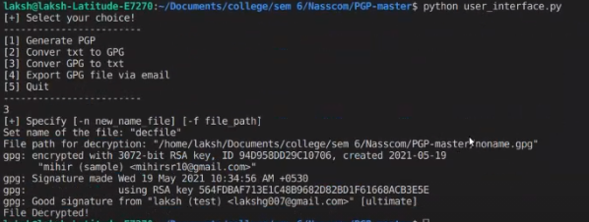
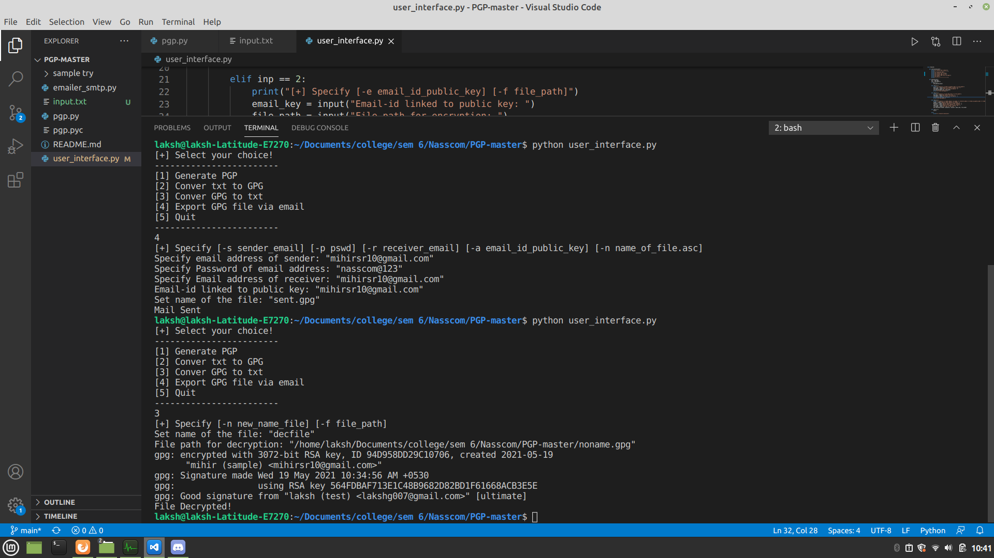
Converting GPG file to txt File

Slide 20
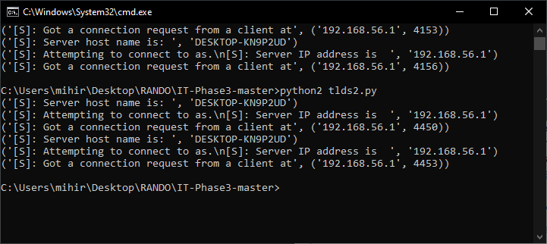
Connecting TLDS2

Slide 21
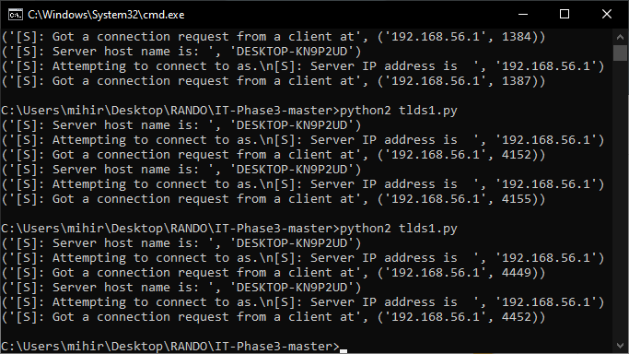
Connecting TLDS1

Slide 22
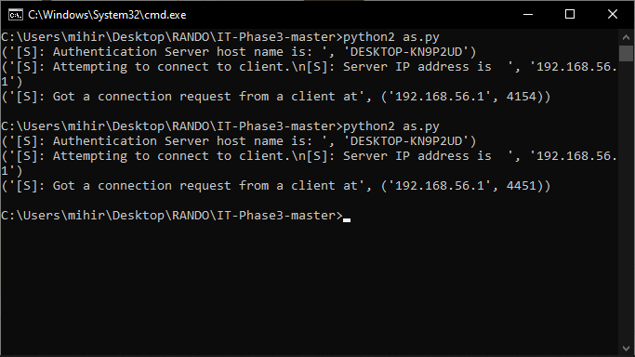
Connecting as.py

Slide 23
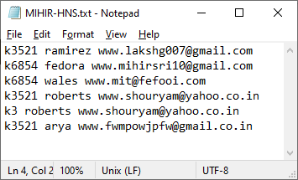
HNS ie Wanted Emails

Slide 24
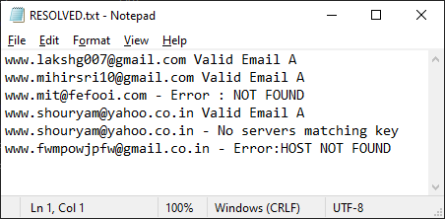
Result

Slide 25
Thank You

