Slide 1
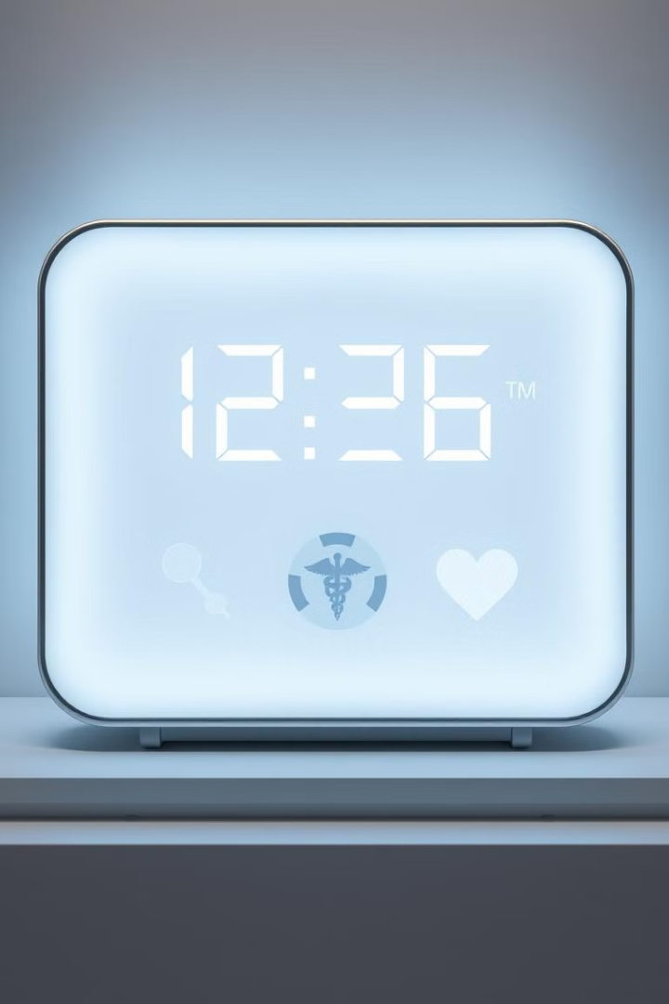

INSTABEDS
SMART HEALTH ACCESS
Welcome to INSTABEDS, a groundbreaking solution designed to revolutionize hospital resource management by providing real-time bed booking and doctor availability information.

Slide 2

Problem Statement
1
Inefficient Resource Management
2
Patient Frustration
This lack of transparency and coordination can cause significant stress and frustration for patients.
Hospitals struggle with efficiently managing bed occupancy and doctor availability, leading to delays in patient admissions and increased wait times.
3
Increased Costs
Inefficient resource allocation can also lead to higher operational costs for hospitals.

Slide 3
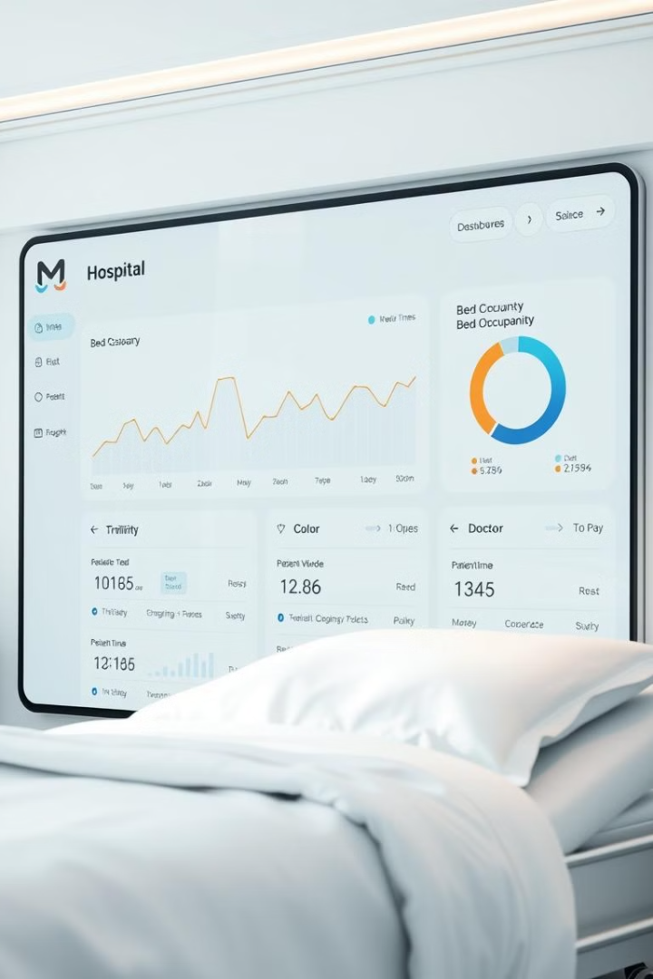
Proposed Solution
Real-Time Data
Pre-Booking
The application provides real-time updates on bed availability, doctor schedules, and wait times, empowering patients to make informed decisions.
Patients can pre-book beds based on real-time occupancy information, significantly reducing wait times for urgent care.
Transparency and Efficiency
This solution promotes better transparency and communication between patients and hospital staff, optimizing resource allocation and improving overall efficiency.

Slide 4
Key Features
Bed Pre-Booking
Real-Time Bed Occupancy Display
Doctor Availability Tracking
Patients can book beds in advance, based on occupancy rates, minimizing wait times and ensuring timely care.
The application displays which doctors are available by specialty, enabling patients to choose the appropriate care provider.
The system provides real-time updates on bed status (available, occupied, cleaning in-progress), offering transparency and a clear view of hospital resources.

Slide 5
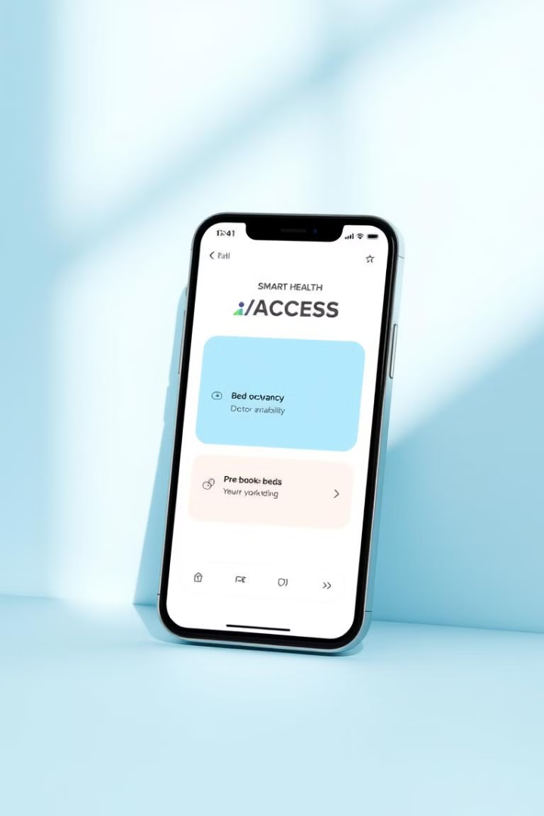




Workflow
Step 1
Patients can easily view bed occupancy and doctor availability in real-time through the user-friendly interface.
Step 2
Based on available information, patients can conveniently pre-book beds if needed.
Step 3
The application provides constant updates on bed status and doctor availability, ensuring seamless access to the latest information.
Step 4
Alerts are sent to both patients and hospital admins, notifying them of changes in occupancy or doctor availability.

Slide 6
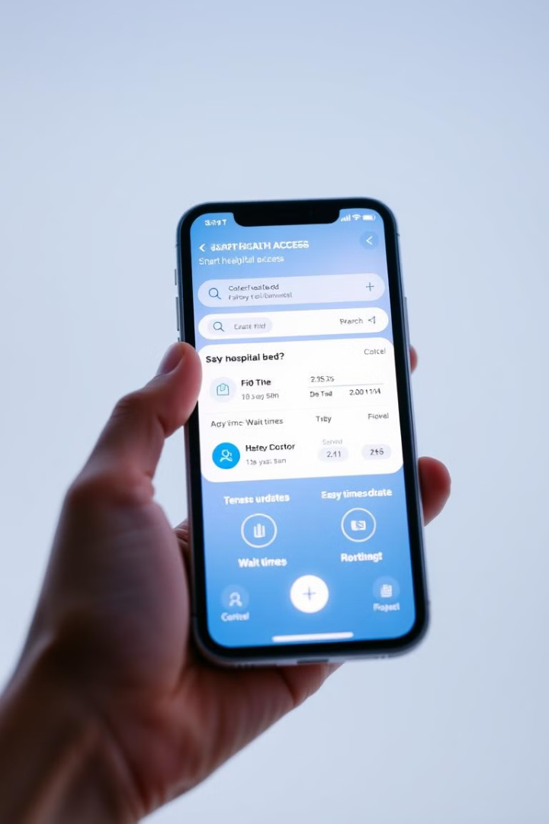
Demo
The demo will walk through the application's key features, showcasing: - The bed occupancy dashboard with real-time updates. - Doctor availability display by specialty. - The bed pre-booking process with step-by-step guidance.

Slide 7
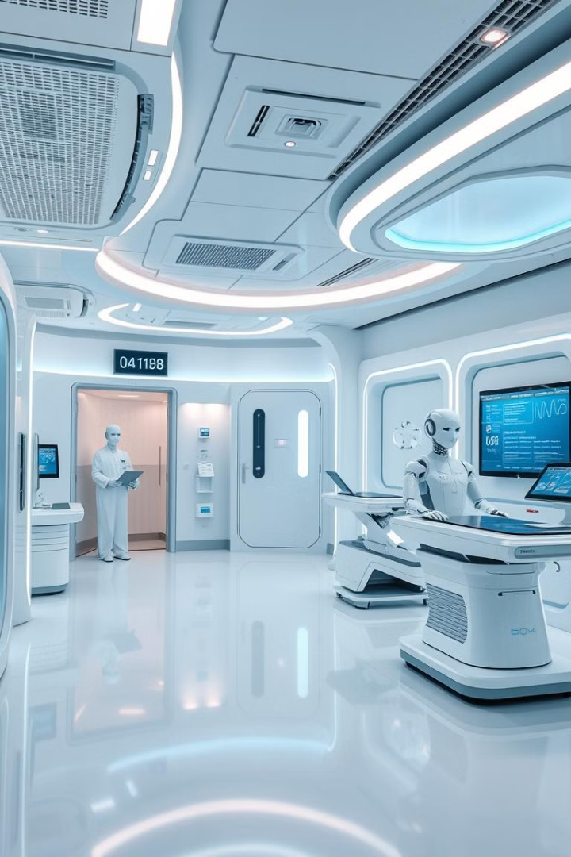
Future Scope
1
Predictive Analytics
2
Integration
Predictive analysis for bed demand using historical data can further optimize resource allocation and minimize wait times.
Seamless integration with hospital systems for real-time data exchange and automated processes.
3
Mobile App
4
Scalability
Develop a dedicated mobile app for enhanced user experience and accessibility on the go.
The application can be easily scaled to accommodate regional or multi-hospital systems.

Slide 8

Conclusion
SMART HEALTH ACCESS provides a critical solution to real-time hospital resource management, improving patient experience and enhancing hospital efficiency.

