Slide 1

Financial Fraud Detection Using Graph Neural Networks
By Lakshya Agrawal (22CS30036)
Supervised by Prof. Pabitra Mitra
Department of CSE, IIT Kharagpur

Slide 2

Presentation Outline
  Problem Statement
  Existing Methodologies
  Our Methodology: Detailed GNN framework
  Experimental Setup and Results
  Analysis & Comparison
  Conclusion

Slide 3
Problem Statement
The Core Challenge: Existing financial fraud detection systems are fundamentally inadequate for identifying sophisticated, real-world fraud due to three critical, interconnected gaps.
  The Imbalance Bottleneck:
    Fraudulent transactions are extremely rare (<1%), causing models to be biased toward the majority class and miss subtle fraud patterns.
  The Relational Blind Spot:
    Traditional models analyze transactions in isolation, failing to capture the complex, networked relationships between entities (e.g., customers, merchants, accounts) that reveal organized fraud rings.
  The Temporal Modeling Gap:
    The evolving nature of fraud and financial behavior is not effectively captured, leading to models that may not generalize over time and are vulnerable to data leakage from improper time-series handling.

Slide 4
Problem Statement
This research aims to answer the following key questions:
  How can we effectively model the complex relational structure of financial transaction data to uncover sophisticated fraud patterns that are invisible to conventional methods?
  What techniques can robustly overcome the extreme class imbalance to build a model that is both accurate and effective at detecting the fraudulent minority class?
  How can temporal dynamics be integrated into a graph-based framework to improve the realism and generalizability of fraud detection systems?

Slide 5
Existing Methodologies
  Traditional ML Models: Logistic Regression, Random Forest, etc., treat transactions as independent, ignoring crucial relational context.
  Graph-Based Approaches:
    Graph Neural Networks (GNNs): Learn from both node features and graph topology via message-passing.
    Graph Attention Networks (GATs): Use self-attention to weigh the importance of different connections, making them highly suitable for fraud detection.
  Handling Class Imbalance:
    Sampling Methods: SMOTE (oversampling) and down-sampling.
    Cost-Sensitive Learning: Assigning higher misclassification costs to fraud.
    Loss Function Modifications: Using Focal Loss to focus learning on hard examples.

Slide 6
Our Methodology: Detailed GNN framework
(1) Data Analysis: PaySim Simulator Data
The research utilizes a dataset generated by the PaySim simulator, which mimics mobile money transactions and injects fraudulent behavior.
Field | Description
Step | Represents 1 hour of time. Total duration is 30 days (744 steps).
action | Transaction type (CASH-IN, CASH-OUT, DEBIT, PAYMENT, TRANSFER).
amount | The value of the transaction.
nameOrig / nameDest | Originating and destination customers.
isFraud | The ground truth label; 1 if fraudulent, 0 otherwise.

Slide 7
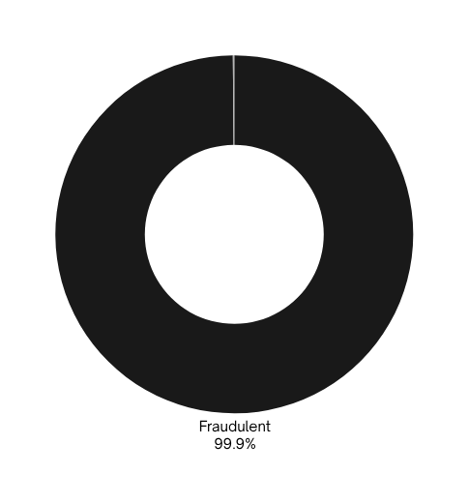
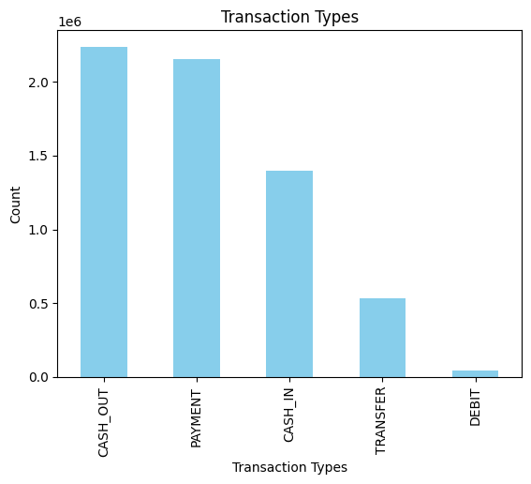
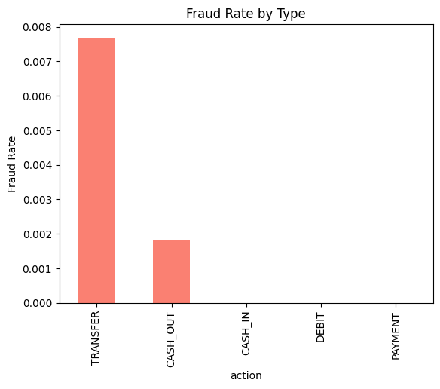
  The dataset contains 6,354,407 legitimate transactions (99.87%) and only 8,213 fraudulent ones (0.13%).
  This equates to a ratio of approximately 774:1. Without proper handling, a model could achieve 99.87% accuracy by simply predicting 'not fraud' every time, making it useless for actual detection.
  The majority of transactions are CASH_OUT and PAYMENT types, indicating high volumes of withdrawals and purchases.
  Fraud is not evenly distributed. It is highly concentrated in TRANSFER and CASH_OUT transactions, where funds are moved out of an account.

Slide 8
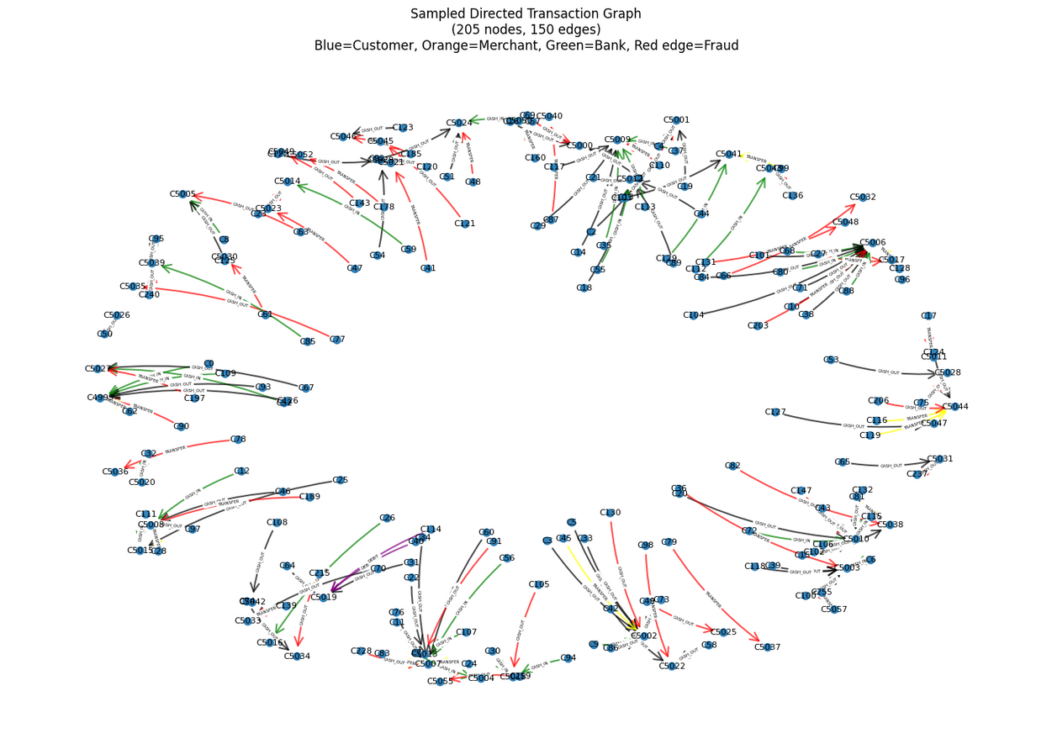
(2) Graph Construction & Feature Engineering

Slide 9
  Heterogeneous Structure: Shows different entity types (customers, merchants, banks) connected by transactions.
  Clear Fraud Visualization: Red edges highlight fraudulent transactions and their distribution.
  Pattern Recognition: Reveals connection clusters that indicate coordinated fraud activities.
  Relational Advantage: Uncovers complex fraud patterns invisible to traditional analytical methods.
Node Features
Nodes represent customers, merchants, or banks.
  Node Type (Customer, Merchant, Bank)
  Avgerage Amount Sent
  Avgerage Amount Received
  Counts of each transaction type
Edge Features
Edges represent transactions between nodes.
  Transaction Amount
  Time Step
  Transaction Type (TRANSFER, CASH_OUT, etc.)

Slide 10

(3) Handling Class Imbalance
A. Two-Step Data Sampling Strategy:
  Down-sampling: Artificially balanced training set by reducing majority class examples
  Upweighting: Compensated for predictive bias by increasing loss contribution of down-sampled class using weight factor:
  $w_{pos}= N_{legitimate}/ (N_{fraudulent}· w_{downsample})$
B. Graph-Aware SMOTE Oversampling:
  Duplicated existing fraudulent transaction edges
  Injected Gaussian noise into feature vectors of synthetic edges
  Achieved predefined target fraud ratio while preserving original validation/test distributions

Slide 11

C. Hybrid Loss Function Design:
  $ℒ_{total}= 0.7 · ℒ_{focal}+ 0.3 · ℒ_{bce}$
  Weighted Binary Cross-Entropy:
  $ℒ_{bce}= −[w_{pos} · y · log⁡(p) + (1 − y) · log⁡(1 − p)]$
where:
    $y ∈ \{0, 1\}$is the true label (0 for legitimate, 1 for fraudulent)
    $p ∈ [0, 1]$is the predicted probability of the positive class (fraud)
    $w_pos$is the positive class weight compensating for down-sampling effects
  Focal Loss for Hard Examples:
  $ℒ_{focal} = −α(1 − p_{t})ᵞ log⁡(p_{t})$
where:
    $p_t = p$if $y=1$, else
    (balancing parameter)
    $γ = 2$(focusing parameter), which reduces the loss for well-classified examples, forcing the model to focus on hard, misclassified examples

Slide 12
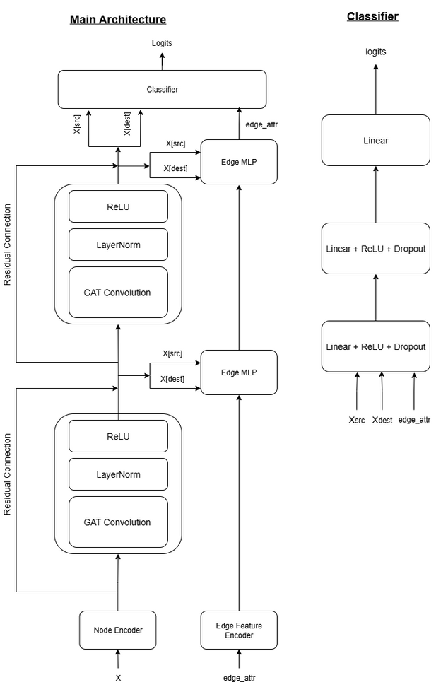
(4) Graph Attention Network (GAT) Architecture
  Input Encoders: Separate linear layers project the raw node features and edge features into a shared, high-dimensional embedding space. This is the first step of representation learning.
  Graph Attention Layers (The Core): Multiple GAT layers with multi-head attention are stacked. Each layer aggregates information from a node's neighborhood, weighting neighbors based on learned attention scores. Residual connections and layer normalization ensure stable training.
  Classification Head: For the final prediction, the updated representations of the source node, destination node, and the edge are concatenated and fed into a multi-layer perceptron (MLP) to produce a final fraud probability score for the transaction.

Slide 13
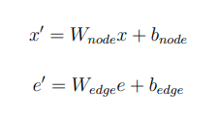



Mathematical Formulation
  Projection of the node and edge features into a shared hidden space using a linear transformation
  Graph attentional operator computes updated node representations for updating the node embeddings
  Predictions are made at the edge level by concatenating source node, destination node, and edge features

Slide 14
(5) Training Strategy
  Temporal Splitting:
Chronological split of dataset to prevent data leakage and simulate real-world scenario:
      Training: First 70% of transactions
      Validation: Next 15% of transactions
      Testing: Most recent 15% of transactions
2. Training Procedure:
The model is trained with the following configuration:
      Optimizer: Adam (LR = 0.001)
      Loss Function: Hybrid (70% Focal + 30% BCE)
      Regularization: Weight Decay (0.01), Dropout (0.3), Gradient Clipping
      Early Stopping: Patience of 20 epochs based on validation F1-score
3. Model Configuration:
The model is configured with the following Configuration:
      Hidden Dimension: 64
      Number of Layers: 2
      Number of attention heads: 4

Slide 15
Experimental Setup & Results
  To manage computational load, the training graph was constructed using all fraudulent transactions and a subsample of 90,000 legitimate ones.
    Nodes: 152,833
    Edges: 98,213
    Fraud Ratio: 8.36%
  To ensure the results are robust and not due to random chance, all experiments were conducted across 20 different random seeds.
Evaluation Metrics
AUC-ROC | Measures the model's ability to distinguish between classes. A value of 1.0 is a perfect classifier.
F1-Score | The harmonic mean of Precision and Recall. A balanced metric that is crucial for imbalanced datasets.
Precision | Of all the transactions we flagged as fraud, how many were actually fraud?
Recall | Of all the actual fraudulent transactions, how many did we successfully catch?
Specificity | Of all legitimate transactions, how many did we correctly identify as non-fraudulent? Measure of false alarms.

Slide 16
Results: Multi-Seed Evaluation
Results of Top 6 out of 20 runs:
RANK | SEED | TEST F1 | TEST AUC | Epochs | Time (s)
1 | 444 | 0.8127 | 0.9765 | 60 | 176
2 | 888 | 0.6603 | 0.9558 | 34 | 90
3 | 999 | 0.6371 | 0.9451 | 39 | 108
4 | 2023 | 0.6012 | 0.9339 | 42 | 98
5 | 42 | 0.5653 | 0.9262 | 34 | 55
6 | 5432 | 0.5320 | 0.9169 | 41 | 107

Slide 17
Best Model Performance (Seed 444)
  Extremely high recall (95.5%) means we miss very few fraudulent transactions.
  High AUC (97.7%) shows excellent discriminative power.
  Good specificity (96.4%) keeps false alarms on legitimate customers relatively low.
Confusion Matrix
 | Predicted Legit | Predicted Fraud
Actual Legit | 13,013 (TN) | 487 (FP)
Actual Fraud | 55 (FN) | 1,176 (TP)

Slide 18
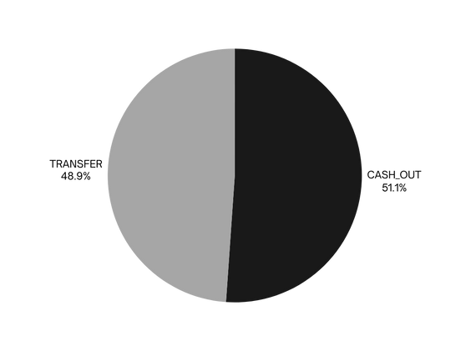
Analysis & Comparison
Feature Analysis: What does the model find?
Transaction Type
The model's high-confidence fraud predictions are almost exclusively CASH_OUT and TRANSFER types, confirming the initial data analysis.
Transaction Amount
Fraudulent transactions detected by the model tend to be very large amounts, often maxing out account balances.
Statistic | Value
Mean Amount | $7,943,249.00
Median Amount | $10,000,000.00
Standard Deviation | $3,602,469.25
Range | $0.00 - $10,000,000.00

Slide 19
Comparison with Traditional ML Models
The GAT model was compared against several standard ML models using the same features and data splits. While some models achieve higher AUC or Recall by flagging almost everything, they suffer from extremely low Precision, rendering them impractical.
Model | AUC_ROC | F1-Score | Precision | Recall | Specificity
Best GAT Model | 0.9765 | 0.8127 | 0.7072 | 0.9553 | 0.9639
Logistic Regression | 0.9830 | 0.5152 | 0.3474 | 0.9968 | 0.8293
Random Forest | 0.9998 | 0.2183 | 0.1225 | 1.0000 | 0.3471
Gradient Boosting | 0.9827 | 0.1542 | 0.0836 | 1.0000 | 0.0000

Slide 20
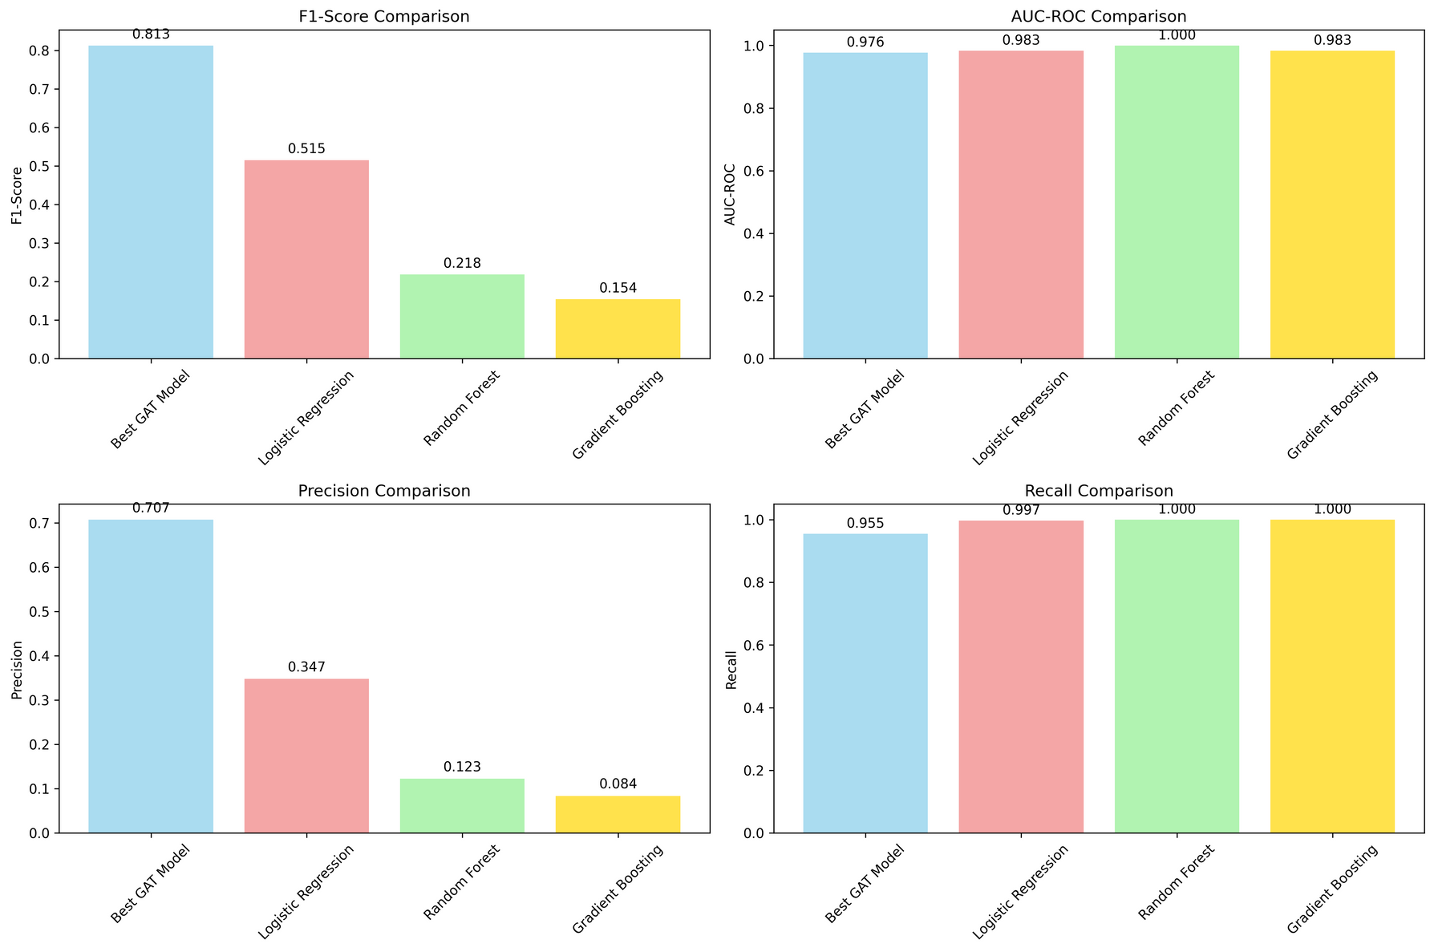
The GAT model provides the best balance between catching fraud (Recall) and avoiding false alarms (Precision), as demonstrated by its significantly higher F1-Score.
Traditional models achieve perfect recall at the cost of flagging many legitimate transactions as fraud, making the GAT's balanced approach superior.

Slide 21
Conclusion
  Model Performance: The GAT model's high F1-score and AUC demonstrate its effectiveness. The high recall is critical for minimizing financial loss, while the reasonable precision makes it practical for real-world use.
  Impact of Imbalance Techniques: The combination of strategic sampling (down-sampling, SMOTE-like oversampling) and a hybrid loss function (Focal + BCE) was crucial for teaching the model to identify the rare fraud class effectively.
  Graph Structure Benefits: The graph-based approach successfully captured relational patterns that traditional methods miss. The attention mechanism allowed the model to focus on the most indicative connections, likely helping to identify coordinated fraudulent behaviors.
Limitations and Challenges
  Scalability: Computational complexity increases with graph size.
  Interpretability: GNNs are inherently 'black box', requiring extra work for explainability.
  Real-Time Detection: Handling dynamic graph updates efficiently is a challenge.
  Generalization: A model trained on one bank's data may not work perfectly for another.

Slide 22
Future Research Directions
Model Enhancements
  Online learning for real-time adaptation.
  Heterogeneous GNNs for richer representations.
  Temporal GNNs for dynamic patterns.
Application Extensions
  Cross-institutional fraud detection.
  Integration with Explainable AI (XAI) techniques.
  Adaptation to other fraud types (e.g., insurance, e-commerce).
Technical Improvements
  Optimization for large-scale deployment.
  Ensemble methods combining multiple graph models.
  Federated learning for privacy-preserving detection.

Slide 23
The End
THANK YOU FOR LISTENING
Complete source code, data, and documentation for this project are publicly available for full reproducibility.
GitHub: https://github.com/laksh0820/Financial-Fraud-Detection

