Slide 1
Minor Project (2017-18)
Billing software
(JAVA)

Slide 2
Group members
Lakshmendra Singh (15-dpce-166)
Akshay dubey (15-dpce-171)
ASHAR Parvez (15-dpce-172)
Hritick goyal (15-dpce-183)
Project Advisor – mohd. Naved qureshi

Slide 3
About the project
Project type – Java based billing software using java_swing GUI
Database Used – Microsoft Access
Programming Language used – JAVA
Development tools – Netbeans, JAVA Development Kit

Slide 4
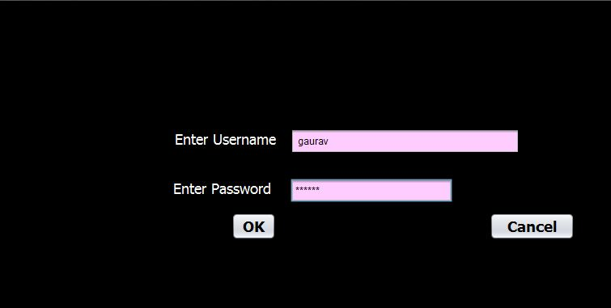
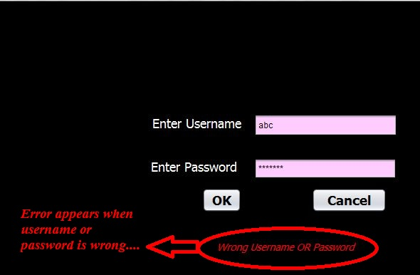
Login page This page is the first page on project start up. User enters his/her username and password and then this page directs the user to main menu through splashform. However if the username/password is incorrect then an error message is displayed.

Slide 5
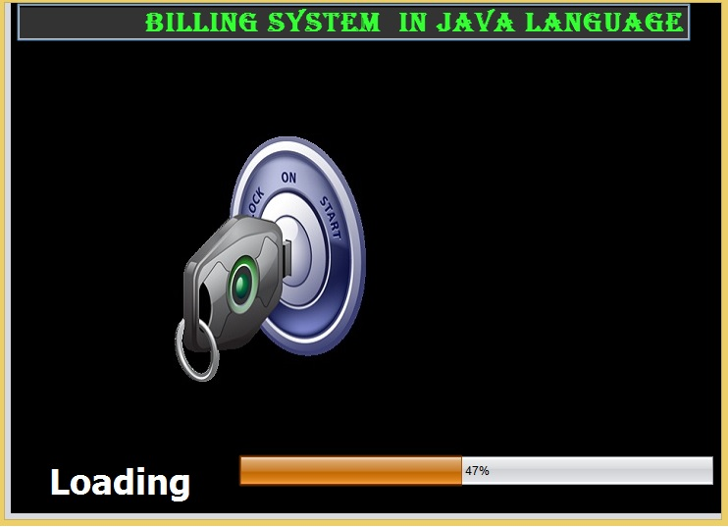
Splashform
It is the in between page that connects login page to mainform.

Slide 6
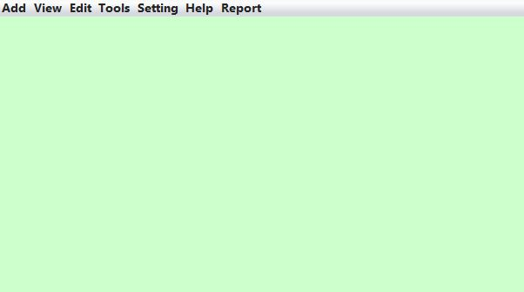
Main menu There are several options for each link in the menu. These options are:-
Add- Add customer, Add item, Billing
View- Customers, Items, and Search options
Edit- Edit customers, Edit items
Tools- Calculator, Notepad
Setting- Change username, Change password
Help- About
Report- All customers and All items

Slide 7
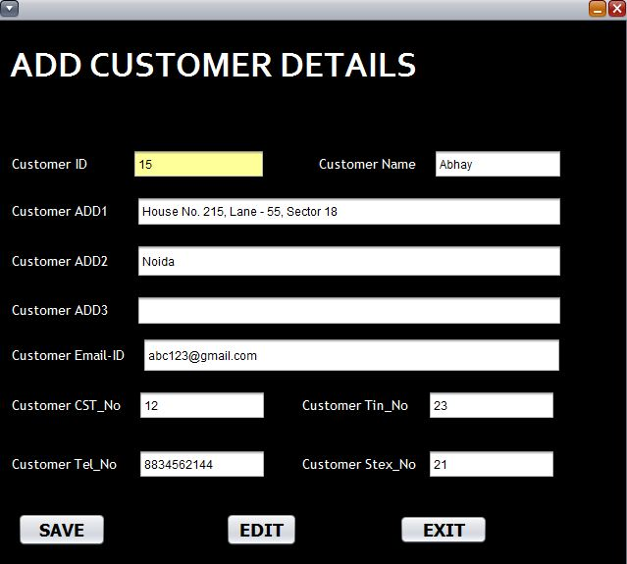
ADD Customer page
The add customer page allows the user to add new customer in database.
Customer id field is automatically generated and other fields are provided by user .
User can add a new customer by pressing “SAVE” button.
When the records are entered in database, a message displaying “Record inserted successfully” appears.

Slide 8
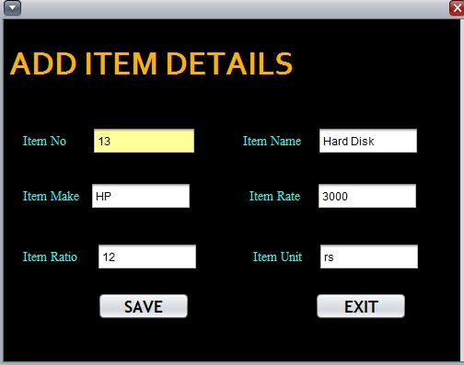
ADD item page
The add item page allows the user to add new item in database.
Item No. field is automatically generated and other fields are provided by user .
User can add a new item by pressing “SAVE” button.
When the records are entered in database, a message displaying “Record inserted successfully” appears.

Slide 9
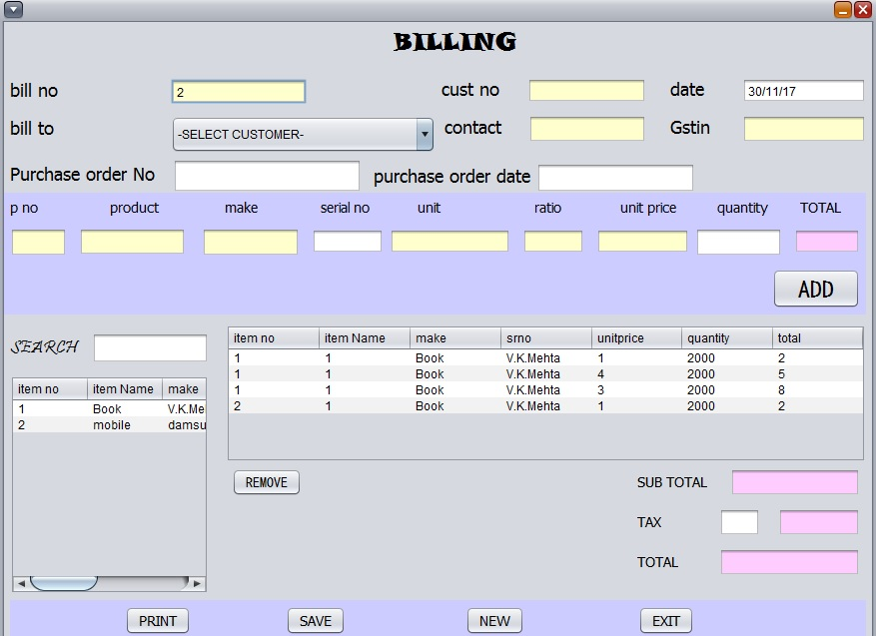
Billing page
This page generates the bill.
Bill no. field is automatically generated, user just has to enter the customer no. all other corresponding fields are automatically generated.
Now, user has to enter product serial no. and quantity to generate sub total.
Then, user enters tax percentage and the grand total is generated.
Finally user can print the bill or save the bill in the database.

Slide 10
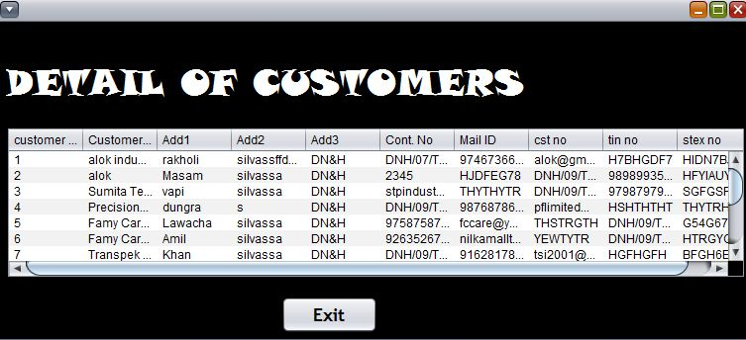
View customers page
This page lets the user to see details of every customer present in the database.
All the fields of the database’s customer master table can be seen in this page.
“EXIT” button is provided to close this page.

Slide 11
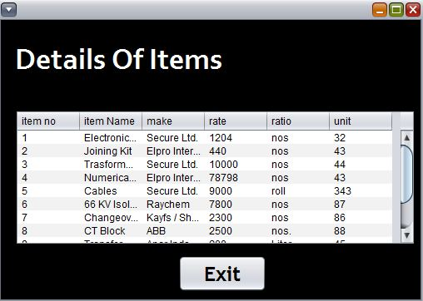
View items page
This page lets the user to see details of every item present in the database.
All the fields of the database’s item master table can be seen in this page.
“EXIT” button is provided to close this page.

Slide 12
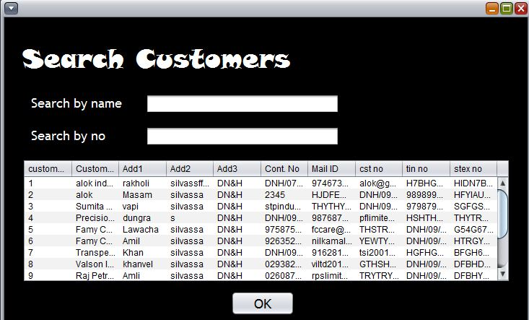
Search customer page
This page enables the user to search for any customer in the database.
Two fields are provided here.
User can search the customer by name.
User can also search the customer by serial no.

Slide 13
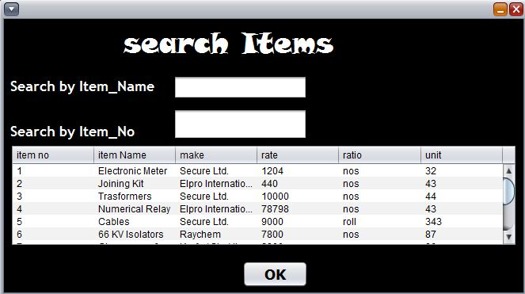
Search items page
This page enables the user to search for any item in the database.
Two fields are provided here.
User can search the item by name.
User can also search the item by serial no.

Slide 14
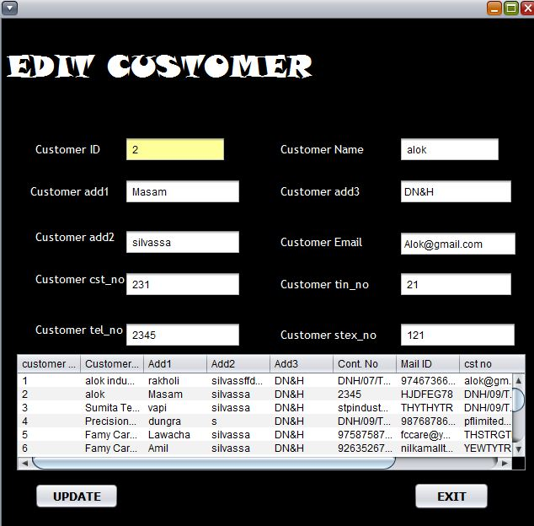
Edit customers page
This page can be used to edit various customer details such as address, contact no., e-mail etc.
A customer is selected from the list.
The corresponding details of the customer are automatically displayed.
User can edit single or multiple fields.
Finally update button is pressed to edit the details of that customer.

Slide 15
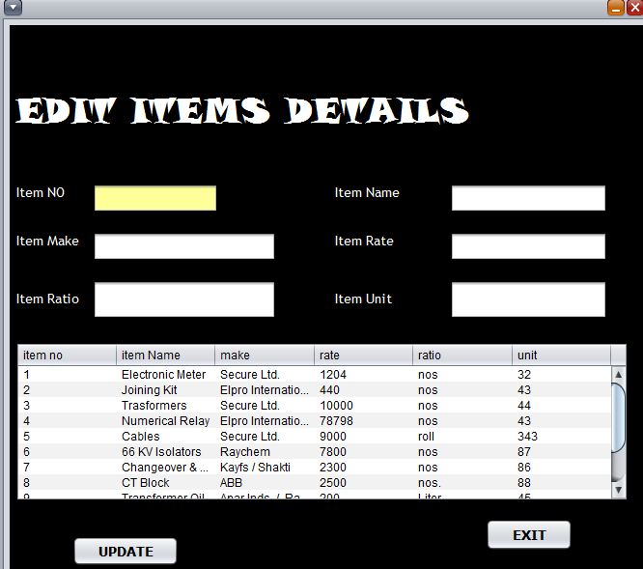
Edit items page
This page can be used to edit various item details such as rate, make, unit etc.
An item is selected from the list.
The corresponding details of the item are automatically displayed.
User can edit single or multiple fields.
Finally update button is pressed to edit the details of that item.

Slide 16
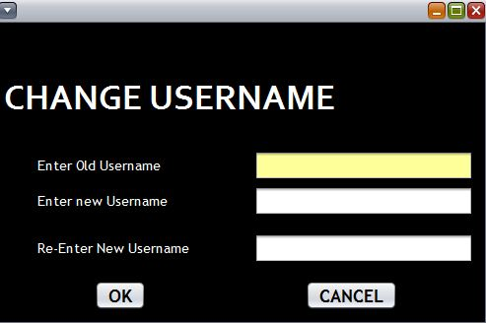
Change username page
Using this page user can change/update an existing username.
User has to enter the old username.
Then user has to enter the new username and re-enter it for conformation.
Finally “OK” button is clicked to change/update username.

Slide 17
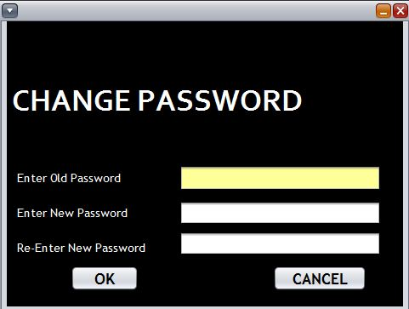
Change password page
Using this page user can change/update an existing password.
User has to enter the old password.
Then user has to enter the new password and re-enter it for conformation.
Finally “OK” button is clicked to change/update password.

Slide 18
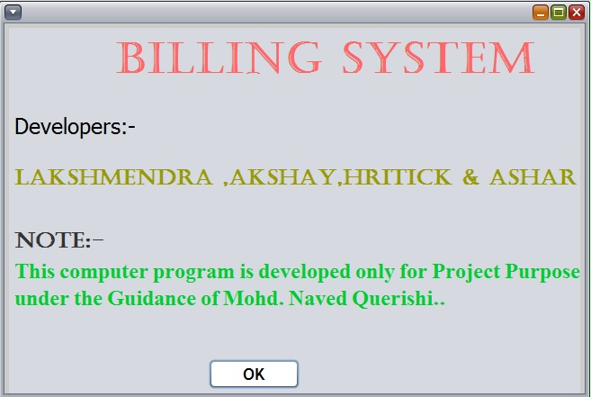
About page
The about page is provides a description about the version, developers etc.

Slide 19
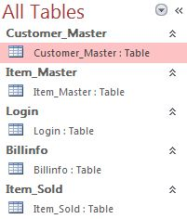
database
The database of this project is MS ACCESS based.
The database contains 5 tables:-
1. “Customer_Master” – for details of customers.
2. “Item_Master” – for details of items.
1. “Login” – for details of users/admin.
1. “Billinfo” – for details of bills generated.
1. “Item_Sold” – for details of items sold by the store.

Slide 20
Thank you

