Slide 1
Major Project (2017-18)
Library automation software
(JAVA)

Slide 2
Group members
Lakshmendra Singh (15-dpce-166)
Akshay dubey (15-dpce-171)
Hritick goyal (15-dpce-183)
Project Advisor – mr. salim ishtiyak sir

Slide 3
About the project
Project type – Java based “Library Automation Software” using java_swing GUI
Database Used – Sqlite manager
Programming Language used – JAVA
Development tools – Netbeans, JAVA Development Kit ,Install Creater

Slide 4
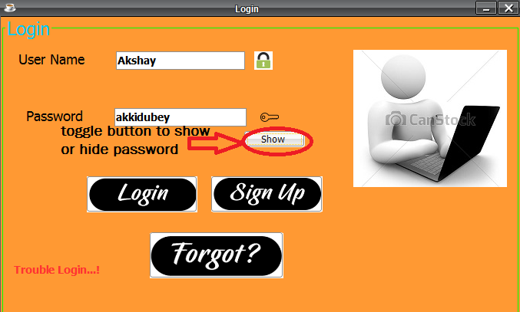
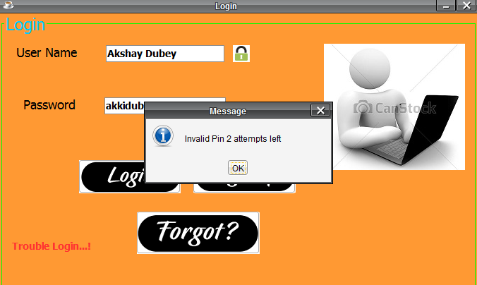
Login page This page is the first page on project start up. User enters his/her username and password and then this page directs the user to main menu through the loading page. However, if the username/password is incorrect then an error message is displayed showing the no. of attempts left. The user can also retrieve his/her password if forgotten by the method of security question.

Slide 5
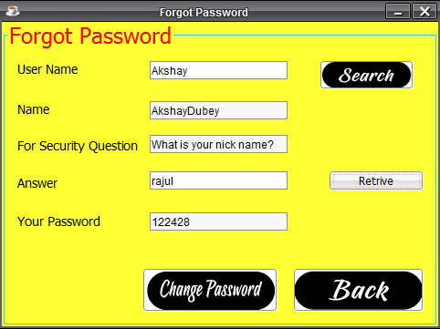
Account recovery page
This page lets the user to recover his/her account in case of forgotten password.
The account can be recovered on the basis of a security question whose answer is already present in the database as entered by the user.
The user needs to enter the username and click on the search button and all the fields related to that account are automatically retrieved from the database.
The user needs to enter the correct answer to the security question for the retrieval of the account to be successful.
The user can also change password if he/she desires.

Slide 6
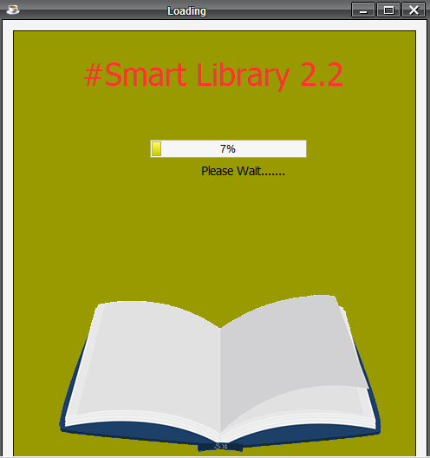
Loading page
It is the in between page that connects login page to main menu.
It supports animated gif and a progress bar to make it look attractive.

Slide 7
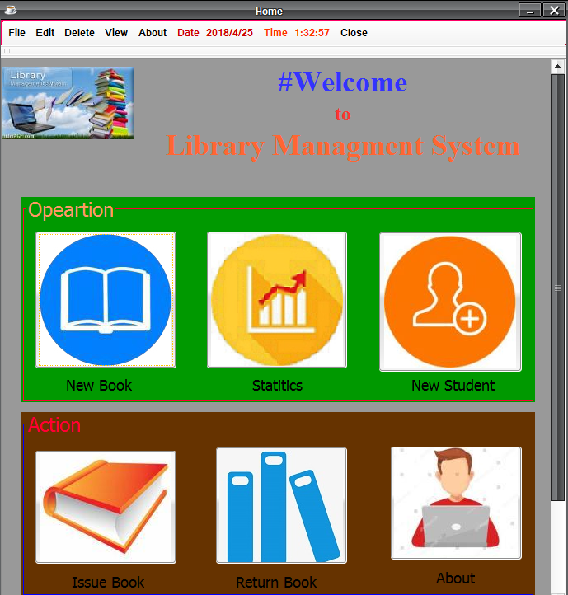
Main menu There are several options for each link in the menu. These options are:-
There are several options for each link in the menu. These options are:-
File- Issue Book, Return Book, Renew, Close
Edit- Student info, Book info, Account info
Delete- Student, Book, Account
View- Student Detail, Book Detail, Statistics, Account Details, Renew Details
New Book- To add a new book into the database.
New Student-To add new student into the database.
Issue Book- To issue a book with a Student ID.
Return Book-To receive book and calculate fine(if any).
About- For information about the developers.

Slide 8
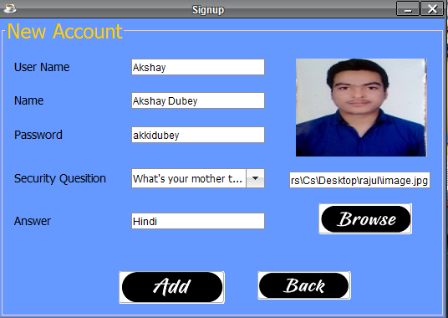
Add account page
The new account page allows the user to add new account in database.
User needs to enter the details in their corresponding fields.
User can add a new account by pressing “Add” button.
The user can also select the security question by dropdown list.
User can also provide the image of the Account Holder.
When the records are entered in database, a message displaying “Account Created” appears.

Slide 9
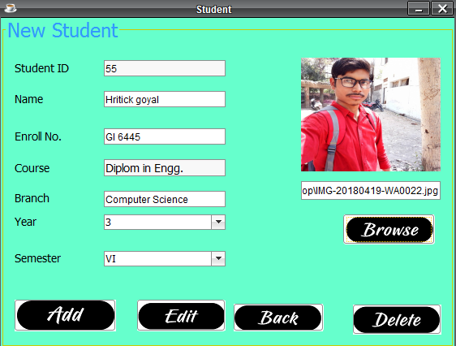
New student page
The new student page allows the user to add new student in database.
Student id field is generated randomly and other fields are provided by user .
User can add a new student by pressing “Add” button.
Year and Semester are provided by dropdown list.
Student can provide his/her image also.
When the records are entered in database, a message displaying “Student Added” appears.

Slide 10
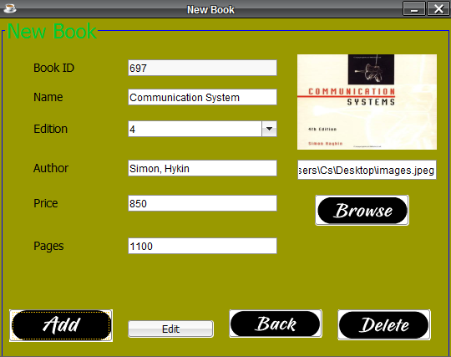
New book page
The new book page allows the user to add new book in database.
Book ID field is generated randomly and other fields are provided by user .
User can add a new item by pressing “Add” button.
The Edition of the book is provided by dropdown list.
User can also provide the image of the book.
When the records are entered in database, a message displaying “Book Added” appears.

Slide 11
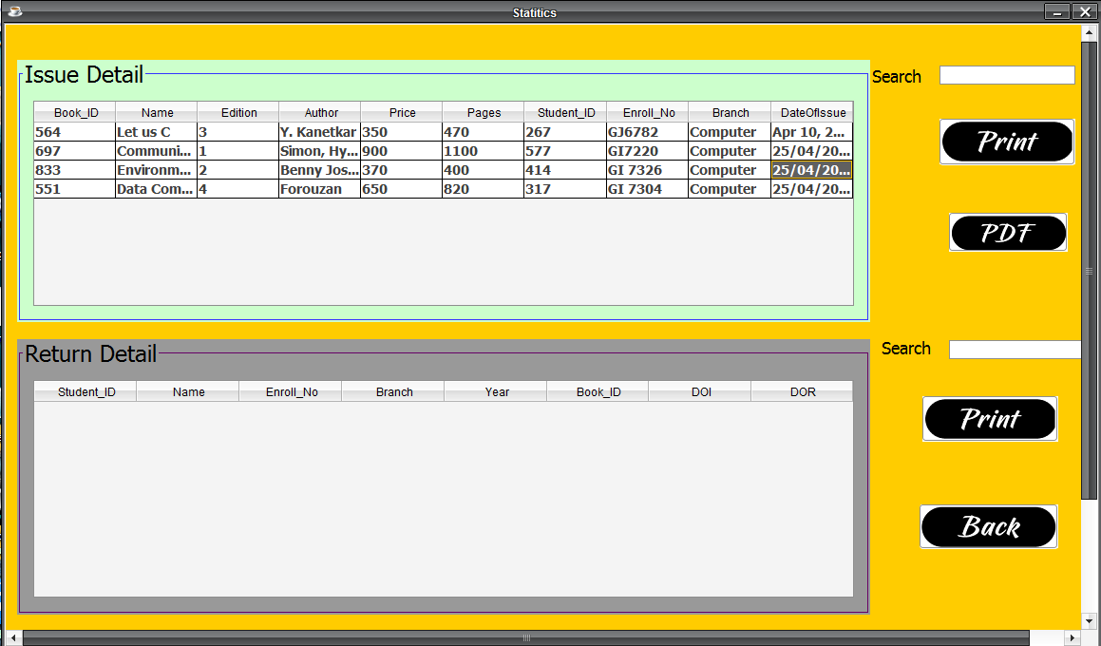
Statistics page
This page shows the statistics of the Database.
It tells about the books that are currently issued and the students to which they are issued.
User can search for the book/student by id, name, edition, Branch, price, pages, author, enrolment no. etc.
The user can print the Library Statistics and even save the Statistics in the PDF form which increases the functionality.

Slide 12
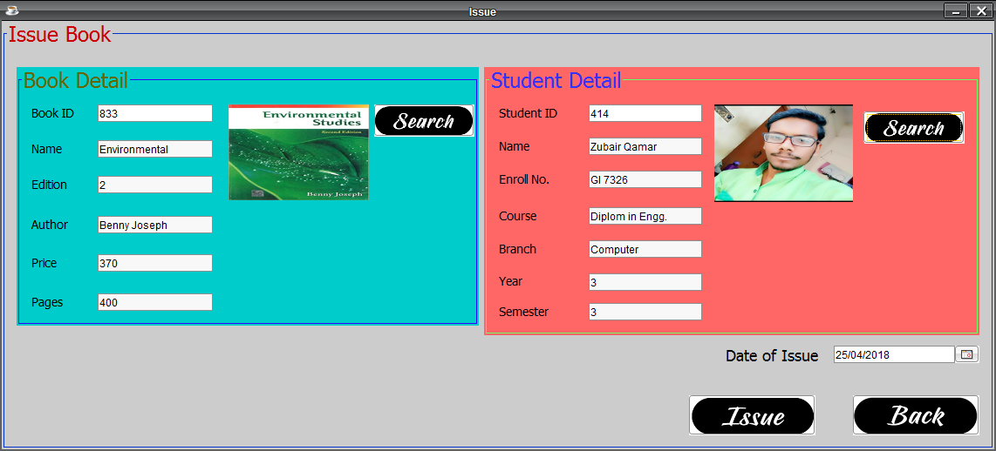
Issue book page
This page lets the user to issue a book in the Database to a particular student present in the Database.
The user needs to enter the Book ID and click on the search button and all the fields related to that book are automatically retrieved from the Database.
The same case is with Student Detail.
A Date Chooser is provided at the bottom to select the date of the issue of the book.
When the user clicks on the “Issue” button, a confirmation message displaying “The Book has been issued” is displayed.

Slide 13
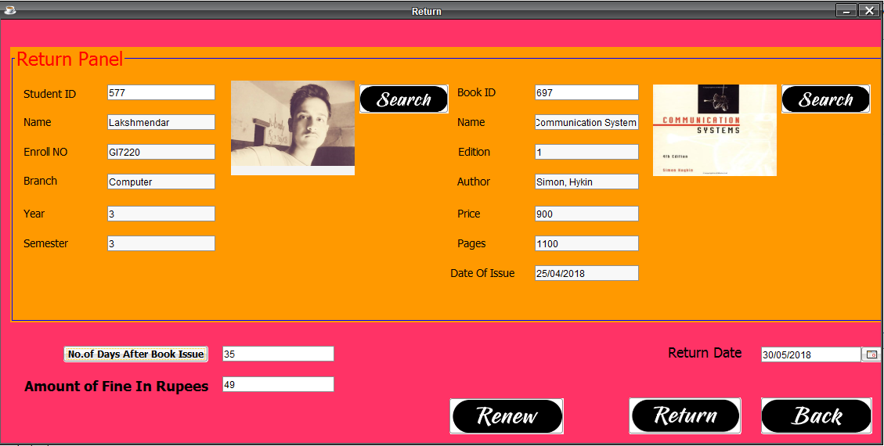
Return book page
This page lets the user to receive the returned book from a student
The user needs to enter the Student ID and click on the search button and all the fields related to that student are automatically retrieved from the Database.
The same case is with Books.
A Date Chooser is provided at the bottom to select the date of return of book.
Thereafter, the no. of days after book issue is calculated.
Finally, the amount of fine in rupees (if any) is calculated based on the no. of days after issue.

Slide 14
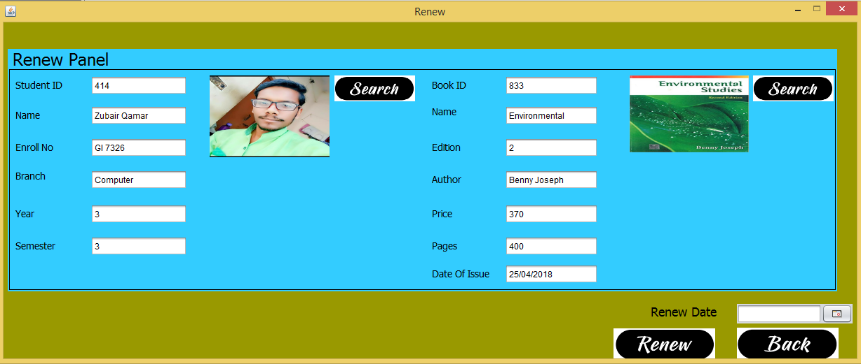
Renew book page
This page lets the user to renew the issued book for a student.
The user needs to enter the Student ID and click on the search button and all the fields related to that student are automatically retrieved from the Database.
The same case is with Books.
A DateofIssue textfield provide the Issue date when the book is first time issued .
A Date Chooser is provided at the bottom to select the date of renew of book.
After click on renew button the book is deleted from issuedetails.

Slide 15
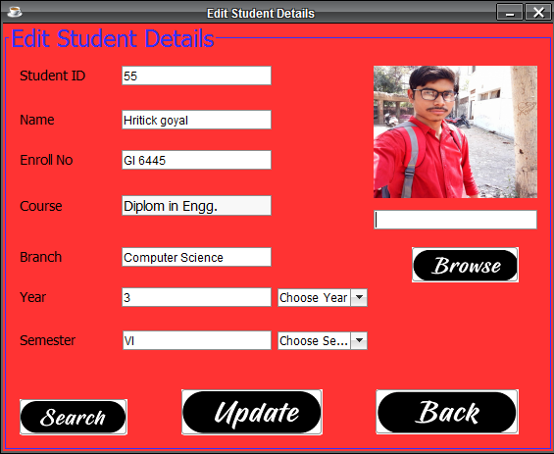
Edit students page
This page enables the user to edit any student’s detail in the Database.
The user needs to enter the Student ID and click on the search button and all the fields related to that student are automatically retrieved from the Database.
User can edit the details by typing or by dropdown list.
User can also update the image of an student.
When the user clicks on the “Update” button, a confirmation message displaying “The Details have been updated” is displayed.

Slide 16
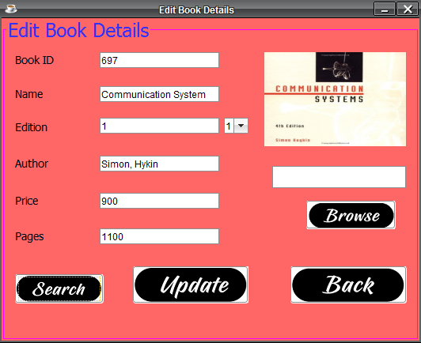
Edit books page
This page enables the user to edit any book’s detail in the Database.
The user needs to enter the Book ID and click on the search button and all the fields related to that book are automatically retrieved from the Database.
User can edit the details by typing or by dropdown list.
User can also update the image of the book.
When the user clicks on the “Update” button, a confirmation message displaying “The Details have been updated” is displayed.

Slide 17
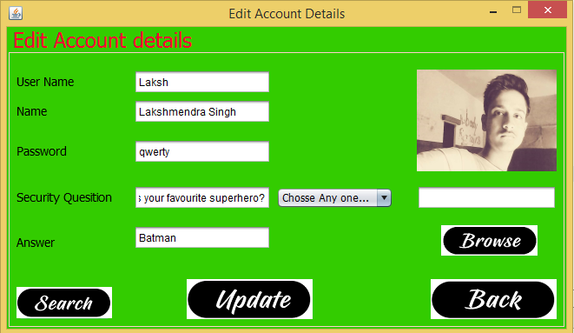
Edit account page
This page enables the user to edit any Account’s detail in the Database.
The user needs to enter the Username and click on the search button and all the fields related to that account are automatically retrieved from the Database.
User can edit the details by typing or by dropdown list.
User can also update the image of the account holder.
When the user clicks on the “Update” button, a confirmation message displaying “The Details have been updated” is displayed.

Slide 18
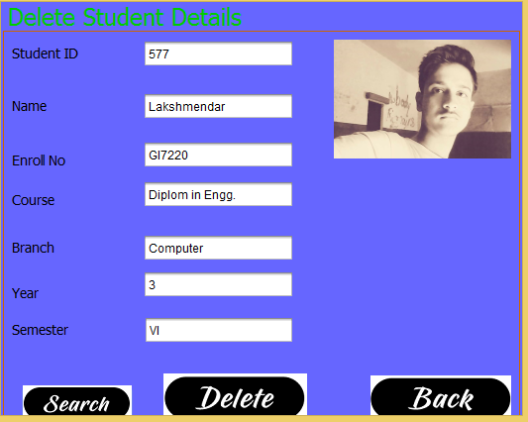
Delete student page
This page enables the user to delete any student’s record from the Database.
The user needs to enter the Student ID and click on the search button and all the fields related to that student are automatically retrieved from the Database.
When the user clicks on the “Delete” button, a confirmation message displaying “The Student record has been deleted” is displayed.

Slide 19
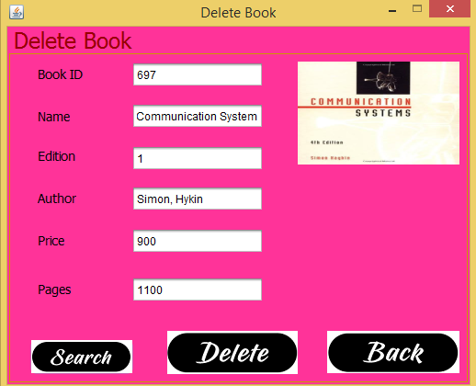
Delete book page
This page enables the user to delete any book’s record from the Database.
The user needs to enter the Book ID and click on the search button and all the fields related to that book including the image are automatically retrieved from the Database.
When the user clicks on the “Delete” button, a confirmation message displaying “The Book has been deleted” is displayed.

Slide 20
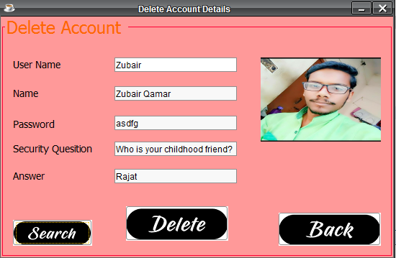
Delete account page
This page enables the user to delete any Account from the Database.
The user needs to enter the Username and click on the search button and all the fields related to that account including the image are automatically retrieved from the Database.
When the user clicks on the “Delete” button, a confirmation message displaying “The Account has been deleted” is displayed.

Slide 21
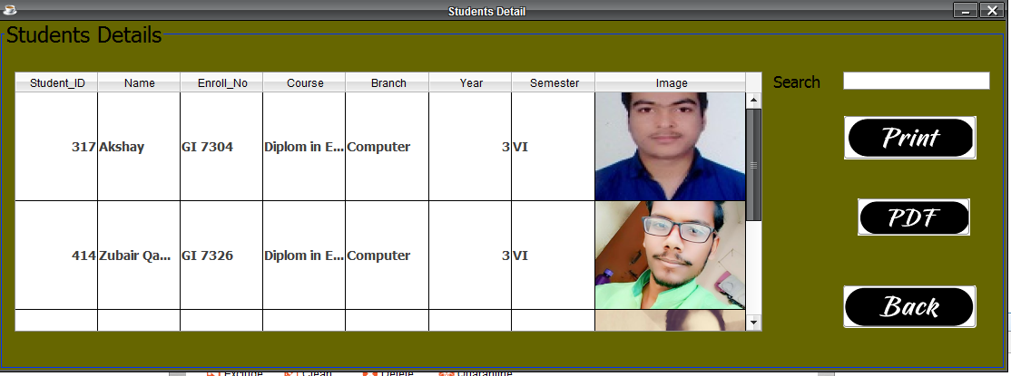
View students page
The View Students page provides description and details about the students present in the Database.
These details include the Student id, Name, Enrolment No, Course, Branch, Year and Semester.
It also shows the image of the student.
The user can search by ID or any other field.
The user can print the details of the Students and can also save these details in the form of PDF file.

Slide 22
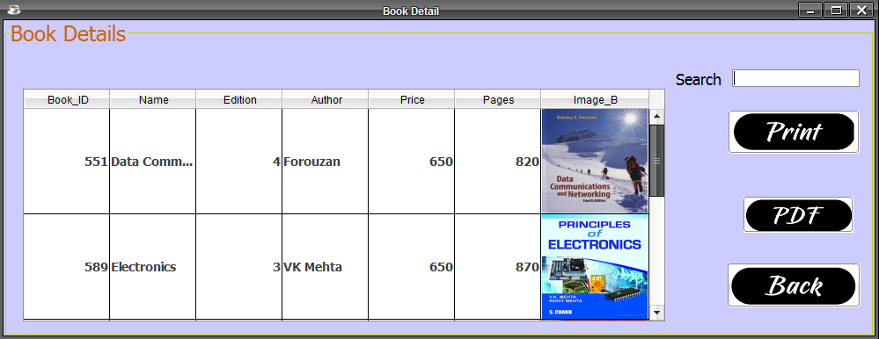
View Books page
The View Books page provides description and details about the books present in the Database.
These details include the Book id, Name, Edition, Author, Price and Pages.
It also shows the image of the book.
The user can search by ID or any other field.
The user can print the details of the Books and can also save these details in the form of PDF file.

Slide 23
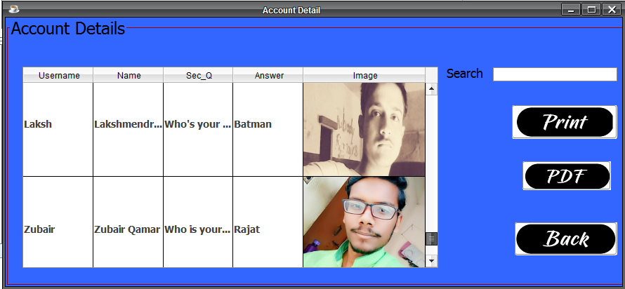
View Account details page
The View Accounts page provides description and details about the User Accounts present in the Database.
These details include the Username, Name, Security Question and Answer.
It also shows the image of the Account Holder.
The user can search by ID or any other field.
The user can print the details of the Account and can also save these details in the form of PDF file.

Slide 24
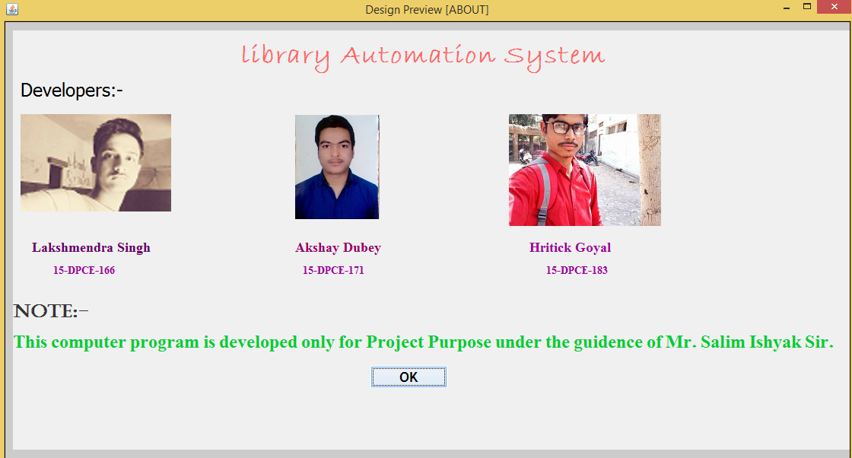
About page
This page tells about the developers, version and other details about the project.

Slide 25
Thank you

