Slide 1
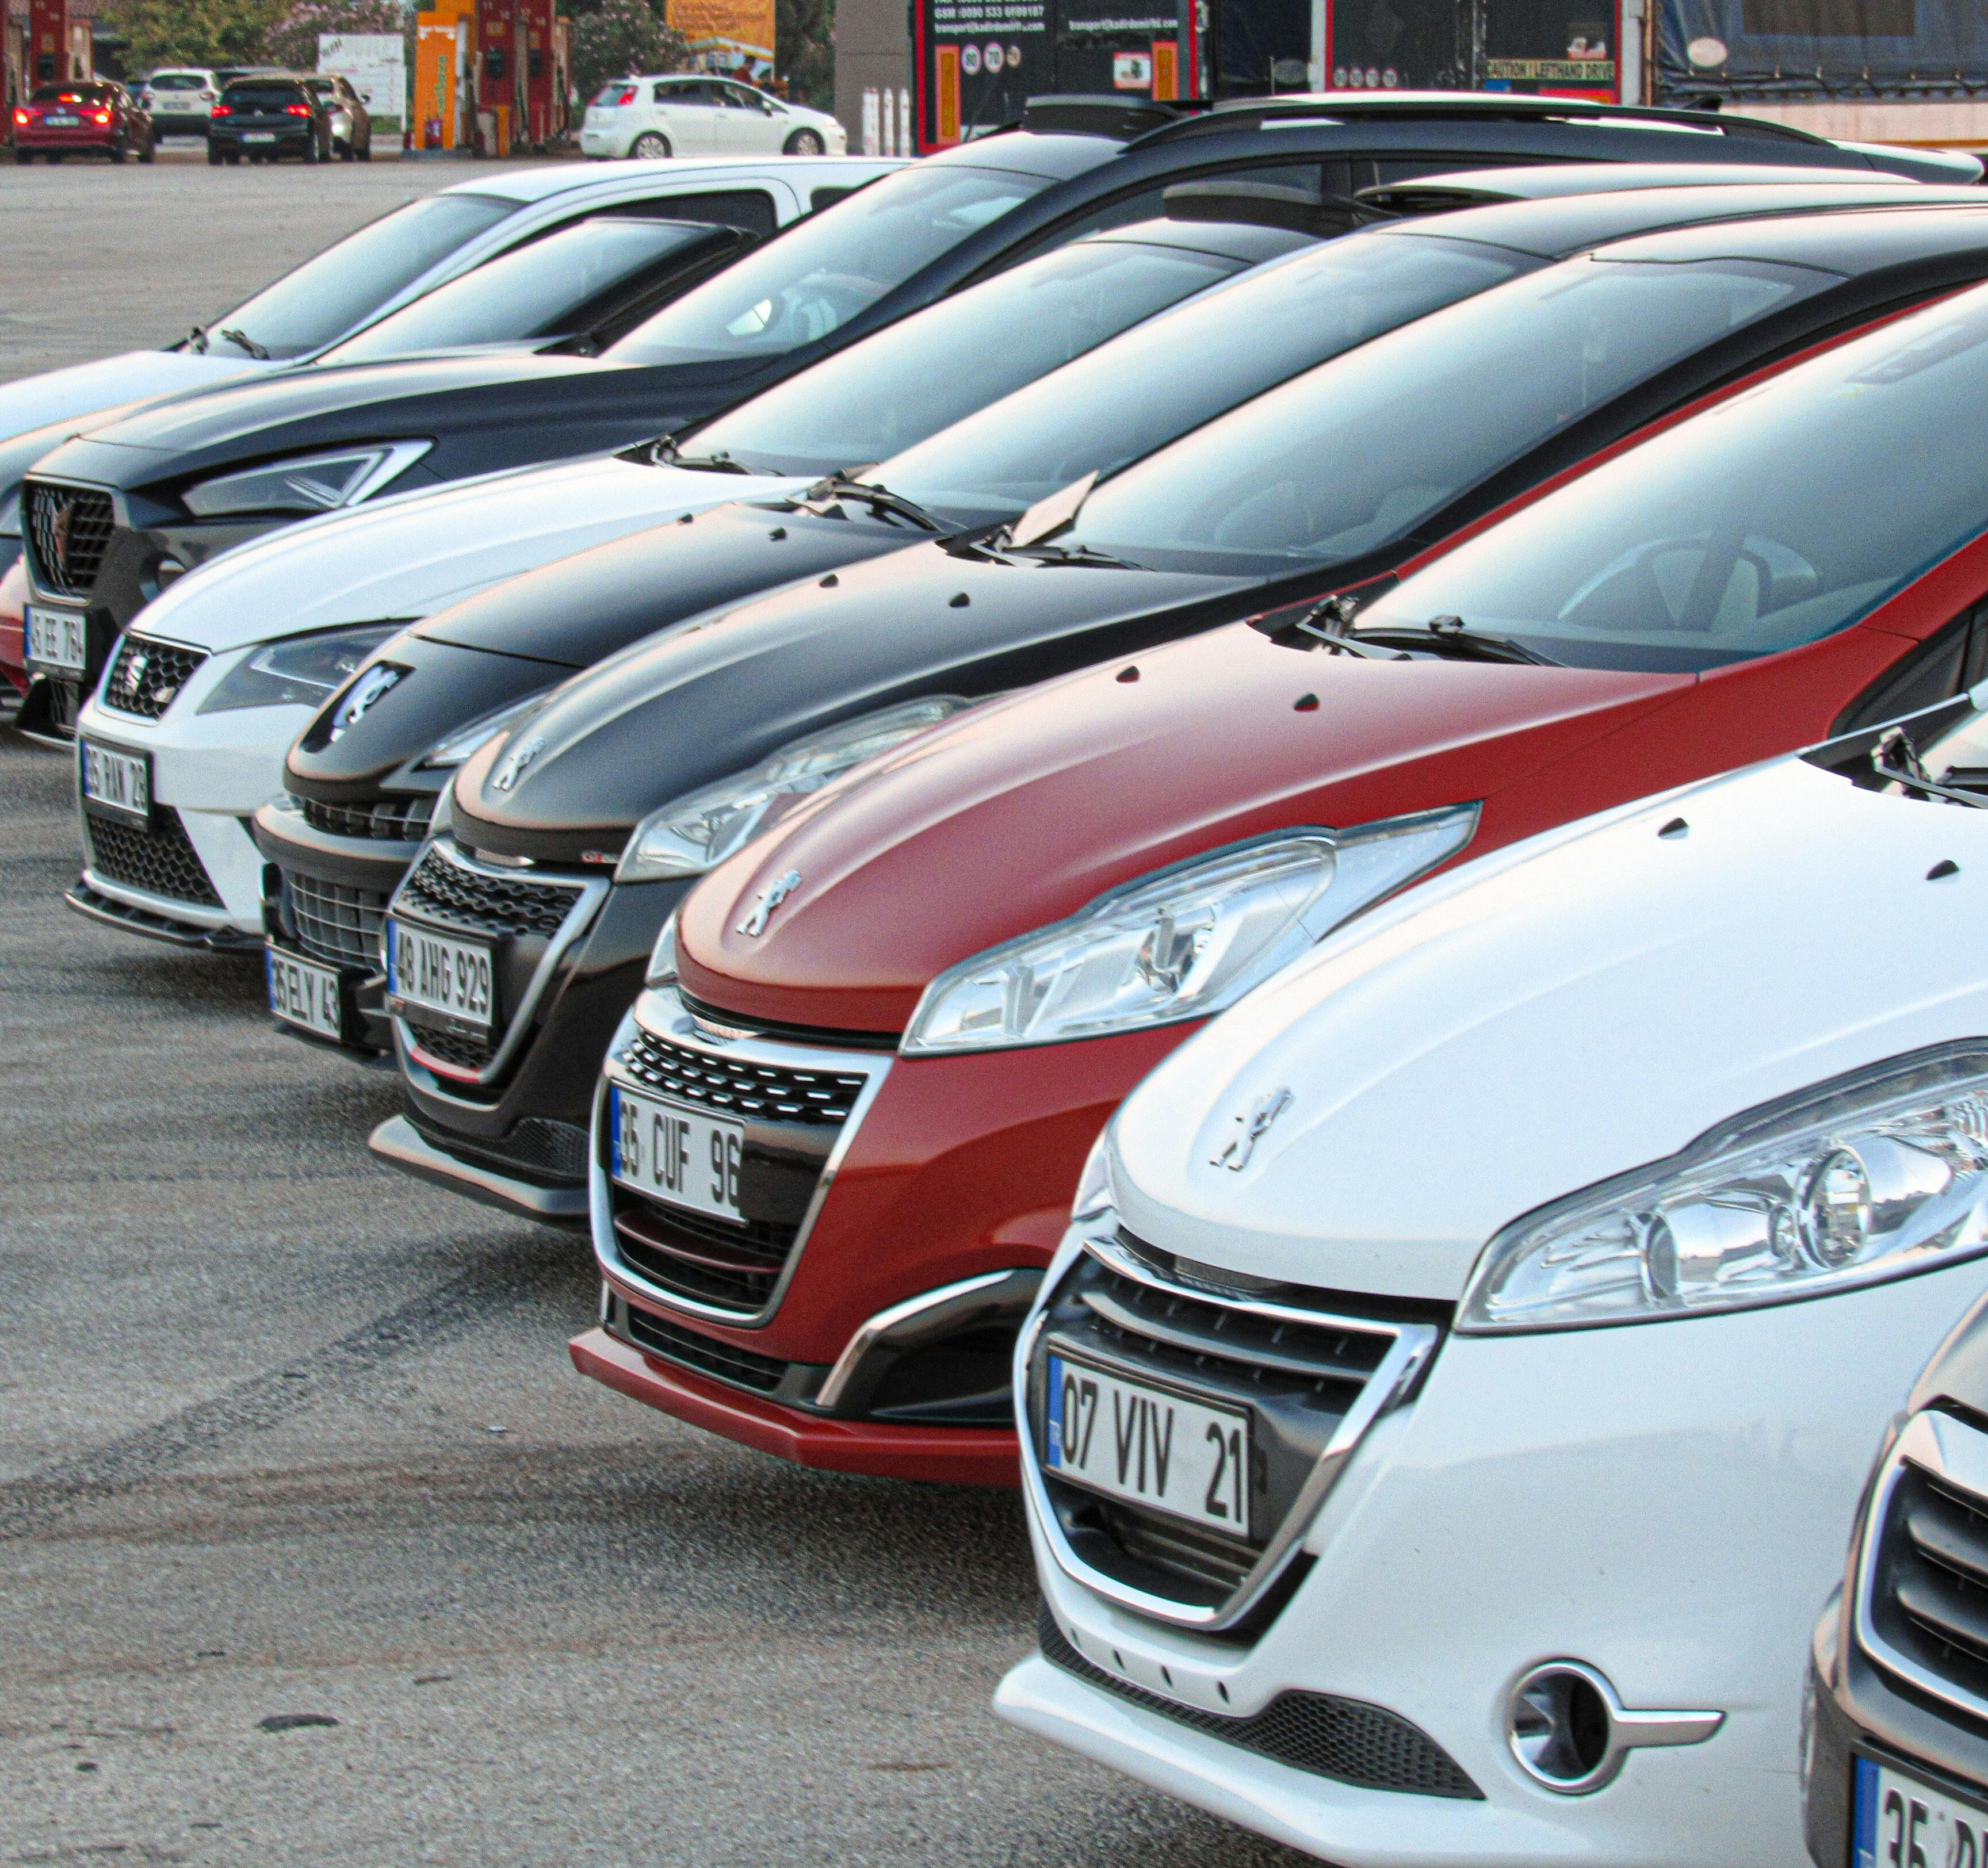
CarSight AI
Making used car pricing less of a guessing game.
Lakshya Mohan Rastogi
DS 440 Capstone Project
CarSight AI
1
Notes:
I wanted this final presentation to start with the real moment behind the project. Buying a used car is already stressful, and the hardest part is not always the price itself. It is trying to understand what the seller's words actually mean.

Slide 2

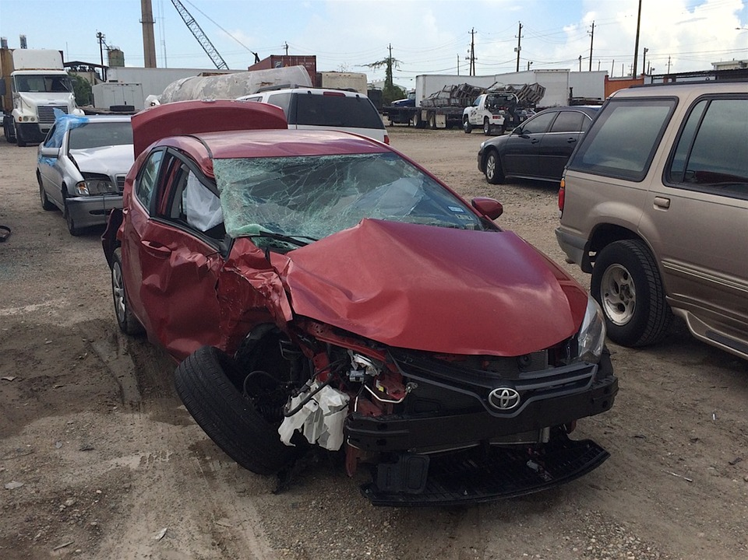

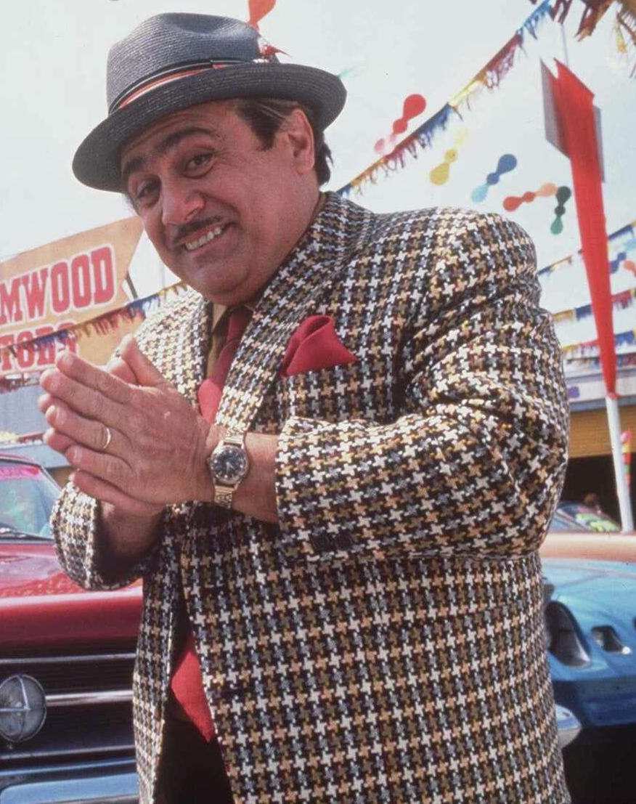
Scenario: Online Listing
The Hook
"Minor scratches. Slight bumper damage. Runs fine."
The "Hidden" Cost of a Used Car
What does "minor" actually mean in dollars?
Traditional tools look at mileage. They don't look at the story.
Nothing much! Just a minor bump, that’s it

Slide 3
THE BUYER MOMENT
The scary part is not the dent.
It is not knowing what that dent should do to the price.
Seller description
The same words can feel harmless to one buyer and like a warning sign to another.
"Small dent on rear bumper. Engine makes a light knocking sound. Runs fine."
What does that mean in dollars?
Can I trust it?
Should I negotiate?
Is it overpriced?
The listing sounds casual, but the risk is real.
The buyer needs a fair starting point.
A single number does not explain enough.
CarSight AI
2
Notes:
This slide is the emotional center of the problem. A phrase like "small dent" sounds simple, but buyers still have to make a money decision from it. My project is about turning that uncertainty into something more readable.

Slide 4
THE GAP
Most pricing tools read the car, not the story.
Year and mileage matter, but the description often carries the risk.
What current tools usually see
What buyers still have to interpret
Year
small dent
Mileage
engine knocking
The missing link
Make / model
scratches everywhere
Broad condition
smoke smell
CarSight AI
3
Notes:
The problem is not that structured pricing data is wrong. It is incomplete. Two cars can have the same year and mileage, but the written condition can completely change how much risk the buyer is taking.

Slide 5
WHO IT HELPS
The goal is a fairer conversation.
CarSight is built for people who need clarity before money changes hands.
First-time buyers
Everyday sellers
Online marketplaces
People who do not know whether a damage description is normal, serious, or a negotiation point.
People who want to price honestly without guessing too high or too low.
Platforms where better explanations can reduce confusion and build trust.
If pricing is explained better, the conversation becomes less about pressure and more about evidence.
CarSight AI
4
Notes:
I did not want this to be just a model score. The project is more useful if it helps a buyer and seller talk about the car in a clearer way. That is why I treated it as a decision support system.

Slide 6
THE SYSTEM
What I built: a pricing support prototype.
It connects text analysis, structured car data, a pricing model, and plain-language explanations.
01
02
03
04
Input
NLP
Model
Explain
Vehicle fields plus the seller's damage description.
Clean text, extract damage terms, classify type and severity.
Combine structured features with text-derived signals.
Return a price range and show what changed the estimate.
Output: a range, not a single magic number.
CarSight AI
5
Notes:
This is the main system view. The important part is that the text does not stay as text. It becomes signals that can be used by the model and then explained back to the user.

Slide 7
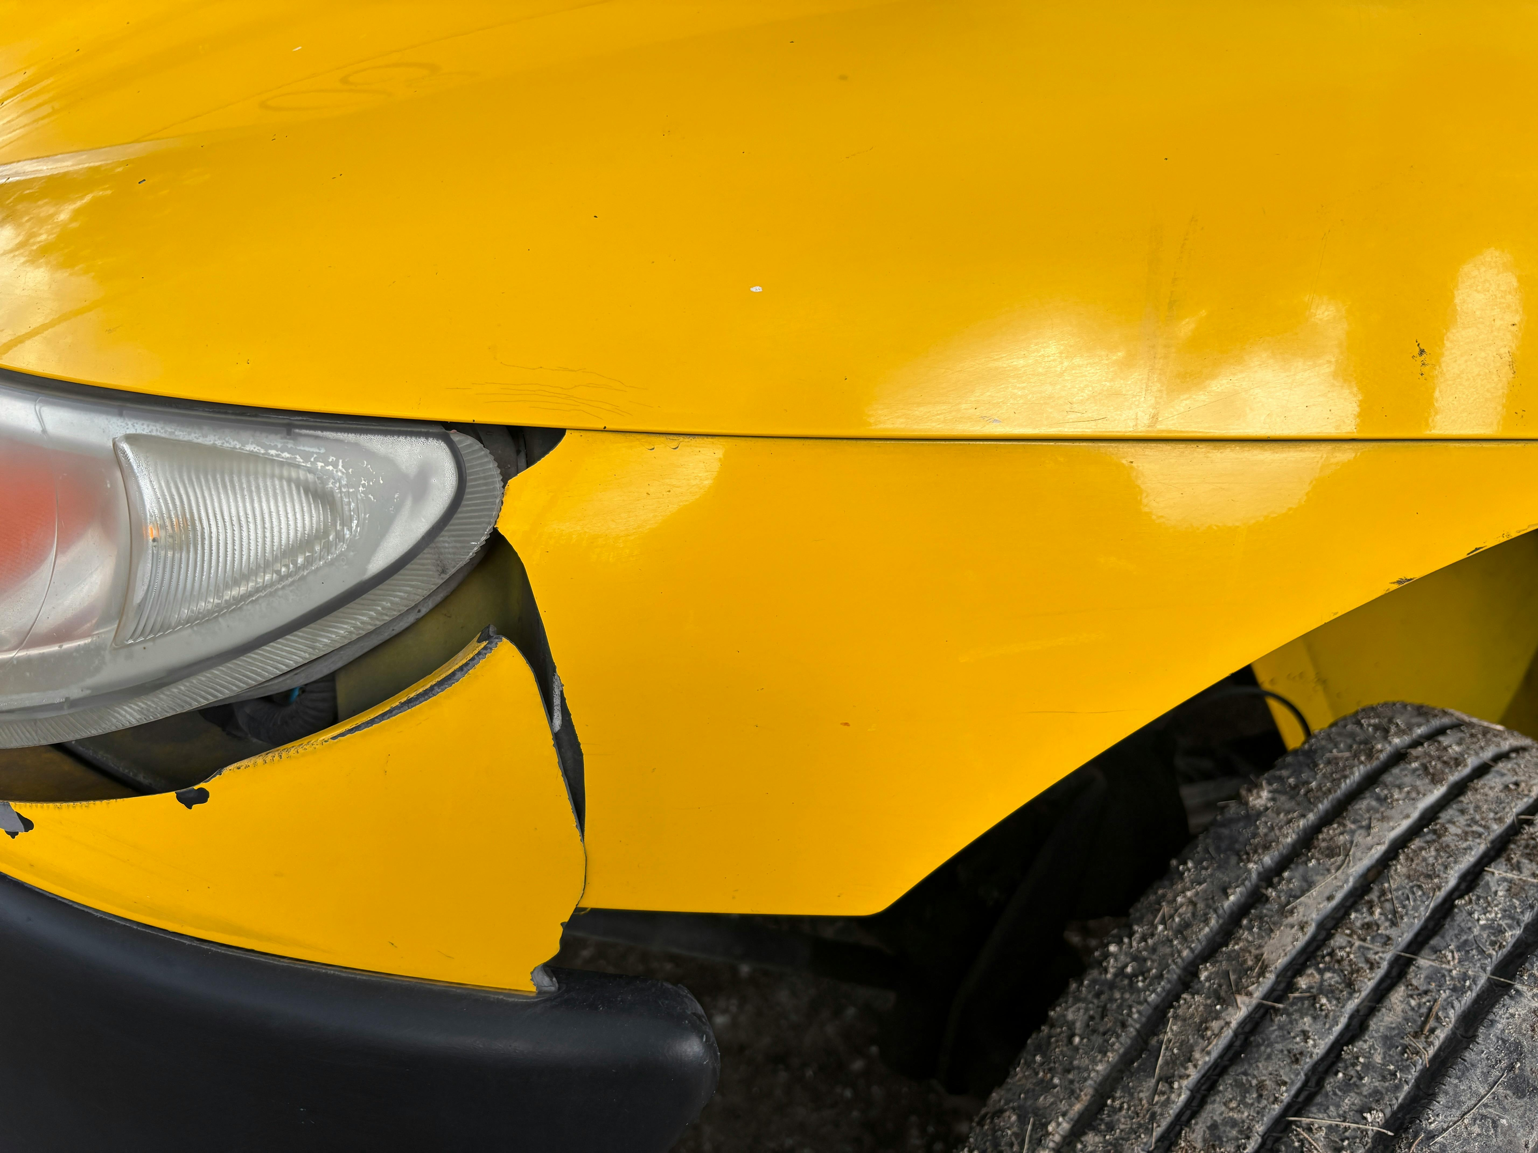
NLP LAYER
Reading damage descriptions
The pipeline looks for the parts of the listing that usually get ignored.
"Rear bumper cracked and engine knocks when cold."
Clean
Remove noise and focus on useful words.
Detect
Find terms linked to body, engine, interior, and other issues.
Score
Convert language into severity and impact signals.
CarSight AI
6
Notes:
For the NLP layer, I kept the first version understandable. It uses text cleaning, TF-IDF style features, and damage rules that make the output explainable. A transformer model could come later, but I wanted the prototype to show the full idea clearly.

Slide 8
VALUATION
From words to a price range
The model combines car facts with damage signals, then shows uncertainty instead of pretending to be exact.
Base value
Damage signal
Uncertainty
+
+
year, mileage, make, model
type + severity
range and confidence
Estimated range
$12,200 - $12,800
CarSight AI
7
Notes:
I chose a range because a single price can give a false sense of certainty. Used car pricing has noise. Damage descriptions also have noise. A range is more honest and more useful for negotiation.

Slide 9
PROTOTYPE
What the dashboard is meant to do
The interface keeps the workflow simple: enter the car, paste the description, review the reasoning.
Vehicle Details
Price Range
Chat Assistant
Year
2018
Mileage
82,000
$12,200 - $12,800
Is this overpriced?
Engine
2.0L
Model
Honda Accord
Confidence: Medium
Main impact: engine + body damage
Yes, the engine note raises risk.
Damage Description
bumper cracked, engine knock
CarSight AI
8
Notes:
The dashboard is intentionally simple. It is not trying to make the user hunt through model details. It gives the range, the damage breakdown, and a place to ask follow-up questions in normal language.

Slide 10
EXPLAINABILITY
The chatbot is there for the follow-up question.
The user should be able to ask why the range changed, not just accept the answer.
User: Should I still make an offer?
CarSight: Yes, but negotiate from the lower end. The engine knock has more pricing impact than the bumper damage, so I would ask for inspection records before paying near the top of the range.
Explain
Negotiate
Risk check
Turns model output into plain language.
Suggests where the buyer has leverage.
Calls out descriptions that deserve caution.
CarSight AI
9
Notes:
This is where the prototype becomes more than a calculator. A buyer may not know what to do with a model score. The chatbot turns the result into a practical next step, like whether to negotiate or request an inspection.

Slide 11
VERIFICATION
How I checked the system
The testing focused on whether the prototype works end to end and whether the output stays understandable.
NLP checks
Model checks
Damage terms map to the right categories and severity levels.
Regression performance is reviewed with MAE and RMSE.
API checks
UI checks
Backend returns a valid price range and explanation.
Dashboard displays results and chatbot responses correctly.
Critical path: data → NLP → model → API → dashboard → final report
This matches the final deliverable focus: design, implementation plan, testing, and documentation.
CarSight AI
10
Notes:
For verification, I looked at the system in layers. I checked the text extraction, the model output, the API response, and the dashboard behavior. That also lines up with the final deliverable expectations for testing and system documentation.

Slide 12
WHAT COMES NEXT
The model works, but it is not over yet.
The main limits are data quality, simple NLP, and real-world coverage.
Better data
Stronger NLP
Image analysis
Marketplace fit
More real listings, cleaner labels, and examples of rare damage types.
Move from TF-IDF and rules toward transformer-based text understanding.
Use car photos to confirm visible damage instead of relying only on text.
Connect the system to live listings and comparison data.
The future version should learn severity from real examples instead of depending mainly on hand-built rules.
CarSight AI
11
Notes:
I want to be honest about limitations. This is a capstone prototype, not a production valuation platform. The biggest next step would be better labeled data, because stronger data would make every later improvement more meaningful.

Slide 13

Less guessing.
More honest pricing.
CarSight AI turns vague damage language into a clearer price range and a better conversation.
Thank you
Lakshya Mohan Rastogi
CarSight AI
12
Notes:
To close, the project is really about confidence. Not confidence that the model knows everything, but confidence that a buyer has a clearer starting point and can ask better questions before making a major purchase.

