Slide 1









Used Car Price Prediction
Hyundai Motor
Company

Slide 2
Project Team
Abhishek Singh
Ankita Keshri
Lakshay Bansal
Md. Zamam Ahmad
Nupur Kwatra

Slide 3
Objective
Perform thorough exploratory data analysis and preprocessing to unveil insights, patterns, and enhance data quality.
Evaluate a range of regression models, including Linear Regression, Decision Tree, Random Forest, and SVR, to identify the most accurate predictor of used car sale prices.
Utilize GridSearchCV to tune hyperparameter of the best model, for elevating model performance and ensuring the chosen regression model's effectiveness in predicting car prices.
Investigate the impact of polynomial regression with degrees 2 and 3 on predictive accuracy, offering insights into nonlinear relationships and enhancing model interpretability.

Slide 4
Project Timeline
Day 1
Data Cleaning
Day 2
Univariate & Bivariate Analysis
Day 3-4
Model Building
Day 5
Presentation Preparation

Slide 5
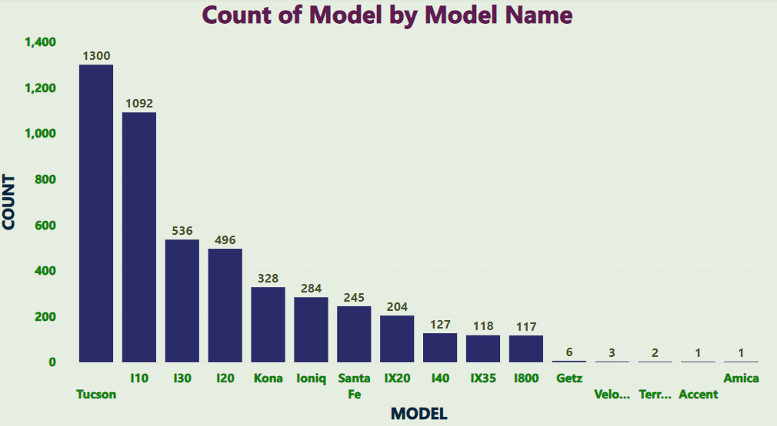
Observations
Count of Different Car Models
Based on the graph, we can see that Tucson, I10, and I30 are the most common car models.

Slide 6
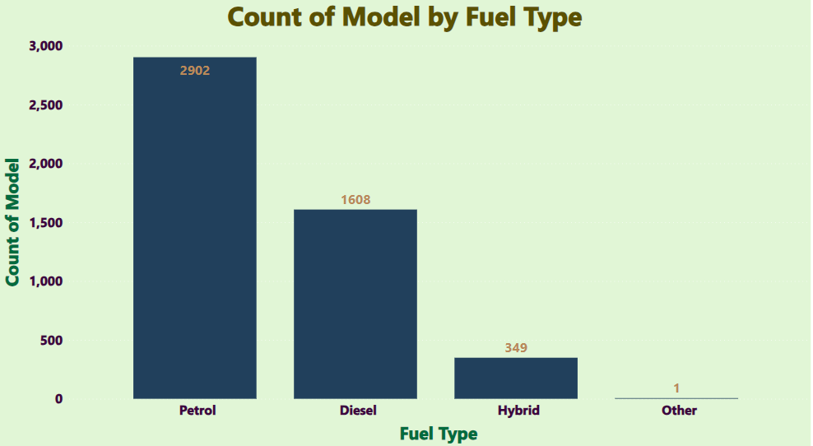
Observations
Count of Car Models across Fuel Types
The data indicates that petrol is the most common fuel type with 2902 counts, followed by diesel with 1608 counts.

Slide 7
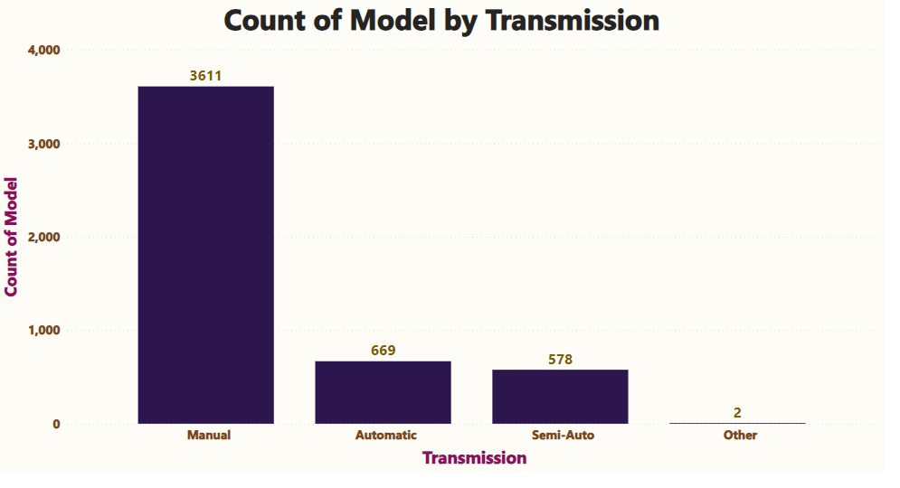
Observations
Count of Car Models by Transmission
Based on the graph we can conclude that the manual transmission model is most popular with 3611, followed by automatic.

Slide 8
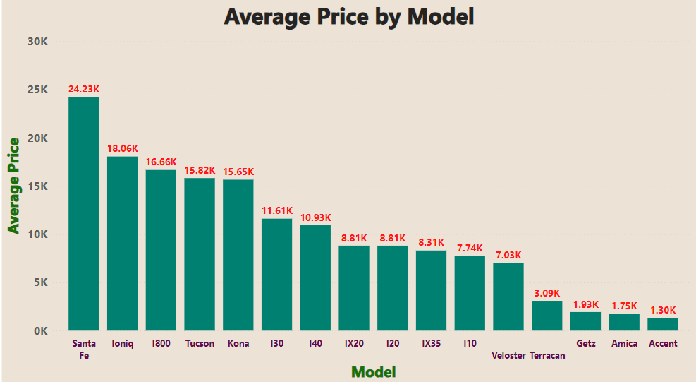
Observations
Average Price of Cars across various Models
The visual shows the average price of car models by name. The y-axis shows the average price, while the x-axis shows the model names.

Slide 9
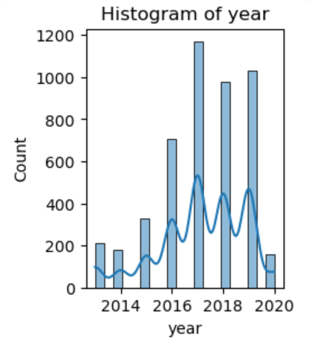
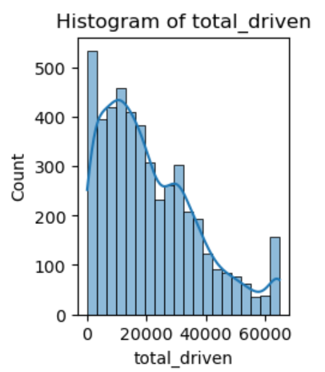
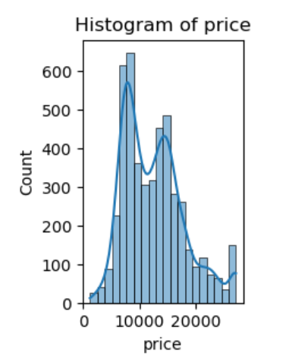
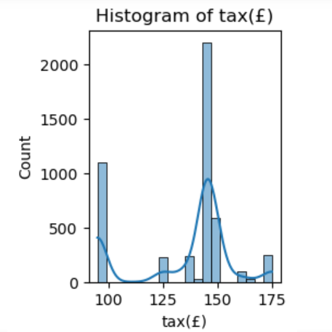
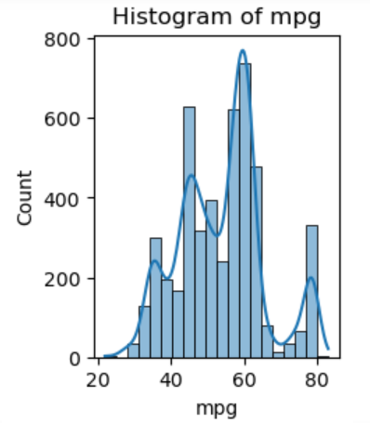
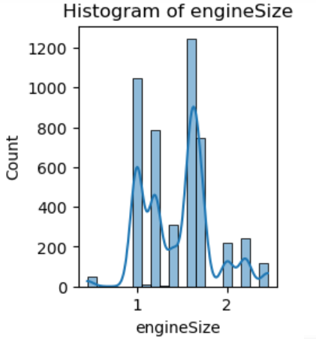
Distribution of Numerical Variables
Observations
The plot shows each numerical variable in an individual histogram, allowing us to observe its frequency, range of values, distribution patterns, and potential outliers.

Slide 10
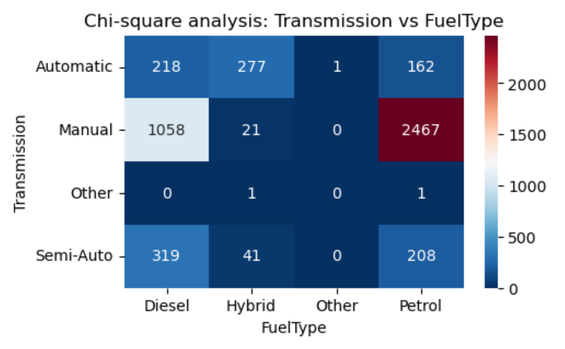
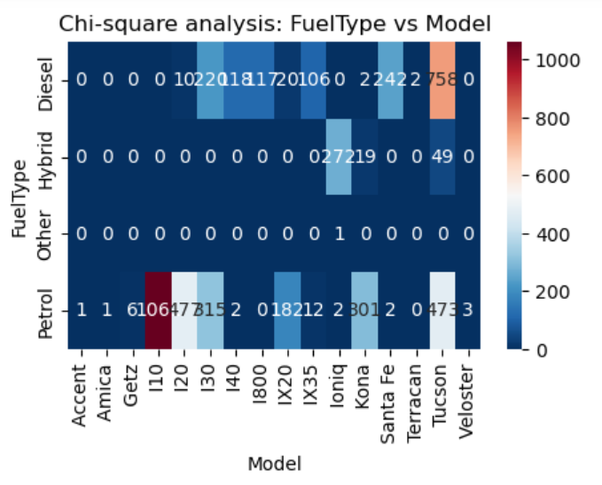
Observations
Distribution of Numerical Variables
Chi-square analysis between Transmission and Fuel Type:
Chi-square value: 1701.3676934890989
p-value: 0.0
Chi-square analysis between Fuel Type and Model:
Chi-square value: 6337.2810088642855
p-value: 0.0

Slide 11
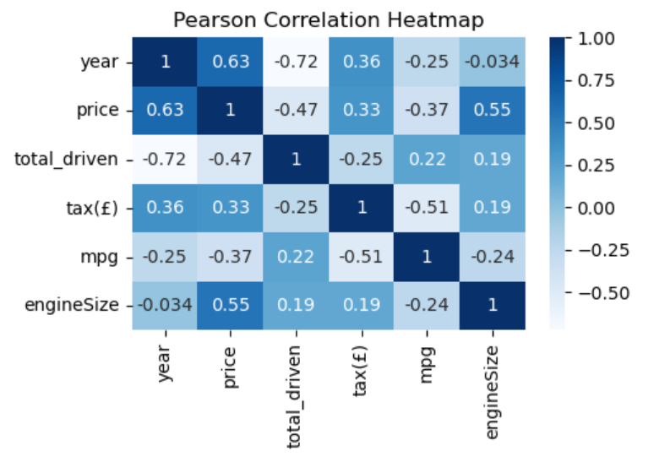
Observations
Pearson Correlation
The Pearson correlation heat map illustrates the strength of linear relationships between variables.
The price has a strong positive correlation with the Engine size, and year, while Total Driven, Fuel Type, and mpg show a weak correlation.

Slide 12
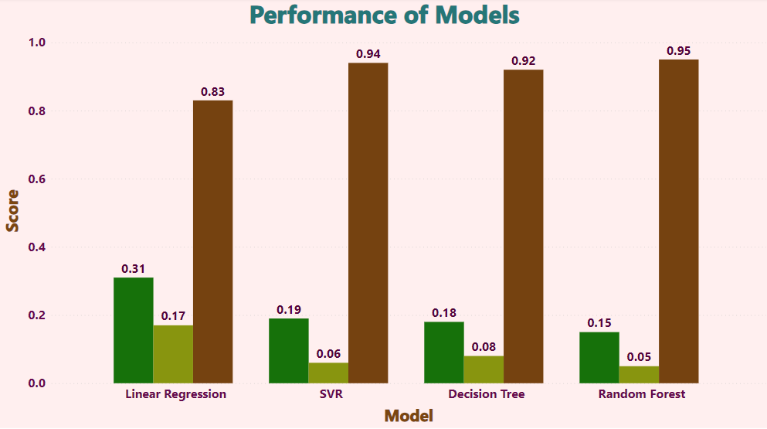
Model Performance
The graph compares the performance of different models based on evaluation metrics Mean Squared Error (MSE), Mean Absolute Error (MAE), and R-squared scores.
The Random Forest model shows the lowest MSE and MAE values, indicating better accuracy and precision in predicting the target variable, with an R-squared score of 0.95 demonstrating a strong correlation between the predicted and actual value, hence it is the better fit model.

Slide 13
Grid Search CV Tuning
GridSearchCV is trying out different outfits to find the best fit. It carefully tests various ways to make the model better, so we can discover the perfect setup that makes our model perform better.
Our grid search CV reveals optimal hyperparameters: Fitting 5 folds for each of 108 candidates, totalling 540 fits. Giving Train Accuracy - : 0.98 and Test Accuracy - : 0.96.
High train accuracy suggests that model has learned the patterns and relationships in the training data very well.
High test accuracy indicates that model is generalizing well to new data and is not overfitting.
Hyperparameter tuning is done to attain best accuracy, and here the data set is small that's why we have used Grid Search CV. Our model improved a lot with these settings.

Slide 14
Random Search CV Tuning
RandomSearchCV is like randomly exploring a treasure map to find valuable spots, helping us discover good model settings without checking every single possibility.
Random search identified key hyperparameters. Fitting 5 folds for each of 10 candidates, totaling 50 fits. Giving Train Accuracy - : 0.97 and Test Accuracy - : 0.96.
High train accuracy suggests that the model has learned the training data well and can potentially memorize the data.
High test accuracy suggests that the model is performing well on new data and is not overfitting the training data.
Random Search CV is done to attain the best accuracy in less time.
Random search efficiently navigated option, resulting in improved model settings for enhanced results.

Slide 15
Polynomial Regression Model
Polynomial regression is a technique where we use a wavy line instead of a straight line to make our predictions, especially when the data points show curves or bends.
Increasing the polynomial degree from 2 to 3 improved the model's fit, lowering the Mean Squared Error (MSE) from 0.10 to 0.08.
The Mean Absolute Error (MAE) decreased as well, going from 0.24 (degree 2) to 0.21 (degree 3), indicating more accurate predictions with the higher degree.
The R-squared value, a measure of how well the model explains the data, increased from 0.90 (degree 2) to 0.92 (degree 3), showing that the degree-3 polynomial regression captured more variance in the data.
The results suggest that choosing a polynomial degree of 3 could provide a good balance between model complexity and performance in this case, but polynomial regression have slightly higher errors compared to Random Forest and Decision Tree models.

Slide 16
Challenges Faced
Evaluating different regression algorithms and overcoming challenges in gridsearchCV to finely tune hyperparameters for improved model performance.
Employing techniques like Cross Validation and extra tree regressor to uncover influential features that play a crucial role in shaping the model's predictions.
Learnings
We got better at using regression tools, tweaking settings, and finding important features by taking help of online resources.
Collaborative teamwork improved task delegation and made us achieve things that we couldn’t have alone.

Slide 17
Thank You

