Slide 1
Optical Character Recognition

Slide 2
Introduction
Handwritten text recognition is challenging due to diverse nature of human handwriting.
With the increasing volume of handwritten documents, automated solutions are needed to accurately convert these documents into digital formats.
It focuses on converting handwritten words into digital text using advanced machine learning techniques.
By improving accuracy and efficiency, it aims to simplify and speed up the transcription process.

Slide 3
Problem Statement
The conversion of handwritten words into digital text presents a challenge because of variability and complexity of handwriting styles.
Aim is to create a system that efficiently converts handwritten words into digital text, making it easier to handle handwritten documents.

Slide 4
Scope
Focuses on developing automated handwritten text recognition system.
Integrates OCR with modern text detection algorithm to convert handwritten text to digital format.
Utilizes YOLO for text detection and Tesseract for character recognition.
Flask-based web application where users can upload image and process through YOLO and Tesseract.
Benefit educational institutions, exam boards by automating transcription process.

Slide 5
Software Requirements Specification
Functional Requirements
User Authentication
Image Upload
Text-Detection(YOLO model)
Text-Recognition(Tesseract OCR)
Result Display
Non-Functional Requirements
Performance
Compatibility
Usability
Reliability

Slide 6
Software Requirements Specification
Software Requirements
Web Application Framework (Flask-based)
Machine Learning Libraries
YOLO(You Only Look Once)
Tesseract OCR
Web Browser Capability (Google Chrome, Microsoft Edge, Mozilla Firefox )
Hardware Requirements
Server Specification
CPU
RAM (Atleast 8gb)
Storage
User Hardware
Internet Connection
Computer or Mobile devices

Slide 7
Implementation
Text Detection (Implemented using Jupyter Notebooks, YOLO for detecting text regions within images.)
Integration with Python Backend (Python is integrated into Flask)
Front-End Development (HTML, CSS, JavaScript)
System Integration (Combining Front-end, back-end and machine learning components.)

Slide 8
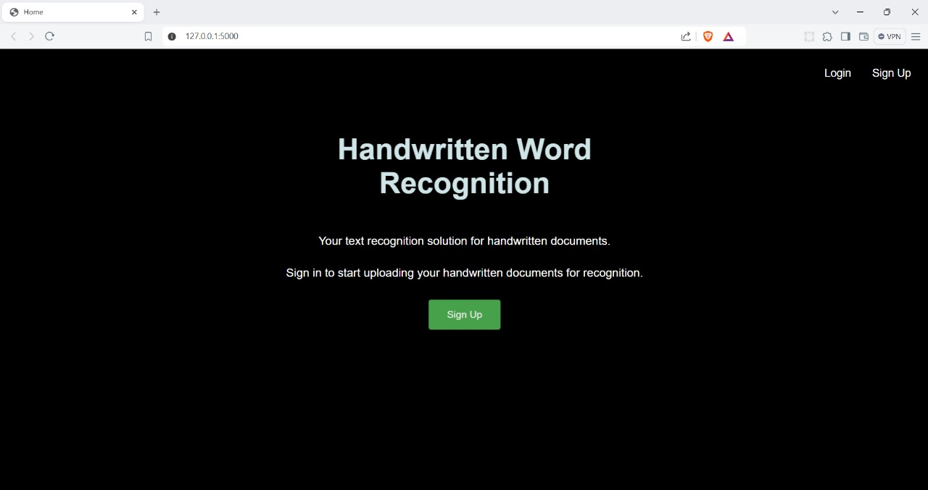
M
Main Page

Slide 9
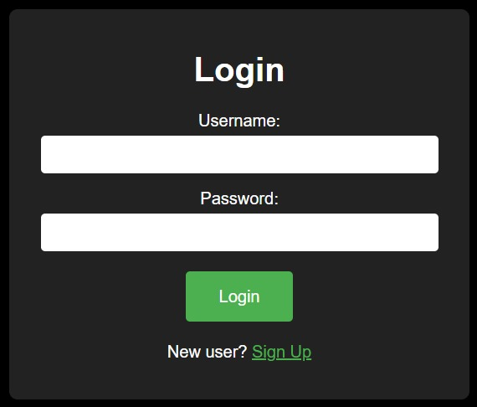
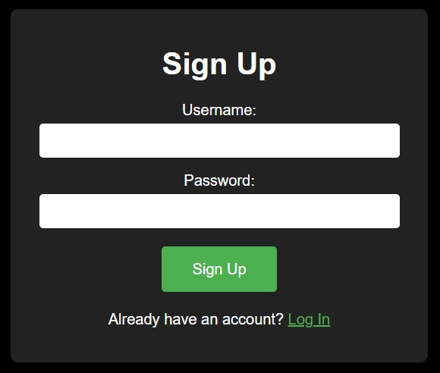
M
Login/SignUp Page

Slide 10
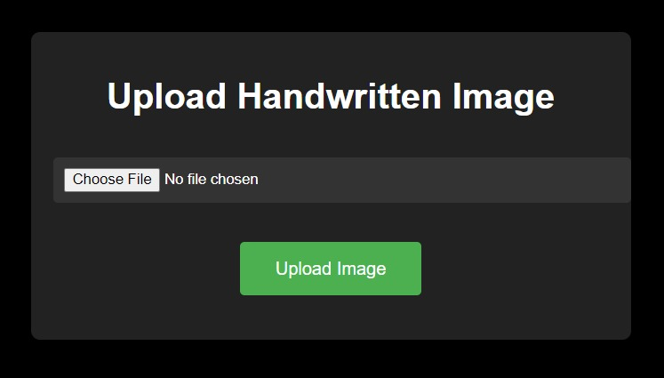
M
Upload Handwritten Image Page

Slide 11
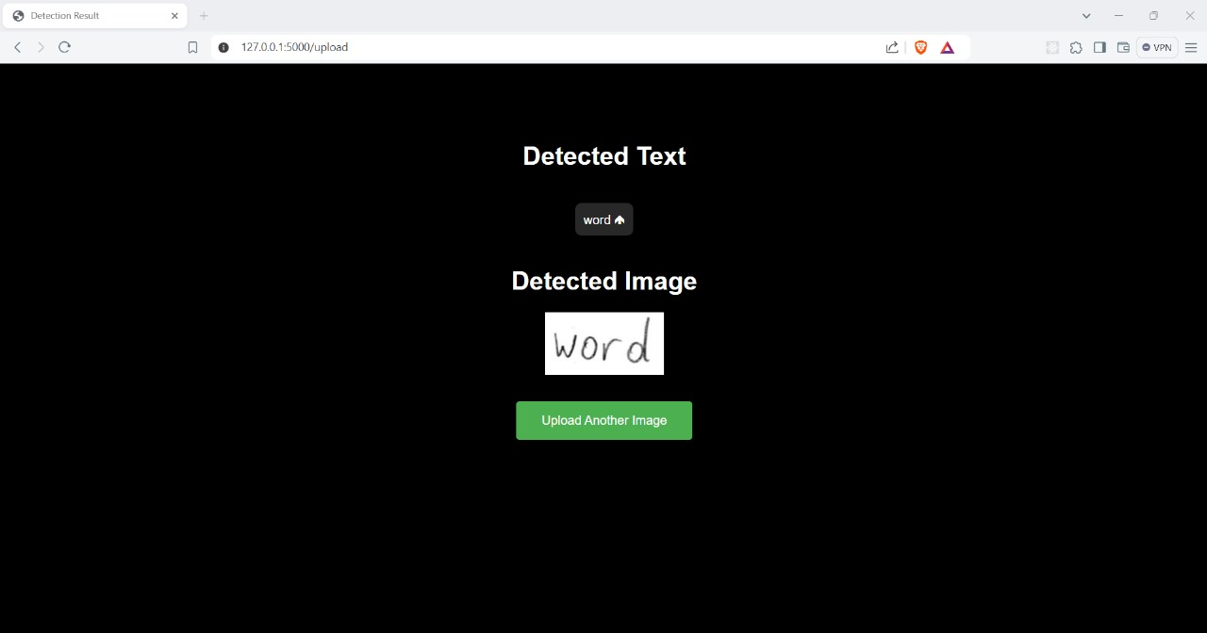
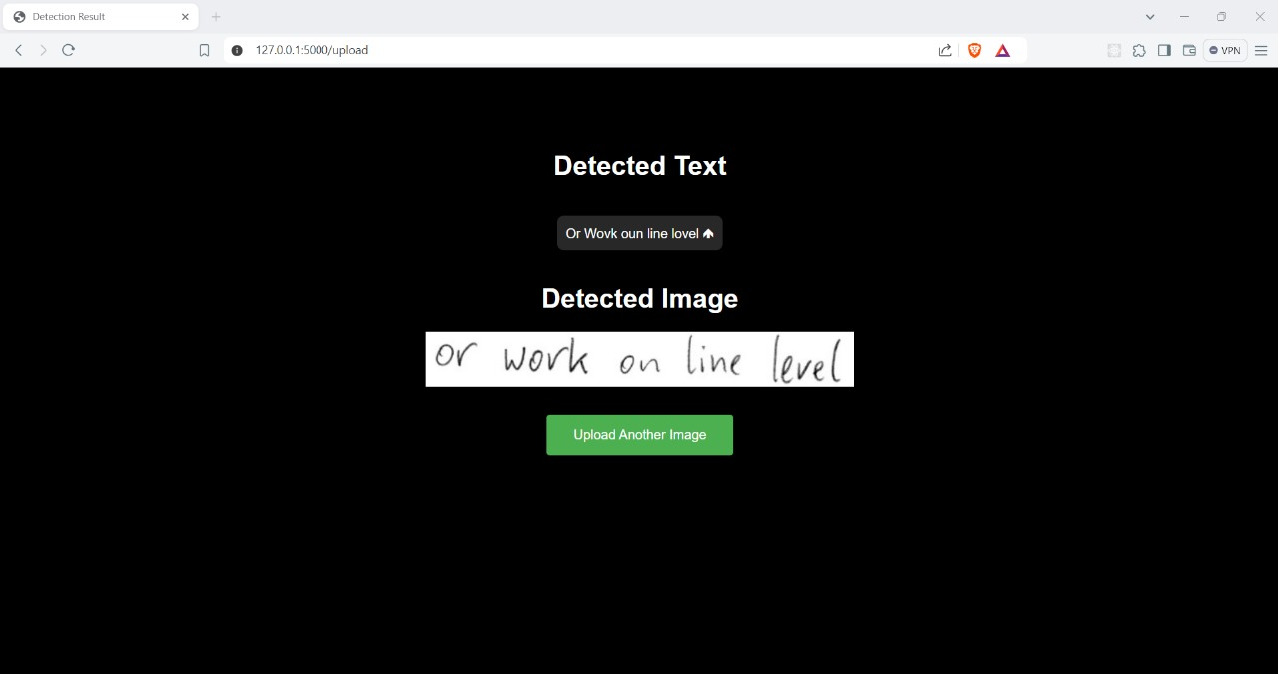
M
Detected Text Page

Slide 12
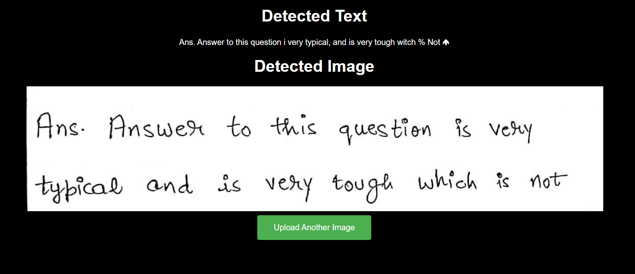
M
Detected Text Page

Slide 13
Future Scope
While our project meets its objectives, there is room for further enhancement. Future work could focus on improving text recognition accuracy by incorporating additional machine learning models or techniques.
Evaluation metrics and markers should be developed to assess and benchmark the performance of the text recognition system.
Additionally, expanding the system to handle more diverse handwriting styles.

Slide 14
Conclusion
This project successfully developed a system for converting handwritten words into digital text using advanced machine-learning techniques.
By integrating YOLO for text detection and Tesseract OCR for text recognition, the system effectively processes and digitizes handwritten documents.
The user-friendly web application facilitates image uploads, detects text, and easily displays results.
Using Flask as the backend framework ensures easy communication between the frontend and the machine learning components.

Slide 15
Thank you
Keerthana – 4SO21CS073
Laksha – 4SO21CS075
M Kushi Suvarna – 4SO21CS82
Mantraj Tryphena – 4SO21CS083

