Slide 1
Urban Sentiment Analysis: New York
ISYE 7406
Joe Mosby, Lakshana Ganesh, Kevin Griffith, Ling Lui, Corey Kirkpatrick, Jessica Van Duyne, Roberto Castillo, Sirapat Niyom
Advisor Dr. Jye-Chyi Lu
Notes:
Jessica

Slide 2



Introduction to Twitter
Twitter is an online social networking and news website where users can post and interact with each other through short messages called “tweets.”
Founded March 21st, 2006
San Francisco, CA
335 mil. active users & over 340 mil. tweets being posted daily.
One of the largest sources of breaking news.
Notes:
Jessica

Slide 3
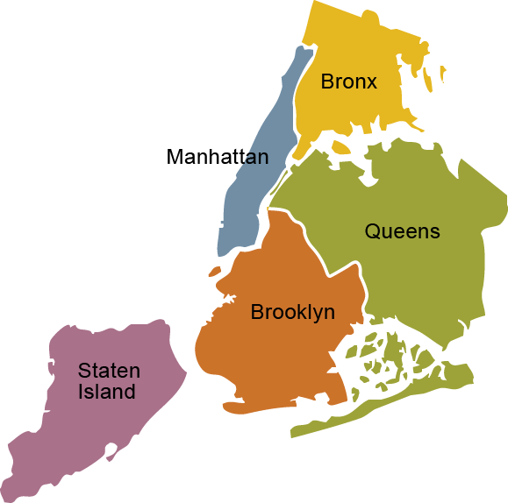
Motivation
Studies have suggested that Social Media usage increases the risk of depression in adults (Lin et al, 2016).Mental Health Resources are scarce in NYC with only 62% of depressed adults having access to mental health service.
We are hoping to identify the optimal time and location for systemic scheduling of public activities to care for the emotional hygiene of NYC residents.
Notes:
Jessica
New York City has been appropriately coined as “the city that never sleeps” and it’s depression rates show this to be true with 548,000 adults (9%) in NYC having depressive symptoms in 2016.

Slide 4
Project Objective
Use Twitter Data and Data Mining methodology to predict when NYC residents have the most “negative” tweets.
This would provide non-profit organizations and city governments the data to most effectively implement strategies that improve quality of life for residents.
3 Intervention Strategies:
Series of free activities based on mindfulness, suicide prevention, and self-love.
Animal-Assistance Therapy - proven to reduce stress.
Art Therapy via coloring books and “Pop-up” mini-sessions.
Notes:
Jessica
Free activities based on mindfulness, suicide prevention, and self-love.
Currently Fresno State has a month of love series that address all of these topics to increase quality of life for students (“6 Ways Campuses Are Helping Students De-Stress”, n.d.). We propose having these activities in the boroughs and on the days most vulnerable..
Offer Animal-Assistance Therapy during periods of time that people feel low.
Studies have suggested that a brief visit with therapy dogs for on-campus students significantly reduces stress (Elly Wood et al., 2018). The study measured using state trait anxiety inventory, and blood pressure taken before and after interacting with the therapy dog.
Art Therapy via coloring books and “Pop-up” art therapy mini-sessions.
Art Therapy is a form of psychotherapy that encourages self-expression through a creative medium such as painting, drawing, modeling, coloring etc. Studies have shown that Art Therapy success is not contingent on the environment it’s performed in (Blomdahl et al, 2013).
Arizona State University (ASU) is one of the many campuses offering Art Therapy during finals week to help students manage stress. ASU is offering art therapy in a compact and easy to manage way- via free coloring books (“College Students Can Benefit from Coloring Away Their Stress”, 2018). We propose an instance of art therapy being applied by non-profits, employers, or other agencies passing out coloring books and markers at the times of the day that people are most likely feeling their lowest.

Slide 5







How We Did It?
n=245k
Collect Tweets
Data Preparation
Initial Feature Space
Classification Methods
Best Model Selection
Optimize Parameters
Classify Remaining Tweets
Optimal Time and Location
Notes:
Collect Tweets
Clean Data->

Slide 6
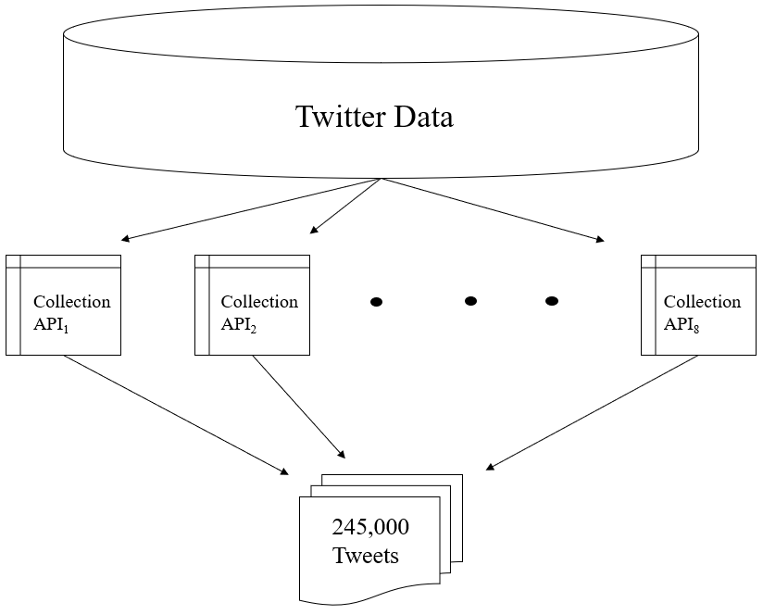
Data Collection
Collection
1,500 tweets per query
245,000 total
Training Set
1,600 randomly sampled
200 per member
Manually classified as…
{negative, neutral, positive}
Notes:
Kevin

Slide 7
Feature Selection
Initial Feature Set
Frequency 0.3% Unigrams [252]
Unigrams (words) that appear in 0.3% of tweets collected
LabMT Score
language assessment by Mechanical Turk - 10,222 word database
New York Slang Count
88 unigrams considered - researched by Google/ Youtube
Exclamation Mark Count
Differentiate between neutral and positive/negative
Notes:
Kevin

Slide 8
Feature Selection - Dimension Reduction
Backward Selection with Cross-Validation
Absolute Count ordered (7)
Sparsity ordered (6)
Neutral unigram removal
5 +/- delta
Final 74-feature space
71 unigrams
LabMT score
NY slang count
Exclamation count
Delta | Unigrams Removed
0.5 | 62
1 | 129
1.5 | 181
2 | 204
2.5 | 226
3 | 239

Slide 9
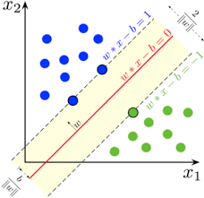
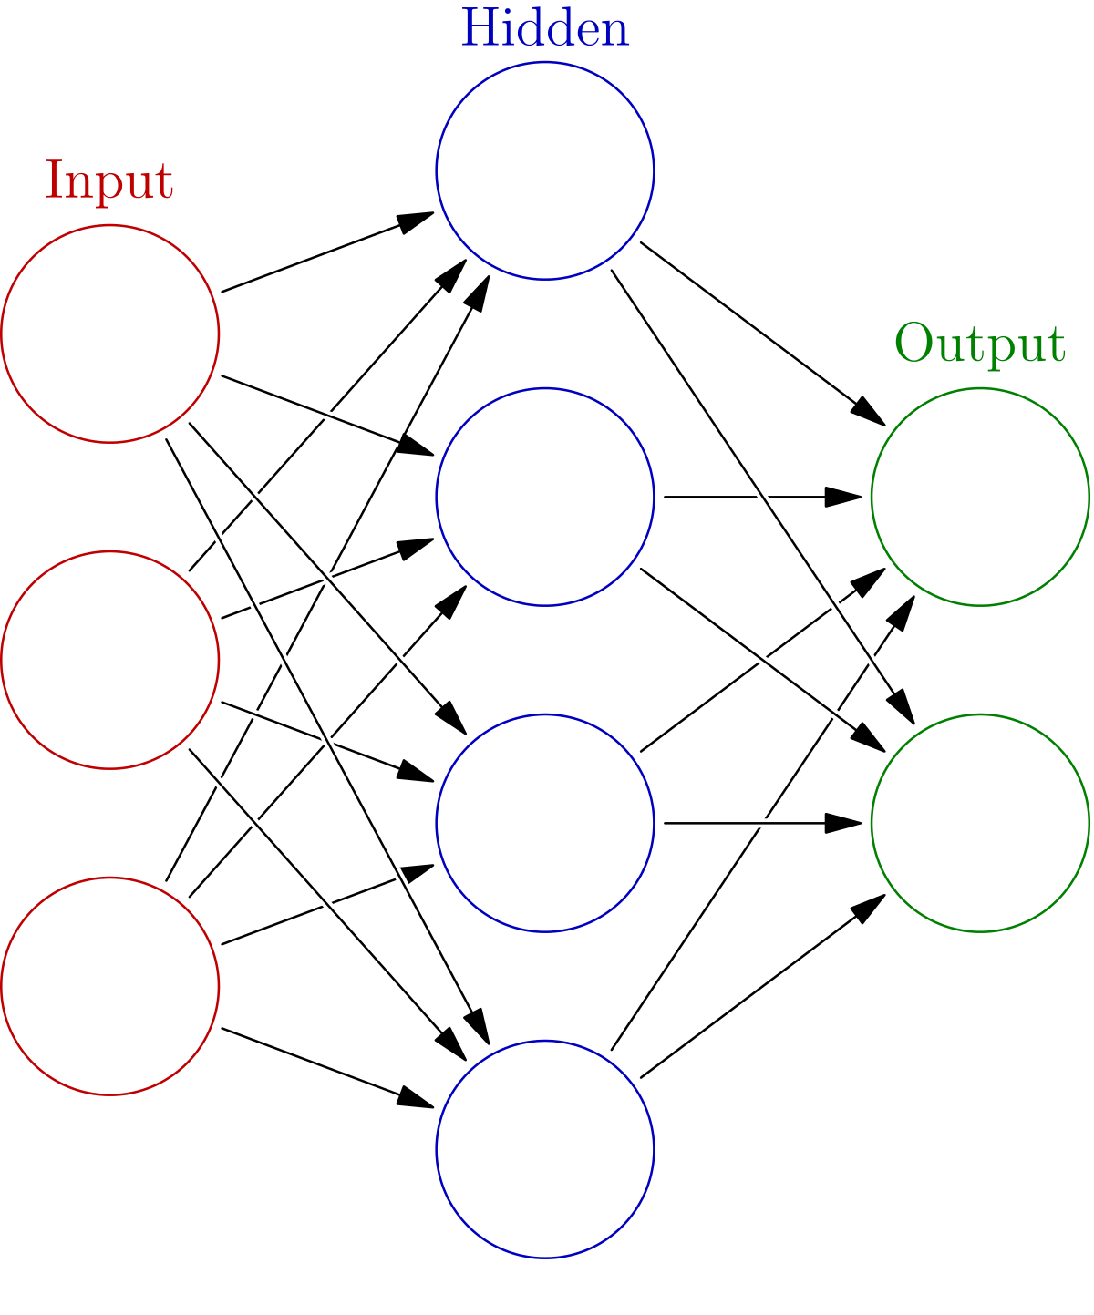
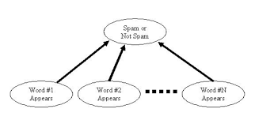
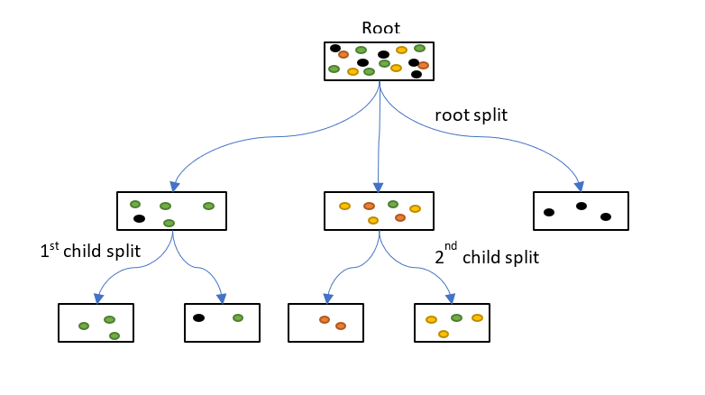
Building a Model - Models Considered
SVM
Neural Networks
Naive Bayes
Decision Trees
Notes:
Joe

Slide 10
Building a Model - Model Comparison
Algorithm | 5-Fold CV Accuracy
Neural Networks | 49.0%
SVM | 46.8%
Decision Tree | 46.6%
Naive Bayes | 48.7%
Notes:
Joe

Slide 11
Building a Model - Model Evaluation
Characteristic | Value
Activation Function | Rectified Linear Unit Function
Optimization Solver | Stochastic Gradient Descent
L2 penalty coefficient | 0.0001
Batch Size | 200
Learning Rate | 0.001
Hidden Layer Sizes | (600, 200, 6)
 | Precision | Recall | Support
Negative | 0.37 | 0.28 | 67
Neutral | 0.52 | 0.66 | 116
Positive | 0.56 | 0.47 | 101
Notes:
Joe

Slide 12
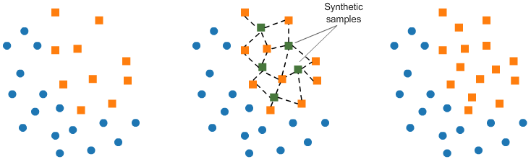
SMOTE
Synthetic Samples
X₁
X₁
X₁
X₂
X₂
X₂

Slide 13
Building a Model - Final Model & Testing
Characteristic | Value
Activation Function | Hyperbolic Tangent Function
Optimization Solver | Stochastic Gradient Descent
L2 penalty coefficient | 0.0001
Batch Size | 200
Learning Rate | 0.001
Hidden Layer Sizes | (300,250,200,100,10)
 | Precision | Recall | Support
Negative | 0.69 | 0.58 | 65
Neutral | 0.49 | 0.59 | 44
Positive | 0.56 | 0.57 | 61
Notes:
Joe

Slide 14
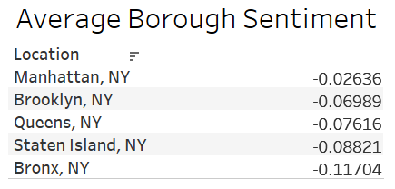
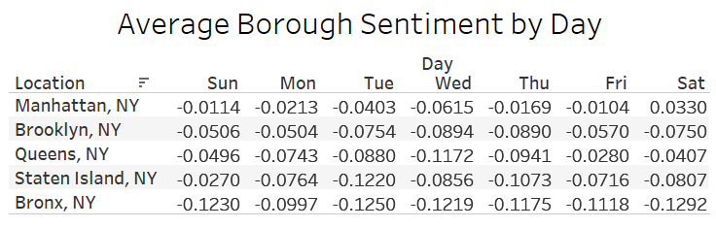
Analysis - Descriptive Statistics
Notes:
Kevin

Slide 15
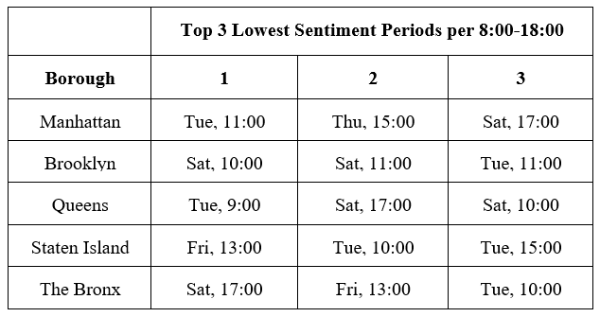
Analysis - Descriptive Statistics
Notes:
Kevin

Slide 16
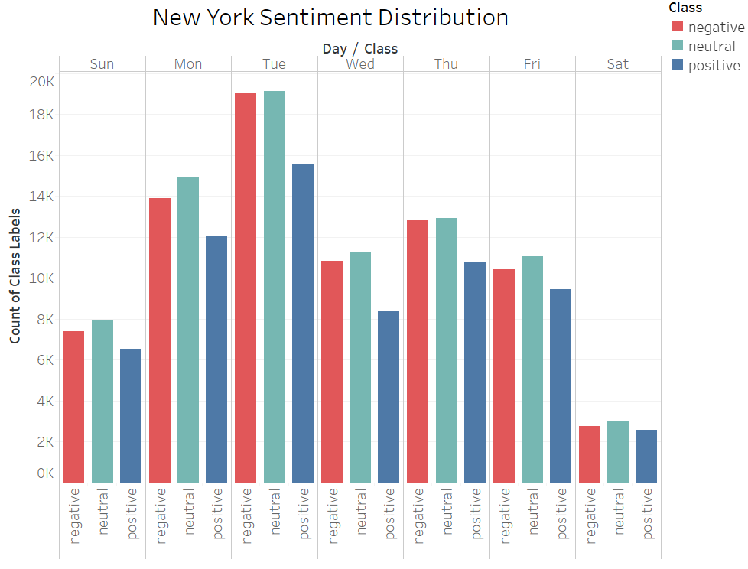
Analysis - Graphical Analysis
Notes:
Kevin

Slide 17
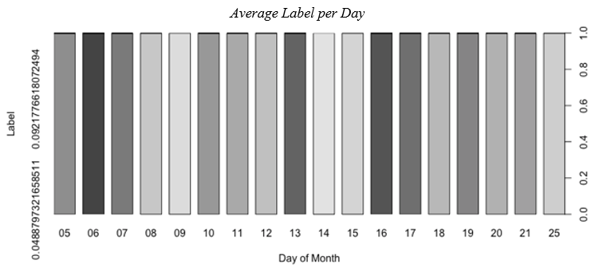
Analysis - Trending Topics
Feb 6th - #PatsParade, #WellnessWednesday
Feb 15th - #TrumpFakeEmergency
Labels {-1,0,1}
Notes:
Kevin

Slide 18
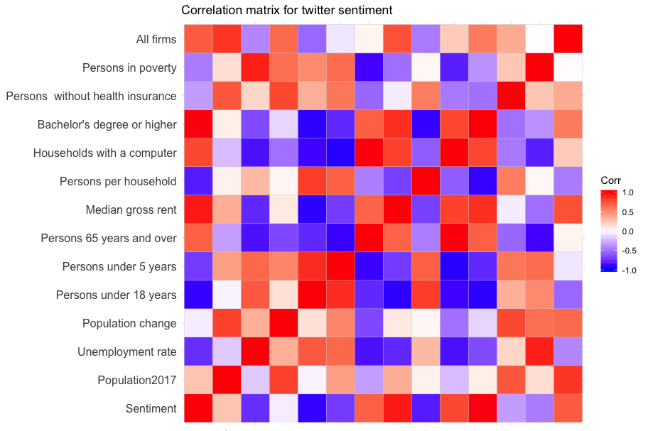
Analysis - Graphical Analysis
Positive Correlation
Person 65 years+
Households with a computer
Bachelor’s degree and higher
The number of firms
Median gross rent
Sentiment
Notes:
Jancy

Slide 19
Analysis - Graphical Analysis
Negative Correlation
Unemployment rate
Persons under 18 years old
Person per household
Persons with health insurance
Persons in poverty
Sentiment
Notes:
Jancy

Slide 20
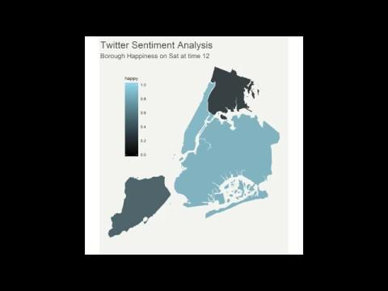
Analysis - Graphical Analysis
Notes:
Jancy

Slide 21
Conclusions
Lowest Sentiment Periods
Saturday
Tuesday Morning
Recommended Strategies
Mindfulness, suicide prevention
Animal-assistance therapy
Art-therapy
 | Top 3 Lowest Sentiment Periods per 8:00-18:00
Borough | 1 | 2 | 3
Manhattan | Tue, 11:00 | Thu, 15:00 | Sat, 17:00
Brooklyn | Sat, 10:00 | Sat, 11:00 | Tue, 11:00
Queens | Tue, 9:00 | Sat, 17:00 | Sat, 10:00
Staten Island | Fri, 13:00 | Tue, 10:00 | Tue, 15:00
The Bronx | Sat, 17:00 | Fri, 13:00 | Tue, 10:00
Notes:
Jancy

Slide 22
Future Work
Data Collection
Sentiment vs Time: Seasonality
Better coverage of the day, hour, and location of tweets
Sentiment vs Socio-Economic variables
States & Cities
Daily weather
Finance market index (e.g. Nasdaq/Dow Jones indices)
Expand to include other social media platforms
Notes:
Jancy

Slide 23
Future Work
Model Improvement
Label problem
Feature selection
N-grams (bi-grams)
Emojis (Weighted features)
PCA
Work with other premade algorithms
Oversampling
Kernel-Based
ADASYN algorithm
Notes:
Jancy

Slide 24
Questions?
Joe Mosby
Kevin Griffith
Corey Kirkpatrick
Jessica Van Duyne
Lakshana Ganesh
Roberto Castillo
Sirapat Niyom
Ling Lui

