Slide 1
Indian Chronicles
By -
Dweepa Prasad
Ishita Bhandari
Lakshana Kolur
Kusumanjali Ramesh

Slide 2
Introduction
Indian history is vastly underappreciated and one of the main reasons for that is, it not being portrayed appropriately. In this modern age, where we cannot live without our gadgets, there are very few sites which educate us about our rich history in a fun way. This led to us creating a website which not only informs people about our Indian culture and history, but makes it appealing at the same time.
Our website chronicles Indian history in interesting ways. We have categorized it in terms of popularity posts, according to the timeline of Indian History and recent posts.

Slide 3
1. List of technologies used

Slide 4
HTML5 : HTML gives the roof, floor, walls, and framing to our website that holds it all together. It is the backbone of our website. We have used newer tags such as <video> for interactive aesthetics.
CSS : We have applied various CSS styles and properties to each of our webpages to make it look as appelaing as possible.
JAVASCRIPT : We have used JavaScript both for functionality and good design. It can be seen in the homepage in the form of comment boxes, slide shows and tabs.s
PHP : This has been used extensively in our SignUp and Login Pages, to store all the data of the users of our website and create an interactive platform, by providing suggestions customised to each user.
CSS3 Animations : Animations have been used for ease transition between webpages and also to create the necessary effects needed.

Slide 5
2. key aspects

Slide 6
Home page
About page
Our carefully curated homepage provides easy access to all recent posts and the websites social media.
The homepage has a very interesting header which is a playback video with the title “Indian Chronicles” in the foreground and a main menu under it which helps the user to navigate through the website with ease.
The page has a floating menu which welcomes you after you log in and lets you comment your views on the website.
It also has a sign up page in case you are a new user.
The about page provides a jist of our website and also its designers. It gives a glimpse into the website and what it offers.
Each page itself has a ‘Like’ button which will record if you have liked a post and you can share it using the social media icons at the bottom of the page.
Individual pages

Slide 7
timeline
popular page
Our timeline page provides a horizontal timeline of events that occured in India, right from the Mughals to the freedom struggle.
We can course through the timeline and choose which event we want based on the image reflected behind each event.
The event expands when you click on it and provides you with a ‘read more’ button which in turn directs you to a new page which contains an extensive report on that event.
The popular tab provides all the posts that are popular right now, in a very convenient way so you can read everything one by one without having to click on multiple links.
The popular page is modified either due to the increased views/likes or due to the user’s liking.
It has left and right arrows which navigates you to different posts.

Slide 8
3. future enhancements

Slide 9
Expanding the user interaction to Multi-user platform wherein users will be able to view what other people have commented and can share their opinion too.
A more refined suggestions/search tool that will suggest all possible related websites in real time.
Using the database created when a user signs up and using that to further website’s reach by sending a monthly newsletter to the emails.
Making the website compatible with all browsers and screen widths.
Incorporating jquery and bootsrap for cleaner design and versatile functionality.
Content wise, Expanding the horizon beyond india, to world history.

Slide 10
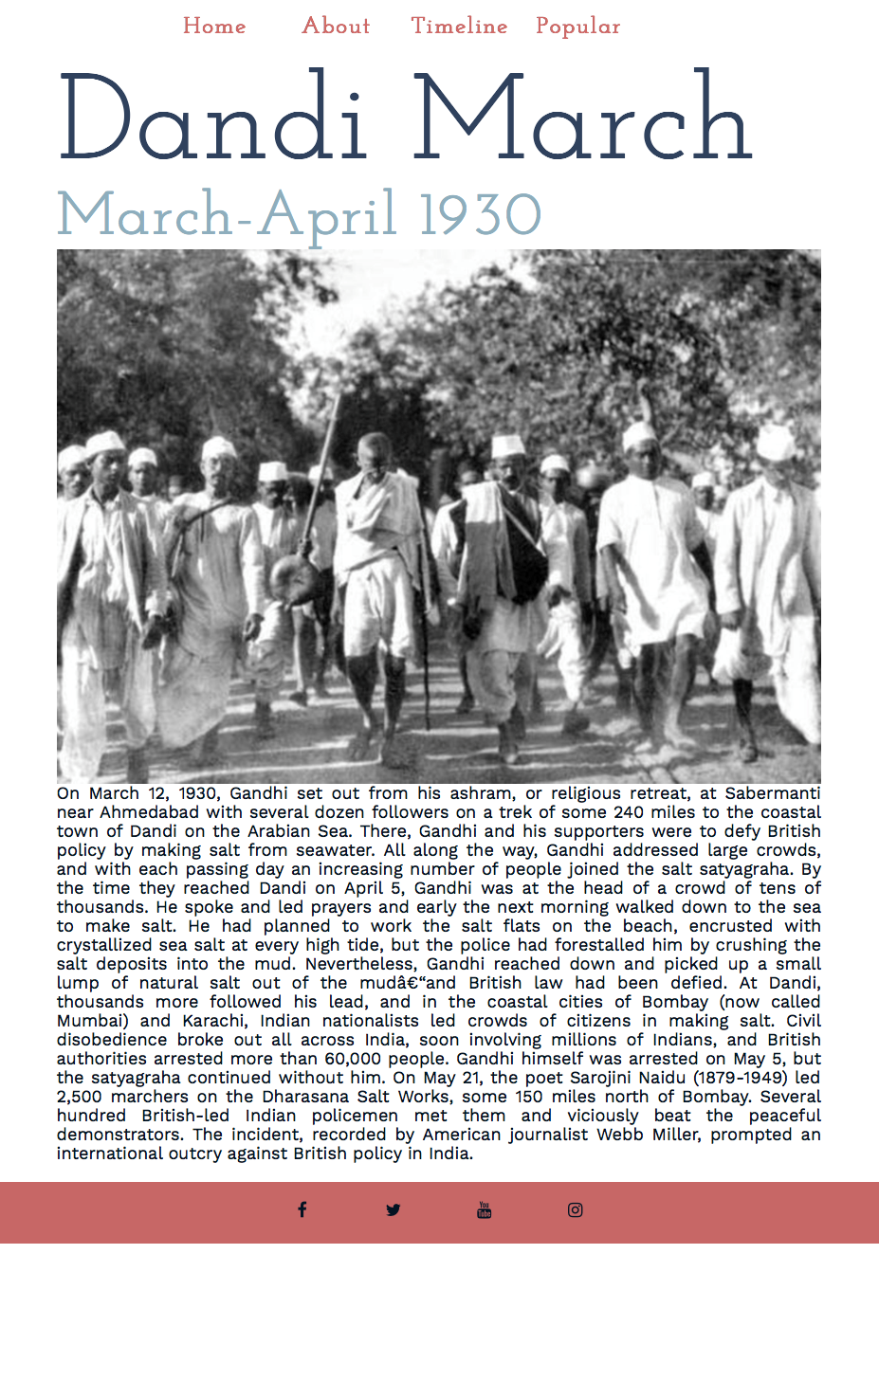
Android/iphone project

Slide 11
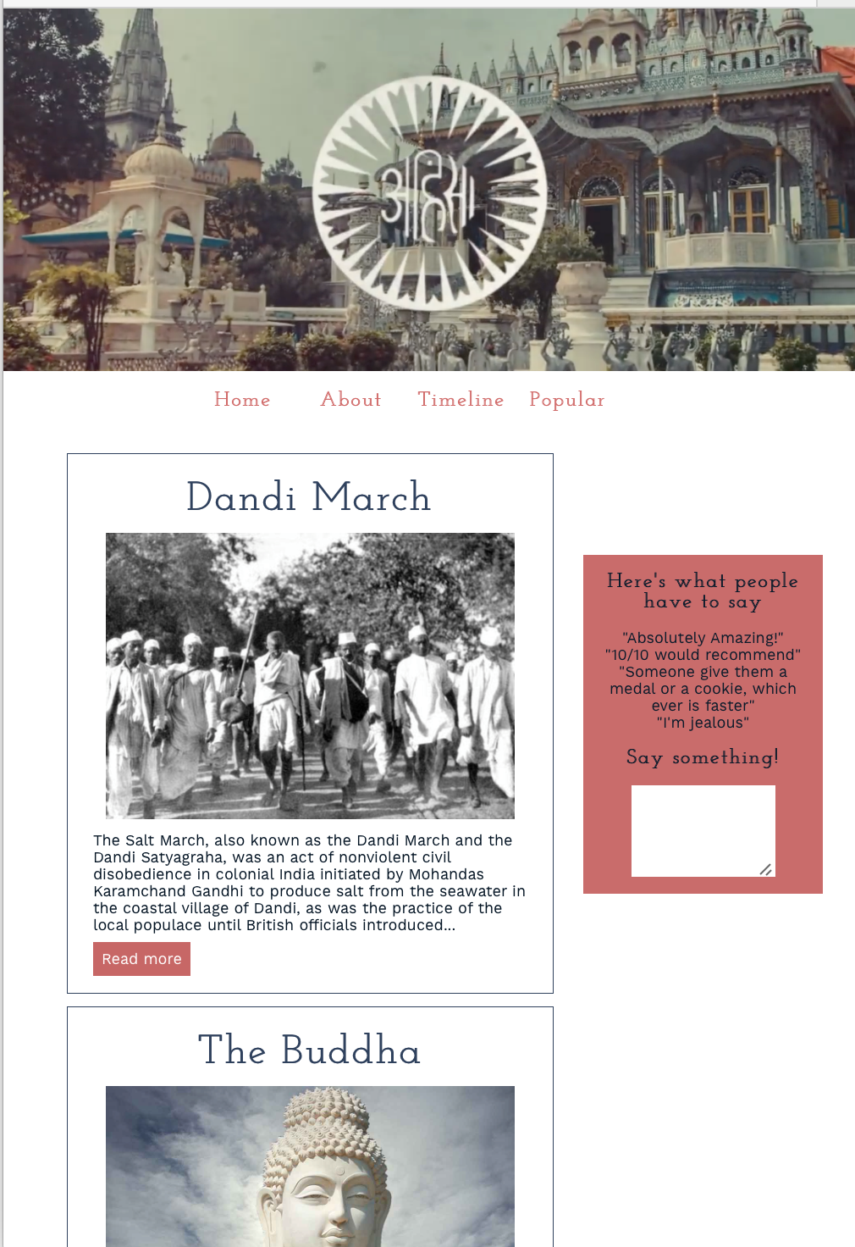
Tablet project

Slide 12
Thank you!
Hope you enjoyed our presentation and our website!

