Slide 1
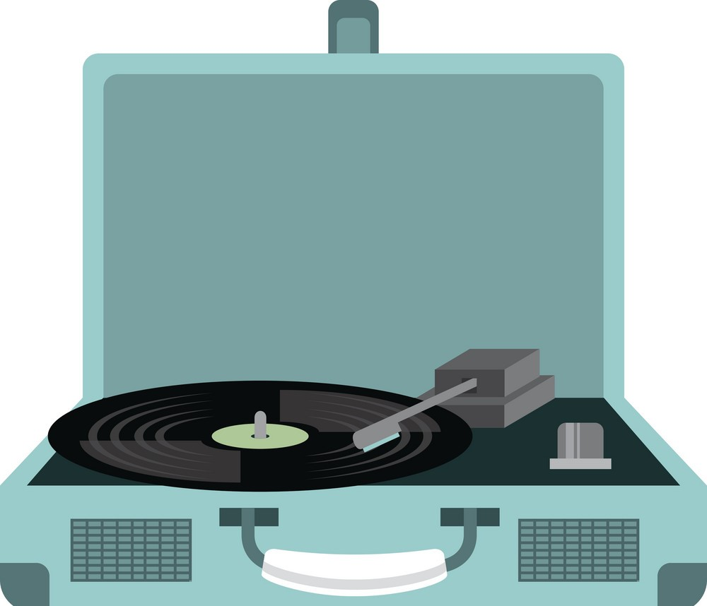
Music Player Using Python

Slide 2
Why python??
Python's versatility and simplicity make it a great choice for crafting music player applications.Its extensive libraries offer robust functionality for audio processing, user interface design, and file management.
Different Libraries included in this project are:
pyGame
PlaySound
Mutagen
Gtts
tkinter

Slide 3
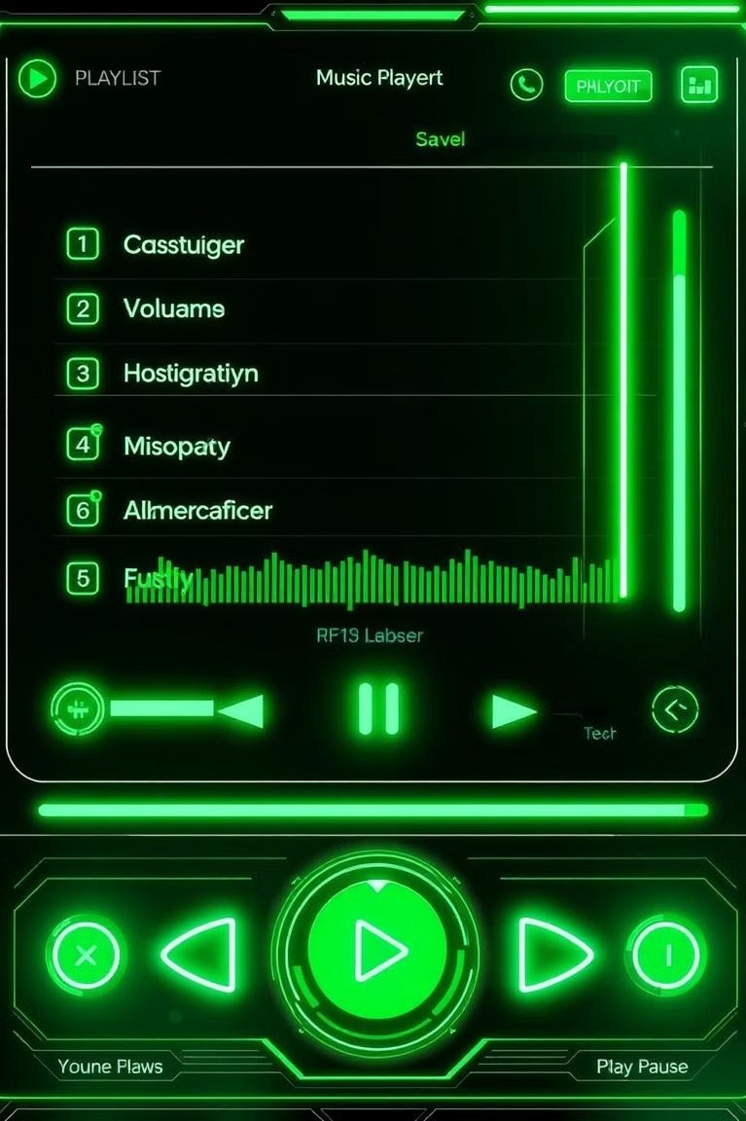
Requirements of Mx-Player
Play & Pause: Basic Playback functionality.
Volume Controls
Playlist Management
Track Information (meta-data)

Slide 4
GUI
Tkinter library of python played a very essential role in creating a graphical user interface(GUI).
In this project all the elements of tkinter were imported in order to get all the widgets,frames and functions with tkinter.
The GUI ensures smooth navigation and a user-friendly experience.

Slide 5
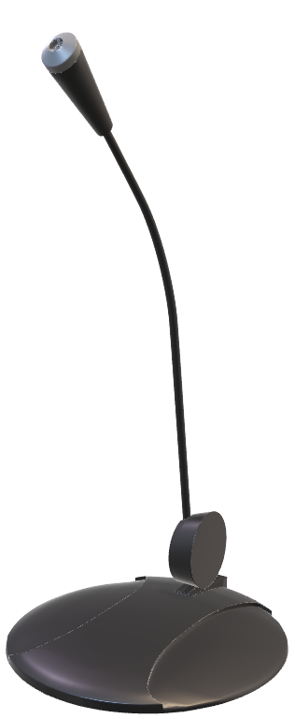
Speech-Recognition
In my project I have user Google speech to text service which enables the music player to listen to speech commands and adds an extra layer of convenience.
The listen_for_commands continuesly works in the background and listens for voice commands such as play,pause,load,next and stop.
Moreover the program written is robust and handles the unknown voice commands efficiently.

Slide 6
Features
Song List (Playlist): Displays available MP3 files.
1
2
Playback Controls: Buttons to play, pause, stop, shuffle etc.
3
Volume Control: Slider to adjust volume
4
Now Playing: Displays the current song.
Album Art: Displays album art for the current song.
5

Slide 7
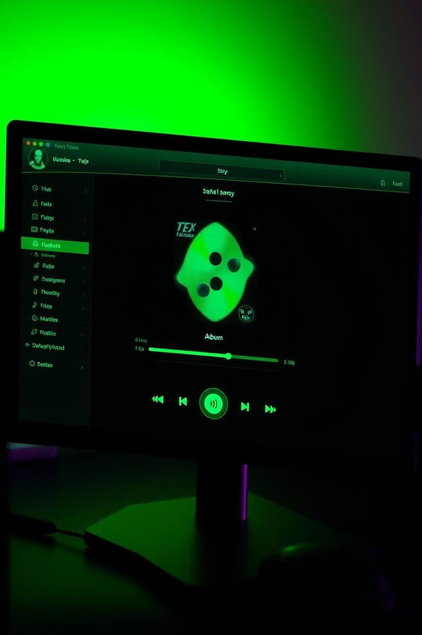
Bringing Music to Life
1
Start
Run the music player application.
2
Browse
Select music files from your library.
3
Play
Enjoy your music collection!

