Slide 1
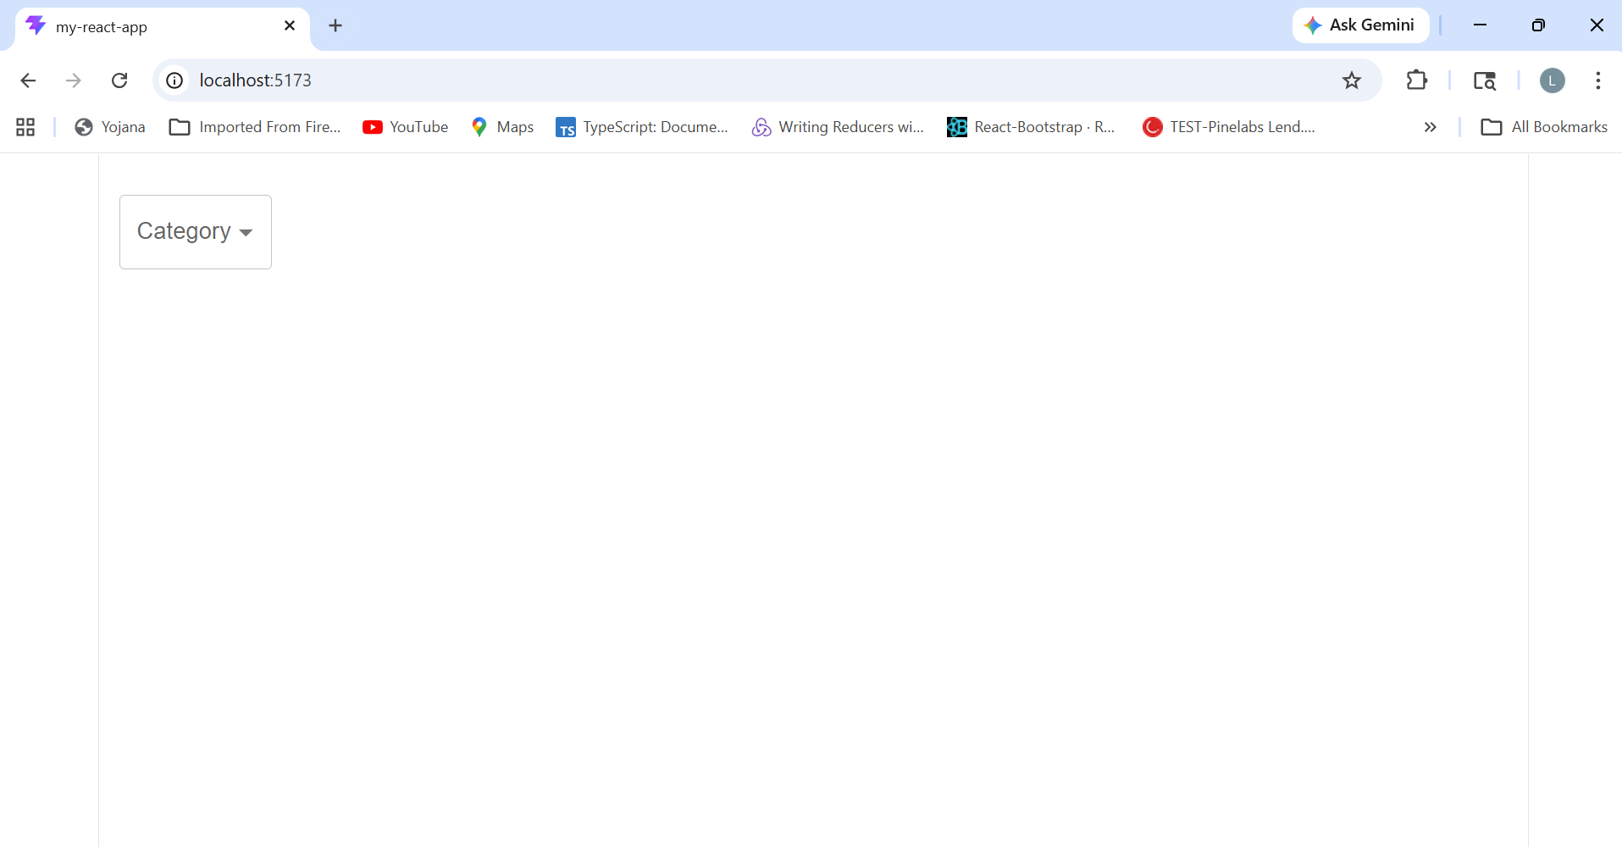

Slide 2
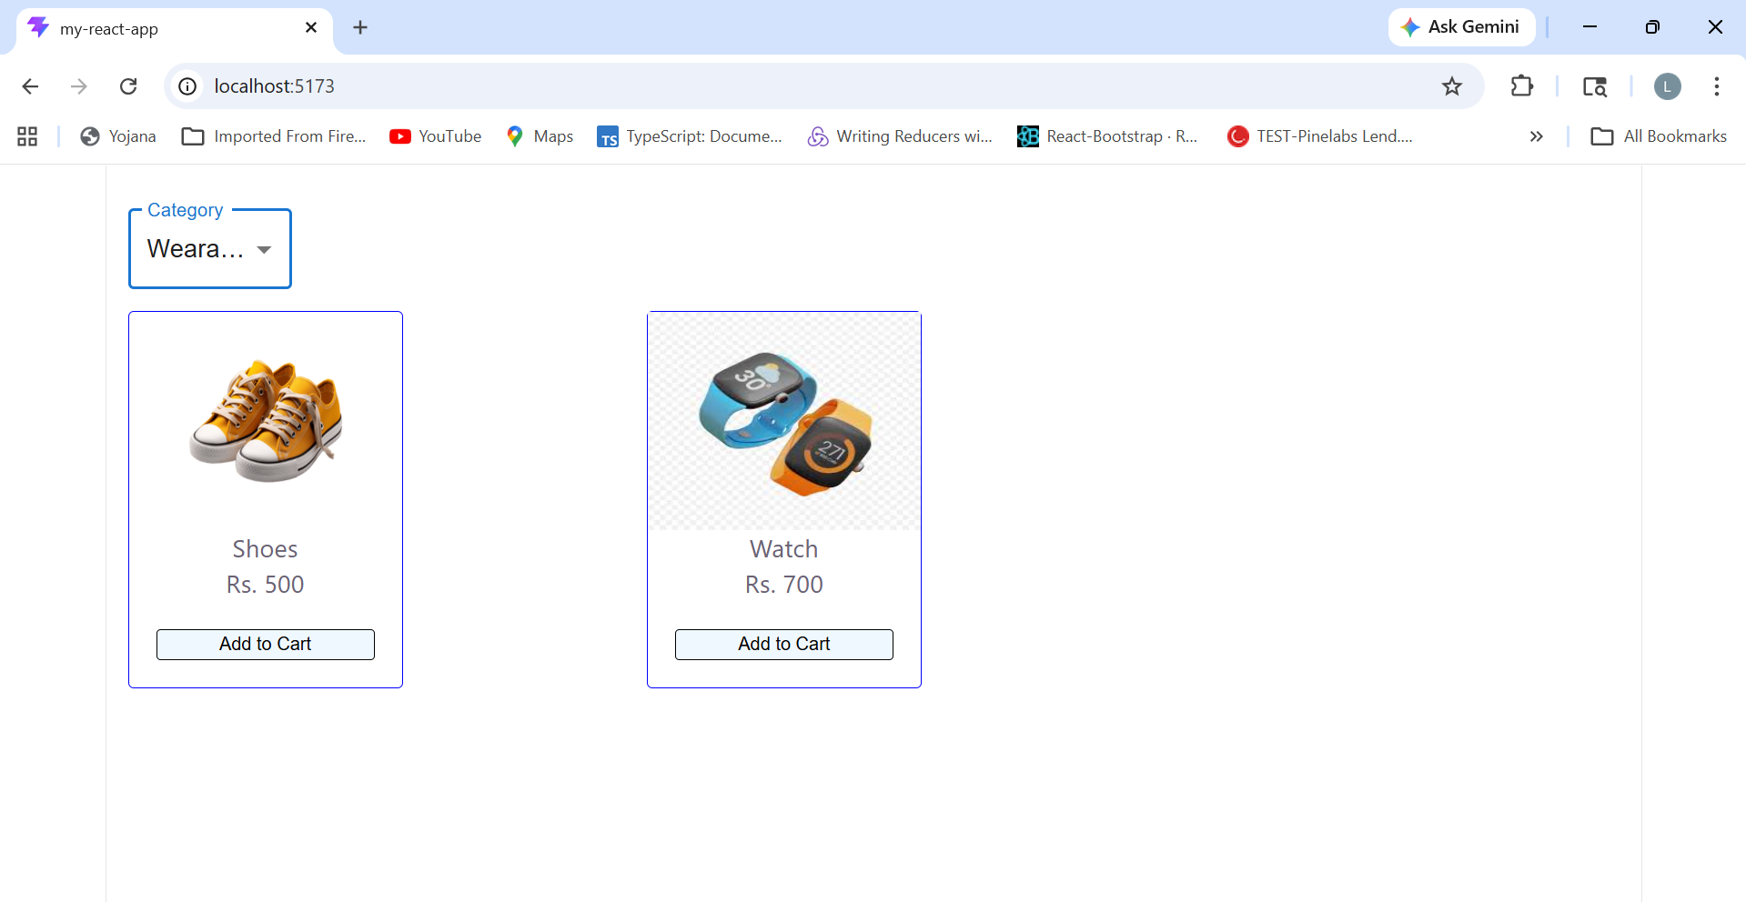
agenda
INTRODUCTION 3
ENGAG
VISUAL AIDS 6
FINAL TIPS & TAKEAWAYS 11

Slide 3

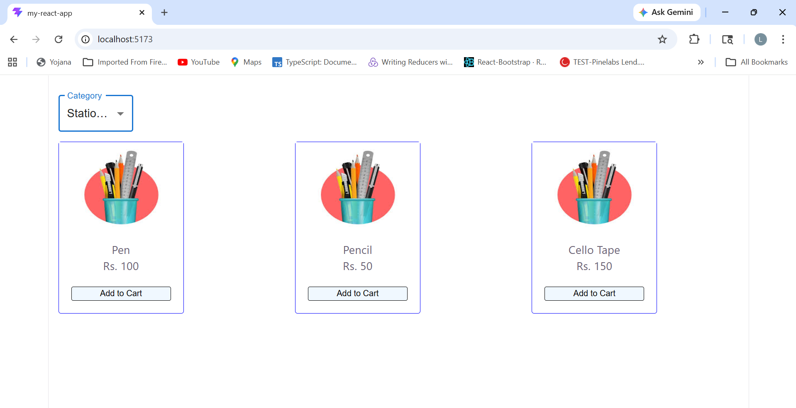
the power of communication

Slide 4

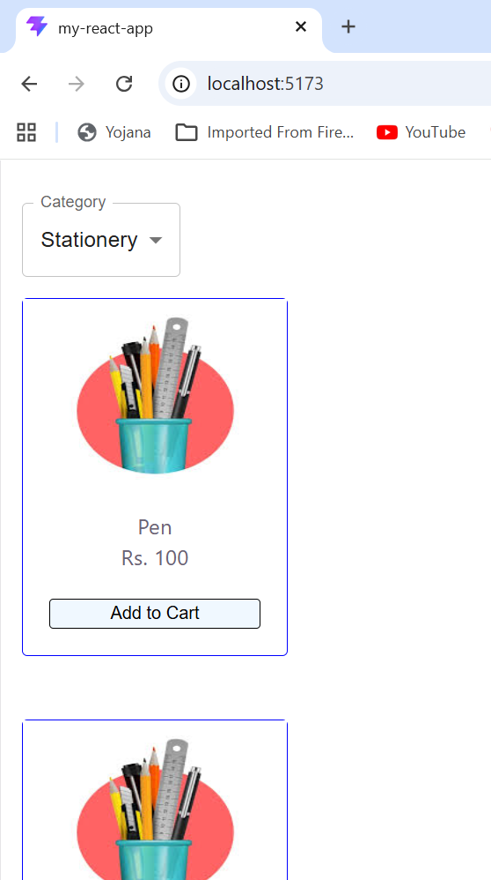
CONFIDEGIES

Slide 5
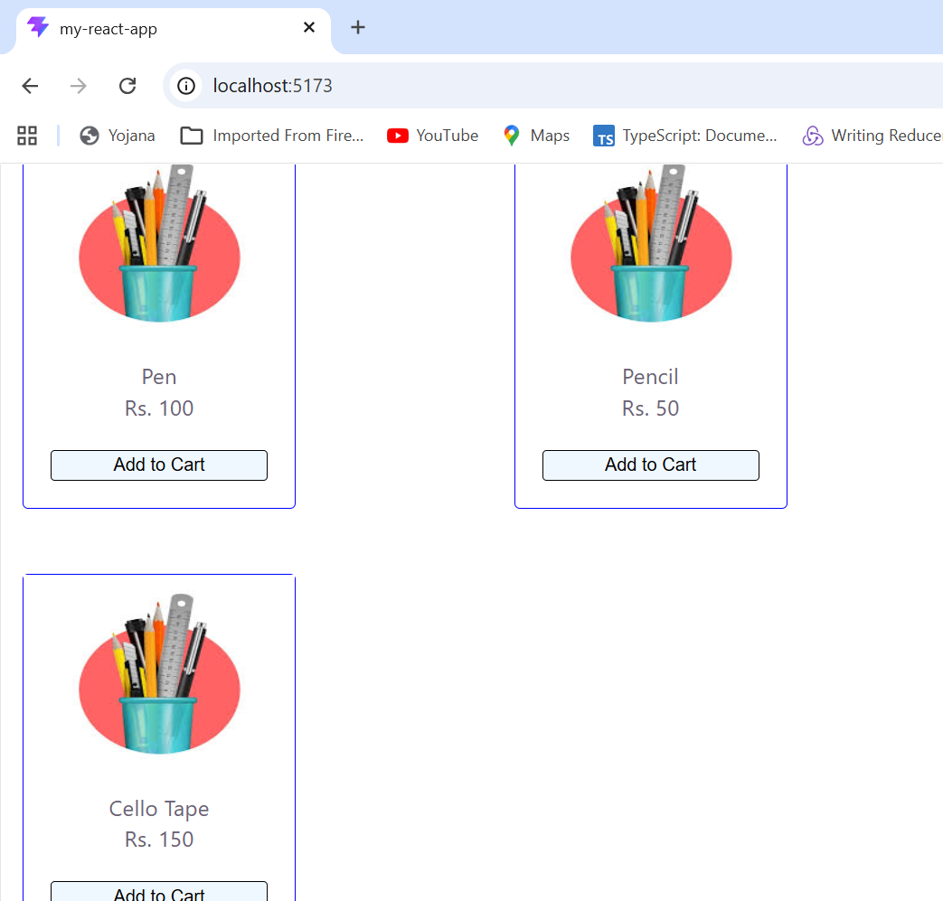

Slide 6
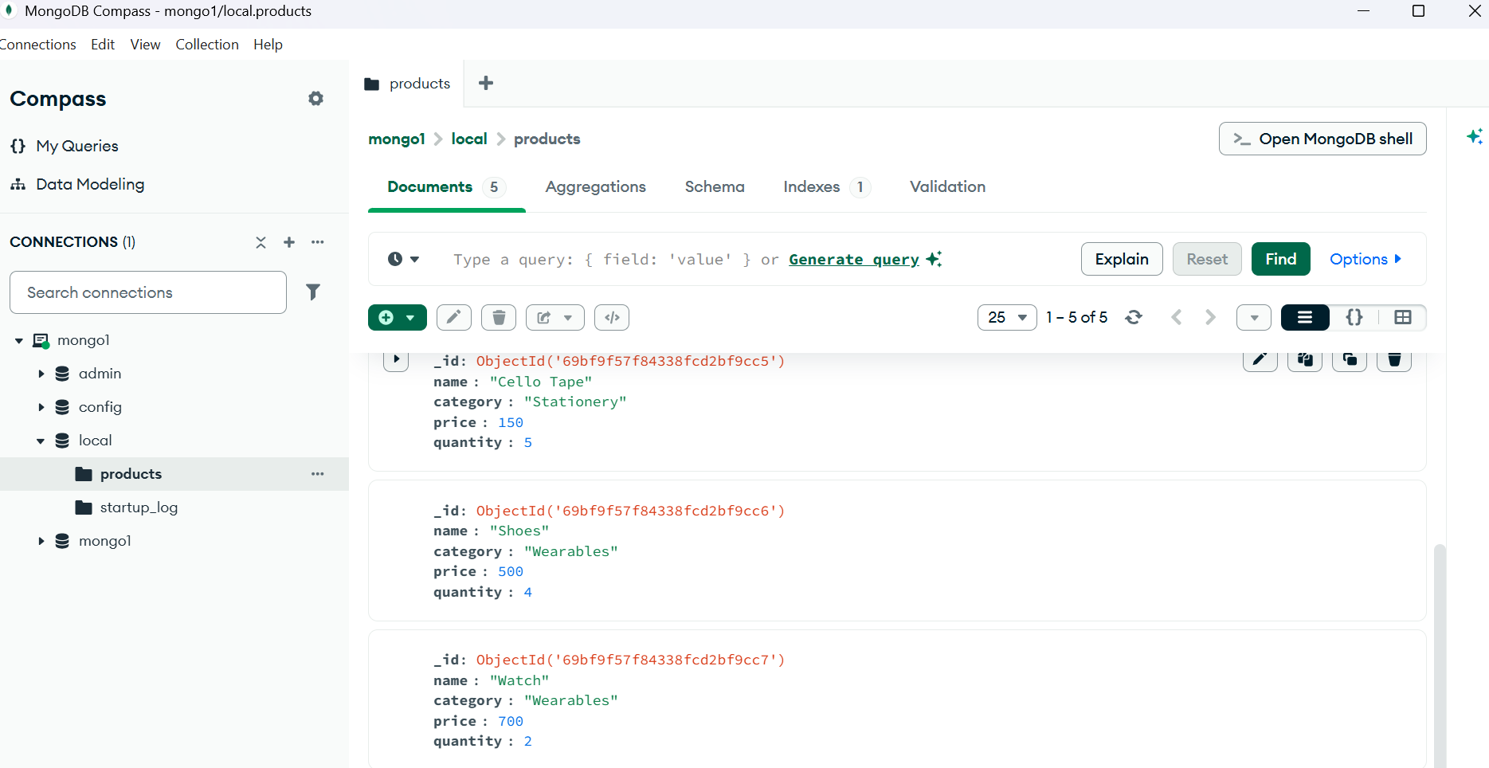

Slide 7
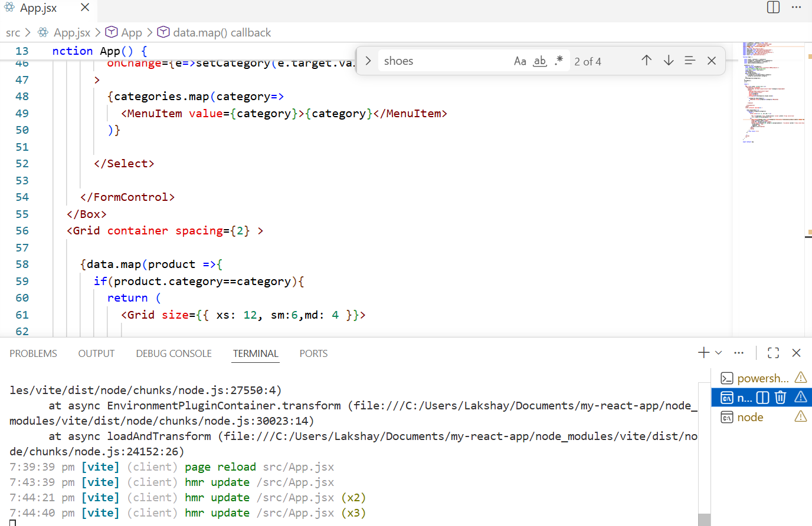
effective delivery techniques
Effective body language enhances your message, making it more impactful and memorable:
Meaningful eye contact
Purposeful gestures
Maintain good posture
Control your expressions
This is a powerful tool in public speaking. It involves varying pitch, tone, and volume to convey emotion, emphasize points, and maintain interest:
Pitch variation
Tone inflection
Volume control

Slide 8
