Slide 1
Image Retrieval and Audio Summarization for Blinds
Group No. 11
Pijush Bhuyan (MT22049)
Abhishek Acharya (MT22004)
Arha Samanta (MT22016)
Lakshay Wadhwa (MT22037)

Slide 2
Problem Statement
By merging picture summarization and text-to-speech capabilities, the project intends to create an effective image retrieval system employing hybrid embeddings that can also address the difficulties faced by those with impaired eyesight when using image search engines.

Slide 3
Motivation
CBIR (Content-Based Image Retrieval) is a technique that searches for similar images based on visual content, rather than relying on keywords or tags. This is particularly useful when dealing with images that lack labeled keywords or tags, making traditional keyword-based search challenging.
In this project, our goal is to build an image IR system using multimodal hybrid embeddings extracted various types of DL models.
We have developed a user-friendly image retrieval system interface that utilizes text-to-speech services to provide a summarized description of the contents of retrieved images, aiming to benefit individuals with poor vision by providing accessible image information.

Slide 4
Literature Review
A Decade Survey of Content Based Image Retrieval using Deep Learning
This Paper summarizes a decade-long CBIR (Content Based Image retrieval) method used in IR systems.
Content-Based Image Retrieval by Clustering
This paper also reviews the development of content-based image retrieval (CBIR) techniques from the early years to the present and discusses the current state-of-the-art in the field.
Deep Learning for Image Retrieval: What Works and What Doesn't
This paper presents a comprehensive study of deep learning methods for content-based image retrieval, including a detailed review of various deep learning architectures and their performance on standard benchmark datasets.

Slide 5
Novelty
We have focussed on creating a complete interface which takes an image as an input, as a result gives the top 5 similar images which are retrieved by using CBIR Based ML Module, in which we have also improvised the machine learning accuracy.
Multimodal hybrid embeddings are used to build the IR system
Talking about any other simple image retrieval system, it simply helps us fetch some images from a database. But here we are trying to build a whole system that will be user-friendly to not only Blinds but also other people who give an image input, and get the audio summary and the most relevant similar images as an output.

Slide 6
Methodology
The project pipeline involves four components:
Extracting features as image embeddings,
Performing clustering on the embeddings,
Building a unigram inverted index using the clustered embeddings, and
Processing test queries to retrieve results for given test images.
The aim is to encode visual information in compact vector representations, cluster similar images together, and build an index for efficient retrieval of results.

Slide 7
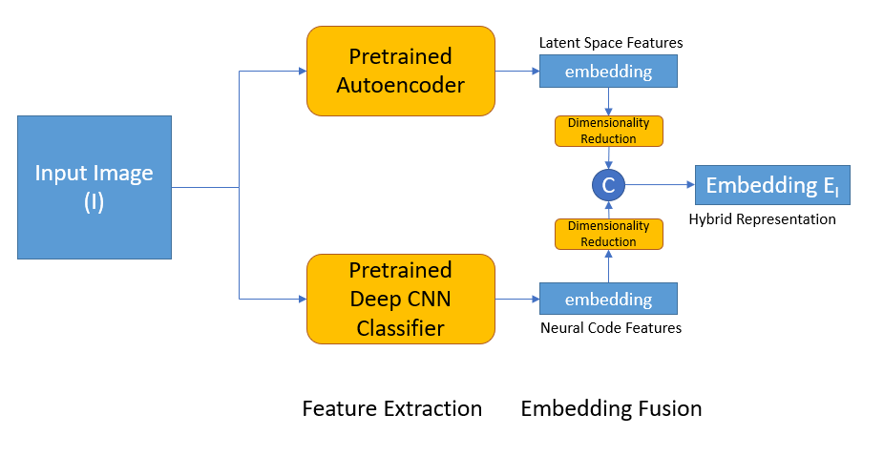
Step 1 – Extract Embeddings

Slide 8
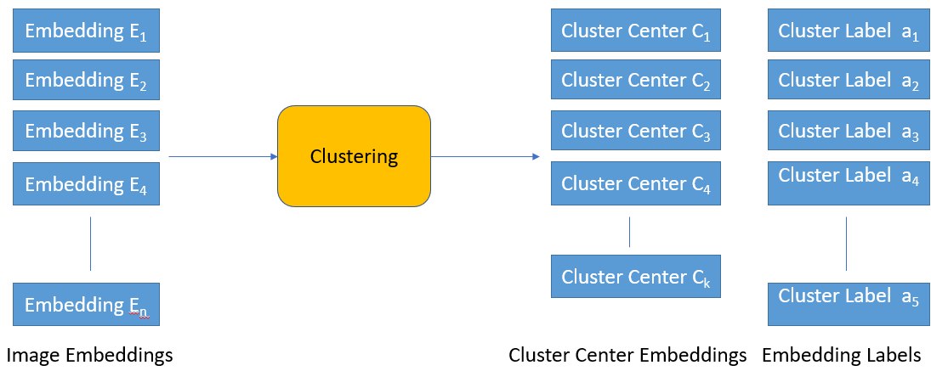
Step 2 – Perform Clustering on Embeddings

Slide 9
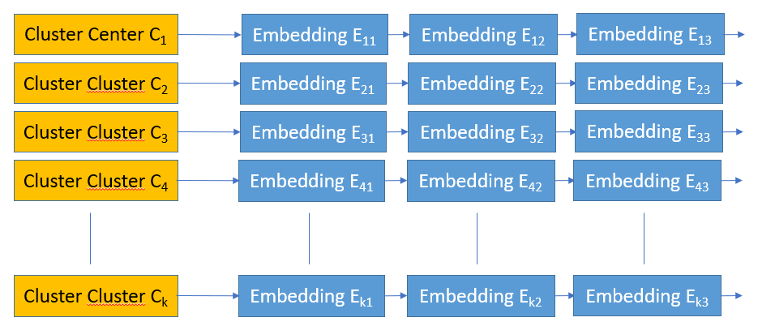
Step 3 – Build Index

Slide 10
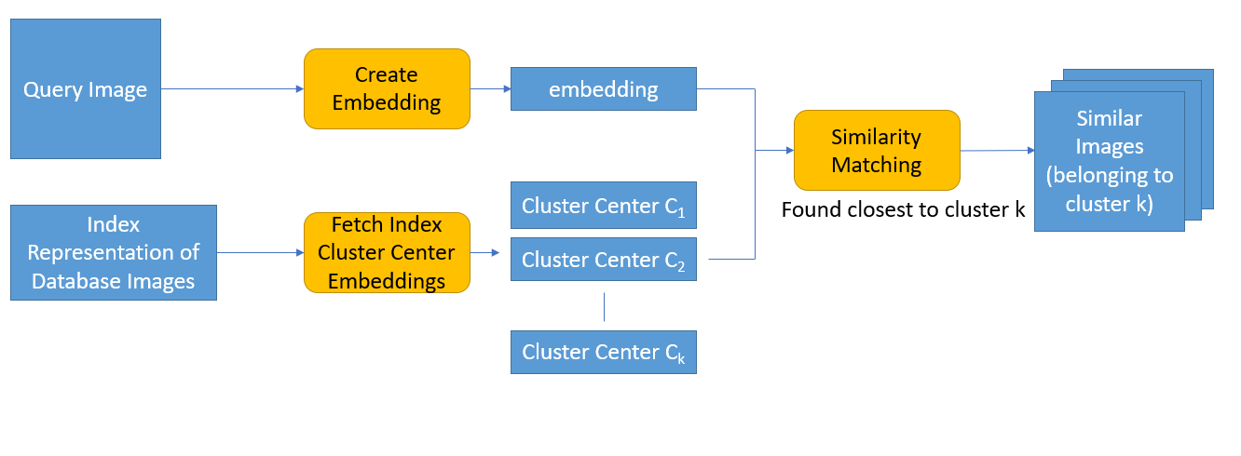
Step 4 – Process Query

Slide 11
Database
We have taken the CIFAR-100 dataset which contains 60000 images with 100 unique classes, 600 images for each class. Details of the dataset are –
Train images – 50,000 (seen)
Test images – 10,000 (unseen)
Size of each image – 32x32x3 (RGB)

Slide 12
DL Models Used
Pretrained Deep CNN Classifier – Efficient-Net B0 (SOTA on CIFAR 100 classification task)
Pretrained Autoencoder
Baseline : Just the efficient-net embeddings
Proposed : Hybrid embeddings from efficient-net and autoencoder

Slide 13
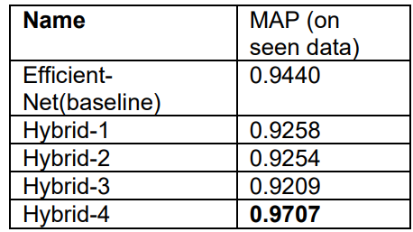
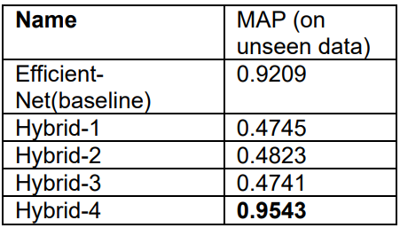
Evaluation Results
Note – baseline : embedding size is 1280
hybrid-1 : 70 % PCA features
hybrid-2 : 80% PCA features
hybrid-3 : 90% PCA features
hybrid-4 : embedding size is 1792 (1280+512)

Slide 14
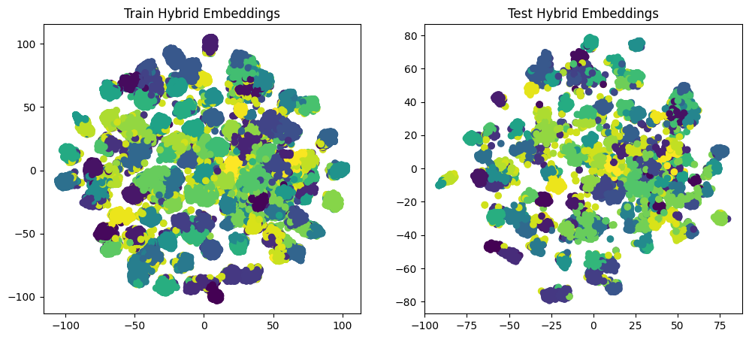
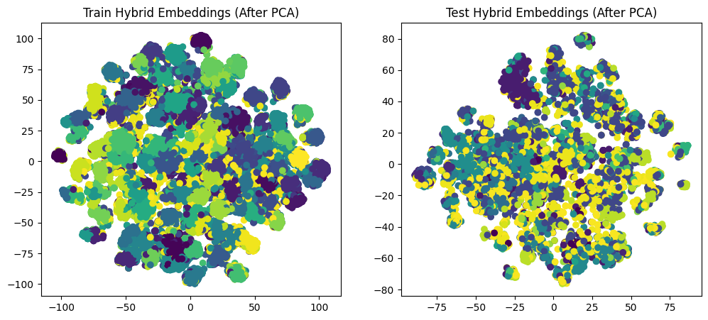
T-SNE Visualization of embedding space

Slide 15
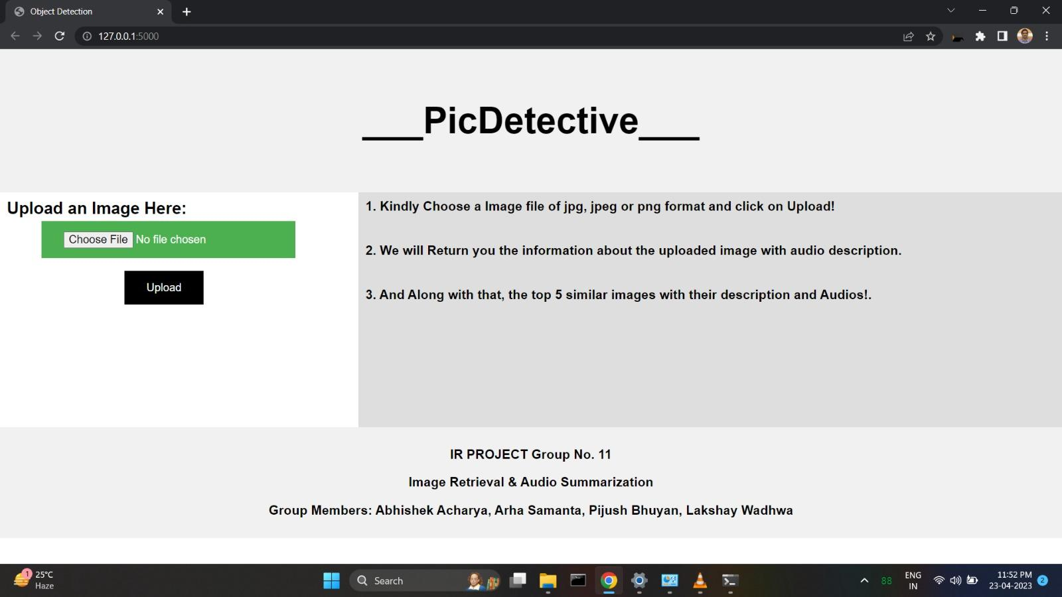
Interface: Input

Slide 16
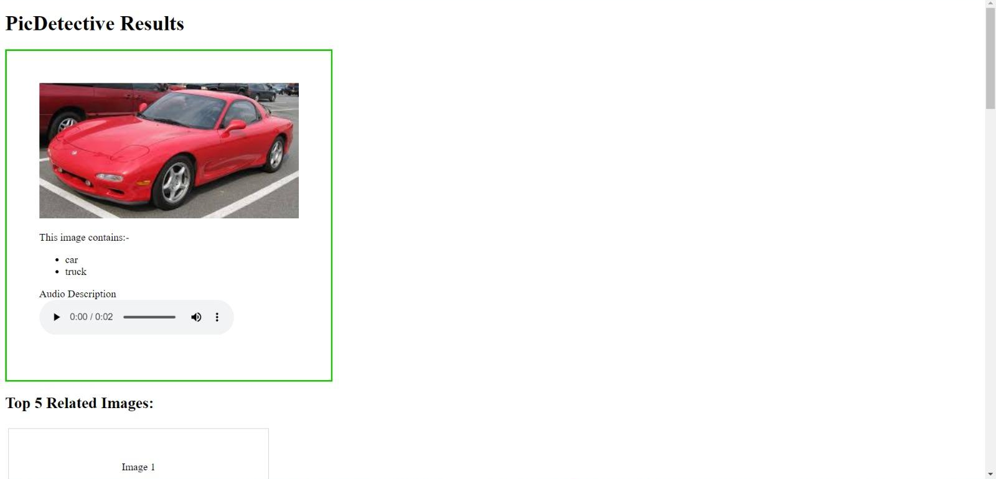
Interface: Output

Slide 17
Thank You!
Group No. 11 Pijush Bhuyan
Abhishek Acharya
Arha Samanta
Lakshay Wadhwa

