Slide 1
CampusDesk
A campus facility issue tracker, taken from laptop to a monitored EKS cluster
DevOps Capstone · Session 21 · Lakshay Jagga
React + FastAPI + PostgreSQL · Docker · GitHub Actions · Trivy · Terraform · EKS · Helm · Prometheus + Grafana
Notes:
CampusDesk is a facility issue tracker for a campus. The application is the small part; the assignment is the delivery pipeline around it.

Slide 2
The problem it solves
Today
With CampusDesk
A student messages someone that the AC is broken. It is never logged, nobody owns it, and there is no record it was ever reported.
The issue gets a building, room, category, priority and an owner. Staff log what they did. Resolution time becomes measurable.
1
Report
2
Triage
3
Worklog
4
Resolve
Student files it
Staff pick it up
Notes as they go
Time recorded
Two tables with a foreign key: issues, and the worklog attached to each one. That relationship is what makes average resolution time computable.
Notes:
The app is deliberately small but real: two related tables, a proper lifecycle, and a metric that matters.

Slide 3
Architecture
Browser
nginx
FastAPI
PostgreSQL
->
->
->
React + Vite
serves SPA, proxies /api
11 endpoints
SQLAlchemy + Alembic
Surrounding it
Docker + Compose
GitHub Actions
Trivy
local stack
test, scan, push, deploy
HIGH/CRITICAL gate
Terraform
Helm
Prometheus + Grafana
VPC + EKS on AWS
2 replicas, Ingress, HPA
metrics and dashboard
Notes:
Four tiers in the request path. Everything else is the delivery and operations machinery around it.

Slide 4
Application and tests
11
24
2
4
REST ENDPOINTS
TESTS PASSING
TABLES, ONE FK
CUSTOM METRICS
The API
Why the tests are trustworthy
GET /health liveness, never touches the DB
GET /ready readiness, does check the DB
GET/POST /api/issues (email required)
PUT/DELETE /api/issues/{id}
GET/POST /api/issues/{id}/updates
GET /api/stats
TESTING=1 is set before any app module imports, so the production engine is never built
Each test gets a fresh in-memory SQLite DB held open with StaticPool
PRAGMA foreign_keys=ON per connection, or the cascade test would pass for the wrong reason
Student mode hides the staff controls; admin mode unlocks them - a demo gate, not security
Notes:
Liveness and readiness differ on purpose: a slow database should not get the pod killed, but it should take the pod out of the Service.

Slide 5
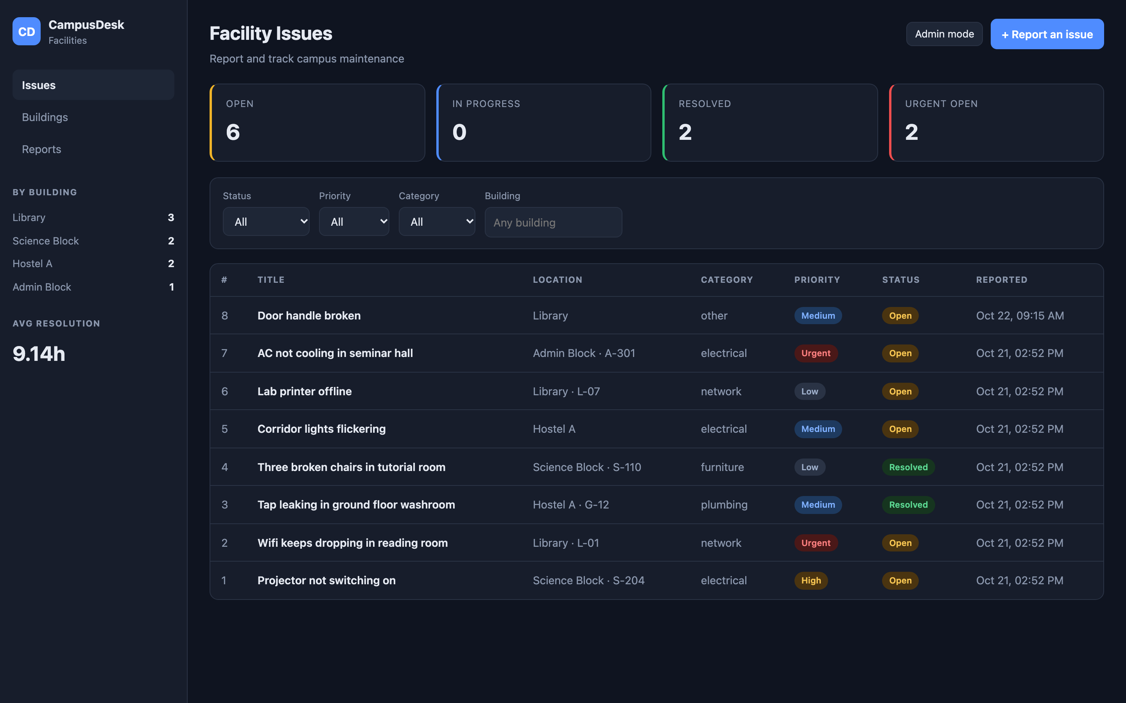
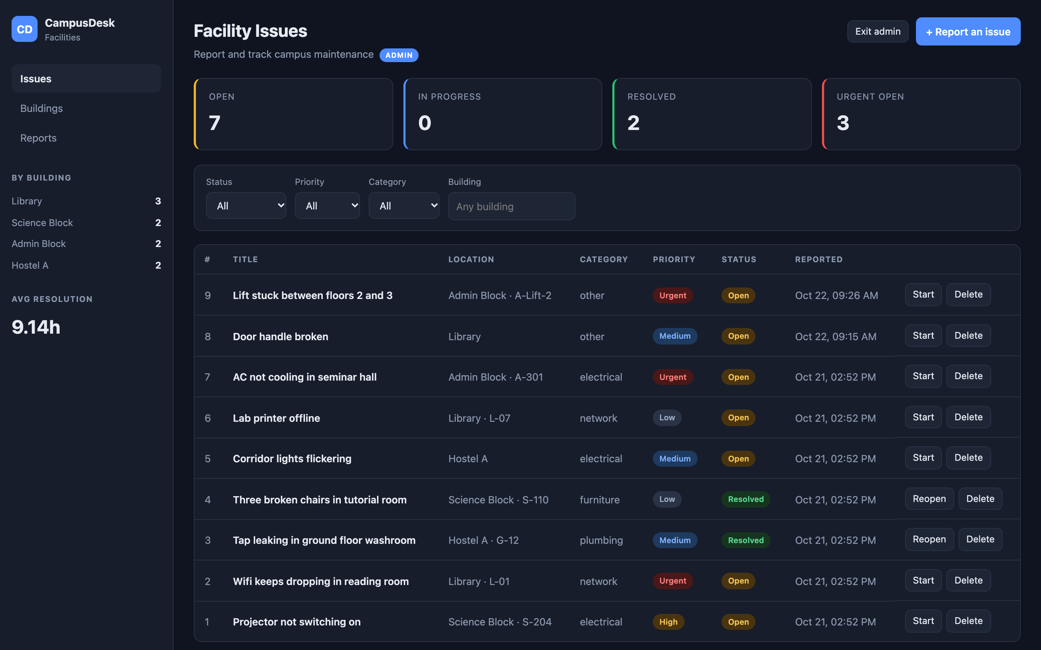
Two modes, one page
Student mode - browse, filter, report. No staff controls.
Admin mode - unlocked with a password, actions column appears.
The gate is a demo, not security: the password is checked in the browser, and the API accepts the same requests either way. Real separation would need accounts, sessions and server-side role checks - none of which the rubric scores.
Notes:
Worth being upfront that this is a demo gate. Claiming it as auth would not survive one question.

Slide 6
Docker and the pipeline
Three CI jobs, in this order
Trivy gate: HIGH / CRITICAL fails the build
1
test
pytest, then the frontend build
backend
5
->
0
2
build-scan-push
HIGH/CRITICAL
build, load locally, Trivy, then push
3
deploy
frontend
17
->
0
helm upgrade --install
HIGH/CRITICAL
Scanning happens before the push, so a vulnerable image never reaches the registry. Images are tagged with the commit SHA, never latest.
Both images clean. Getting there took real debugging - see the bugs slide.
Notes:
The build-load-scan-push ordering is the point: the gate runs before anything is published.

Slide 7
It actually ran on AWS
Not a plan file. A real VPC, a real EKS cluster, a public load balancer, then destroyed.

Slide 8
Terraform: VPC and EKS
15
3
2
15
RESOURCES CREATED
WORKER NODES
AVAILABILITY ZONES
DESTROYED AFTER
terraform apply
Apply complete! Resources: 15 added, 0 changed, 0 destroyed.
cluster_name = "campusdesk-eks"
cluster_endpoint = "https://1223FE2F....eu-north-1.eks.amazonaws.com"
vpc_id = "vpc-062c859f80be09940"
public_subnet_ids = ["subnet-0bc508ac...", "subnet-06c00fe0..."]
Destroy complete! Resources: 15 destroyed.
Public subnets rather than private behind a NAT gateway - that would add about $32/month for no benefit on a cluster that lives for an hour.
Notes:
Applied for real against eu-north-1, then destroyed cleanly. Total spend was a few dollars.

Slide 9
Kubernetes and Helm on EKS
Deployed state
Chart decisions
backend 2/2 replicas
frontend 2/2 replicas
postgres 1/1 StatefulSet
ingress nginx, public AWS LB
hpa cpu 6%/60%, 2 -> 6
Alembic runs in an initContainer, so the schema migrates once per rollout, not once per replica racing
HPA targets 60% of the CPU request, not the limit
Images built for linux/amd64 - the build machine is Apple Silicon, the nodes are x86_64
Serving real traffic on a public load balancer
$ curl http://ada910aa...elb.eu-north-1.amazonaws.com/
<title>CampusDesk</title>
$ curl http://ada910aa...elb.eu-north-1.amazonaws.com/api/stats
{"total":7,"open":7,"urgent_open":2,"by_building":{"Hostel A":2,...}}
Notes:
Two replicas of each service, an Ingress routing / and /api, and an HPA reading real CPU through metrics-server.

Slide 10
Observability
Request rate says the service is alive. These say whether the campus is getting fixed.
campusdesk_issues_open
gauge
current backlog, by priority
campusdesk_issues_created_total
counter
reported, by category
campusdesk_issues_resolved_total
counter
closed, by category
campusdesk_issue_resolution_seconds
histogram
report to resolution
The gauge is recomputed from the database after every write, never incremented - a gauge must reflect current state. Every priority label is set explicitly, including the zeroes, or a priority that drops to zero keeps its last value forever.
Prometheus scraped both backend pods (health=up). Grafana served a 7-panel dashboard.
Notes:
Histogram buckets run from 5 minutes to a week. Campus repairs take hours and days; the default buckets top out at 10 seconds and would put everything in +Inf.

Slide 11
Six bugs worth recording
1
Migration crashed
2
Every write failed
type "category" already exists
invalid input value for enum: "RESOLVED"
sa.Enum emits its own CREATE TYPE on top of the explicit one. Fixed with create_type=False.
SQLAlchemy persists enum names; the migration used values. Fixed with values_callable.
3
Frontend: 17 CVEs
4
Trivy vs pip list
stale base image layer
CVEs for versions not installed
apk upgrade ran against a cached index. Rebuilt with --pull --no-cache.
Stale wheels in a whited-out layer, plus pip/_vendor/vendor.txt. Removed pip from the runtime.
5
Postgres Pending
6
Ingress 404 on /api
unbound PersistentVolumeClaim
rewrite-target stripped the prefix
EKS 1.31 ships gp2 on the removed in-tree provisioner. Made persistence a chart value.
Routes are registered at /api/..., so the prefix must survive. Removed the rewrite.
Notes:
These are the slides worth talking through. Bug 4 in particular took extracting the image tarball to diagnose.

Slide 12
The one that took real digging
Trivy kept failing the build on CVEs for package versions the image did not contain
Trivy said
pip list said
urllib3 2.7.0 · certifi 2026.6.17
msgpack 1.1.2 · setuptools 70.3.0
urllib3 2.8.0 · certifi 2026.10.19
msgpack 1.2.3 · setuptools 84.2.1
Two causes, stacked
1
Layer history
COPY --from=builder /wheels then rm -rf only whites the files out in a later layer. The superseded wheels stay in the image, and Trivy reads every layer.
2
pip's own bundle
pip/_vendor/vendor.txt literally declares urllib3==2.7.0. Trivy parses it. Those copies are used only by pip and never imported by the app.
Fix: drop the wheel stage, and remove pip from the runtime image once dependencies are installed - which also takes a package manager out of production.
Notes:
Diagnosed by extracting the image tarball and listing what was actually in each layer. The filesystem was clean; the layer history was not.

Slide 13
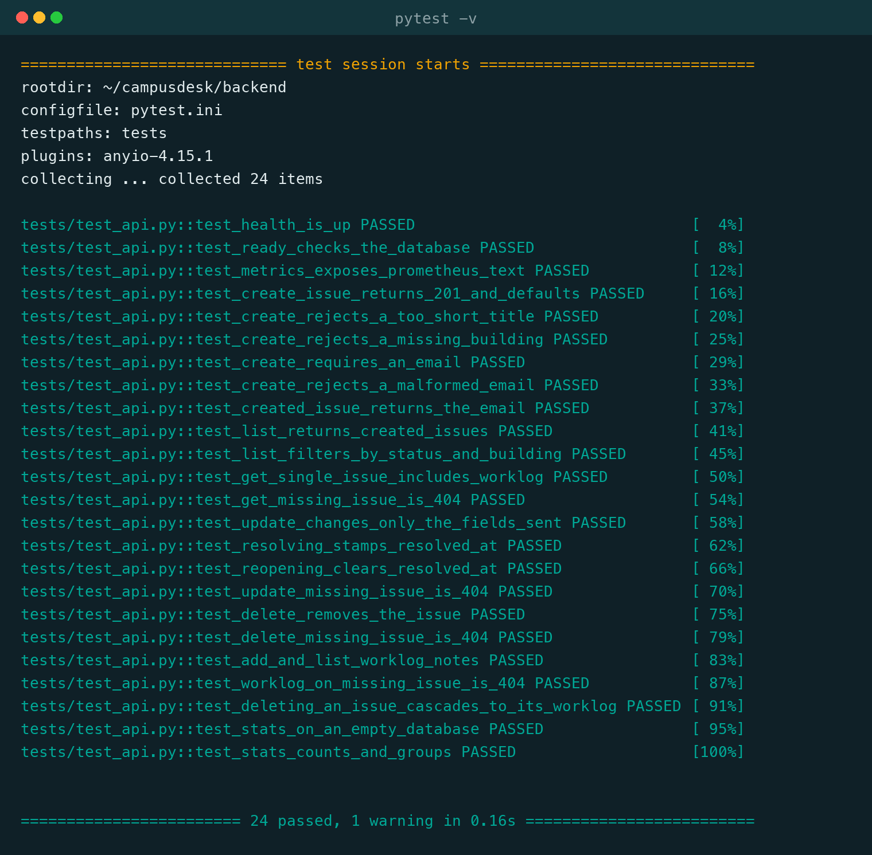
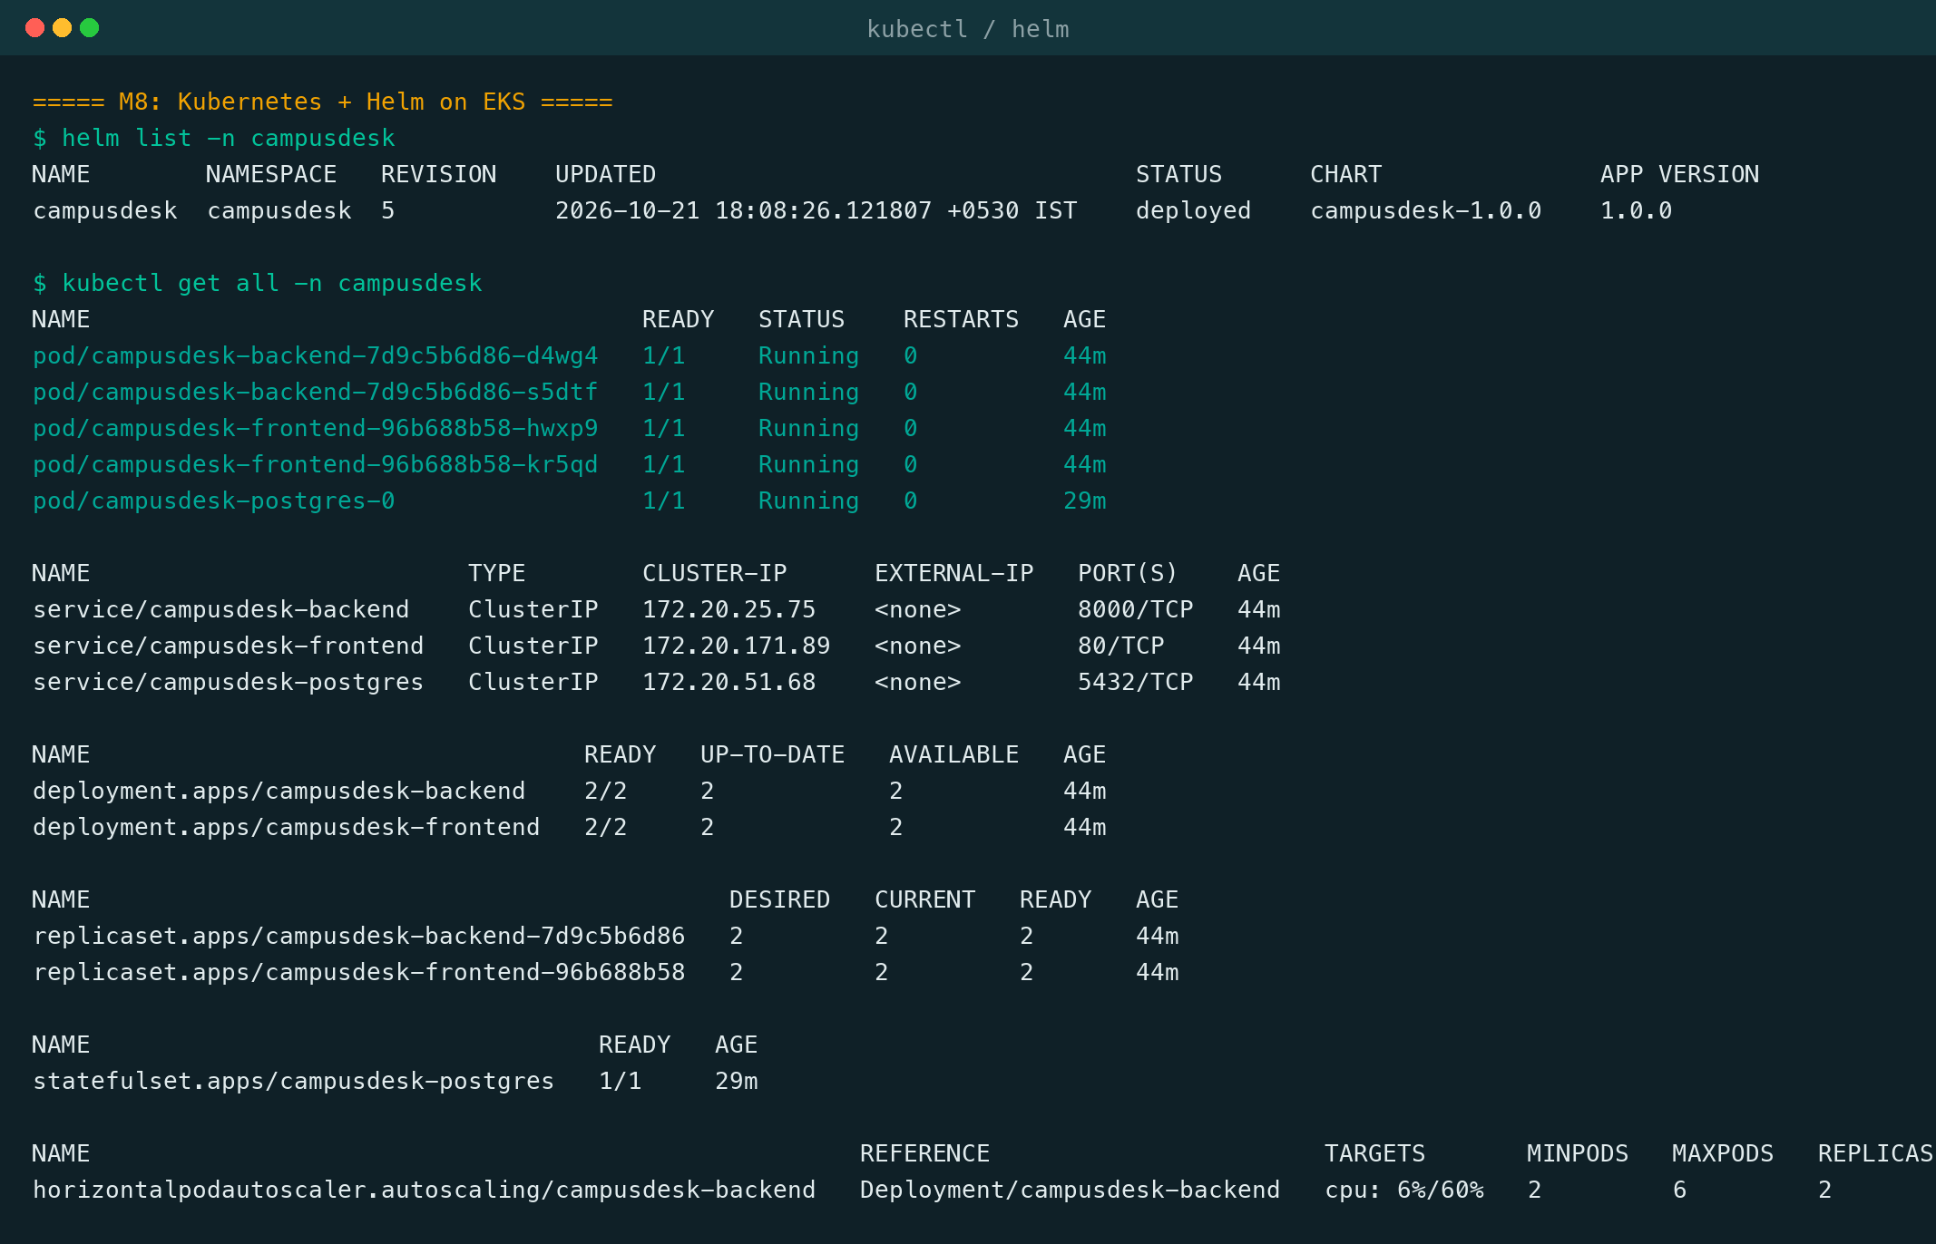
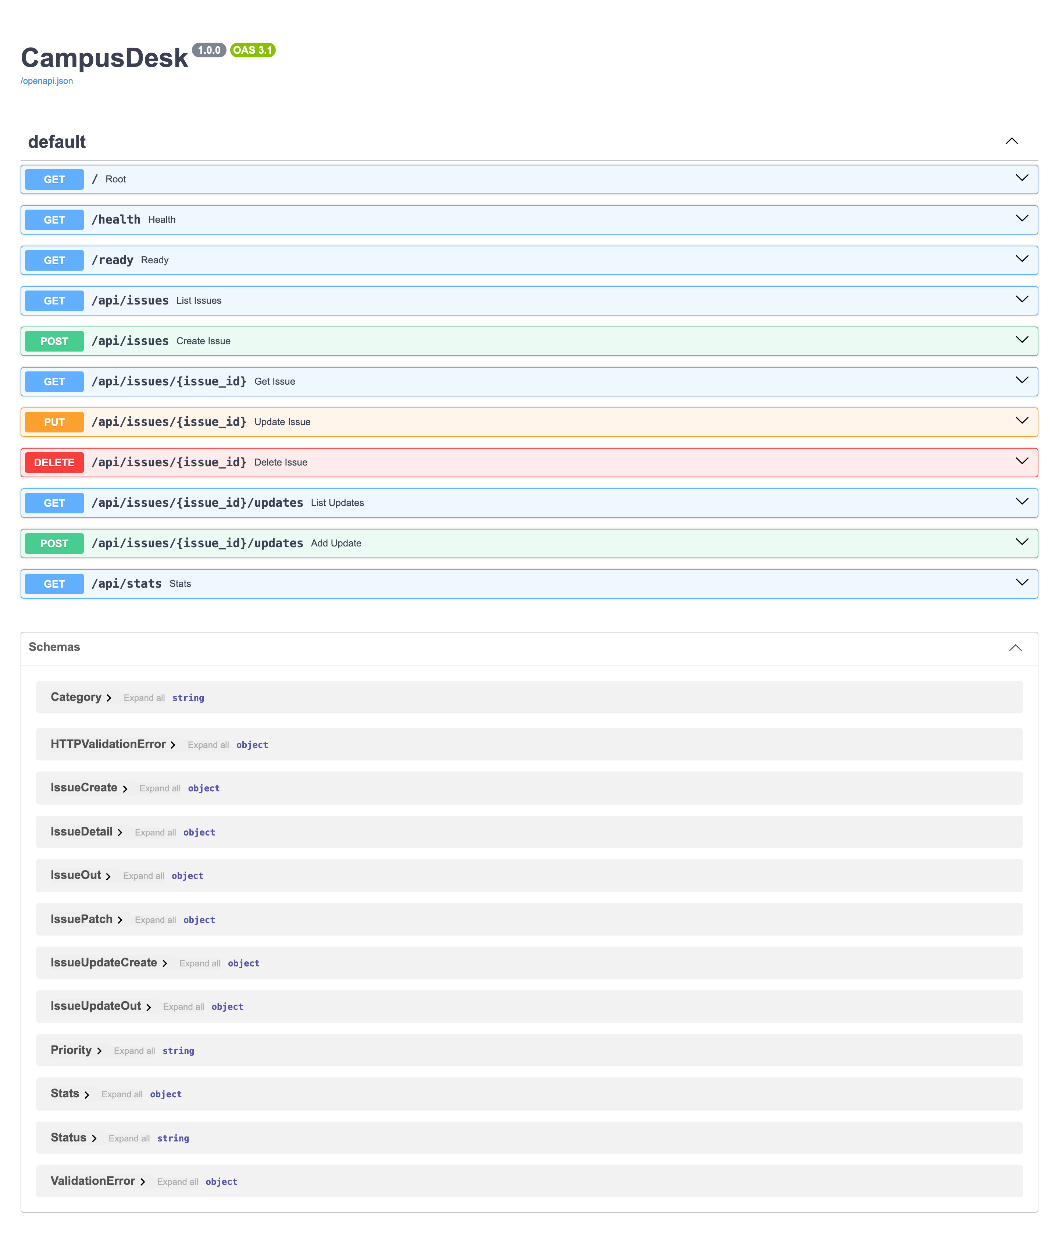
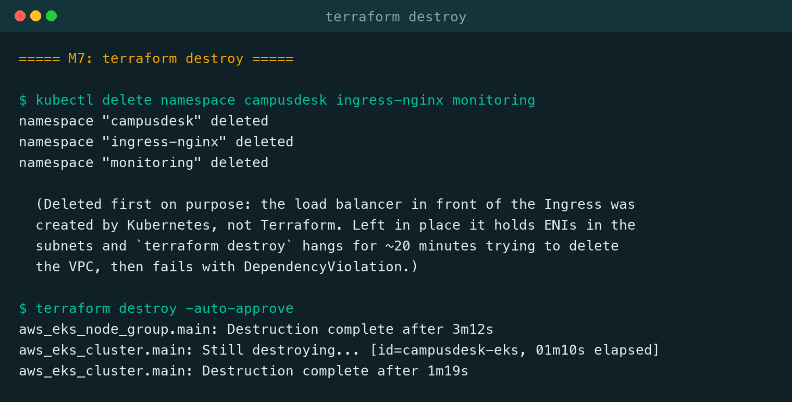
Evidence
Helm release and pods on real EKS
24 tests, every name listed
All 11 endpoints
Browser shots driven by Playwright against the running app; terminal shots are the exact command output, typeset.
Torn down, nothing left running
Notes:
Nothing here is mocked. The browser shots are real renders; the terminal shots are real output.

Slide 14
What was delivered
M1
Application
11 endpoints, 2 tables
M2
Testing
24 tests passing
M3
Git
public repo, clean ignores
M4
Docker
2 images, healthcheck-gated
M5
CI/CD
test, scan, push, deploy
M6
DevSecOps
0 HIGH/CRITICAL
M7
Terraform
15 created, 15 destroyed
M8
Kubernetes
EKS, Ingress, HPA
M9
Observability
scraped, dashboarded
M10
Documentation
README + this deck
Notes:
Every module has working, evidenced output rather than a configuration file alone.

Slide 15
What was not run
Recorded in the README rather than glossed over
The GitHub Actions pipeline has never executed
GitHub only runs workflows found at a repository root, and this folder sits inside the coursework repo. Every step it defines was run by hand and evidenced. Pushing this folder as its own repository would make it run.
No HPA scale-up under load was demonstrated
The HPA was deployed and reading CPU at 6%/60% through metrics-server, but no load test was run before teardown.
The AWS load balancer was not created by Terraform
It was provisioned by the Kubernetes Service, so it sits outside the state file and had to be deleted separately before destroy would complete.
Notes:
Stating the gaps plainly is more credible than implying everything worked first time.

Slide 16
Thank you
CampusDesk - from docker compose up to a monitored EKS cluster, and safely back down again
Questions welcome
Notes:
Happy to walk through any of the six bugs, or the Terraform and Helm code.

