Slide 1
AI Resume Generator
Smart Resume Creation from Just a Paragraph
MADE BY : LAKSHAY AGGARWAL / RIBHAV BHALLA
22CSU272 / 22CSU261

Slide 2

The Problem We're Solving
Creating resumes is tedious for many users.
People struggle with formatting, wording, and structure.
Need for quick, intelligent resume building based on free-form input.

Slide 3
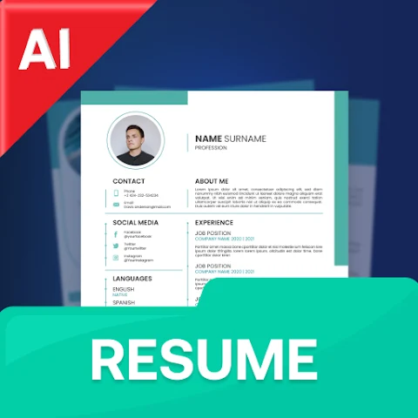
Our AI-Powered Solution
User writes a paragraph describing their experience and skills.
Our app uses AI to extract structured data (name, email, skills, etc.).
Data is displayed in an editable form.
Final resume is generated in a clean format.

Slide 4




Technologies Used
Frontend: ReactJS + Vite + TailwindCSS + DaisyUI
Backend: Spring Boot (API, data flow)
AI: Ollama with DeepSeek model (prompt-based extraction)
Deployment: Local setup for testing/demo

Slide 5
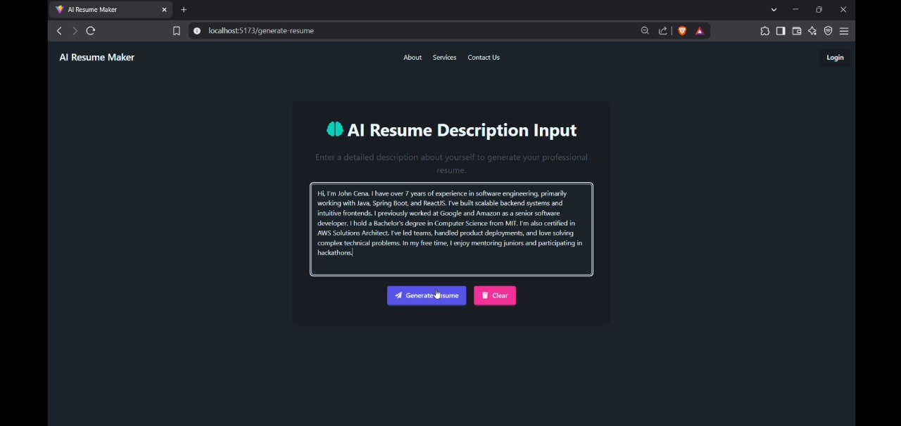
How We Use AI
Prompt-based interaction with DeepSeek via Ollama
Input: User paragraph
Output: Structured JSON with fields like name, email, skills, etc.
Error-handling and re-prompting if AI output is incomplete

Slide 6
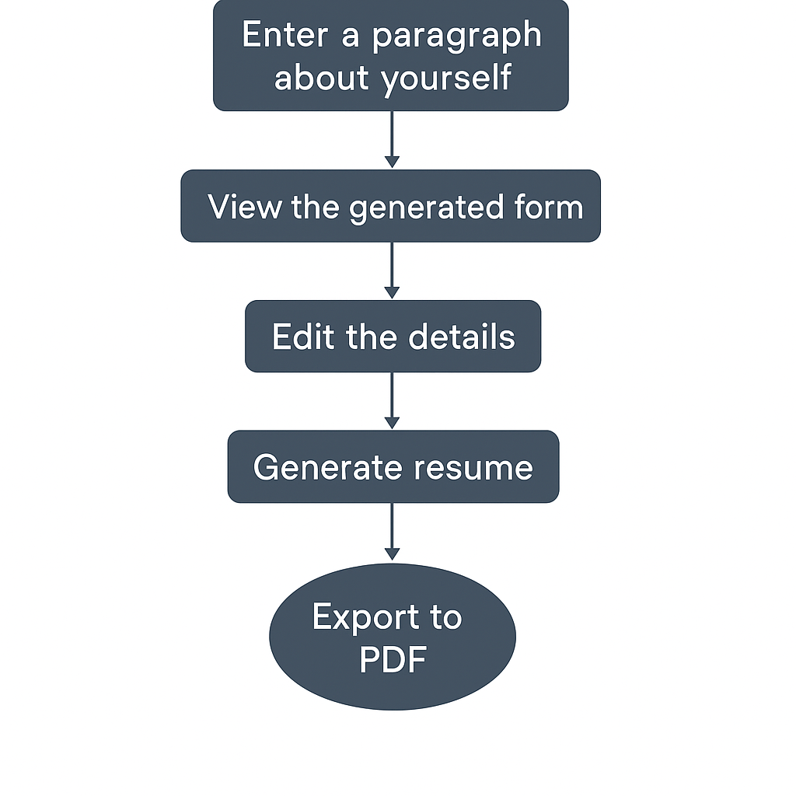
System Architecture
User flow:
User submits paragraph via frontend
Frontend sends to Spring Boot backend
Backend calls Ollama (DeepSeek)
Gets JSON → Sends to frontend form
User edits → Resume generated

Slide 7
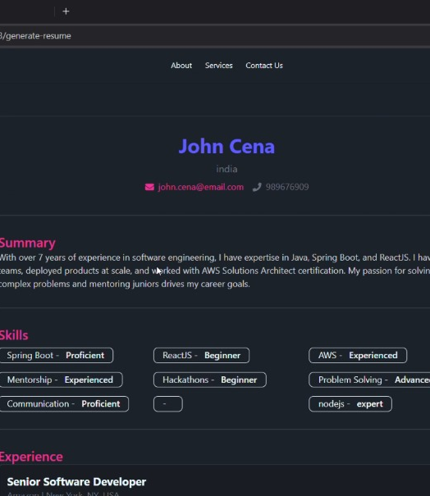
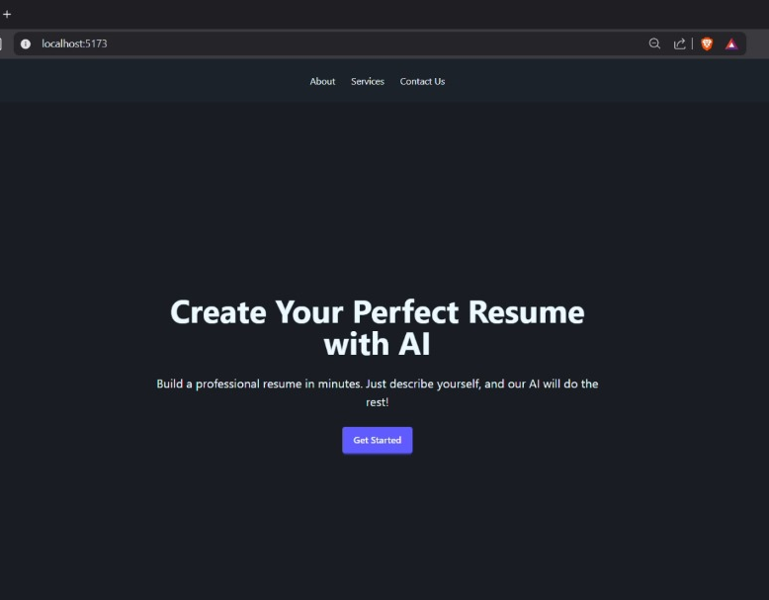
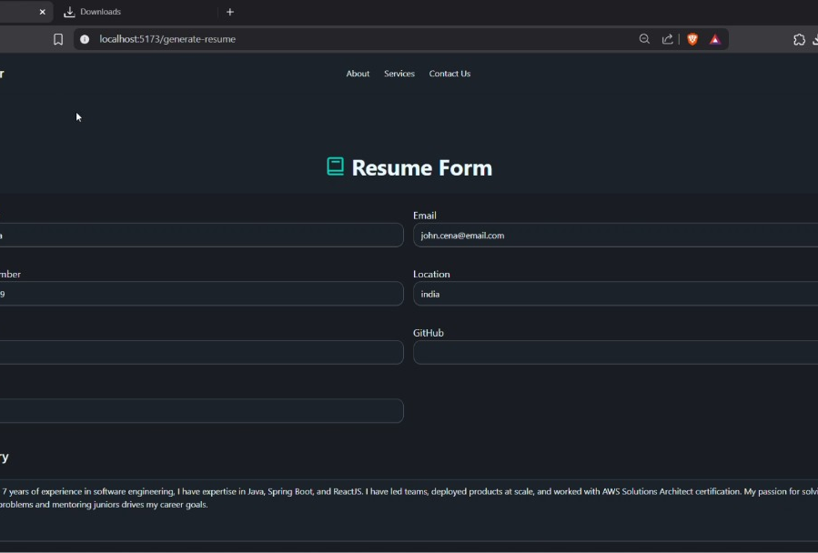
Live Demo / App Screenshots

Slide 8

Key Challenges
Prompt design for accurate data extraction
Handling edge cases in user input
Sync between JSON and form fields
UI responsiveness for structured display

Slide 9

What We Learned & What's Next
Learned full-stack integration with LLMs
Gained experience with prompt engineering
Future work: PDF export, cloud deployment, multiple templates

Slide 10
THANK YOU

