Slide 1

Department of Collegiate and Technical Education
Model for Network Security(unit-1)
Course Outcome3 :
Network Security and Management ( VI Semester)
Computer Science and Engineering
Session-3
Computer Science & Engineering – 15CS62T

Slide 2
Table of Content
Recap
Model for Network Security
Model for Network Access Security
Standards
Computer Science & Engineering – 15CS62T

Slide 3
Recap
Authentication
Access control
Data confidentiality
Data integrity
Nonrepudiation
Security Services
Security Mechanisms
Computer Science & Engineering – 15CS62T
Notes:
This definition introduces three key objectives that are at the heart of computer
security:
• Confidentiality: This term covers two related concepts:
Data confidentiality: Assures that private or confidential information is
not made available or disclosed to unauthorized individuals.
Privacy: Assures that individuals control or influence what information
related to them may be collected and stored and by whom and to whom
that information may be disclosed.
•Integrity: This term covers two related concepts:

Slide 4
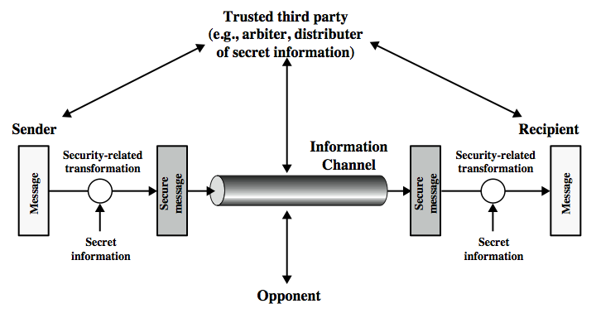
Model for Network Security
Computer Science & Engineering – 15CS62T

Slide 5
Model for Network Security
steps in designing a security service:
Design a suitable algorithm for the security transformation
generate the secret information (keys) used by the algorithm
develop methods to distribute and share the secret information
specify a protocol enabling the principals to use the transformation and secret information for a security service
Computer Science & Engineering – 15CS62T

Slide 6
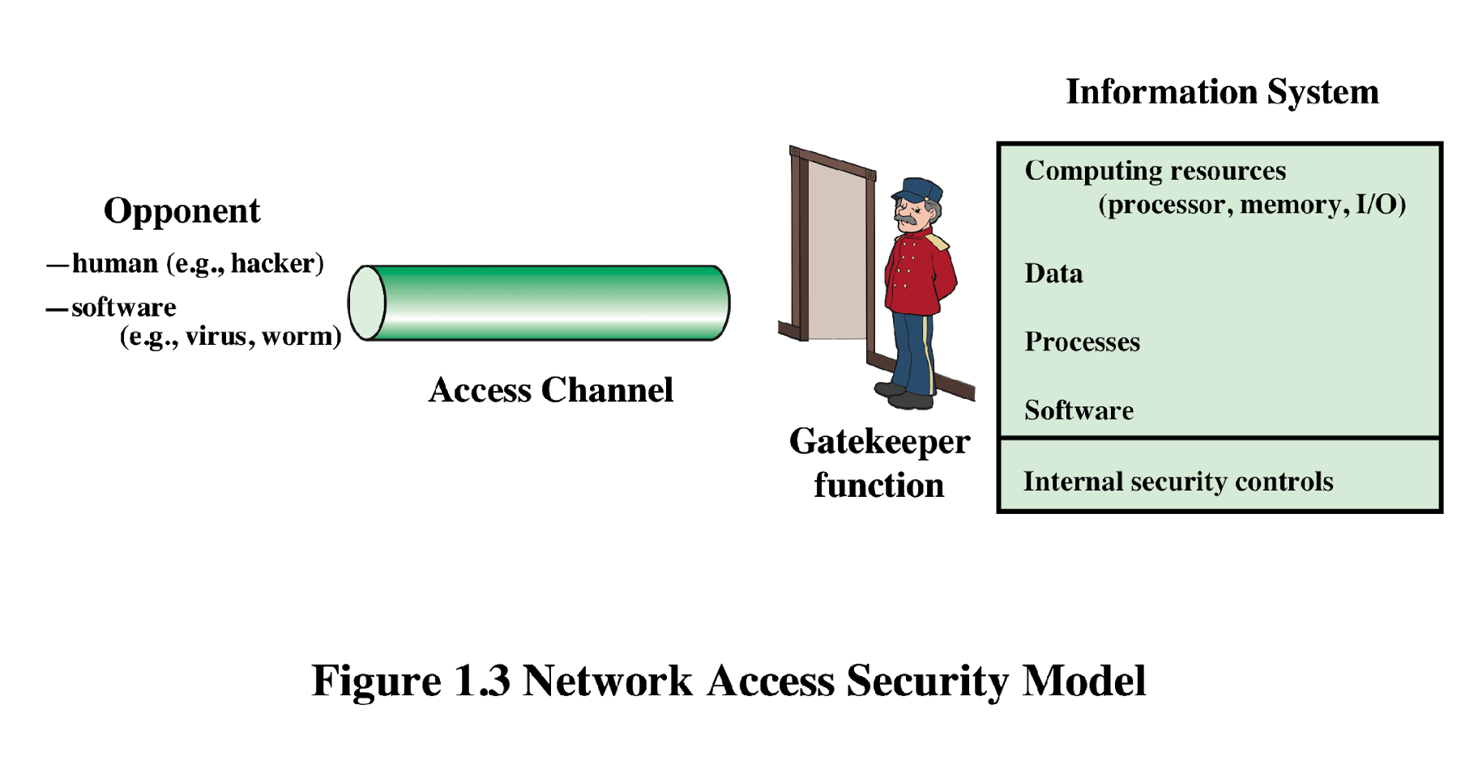
Network Access Security Model
Computer Science & Engineering – 15CS62T

Slide 7
Network Access Security Model
This model which reflects a concern for protecting an information system from unwanted access.
Two ways to secure a system:
select appropriate gatekeeper functions to identify users.
implement security controls to ensure only authorised users access designated information or resources
Computer Science & Engineering – 15CS62T

Slide 8
Standards
NIST
ISOC(Internet Society)
Professional membership society with worldwide organizational and individual membership
Provides leadership in addressing issues that confront the future of the Internet
Is the organization home for the groups responsible for Internet infrastructure standards, including the Internet Engineering Task Force (IETF) and the Internet Architecture Board (IAB)
Internet standards and related specifications are published as Requests for Comments (RFCs)
National Institute of Standards and Technology
U.S. federal agency that deals with measurement science, standards, and technology related to U.S. government use and to the promotion of U.S. private-sector innovation
NIST Federal Information Processing Standards (FIPS) and Special Publications (SP) have a worldwide impact
Computer Science & Engineering – 15CS62T

Slide 9
Summary
Model for Network Security
Model for Network Access Security
Standards
Computer Science & Engineering – 15CS62T

Slide 10
References
Network Security Essentials: Applications and Standards, 4/e, William Stallings, Pearson Educaiton, ISBN: 9788131716649 (Chap 1).
http://williamstallings.com/NetworkSecurity/
http://www.tutorialspoint.com/NetworkSecurityEssentials
https://www.brainkart.com/article/A-Model-For-Network-Security_8384
Computer Science & Engineering – 15CS62T

Slide 11

Thank you
Computer Science & Engineering – 15CS62T

