Slide 1
Airbnb India Market Intelligence
BCA PROJECT | DATA ANALYTICS, STATISTICAL ANALYSIS & MACHINE LEARNING
Pricing Analysis, Market Segmentation & Price Prediction
Lakshay Garg
Bachelor of Computer Applications (BCA)
Maharaja Agrasen Institute of Management Studies (MAIMS)
Guru Gobind Singh Indraprastha University (GGSIPU)
Academic Year 2026–27
Notes:
SLIDE 1: TITLE SLIDE (about 20 sec)
1. What this slide explains: Introduces me, my course and the project title.
2. What to say: Good morning. I am Lakshay Garg from BCA at MAIMS. My project is Airbnb India Market Intelligence. It covers pricing analysis, market segmentation and price prediction. I analysed over one lakh listings from five Indian cities and turned the results into two working apps.
3. Why this analysis/technique was used: A clear title tells the panel the three parts of the project from the very first slide: pricing, segmentation and prediction.
4. Likely evaluator question: Why did you choose Airbnb data for your project?
5. Suggested answer: Pricing is a real business problem that everyone understands. The data mixes locations, categories and numbers, so I could practise cleaning, statistics, machine learning and app building in one project.

Slide 2



Project Overview
01 | OVERVIEW
What is Airbnb?
THE PROJECT IN NUMBERS
An online marketplace where hosts rent homes, apartments and rooms to travellers for short stays. Each host sets their own nightly price.
102,599
5 | 60
listings analysed
cities | neighbourhoods
What this project analyses
102,599 Airbnb-style listings from five Indian cities: prices, locations, room types, booking rules, reviews and availability.
₹2,750
₹954
median nightly price
average prediction error (test set)
Final outcome
Pricing insights, statistical evidence, four market segments, a tested price-prediction model and two working Streamlit apps.
Analytics explains the market; the model estimates a fair starting price for a listing.
Notes:
SLIDE 2: PROJECT OVERVIEW (about 30 sec)
1. What this slide explains: What Airbnb is, what the project analyses and what it produced.
2. What to say: Airbnb is an online marketplace where hosts rent out homes or rooms to travellers, and every host sets their own price. I analysed 102,599 listings from Delhi, Mumbai, Bengaluru, Jaipur and Hyderabad. The final outcome has four parts: pricing insights, four market segments, a price-prediction model that is wrong by about 954 rupees on average, and two Streamlit apps.
3. Why this analysis/technique was used: The overview gives the evaluator the full picture before the details, so every later slide fits into a story.
4. Likely evaluator question: What exactly is the final output of your project?
5. Suggested answer: A cleaned and analysed dataset, statistical evidence on price drivers, a saved XGBoost model, four customer segments, and two apps: an analytics dashboard and a price predictor.

Slide 3





Problem Statement
02 | PROBLEM STATEMENT
THE BUSINESS PROBLEM WE STARTED WITH
WHAT THE DATA ACTUALLY ESTABLISHED
Room type is the biggest driver
Entire homes ≈ 2× private rooms (₹3,850 vs ₹1,900)
Prices differ by city
Property type matters
A night in Mumbai and a night in Jaipur are priced very differently.
Room type and listing features shape what guests will pay.
Location matters
Mumbai ₹3,450 vs Jaipur ₹2,200 median; neighbourhoods up to 1.56× apart
Ratings did not raise prices
Median ₹2,750 for every rating from 1 to 5
Hosts guess prices
Raw data is not insight
Prediction is a starting point
New hosts struggle to set a competitive, fair price.
Listing data must be cleaned and analysed before decisions.
Model explains ~49% of price variation (R² 0.486)
Notes:
SLIDE 3: PROBLEM STATEMENT (about 40 sec)
1. What this slide explains: The business problem I set out to solve, kept separate from what the data actually proved.
2. What to say: On the left is the problem I started with. Prices differ by city, room type matters, hosts often guess their price, and raw data cannot be used directly. On the right is what the data actually established. Room type was the biggest driver: entire homes cost about twice as much as private rooms. Location mattered too. Ratings and reviews showed no link with price. My model explains about half of the price variation, so it gives a starting price, not an exact one.
3. Why this analysis/technique was used: Separating assumptions from evidence shows I did not force the data to agree with my expectations.
4. Likely evaluator question: Did the data confirm everything you expected?
5. Suggested answer: No. I expected higher ratings to mean higher prices, but the median price is 2,750 rupees for every rating from 1 to 5. I reported that honestly.

Slide 4
Project Objectives
03 | OBJECTIVES
1
COMPLETED
2
COMPLETED
3
COMPLETED
4
COMPLETED
Analyse listing data
Identify pricing patterns
Compare cities & room types
Test hypotheses
Clean and understand 102,599 listings
Distribution, skew, typical price
City, neighbourhood and room-type gaps
Seven statistical tests with effect sizes
5
COMPLETED
6
COMPLETED
7
COMPLETED
7 / 7
Predict nightly price
Segment the market
Build dashboard & app
objectives completed and verified in the executed notebook
Four ML models vs a baseline
K-Means clustering with PCA view
Two separate Streamlit applications
Notes:
SLIDE 4: PROJECT OBJECTIVES (about 25 sec)
1. What this slide explains: The seven objectives and their completion status.
2. What to say: I set seven objectives. Analyse the listing data, find pricing patterns, compare cities and room types, run hypothesis tests, build price-prediction models, segment listings with clustering, and build a dashboard and a prediction app. All seven were completed and verified by running the notebook from top to bottom.
3. Why this analysis/technique was used: Clear objectives make the project measurable; each one maps to a section of the notebook and a slide in this deck.
4. Likely evaluator question: How do you know each objective was actually achieved?
5. Suggested answer: The final notebook runs end to end without errors, every number in this deck comes from its output, and 13 automated tests confirm that both apps work.

Slide 5

Dataset Description
04 | DATASET
102,599
25
5
60
SAMPLE ROWS (FIRST 5 LISTINGS, SELECTED COLUMNS)
City | Neighbourhood | Room type | Min. nights | Reviews | Price (₹)
Hyderabad | Charminar | Private room | 10 | 9 | 950
Bengaluru | HSR Layout | Entire home/apt | 30 | 45 | 4,550
Mumbai | Chembur | Private room | 3 | 0 | 1,500
Hyderabad | Banjara Hills | Entire home/apt | 30 | 270 | 5,000
Bengaluru | MG Road | Entire home/apt | 10 | 9 | 5,900
rows (listings)
columns
cities
neighbourhoods
Target variable
price_inr_per_night: nightly price in ₹ (₹400 – ₹23,500)
Location
city, neighbourhood, latitude, longitude
Property & booking
About the source
room_type, construction_year, minimum_nights, instant_bookable, cancellation_policy, availability_365
File supplied for the project (airbnb_india_listings.csv); original publisher not documented. Near-perfect category splits (e.g. 33.5 / 33.2 / 33.2% cancellation policies) suggest it may be synthetic, so results describe this dataset.
Host & reviews
host_identity_verified, calculated_host_listings_count, number_of_reviews, reviews_per_month, review_rate_number
Notes:
SLIDE 5: DATASET DESCRIPTION (about 35 sec)
1. What this slide explains: Size, columns, target variable, a sample of the data, and an honest note about the source.
2. What to say: The dataset has 102,599 rows and 25 columns. It covers five cities with exactly 12 neighbourhoods each. The target, the value I predict, is price per night in rupees. The other columns describe location, property, booking rules, the host and reviews. One honest note: the file's original source is not documented, and some columns are split almost perfectly evenly. It may be synthetic, so my results describe this dataset rather than the verified Indian Airbnb market.
3. Why this analysis/technique was used: Before any analysis the audience must know what one row means and what is being predicted.
4. Likely evaluator question: Why do you think the data might be synthetic?
5. Suggested answer: Cancellation policies are split 33.5, 33.2 and 33.2 percent, every city has the same room-type mix, and the two host columns contradict each other. Real marketplaces are rarely that even.

Slide 6








Technology Stack
05 | TOOLS
Python
Pandas & NumPy
Matplotlib & Seaborn
SciPy
Core language for every step of the project
Load, clean, reshape and summarise the data
Charts for EDA, models and clustering
Hypothesis tests: t-test, ANOVA, chi-square
Scikit-learn
XGBoost
Google Colab
Streamlit
Pipelines, models, CV, K-Means and PCA
Gradient-boosted trees: the final model
Free cloud notebook to run the analysis
Turns Python into the two web apps
Also used: Plotly (interactive charts) and Joblib (saving the model bundle).
Notes:
SLIDE 6: TECHNOLOGY STACK (about 25 sec)
1. What this slide explains: The tools used and the role of each.
2. What to say: I worked in Python on Google Colab. Pandas and NumPy handled the data, Matplotlib and Seaborn the charts, and SciPy the statistical tests. Scikit-learn provided preprocessing, models and K-Means, XGBoost the final model, and Streamlit turned the work into web apps.
3. Why this analysis/technique was used: These are industry-standard, free tools, so the project can be reproduced by anyone.
4. Likely evaluator question: Why Streamlit instead of a web framework like Flask?
5. Suggested answer: Streamlit turns a Python script into an interactive web app without HTML or JavaScript, so I could focus on the analysis and the model.

Slide 7



Project Workflow
06 | WORKFLOW
1
2
3
4
5
Dataset
Data Understanding
Data Cleaning
Feature Engineering
EDA
102,599 listings · 25 columns
Types, ranges, quality checks
Logged rules, no rows lost
Analysis features + encoding
Price, city, room type, reviews
10
9
8
7
6
Insights
Dashboard & Prediction
Clustering
Machine Learning
Statistical Analysis
Host & platform actions
Two tested Streamlit apps
K-Means, 4 segments, PCA
4 models + baseline, CV, tuning
7 tests with effect sizes
Notes:
SLIDE 7: PROJECT WORKFLOW (about 30 sec)
1. What this slide explains: The ten stages of the project in order.
2. What to say: The project followed ten stages. I loaded the dataset, understood its structure, cleaned it and engineered features. Then I explored it with charts and tested the patterns statistically. Next I built the machine learning models and clustered the listings. Finally I built the apps and wrote the insights. Each stage feeds the next, and the notebook follows the same order.
3. Why this analysis/technique was used: A fixed workflow prevents mistakes, for example cleaning data before analysing it, and splitting the data before training models.
4. Likely evaluator question: Which stage took the most effort?
5. Suggested answer: Making the model pipeline leakage-free and making the saved model load correctly in the app. The original version saved a dictionary instead of the model, so predictions failed until I fixed it.

Slide 8






Data Cleaning and Preprocessing
07 | DATA PREPARATION
Missing values
BEFORE AND AFTER CLEANING (ACTUAL COUNTS)
Logical fill: 0 reviews ⇒ 0 reviews/month; rest imputed in the ML pipeline
Check | Before | After
Rows (listings) | 102,599 | 102,599
Duplicate rows / IDs | 0 | 0
Invalid prices, ratings, coordinates | 0 | 0
Review dates in the future (up to 2058) | 5 | 0 (set missing)
reviews_per_month missing | 15,879 | 22
Ratings missing | 326 | 326 (imputed in pipeline)
High-price outliers flagged | – | 3,168 (3.09%), kept
Duplicates
Checked whole rows and listing IDs: none found
Invalid values
Rules for price, rating, nights, coordinates, dates
Outliers (IQR rule)
Prices above ₹7,550 flagged, kept as real premium listings
Type conversion
Numbers to numeric, review dates to datetime
Feature preparation
No rows deleted. Remaining gaps are filled inside the ML pipeline using training data only, which prevents data leakage.
8 analysis columns; 25 ⇒ 34 columns
Notes:
SLIDE 8: DATA CLEANING AND PREPROCESSING (about 40 sec)
1. What this slide explains: Every cleaning rule and its effect on the data.
2. What to say: I checked for duplicates, invalid values and wrong types, and found none. Five review dates were in the future, up to the year 2058, so I set them to missing. The biggest fix was logical: 15,857 listings with zero reviews had a blank reviews-per-month, which really means zero. After cleaning, only 22 of those values were still missing. 3,168 listings, about 3 percent, were flagged as high-price outliers. I kept them because they look like genuine premium listings. No rows were deleted.
3. Why this analysis/technique was used: Dirty data gives misleading results. Logging each rule makes the cleaning transparent and repeatable.
4. Likely evaluator question: Why didn't you delete the outliers?
5. Suggested answer: Prices like 9,000 rupees for a Mumbai apartment are realistic. Deleting them would hide the luxury segment, so I kept them and reported that the model under-predicts them.

Slide 9
EDA: Price, City and Room Type
08 | EXPLORATORY DATA ANALYSIS
Price distribution (number of listings)
Median price by city (₹ per night)
Median price by room type (₹ per night)
Right-skewed: most listings cost ₹1,000–4,000; median ₹2,750 is the typical price (mean ₹3,173).
Mumbai highest (₹3,450), Jaipur lowest (₹2,200): about 57% apart.
Entire home ≈ 2× private room (₹3,850 vs ₹1,900), and the ratio holds in every city.
Notes:
SLIDE 9: EDA: PRICE, CITY AND ROOM TYPE (about 40 sec)
1. What this slide explains: The three most important charts from the exploratory analysis.
2. What to say: Most listings cost between 1,000 and 4,000 rupees, with a long tail of expensive ones, so I use the median of 2,750 as the typical price. Mumbai is the most expensive city with a median of 3,450, and Jaipur the cheapest at 2,200. Room type shows the biggest gap. An entire home has a median of 3,850 rupees, about twice a private room at 1,900, and this ratio holds in every city.
3. Why this analysis/technique was used: EDA shows the shape of the data and the obvious drivers before any modelling.
4. Likely evaluator question: Why use the median instead of the average price?
5. Suggested answer: Prices are right-skewed. A few very expensive listings pull the average up to 3,173, while the median of 2,750 shows the typical listing.

Slide 10
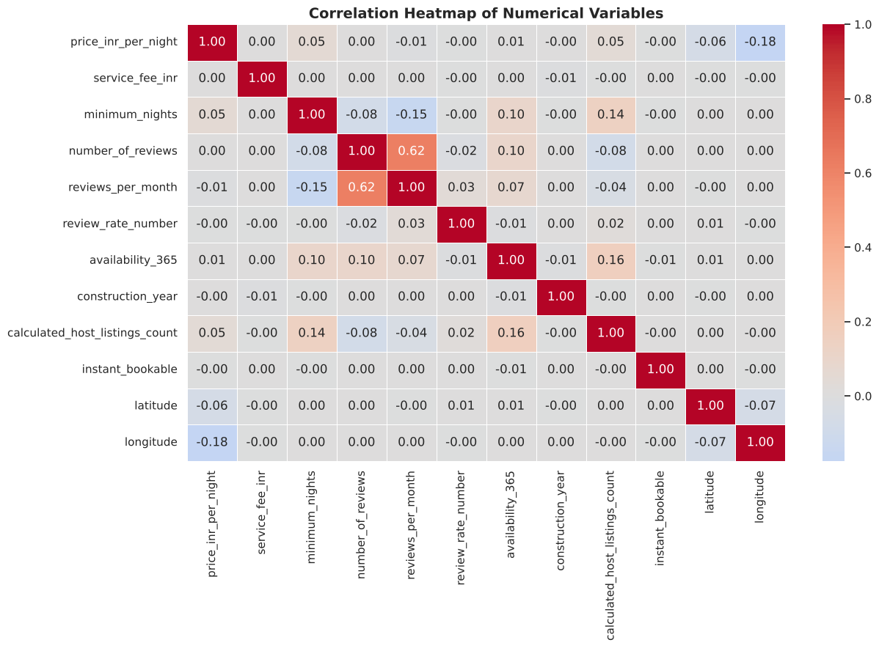
EDA: Availability and Correlation
08 | EXPLORATORY DATA ANALYSIS
Listings by availability (days open per year)
Correlation heatmap (actual notebook output)
Median price by group: ₹2,700 | ₹2,900 | ₹2,700
Availability barely changes price. Half of all listings are open 90 days or fewer, a first sign of dormant listings (confirmed by clustering).
All |r| < 0.06 except longitude (−0.175), which reflects Mumbai being the westernmost and priciest city. Price is driven by categories (room type, location), not numbers like reviews.
Notes:
SLIDE 10: EDA: AVAILABILITY AND CORRELATION (about 35 sec)
1. What this slide explains: Availability patterns and how numeric variables relate to price.
2. What to say: Half the listings are available for 90 days or fewer, but median price barely changes with availability: 2,700, 2,900 and 2,700 rupees. The correlation heatmap shows that every numeric variable has a very weak link with price. The only visible one is longitude at minus 0.175. That simply reflects Mumbai being the westernmost and most expensive city. So price here is driven by categories like room type and location, not by numbers like reviews.
3. Why this analysis/technique was used: Correlation quickly shows which numeric variables move together and guides feature selection.
4. Likely evaluator question: Does the longitude correlation mean longitude causes higher prices?
5. Suggested answer: No. Correlation is not causation. Longitude is lower in the west, where Mumbai is, and Mumbai is expensive for other reasons.

Slide 11
Statistical Analysis
09 | STATISTICAL ANALYSIS
Test | Question | Result | Meaning
Shapiro-Wilk + Q-Q plot | Is price normally distributed? | W = 0.891, p ≈ 1e-50 | No, so rank-based tests are also used
Pearson & Spearman | Is price linked to reviews or rating? | ρ = 0.019 (reviews); rating p ≈ 0.79 | No meaningful link
Welch's t-test + Cohen's d | Entire home vs private room? | t = 232.2, d = 1.41 | Large gap (mean ₹4,223 vs ₹2,066)
One-way ANOVA (η²) | Do the 4 room types differ? | F = 18,395, η² = 0.350 | Room type explains ~35% of variation
Kruskal-Wallis | Room types / cities differ (ranks)? | H = 46,994 / 7,167 | Both differ; city effect smaller (ε² = 0.07)
Chi-square + Cramér's V | Is room-type mix linked to city? | p = 0.624, V = 0.006 | Not linked: same mix in every city
95% confidence interval | Where is the true mean price? | ₹3,162 – ₹3,185 | Very precise, thanks to 1 lakh listings
What is a p-value?
Key finding
The chance of seeing a difference this large if there were really no difference. p < 0.05 means 'statistically significant'. With 1 lakh listings even tiny effects become significant, so effect sizes are reported too.
Room type has a large, real effect (Cohen's d 1.41, η² 0.35). Reviews are 'significant' but negligible (ρ 0.019): significance alone does not mean importance.
Notes:
SLIDE 11: STATISTICAL ANALYSIS (about 50 sec)
1. What this slide explains: The hypothesis tests performed and what their results mean.
2. What to say: Each test starts with a null hypothesis, for example that room types have the same price. The p-value is the chance of seeing a difference this large if that were true. If p is below 0.05, I reject it. Room type had a large effect, with Cohen's d of 1.41, and it explains about 35 percent of price variation. But with one lakh listings even tiny effects look significant. Reviews had a significant but negligible correlation of 0.019. That is why I always report effect sizes. Interestingly, city and room type turned out to be independent, with a p-value of 0.624.
3. Why this analysis/technique was used: Charts can mislead. Tests check whether differences are real, and effect sizes show whether they matter.
4. Likely evaluator question: What is the difference between statistical significance and practical importance?
5. Suggested answer: Significance says a difference probably isn't chance. Effect size says how big it is. With very large samples, tiny useless differences become significant.

Slide 12


Feature Engineering
10 | FEATURE ENGINEERING
Original columns
Engineered for analysis
Prepared for the model
number_of_reviews
last_review (text date)
review_rate_number
availability_365
host_id
listing_name
city, neighbourhood, room_type
has_reviews (0/1)
log_number_of_reviews
last_review_year, _month
review_rate_missing (0/1)
availability_category (Low/Med/High)
host_category
listing_name_length
price_outlier_iqr (analysis only)
Median / most-frequent imputation
One-hot encoding: 13 inputs ⇒ 83 columns
Standard scaling of numbers
neighbourhood added as a feature
latitude / longitude dropped (CV RMSE +₹0.4 only)
All fitted on training data only
Why it helps: readable categories make EDA clearer; encoding and scaling let algorithms use text categories; leakage-safe rules keep test scores honest (the outlier flag is never a model input).
Notes:
SLIDE 12: FEATURE ENGINEERING (about 30 sec)
1. What this slide explains: The new columns created and how features were prepared for the model.
2. What to say: I created eight analysis features, such as whether a listing has reviews, an availability category and a host category. For the model, the pipeline fills missing values, scales numbers and one-hot encodes categories, turning 13 inputs into 83 model columns. I added neighbourhood as a feature because location within a city matters. I dropped latitude and longitude, because that cost only 40 paise of error and hosts know their neighbourhood, not their coordinates.
3. Why this analysis/technique was used: Good features make patterns easier to see and to learn, and model-ready encoding is required for most algorithms.
4. Likely evaluator question: Why is the price outlier flag not used as a model input?
5. Suggested answer: It is calculated from the price itself. Using it would leak the answer into the model and make the scores falsely good.

Slide 13




Machine Learning Approach
11 | MACHINE LEARNING
PROBLEM
TARGET
INPUTS
SPLIT
Supervised regression
price_inr_per_night (₹)
13 features (5 categorical, 8 numeric)
80/20 ⇒ 82,079 train | 20,520 test
Baseline
Linear Regression
Decision Tree
Random Forest
XGBoost
Predicts the median price for every listing: the bar to beat
Price = weighted sum of features; simple and explainable
A flowchart of yes/no questions that ends in a price
Averages 100 trees trained on random samples
Builds trees one after another, each fixing earlier errors
SHARED, LEAKAGE-SAFE PIPELINE (FITTED ON TRAINING DATA ONLY)
Listing features
Fill missing values
Scale numbers + one-hot categories
Model
Predicted ₹ price
Notes:
SLIDE 13: MACHINE LEARNING APPROACH (about 40 sec)
1. What this slide explains: The regression problem and the algorithms compared.
2. What to say: This is supervised regression: the model learns from listings with known prices and predicts a number. I split the data 80/20, giving 82,079 listings for training and 20,520 for testing, with the same city mix in both. I compared a median baseline, Linear Regression, a Decision Tree, Random Forest and XGBoost. Every model uses the same preprocessing pipeline, which is fitted only on training data to prevent data leakage.
3. Why this analysis/technique was used: Comparing simple and advanced models against a baseline shows whether complexity actually adds value.
4. Likely evaluator question: What is data leakage and how did you avoid it?
5. Suggested answer: Leakage is when the model sees information it would not have in real use. I split the data first, kept preprocessing inside a pipeline fitted on training data, and excluded columns derived from price.

Slide 14
Model Comparison
12 | RESULTS
Model | Test MAE | Test RMSE | Test R² | CV RMSE
XGBoost (selected) | ₹954 | ₹1,341 | 0.486 | ₹1,367
Random Forest | ₹954 | ₹1,341 | 0.486 | ₹1,368
Linear Regression | ₹971 | ₹1,355 | 0.475 | ₹1,379
Decision Tree | ₹1,012 | ₹1,434 | 0.412 | ₹1,461
Baseline (median) | ₹1,385 | ₹1,916 | −0.049 | ₹1,931
Test MAE by model (₹, lower is better)
Test = 20,520 unseen listings. CV = 3-fold cross-validation on training data. Tuned versions changed CV RMSE by less than ₹2.
Why XGBoost was selected
Lowest cross-validation RMSE (₹1,367). Ties Random Forest on the test set but trains ~10× faster (6 s vs 56 s). Chosen by CV, so the test score stays an honest estimate.
About 31% lower error than the baseline for the best models.
Notes:
SLIDE 14: MODEL COMPARISON (about 40 sec)
1. What this slide explains: The test results of every model and why XGBoost was selected.
2. What to say: Every real model beat the baseline by about 30 percent. XGBoost and Random Forest tied for best, with a test error of about 954 rupees and an R-squared of 0.486. I selected XGBoost because it had the lowest cross-validation error and trains about ten times faster. Linear Regression was close behind, which tells me price is mostly simple category effects. Tuning improved the error by less than 2 rupees, so the limit is the information in the data, not the model.
3. Why this analysis/technique was used: Selecting by cross-validation, not by the test score, keeps the final test result honest.
4. Likely evaluator question: Why did linear regression perform almost as well as XGBoost?
5. Suggested answer: Price mainly depends on additive category effects such as room type, city and neighbourhood, which a linear model captures well. There is little complex pattern left for trees to find.

Slide 15
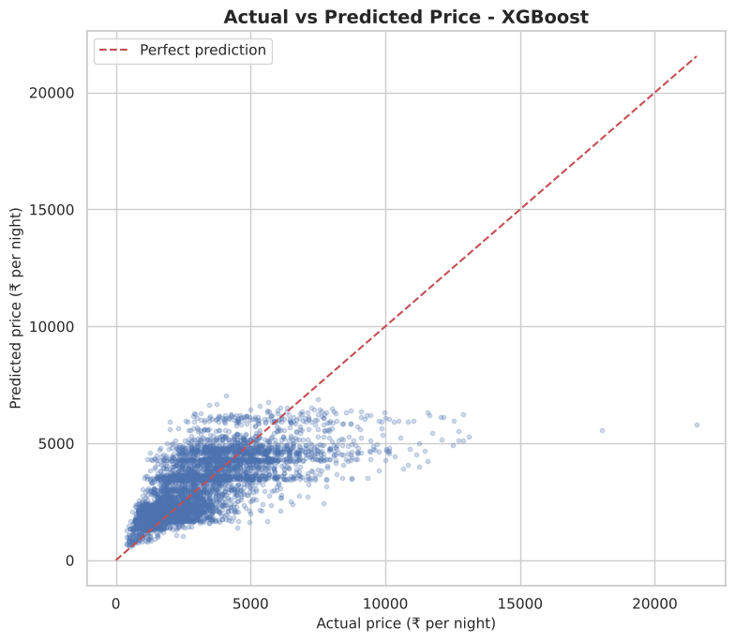
Final Model Evaluation
13 | EVALUATION
₹954
₹1,341
0.486
How it was evaluated
80/20 split, stratified by city
3-fold cross-validation
Randomized search tuning
Test set used only once
MAE
RMSE
R²
Average miss per listing (baseline ₹1,385)
Like MAE, but big misses count more
Explains ~49% of price differences
Actual vs predicted (test sample)
Average residual by actual price (₹)
Limitations
Over-prices budget listings, under-prices luxury (≈ ₹4,600 low above ₹8,000)
Half of price variation unexplained (no amenities, size, season)
Tested only on unseen listings from this dataset
Positive = predicted too low
Notes:
SLIDE 15: FINAL MODEL EVALUATION (about 45 sec)
1. What this slide explains: What the metrics mean, how the model was evaluated, and where it makes mistakes.
2. What to say: MAE of 954 rupees means the prediction misses by about 954 rupees on average. RMSE of 1,341 is higher because big mistakes count more. An R-squared of 0.486 means the model explains about half of the price differences. I used an 80/20 split, 3-fold cross-validation and randomized search tuning, and the test set was used only once. The residual chart shows the main weakness. The model over-prices cheap listings and under-prices expensive ones: above 8,000 rupees it is about 4,600 rupees too low. So it is a starting point, not an exact price.
3. Why this analysis/technique was used: Residual analysis shows where the model fails, which matters more for real users than one overall score.
4. Likely evaluator question: Is an R-squared of 0.486 good enough?
5. Suggested answer: It is about 30 percent better than the baseline, but half the variation is unexplained, because the data has no amenities, size, photos or season. I present it as a starting estimate.

Slide 16
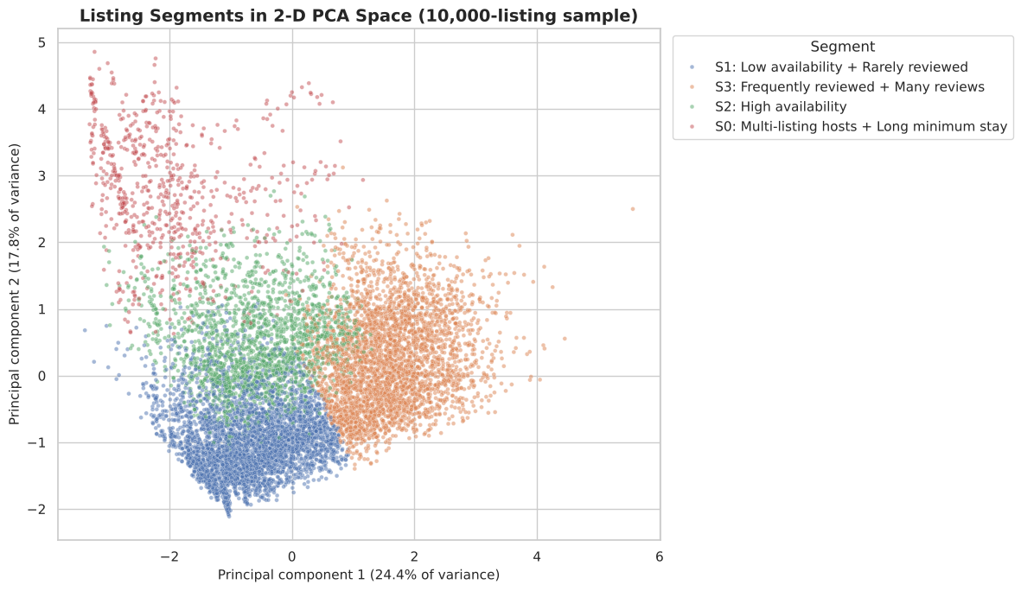
K-Means Clustering and Segmentation
14 | MARKET SEGMENTATION
ALGORITHM
PRICE INCLUDED?
CLUSTERS (K)
K-Means on 8 standardised features
Yes: price-and-activity segments
4 chosen; best silhouette K = 3
Segments in 2-D PCA space (actual notebook output)
32.5%
₹2,750 median
39.2%
₹2,700 median
Active performers
Dormant listings
Median 51 reviews, short stays
Median 0 days available
Action: Protect reviews, keep calendar open
Action: Reactivate or close the calendar
21.3%
₹2,650 median
7.0%
₹3,200 median
Open but under-booked
Professional long-stay
313 days open, only 4 reviews
30-night minimum, 50 listings/host
Action: Revisit price, photos, description
Action: Offer monthly-stay pricing
Silhouette: K=3 → 0.192 (best), K=4 → 0.172. Kept 4 to separate dormant from open-but-unbooked listings.
Notes:
SLIDE 16: K-MEANS CLUSTERING AND SEGMENTATION (about 45 sec)
1. What this slide explains: How listings were grouped into segments and what each segment means.
2. What to say: K-Means groups similar listings without being told the answer. I used eight standardised features, and yes, price is one of them, so these are price-and-activity segments. Three clusters had the best silhouette score, 0.192. I kept four because it splits dormant listings from listings that are open but not getting booked, and these need different actions. The four segments are active performers, dormant listings, open-but-under-booked listings, and professional long-stay hosts. The PCA chart shows the segments overlap, which matches the low silhouette score.
3. Why this analysis/technique was used: Segmentation lets hosts and the platform take different actions for different groups instead of one generic strategy.
4. Likely evaluator question: Why not use the cluster label as a feature for price prediction?
5. Suggested answer: Price was used to build the clusters, so the label contains price information. That would be data leakage.

Slide 17
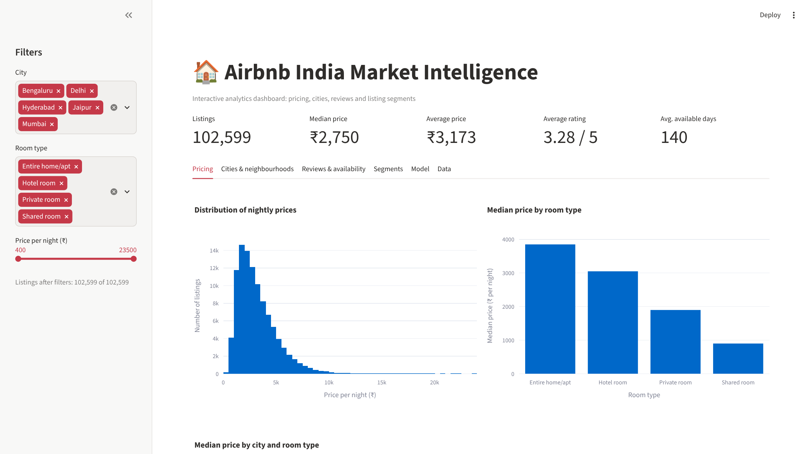
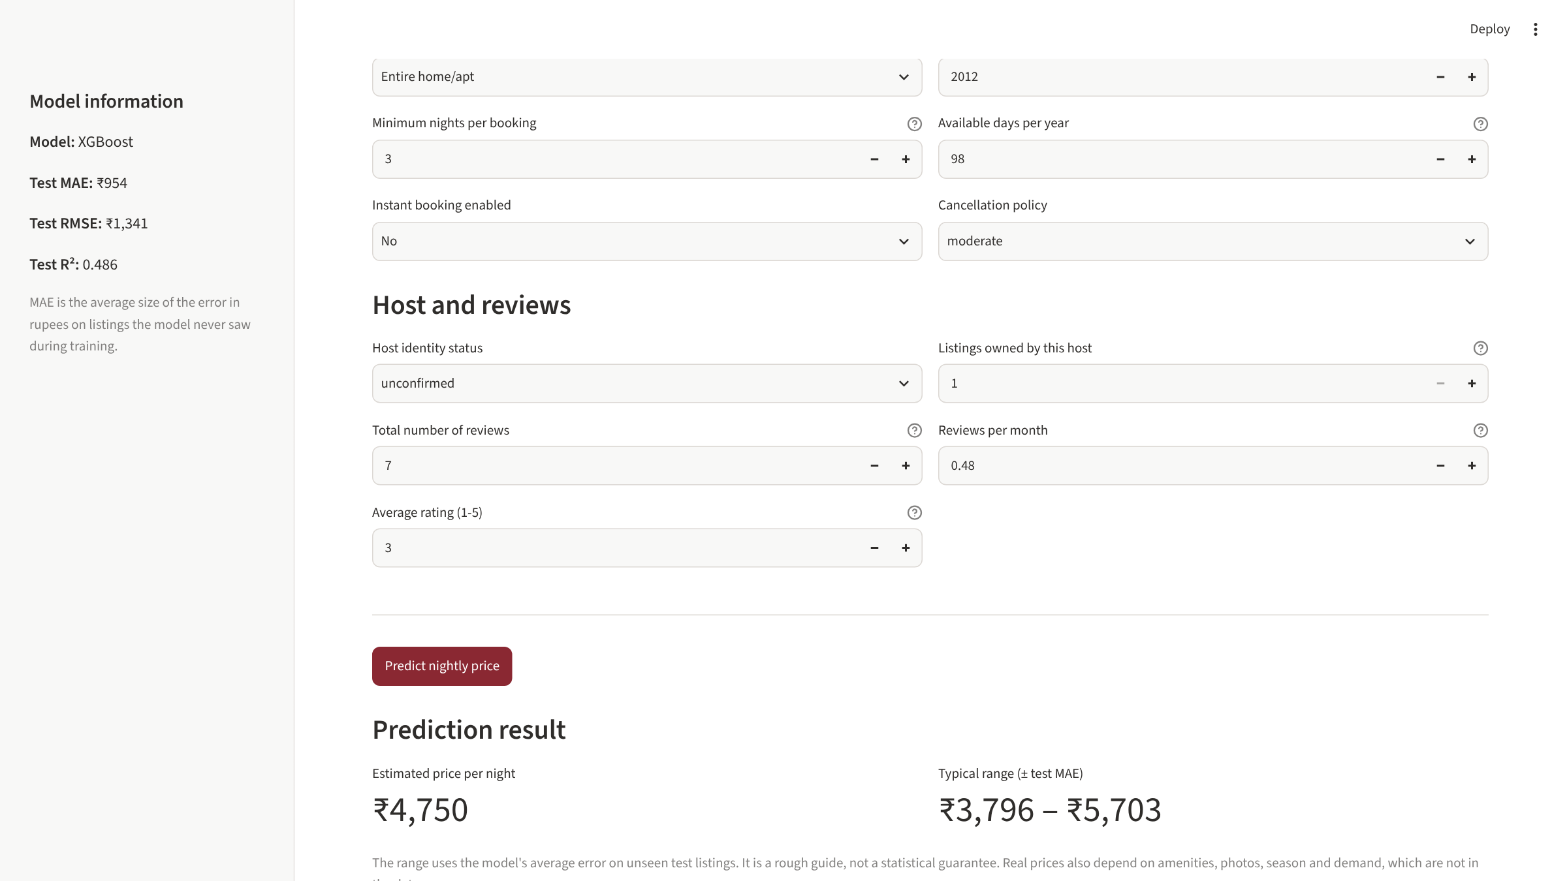
Dashboard and Price Prediction App
15 | APPLICATIONS
Analytics dashboard (port 8501)
Price prediction app (port 8502)
Filter by city, room type and price; see KPIs, price charts, neighbourhoods, reviews, segments and model metrics.
Enter city, neighbourhood, room type, booking rules and reviews; get a price with a ± MAE range.
1
Host enters listing details
2
Inputs checked against the saved schema
3
Saved XGBoost pipeline predicts
4
Shows ₹4,750 ± ₹954 (default listing)
Verified: real screenshots, 13/13 app tests passed. Not yet deployed online.
Notes:
SLIDE 17: DASHBOARD AND PRICE PREDICTION APP (about 40 sec)
1. What this slide explains: The two Streamlit applications and how a prediction is generated.
2. What to say: These are real screenshots from the apps running on my machine. The dashboard lets anyone filter by city, room type and price, and shows prices, neighbourhoods, reviews, segments and model results. In the prediction app, a host enters city, neighbourhood, room type, booking rules and review details. The app checks the inputs against the saved schema, the saved XGBoost pipeline predicts a price, and the app shows the estimate with a range of plus or minus the average error. For the default listing it shows 4,750 rupees, exactly what the notebook predicted. Both apps passed 13 automated tests. They are not deployed online yet.
3. Why this analysis/technique was used: Apps turn analysis into a tool that non-technical hosts can actually use.
4. Likely evaluator question: How do you make sure the app's inputs match what the model expects?
5. Suggested answer: The app builds its form from the input schema saved with the model, filters neighbourhoods by city, and validates every input before predicting.

Slide 18



Results, Business Insights and Limitations
16 | RESULTS AND VALUE
2.0×
₹3,450 vs ₹2,200
₹954
39%
entire home vs private room price
Mumbai vs Jaipur median
average prediction error (R² 0.486)
listings look dormant
Airbnb hosts
Guests
Market analysts
Honest limitations
Data quality: source undocumented, possibly synthetic
Missing values: small; last_review 15.5% empty
No amenities, size, photos or season
Model error: ~₹954 average, luxury under-priced
Generalisation: tested only within this dataset
Benchmark against the same room type in the same neighbourhood
Use the app's estimate as a starting price
Open but rarely booked? Review price and photos
Private rooms cost about half of entire homes
Neighbourhoods in one city differ up to 1.56×
Higher ratings did not cost more in this data
Room type and location explain most price variation
Segment by activity: 39% dormant, 21% under-booked
Report effect sizes, not just p-values
Notes:
SLIDE 18: RESULTS, BUSINESS INSIGHTS AND LIMITATIONS (about 40 sec)
1. What this slide explains: The key results, who benefits, and the honest limitations.
2. What to say: The main results: entire homes cost about twice as much as private rooms, Mumbai is the most expensive city, the model misses by about 954 rupees, and 39 percent of listings look dormant. Hosts can benchmark against the same room type in the same neighbourhood. Guests can save money by choosing private rooms or cheaper neighbourhoods. Analysts can see which levers matter. The limitations: the data may be synthetic, it has no amenities or season information, the model under-prices luxury listings, and it has only been tested on unseen listings from this same dataset.
3. Why this analysis/technique was used: Results only matter if they lead to decisions, and honest limitations show how far the results can be trusted.
4. Likely evaluator question: Would your model work on real Airbnb data from 2026?
5. Suggested answer: Not directly. It was tested only on unseen listings from this dataset. It would need retraining and checking on real, recent data first.

Slide 19
Conclusion and Future Scope
WHAT WAS ACHIEVED
FUTURE SCOPE (PROPOSED)
Clean, documented analysis of 102,599 listings
01
More recent, documented listing data
Thank You
Room type and location proven as main price drivers
02
Amenities, size, photos and seasonality
Questions & Answers
03
Advanced models and explainable AI (e.g. SHAP)
XGBoost model ~30% better than baseline
04
More cities and regions across India
Four actionable market segments
05
Live data integration and model refresh
Two tested Streamlit apps
06
Online deployment on Streamlit Cloud
Lakshay Garg | BCA | MAIMS
GGSIPU · 2026–27
Notes:
SLIDE 19: CONCLUSION, FUTURE SCOPE AND THANK YOU (about 30 sec)
1. What this slide explains: What was achieved, what could come next, and the close.
2. What to say: To conclude: I built a complete, tested pipeline from raw data to working apps. It showed that room type and location drive price, produced a model that is 30 percent better than the baseline, and found four actionable segments. In the future I would use more recent and documented data, add amenities and season, try explainable AI and more advanced models, cover more cities, and deploy the apps online with live data. Thank you. I am happy to answer your questions.
3. Why this analysis/technique was used: A strong conclusion repeats the key results and separates completed work from proposed future work.
4. Likely evaluator question: If you had one more month, what would you improve first?
5. Suggested answer: I would get documented real data with amenities and property size, because the model is limited by missing information, not by the algorithm.

