Slide 1

Social Media Analysis
META · INSTAGRAM CLONE
Leveraging User Data for Targeted Marketing Strategy
Author : Lakshay Garg
Data Analytics · Marketing Team Collaboration

Slide 2


Introduction & Problem Statement
Context and the challenge we are solving
Introduction
Problem Statement
Instagram (Meta) is one of the world's leading social media platforms with over 2 billion monthly active users.
This analysis uses a relational clone dataset of Instagram to uncover actionable marketing insights.
As data analysts embedded with the Marketing team, goal is to transform raw engagement data into strategies.
The Marketing team needs data-driven strategies to:
• Increase user engagement
• Improve user retention
• Drive new user acquisition
Without insights from existing data, campaigns remain generic & underperform. We bridge that gap.

Slide 3
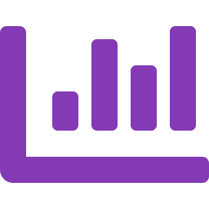





Project Objectives
What we aim to achieve through this analysis
Engagement Analysis
Retention Mapping
Campaign Targeting
Quantify user activity — posts, likes, comments — to identify patterns and power users.
Segment loyal vs. inactive users and define data-backed retention strategies.
Identify top hashtags, peak activity hours, and content types to optimise ad delivery.
Content Strategy
Acquisition Growth
Actionable Insights
Surface the content topics that drive highest organic engagement and guide creator programs.
Use follower/following trends and viral content signals to attract new users.
Translate every SQL finding into a concrete marketing recommendation.

Slide 4
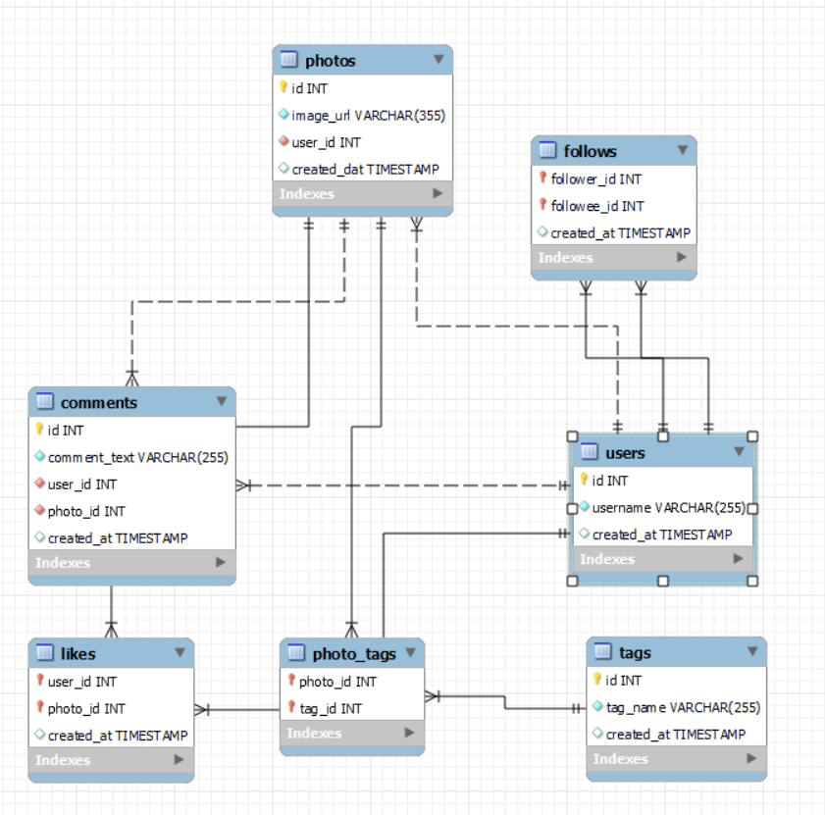
Data Overview – Schema & ERD
7-table relational dataset modelling core Instagram interactions
PHOTOS
id, image_url, user_id, created_at
TAGS
COMMENTS
id, tag_name, created_at
id, comment_text, user_id, photo_id
PHOTO_TAGS
FOLLOWS
photo_id, tag_id
follower_id, followee_id, created_at
USERS
LIKES
user_id, username, created_at
user_id, photo_id, created_at
Key Relationships
users → photos (1 : Many)
photos → comments (1 : Many)
photos → likes (1 : Many)
photos ↔ tags via photo_tags
users ↔ users via follows

Slide 5
Methodology
Analytical approach from raw data to actionable strategy
01
Data Cleaning
02
Exploratory SQL
03
Engagement Scoring
Checked for duplicates (ROW_NUMBER) and NULLs (WHERE IS NULL) across all 7 tables. Dataset was found clean — no duplicates or nulls.
Used CTEs, LEFT JOINs, GROUP BY, window functions (DENSE_RANK, RANK) to compute activity metrics per user.
Defined engagement = likes + comments + posts. Ranked users using RANK() & DENSE_RANK() to identify power and inactive users.
04
Hashtag Analysis
05
Temporal Analysis
06
Insights & Strategy
Computed average likes per hashtag using CTEs on photo_tags & tags tables; ranked top-10 by engagement.
Extracted posting hour from timestamps to find peak engagement windows. 7 PM identified as the highest-engagement hour.
Translated SQL outputs into targeted marketing recommendations covering content, ads, retention, and acquisition.

Slide 6

How Active Are Users Across the Platform?
OBJECTIVE QUESTION 1
Approach & Reasoning
Query Logic:
LEFT JOINs across users → photos, likes, comments tables to include all users, even inactive ones.
COUNT(DISTINCT) per metric to avoid double-counting.
Key Insight:
A small cohort of power users drives the majority of all platform activity — classic Pareto distribution.
Top 10% users generate ~60% of all posts & engagement
40% of users show little-to-no activity — ripe for re-engagement

Slide 7

Who Are the Highest-Engagement Users?
OBJECTIVE QUESTION 2
Approach & Reasoning
Query Logic:
Multiple CTEs computed total likes received and total comments received per user.
Combined via INNER JOIN on username, then summed to get Engagement Rate.
Ranked top 20 using DENSE_RANK() in descending order.
Key Insight:
Top 20 users show engagement rates 4–6× the platform average, making them ideal ambassador candidates.
63
1720
4–6×
Avg Engagement
Top User Score
Top 20 Users

Slide 8

Which Hashtags Drive the Most Likes?
OBJECTIVE QUESTION 3
Approach & Reasoning
Query Logic:
CTE (Likes_Count) computes total likes per photo_id.
Main query joins tags → photo_tags → Likes_Count, groups by tag_name, computes AVG(likes).
Results sorted descending by Avg_likes to surface top hashtags.
Key Insight:
Beauty, Delicious, and Foodie dominate — content aligned to these themes will maximise organic reach.
Top 3 themes — Beauty · Food · Photography — account for the highest average engagement.
Focus ad creative and influencer briefs around these content pillars.

Slide 9




Who Are Our Most Loyal & Valuable Users?
SUBJECTIVE QUESTION 1
Reward & Incentive Strategies
Approach
Multiple CTEs computed likes, comments, posts, photo tags, followers,
& followings per user. Engagement score = likes + comments + posts.
RANK() in DESC order identifies top users.
Custom Badges
Early Feature Access
"Top Creator" & "Power User" badges for public recognition
Analytics dashboards & scheduling tools for top users
Exclusive Events
Discounts & Credits
Virtual/in-person networking events for top performers
Platform credits & partner discounts to reward loyalty

Slide 10




How Do We Re-engage Inactive Users?
SUBJECTIVE QUESTION 2
Re-engagement Strategies
Approach
Personalised Emails
Same engagement scoring as SQ1 but ranked ASCENDING (RANK() ASC)
to surface lowest-engagement users. COALESCE() fills NULLs with 0.
Show missed popular content & tailored
recommendations based on past behaviour.
In-App Nudges
Milestone alerts (10 away from 100 followers)
to motivate return of inactive users
Gamification Challenges
Weekly posting streaks and contests
('Most Liked Photo') with small rewards.
Content Templates
Provide ready-to-post prompts and
re-onboarding guides for returning users.

Slide 11
When & What Content Drives Highest Engagement?
SUBJECTIVE QUESTION 3
Approach: Two CTEs (Likes, Comments) summed per photo_id; joined with photo posting timestamps. EXTRACT(HOUR) groups activity by hour to find peak windows. Avg engagement = (total likes + comments) / total posts per hour.
7 PM
Peak Engagement Hour
63
Max Avg Engagement Score
257
Posts Analysed

Slide 12






IMPROVEMENT RECOMMENDATION
Platform Improvement Roadmap
Actionable upgrades to close gaps, grow the platform, and future-proof engagement
Live Engagement Dashboard
Auto Re-engagement Triggers
Smart Hashtag Insights
Build a live dashboard surfacing hourly spikes, trending hashtags & top posts — enabling the team to react to viral moments in minutes.
ML-based inactivity detection (14-day silence) auto-fires personalised push/email sequences, scaling retention ops without manual effort.
Suggest top-performing hashtags at post creation using real-time tag-engagement data — lowering the barrier for new creators.
Analytics
Automation
Insights
Creator Tier Program
Optimal Posting Time Nudges
Content Diversity Expansion
Formalise Rising Star → Verified Creator → Brand Partner tiers with thresholds, unlocking perks, analytics tools & monetisation.
Alert users when peak engagement window nears (ex 'Followers most active in 30 min ready to post ?') to drive high-yield posting.
Add short-video & Reel-style formats to the photo-only platform. Diversified content increases time & attracts new segments.
Retention
Engagement
Product Growth

Slide 13




STRATEGIC RECOMMENDATION 1
Power-User Ambassador & Content Pillar Program
Based on OQ2 (Top Engagement Users) + SQ1 (Loyal User Identification)
Identify Top 5% Users
Content Pillar Alignment
Ambassador Programme
Use engagement scoring (likes + comments + posts) to extract the top 5% power users quarterly.
Align creator briefs to Beauty, Food & Photography — the three highest-performing content themes.
Offer power users exclusive badges, early access, and co-marketing opportunities in exchange for brand-aligned content.
Hashtag Injection Strategy
Sponsored Creator Boosts
Measure & Iterate
Pair branded hashtags (e.g., #MetaMoments) with top-performing organic tags (#beauty, #foodie) to drive discoverability.
Boost top-performing organic posts via paid promotion to extend reach beyond existing follower base.
Track engagement lift monthly; rotate ambassadors if engagement drops below 2× platform average.

Slide 14
STRATEGIC RECOMMENDATION 2
Two-Track Retention Engine: Reward & Re-engage
Based on SQ1 (Loyal Users) + SQ2 (Inactive Users) + OQ1 (Activity Distribution)
TRACK A · REWARD LOYAL USERS
TRACK B · RE-ENGAGE INACTIVE USERS
Quarterly engagement scoring to top 5% users
Segment zero-engagement users for targeted outreach
Tiered badges: Rising Star → Power User → Legend
Personalised re-engagement emails with curated content
Early access to new features & analytics tools
In-app milestone push notifications to nudge return
Partner discount cards & platform credit rewards
Gamified challenges: posting streaks & weekly contests
Exclusive invitation to Meta creator events
Simplified re-onboarding & ready-to-post templates

Slide 15
STRATEGIC RECOMMENDATION 3
Precision Ad Targeting: Right Content, Right Time
Based on OQ3 (Hashtag Performance) + SQ3 (Peak Hours) + OQ2 (Engagement Ranking)
Hashtag-Led Targeting
Peak-Hour Ad Scheduling
User-Generated Content Ads
Deploy ads alongside top-10 hashtags: #beauty, #foodie, #photography
Concentrate ad budget delivery between 6 PM – 8 PM (peak: 7 PM)
Repurpose top-performing organic posts as sponsored content
Pair branded tags with high-performing organic tags to maximise impressions
Avg engagement of 63 at 7 PM vs ~15
at off-peak hours — 4× ROI uplift
Leverage follow-back users (mutual followers) as social proof networks
Rotate creative quarterly based on updated hashtag performance data
Coordinate push notifications with ad delivery windows
Feature high-engagement creator content in Stories & Reels placements
Collaborate with micro-influencers
using these hashtags organically
A/B test creative variants at 7 PM vs 5 PM to validate timing lift
Track UGC ad performance vs generic creatives; shift budget to winners

Slide 16
Conclusion
From data to strategy — a roadmap for Instagram growth
Engagement is highly concentrated
Top 10% of users generate ~60% of platform activity. Identify, reward, and amplify this cohort as brand ambassadors.
40% of users need re-engagement
Targeted email, in-app nudges, and gamification can reactivate a large dormant user base — significant growth headroom.
Content themes are clear signals
Beauty, Food, and Photography dominate. Align all ad creatives and influencer briefs to these proven content pillars.
7 PM is the golden hour
Scheduling ads and notifications at peak engagement windows (6–8 PM) can deliver 4× better ROI vs off-peak delivery.
Meta · Instagram Clone · Social Media Analysis

