Slide 1

Machine Training with Reinforcement Learning
(Q-Learning & DQN)
By: Lakshay 23CSU178

Slide 2
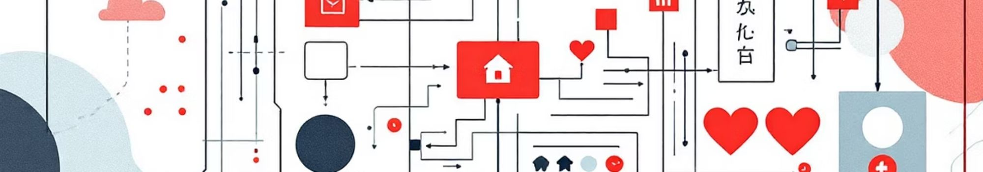

Introduction to Reinforcement Learning
RL Overview
Agent-Environment Interaction
Training Through Rewards
Reinforcement Learning is a paradigm where an agent learns to make decisions by performing actions in an environment to maximize cumulative reward.
The agent's goal is to learn an optimal policy—a mapping from states to actions—that yields the highest long-term reward. Positive rewards reinforce desired behaviors.
The core of RL involves an agent observing its state in an environment, taking an action, and receiving a reward and a new state. This feedback loop drives learning.

Slide 3

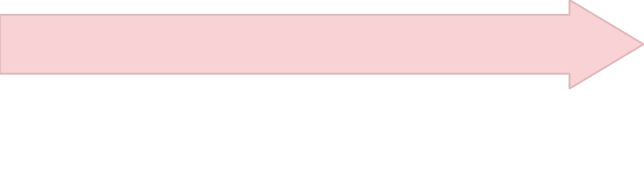

Project Objective: Training a Machine
This project aims to demonstrate and compare two fundamental reinforcement learning algorithms: Q-Learning and Deep Q-Networks (DQN), in a simulated environment.
Compare Learning Methods
Dataset-based Room States
Analyzing the performance and efficiency of Q-Learning versus DQN in achieving optimal behavior.
Train with Q-Learning & DQN
Utilizing a pre-generated dataset to define the environment's states, simulating various room configurations.
Implementing both algorithms to showcase their distinct learning mechanisms.

Slide 4


Dataset for Environment Simulation
To facilitate reproducible and consistent training, a custom dataset was generated to represent the environment.
Generated 5x5 Grid Environment: A discrete, grid-based world was created, offering a manageable state space for learning.
Contains Dirty/Clean Spots: Each cell in the grid can be either dirty or clean, presenting the agent with cleaning tasks.
Used for Training Episodes: This dataset provides a fixed set of initial conditions for each training episode, ensuring fairness in comparison.
State Representation: Each state captures the agent's position and the cleanliness status of all cells.

Slide 5




Environment Simulation Details
The simulated environment is crucial for observing the agent's learning process and evaluating its policy.
Grid Simulation in Python
Agent Movement
The environment logic was entirely implemented in Python, allowing for flexible state management and action execution.
The agent can move in four cardinal directions (Up, Down, Left, Right), one step at a time.
Reward for Cleaning
Cleaning Action
Cleaning a dirty spot yields a positive reward of +10, encouraging the agent to clean effectively.
If the agent is on a dirty spot, it can perform a "clean" action.

Slide 6

Q-Learning Approach
Q-Learning is a model-free reinforcement learning algorithm that finds the best action to take given the current state.
Uses Q-Table
Bellman Equation Updates
A Q-table stores state-action pair values, representing the expected future reward for taking an action in a given state.
Q-values are iteratively updated using the Bellman equation, which incorporates immediate rewards and discounted future rewards.
Epsilon-Greedy Exploration
The agent balances exploration (trying new actions) and exploitation (using known best actions) through an epsilon-greedy policy.

Slide 7
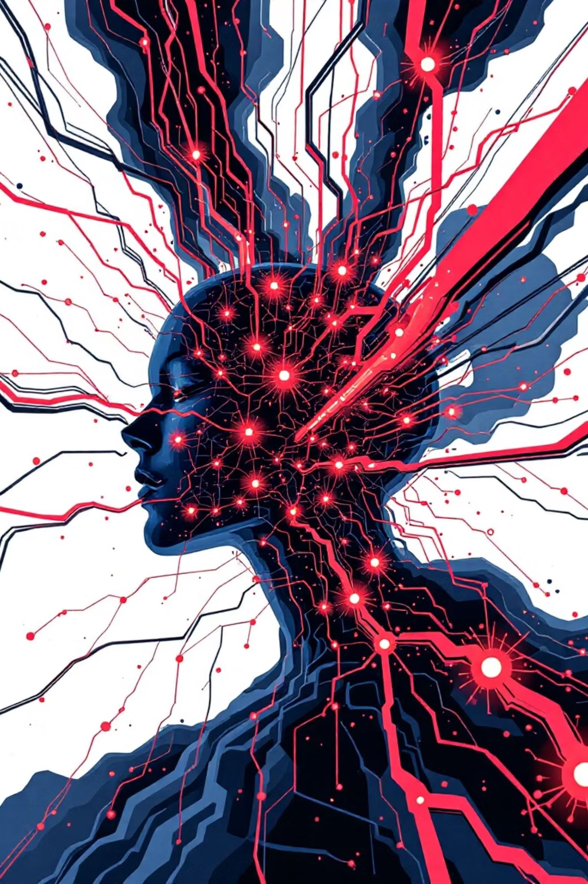
Deep Q-Network (DQN) Approach
DQN extends Q-Learning by using a neural network to approximate the Q-function, enabling it to handle larger state spaces.
Neural Network for Q-Values
Instead of a table, a deep neural network takes the state as input and outputs the Q-values for all possible actions.
Experience Replay
DQN uses a replay memory to store past experiences (state, action, reward, next state), which are then sampled randomly for training. This decorrelates successive samples.
Target Network
A separate target network, updated periodically, stabilizes the training process by providing consistent Q-targets.
Better Generalization
The neural network's ability to generalize allows DQN to perform well in environments with continuous or high-dimensional state spaces.

Slide 8
Performance Comparison: Q-Learning vs. DQN
A key aspect of this project is to analyze the performance differences between traditional Q-Learning and the more advanced DQN.
Scalability
Limited by state-action space size
Handles large, continuous state spaces
Memory Usage
High for large state spaces (Q-table)
Relatively lower, fixed replay memory
Learning Speed
Can be slow in complex environments
Often learns faster with good generalization
Generalization
Poor, needs to visit all state-action pairs
Good, generalizes from unseen states
While Q-Learning is simpler and effective for small, discrete environments, DQN's use of deep learning provides significant advantages for complex, real-world problems.

Slide 9
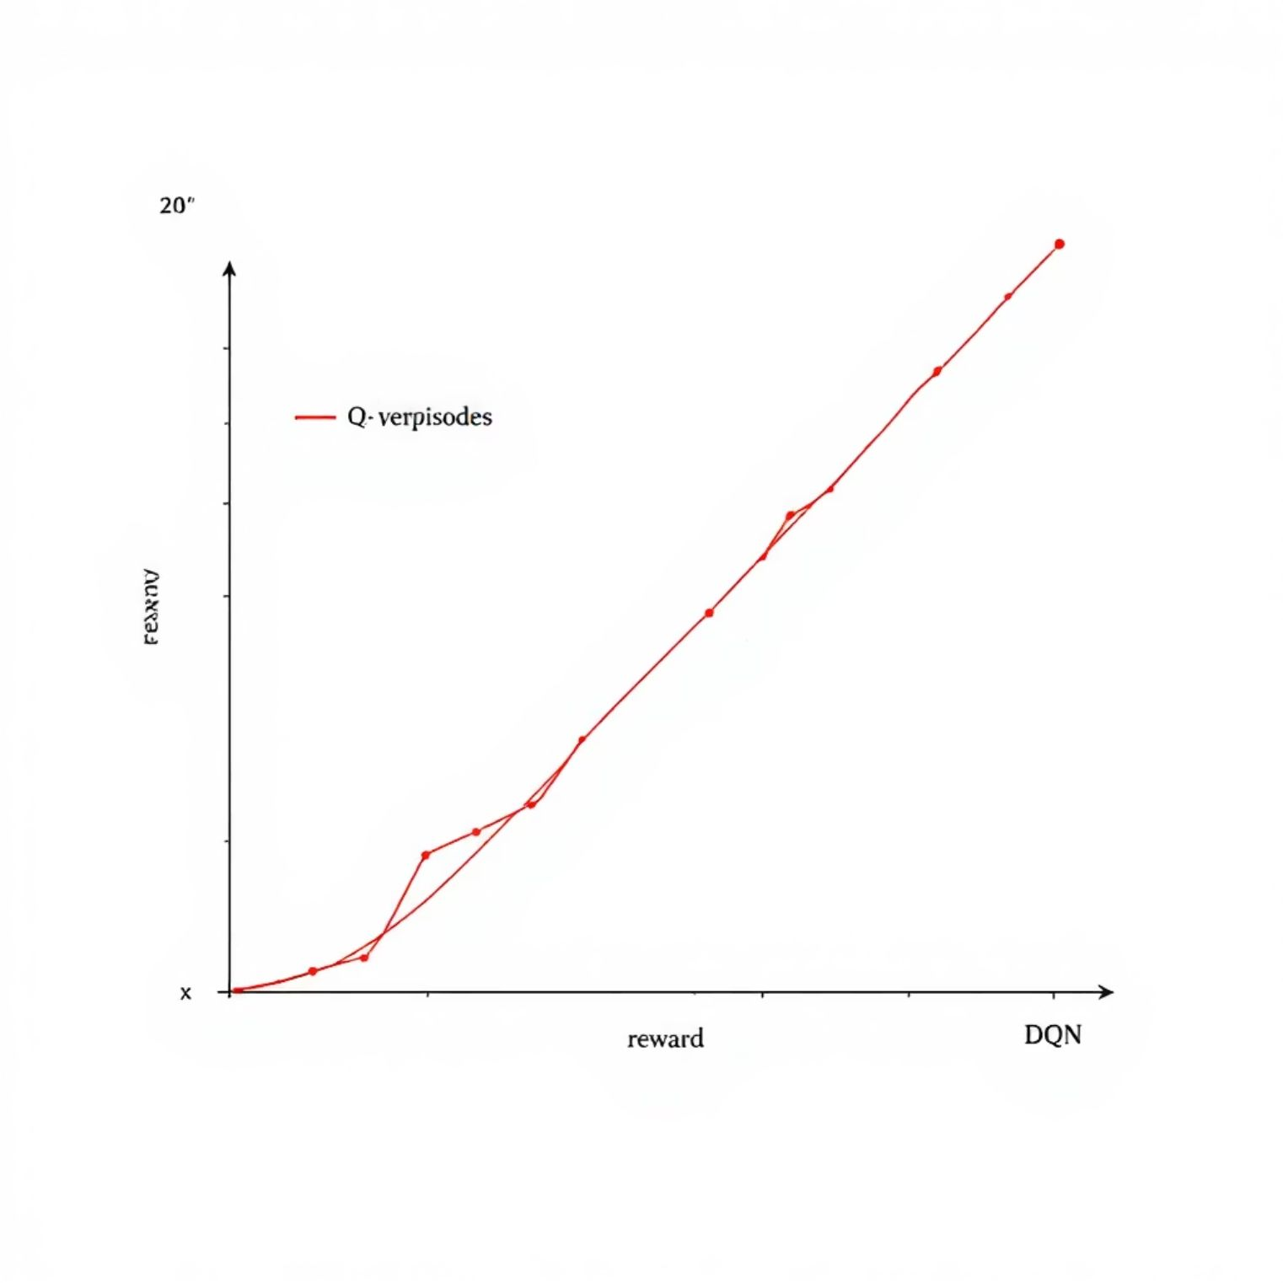
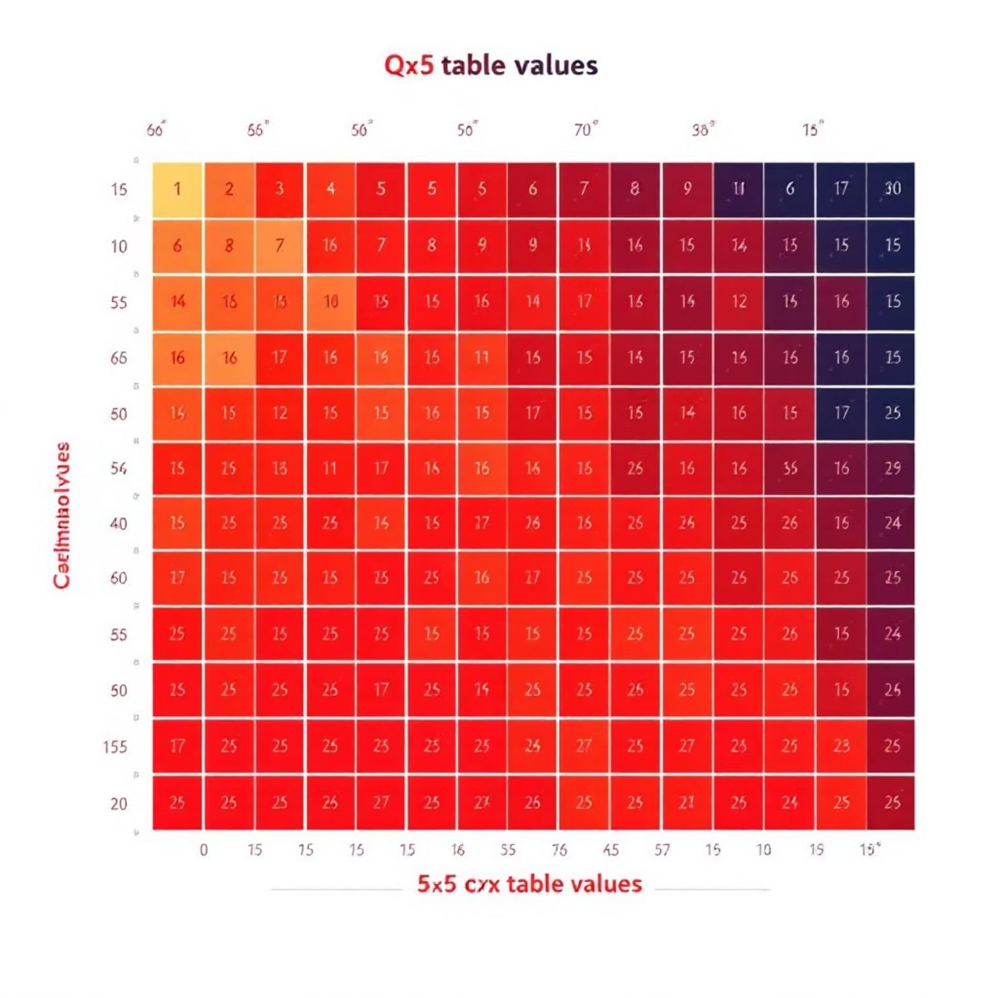
Analysis of Results and Visualizations
To thoroughly evaluate the performance, various metrics and visualizations were generated.
Reward Growth Curves
Plots showing the cumulative reward per episode, indicating the learning progress over time for both algorithms.
Smoothed Curves
Averaged reward curves to filter out noise and highlight underlying learning trends.
Episode Steps
Graphs illustrating the number of steps taken per episode, showcasing efficiency improvements as the agent learns.
Q-Table Heatmap
For Q-Learning, a visual representation of the learned Q-values, helping to understand the agent's policy directly.
The visualizations clearly demonstrate the superior learning capability and generalization of DQN in this environment.

Slide 10

Conclusion: DQN's Superiority and Future Work
This project successfully implemented and compared Q-Learning and DQN for machine training in a simulated environment.
DQN Performs Better
Our results unequivocally show that DQN achieved faster and more stable learning, particularly evident in its reward growth and efficiency.
RL Successfully Trained Machine
Both algorithms demonstrated the power of Reinforcement Learning in training an autonomous agent to perform tasks in a dynamic environment.
Dataset Improved Learning Diversity
The use of a varied dataset ensured that the agent learned a robust policy capable of handling diverse environmental configurations.
Future work could explore more complex environments, incorporate prioritized experience replay, or experiment with other advanced DQN variants.

