Slide 1
Table of Contents
Project Overview
Objectives
Dataset
Tools
Insights
Introduction
Recommendations

Slide 2
Project Overview
Project:
Motor Vehicle Theft
Conducted By:
Lakshay Murli

Slide 3

Introduction
This report presents an analysis of data on motor vehicle thefts from the New Zealand Police Department’s vehicle of interest database. The dataset covers a period of six months and each record represents a single stolen vehicle.

Slide 4
Objectives
Data cleaning - Optimizing data integrity through SQL, converting field types for accuracy, purging duplicates, and eliminating null values.
Data Retrieval - Crafting SQL queries for data retrieval and manipulation across relational database tables.
Data Exploration - Utilizing SQL queries to analyze database structures, detect patterns, and unveil intricate relationships.
Data Integration - Leveraging SQL queries to seamlessly merge data from diverse sources through join operations.
Statistical Analysis - Employing SQL queries for statistical analysis, including calculations of averages, counts, and total sums.
Visualization - Utilizing Power BI to visualize and present the insights derived from SQL queries in a dynamic and interactive manner.

Slide 5
Dataset
Make_details
stolen_vehicles
location
Number of Tables:
3

Slide 6
Tools
SQL and Power BI
Data Visualization and Dynamic Dashboard
MS Powerpoint
Presentation and Insights
MS Power Query and SQL
Data Cleaning and Preparation
SQL and DAX
Calculated Columns and Measures

Slide 7
Insights

Slide 8
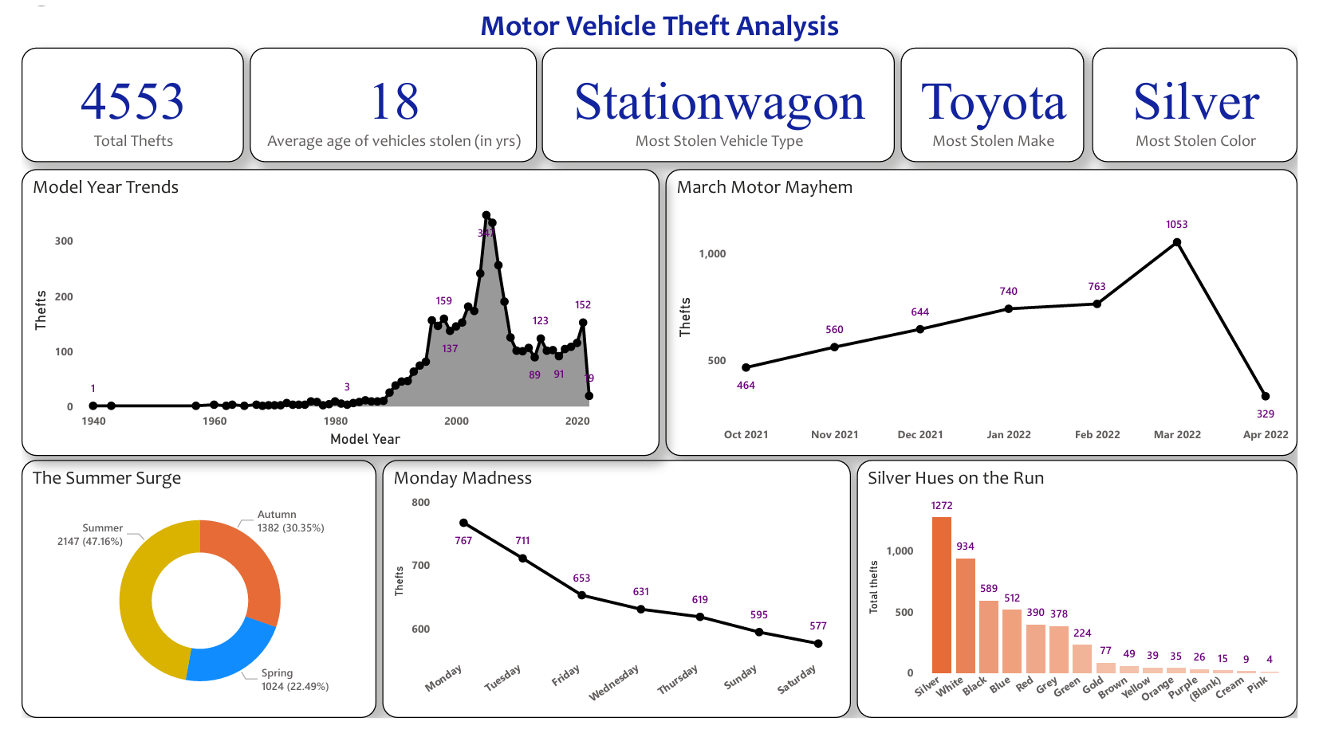

Slide 9
Insights
From Oct ‘21 to Apr ’22, New Zealand saw 4,553 vehicle thefts, peaking at 1,053 in March – which is approximately around 33 per day!! The surge in March may be linked to events drawing crowds, creating opportunities for thieves.
Summer and autumn witness increased thefts. Tourist activity, including car rentals, contributes to this surge. Station wagons are often stolen during these seasons, coinciding with camping and outdoor activities.
Across all days of the week, Mondays see the most thefts as compared to other days ; Saturdays being the least.

Slide 10
Insights Cont’d
Vehicle thefts were low for older car models, with occasional fluctuations. Thefts increased steadily from 1988 to 2005, possibly because older models lack modern security measures like GPS tracking. Vehicle thefts decreased since 2006, reflecting improved security technology and community policing. However, a recent uptick from 2018 to 2022 may be influenced by changing economic conditions.
Silver cars are favored by thieves, possibly because silver is common, making stolen vehicles less conspicuous and memorable.

Slide 11
Recommendations

Slide 12
Recommendations
The analysis of vehicle thefts in New Zealand has highlighted distinct patterns, with theft rates influenced by seasons and regional preferences.
To address this:
Enhance vigilance during peak theft periods such as holidays and weekdays, with increased patrols, public awareness campaigns and community watch programs.
Law enforcement agencies should adapt their strategies to combat thefts on weekdays and holidays, allocating resources more effectively.

Slide 13
Recommendations Cont’d
Engage communities in crime prevention initiatives, such as neighbourhood watch programs, encouraging the reporting of suspicious activities, and promoting vehicle security awareness.
Promote secure practices for tourists, especially during peak theft seasons, providing information on secure parking, and general safety tips.

Slide 14
Thank You

