Slide 1
Table of Contents
Project Overview
Objectives
Dataset
Tools
Insights
Introduction
Recommendations

Slide 2
Project Overview
Project:
Global CO2 emissions
(For Visualization: Click Here)
Conducted By:
Lakshay Murli

Slide 3
Introduction
In this Tableau project, we delve into the dynamics of CO2 emissions worldwide, aiming to understand their trends and drivers. By analyzing historical data dating back to 1700, we explore the correlation between CO2 emissions, population, GDP, and other key factors. Through interactive visualizations, we seek to gain insights into the evolving relationship between human activities and environmental sustainability on a global scale.

Slide 4
Objectives
Data Exploration - Utilizing Tableau to explore the structure, patterns, and relationships among measures and dimensions within the dataset.
Statistical Analysis - Leveraging Tableau's calculated fields to perform statistical analysis, including calculations of averages, counts, and total sums.
Visualization - Employing Tableau to visualize data, uncover trends and patterns, and analyze future goals.

Slide 5
Dataset
Number of Tables:
1
Co2_N _Emmissions

Slide 6
Tools
Tableau
Data Visualization and Dynamic Dashboard
Calculated Columns and Measures
MS Powerpoint
Presentation and Insights
MS Excel
Data Cleaning and Preparation

Slide 7
Insights

Slide 8
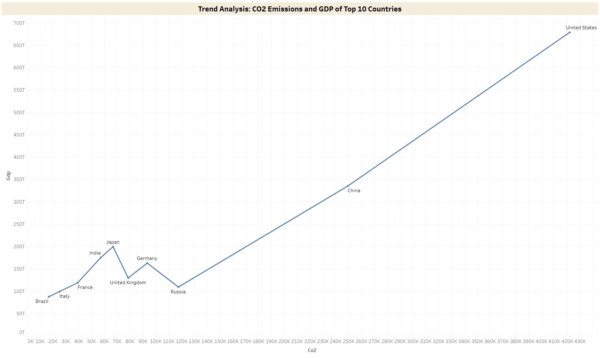
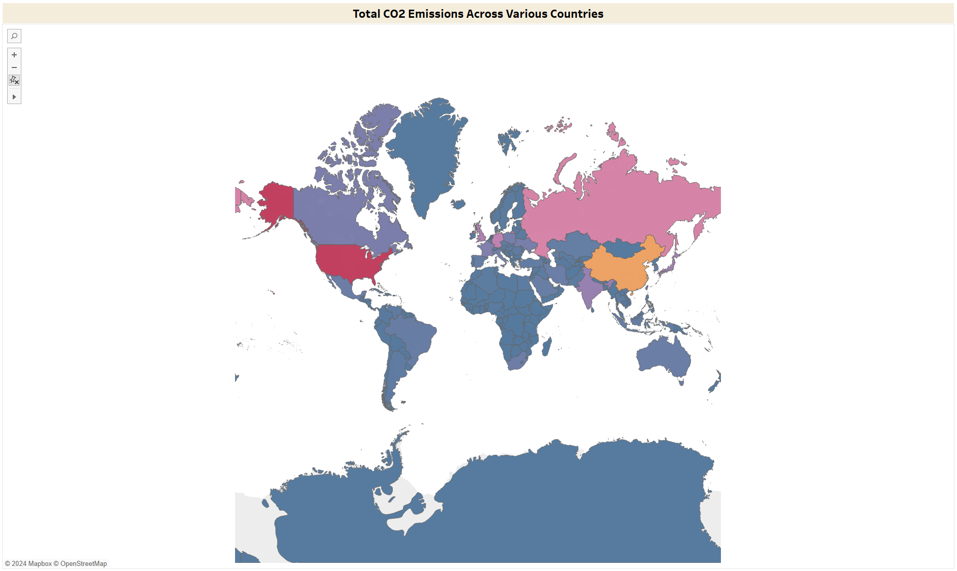
Total CO2 Emissions Across Various Countries
This visual analyzes the total CO2 emissions in every country worldwide. Over the period from 1750 to 2021, the USA ranks first in total CO2 emissions, followed by China, Russia, Germany, the UK, and India in sixth position. However, examining the trend for the last decade reveals that China surpasses the USA for the top position, driven by its industrial revolution. Additionally, India moves up to third position from sixth. The visual indicates that CO2 emissions in India began to increase significantly around 1995. This rise is attributed to the country's increasing per capita income, rising population, and shifts in energy consumption patterns.

Slide 9
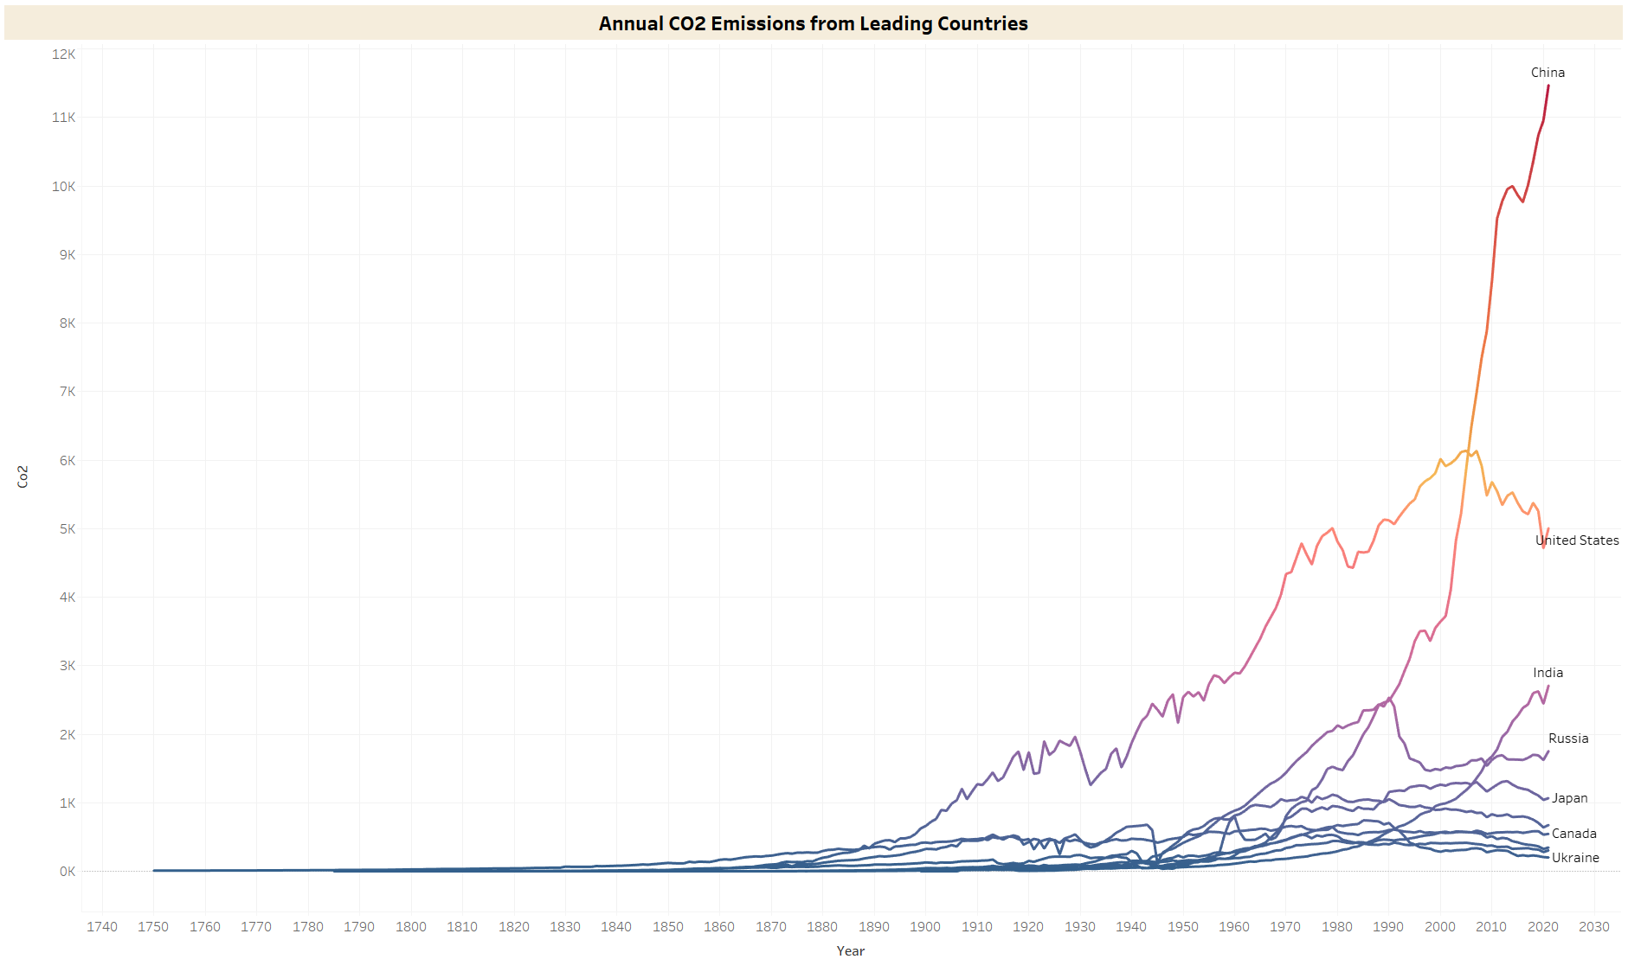
Annual CO2 Emissions from Leading Countries
This visual depicts the trend of CO2 emissions from the 1700s to 2021 for the top 10 countries. It reveals that China currently leads in CO2 emissions, followed by the USA and India. Notably, CO2 emissions in China were minimal until the 1900s due to a delayed industrial revolution. Until 2005, the USA held the top position in CO2 emissions. The sudden surge in CO2 emissions in China may be attributed to factors such as urbanization and increased household wealth.
Another analysis highlights the United Kingdom as the sole country with CO2 emissions dating back to the 1700s. This longevity in emissions is attributed to the Industrial Revolution, which commenced in the UK during the mid-1700s, establishing it as the earliest contributor to CO2 emissions globally.

Slide 10
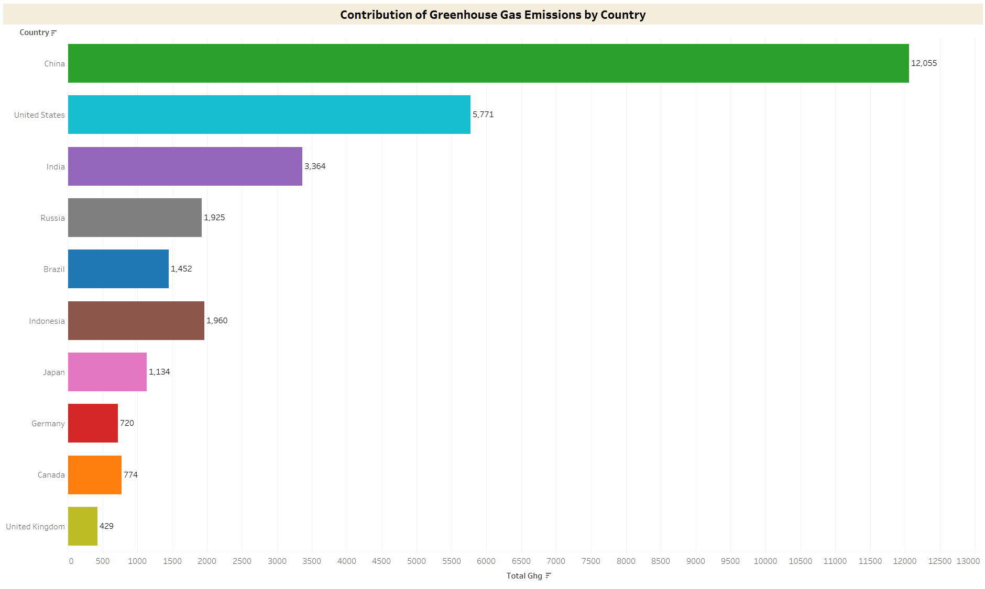
Contribution of Greenhouse Gas Emissions By Country
This visual analyzes the country-wise contribution of total greenhouse gases, including nitrous oxide, methane, CO2, and other gases, for the top 10 countries over the last 10 years. It reveals that China has consistently been the leading greenhouse gas-producing country, followed by the USA and India. However, Brazil's position has improved over the years. In 2010, Brazil ranked fourth, but it has since reduced its emissions and moved down to sixth position. This improvement is attributed to Brazil's commitment to cut emissions by 43% by 2030 compared to 2005 levels, achieved through measures such as controlling deforestation and capping emissions. Meanwhile, China and India have experienced continuous increases in emissions. The USA has maintained relatively stable emissions, hovering around 5,700 over the past decade.

Slide 11
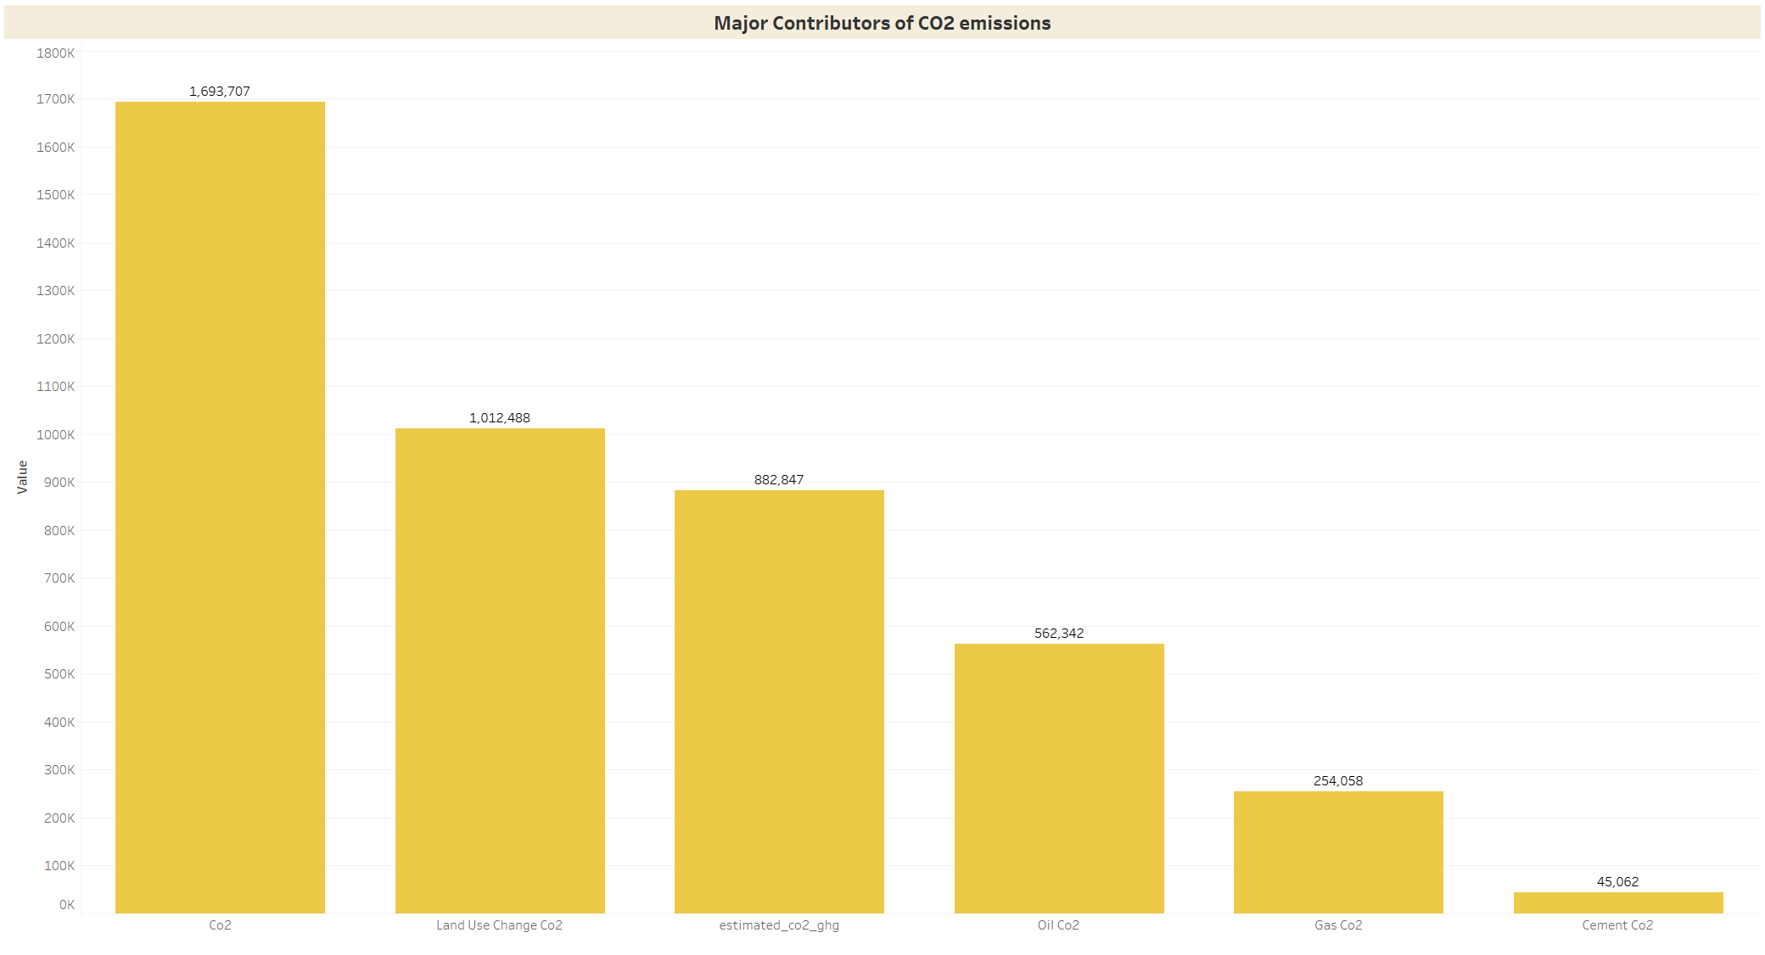
Major Contributors of CO2 emissions
This visual examines the contribution of CO2 emissions from various factors such as land use change, oil, cement, etc. It indicates that the largest contribution to total CO2 emissions worldwide, amounting to 1,012,488 arises from changes in land use, encompassing activities such as mining and deforestation. This is primarily attributed to the industrial revolution and increasing urbanization, leading developed countries to clear forests, making it a significant factor in CO2 emissions. Conversely, the smallest contributing factor is cement, accounting for 45,062 emissions.

Slide 12
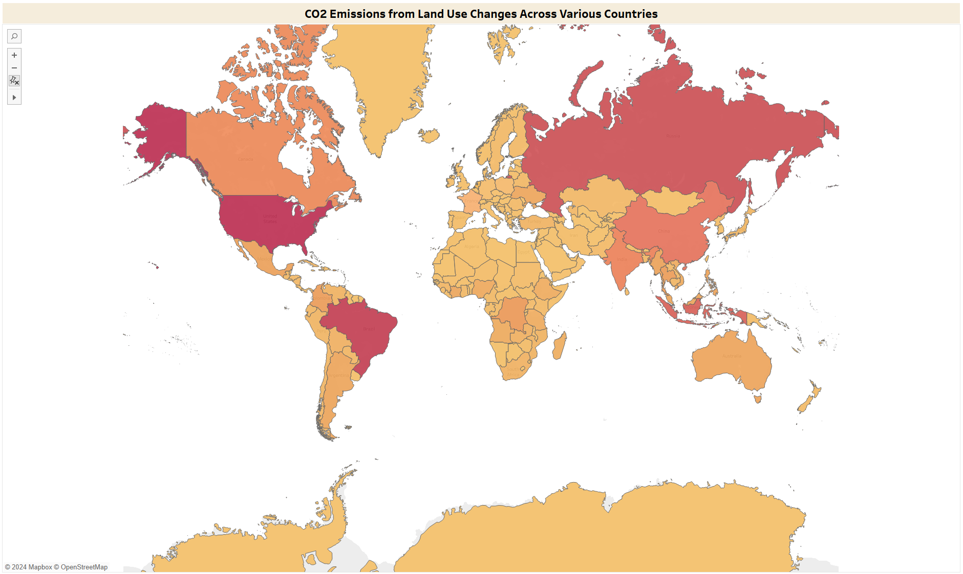
CO2 Emissions from Land Use Changes Across Various Countries
In this visual, the analysis focuses on CO2 emissions attributed to land use change, a leading cause of CO2 emissions. From the 1700s to the present day, the USA emerges as the leading country in CO2 emissions from land use change, followed by Brazil, Russia, Indonesia, China, and India. In the USA and Brazil, deforestation is the primary contributor to CO2 emissions. In the USA, deforestation is driven by urbanization and infrastructure development, while in Brazil, it is primarily due to clearing land for agriculture and livestock. However, both countries have made significant efforts to manage their CO2 emissions in recent years. Over the past decade, all these countries have shown impressive improvements. Notably, the USA has experienced a significant decline in deforestation cases, possibly attributed to the net growth of forests, including urban trees, which remove carbon from the atmosphere.

Slide 13
Trend Analysis: CO2 Emissions and GDP of Top 10 Countries
The visual examines the trend of CO2 emissions with GDP in the top 10 countries. Since the industrial age, fossil fuels have played a pivotal role in driving economic development, powering various sectors such as electricity generation, transportation, and industrial activities. Consequently, economic growth has been closely associated with an increase in greenhouse gas emissions, including CO2. This correlation is evident in the linear trend observed between CO2 emissions and GDP. Countries with higher GDP, such as the USA, China, and Russia, exhibit higher CO2 emissions. However, analyzing data from 2010 onwards reveals interesting insights. Despite having a lower GDP than the USA, China demonstrates significantly higher CO2 emissions. India emerges as the third-highest emitter in terms of both GDP and CO2 emissions.

Slide 14
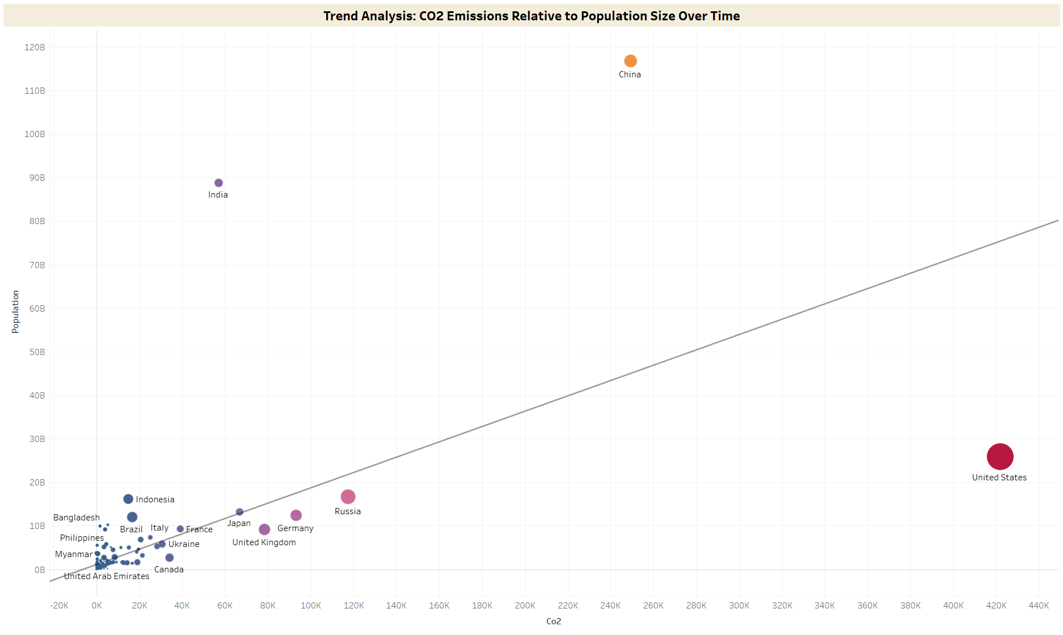
Trend Analysis: CO2 Emissions Relative to Population Size Over Time
In this visual, the trend of CO2 emissions is analyzed in relation to the population of countries and the impact of CO2 emissions on their temperature. While there is a significant linear relationship between population and CO2 emissions, driven by increased demands and associated factors, the top three countries—USA, China, and India—deviate from this linearity. Despite being less populated, the USA exhibits high CO2 emissions attributable to its industrial revolution. Additionally, bubble size represents the impact of CO2 emissions on temperature, with larger bubbles indicating a higher change in temperature due to CO2. Here, the USA experiences the greatest impact on temperature due to CO2, followed by China. Furthermore, discrepancies are observed, as countries with lower CO2 emissions than India, such as Russia, the UK, Brazil, Indonesia, and France, demonstrate higher temperature changes due to CO2. This suggests a lack of a specific relationship between temperature change and CO2 emissions.

Slide 15
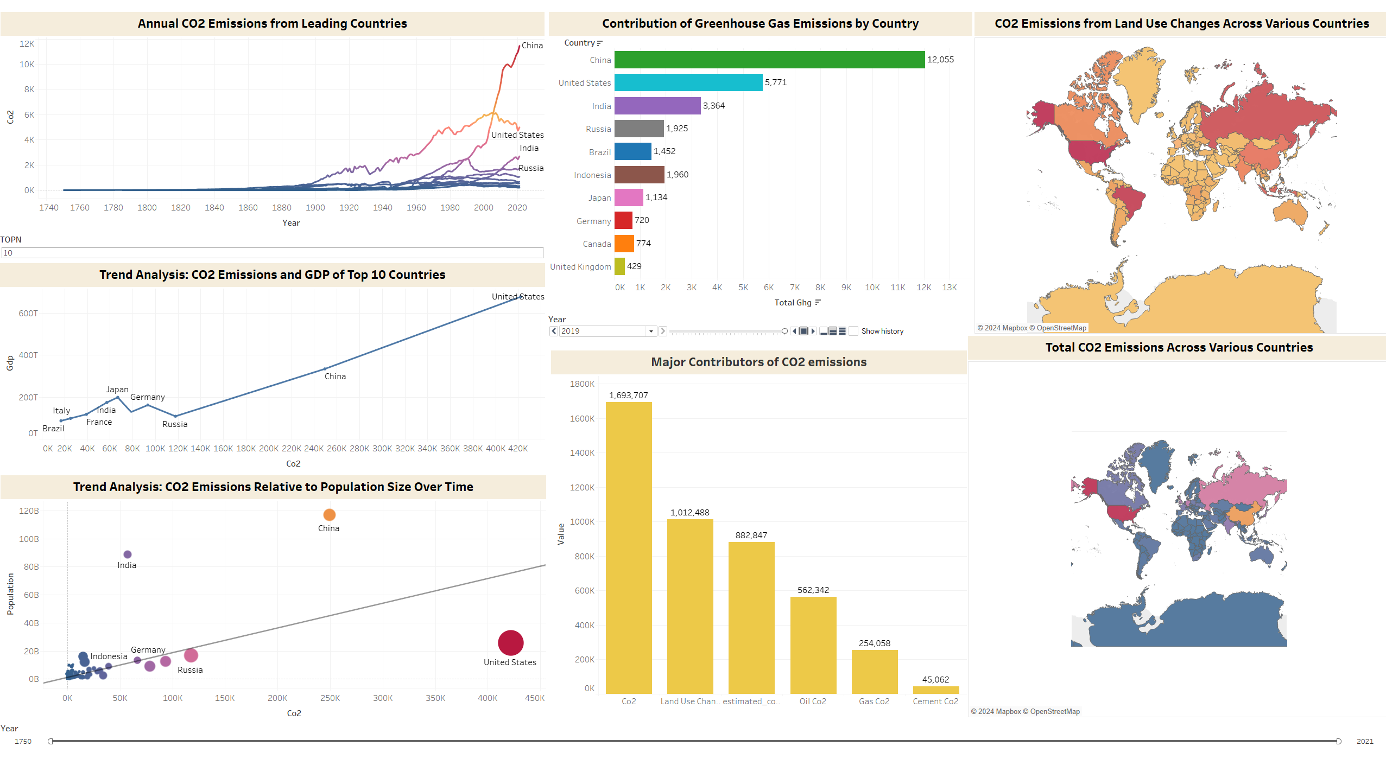
Dashboard

Slide 16
Recommendations

Slide 17
Recommendations
To effectively address global CO2 emissions, our primary focus should be on developed countries, particularly those heavily impacted by industrialization and urbanization.
Countries such as the USA, China, Russia, and India are key targets for mitigation efforts. With the advent of modern technologies, CO2 emissions continue to rise, making it imperative that we take proactive measures to curb emissions.
One of the main areas of focus should be land use change, as it is a major contributor to CO2 emissions. Deforestation, in particular, must be addressed globally, and efforts should be made to plant trees and restore ecosystems wherever possible.

Slide 18
Recommendations Cont’d
Furthermore, population control is essential in tackling CO2 emissions. There is a notable correlation between population growth and CO2 emissions, with increasing populations leading to greater demands, land use changes, and industrial activities. Therefore, it is crucial to implement measures to control population growth, especially in countries like China and India, where population growth rates are significant.
By addressing these key areas, we can take significant steps towards reducing global CO2 emissions and mitigating the impacts of climate change.

Slide 19
Thank You

