Slide 1
Technova
All electronics

Slide 2
Name :- Lakshay Tanwar roll no :- 2110991981 Group :-G5 subject teacher :-Lovish Arora sir

Slide 3
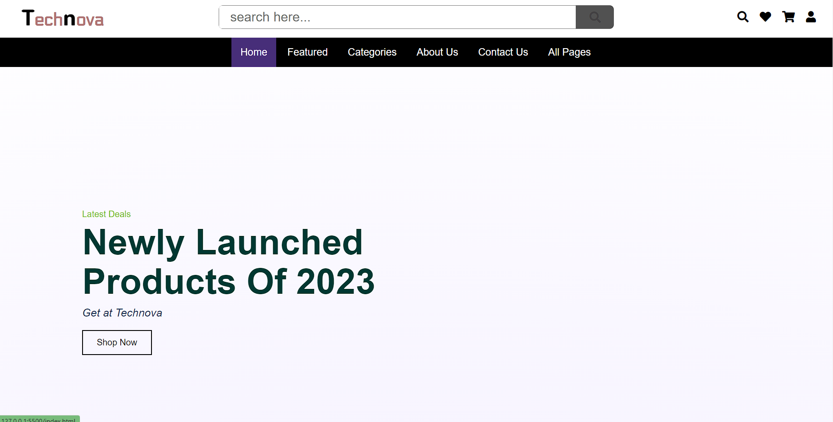
All electronic shop

Slide 4
What do our website do?
Our Website is desine for all your electronic product need with it you can choose all your heart content item you call get it at your house we also have local branches which can be seen in our website hope you enjoy it.

Slide 5
Types
1. mobile phone
2. Televison
3.refrigerator
4.washing mashine
5 kitchen product
6 home product

Slide 6
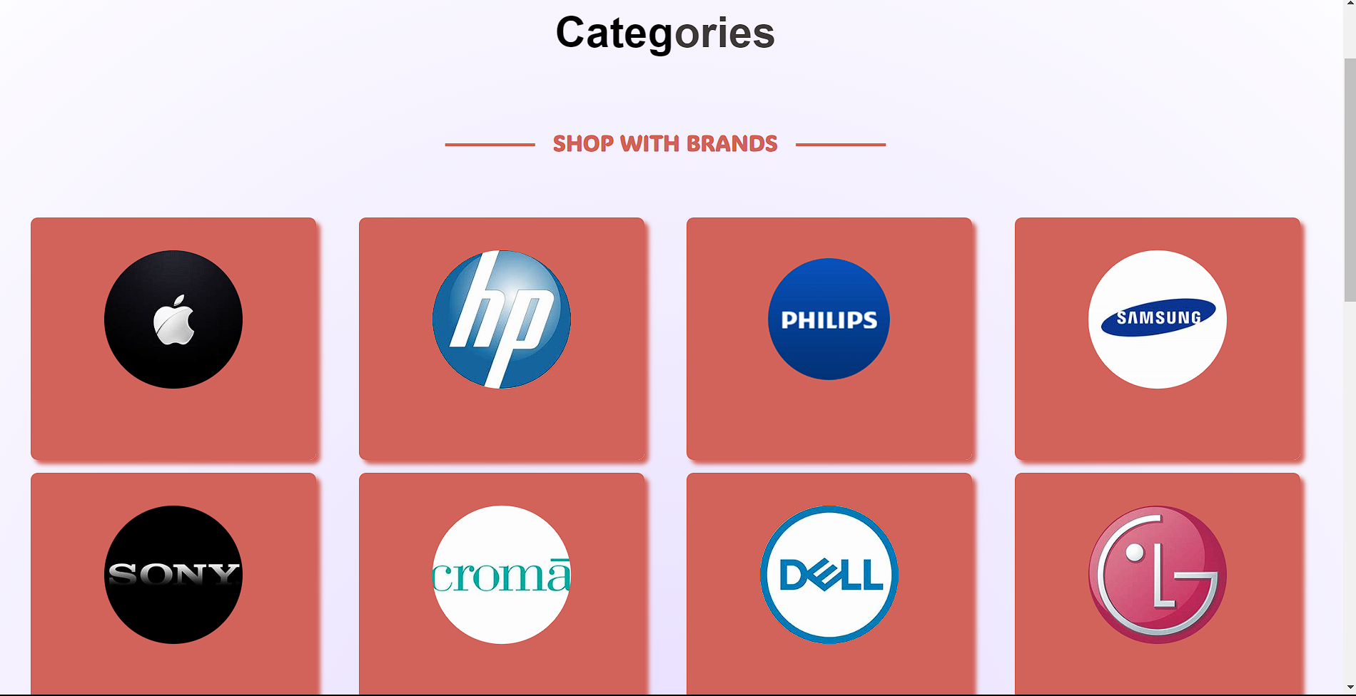
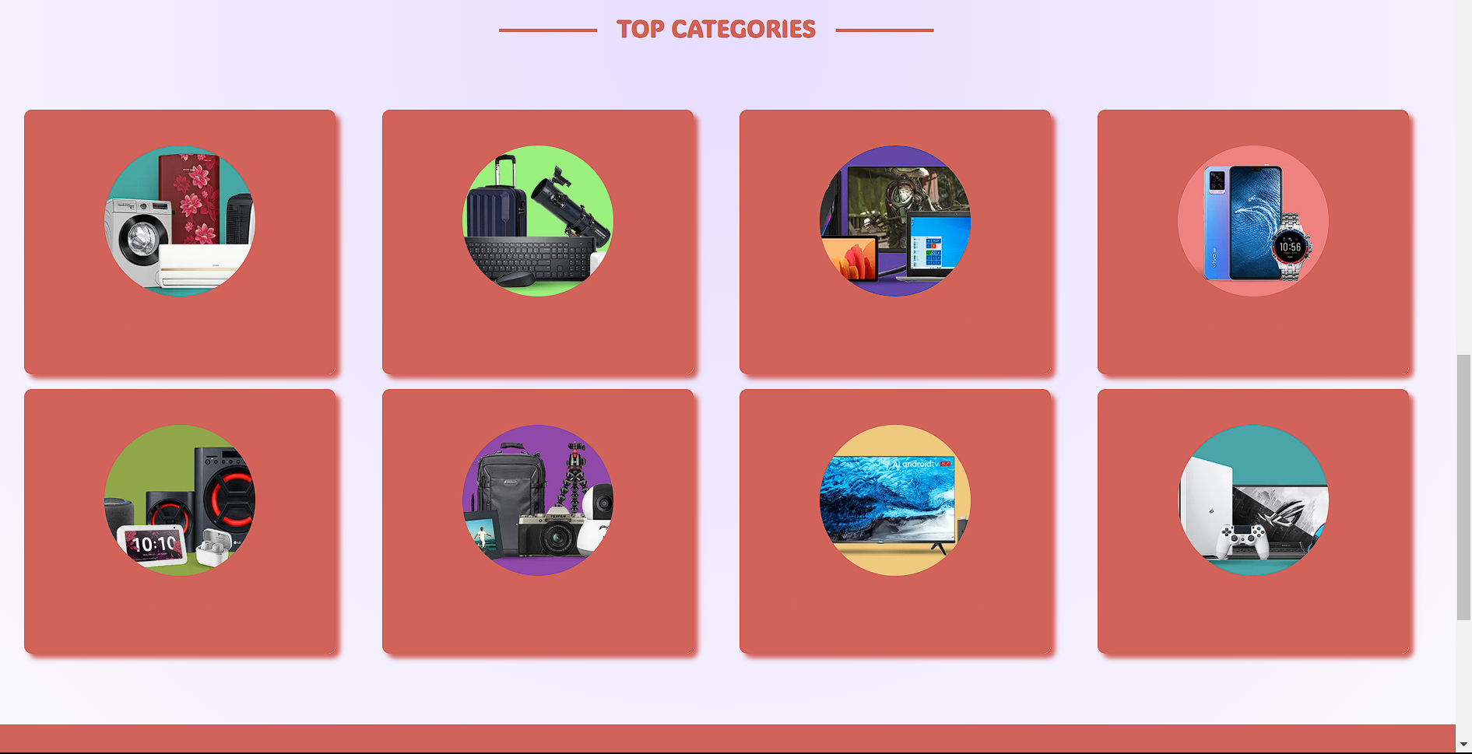
Chossing Option
We have collab with may brand you can choose which one you here all the product you need
We also have different typr of product which can help you choose beeter any type of prodct aviable here

Slide 7
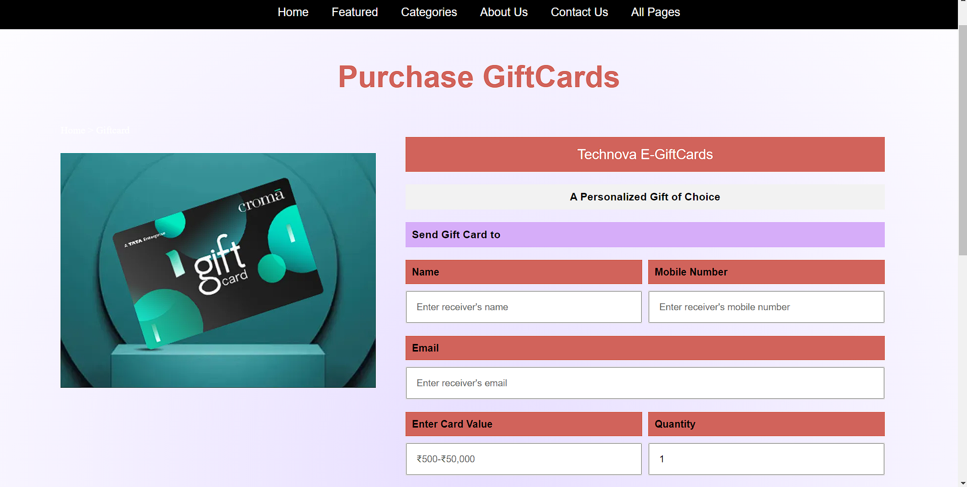
Gift card
We also provide with gift card which can which can help your friend or family

Slide 8
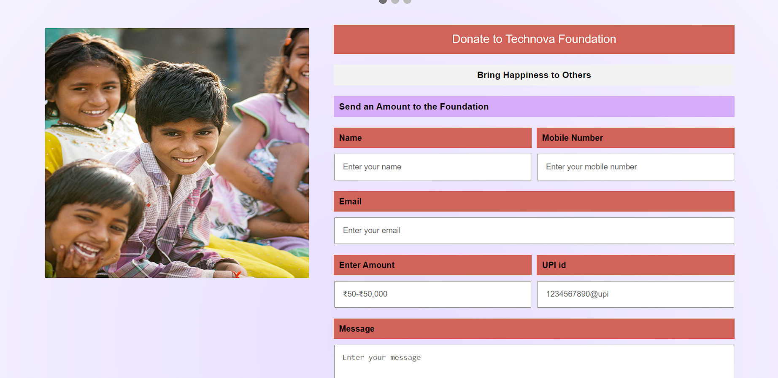
Foundation
In today time many leading company are onening foundion which can help poor peephole we also started foundation

Slide 9
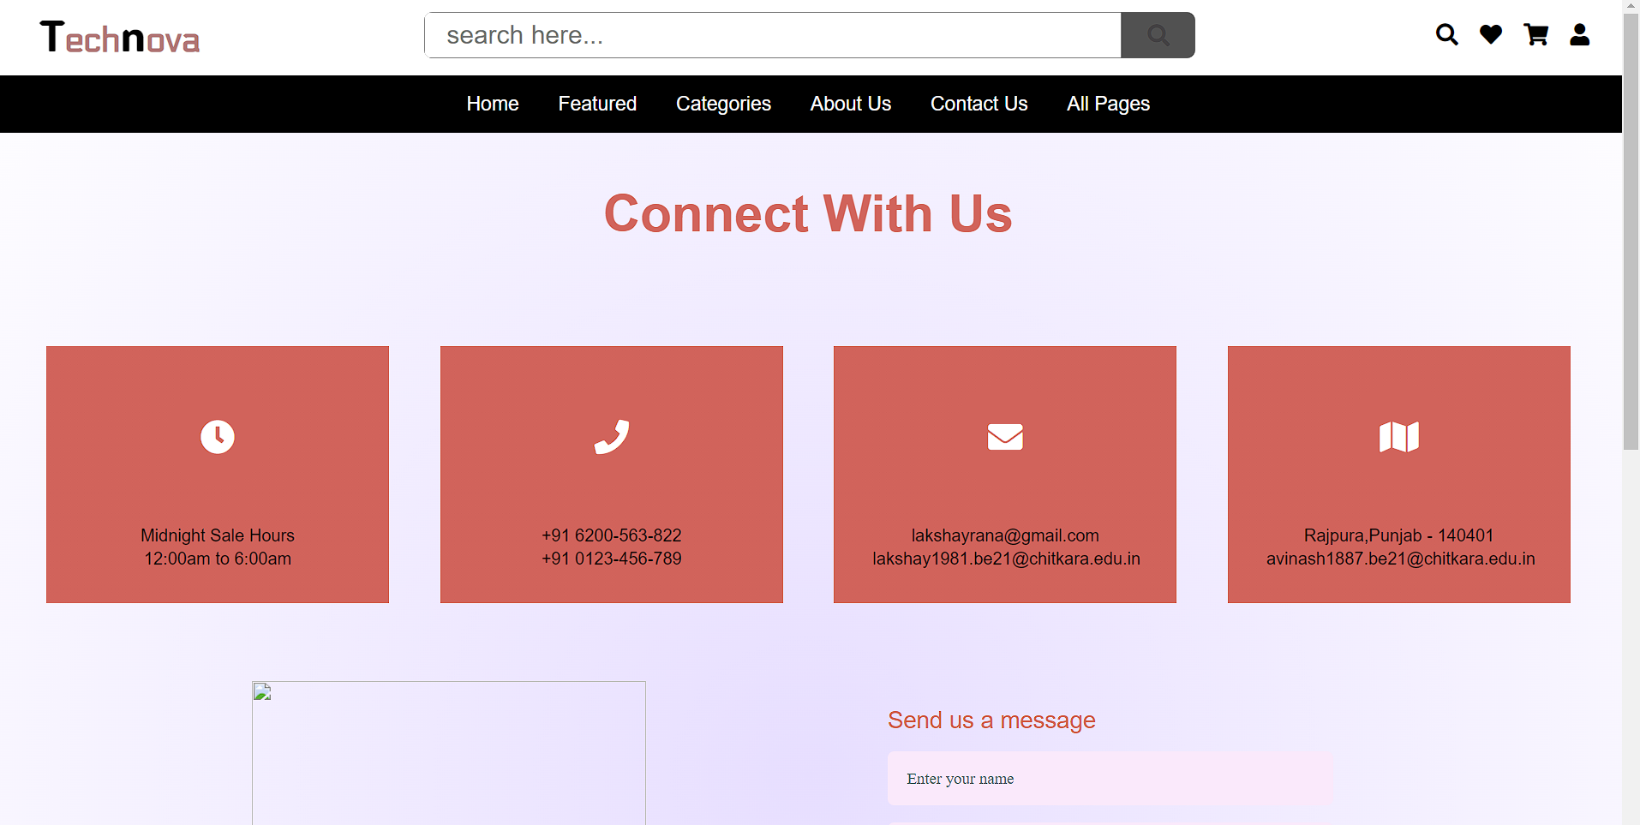
Costmer care
we are giving 24/7 custmor care support with this you can contact with us faster

Slide 10
Why choose us ?
We are beeter in every aspect to any other company we provide fast dilviry we have evry brand partenership with us so you can choose all product you need.

Slide 11
--ThankYou--

