Slide 1

ISCG 7424 Mobile Software Development Semester 1, 2020 Team Project
Parcel Tracker
Track your parcels here
Abdullah Raza
1502734
Lakshay Sethi
1487100
Wandan Li
1525797

Slide 2
Introduction
We have selected the Parcel Track app. We want to develop this app which facilitates precise package tracking as online shopping is taking off these days and delivery services are a key part of daily life. This app increases the users experience and makings tracking their packages extremely convenient.

Slide 3

Use Case Diagram
Generate Delivery
Receive Message
Send Message
Administrator
Assign Delivery
Driver
Receiver
Track Delivery

Slide 4
Use Case Scenarios
Every morning, the administrator will get a list of un-assigned deliveries from the database by clicking the “Generate” button in the app. He selects a few of deliveries the destination are in the same area and enter the driver’s name in the alert dialog after he clicks on the “Assign” button. He confirms and the app will go back to the deliveries list, he can assign other deliveries to other driver.
After the administrator assigned the deliveries will be displayed in the driver’s app. The driver click on the delivery card, will send a message to the receiver to tell him how long the parcel will be arrived.
After the driver send the message, the receiver can receive the message and can see the delivery in his app. He can click on the card and a google map will be displayed and show where is the parcel.

Slide 5
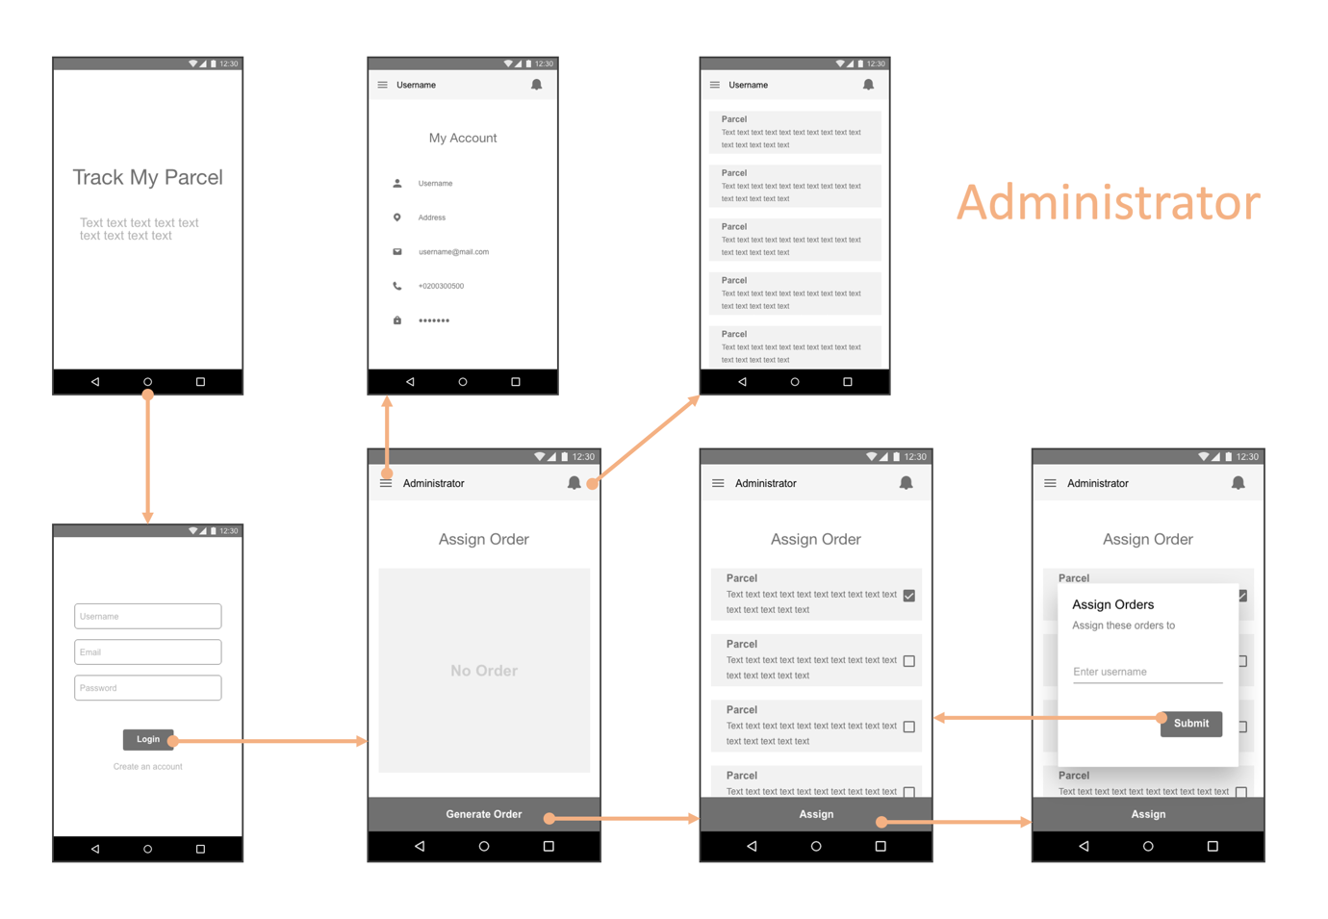
Wireframes - Administrator

Slide 6
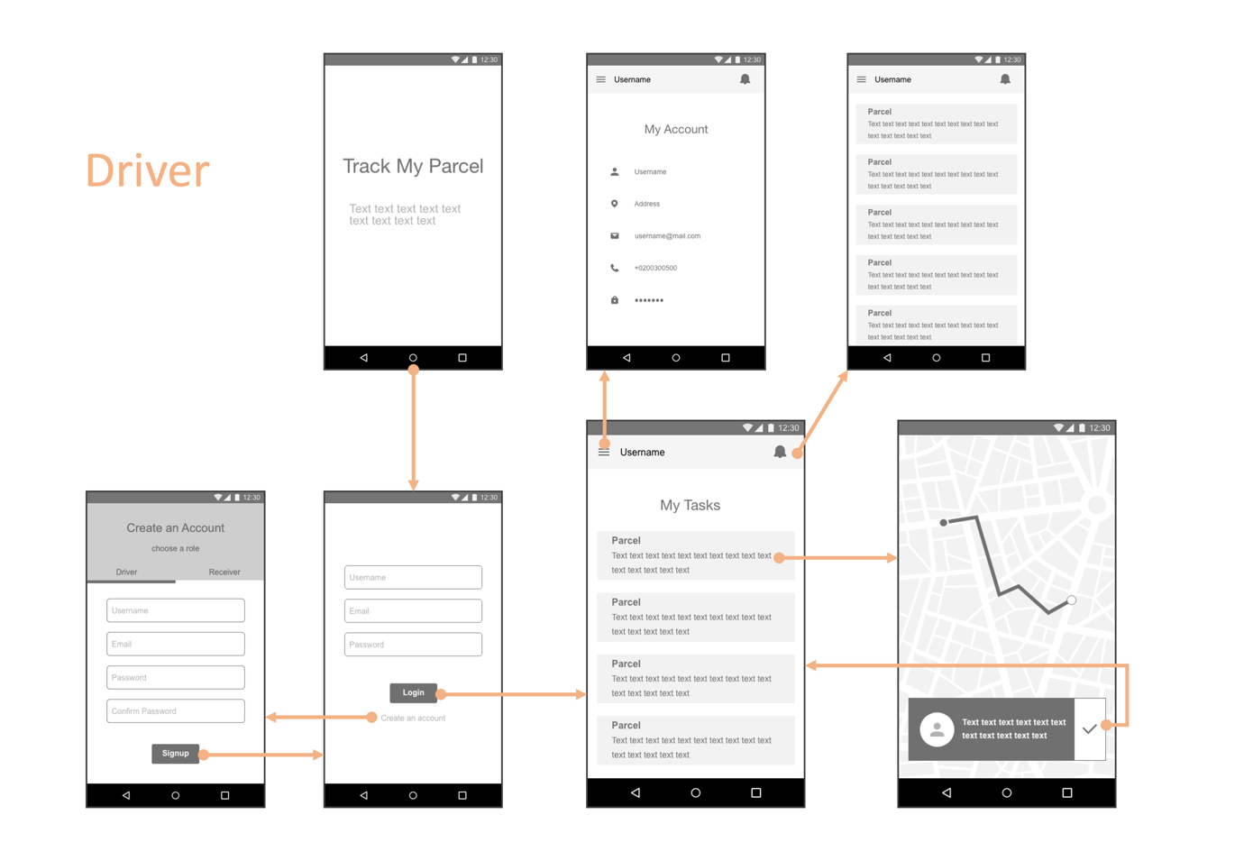
Wireframes - Driver

Slide 7
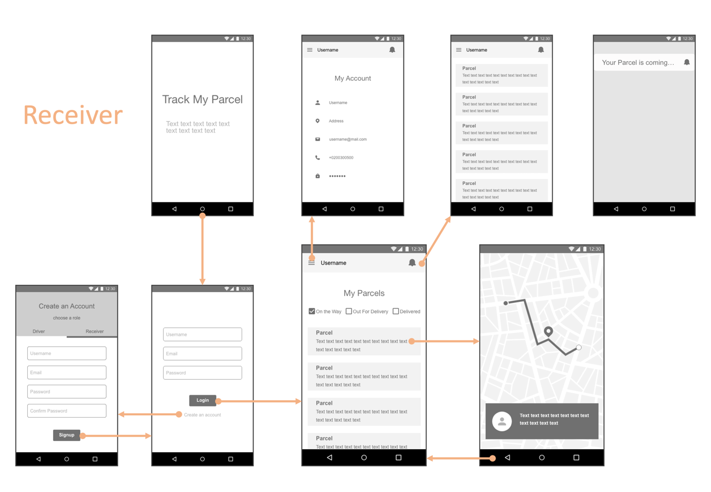
Wireframes - Receiver

Slide 8
Architectural Design
Firebase
User
Android Studio
Java
Firebase Store
Google Map
GPS Sensor
Internet

Slide 9

Project Highlights
Object Orientated Design
Multiple Activities with appropriate navigation
Store/Retrieval of Information
Recycle View
Sensor: GPS
Firebase
Firestore as instant messaging
Google Map
Login (+ using Gmail)
Signup
Radom generate data
Unit Test
Version Control

Slide 10
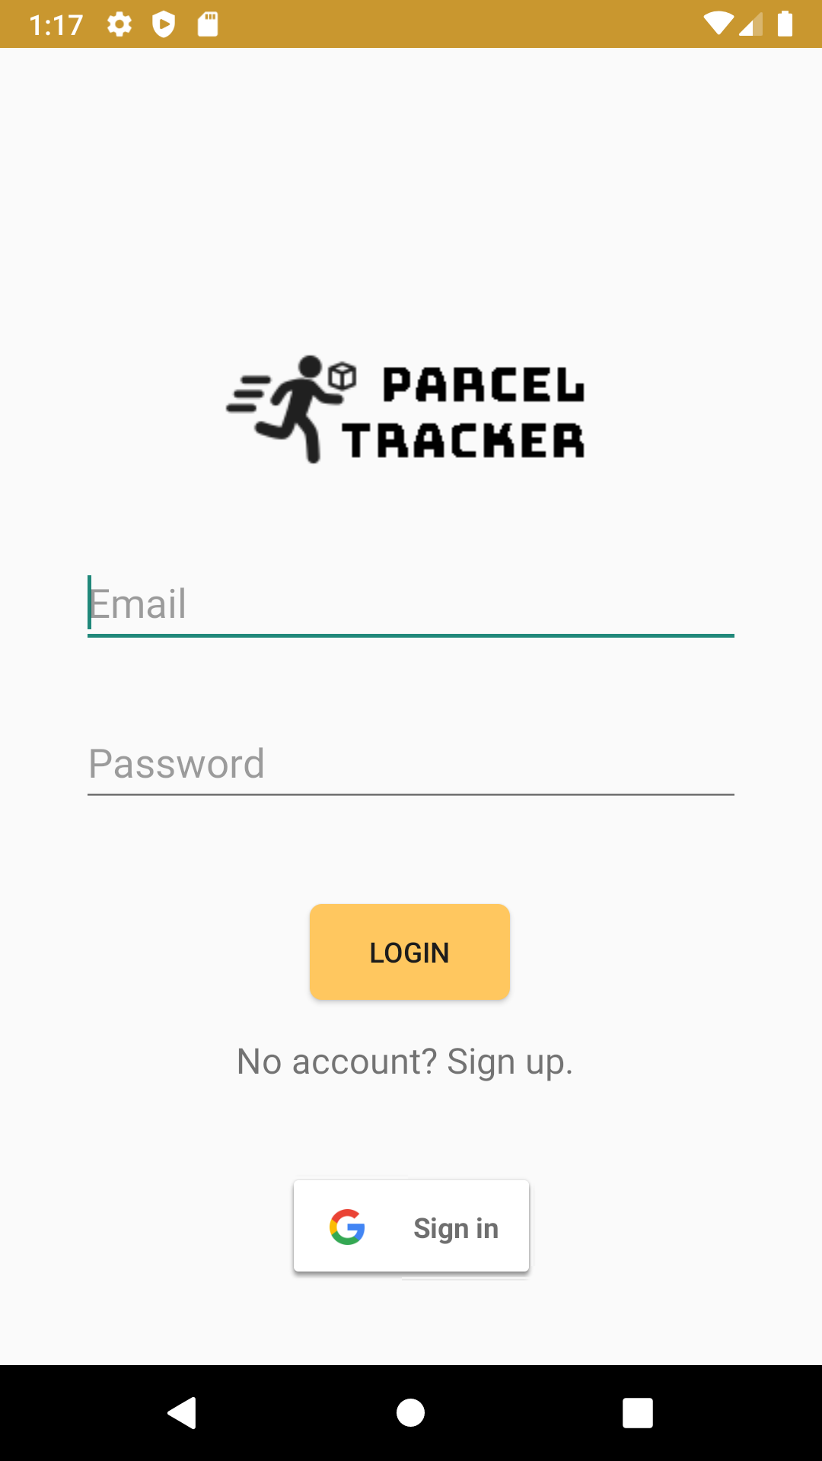
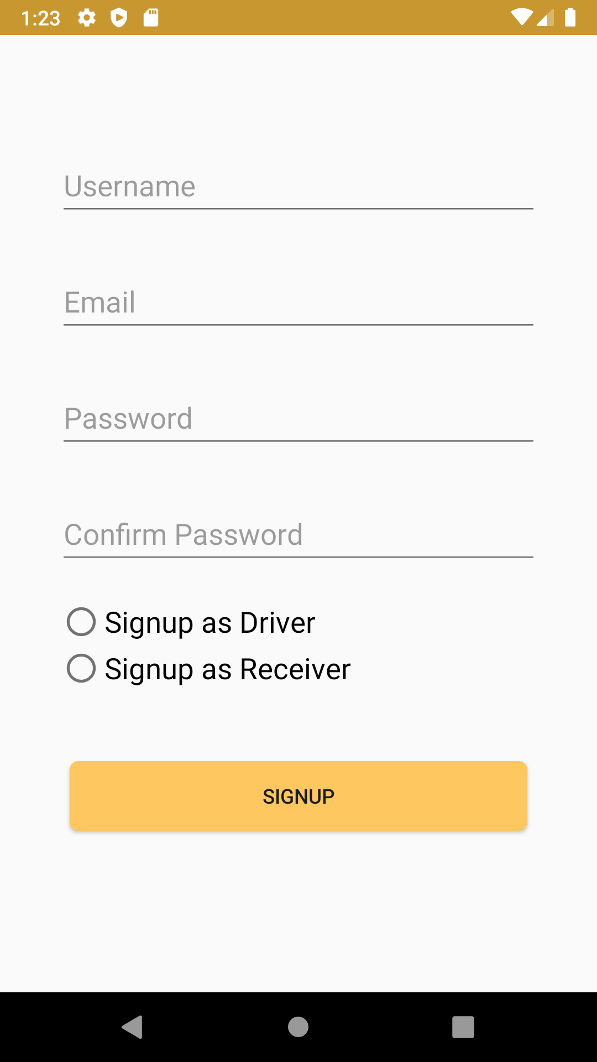
Product Screenshots – Login & Signup

Slide 11
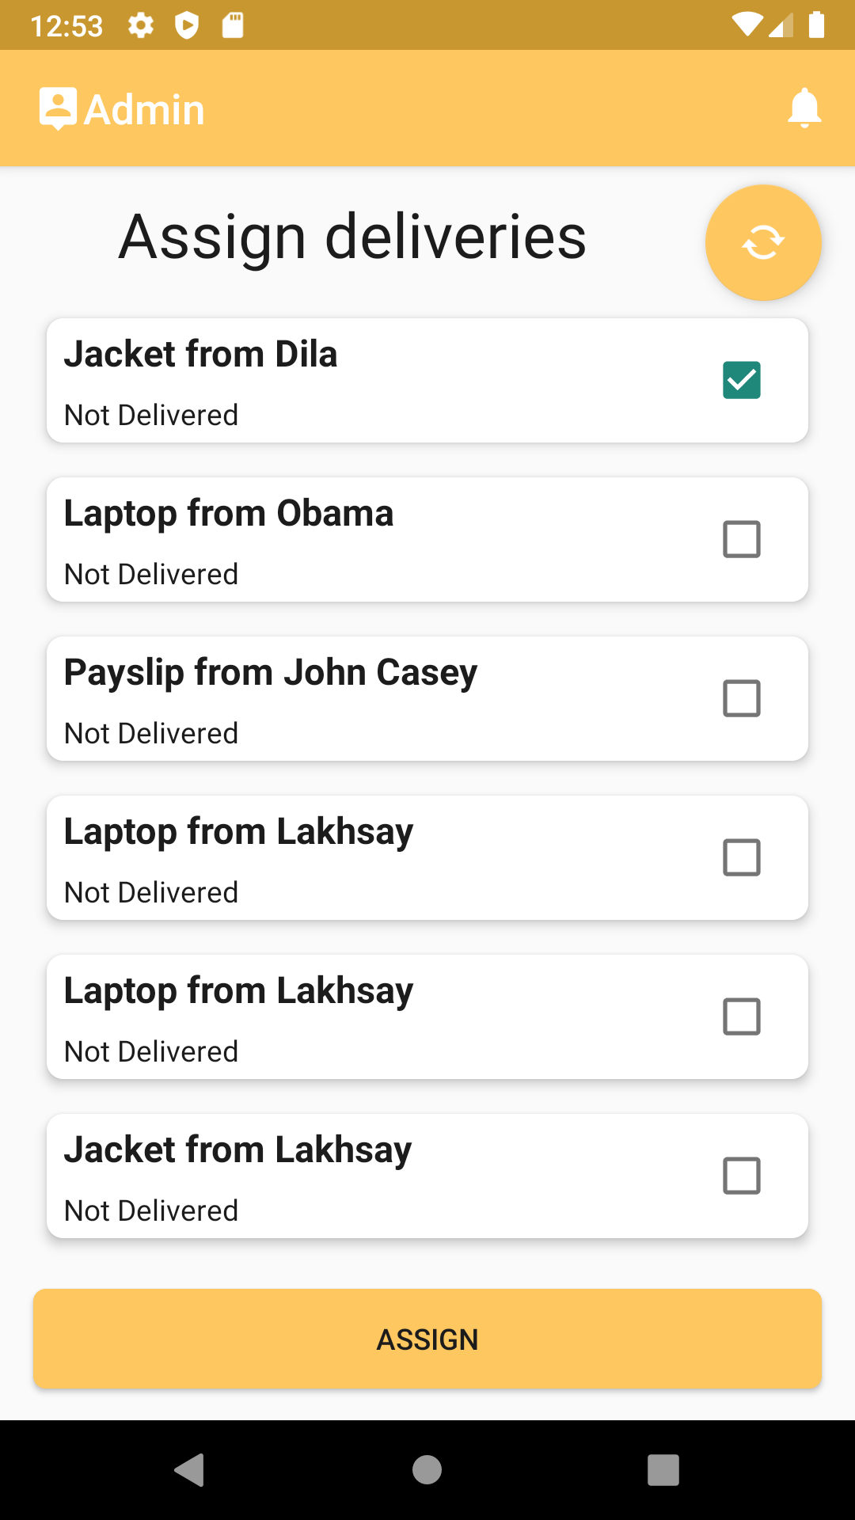
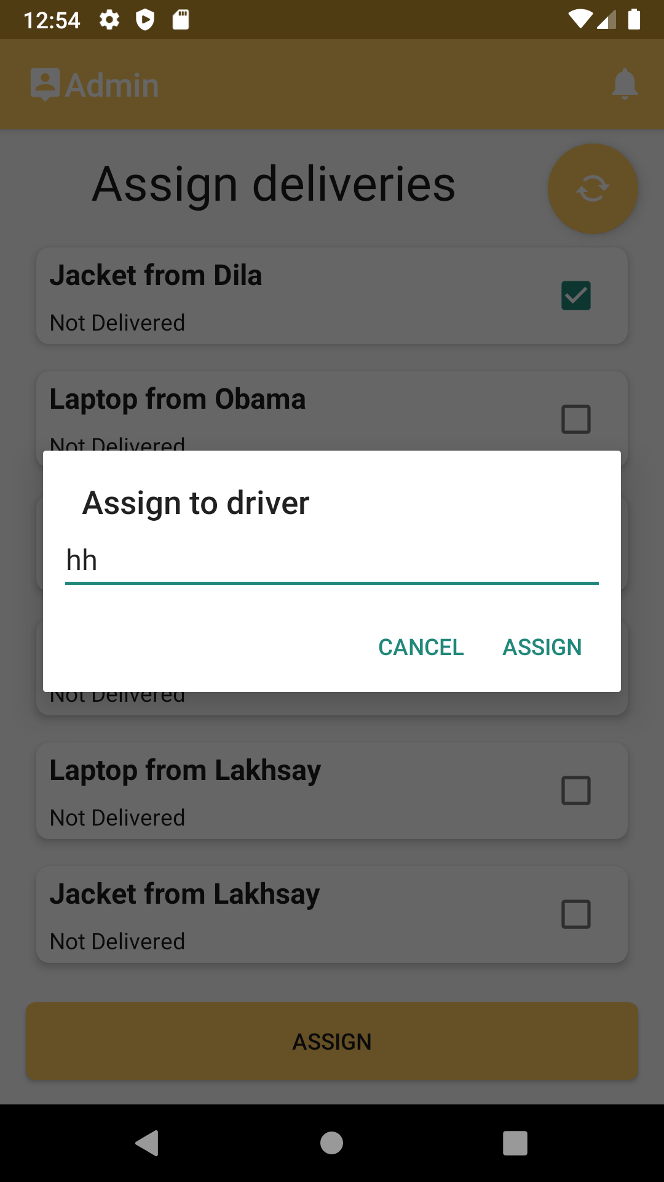
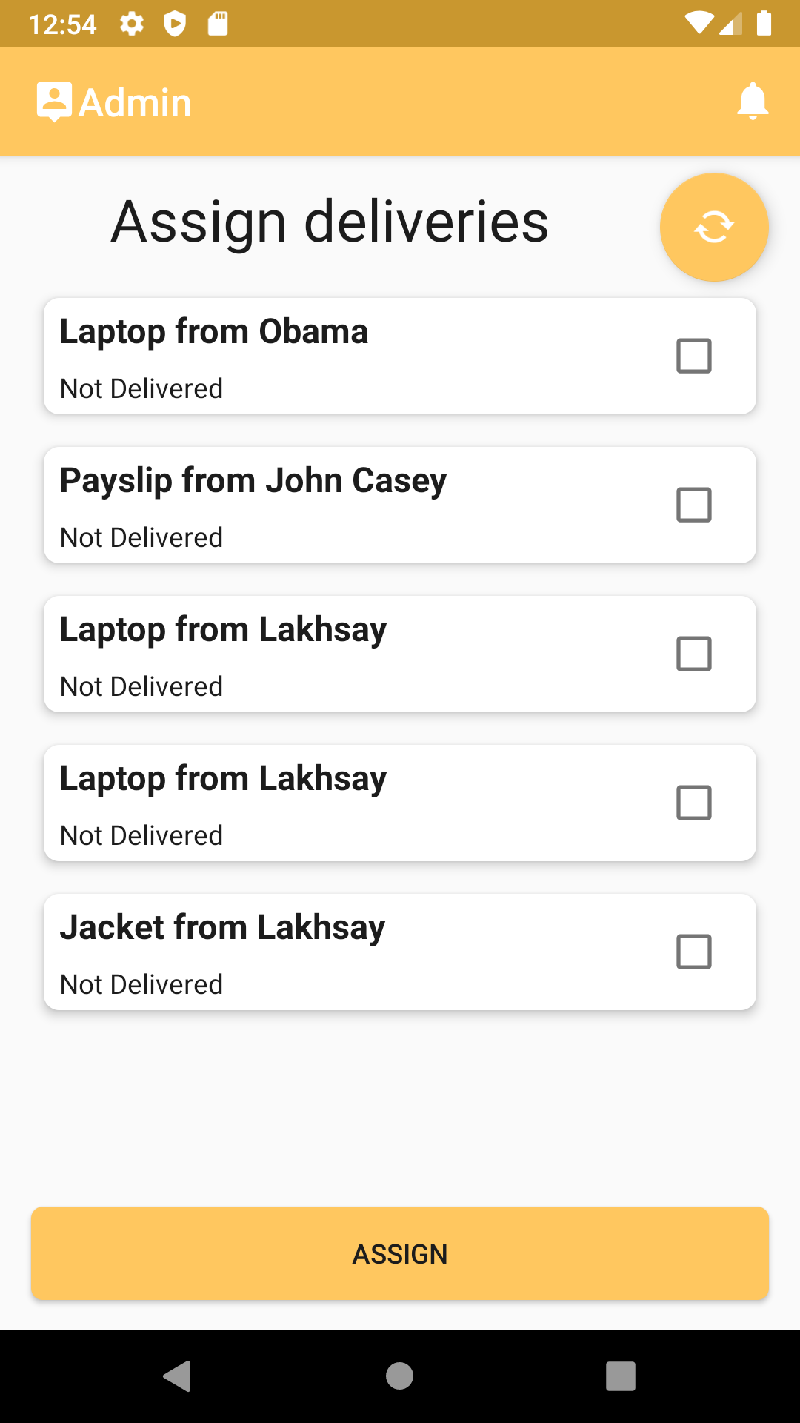
Product Screenshots - Administrator

Slide 12
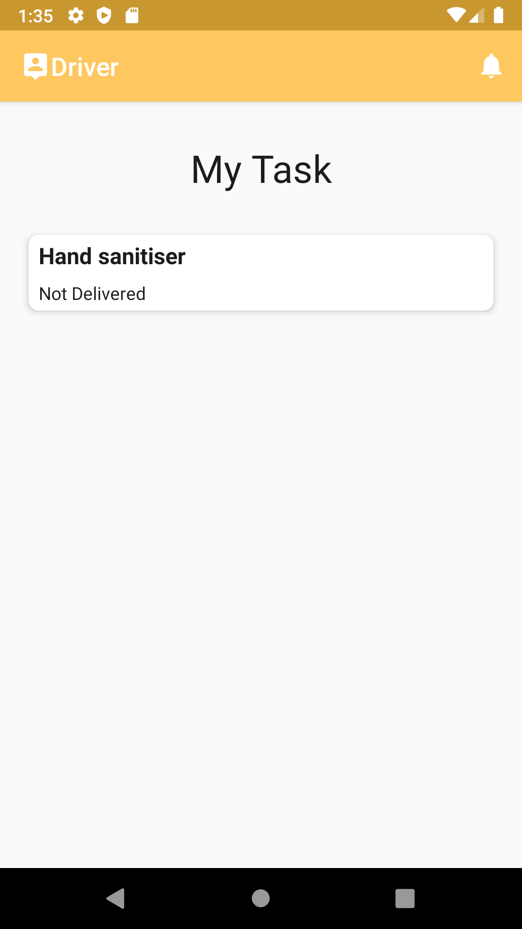
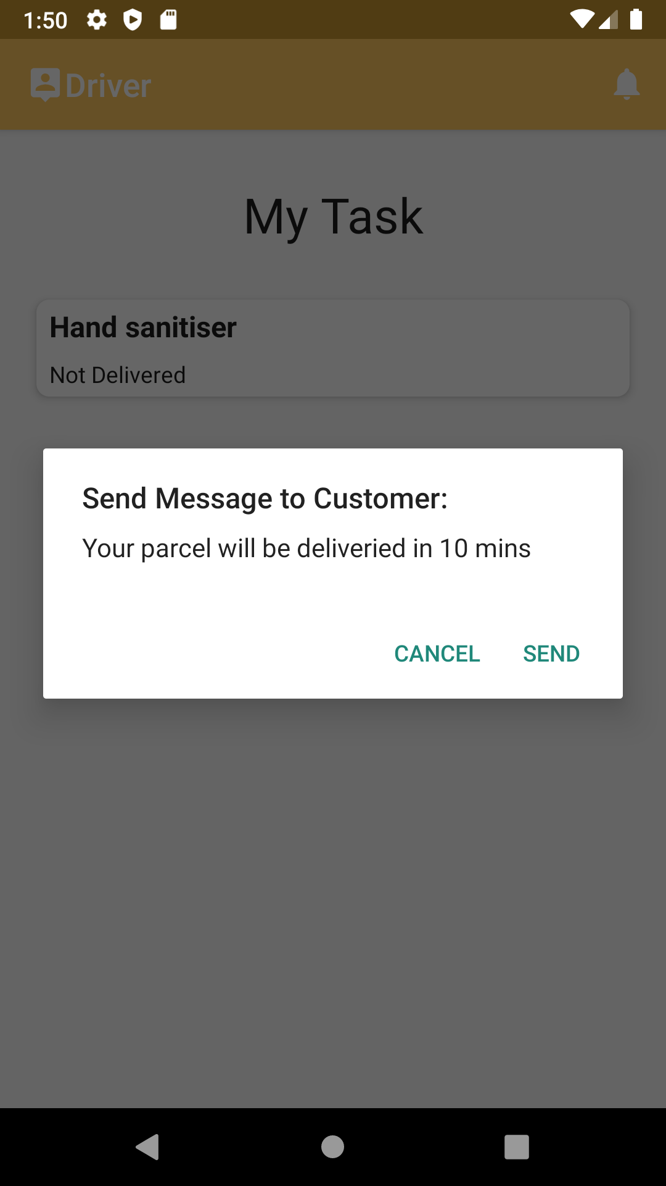
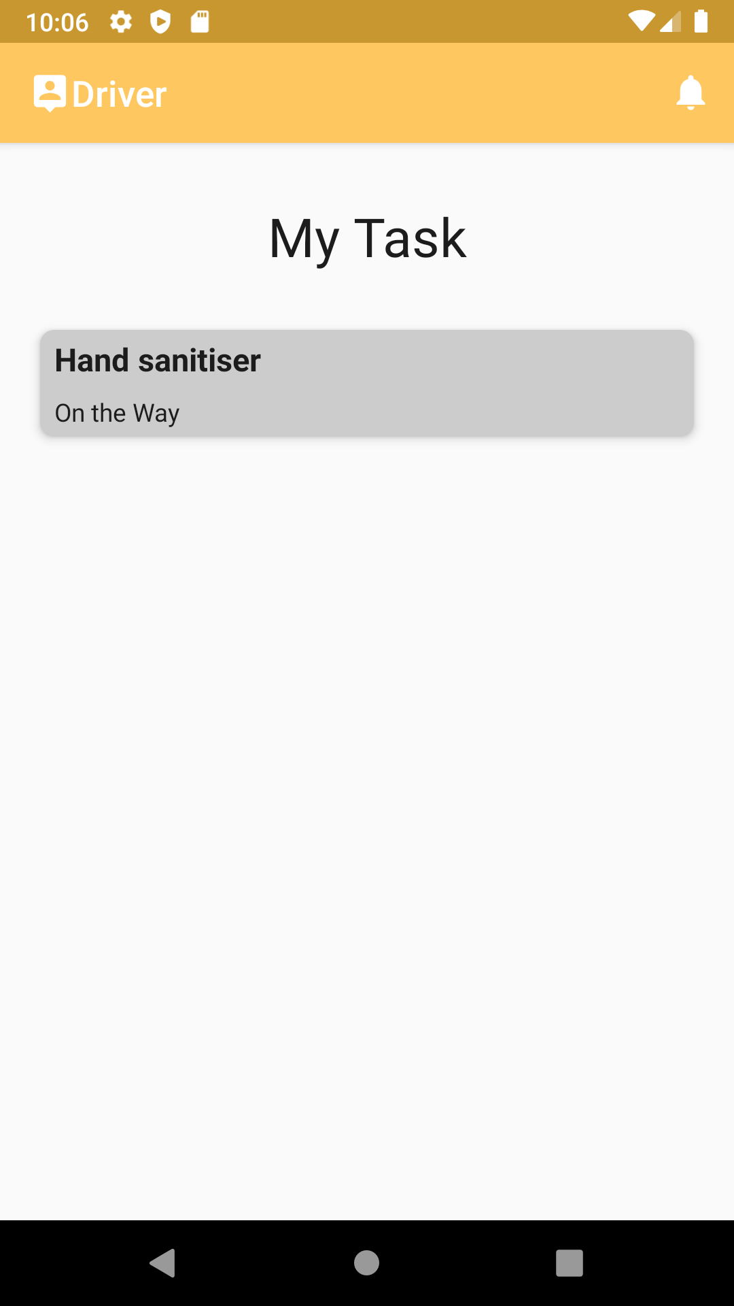
Product Screenshots - Driver

Slide 13
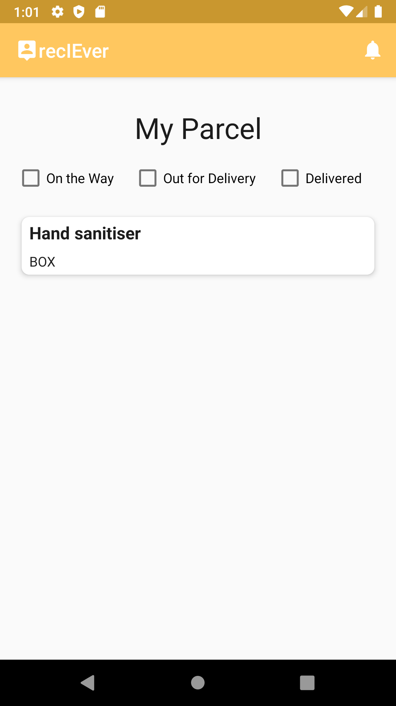
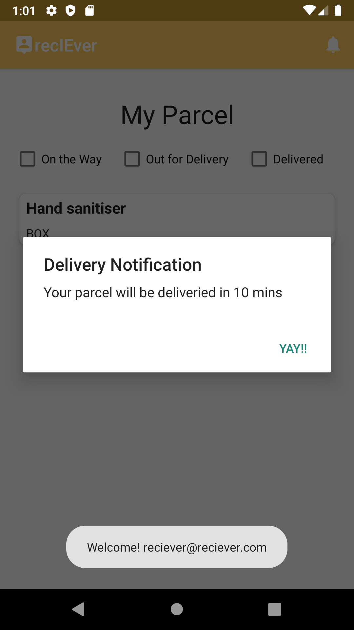
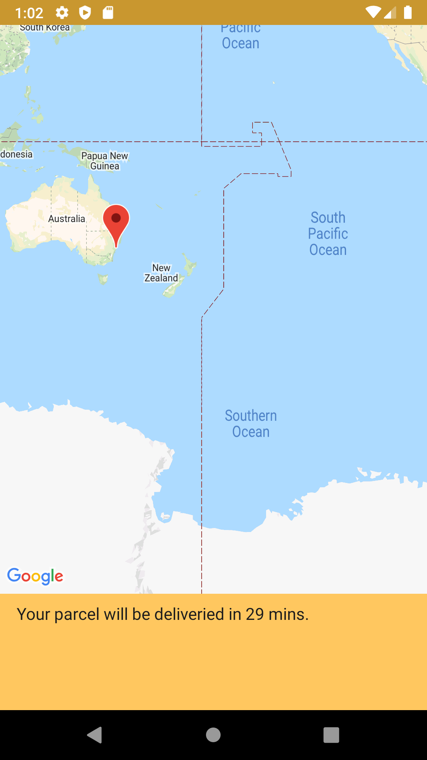
Product Screenshots - Receiver

Slide 14
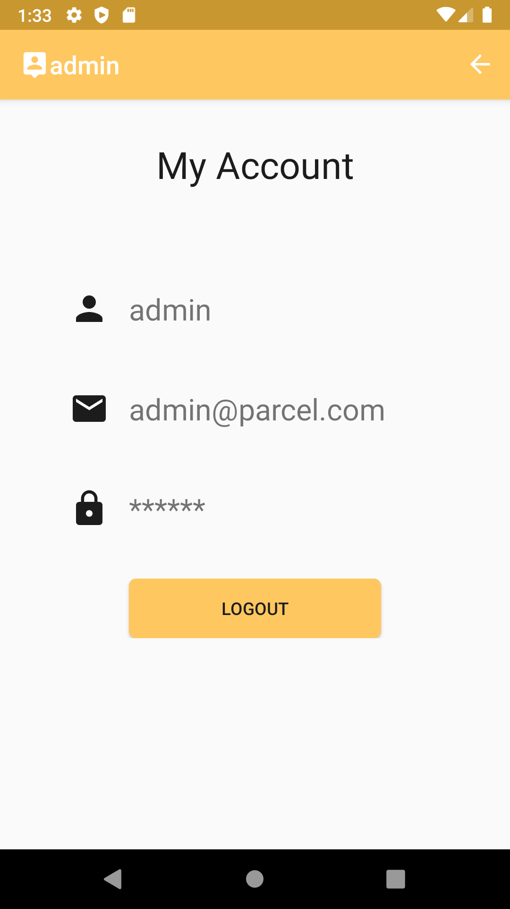
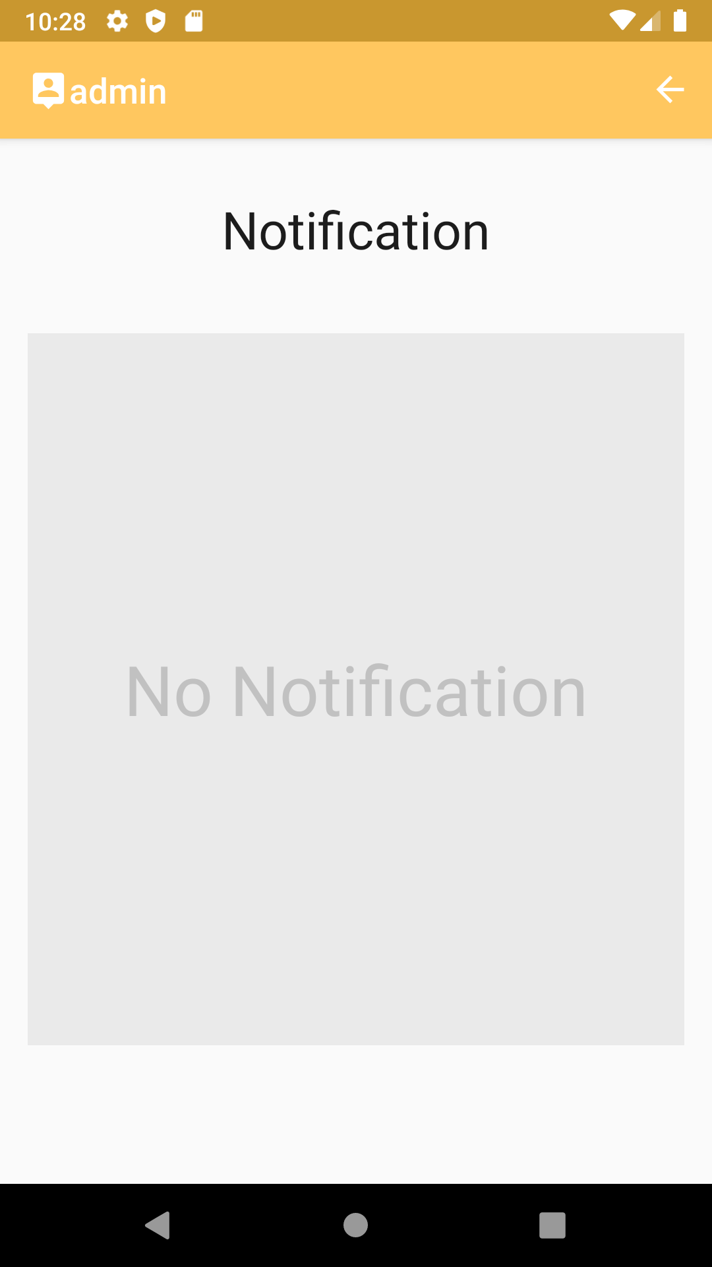
Product Screenshots - Others

Slide 15

Team Reflection
Well Done!
Used GitHub issues to manage task
Used Trello to manage project
Good communication via Messenger
Everyone is actively involved in the project

Slide 16

Team Reflection
We Should:
Do Better!
Have a product owner, to control everything is running to the right direction in the right time
Have project plan
Clearly assign the tasks to each member: who, what, when
Try to estimate the time required for the work as accurately as possible
Use Agile practice: continuous integration, continuous delivery

Slide 17
- Thanks -

