Slide 1
INNOVACER DATA SCIENCE ASSIGNMENT
Name : Lakshay Sharma
College : The LNM Institute of Information Technology
Roll No : 17ucc034

Slide 2
Insights on the Data
Dataset was high dimensional with low sample size . Due to this fact it is hard to obtain high accuracy, precision and recall at the same time .
There is a class imbalance problem in the dataset which adversely affects a model's accuracy. This occurs when the number of instances of one class(non-recurring cases) in the dataset outweighs the number of instances from the other class(recurring cases).
Here we have used several machine learning algorithms and have also used feature engineering to improve the overall accuracy.

Slide 3
Task A :Build a classifier to predict the outcome of a new patient with high accuracy.
Approach Used : -
(1.) Data is read , pre-processed and cleaned according to the problem statement. Irrelevant columns were dropped that were not needed for our analysis . Features were divided based on their categories.
(2.) In the next step exploratory data analysis was performed which helped in identifying 2 major issues :-
(a.) Problem of multi collinearity that means the columns are depending on each other so we should avoid it because we want to avoid using same column twice .
(b.) Problem of class Imbalance This occurs when the number of instances of one class(non-recurring cases) in the dataset outweighs the number of instances from the other class(recurring cases).
(3.) Now important features were selected through feature engineering and through EDA which we will be using further for the prediction .
(4.) Now in the next step we have selected different prediction features and have tried to find accuracy score for two models namely Random Forest Classifier and SVM.
-> First Time features were selected on the basis of correlation value.
-> Next time Mean Features Only .
-> Important Features From Random Forest Classifier.
-> Highest Accuracy Achieved Though This Method : 85% Random Forest Classifier

Slide 4
5.) After this Cross validation was Performed to estimate the skills of other machine learning models . But according to our analysis only Random Forest Classifier Performed Fair Enough . Others were not up to the mark .
6.) To Improve this scenario we further performed Grid Search CV for parameter tuning for all other method except Random Forest . According to our results improved but not up to the mark.
Results :-
So Best Accuracy we achieved was - 85% through Random Forest Classifier by removing multicollinearity and using feature Engineering.
Task B : Build a regression model to predict the recurrence time for patients whose outcome is R.
Approach Used :-
1.) Data is read , pre-processed and cleaned according to the problem statement. Irrelevant columns were dropped that were not needed for our analysis .
2.) Then only those rows of dataset are selected in which Disease is Recurrent (For Linear Regression) whereas for Logistic Regression whole dataset is intact . While Doing EDA it was observed that there was a problem of Class Imbalance in it .

Slide 5
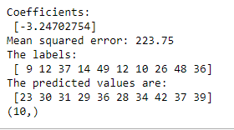
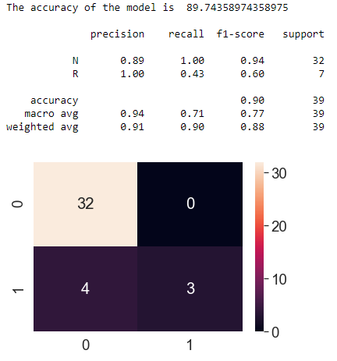
3.) For both Linear and Logistic Regression 2 models were built :-
i) Model 1 with single value as the predictor.
ii) Model 2 with feature engineering involve.
4.) So for Model 1 “radius_mean” was selected because of its high negative correlation with Time whereas a Drop List was prepared for Model 2 in which a number of features were dropped because they were highly correlated with other predictors and causes the problems associated with multicollinearity.
5.) For overall clarity I have also made logistic regression model which shows different important parameters like precision , recall , f1-score and support . (Not asked in the problem statement)
Results :-
1.) For Linear Regress we obtain a MSE of 223.75 2.) For Logistic Regression Model we obtain a accuracy of 89 % with

Slide 6
THANK YOU

